Slide 1
Stopping Times
報告人:李振綱

Slide 2
On Binomial Tree Model
European Derivative Securities
Non-Path-Dependent American Derivative Securities
Stopping Times

Slide 3
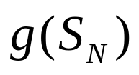
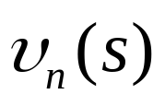



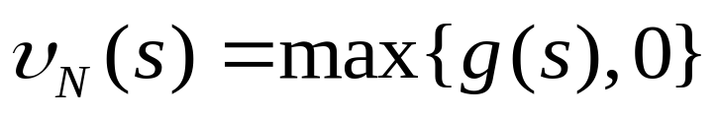
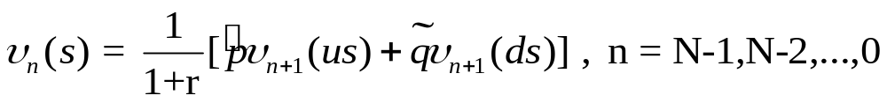
European Derivative Securities
: a derivative security that pays off at time N for some function g.
: the value of the derivative security at each time n as s function of the stock price at that time. ( and are risk-neutral probabilities. r is interest rate.)

Slide 4
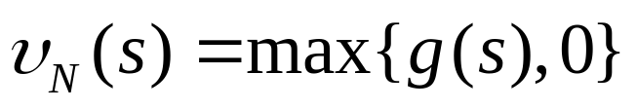


Non-Path-Dependent American Derivative Securities
For example, let interest rate be r = ¼, so the risk-neutral probabilities are = = ½.
Comsider an American put option, expiring at time two, with strike price 5.
Notes:
講non-path美式選擇權的Value

Slide 5


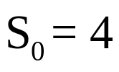



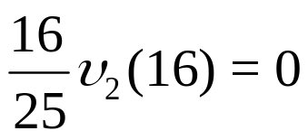
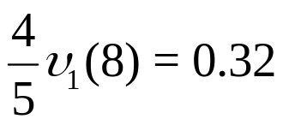

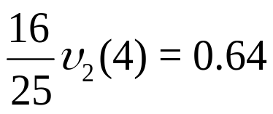
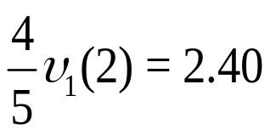
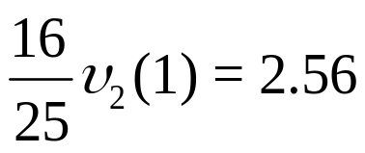
Example : American put option
Notes:
為一supermartingale
E:discounted price process是一個martingale
A:discounted price process是一個supermartingale

Slide 6













Stopping Times
Exercise rule
Exercise rule
Notes:
Tau : stopping time
Lo : insider information

Slide 7


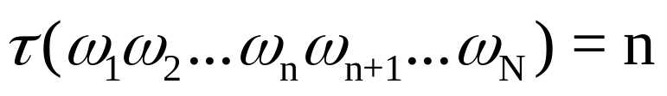
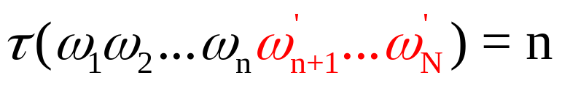
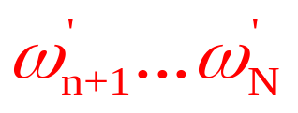
Stopping Times
Definition
In an N-period binomial model, a stopping time is a random variable that takes values 0,1,…,N or and satisfies the condition that if ,then for all .

Slide 8


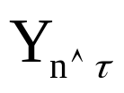



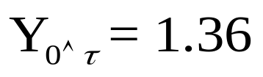



Stopped Process
The notation denotes the minimum of n and . We define the stopped process by the formula below.
For example,

Slide 9


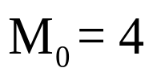
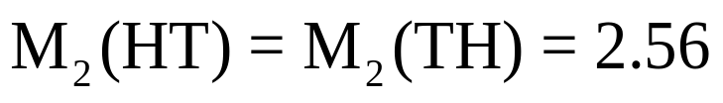

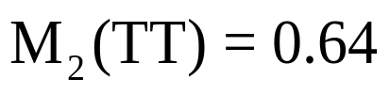
Thm(Optional sampling --- Part 1).
A martingale stopped at a stopping time is a martingale. A supermartingale (or submartingale) stopped at a stopping time is a supermartingale (or submartingale, respectively).
Which is a martingale under the risk-neutral probabilities = = ½.

Slide 10


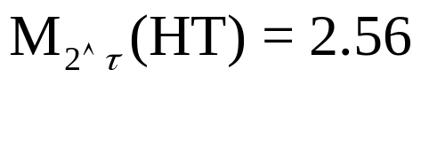

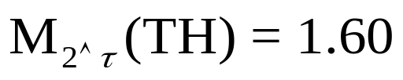

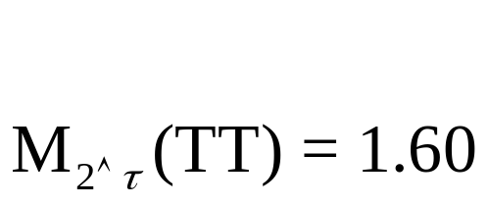


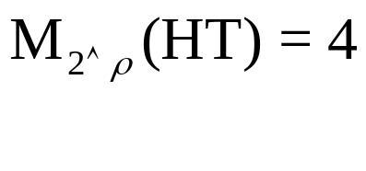
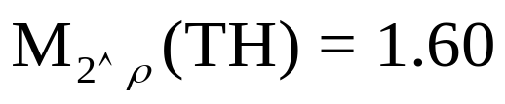

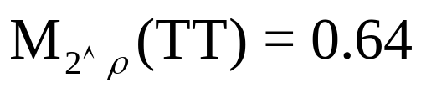
Discounted stock price stopped at a stopped at a stopping time
Discounted stock price stopped at a stopped at a nonstopping time

Slide 11

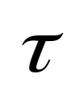
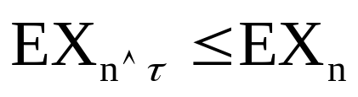
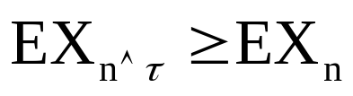
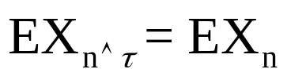
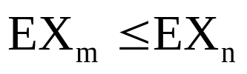

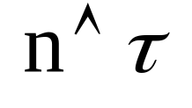

Thm(Optional sampling --- Part 2).
Let , n=0,1,…,N be a submartingale, and let be a stopping time.
Then ,
if is a supermartingale, then ; if a martingale, then .
(A submartingale has a tendency to go up. In particular, if is a submartingale, then
whenever m n. This inequality still holds if we replace m by ,where is a stopping time.)

