Slide 1
Lookback Option
Part 1 (a) John C. Hull Ch24 lookback option
(b) Shreve 7.4.1 ~7.4.3
Part 2 (a) Shreve 7.4.4

Slide 2
7.4 Lookback Option
(part1)
劉亮志

Slide 3
(a) John C. Hull Ch24 lookback option

Slide 4
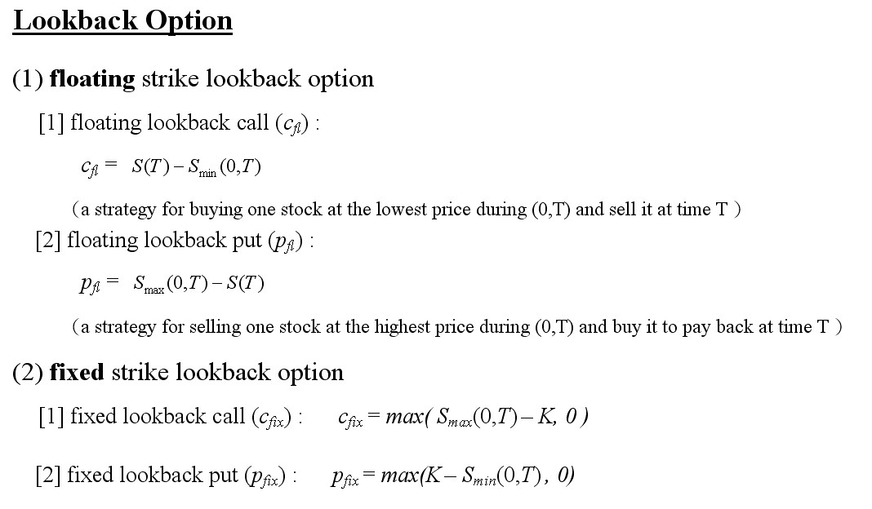

Slide 5
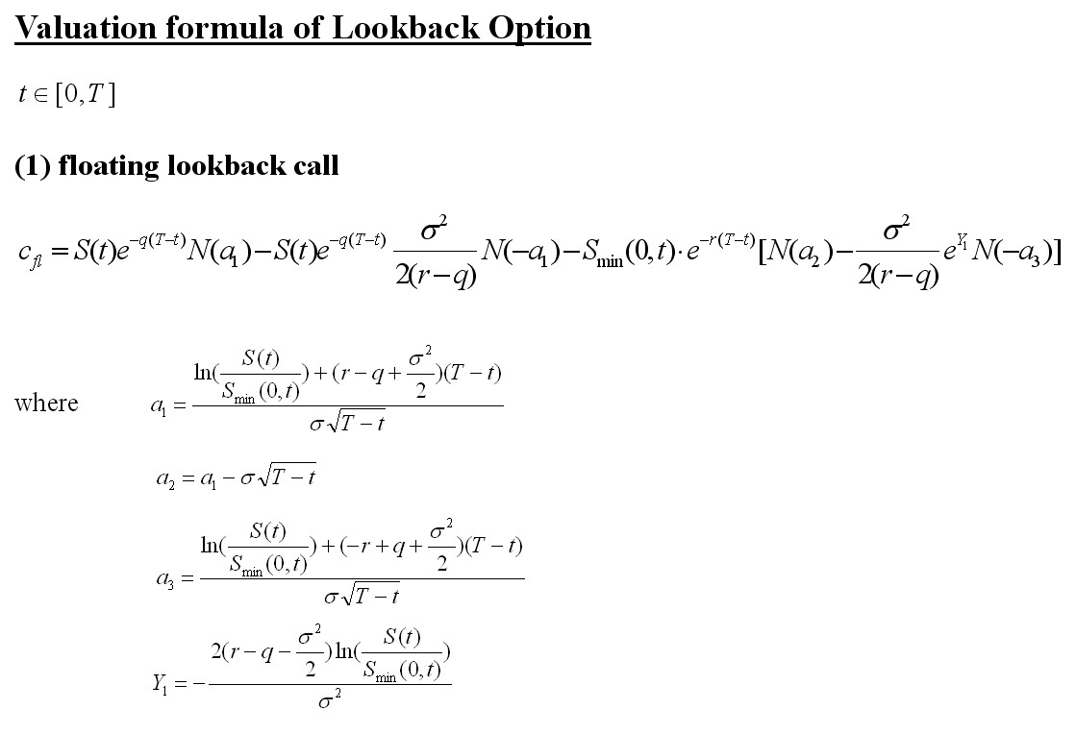

Slide 6
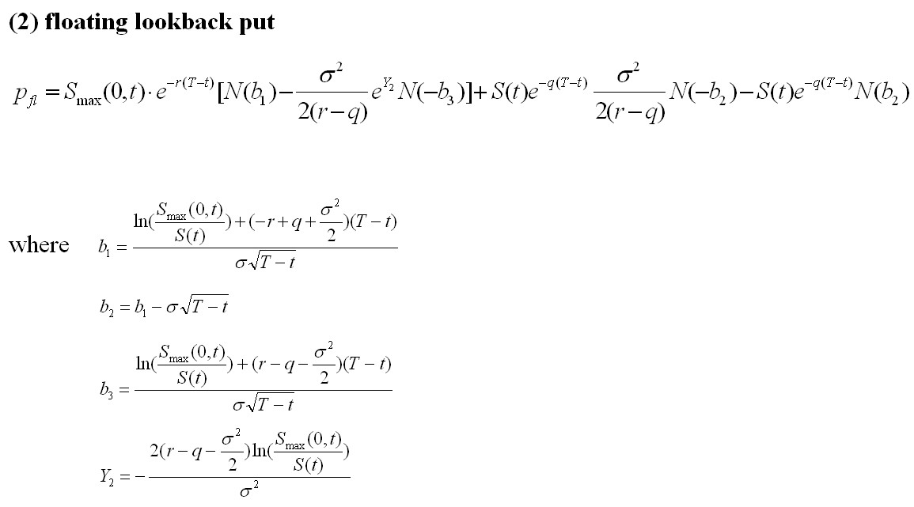

Slide 7
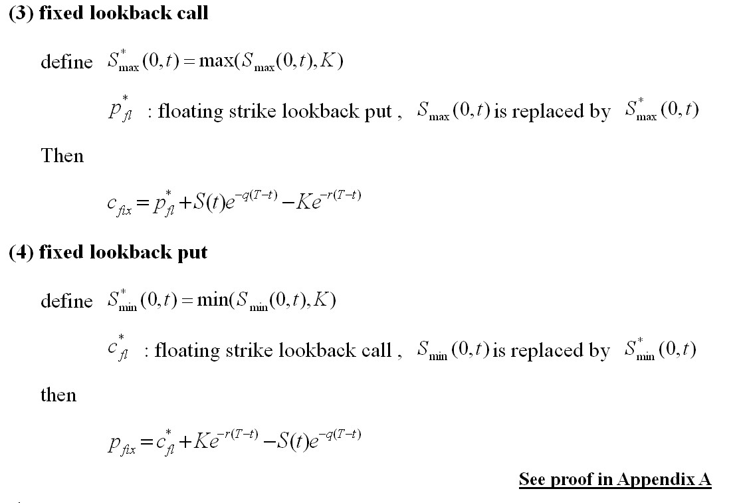

Slide 8
(b)-1 Shreve 7.4.1~7.4.2

Slide 9
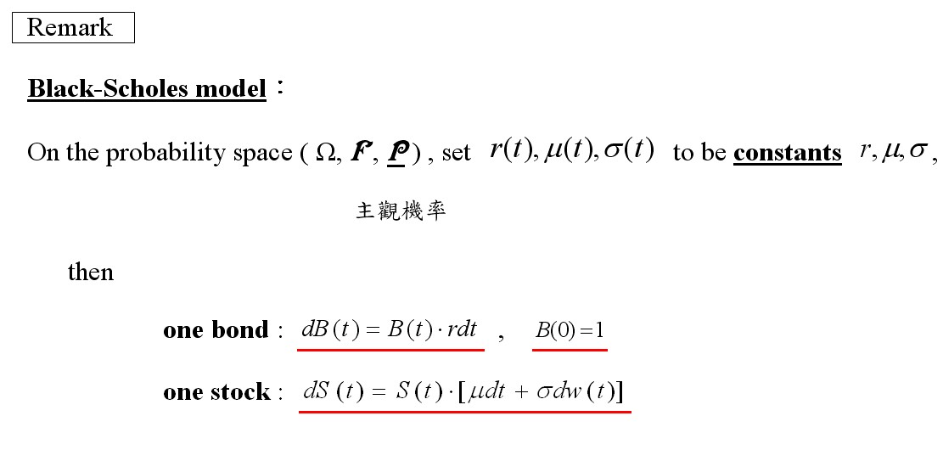

Slide 10
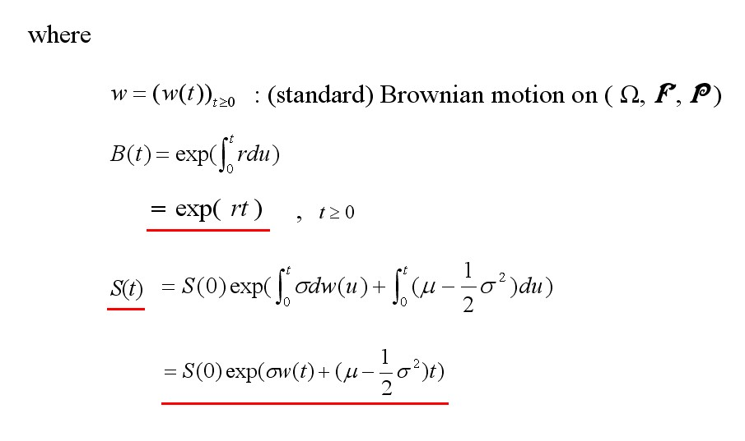

Slide 11


Slide 12
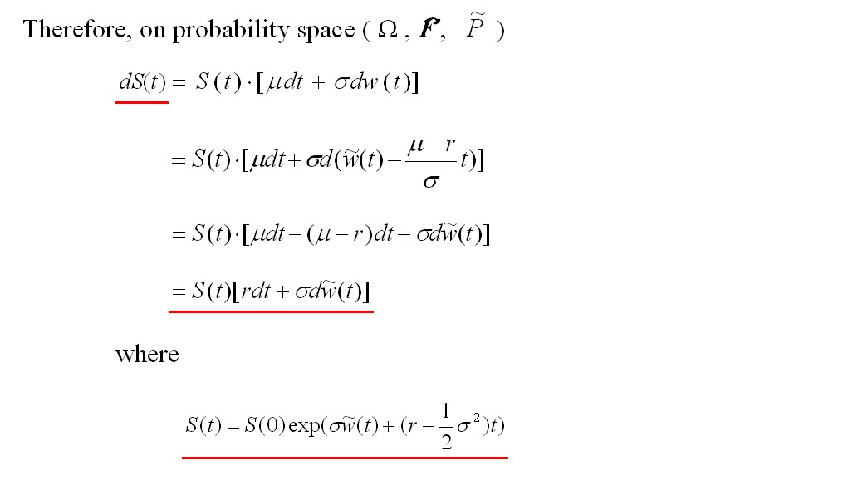

Slide 13
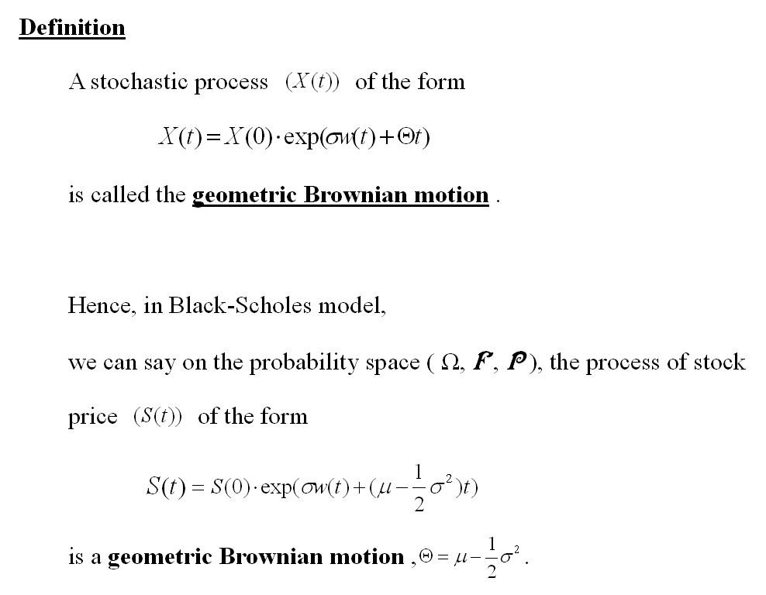

Slide 14
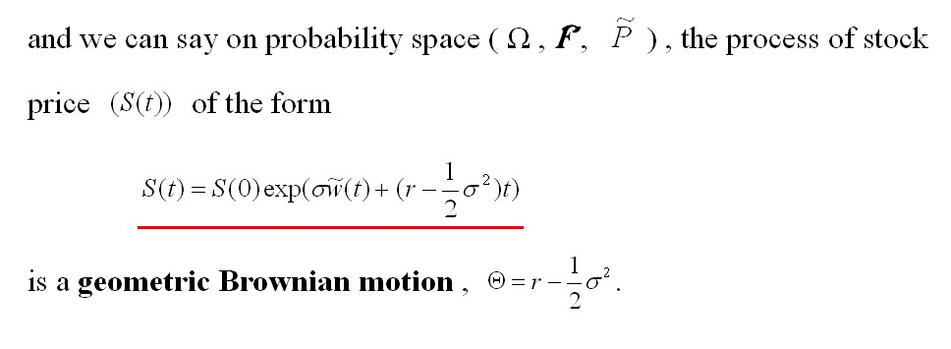

Slide 15
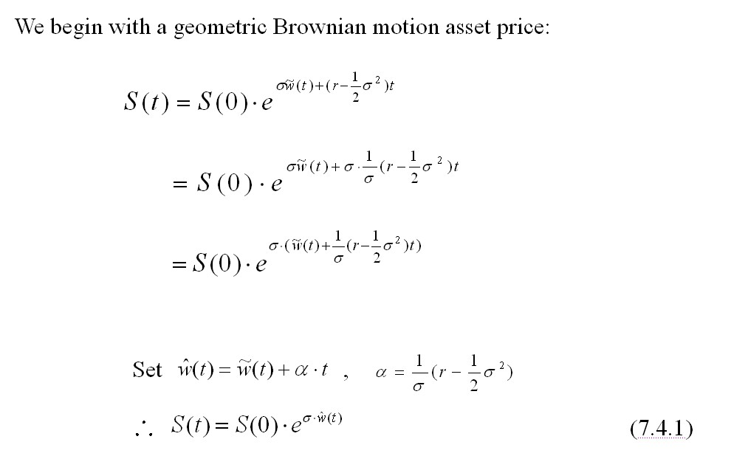

Slide 16


Slide 17
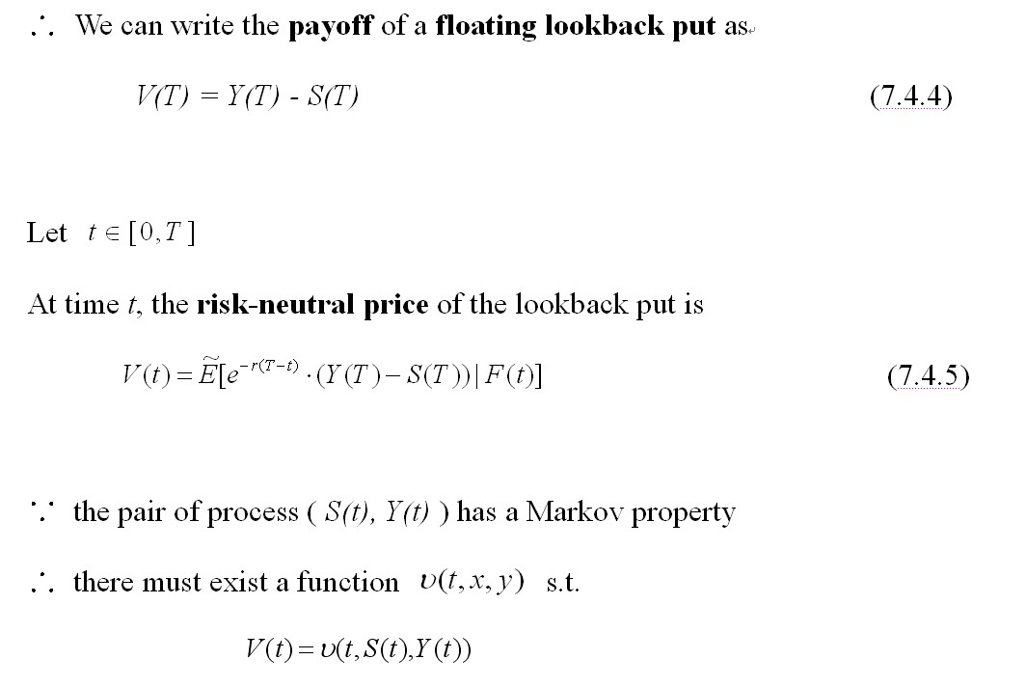

Slide 18
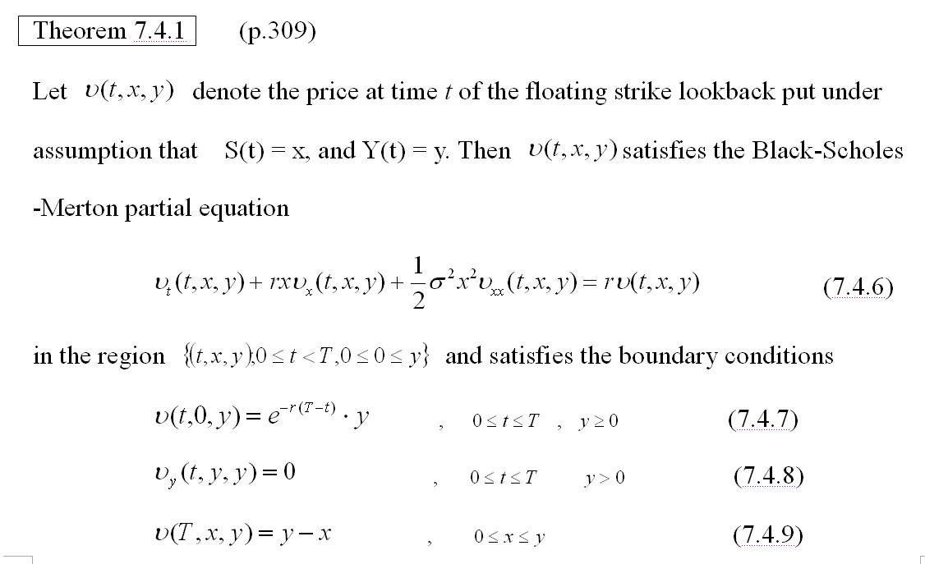

Slide 19


Slide 20
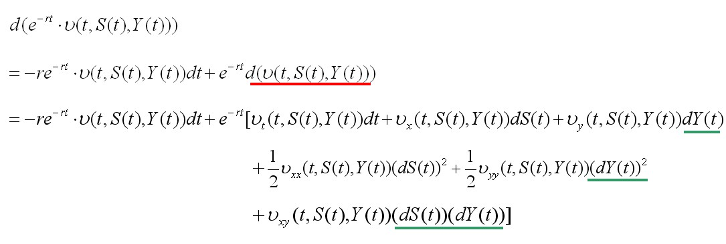


Slide 21



Slide 22
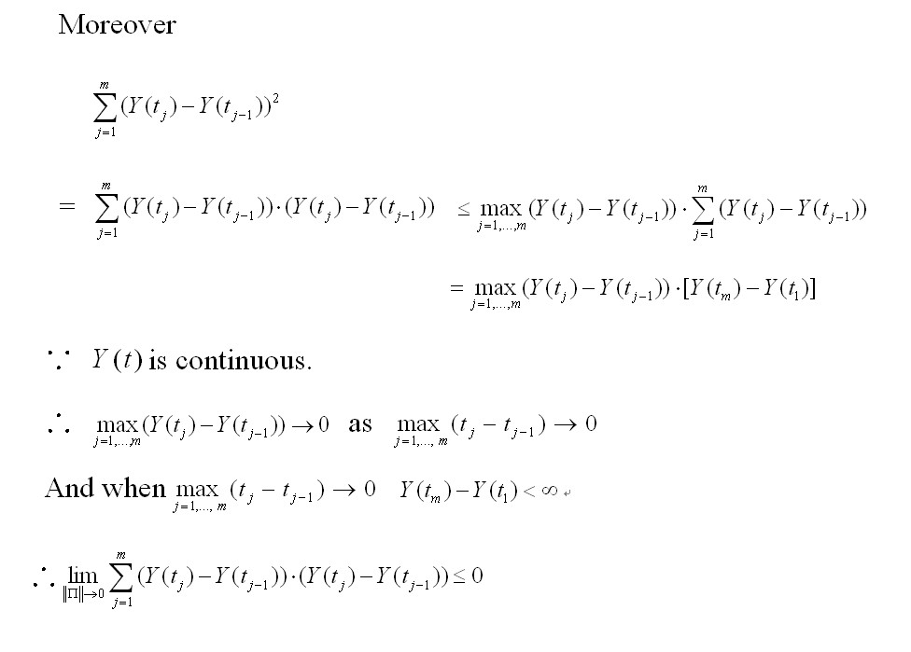

Slide 23
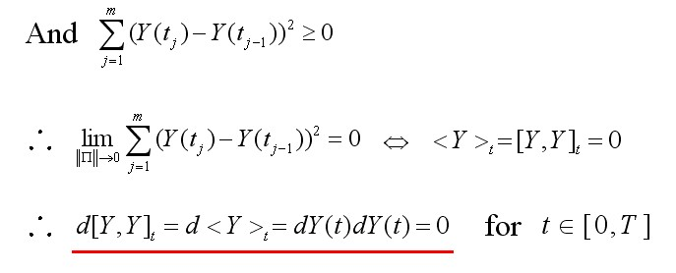
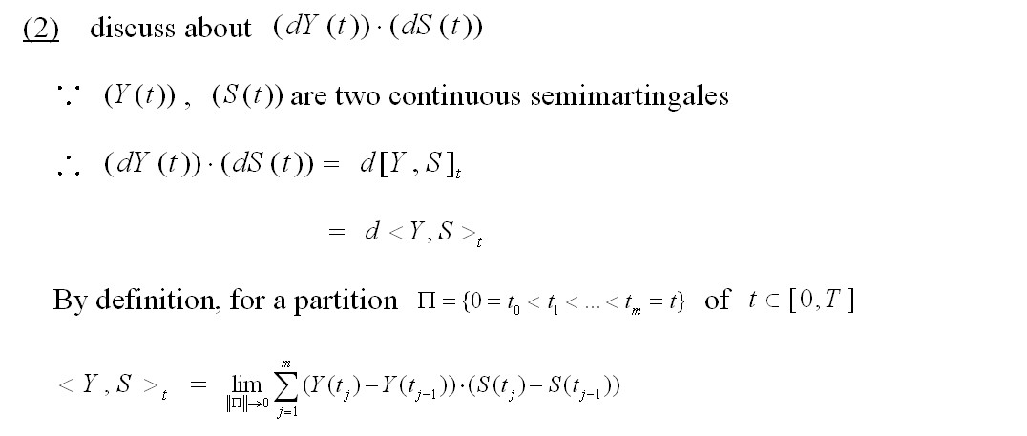

Slide 24
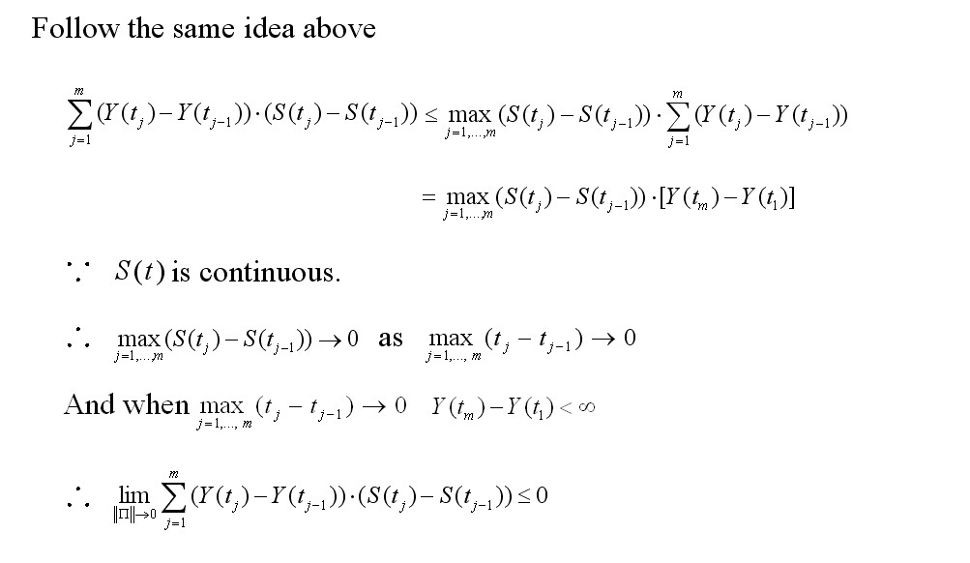

Slide 25
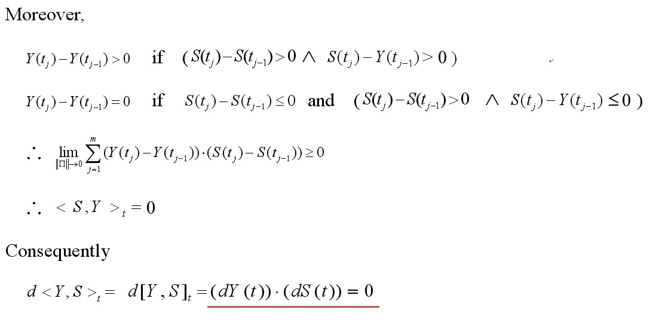

Slide 26
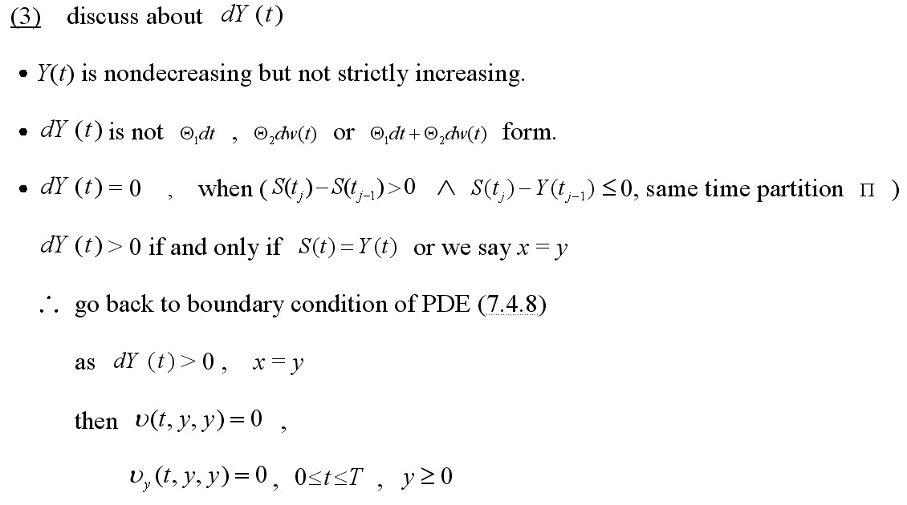

Slide 27
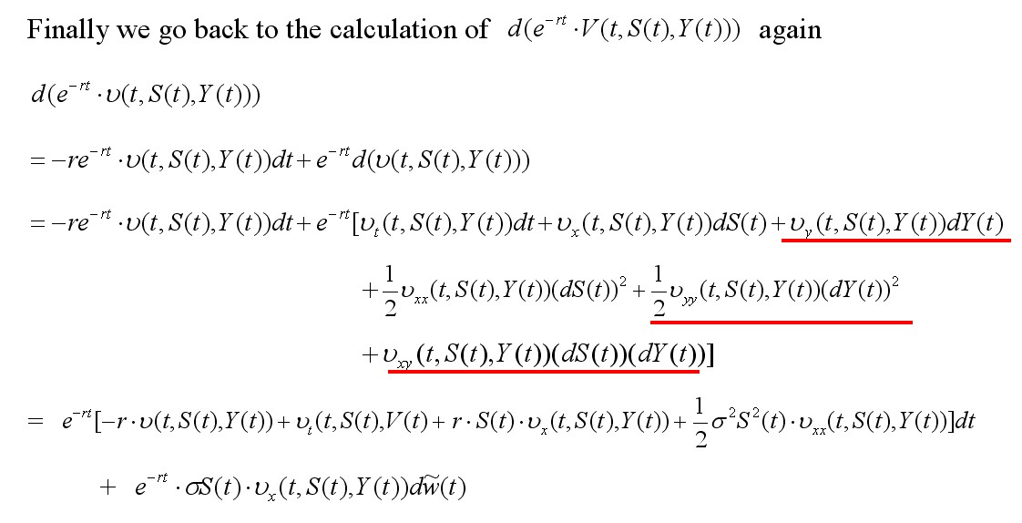

Slide 28


Slide 29
(b)-2 Shreve 7.4.3

Slide 30
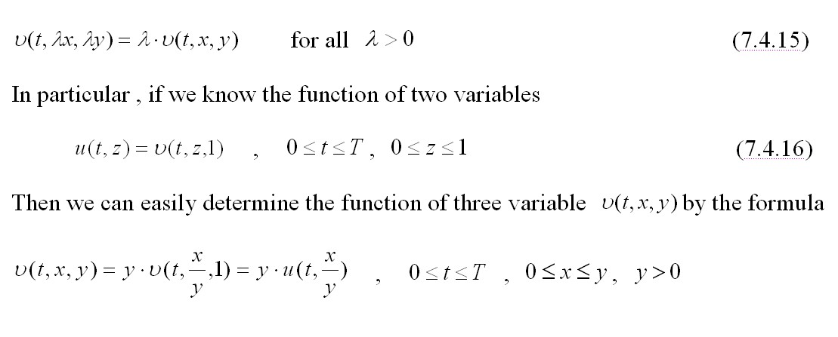

Slide 31
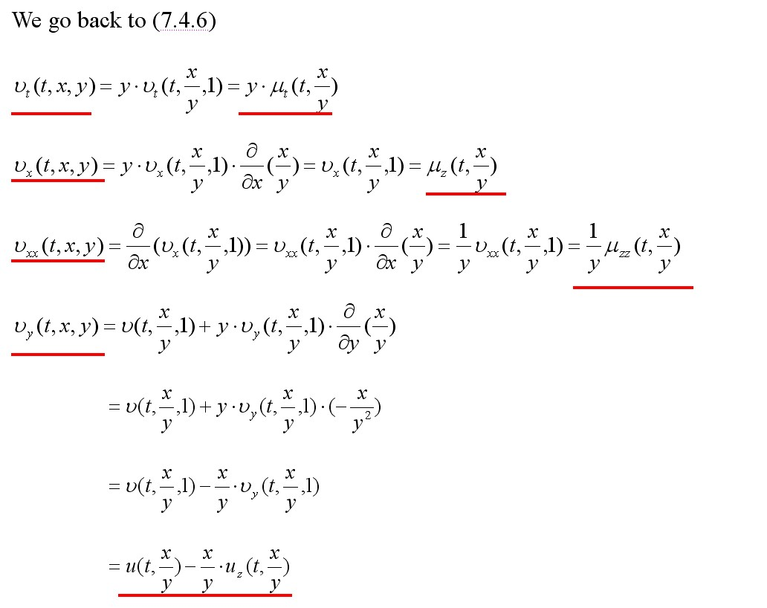

Slide 32


Slide 33
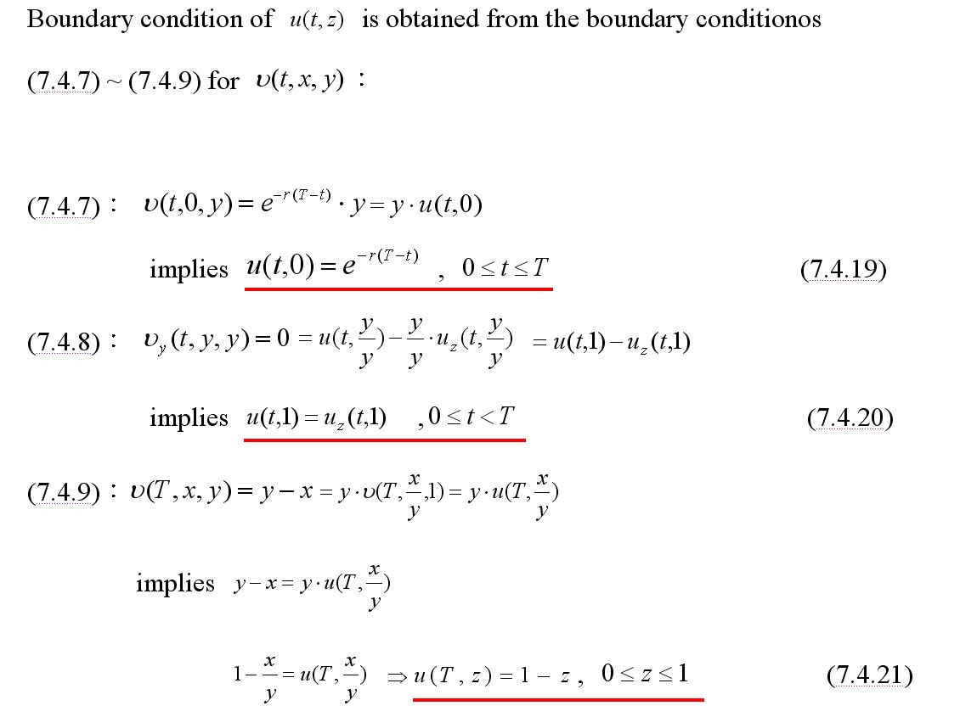

Slide 34
Appendix A
The proofs of parity

Slide 35
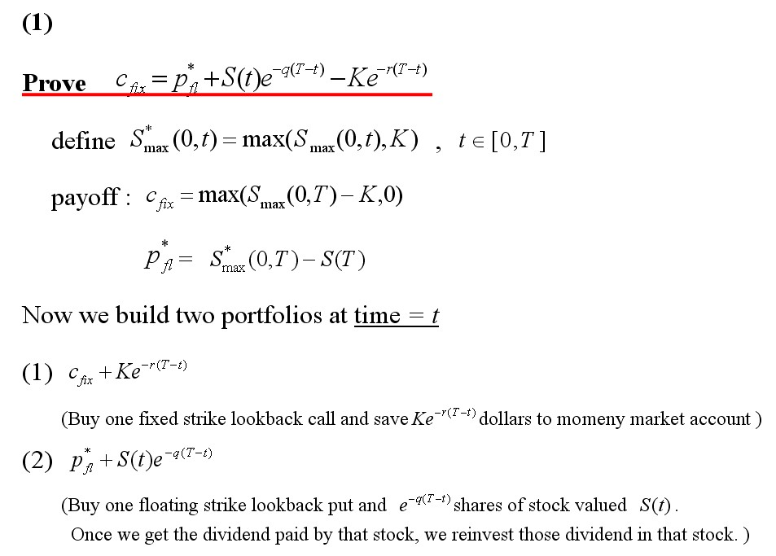

Slide 36
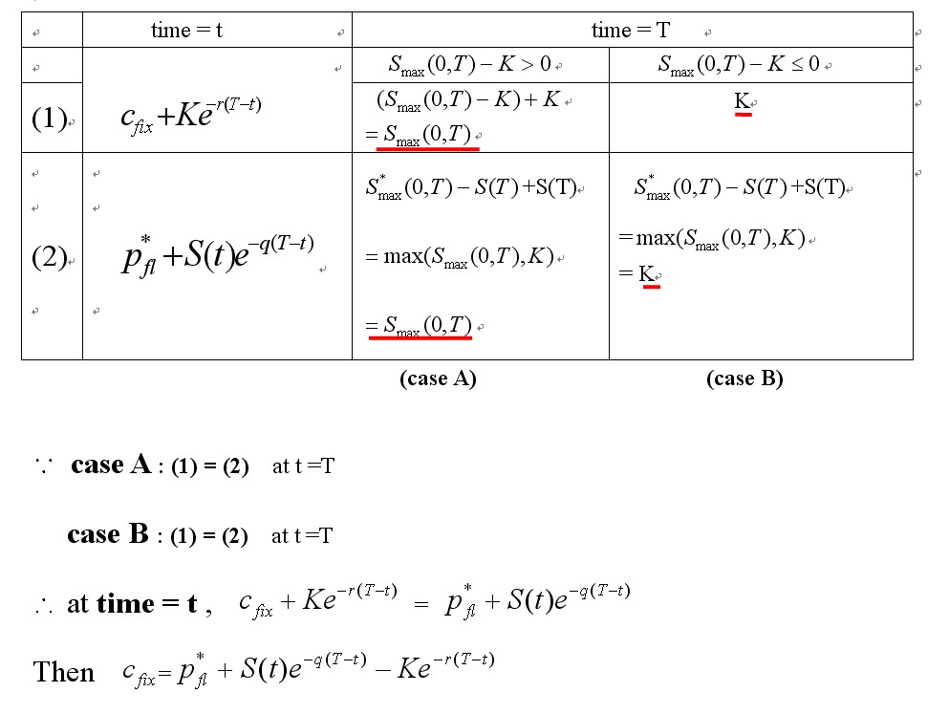

Slide 37
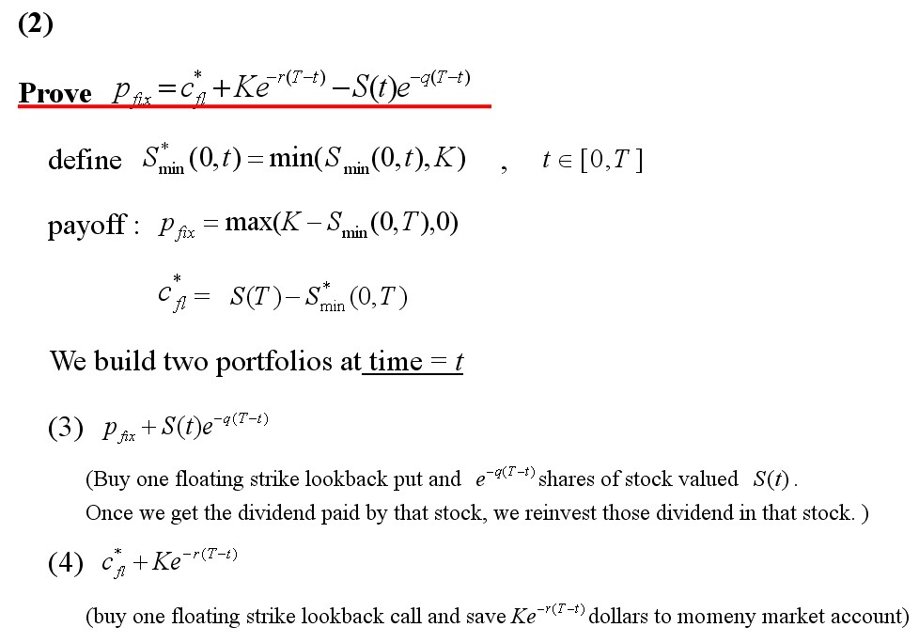

Slide 38
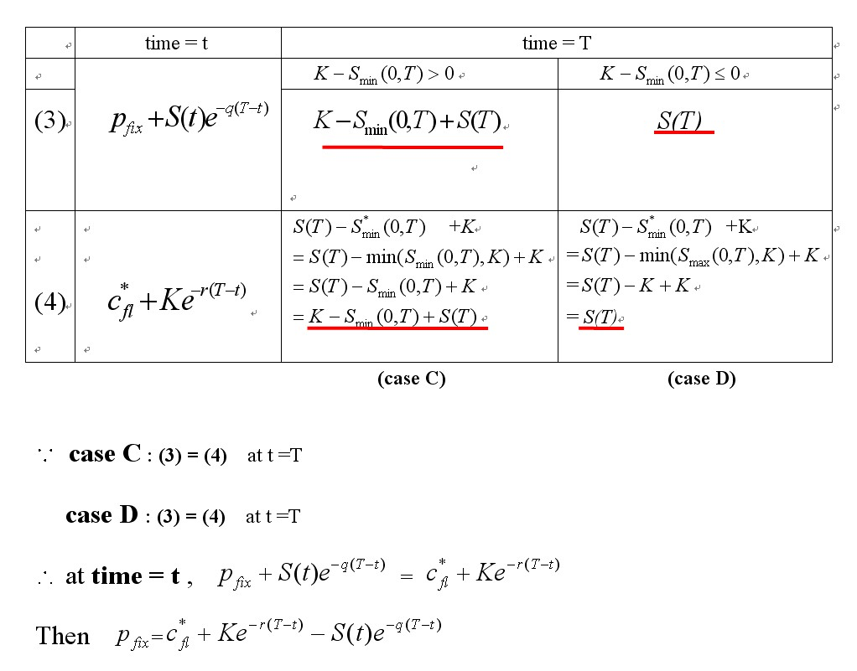

Slide 39
Appendix B
The assumptions of Black-Scholes world

Slide 40
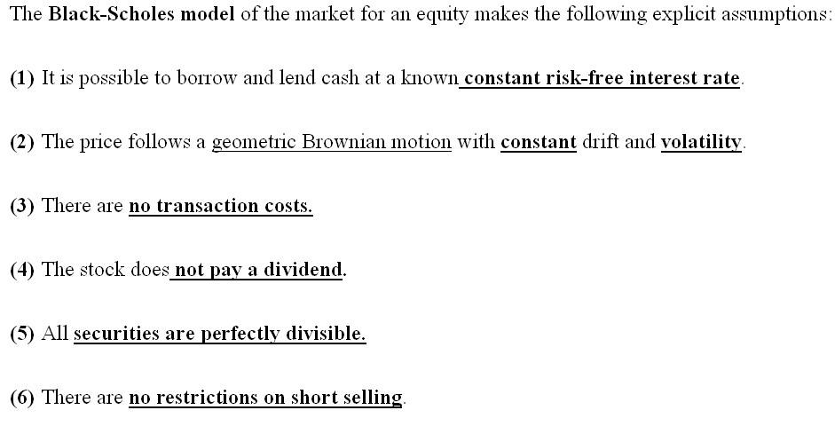

Slide 41
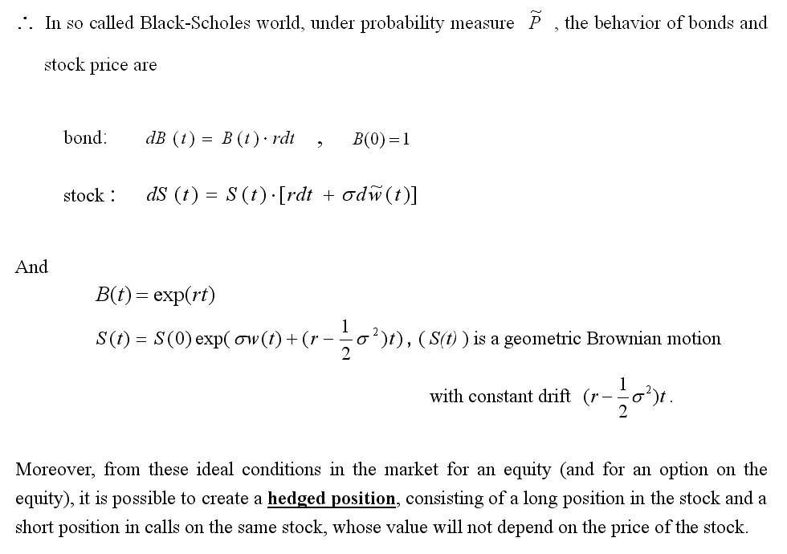

Slide 42
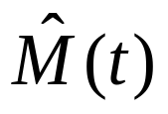
Appendix C
about

Slide 43
