Slide 1
Stochastic Calculus for Finance II
Chapter 1
財金所 潘政宏

Slide 2
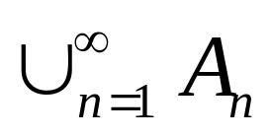
1.1 Probability Space
The set of all sample points is called sample
space, say Ω .
Def1.1.1:Let F be a collection of subsets of
nonempty set Ω. We say that F is a
σ-algebra if
(1) the empty set φ ∈ F.
(2) A ∈ F, then A^{c} ∈ F.
(3) A₁,A₂,A₃,… ∈ F, then ∈ F.

Slide 3
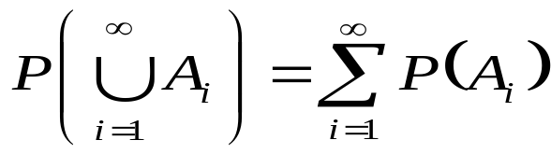
1.1 Probability Space
(Ω, F) is called a measurable space.
Def1.1.2:Given (Ω, F) , a probability measure is a
real-valued function P: F →[0,1] and
(1) ∀A ∈ F, P(A) ∈[0,1].
(2) A₁,A₂,A₃,… is a sequence of disjoint sets
in F, then
  (3) P(Ω)=1
  (Ω, F ,P) is called a probability space.

Slide 4
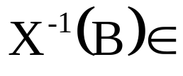
1.2 Random variables
Def1.2.1: Let (Ω, F ,P) be a probability space.
X : Ω →R is a random variable if
∀B ∈ B, F
(Ω, F) (R, B)
X⁻¹ (B)
X
B
∈ F
∈ B

Slide 5



1.6 Change of Measure
Thm1.6.1:
Let (Ω, F, P) be a probability space and let Z be an almost surely nonnegative random variable with EZ=1. For A ∈ F define
Then is a probability measure. Furthermore, if X is a nonnegative random variable, then
If Z is almost surely strictly positive, we also have
for every nonnegative random variable Y.

Slide 6
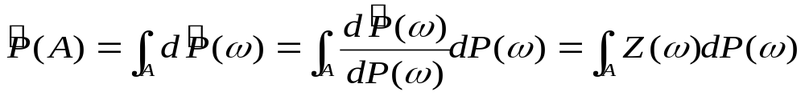
1.6 Change of Measure

Slide 7
1.6 Change of Measure
Def1.6.3:
Let Ω be a nonempty set and F a σ-algebra of
subsets of Ω. Two probability measures P and
on (Ω, F) are said to be equivalent if they agree
which sets in F have probability zero.
i.e.

Slide 8
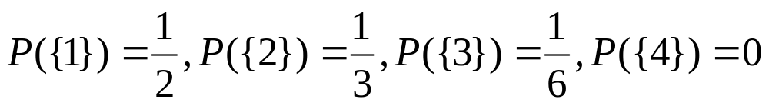
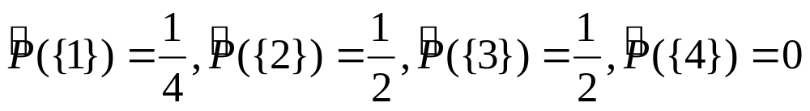
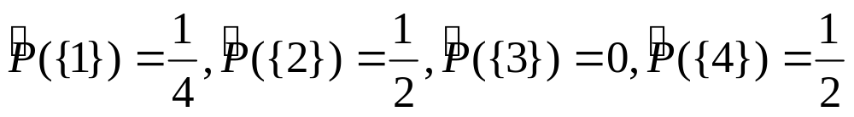
1.6 Change of Measure
Example:
Ω={1,2,3,4}
F= σ({1},{2},{3},{4})

Slide 9

1.6 Change of Measure
Thm1.6.7 (Radon-Nikodým):
Let P and be equivalent probability measures defined on
(Ω, F). Then there exists an almost surely positive random
variable Z such that EZ=1 and

Slide 10
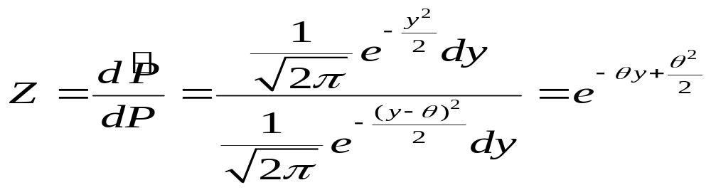
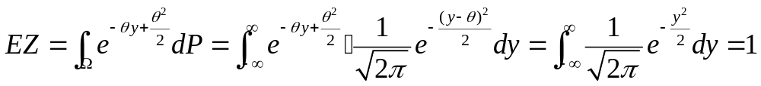
1.6 Change of Measure
EX:X~N(0,1) with respect to P.
Y=X+θ~N(θ,1) with respect to P.
Find such that Y~N(0,1) with respect to .
Sol:Let
then Z>0 and

