Slide 1
8-4 Finite-Expiration American Put
財金所 潘政宏

Slide 2
Consider an American put on a stock whose
price is the geometric Brownian motion:
But now the put has a finite expiration time T.

Slide 3
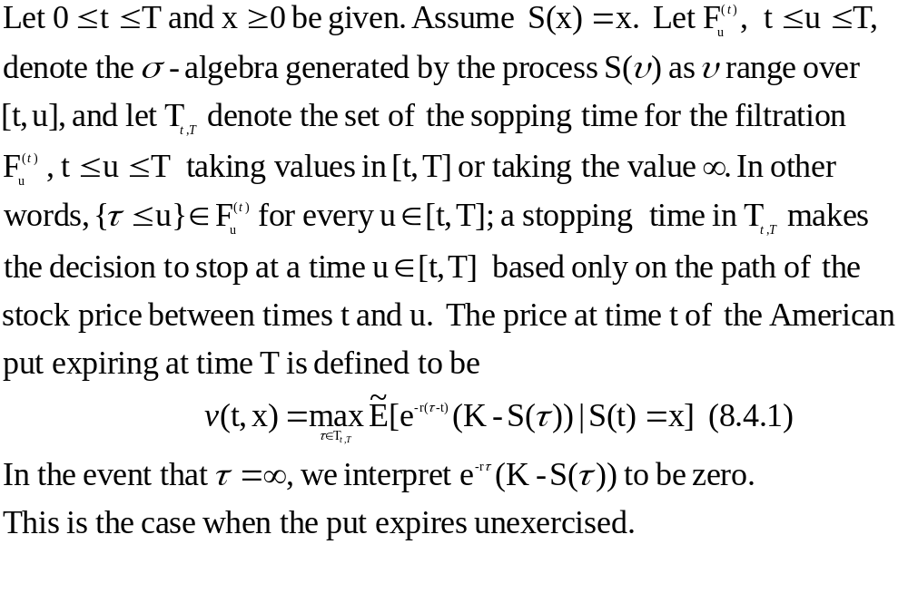
Definition 8.4.1

Slide 4
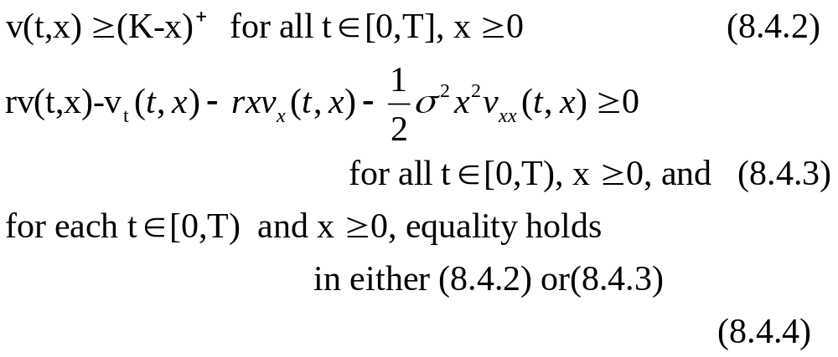
8.4.1 Analytical Characterization of the Put Price
The finite-expiration American put price function
v(t,x) satisfies the linear complementarity
conditions :

Slide 5
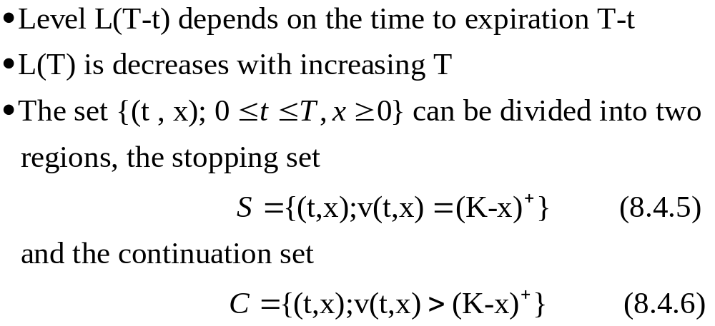
L(T-t)

Slide 6
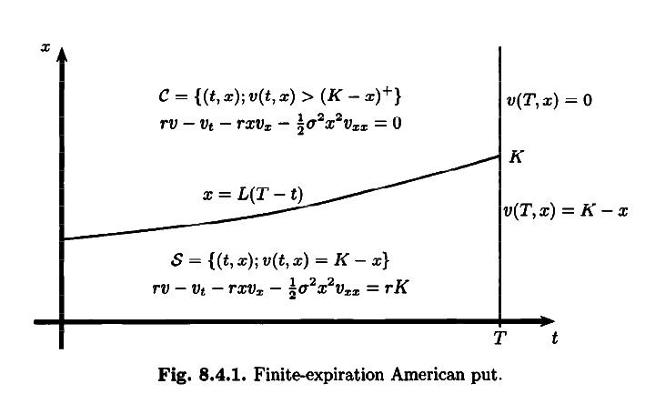
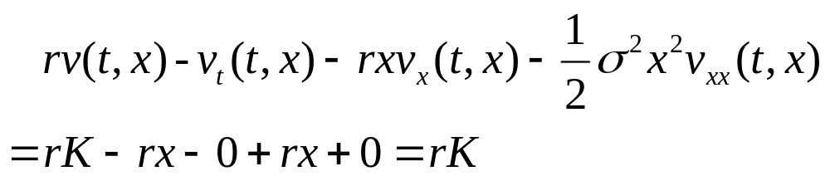

Slide 7
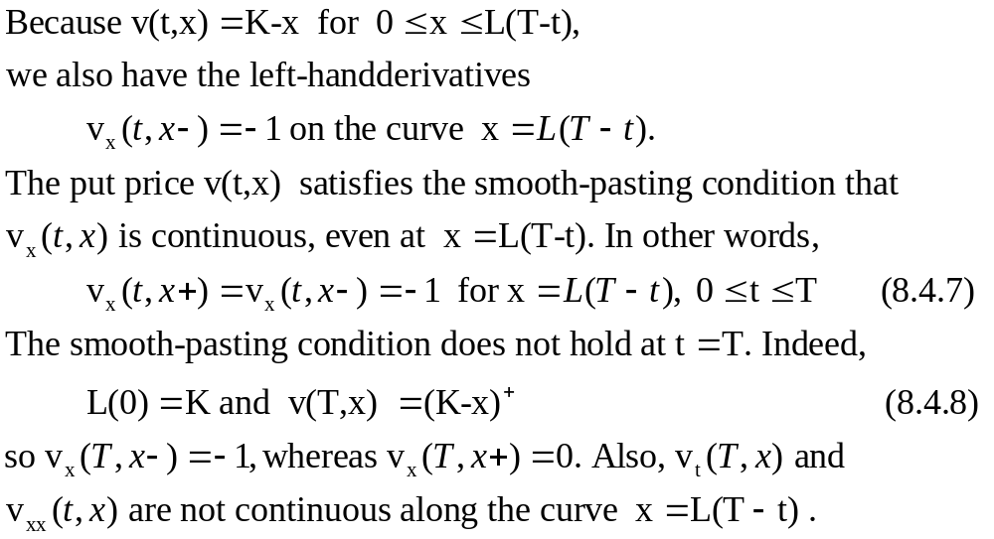

Slide 8
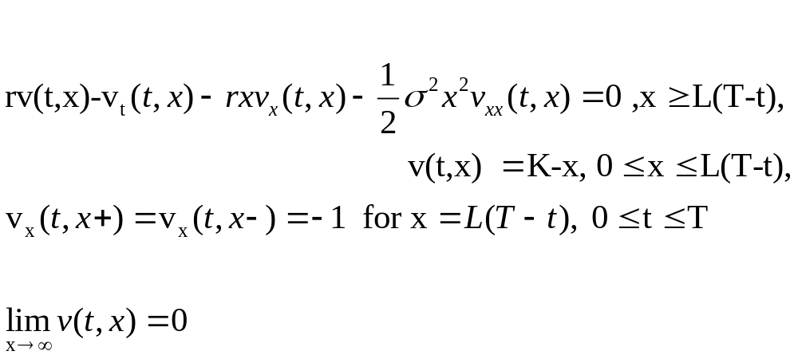
Determine the function v(t,x)

Slide 9
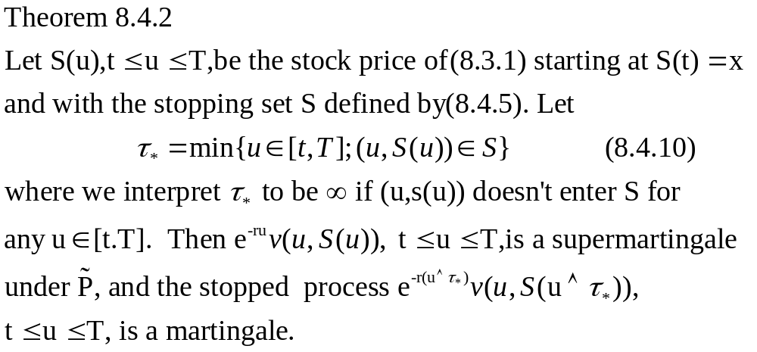
8.4.2 Probabilistic Characterization of the Put Price

Slide 10
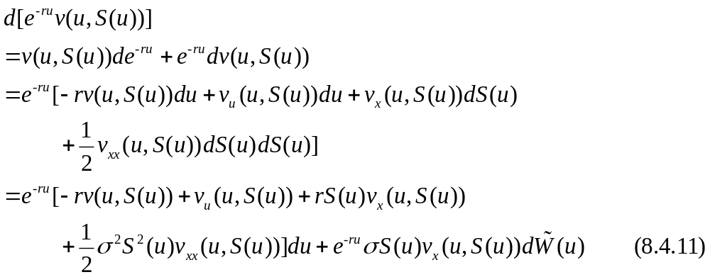
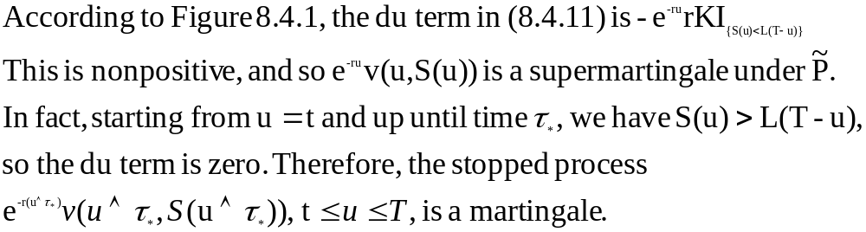

Slide 11
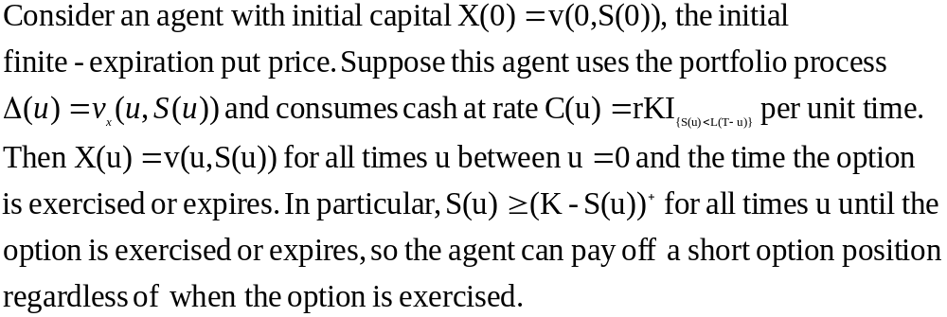
Corollary 8.4.3

Slide 12
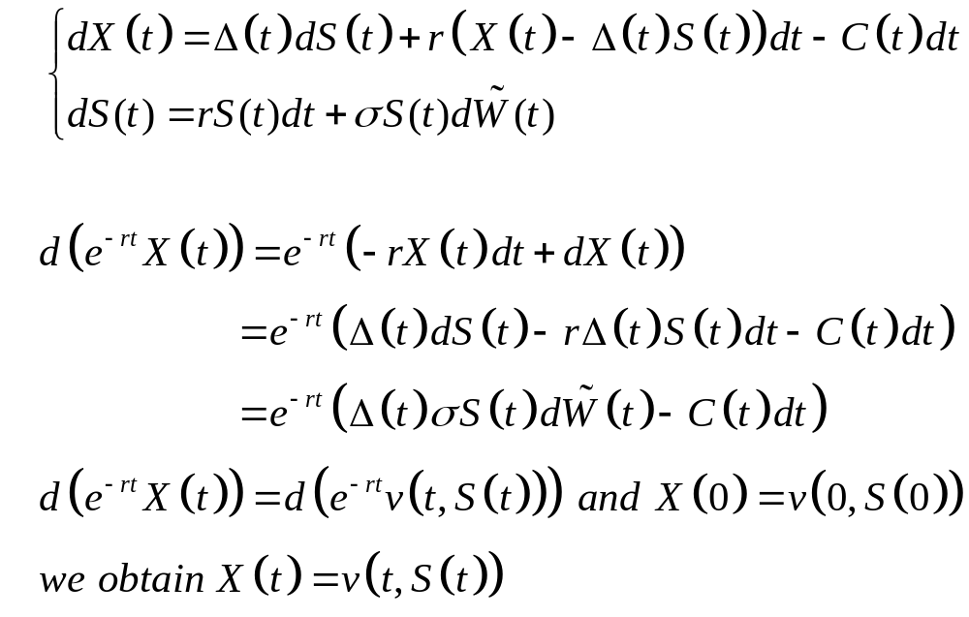
Proof 8.4.3

Slide 13
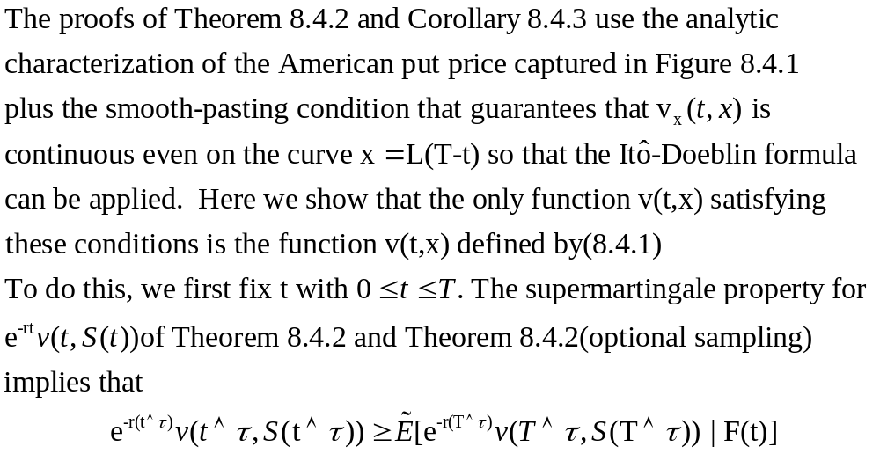
Remark 8.4.4

Slide 14
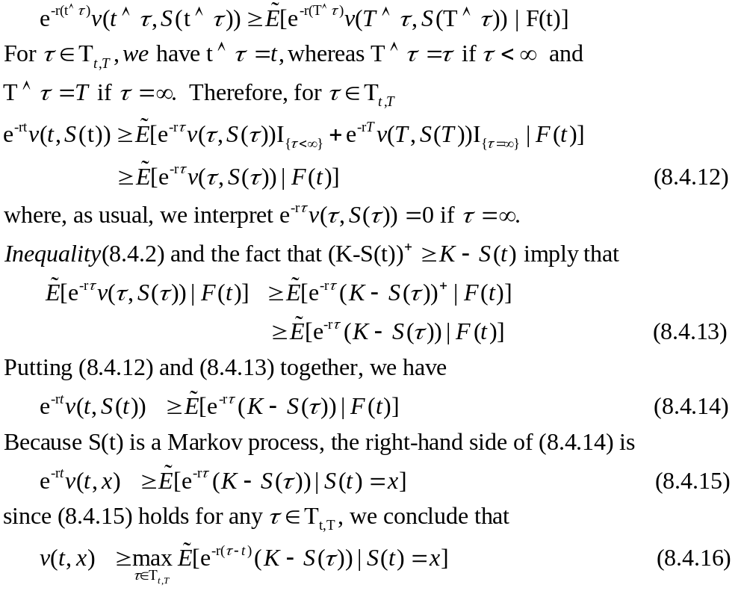

Slide 15
