Slide 1
The Relation between Top Management Turnover and the Firms’ Default Risk
Wei Ting (丁 緯)
Chung Yuan Christian University

Slide 2
INTRODUCTION
China has sustained economic growth since its economic reform.
One of the important policies for the Chinese security market was rapid facilitation from a socialist planned economy into a market economy.
Many studies indicated the development of an improved system of managerial resource allocation that is responsive to market forces is important in the Chinese economic reform (Groves et al., 1995).

Slide 3
INTRODUCTION
Groves, et al. (1995) further show that those firms with poorly performing were more likely to have a new top manager.
Many empirical studies connect the reason of top management turnover with firm performance and provide the evidence that the likelihood of management turnover is negatively related to firm performance (Weisbach, 1988).
Stiglitz and Weiss (1983) explore the termination of the contract of management and indicated that the probability of top management turnover should depend on current and past relative performance.
Warner et al. (1988) also find that firms with low stock returns are more likely to change their top management than other firms.

Slide 4
INTRODUCTION
Although there are complete studies exploring the relation between top management turnover and firms’ performance, little research explored the relations between top management turnover and the probability of firms’ default.
Recently, many famous accounting scandal cases, such as Enron and WorldCom, have made the public pay more attention to the default risk.
These corporate scandals in the emerging markets are more serious.

Slide 5
INTRODUCTION
In China, Sun and Zhang (2006) pointed out that about 20 percent of publicly listed firms have been convicted by the CSRC for serious frauds and scandals since the Chinese stock market was established in the early 1990s.
Accordingly, in this study we explore the relations between top management turnover and the probability of firms’ default in the biggest emerging market, China, which has extensive fraud and with less mature securities regulations to protect investors.

Slide 6
INTRODUCTION
In addition to the poorly performing firms that are more likely to have a new manager, many studies show that after replacing top management a potential improvement in firm performance and subsequently firm value follows.
Denis and Denis (1995) and Huson, Malatesta, and Parrino (2004) document substantial improvements in firm performance after the incumbent top management are removed after poor performance.
Therefore, in our study we also realize the impacts of the probability of firms’ default after replacing top management.

Slide 7
INTRODUCTION
Our study makes several contributions to the literature in this field.
  First, we provide evidence of the relationship between top management turnover and the probability of firms’ default risk.
  Second, we examine listed firms in the Chinese stock market to explore such relationships. Companies in the unsafe and deficient security markets have higher risk; therefore, the investors hope to find a good top management to not only to understand firms’ performance but also default risk.
  Lastly, we also explore after the incumbent top management are removed could decrease the probability of firms’ default.

Slide 8
LITERATURE REVIEW : KMV Default Risk
Many related models have been developed in an attempt to forecast the probability of business failure. ( Z-score model ;Altman, 1968).
However, there has been a general tendency in these studies to use historical data to predict the default risk, which may not be capable of adequately reflecting the actual probability of bankruptcy (Hillegeist et al., 2004).
The KMV model is based upon compelling and intuitive theory, and since it uses equity market data, it incorporates the most up-to-date information available on a firm’s financial health condition.
Dacorogna et al. (2003) demonstrated that the forecasting ability and time-varying characters of the KMV model were superior to other models.

Slide 9
LITERATURE REVIEW : CEO Replacement and the Default Risk
There is a general consensus that the likelihood of top management turnover is negatively related to firms’ past performance (Gilson and Vetsuypens 1993).
Desai et al. (2004) consider that the revelation of fraud results in a large decline in firm value, and then it may benefit the firm to initiate the change of top management.
Sun and Zhang (2006) examine the management turnover associated with fraud, and find that firms associated with fraud have higher management turnover than matching non-fraud firms.
Gilson (1989) investigates top management turnover in financially distressed firms and finds in the investigative year 52% of firms with top management turnover are in default on their debt or bankrupt.

Slide 10
LITERATURE REVIEW : CEO Replacement and the Default Risk
Although these studies find that the top management turnover is closely related to the bankruptcy, they only focus on the bankrupt or fraud firms.
In our studies, we use KMV model to estimate all firms’ probability of default to more accurately explore the relation between top management turnover and firms’ default risk.
Following Sun and Zhang (2006) and Gilson (1989), we predict that there will be a positive correlation between top management turnover and the risk of bankruptcy for a firm. Thus, our first hypothesis is as follows:
Hypothesis 1 : Ceteris paribus, the relationship between top management turnover and default risk will be positive.

Slide 11
LITERATURE REVIEW : CEO Replacement and the Default Risk
Top management replacement leads to higher default risk, the probability of default will decrease with lower levels of top management turnover. Accordingly, in our studies we also document this relationship and our second hypothesis is as follows:
Hypothesis 2 : Ceteris paribus, after replacement of the top management, the probability of firms’ default will decrease.

Slide 12
DATA AND METHODOLOGY : Data Description
Our discussion of the relationship between top management turnover and the probability of firms’ default is based upon data obtained from the Chinese Stock Market and Accounting Research (CSMAR) database.
This sample is comprised of all publicly-listed enterprises in the Shanghai and Shenzhen Stock Exchange.
Our sample span covers the five-year period, from 2001 to 2005.
This selection process yields a total of 433 firms, and 2,165 firm-year observations.

Slide 13
DATA AND METHODOLOGY : Empirical Models
We employ the multivariate random effects balanced panel regression method to examine the effects of top management turnover and the default risk for publicly-listed firms in China.
We begin by constructing an annual time series model of top management turnover and corporate default risk using the KMV model to assess the firms’ probability of default. The KMV model calculates the actual probability of default based upon the option pricing theory of Black and Scholes (1973) and Merton (1974). The computation of ‘expected default frequency’ (EDF) is based on the company’s capital structure, the volatility of its asset returns, and the current asset value.
Guided by related theories drawn from the aforementioned prior studies, the control variables are comprised of the debt ratio, return on assets, total assets, the same person occupying both the chairman of the board of directors and CEO positions, and the number of board directors.

Slide 14
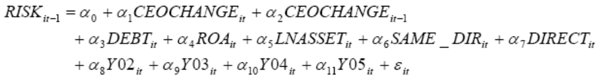
DATA AND METHODOLOGY : Empirical Models
The empirical model to explore hypothesis H1, we use the probability of “prior” firms default as an independence variable, is described as follows:
When the coefficient of CEOCHANGE_{it} is positive, the indication is that firms with higher probability of default will change their top management in the posterior. At these times the hypothesis H1 is supported.

Slide 15
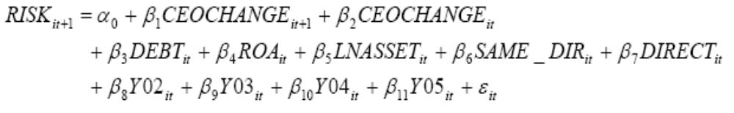
DATA AND METHODOLOGY : Empirical Models
The empirical model to explore hypothesis H2, we use the probability of “posterior” firms default as an independence variable, is described as follows:
When the coefficient of CEOCHANGE_{it} is negative which shows that when the firms change their top managements, the probability of default will decrease in the next period. These results support hypothesis H2.

Slide 16
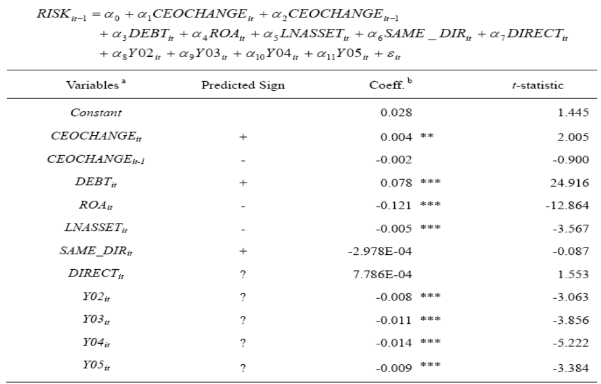
EMPIRICAL RESULTS AND ANALYSIS : Empirical analysis (H1)

Slide 17
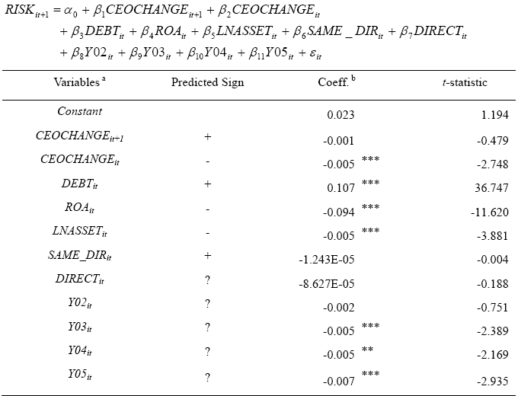
EMPIRICAL RESULTS AND ANALYSIS : Empirical analysis (H2)

Slide 18
CONCLUSIONS
In a country changing from a socialist planned economy into a market economy, China, they need top management to have talented and professional decision-makers to increase firm performance and decrease risk.
The prior literature suggests that a firm with sub par performance provides the board of directors to have more incentive to change top management.
In China where financial crisis and fraud are extensive, efficiently controlling the probability of firms’ default risk is another important mission for the top management.

Slide 19
CONCLUSIONS
However, few studies explore the relation between top management turnover and firms’ probability of default risk.
Therefore, in our studies we use KMV model, which is the completed include both historical data and market data, to compute the actual probability of default to explore this relation and then complement the findings of prior studies.
We find that the firms with higher default risk are more likely to change their top management. Furthermore, we also explore that firms changing the top management result in those firms’ posterior default risk lessening compared to other companies.

Slide 20
The End
Thank for your Listening

