Slide 1
台灣樂透市場投注者選號行為之研究
Selection Behavior of Taiwan Lotto Players
-Dynamic analyses of number selection
何淮中
中央研究院統計科學研究所
林修葳
台灣大學國際企業學系暨研究所
李世欽
致理技術學院財金系

Slide 2
Outline
(I) Importance of studying lotto markets
(II) Motivation and purpose
(III) Hypotheses
(IV) Methodologies
(V) Empirical results
(VI) Conclusions

Slide 3
(I) Importance of studying lotto markets
(1)Thaler (1992): Lotto games, which have attracted the most attention in wagering markets, are better suited for testing the concepts of rationality
than stock markets.
(2) Durham, Hertzl, Martin (2005) : Betting markets have several advantages over traditional capital markets and experimental laboratory.

Slide 4
(II) Motivation and purpose
Indirect analyses (publicly available data)
(Farrell, Lanot, Hartley, and Walker 2000; Papachristou, 2004) Investigate the betting behavior or to estimate the elasticity of demand for lottery by using only public, limited available data.
Propose a more efficient method

Slide 5
Direct analyses
(1) Dynamic models
(Rabin, 2002; Rabin and Vayanos, 2007) : Develop cognitive models to explain gambler’s fallacy and hot-hand biases in people's decision-making.
(2) Thinking through category
(Mullainathan, 2002) : Present a model of human inference in which people use coarse categories to make inferences.
The first two models provide some more insights into financial anomalies .
(3) Illusion of control
Individuals believe that they exert control over events that are in fact randomly determined (Langer, 1975).

Slide 6
Gambler’s fallacy
(III) Hypotheses
Expecting outcomes in random sequences to exhibit systematic reversals
In the fairness of coin-flipping experiments, subjects seem to believe that heads and tails should balance even in small samples (Tversky and Kahneman,1971)
Pick-three lottery game:
1. Clotfelter and cook (1993):Maryland lottery
2. Terrell (1994) :New Jersey lottery
Lotto(6/49): Papachristou (2004) documents that history information
only marginally affected in UK.

Slide 7
Hot-hand fallacy
Basketball fans expect that players have significant hot hands, being more likely to make a shot following a successful streak (Gilovich, Vallone, and Tversky, 1985).
Rabin and Vayanos (2007) propose a model to reconcile the gambler’s fallacy and hot-hand fallacy in the prediction of random sequences.
In their model, individuals judge the performance of a fund manager depending not only on luck from which the gambler’s fallacy is generated, but also on the latent variable describing the ability of the manager .

Slide 8
Thinking through categories
The set of categories forms a partition of the posterior space and people choose the category which is most likely given by the data.
Which lotto ticket is more likely to win the jackpot prize ?
1.) 3 16 17 29 34 37 2.) 1 2 3 4 5 6
Most people prefer the first ticket because winner numbers come from a random machine and the event of 6 consecutive numbers is less likely than that of non-consecutive numbers and thus creates an impression that the latter is more random.

Slide 9
Illusion of control
Lotteries in North America did not become popular until New Jersey introduced a game which allowed players to select their own numbers
(Thaler, 1992)
Subjects bet more money and played with more confidence than other people in their chance of winning if they threw the dice themselves. Strickland, Lewicki and Katz (1966)
System bet players tend to take chances and seem to have more confidence than ordinary bet type player.

Slide 10
(IV) Methodologies
Data
Conscious selection
Average picking frequency
  Winner ball and loser ball groups
Dynamic models
  Variable HIT : Luck
  variable HOT : Ability
Non-consecutive combinations
  Variable JUMP
Three types of bets
  Ordinary bet, System roll, System bet

Slide 11
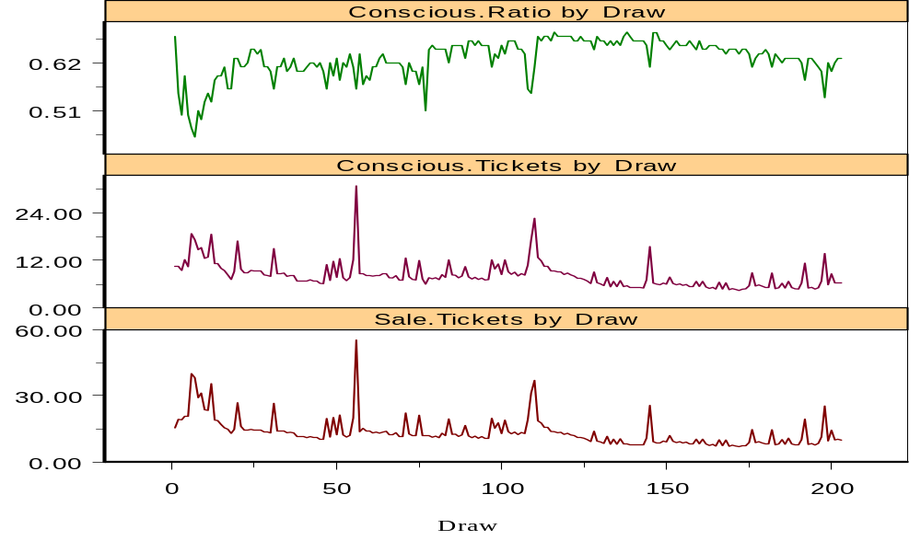
(V) Empirical results
Figure 1 The time series pattern of the proportion of numbers consciously chosen by lotto players

Slide 12
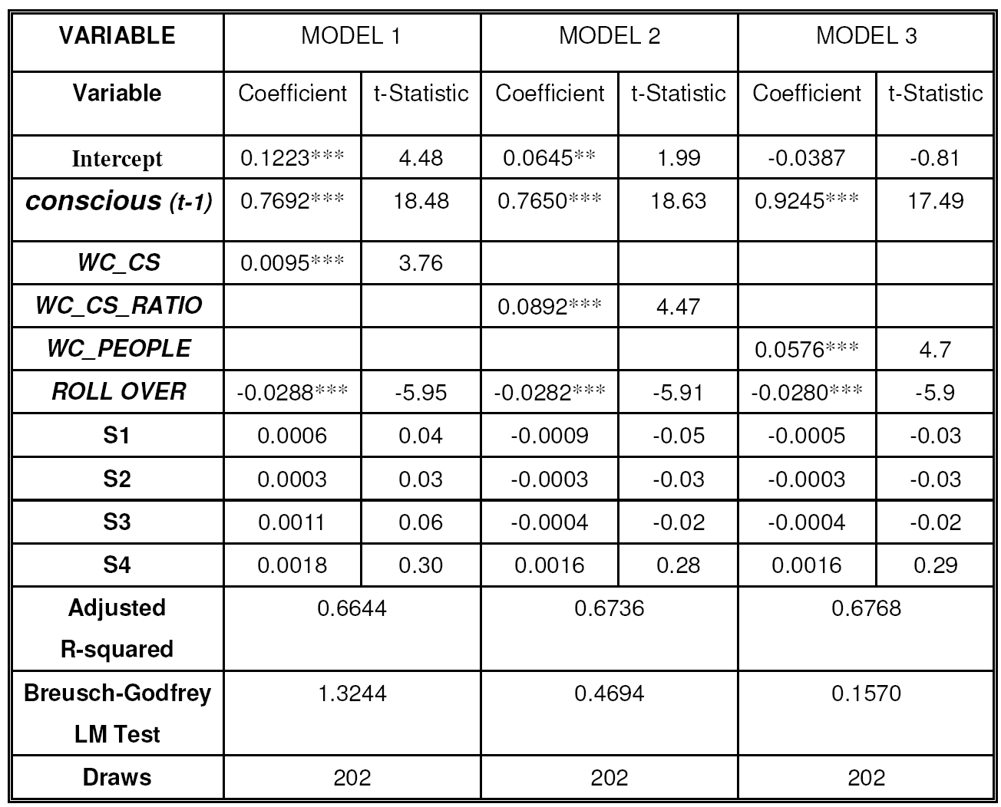
Table 1 Determinants of the ratio of conscious number selection

Slide 13
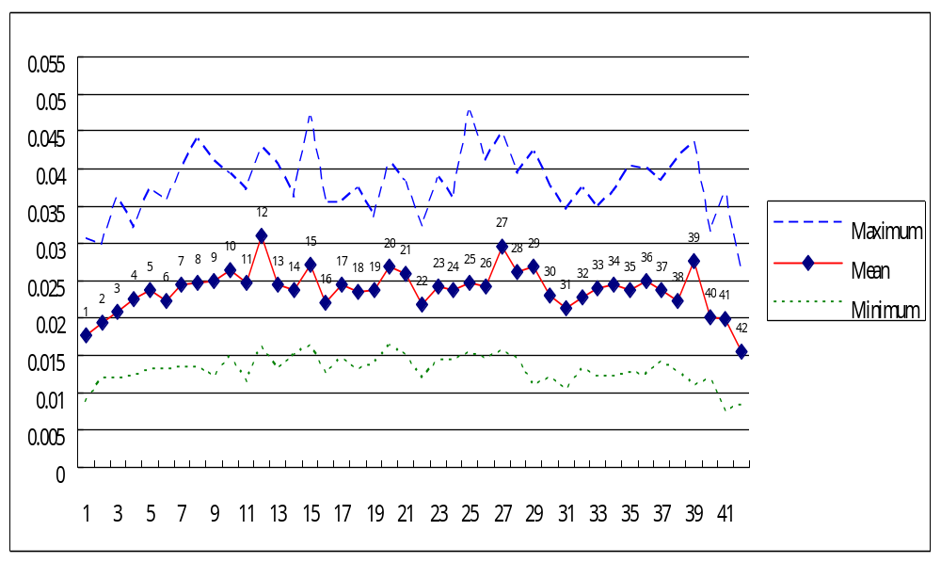
Figure 2 The average probability of picking individual numbers

Slide 14
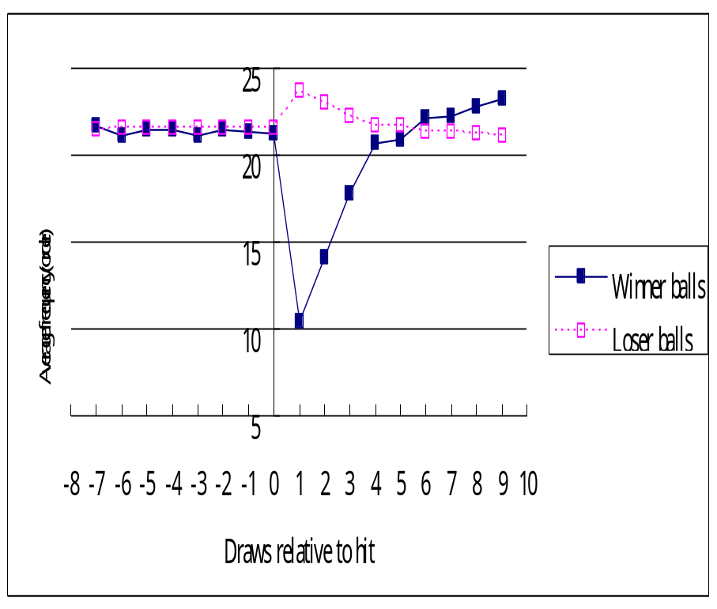
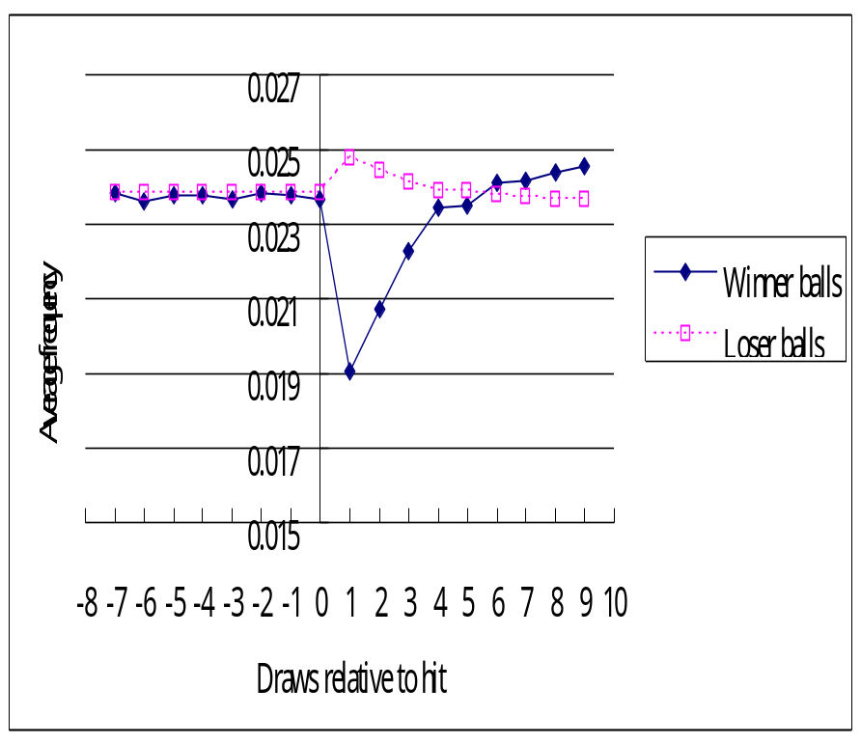
Figure 3 Picking frequencies for reaction to hit.

Slide 15
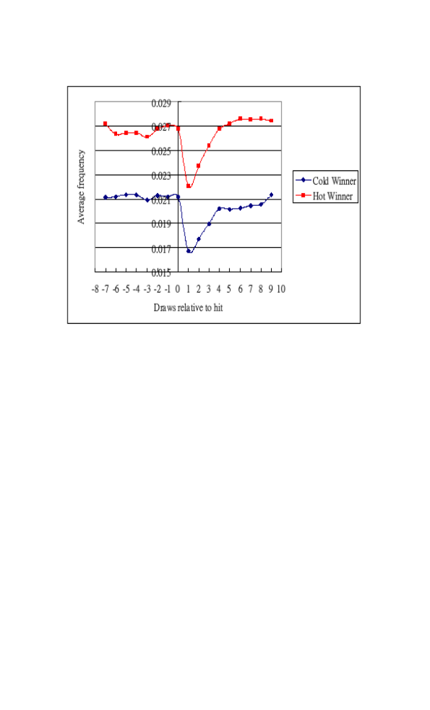
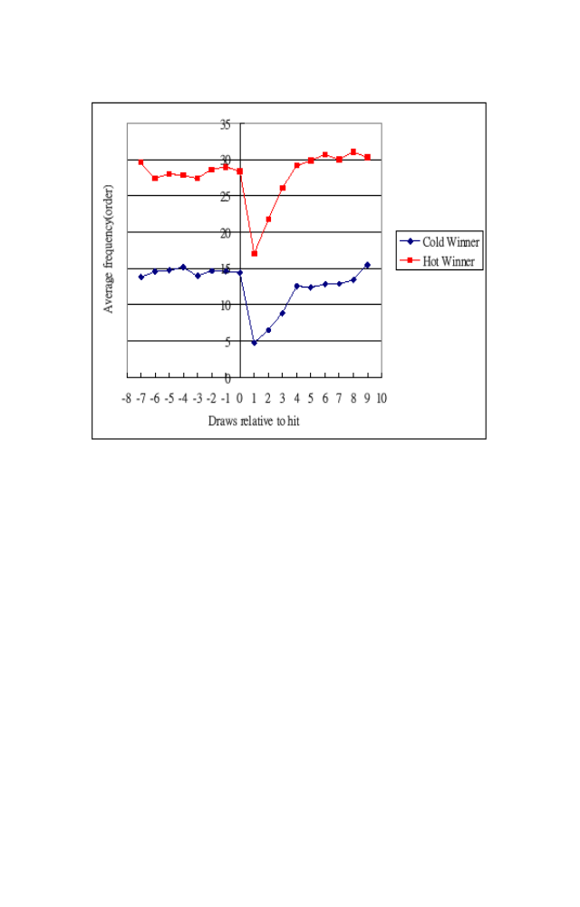
Figure 4 Picking frequencies for reaction to hit across winning frequencies.

Slide 16
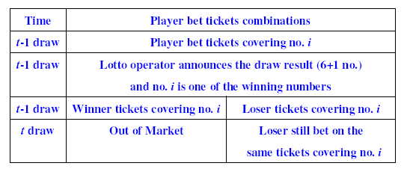
Table 2. Playing strategy for lotto tickets covering no. i

Slide 17
Table 2. Playing strategy for lotto tickets covering no. i
Alternative reason - wealth effect:
players choose constant numbers in each draw and out market if they win.
Difference=Q(i,t-1)-Q(i,t)-Q_win(i,t-1)
The t-test for mean is 0.002705786 with a one-sided p-value of 0.0000 (t= 23.40)
This effect cannot completely explain the behavior of gambler’s fallacy.

Slide 18
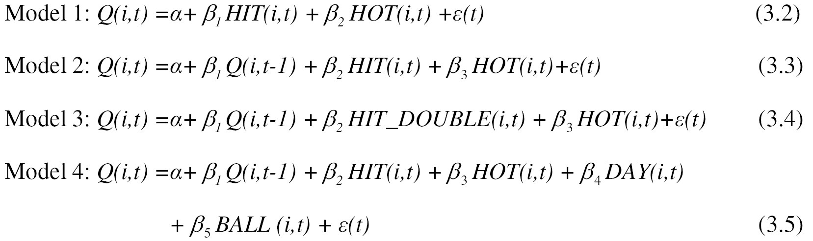
Table 3 Determinants of the probability of the numbers picked by the players

Slide 19
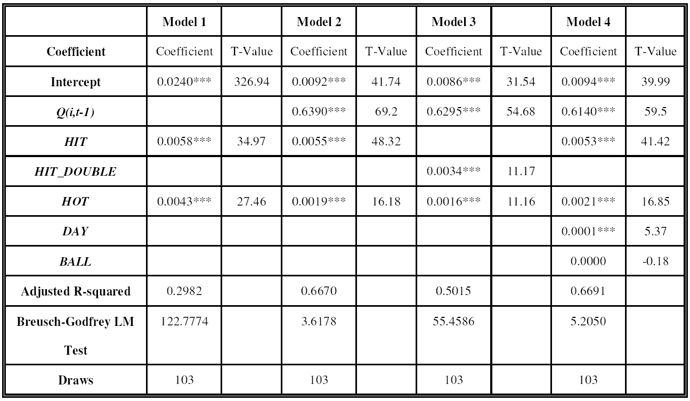
Table 3 Determinants of the probability of the numbers picked by the players

Slide 20
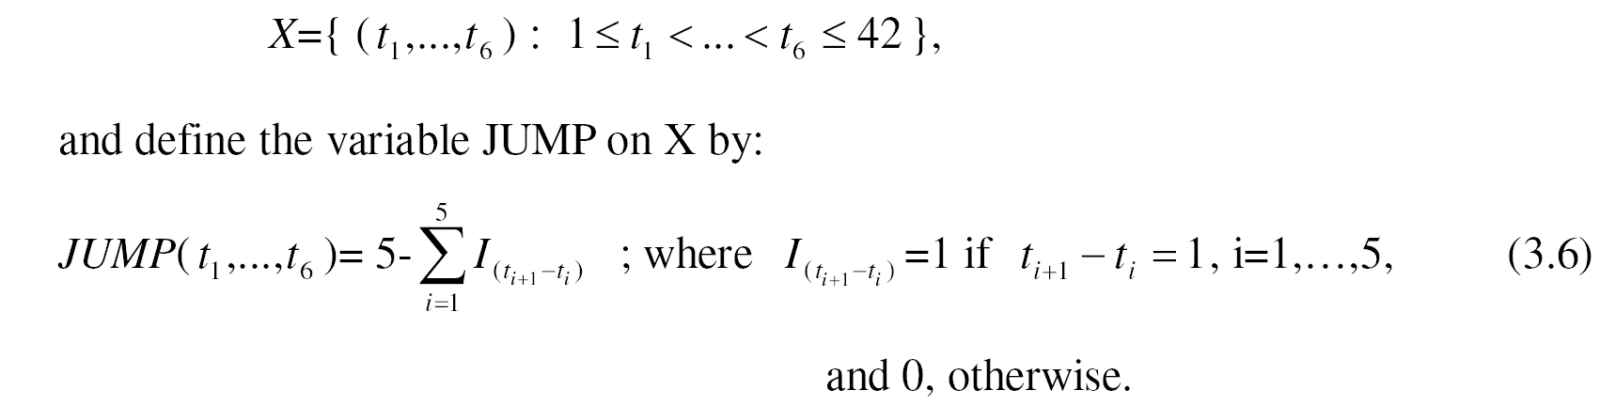
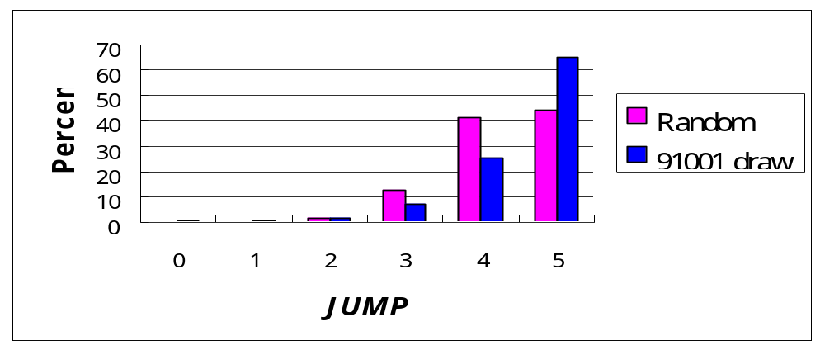
Table 4 Descriptive statistics of JUMP

Slide 21
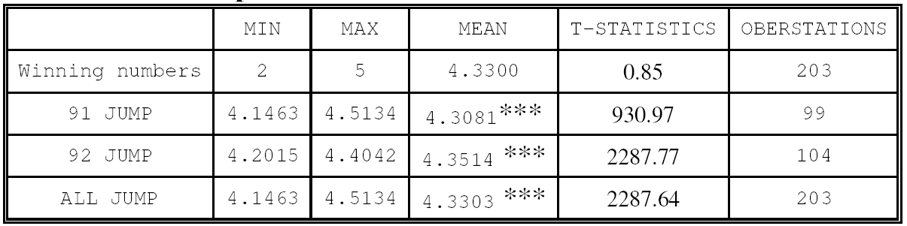
Table 4 Descriptive statistics of JUMP

Slide 22
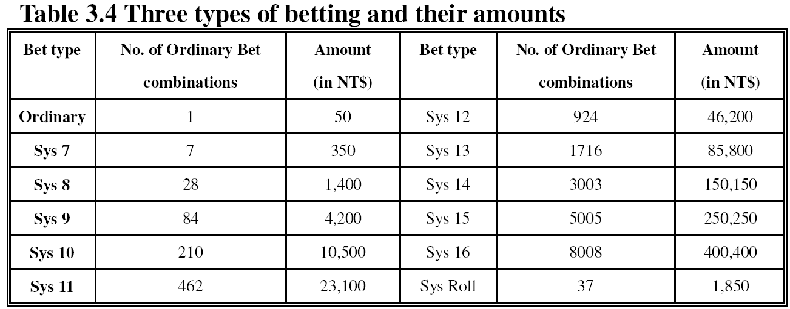
Three types of betting starting at the 100th draw
Ordinary bet : select 6 numbers
System roll : select 5 numbers, the computer assign the remaining 37 number to these 5 numbers.
System bet : selection 7 to 16 numbers

Slide 23
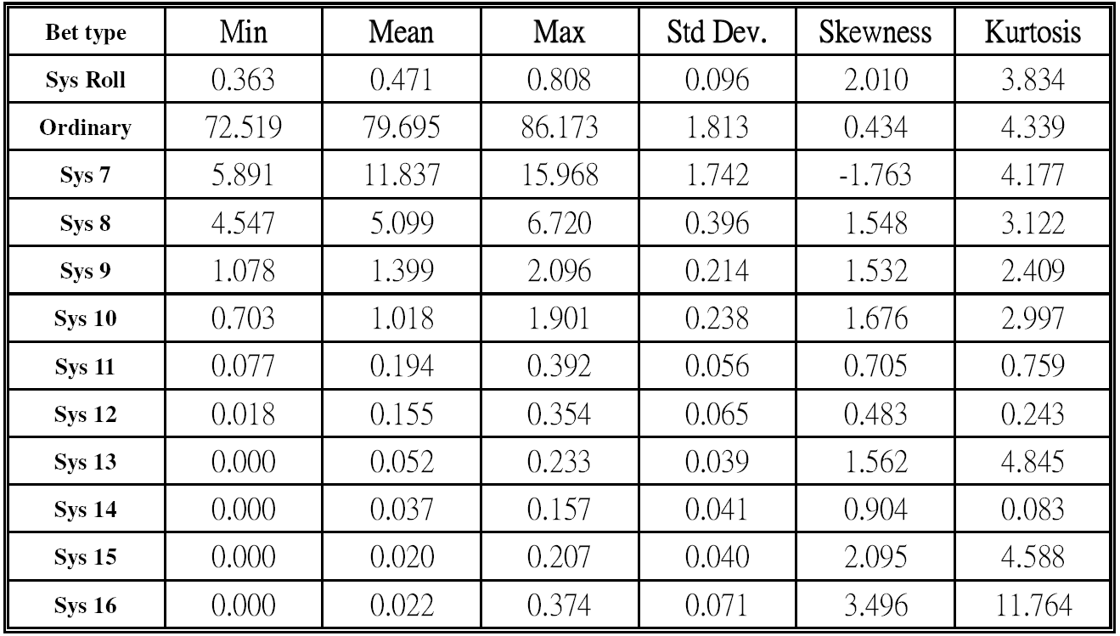
Table 6 Descriptive statistics for betting types
Small system bet : Sys7-Sys9
Medium system bet : Sys10-Sys11
Large system bet : Sys12-Sys16

Slide 24
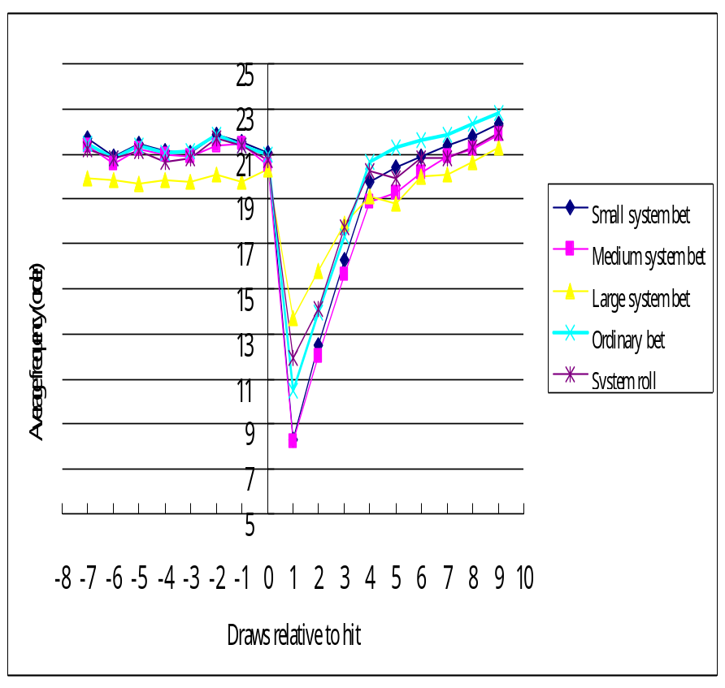
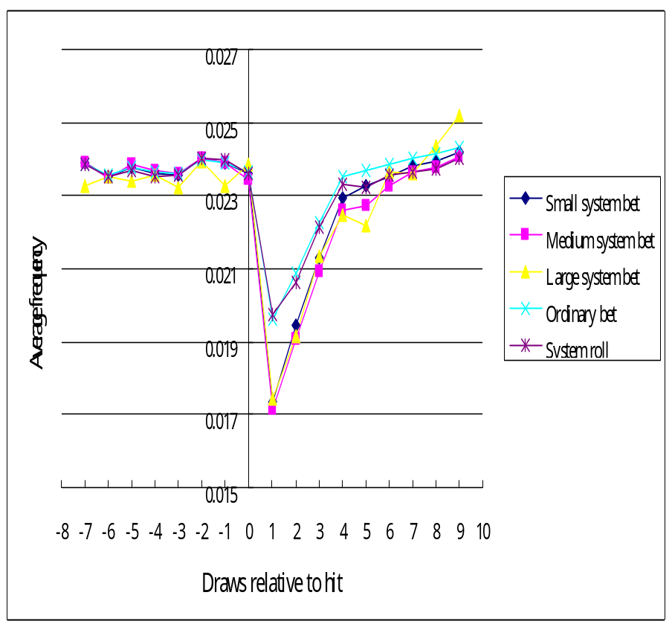
Figure 5 Picking frequencies for reaction to hit across betting types.

Slide 25
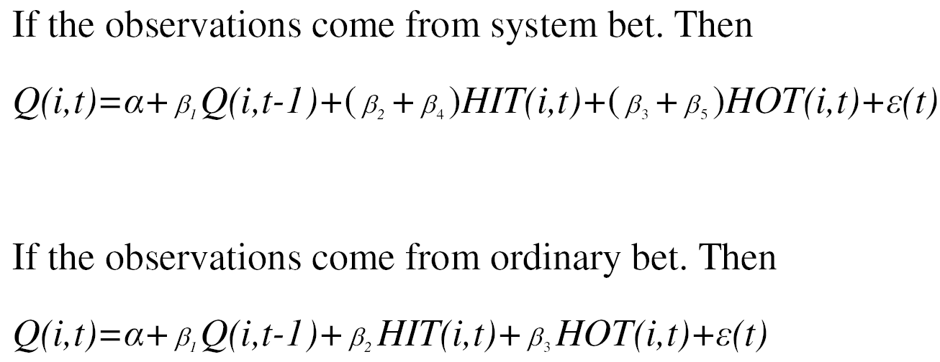
Table 7 Determinants of the probability of the numbers picked across betting types
1. HIT_NOT_P6 equals to HIT if the probability distribution does not come from an ordinary bet.
2. HOT_NOT_P6 equal to HOT if the probability distribution does not come from an ordinary bet.
For example :

Slide 26
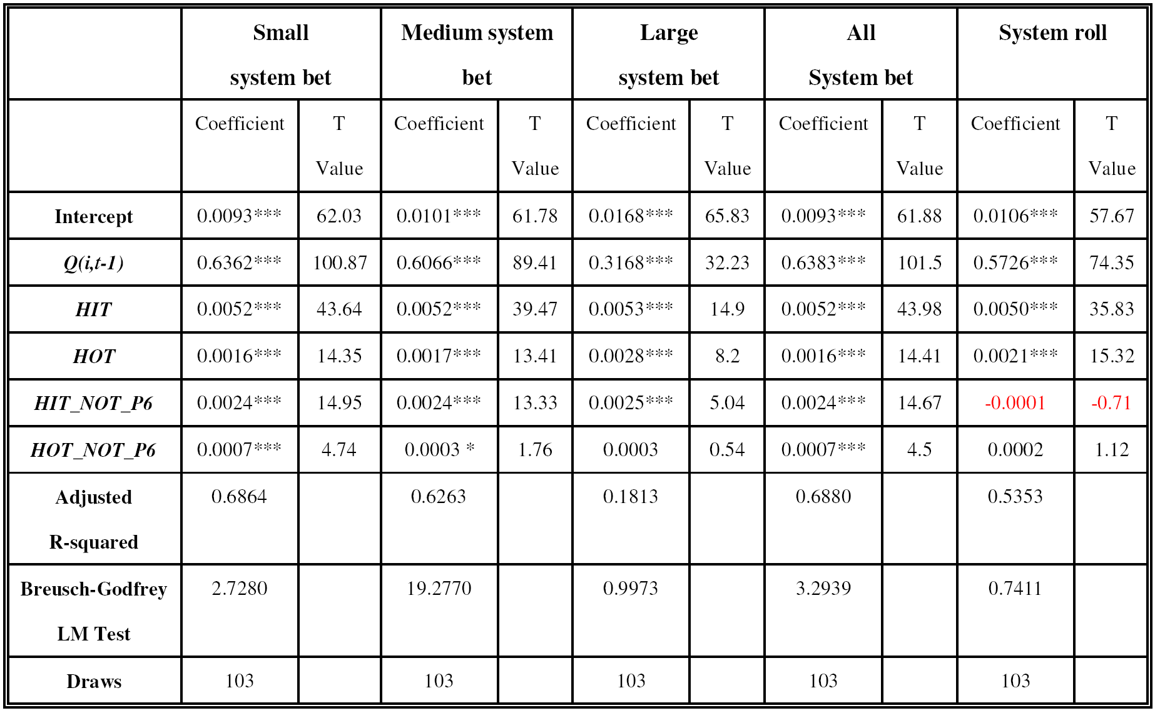
Table 7 Determinants of the probability of the numbers picked across betting types

Slide 27
(VI) Conclusions
This paper analyzes a sample of 1,679,676,226 combinations of lottery
ticket numbers consciously chosen by the players of the Taiwan lotto for
the period from 2002 to 2003.
First, the gambler’s fallacy temporarily influences players’ selection of lotto numbers.
In addition, we find that after controlling for the mechanism of player strategy, the gambler’s fallacy is still observed.
Second, such negative influence can be partially offset by picking the numbers that appeared more frequently in the past.
Third, most players avoid picking consecutive numbers, extending the concept of representativeness heuristic. In addition, the win-stay strategy is shown to exist.
Forth, the players using the system bet strategy have stronger misconceptions about random processes than the players using the ordinary bet strategy.

