Slide 1
An empirical investigation of auditor independence and accounting conservatism: Further evidence from Taiwan market-based incentives
Authors: Yi-Hsing Liao
Notes:
The electronics industry continues to grow and change at a rapid pace, and so has Cadence.
Today, I want to review with you some of the factors affecting the future success of companies designing & building electronic products, and describe how Cadence is working with those companies to help meet their business objectives...

Slide 2
Outline Presented
Research motivation
Research purposes
Research design
Hypotheses development
Empirical methodology and variable measurement
Sample formation and data resources
Empirical results and analysis
Summary and concluding remarks

Slide 3
Research motivation
According to the literatures surveyed, whether non-audit services really create a threat to auditor’s independence and reporting quality has been controversial for a long time and not yet come to a conclusion currently. In addition, a number of prior studies find that they are short of significant evidence to support the argument that non-audit services reduce auditor independence. One of the reasons why the auditing literatures can not draw a consistent conclusion on the matter is that they only focus on the impacts of non-audit services on auditor independence but ignore the role of market forces (Craswell et al. 1995; Larcker and Richardson 2004; Ruddock et al. 2006). Therefore, to explore the effect of market forces on the relationship between non-audit services and accounting conservatism is potentially interesting.

Slide 4
Research purposes
This paper aims to extend the literatures of non-audit services research, and further explore the impacts of market forces on the relationship between the provision of non-audit services and accounting conservatism from the viewpoint of corporate governance. I hope my research can provide additional evidence with respect to market forces definitely serve to discipline auditors from compromising their independence.

Slide 5
Research design-Hypotheses development
H₁: Ceteris paribus, the auditors’ fee dependence is negatively associated with the level of accounting conservatism. .
H₂: Ceteris paribus, the negative effect of auditors’ fee dependence on earnings conservatism is higher for firms with weak quality of board oversight than for firms with strong quality of board oversight .

Slide 6

Empirical methodology and variable measurement
Proxies for Auditor Independence:
the ratio of non-audit fees to total fees
abnormal non-audit fees based on the expectation models
abnormal total fees based on the expectation models

Slide 7
Empirical methodology and variable measurement
Proxies for Board Characteristics:
This paper employs four characteristics for board of director to shed light on the independence and monitoring motivation of the board: (i) Percentage of independent directors and supervisors on the board, (ii) Percentage of family directors and supervisors on the board, (iii) CEO duality, and (iv) Board size.
The percentile rank method is applied to the four individual measures of board characteristics-INDEP, FAM, CEO, and BOSIZE-to drive an overall governance score which I denote as CGTS (Milliron 2000; Bushman et al. 2004). For the following analysis, this paper will use the aggregate CGTS measure as a proxy for board characteristics governance.

Slide 8
Empirical methodology and variable measurement
Measurement of Accounting Conservatism:
The accrual-based conservatism measure (hereafter ACCRUAL) is computed as follows: Net income before extraordinary items plus depreciation expense less cash flows from operations is deflated by average total assets, and averaged over 3 years centered around year “t”.
Basu’s asymmetric timeliness of earnings measure with the backward-cumulation approach.

Slide 9
Empirical methodology and variable measurement
Empirical model for tests using accrual-based conservatism measures is as follows:
According to H1, as auditors reduces their independence, the level of accounting conservatism will decrease, therefore, I predict that β1 >0. Furthermore, β3 represents the incremental effect of client importance on accounting conservatism for firms with strong board governance. If H2 is valid, then I would predict that β3 <0.

Slide 10
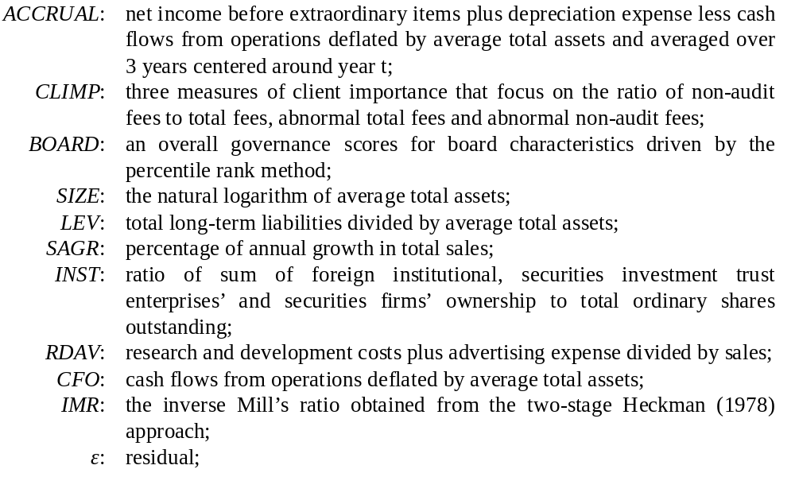
Empirical methodology and variable measurement

Slide 11
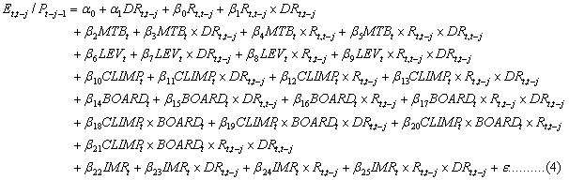
Empirical methodology and variable measurement
Empirical model for tests using Basu’s asymmetric timeliness of earnings measure is as follows:
Under Basu (1997) regression specification, I expect the coefficient for β13 to be significantly negative. According to H2, I predict that the coefficient of β21 will be significantly positive.

Slide 12
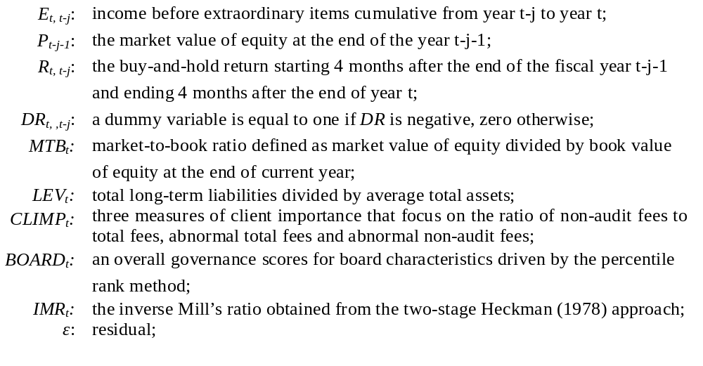
Empirical methodology and variable measurement

Slide 13
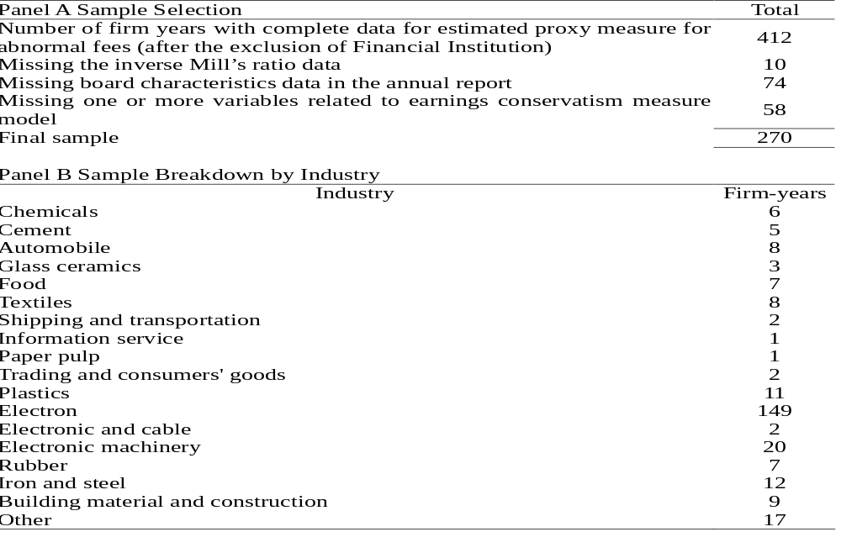
Sample formation and data resources
TABLE 2 Sample Selection and Sample Breakdown by Industry from 2002 to 2006

Slide 14
Sample formation and data resources
sample period
the sample period spans five years from 2002 through 2006.
data sources
Regarding data sources, except for the board characteristics variables which are manually collected from the annual reports, the regression variables required for estimating accounting conservatism and other financial variables of the empirical model are all collected from the TEJ database and the Times Winner database.
The demand for non-audit services may depend upon firm’s economic characteristics. To address this self-selection bias issue, my study uses the two-stage procedure of Heckman (1979) to solve the problem.

Slide 15
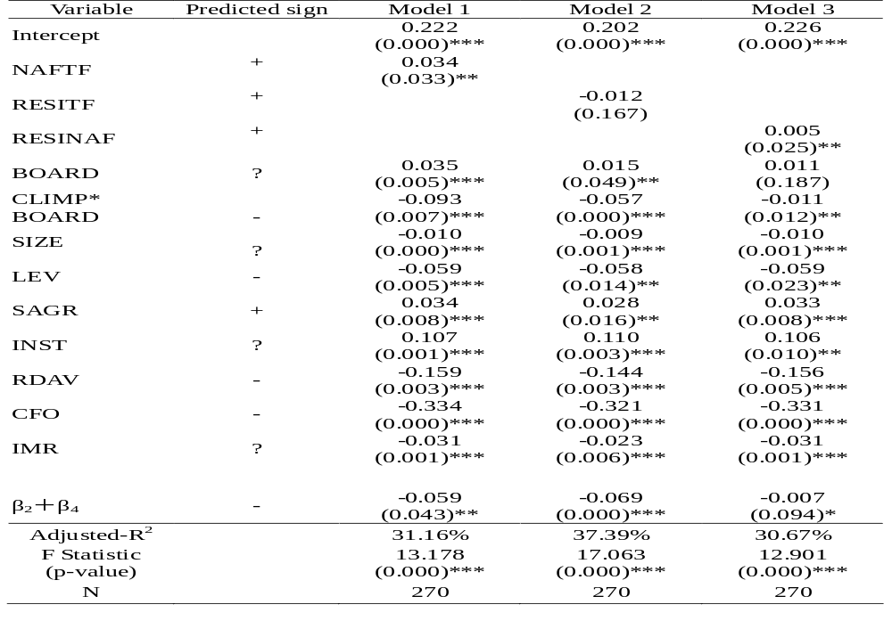
Empirical results and analysis-Table 5

Slide 16
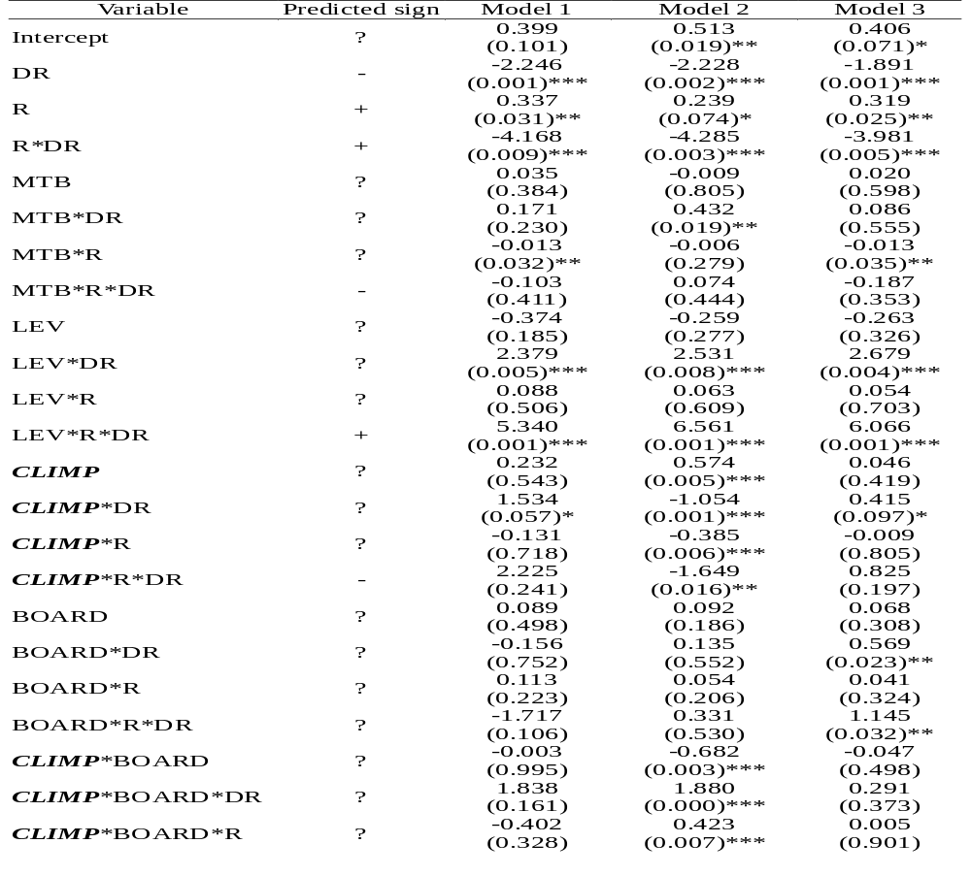
Empirical results and analysis-Table 6

Slide 17
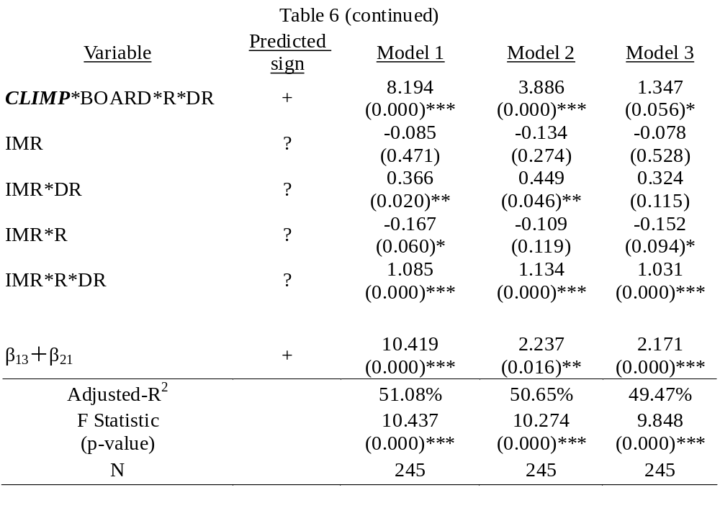
Empirical results and analysis-Table 6

Slide 18
Robustness tests
I rerun the analyses after deleting the outliers and the results do not change.
I repeat all tests reported in Tables 5 and 6 with board governance based on outside directors and supervisors in replace of independent counterparts, all results are not qualitatively affected.
I perform book-to-market ratio tests following Beaver and Ryan (2000) as another conservatism measure.
The paper further investigates the impacts of alternative market forces such as litigation risk and reputation loss on the relationship between client importance and accounting conservatism.
To ensure that the clients of any one audit firm are not driving the results, I form five separate subsamples by deleting in turn the clients of each of the Big 4 firms and non-Big 4 firms at a time.

Slide 19
Summary and concluding remarks
Empirical results reveal that the impairment of auditor independence is significantly associated with the reduction of conservatism. Especially, I further find that sound board governance mechanisms definitely offset the effect of aggressive accounting caused by impaired auditor independence.
Collectively, these findings are consistent with the view that board governance is the primary determinant of auditor’s attitude toward conservative accounting.

Slide 20
Thank you for your attention!

