Slide 1
Pricing Discrete Lookback Options Under A Jump Diffusion Model
Department：NTU Finance
Supervisor：傅承德 教授
Student：顏汝芳

Slide 2
Agenda
I. Background
II. The Model
III. Numerical Results
IV. Conclusion

Slide 3
I. Background
- Introduction
- Motivation
- Pricing Issues
- Literature Review

Slide 4
Introduction
Popular Products: (options)
  Maturity style
    European
    American
  Path-dependent Payoff
    Lookback option
    Barrier option
    Asian option …etc.

Slide 5
Introduction
Lookback Option:
a contract whose payoffs depend on the maximum or the minimum of the underlying assets price during the lifetime of the options.

Slide 6
Introduction
Two types:
  Floating strike price.
  Fixed strike price.
Two cases
  continuous monitoring (analytical use).
  discrete monitoring (practical use).

Slide 7
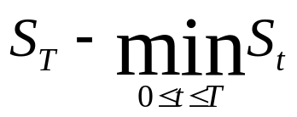
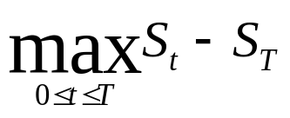
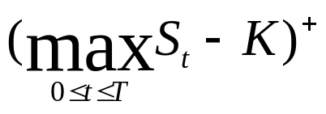
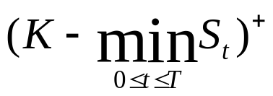
Introduction
Time-T payoffs can be expressed as
  For European floating strike lookback calls and puts respectively:
  and
  For European fixed strike lookback calls and puts respectively:
  and

Slide 8
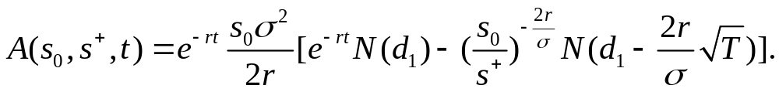
Introduction
Under the Black-Scholes model
  The value process of a Lookback put option (LBP) is
  given by (continuous case)
  where
P( s, s⁺, t )

Slide 9
Motivation
Empirical Phenomena
  Asymmetric leptokurtic
    left-skewed; high peak, heavy tails
  Volatility smile
Models which capture these features:
  SV (stochastic volatility) model
  CEV (constant elasticity volatility) model
  Jump diffusion models

Slide 10
Introduction
For continuous-version lookback options
  Under the Black-Scholes model
    Goldman,Sosin and Gatto (1979)
    Xu and Kwok (2005)
    Buchen and Konstandatos (2005)
  Under the jump diffusion model
    Kou and Wang (2003, 2004)
  In general exponential Levy models
    Nguyen-Ngoc (2003)

Slide 11
Motivation
In practice, many contracts with lookback features are settled by reference to a discrete sampling of the price process at regular time intervals (daily at 10:00 am).
These options are usually referred to as discrete lookback options. In these circumstances the continuous-sampling formulae are inaccurate.
The values of lookback options are quite sensitive to whether the extrema are monitored discretely or continuously.

Slide 12
Motivation
For discrete lookback option
  Essentially, there are no closed solutions.
  Direct Monte Carlo simulation or standard binomial trees may be difficult.
  Numerically, the difference between discretely and continuously monitored lookback options can be surprisingly large, even for high monitoring frequency, see Levy and Mantion (1998).

Slide 13
Pricing Issues
Can we price discrete lookback options under a jump diffusion model by using the continuous one ?

Slide 14
Literature Review
For discrete-version lookback options
  Broadie, Glasserman and Kou provided in 1999
  a technique for approximately pricing discrete
  lookback options under Black-Scholes model.
  They use Siegmund’s corrected diffusion
  approximation, refer to Siegmund (1985).

Slide 15
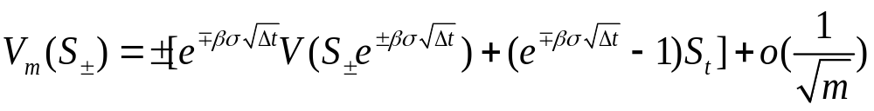



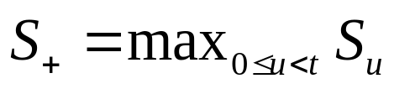
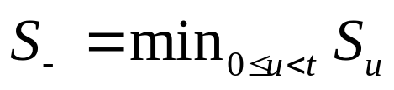
Literature Review
Theorem 3. The price of a discrete lookback at the k^{th} fixing date
and the price of a continuous lookback at time t=kΔt satisfy
Where, in and , the top for puts and the bottom for calls;
the constant ,
ζ the Rimann zeta function.
Otherwise and .
( Cited from Broadie, Glasserman and Kou, (1999), “Connecting discrete and continuous path-dependent options”.)

Slide 16
Literature Review
Table 4. Performance of the approximation of Theorem 3 for pricing a discrete lookback put option with a predetermined maximum. The parameters are: S=100, r=0.1, σ=0.3, T=0.5, with the number of monitoring points m and the predetermined maximum S₊ varying as indicated. The option in the left panel has a continuously monitored option price of 16.84677, the right panel is 21.06454.
S₊=110 S₊=120
m True Approx. Error True Approx. Error
5 13.29955 12.79091 -0.50864 18.83723 18.44999 -0.38724
10 14.12285 13.85570 -0.26715 19.32291 19.11622 -0.20669
20 14.80601 14.66876 -0.13725 19.74330 19.63509 -0.10821
40 15.34459 15.27470 -0.06990 20.08297 20.02718 -0.05579
80 15.75452 15.71899 -0.03553 20.34598 20.31747 -0.02851
160 16.05908 16.04117 -0.01791 20.54389 20.52942 -0.01447

Slide 17
II. The Model
- Continuity Correction
- Continuous-Monitoring Case
- Discrete-Monitoring Case
- Some known results

Slide 18
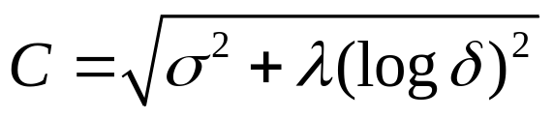
Continuity Correction
Theorem 2.1 For 0 < δ < 1 the discrete-version at k^{th} and continuous-version at time t = kΔt floating strike LBP option satisfy
and for δ >1 floating strike LBC have the approximation
The constant .
Continuity Correction

Slide 19
Continuous-Monitoring Case
Incomplete Market
  Change the measure from original probability to a risk-neutral probability measure, see, for example, Shreve (2004);
  Choose the only market pricing measure among risk-neutral probabilities, we refer to Brockhaus et al. (2000) which is focusing on risk minimizing strategy and its associated minimal martingale measure under the jump-diffusion processes.

Slide 20
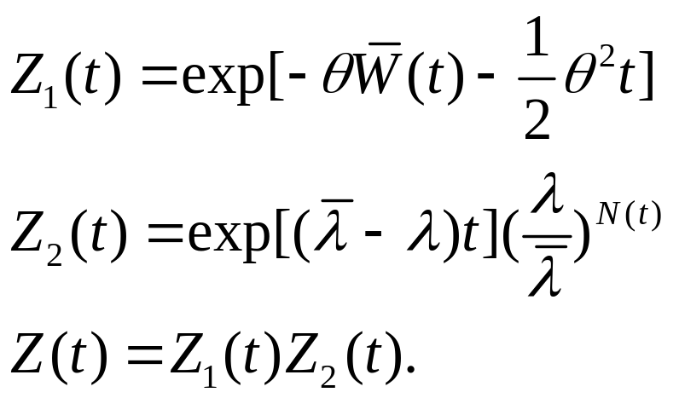
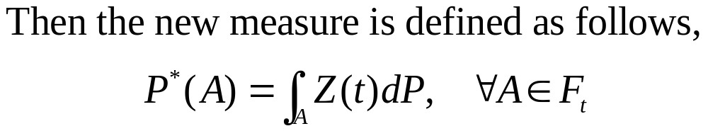
Continuous-Monitoring Case
To construct a risk-neutral measure
Let θ be a constant and λ be positive number. Define

Slide 21
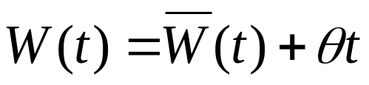


Continuous-Monitoring Case
Under the probability measure P*,
  the process is a Brownian motion,
  is a Poisson process with intensity λ , and
  and are independent.

Slide 22
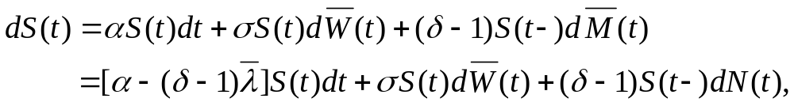
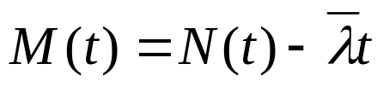
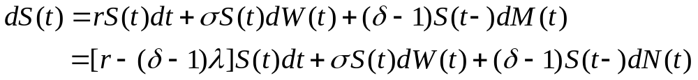
Continuous-Monitoring Case
Under the original measure P,
where is the compensated Poisson process and is a martingale.
P* is risk-neutral if and only if

Slide 23
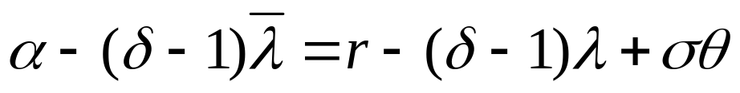
By contrast, we can get the relation
Since there are one equation and 2 unknowns, θ and λ, there are multiple risk-neutral measures.
Extra stocks would help determine a unique risk-neutral measure.

Slide 24
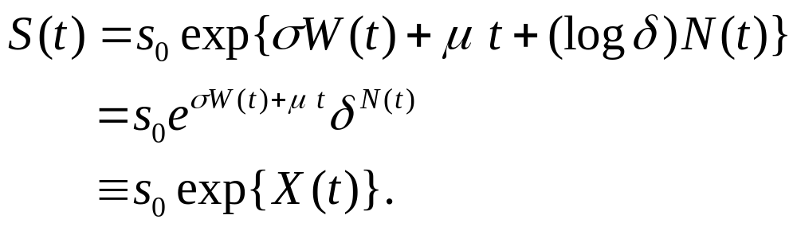
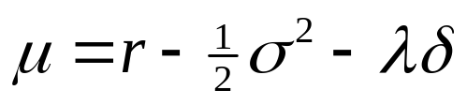
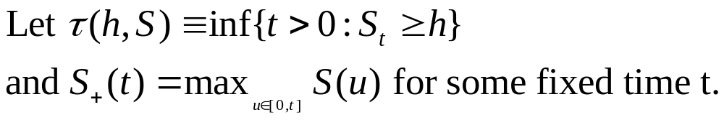
Continuous-Monitoring Case
On ‘the’ probability space (Ω,F,P*)
where and δ > 0, δ ≠ 1.
.

Slide 25

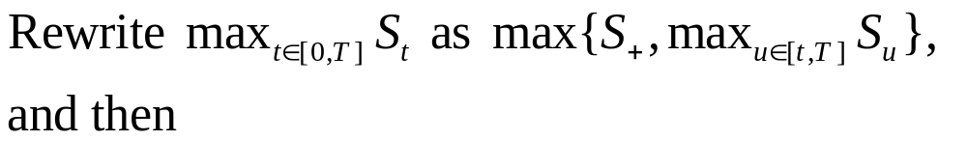
Continuous-Monitoring Case
The price of a continuous floating strike lookback put (LBP) option at arbitrary time 0<t<T is given by ( t=kΔt )
where

Slide 26
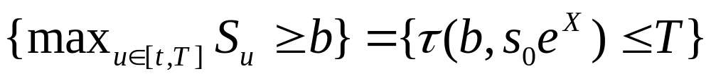
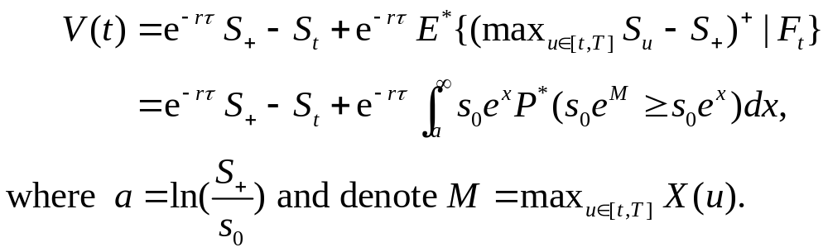
Continuous-Monitoring Case
Then we can use the fact that
to get the continuous value process as follows,
Remark1

Slide 27
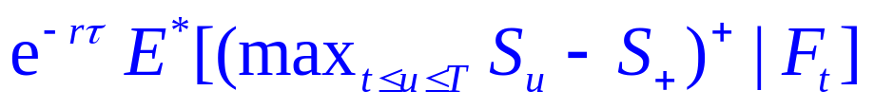

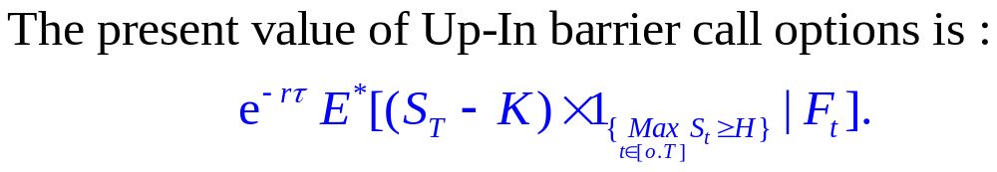
Continuous-Monitoring Case
Remark 1. Focus on
which can be deemed the discounted value of a Up-and-In barrier call option with barrier and strike price called the moving barrier option. This issue is quite interesting and will be open for later discussion.

Slide 28
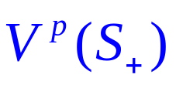
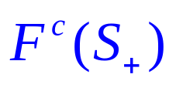
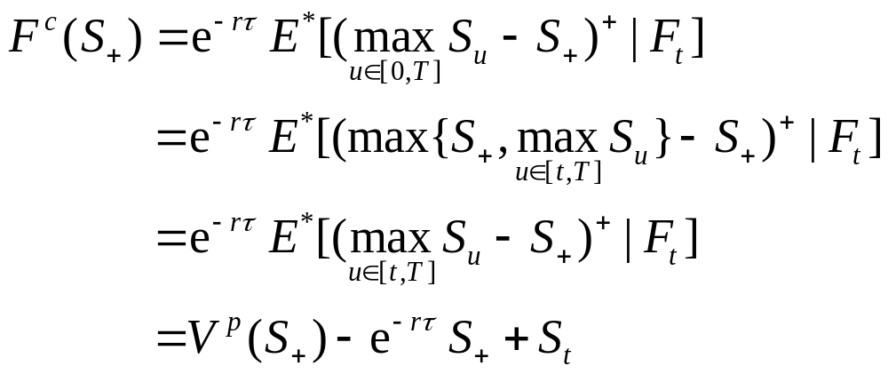
Continuous-Monitoring Case
The floating strike lookback put →
The fixed strike lookback call →
The relation between them at an arbitrary time t satisfies

Slide 29
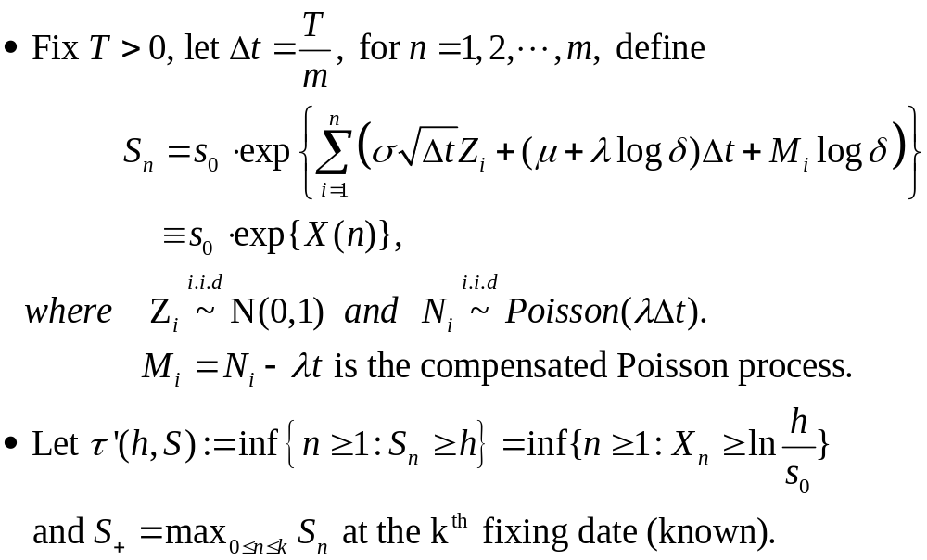
Discrete-Monitoring Case

Slide 30
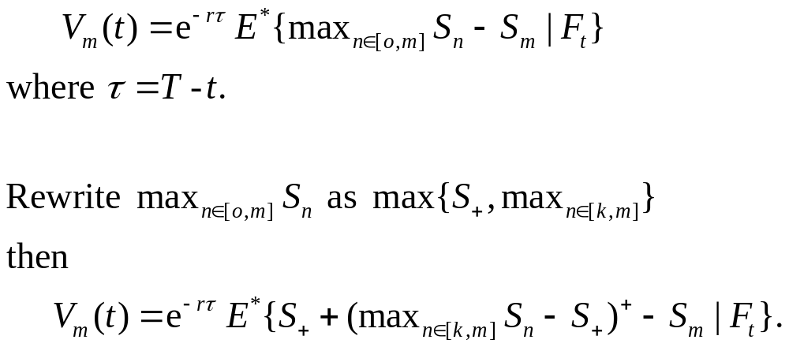
Discrete-Monitoring Case
The price of a discrete floating strike LBP option at the k^{th} fixing date is given by
.

Slide 31
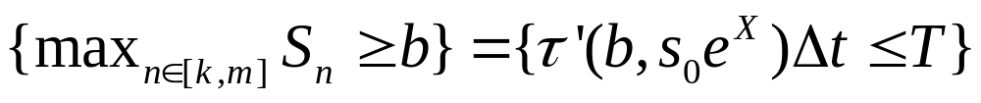
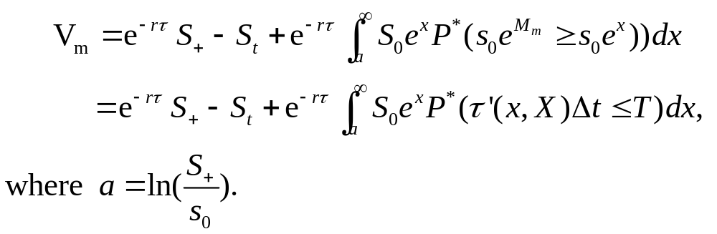
Discrete-Monitoring Case
Similarly, we can use the fact that
to get the discrete value process as follows,

Slide 32
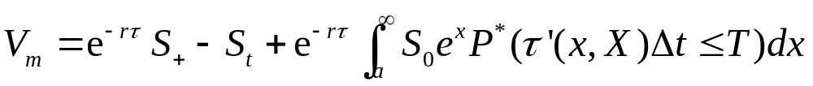
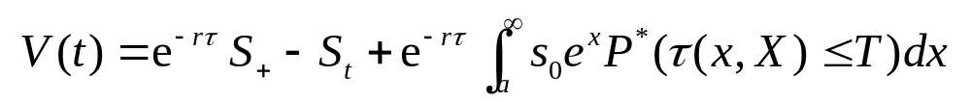
Comparison
Discrete-monitoring case
Continuous-monitoring case
What’s the connection
between them ?

Slide 33


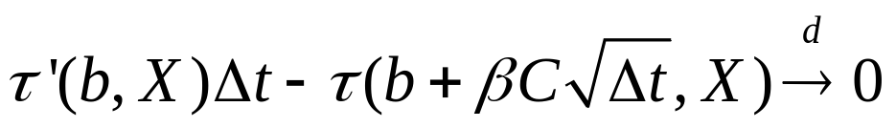

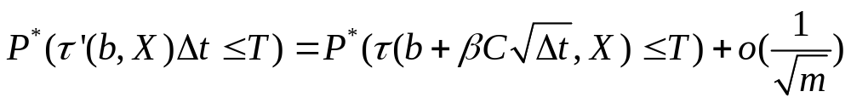
Some known results
From Fuh and Luo (2007) we have the relations between the distributions of and as follows.
Proposition 1.2. For a fixed constant b > 0, we have
where “ ” means converging in distribution, moreover
.

Slide 34
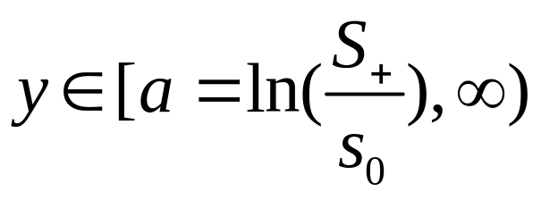
Continuity Correction
We need to extend the results
fixed constant b r.v.
That is, we have to discuss the uniform convergence of the distribution of stopping time when the constant b is a variable number.

Slide 35
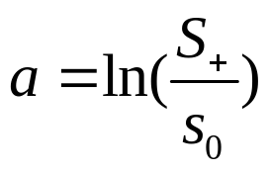
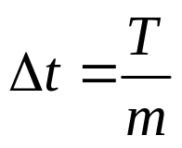

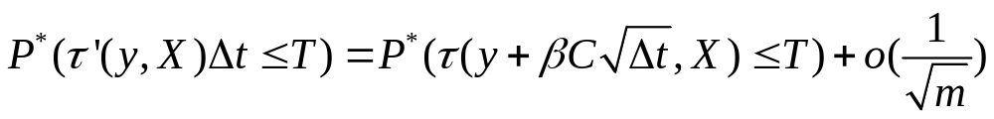
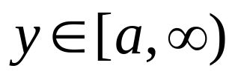
Continuity Correction
Lemma 1.3 Suppose that y is a flexible number,
and . Then we have that as m ∞
holds for all .

Slide 36
Continuity Correction
Theorem 2.1 For 0 < δ < 1 the discrete-version at k^{th} and continuous-version at time t = kΔt floating strike LBP option satisfy
and for δ >1 the floating strike LBC option satisfy
The constant .
Continuity Correction

Slide 37
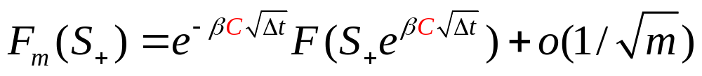
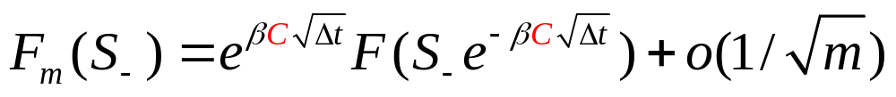
Continuity Correction
Theorem 2.2 For 0 < δ < 1 the discrete-version at k^{th} and continuous-version at time t = kΔt fixed strike LBC option satisfy
and for δ >1 the fixed strike LBP option satisfy
The constant .
Continuity Correction

Slide 38

Continuity Correction
overshoot
Overshoot
  Due to the jump part
  Due to discretization effect
Thus our formula coincides with Broadie et al. (1999) when δ =1.
For 0 < δ < 1 → Spectrally negative jump processes; For δ > 1 → Spectrally positive jump processes.
S_{t}
S₊
t

Slide 39
III. Numerical Results
- Continuous LBP options
- Results

Slide 40
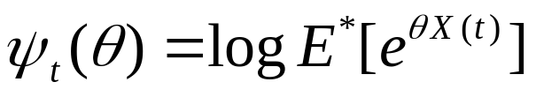
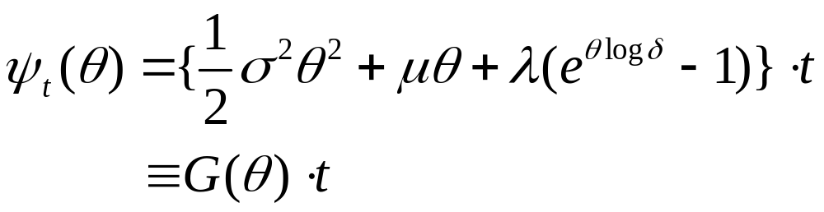
Continuous LBP options
Let be the cumulant generating
functions of X(t). And then it is given by
Denote g(．) as the inverse function of G(．).

Slide 41
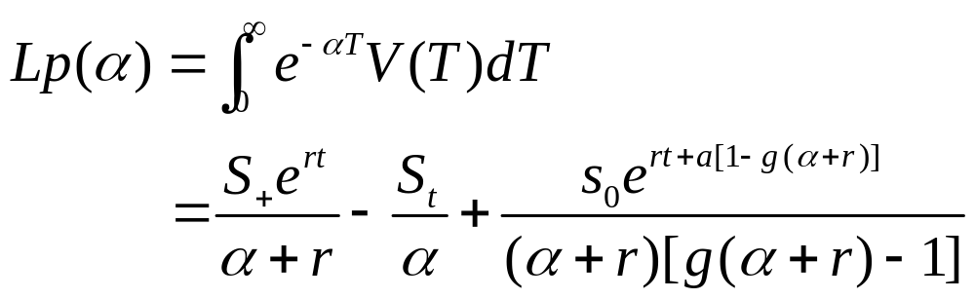
Continuous LBP options
Laplace transform
Proposition 1.4 For α such that α +r >0 the Laplace transform w.r.t. T of the LBP option is given by

Slide 42
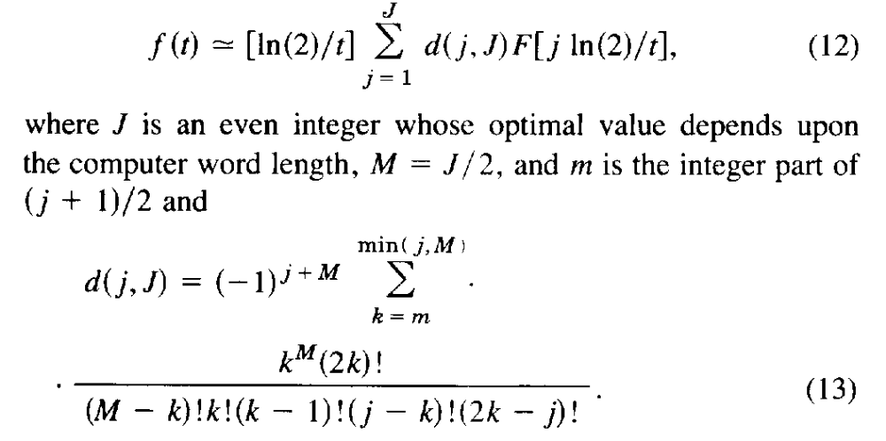
Continuous LBP options
Inverse Laplace transform
  Gaver-Stehfest algorithm for numerical

Slide 43
Results
The LBP parameters we used here are:
m = 250, s = 90, s⁺ = 90, s_{t} = 80, r = 0.1, σ = 0.3,
δ = 0.9, λ = 1, T = 1(year), t = 0.8.
Discrete : use Monte-Carlo simulation method with 10⁵ replications and we get the value is 8.4029.
Continuous : use Mathematica4.0 and we get 9.9901.
Corrected continuity : use Mathematica4.0 and the approximation discrete value (theorem 1.1) is 8.46003
Absolute error : 0.0571.
Relative err : 0.67 %

Slide 44
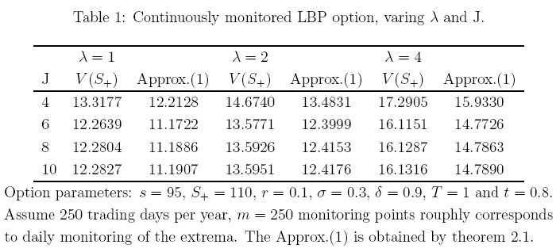
Results

Slide 45
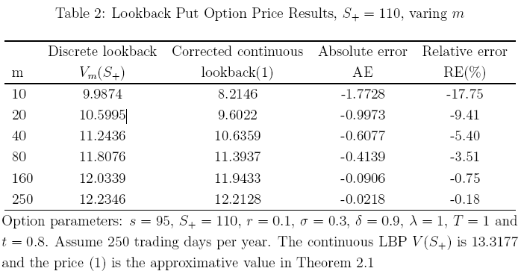
Results

Slide 46
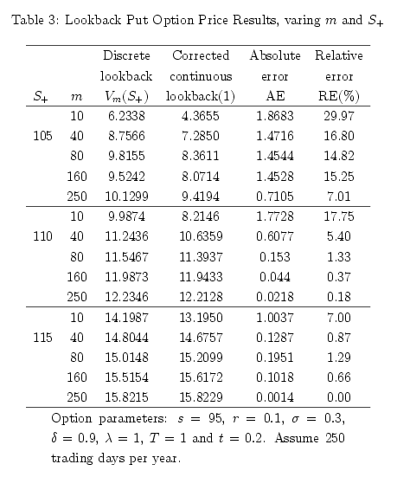

Slide 47
IV. Conclusion

Slide 48
Further Works
How about uniform convergence of the distribution of stopping times ? (Lemma 3.3)
What if the condition becomes δ >1 for LBP while 0 <δ <1 for LBC ?
Holds for other Jump-diffusion models ? e.g. Double exponential jump-diffusion model

Slide 49
Thanks sincerely
for listening and advising☺

