Slide 1
Interest Rate Models: An Introduction CH3. Discrete-Time Binomial Models Andrew J. G. Cairns 報告者:張國培 指導教授:戴天時

Slide 2
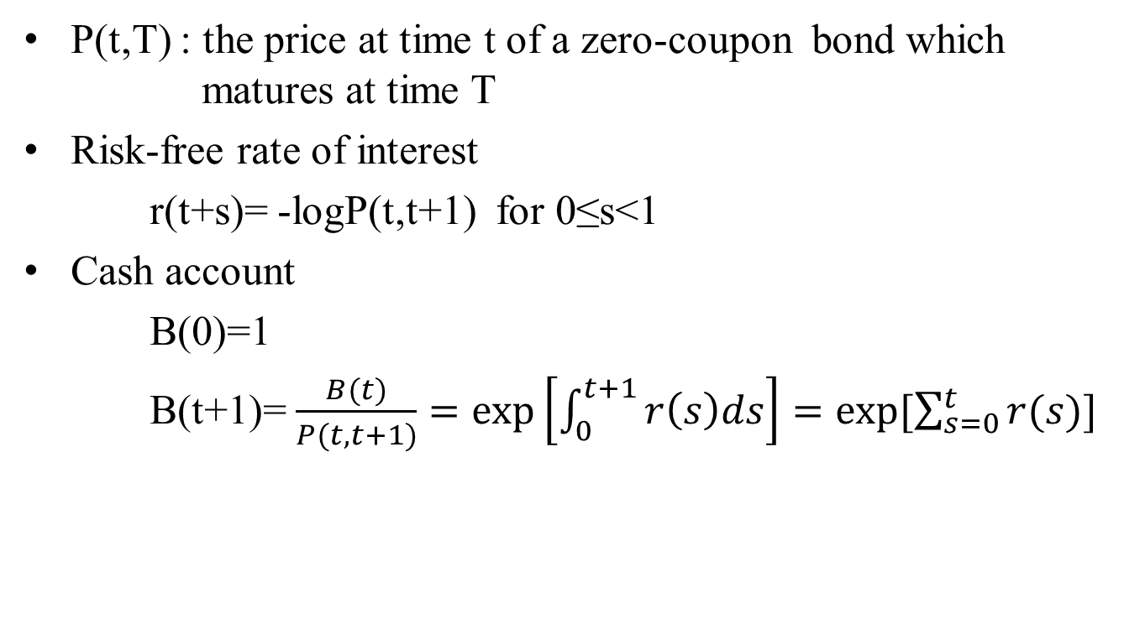
3.1 A Simple No-Arbitrage Model
P(t,T) : the price at time t of a zero-coupon bond which matures at time T
Risk-free rate of interest
r(t+s)= -logP(t,t+1) for 0≤s<1
Cash account
B(0)=1
B(t+1)= $\frac{B(t)}{P(t,t+1)}=\exp\left[\int_{0}^{t+1}{r\left(s\right)ds}\right]=exp⁡[\sum_{s=0}^{t}{r(s)}]$

Slide 4
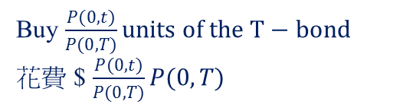

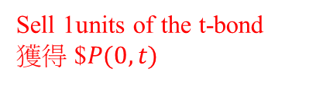



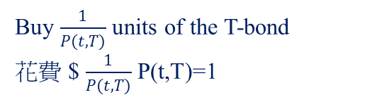

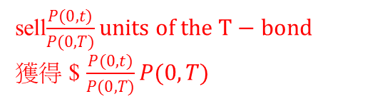
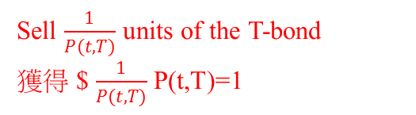
Case1: When P(t,T)< $\frac{P(0,T)}{P(0,t)}$
sell$\frac{P(0,t)}{P(0,T)}units of the T−bond$
獲得 $ $\frac{P(0,t)}{P(0,T)}P(0,T)$
0
t
T
Buy 1units of the t-bond
花費 $$P(0,t)$
Buy $\frac{1}{P(t,T)}$ units of the T-bond
花費 $ $\frac{1}{P(t,T)}$ P(t,T)=1
套利: $ $\frac{1}{P(t,T)}−\frac{P(0,t)}{P(0,T)}$>0
Case2: When P(t,T)> $\frac{P(0,T)}{P(0,t)}$
Sell $\frac{1}{P(t,T)}$ units of the T-bond
獲得 $ $\frac{1}{P(t,T)}$ P(t,T)=1
Sell 1units of the t-bond
獲得 $$P(0,t)$
0
t
T
Buy $\frac{P(0,t)}{P(0,T)}units of the T−bond$
花費 $ $\frac{P(0,t)}{P(0,T)}P(0,T)$
套利: $ $\frac{P(0,t)}{P(0,T)}$- $\frac{1}{P(t,T)}$>0

Slide 10






3.3 Recombining Binomial Model
$$P(2,T,0)$$
$$P(1,T,0)$$
$$P(0,T,0)$$
$$P(2,T,1)$$
$$P(1,T,1)$$
$$P(2,T,2)$$

Slide 11






$$P(2,T,0)$$
$$P(1,T,0)$$
$$P(0,T,0)$$
$$P(2,T,1)$$
$$P(1,T,1)$$
$$P(2,T,2)$$
( q*u(T)+(1-q)*d(T)=1 )

Slide 14
table for P(t,1)
 | t
x | 0 | 1
0 | 0.94 | 1
1 |  | 1
table for P(t,2)
 | t
x | 0 | 1 | 2
0 | 0.9 | 0.965 | 1
1 |  | 0.94 | 1
2 |  |  | 1
table for P(t,3)
 | t
x | 0 | 1 | 2 | 3
0 | 0.87 | 0.940057 | 0.981838 | 1
1 |  | 0.891981 | 0.956401 | 1
2 |  |  | 0.931624 | 1
3 |  |  |  | 1
table for P(t,4)
 | t
x | 0 | 1 | 2 | 3 | 4
0 | 0.84 | 0.91454 | 0.962583 | 0.988124 | 1
1 |  | 0.845287 | 0.913355 | 0.962525 | 1
2 |  |  | 0.866644 | 0.937589 | 1
3 |  |  |  | 0.913299 | 1
4 |  |  |  |  | 1

