Slide 1
Interest Rate Models
報告者：鄭傑仁

Slide 2
3.4 Models for the Risk-Free Rate of Interest
3.4.1 Time Homogeneity
3.4.2 Calculation of Bond Prices
3.4.3 Derivative Price

Slide 3
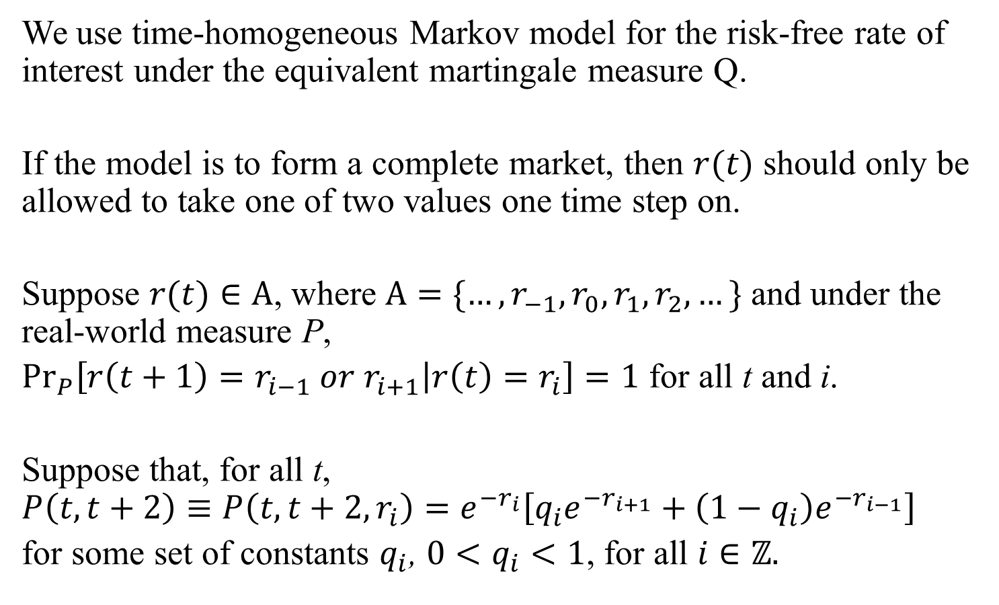
3.4.1 Time Homogeneity
We use time-homogeneous Markov model for the risk-free rate of interest under the equivalent martingale measure Q.
If the model is to form a complete market, then $r(t)$ should only be allowed to take one of two values one time step on.
Suppose $r(t)∈A$, where $A=\{…, r_{−1}, r_{0}, r_{1}, r_{2}, …\}$ and under the real-world measure P,
${Pr}_{P}\left[r\left(t+1\right)=r_{i−1} or r_{i+1} | r\left(t\right)=r_{i}\right]=1$ for all t and i.
Suppose that, for all t, $P\left(t,t+2\right)≡P\left(t,t+2,r_{i}\right)=e^{−r_{i}}\left[q_{i}e^{−r_{i+1}}+\left(1−q_{i}\right)e^{−r_{i−1}}\right]$
for some set of constants $q_{i}$, $0<q_{i}<1$, for all $i∈ℤ.$

Slide 4
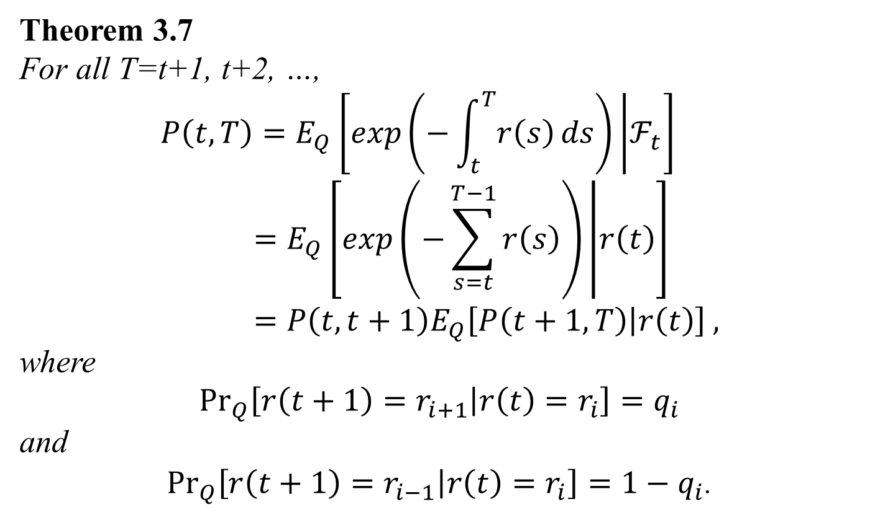
3.4.1 Time Homogeneity
Theorem 3.7
For all T=t+1, t+2, …,
$$P\left(t,T\right)=E_{Q}\left[\exp\left(−\int_{t}^{T}{r\left(s\right)}ds\right) | ℱ_{t}\right]=E_{Q}\left[\exp\left(−\sum_{s=t}^{T−1}{r\left(s\right)}\right) | r\left(t\right)\right]=P\left(t,t+1\right)E_{Q}\left[P\left(t+1,T\right) | r\left(t\right)\right] ,$$
where
$${Pr}_{Q}\left[r\left(t+1\right)=r_{i+1} | r\left(t\right)=r_{i}\right]=q_{i}$$
and
${Pr}_{Q}\left[r\left(t+1\right)=r_{i−1} | r\left(t\right)=r_{i}\right]=1−q_{i}$.

Slide 5
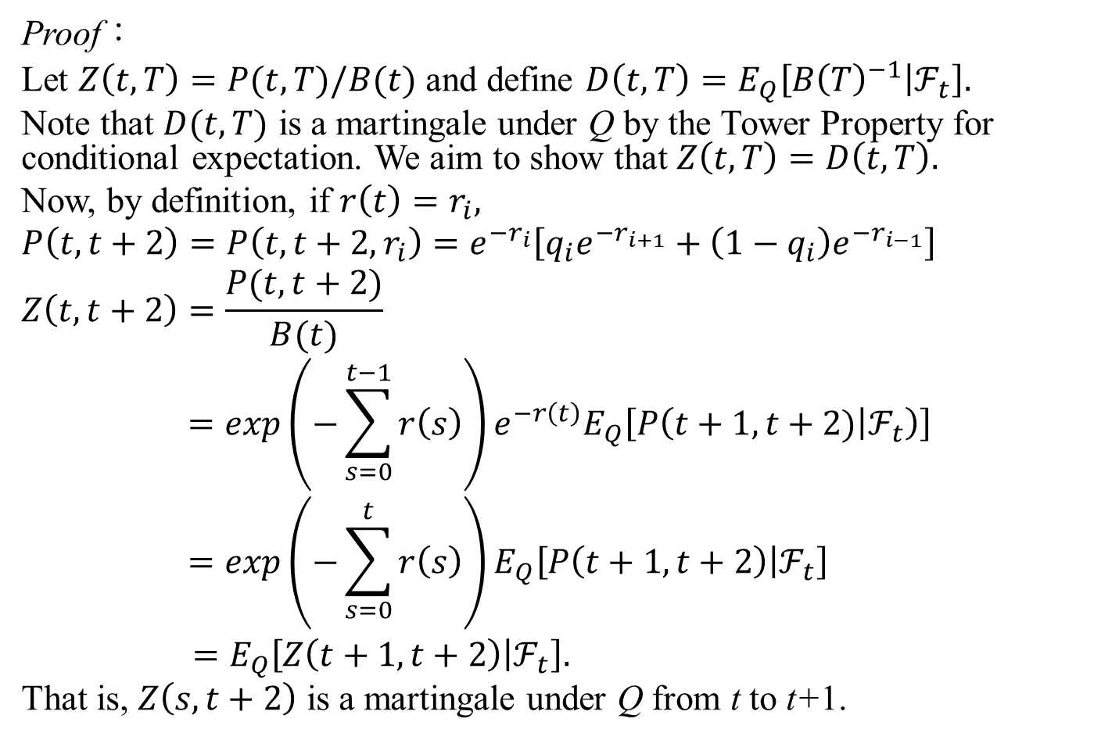
3.4.1 Time Homogeneity
Proof：
Let $Z\left(t,T\right)=P(t,T)/B(t)$ and define $D\left(t,T\right)=E_{Q}\left[{B\left(T\right)}^{−1} | ℱ_{t}\right].$
Note that $D(t,T)$ is a martingale under Q by the Tower Property for conditional expectation. We aim to show that $Z\left(t,T\right)=D\left(t,T\right).$
Now, by definition, if $r\left(t\right)=r_{i},$
$$P\left(t,t+2\right)=P\left(t,t+2,r_{i}\right)=e^{−r_{i}}\left[q_{i}e^{−r_{i+1}}+\left(1−q_{i}\right)e^{−r_{i−1}}\right]$$
$$Z\left(t,t+2\right)=\frac{P(t,t+2)}{B(t)}$$
$$=\exp\left(−\sum_{s=0}^{t−1}{r\left(s\right)}\right)e^{−r\left(t\right)}E_{Q}\left[P\left(t+1,t+2) | ℱ_{t}\right)\right]$$
$$=\exp\left(−\sum_{s=0}^{t}{r\left(s\right)}\right)E_{Q}\left[P\left(t+1,t+2\right) | ℱ_{t}\right]$$
$=E_{Q}\left[Z\left(t+1,t+2\right) | ℱ_{t}\right].$
That is, $Z\left(s,t+2\right)$ is a martingale under Q from t to t+1.

Slide 6
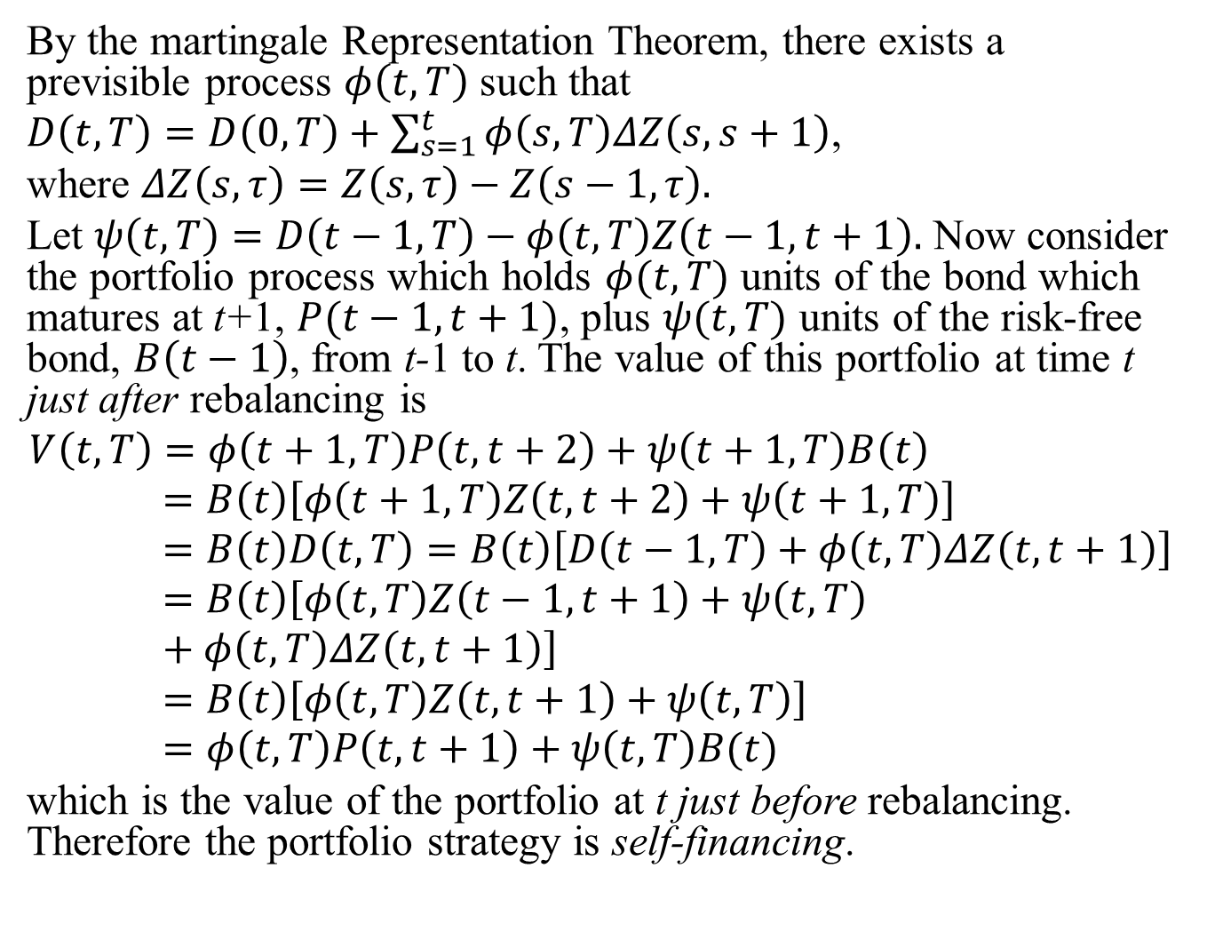
By the martingale Representation Theorem, there exists a previsible process $φ\left(t,T\right)$ such that
$D\left(t,T\right)=D\left(0,T\right)+\sum_{s=1}^{t}{φ\left(s,T\right)ΔZ\left(s,s+1\right)}$,
where $ΔZ\left(s,τ\right)=Z\left(s,τ\right)−Z\left(s−1,τ\right).$
Let $ψ\left(t,T\right)=D\left(t−1,T\right)−φ\left(t,T\right)Z\left(t−1,t+1\right).$ Now consider the portfolio process which holds $φ(t,T)$ units of the bond which matures at t+1, $P(t−1,t+1)$, plus $ψ(t,T)$ units of the risk-free bond, $B\left(t−1\right)$, from t-1 to t. The value of this portfolio at time t just after rebalancing is
$$V\left(t,T\right)=φ\left(t+1,T\right)P\left(t,t+2\right)+ψ\left(t+1,T\right)B\left(t\right)=B\left(t\right)\left[φ\left(t+1,T\right)Z\left(t,t+2\right)+ψ\left(t+1,T\right)\right]=B\left(t\right)D\left(t,T\right)=B\left(t\right)\left[D\left(t−1,T\right)+φ\left(t,T\right)ΔZ\left(t,t+1\right)\right]=B\left(t\right)\left[φ\left(t,T\right)Z\left(t−1,t+1\right)+ψ\left(t,T\right)+φ\left(t,T\right)ΔZ\left(t,t+1\right)\right]=B\left(t\right)\left[φ\left(t,T\right)Z\left(t,t+1\right)+ψ\left(t,T\right)\right]=φ\left(t,T\right)P\left(t,t+1\right)+ψ\left(t,T\right)B(t)$$
which is the value of the portfolio at t just before rebalancing. Therefore the portfolio strategy is self-financing.

Slide 7
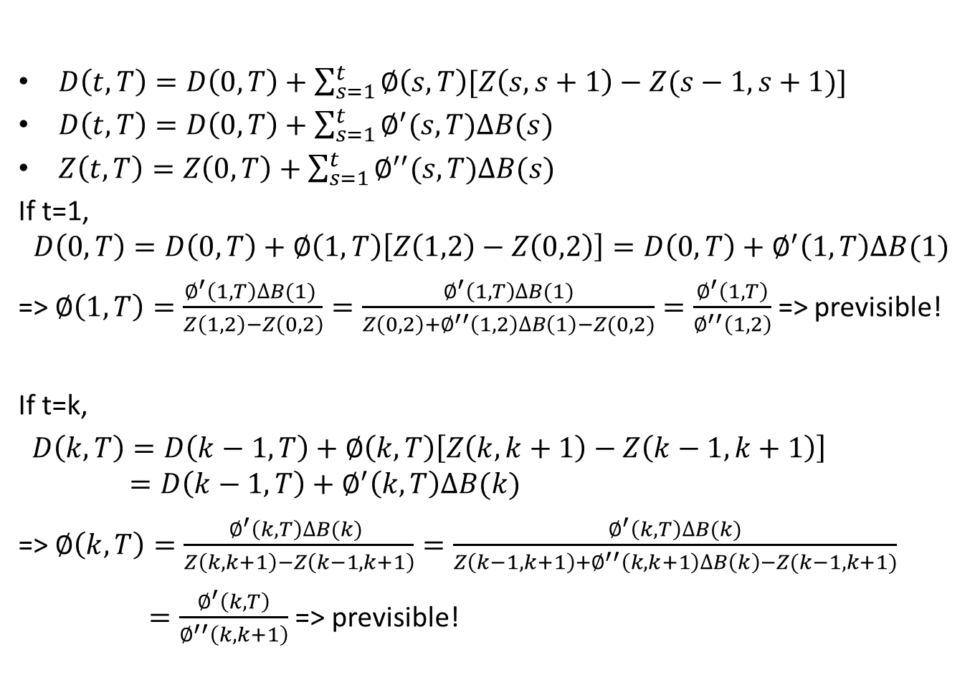
Claim: Exists a previsible process $φ\left(t,T\right)$
$D\left(t,T\right)=D\left(0,T\right)+\sum_{s=1}^{t}{∅\left(s,T\right)[Z\left(s,s+1\right)−Z(s−1,s+1)]}$
$D\left(t,T\right)=D\left(0,T\right)+\sum_{s=1}^{t}{∅^{′}(s,T)∆B(s)}$
$Z\left(t,T\right)=Z\left(0,T\right)+\sum_{s=1}^{t}{∅^{′′}(s,T)∆B(s)}$
If t=1,
$$D\left(0,T\right)=D\left(0,T\right)+∅\left(1,T\right)\left[Z\left(1,2\right)−Z\left(0,2\right)\right]=D\left(0,T\right)+∅^{′}\left(1,T\right)∆B(1)$$
=> $∅\left(1,T\right)=\frac{∅^{′}\left(1,T\right)∆B(1) }{Z\left(1,2\right)−Z\left(0,2\right)}=\frac{∅^{′}\left(1,T\right)∆B(1)}{Z\left(0,2\right)+∅^{′′}\left(1,2\right)∆B\left(1\right)−Z(0,2)}=\frac{∅^{′}\left(1,T\right)}{∅^{′′}\left(1,2\right)}$ => previsible!
If t=k,
$D\left(k,T\right)=D\left(k−1,T\right)+∅\left(k,T\right)\left[Z\left(k,k+1\right)−Z\left(k−1,k+1\right)\right]$
$$=D\left(k−1,T\right)+∅^{′}\left(k,T\right)∆B(k)$$
=> $∅\left(k,T\right)=\frac{∅^{′}\left(k,T\right)∆B(k) }{Z\left(k,k+1\right)−Z\left(k−1,k+1\right)}=\frac{∅^{′}\left(k,T\right)∆B(k)}{Z\left(k−1,k+1\right)+∅^{′′}\left(k,k+1\right)∆B\left(k\right)−Z(k−1,k+1)}$
$=\frac{∅^{′}\left(k,T\right)}{∅^{′′}\left(k,k+1\right)}$ => previsible!

Slide 8
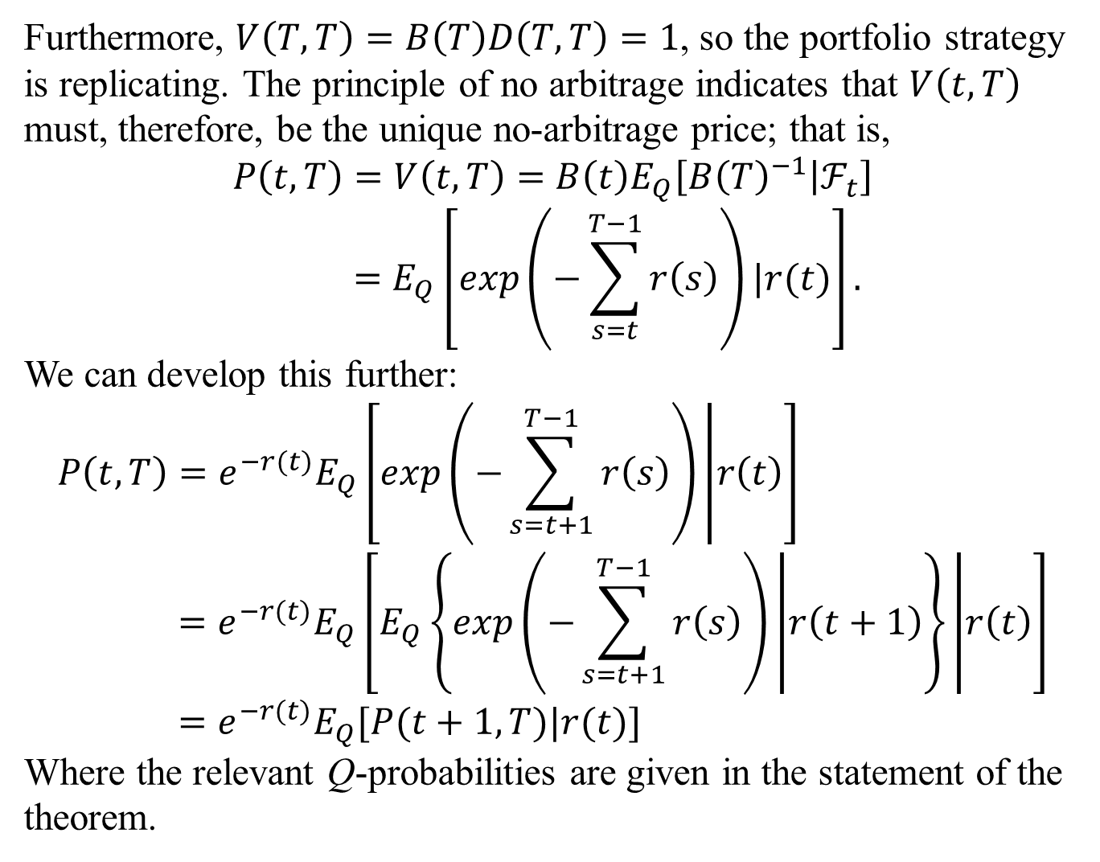
Furthermore, $V\left(T,T\right)=B\left(T\right)D\left(T,T\right)=1$, so the portfolio strategy is replicating. The principle of no arbitrage indicates that $V\left(t,T\right)$ must, therefore, be the unique no-arbitrage price; that is,
$$P\left(t,T\right)=V\left(t,T\right)=B\left(t\right)E_{Q}\left[{B\left(T\right)}^{−1} | ℱ_{t}\right]=E_{Q}\left[\exp\left(−\sum_{s=t}^{T−1}{r\left(s\right)}\right)|r(t)\right].$$
We can develop this further:
$$P\left(t,T\right)=e^{−r(t)}E_{Q}\left[\exp\left(−\sum_{s=t+1}^{T−1}{r\left(s\right)}\right) | r\left(t\right)\right]=e^{−r(t)}E_{Q}\left[E_{Q}\left\{\exp\left(−\sum_{s=t+1}^{T−1}{r\left(s\right)}\right) | r\left(t+1\right)\right\} | r\left(t\right)\right]=e^{−r(t)}E_{Q}[P(t+1,T)|r(t)]$$
Where the relevant Q-probabilities are given in the statement of the theorem.

Slide 9
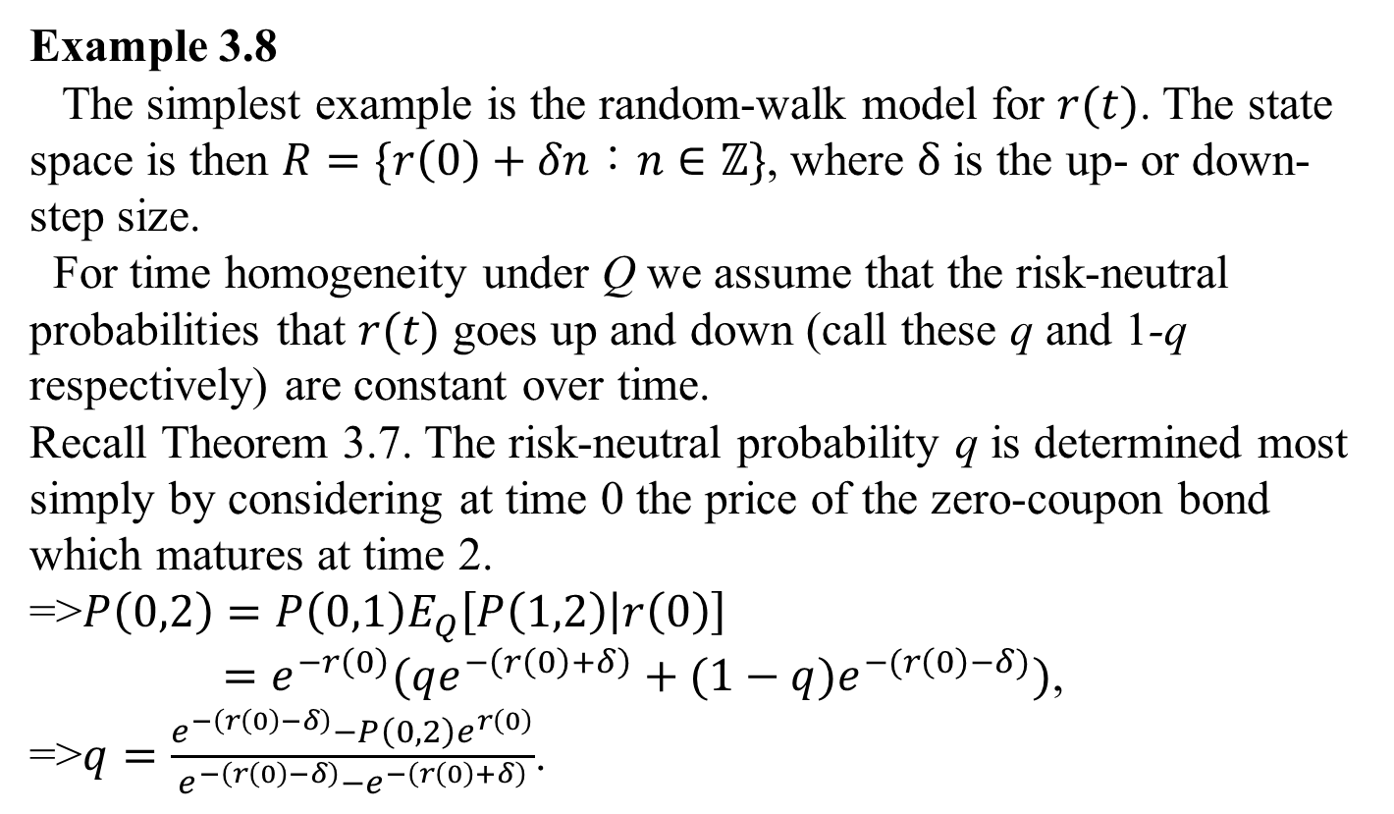
3.4.1 Time Homogeneity
Example 3.8
The simplest example is the random-walk model for $r(t)$. The state space is then $R=\{r\left(0\right)+δn：n∈ℤ\}$, where $δ$ is the up- or down-step size.
For time homogeneity under Q we assume that the risk-neutral probabilities that $r(t)$ goes up and down (call these q and 1-q respectively) are constant over time.
Recall Theorem 3.7. The risk-neutral probability q is determined most simply by considering at time 0 the price of the zero-coupon bond which matures at time 2.
=>$P\left(0,2\right)=P\left(0,1\right)E_{Q}\left[P\left(1,2\right) | r\left(0\right)\right]$
$=e^{−r\left(0\right)}(qe^{−\left(r\left(0\right)+δ\right)}+(1−q)e^{−(r\left(0\right)−δ)})$,
=>$q=\frac{e^{−\left(r\left(0\right)−δ\right)}−P\left(0,2\right)e^{r\left(0\right)}}{e^{−\left(r\left(0\right)−δ\right)}−e^{−\left(r\left(0\right)+δ\right)}}$.

Slide 10
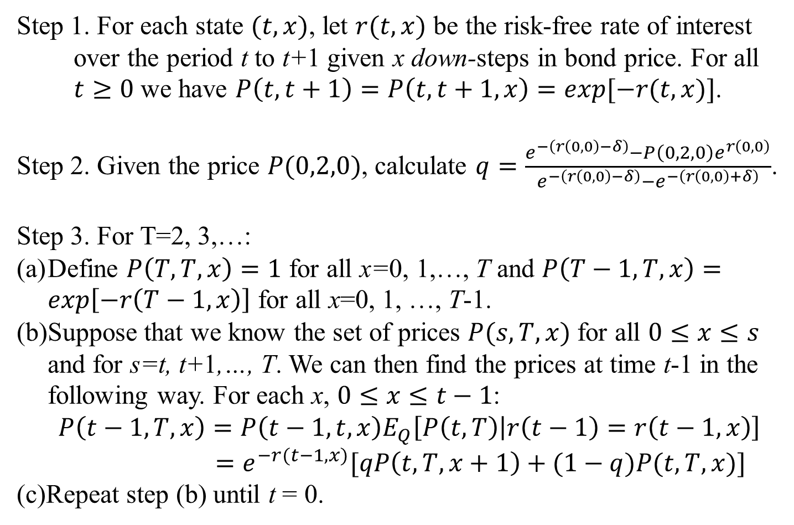
3.4.2 Calculation of Bond Prices
Step 1. For each state $(t,x)$, let $r(t,x)$ be the risk-free rate of interest over the period t to t+1 given x down-steps in bond price. For all $t≥0$ we have $P\left(t,t+1\right)=P\left(t,t+1,x\right)=exp⁡[−r(t,x)]$.
Step 2. Given the price $P(0,2,0)$, calculate $q=\frac{e^{−\left(r\left(0,0\right)−δ\right)}−P\left(0,2,0\right)e^{r\left(0,0\right)}}{e^{−\left(r\left(0,0\right)−δ\right)}−e^{−\left(r\left(0,0\right)+δ\right)}}$.
Step 3. For T=2, 3,…:
Define $P\left(T,T,x\right)=1$ for all x=0, 1,…, T and $P\left(T−1,T,x\right)=\exp\left[−r\left(T−1,x\right)\right]$ for all x=0, 1, …, T-1.
Suppose that we know the set of prices $P(s,T,x)$ for all $0≤x≤s$ and for s=t, t+1,…, T. We can then find the prices at time t-1 in the following way. For each x, $0≤x≤t−1$:
$$P\left(t−1,T,x\right)=P\left(t−1,t,x\right)E_{Q}\left[P\left(t,T\right) | r\left(t−1\right)=r\left(t−1,x\right)\right]$$
$=e^{−r(t−1,x)}[qP\left(t,T,x+1\right)+(1−q)P(t,T,x)]$
(c)Repeat step (b) until t = 0.

Slide 11
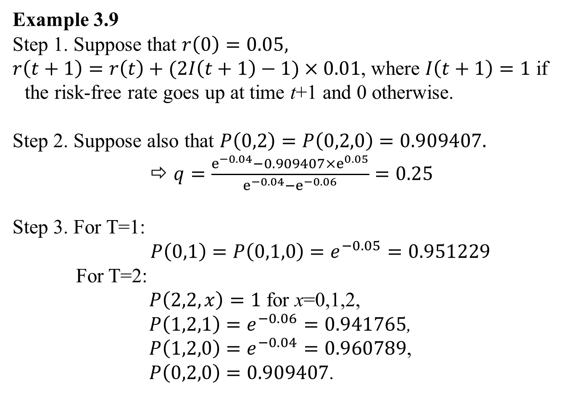
3.4.2 Calculation of Bond Prices
Example 3.9
Step 1. Suppose that $r\left(0\right)=0.05,$
$r\left(t+1\right)=r\left(t\right)+(2I\left(t+1\right)−1)×0.01$, where $I\left(t+1\right)=1$ if the risk-free rate goes up at time t+1 and 0 otherwise.
Step 2. Suppose also that $P\left(0,2\right)=P\left(0,2,0\right)=0.909407.$
$q=\frac{e^{−0.04}−0.909407×e^{0.05}}{e^{−0.04}−e^{−0.06}}=0.25$
Step 3. For T=1:
$P\left(0,1\right)=P\left(0,1,0\right)=e^{−0.05}=0.951229$
For T=2:
$P\left(2,2,x\right)=1$ for x=0,1,2,
$P\left(1,2,1\right)=e^{−0.06}=0.941765$,
$P\left(1,2,0\right)=e^{−0.04}=0.960789$,
$P\left(0,2,0\right)=0.909407$.

Slide 12
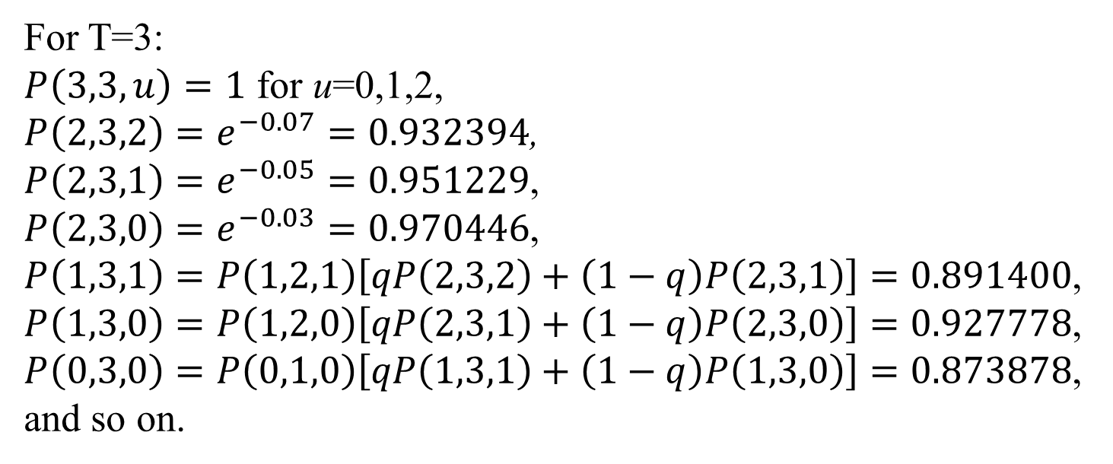
3.4.2 Calculation of Bond Prices
For T=3:
$P\left(3,3,u\right)=1$ for u=0,1,2,
$P\left(2,3,2\right)=e^{−0.07}=0.932394$,
$P\left(2,3,1\right)=e^{−0.05}=0.951229$,
$P\left(2,3,0\right)=e^{−0.03}=0.970446$,
$P\left(1,3,1\right)=P\left(1,2,1\right)\left[qP\left(2,3,2\right)+\left(1−q\right)P\left(2,3,1\right)\right]=0.891400$,
$P\left(1,3,0\right)=P\left(1,2,0\right)\left[qP\left(2,3,1\right)+\left(1−q\right)P\left(2,3,0\right)\right]=0.927778$,
$P\left(0,3,0\right)=P\left(0,1,0\right)\left[qP\left(1,3,1\right)+\left(1−q\right)P\left(1,3,0\right)\right]=0.873878$,
and so on.

Slide 13
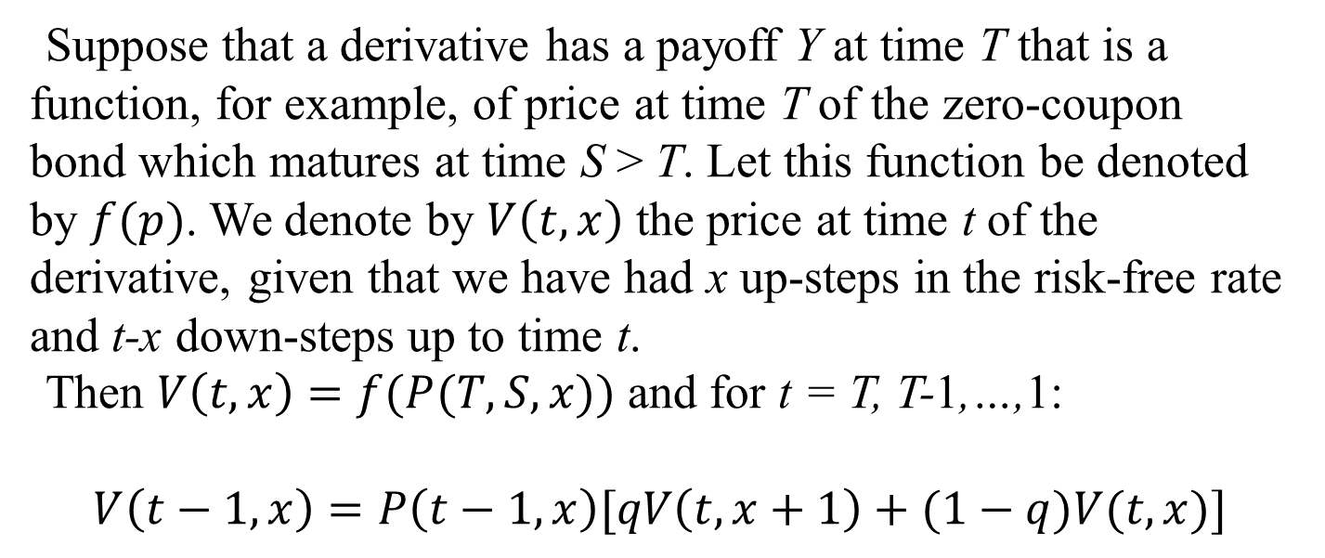
3.4.3 Derivative Prices
Suppose that a derivative has a payoff Y at time T that is a function, for example, of price at time T of the zero-coupon bond which matures at time S > T. Let this function be denoted by $f(p)$. We denote by $V\left(t,x\right)$ the price at time t of the derivative, given that we have had x up-steps in the risk-free rate and t-x down-steps up to time t.
Then $V\left(t,x\right)=f(P(T,S,x))$ and for t = T, T-1,…,1:
$$V\left(t−1,x\right)=P\left(t−1,x\right)[qV\left(t,x+1\right)+(1−q)V(t,x)]$$

Slide 14
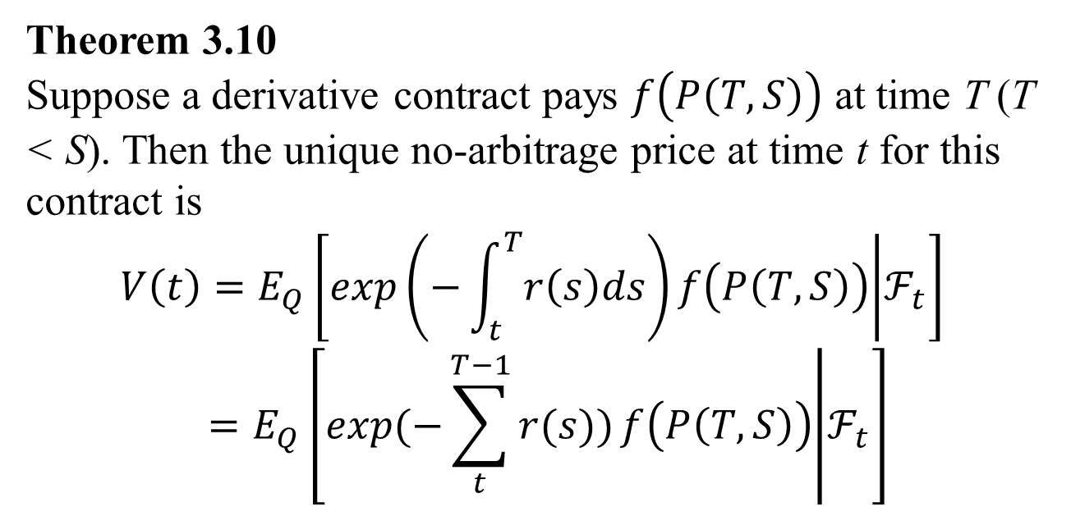
3.4.3 Derivative Prices
Theorem 3.10
Suppose a derivative contract pays $f\left(P\left(T,S\right)\right)$ at time T (T < S). Then the unique no-arbitrage price at time t for this contract is
$$V\left(t\right)=E_{Q}\left[\exp\left(−\int_{t}^{T}{r\left(s\right)ds}\right)f\left(P\left(T,S\right)\right) | ℱ_{t}\right]$$
$$=E_{Q}\left[\exp{(−\sum_{t}^{T−1}{r(s)})}f\left(P\left(T,S\right)\right) | ℱ_{t}\right]$$

Slide 15
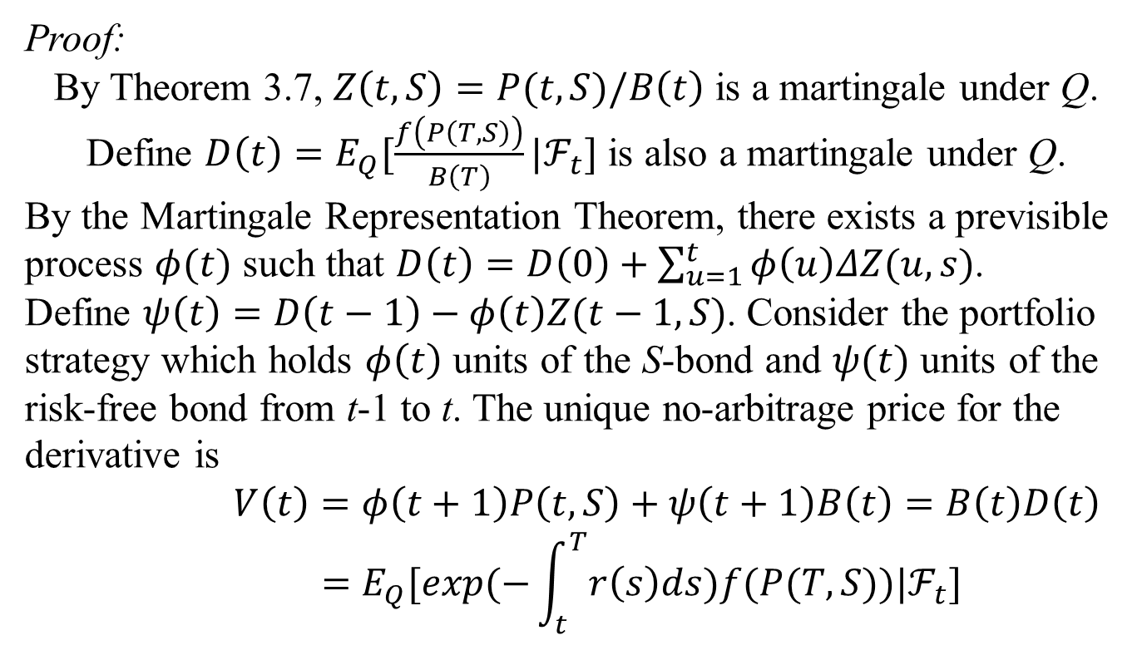
3.4.3 Derivative Prices
Proof:
By Theorem 3.7, $Z\left(t,S\right)=P(t,S)/B\left(t\right)$ is a martingale under Q. Define $D\left(t\right)=E_{Q}[\frac{f\left(P\left(T,S\right)\right)}{B\left(T\right)}|ℱ_{t}]$ is also a martingale under Q.
By the Martingale Representation Theorem, there exists a previsible process $φ(t)$ such that $D\left(t\right)=D\left(0\right)+\sum_{u=1}^{t}{φ\left(u\right)ΔZ(u,s)}$.
Define $ψ\left(t\right)=D\left(t−1\right)−φ\left(t\right)Z(t−1,S)$. Consider the portfolio strategy which holds $φ\left(t\right)$ units of the S-bond and $ψ(t)$ units of the risk-free bond from t-1 to t. The unique no-arbitrage price for the derivative is
$$V\left(t\right)=φ\left(t+1\right)P\left(t,S\right)+ψ\left(t+1\right)B\left(t\right)=B\left(t\right)D\left(t\right)$$
$$=E_{Q}[exp⁡(−\int_{t}^{T}{r\left(s\right)ds})f(P(T,S))|ℱ_{t}]$$

Slide 16
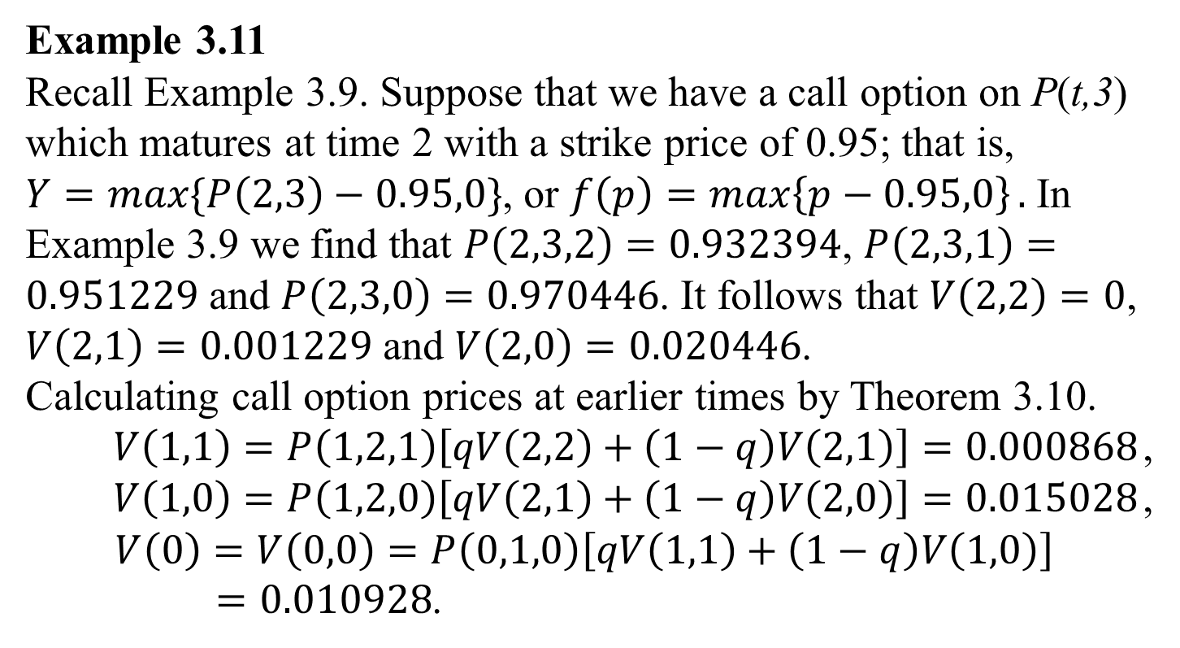
3.4.3 Derivative Prices
Example 3.11
Recall Example 3.9. Suppose that we have a call option on P(t,3) which matures at time 2 with a strike price of 0.95; that is, $Y=max⁡\{P\left(2,3\right)−0.95,0\}$, or $f\left(p\right)=\max\left\{p−0.95,0\right\}.$ In Example 3.9 we find that $P\left(2,3,2\right)=0.932394$, $P\left(2,3,1\right)=0.951229$ and $P\left(2,3,0\right)=0.970446$. It follows that $V\left(2,2\right)=0$, $V\left(2,1\right)=0.001229$ and $V\left(2,0\right)=0.020446$.
Calculating call option prices at earlier times by Theorem 3.10.
$V\left(1,1\right)=P\left(1,2,1\right)\left[qV\left(2,2\right)+\left(1−q\right)V\left(2,1\right)\right]=0.000868$,
$V\left(1,0\right)=P\left(1,2,0\right)\left[qV\left(2,1\right)+\left(1−q\right)V\left(2,0\right)\right]=0.015028$,
$$V\left(0\right)=V\left(0,0\right)=P\left(0,1,0\right)\left[qV\left(1,1\right)+\left(1−q\right)V\left(1,0\right)\right]$$
$=0.010928$.

Slide 17
3.4.3 Derivative Prices
P(2,3,0)
V(2,0)
1-q
V(1,0)
1-q
V(0,0)
q
P(2,3,1)
V(2,1)
1-q
V(1,1)
q
q
P(2,3,2)
V(2,2)

Slide 18
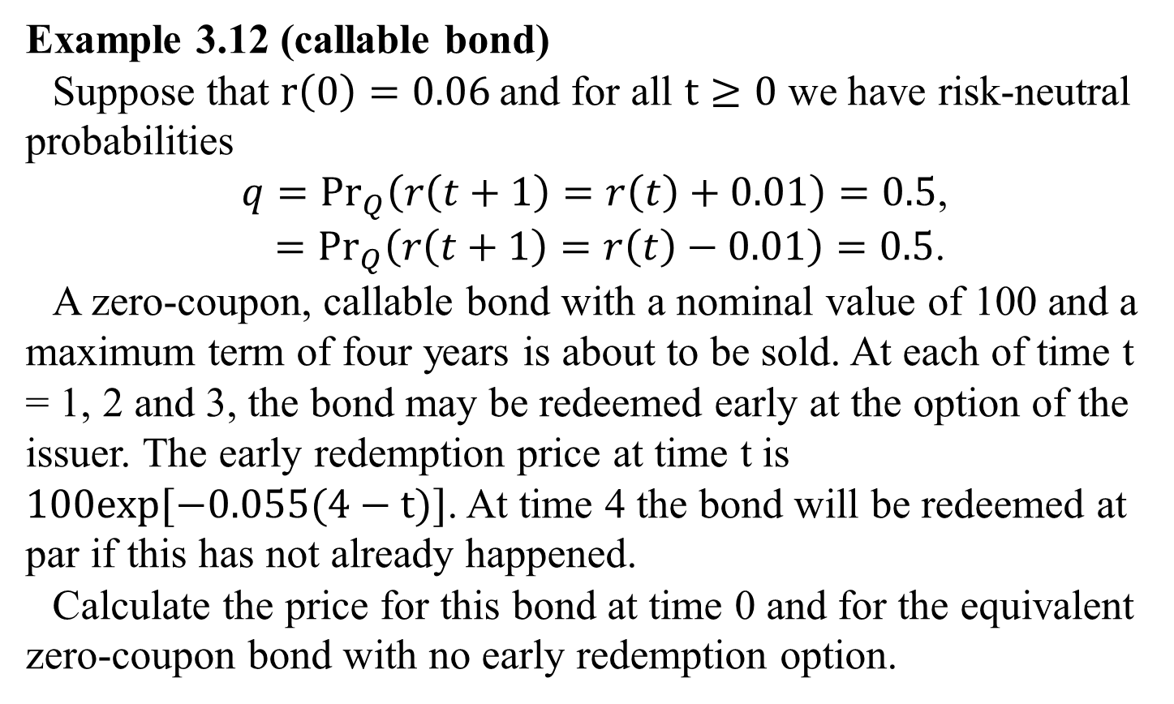
3.4.3 Derivative Prices
Example 3.12 (callable bond)
Suppose that $r\left(0\right)=0.06$and for all $t≥0$ we have risk-neutral probabilities
$q={Pr}_{Q}\left(r\left(t+1\right)=r\left(t\right)+0.01\right)=0.5$,
$={Pr}_{Q}\left(r\left(t+1\right)=r\left(t\right)−0.01\right)=0.5$.
A zero-coupon, callable bond with a nominal value of 100 and a maximum term of four years is about to be sold. At each of time t = 1, 2 and 3, the bond may be redeemed early at the option of the issuer. The early redemption price at time t is $100exp⁡[−0.055(4−t)]$. At time 4 the bond will be redeemed at par if this has not already happened.
Calculate the price for this bond at time 0 and for the equivalent zero-coupon bond with no early redemption option.

Slide 19
3.4.3 Derivative Prices
Solution :
Let X(t) be the number of up-steps in the risk-free rate of interest up to time t.
The table is the recombining binomial tree for the risk-free rate of interest, where r(t ,x) represents the risk-free rate of interest from t to t+1given X(t) = x.

Slide 20
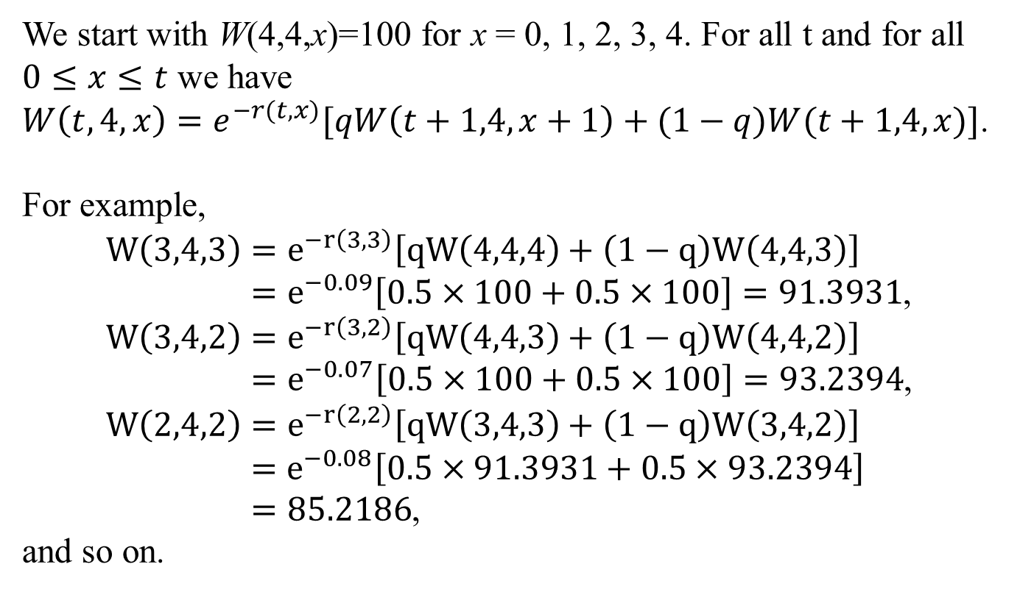
3.4.3 Derivative Prices
We start with W(4,4,x)=100 for x = 0, 1, 2, 3, 4. For all t and for all $0≤x≤t$ we have
$W\left(t,4,x\right)=e^{−r(t,x)}[qW\left(t+1,4,x+1\right)+(1−q)W(t+1,4,x)]$.
For example,
$$W\left(3,4,3\right)=e^{−r\left(3,3\right)}\left[qW\left(4,4,4\right)+\left(1−q\right)W\left(4,4,3\right)\right]$$
$=e^{−0.09}\left[0.5×100+0.5×100\right]=91.3931$,
$$W\left(3,4,2\right)=e^{−r\left(3,2\right)}\left[qW\left(4,4,3\right)+\left(1−q\right)W\left(4,4,2\right)\right]$$
$=e^{−0.07}\left[0.5×100+0.5×100\right]=93.2394$,
$$W\left(2,4,2\right)=e^{−r\left(2,2\right)}\left[qW\left(3,4,3\right)+\left(1−q\right)W\left(3,4,2\right)\right]$$
$$=e^{−0.08}\left[0.5×91.3931+0.5×93.2394\right]$$
$=85.2186$,
and so on.

Slide 21
3.4.3 Derivative Prices

Slide 22
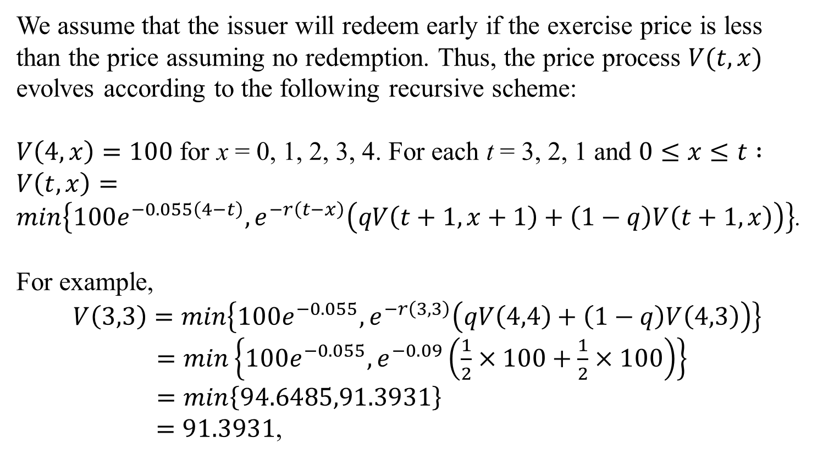
3.4.3 Derivative Prices
We assume that the issuer will redeem early if the exercise price is less than the price assuming no redemption. Thus, the price process $V(t,x)$ evolves according to the following recursive scheme:
$V\left(4,x\right)=100$ for x = 0, 1, 2, 3, 4. For each t = 3, 2, 1 and $0≤x≤t :$
$V\left(t,x\right)=\min\left\{100e^{−0.055\left(4−t\right)},e^{−r\left(t−x\right)}\left(qV\left(t+1,x+1\right)+\left(1−q\right)V\left(t+1,x\right)\right)\right\}$.
For example,
$$V\left(3,3\right)=\min\left\{100e^{−0.055},e^{−r\left(3,3\right)}\left(qV\left(4,4\right)+\left(1−q\right)V\left(4,3\right)\right)\right\}$$
$=\min\left\{100e^{−0.055},e^{−0.09}\left(\frac{1}{2}×100+\frac{1}{2}×100\right)\right\}$
$=\min\left\{94.6485,91.3931\right\}$
$=91.3931$,

Slide 23
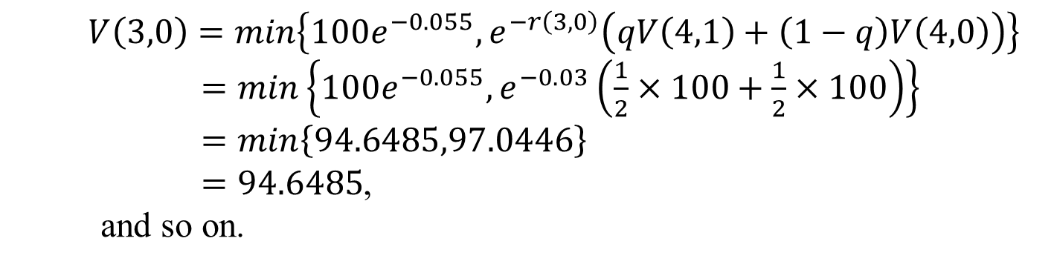
3.4.3 Derivative Prices
$$V\left(3,0\right)=\min\left\{100e^{−0.055},e^{−r\left(3,0\right)}\left(qV\left(4,1\right)+\left(1−q\right)V\left(4,0\right)\right)\right\}$$
$=\min\left\{100e^{−0.055},e^{−0.03}\left(\frac{1}{2}×100+\frac{1}{2}×100\right)\right\}$
$=\min\left\{94.6485,97.0446\right\}$
$=94.6485$,
and so on.

Slide 24
3.5 Futures contracts
Let f (t, S, T) be the futures price at time t for delivery at time S of the zero-coupon bond which matures at time T, where S < T.
If the equity market with a constant risk-free rate of interest, we know that the forward and futures price are equal. When the risk-free rate of interest is stochastic, forward and futures price are not equal.

Slide 25
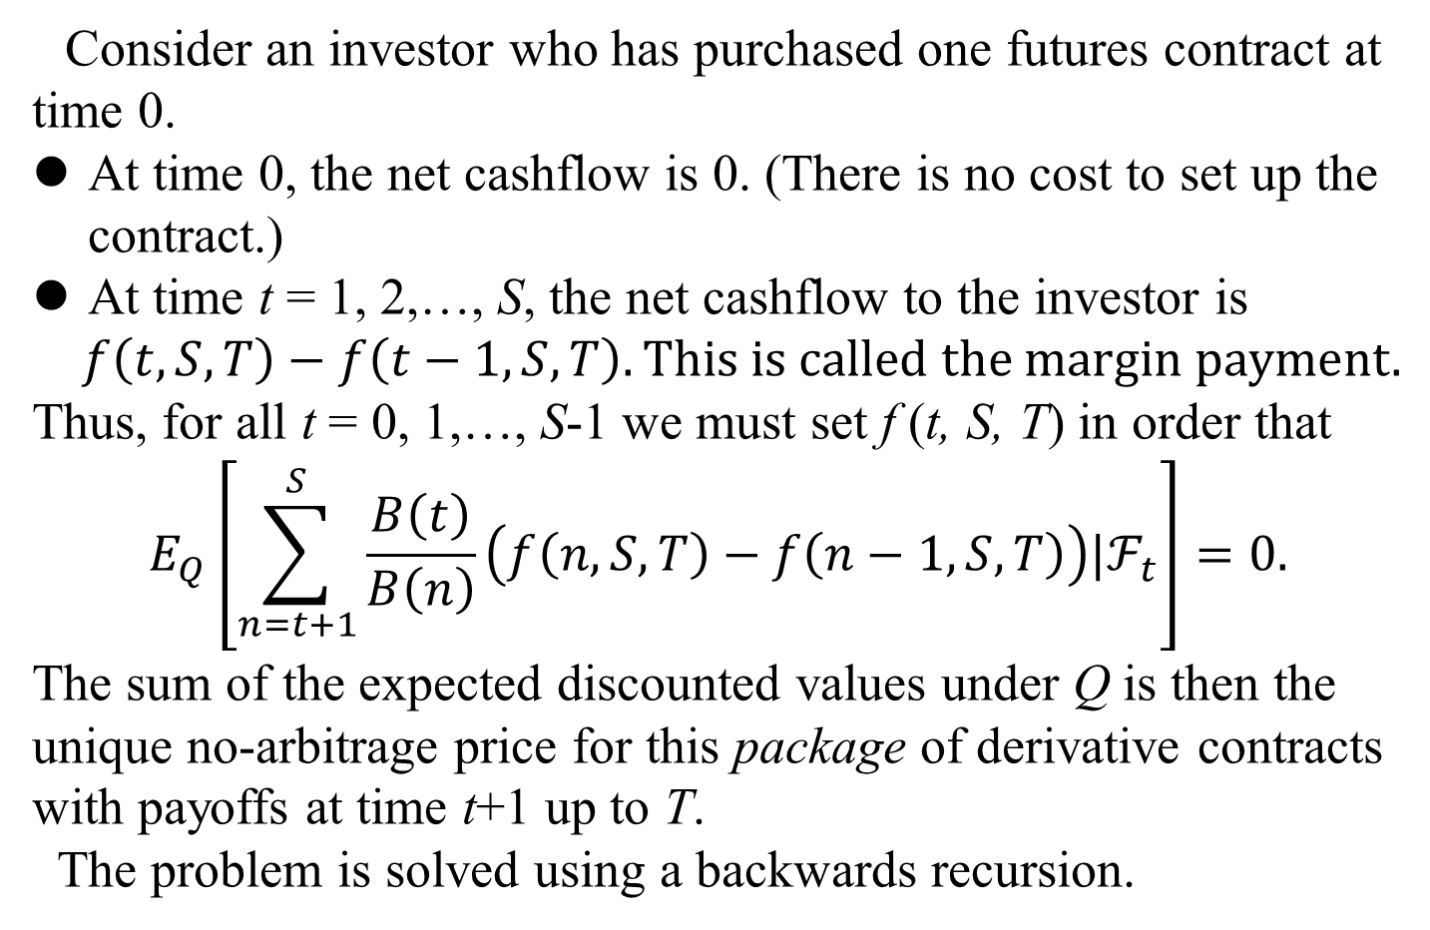
Consider an investor who has purchased one futures contract at time 0.
At time 0, the net cashflow is 0. (There is no cost to set up the contract.)
At time t = 1, 2,…, S, the net cashflow to the investor is
$$f\left(t,S,T\right)−f\left(t−1,S,T\right).This is called the margin payment.$$
Thus, for all t = 0, 1,…, S-1 we must set f (t, S, T) in order that
$$E_{Q}\left[\sum_{n=t+1}^{S}{\frac{B\left(t\right)}{B\left(n\right)}\left(f\left(n,S,T\right)−f\left(n−1,S,T\right)\right)|ℱ_{t}}\right]=0.$$
The sum of the expected discounted values under Q is then the unique no-arbitrage price for this package of derivative contracts with payoffs at time t+1 up to T.
The problem is solved using a backwards recursion.

Slide 26
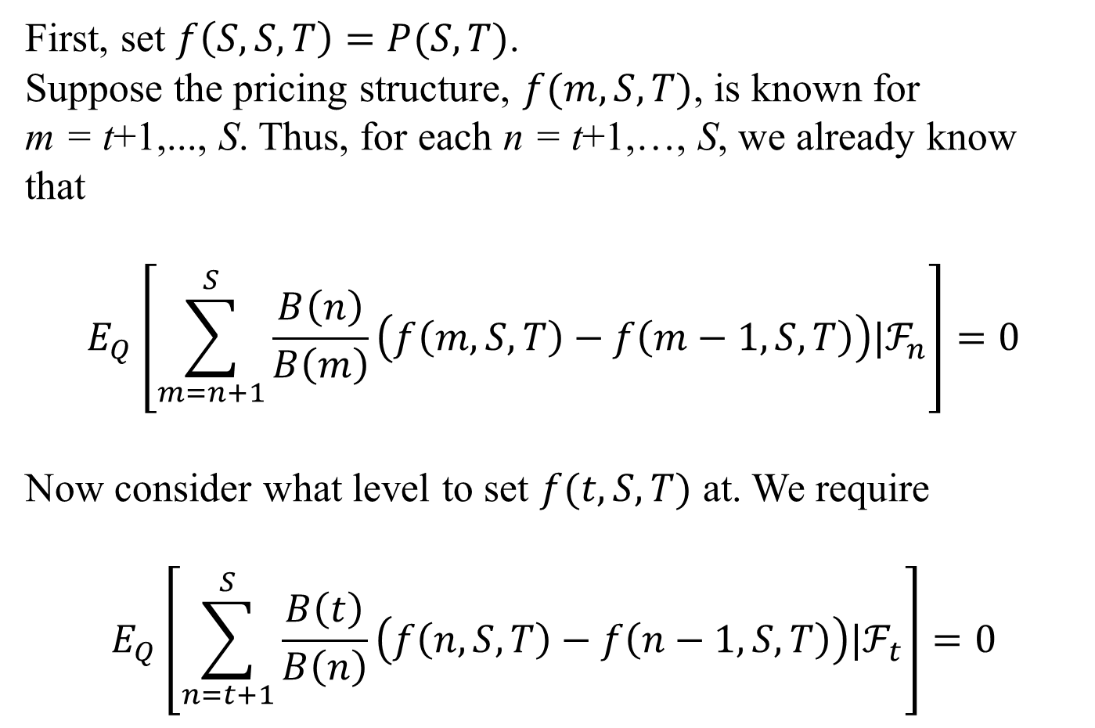
First, set $f\left(S,S,T\right)=P(S,T)$.
Suppose the pricing structure, $f(m,S,T)$, is known for
m = t+1,..., S. Thus, for each n = t+1,…, S, we already know that
$$E_{Q}\left[\sum_{m=n+1}^{S}{\frac{B\left(n\right)}{B\left(m\right)}\left(f\left(m,S,T\right)−f\left(m−1,S,T\right)\right)|ℱ_{n}}\right]=0$$
Now consider what level to set $f(t,S,T)$ at. We require
$$E_{Q}\left[\sum_{n=t+1}^{S}{\frac{B\left(t\right)}{B\left(n\right)}\left(f\left(n,S,T\right)−f\left(n−1,S,T\right)\right)|ℱ_{t}}\right]=0$$

Slide 27
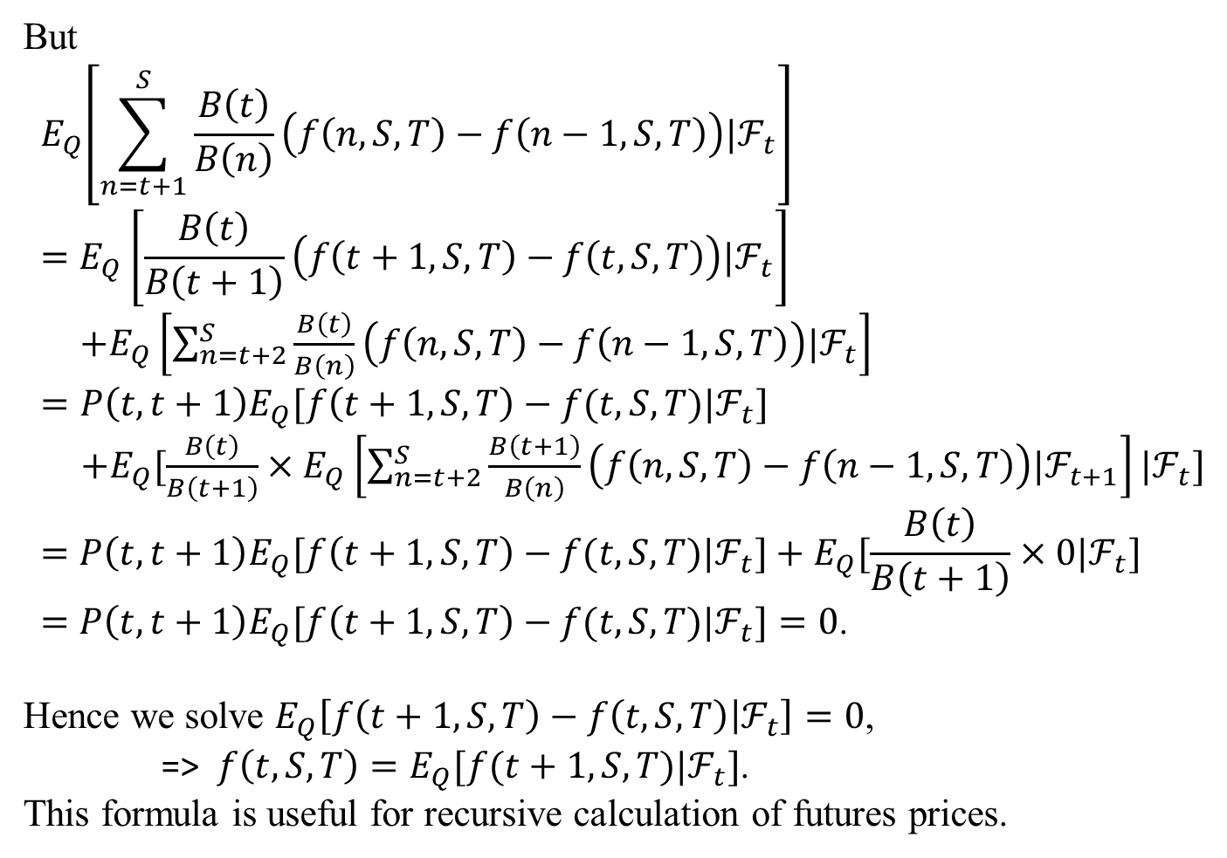
But
$${ E}_{Q}\left[\sum_{n=t+1}^{S}{\frac{B\left(t\right)}{B\left(n\right)}\left(f\left(n,S,T\right)−f\left(n−1,S,T\right)\right)|ℱ_{t}}\right]$$
$$=E_{Q}\left[\frac{B\left(t\right)}{B\left(t+1\right)}\left(f\left(t+1,S,T\right)−f\left(t,S,T\right)\right)|ℱ_{t}\right]$$
$+E_{Q}\left[\sum_{n=t+2}^{S}{\frac{B\left(t\right)}{B\left(n\right)}\left(f\left(n,S,T\right)−f\left(n−1,S,T\right)\right)|ℱ_{t}}\right]$
$=P\left(t,t+1\right)E_{Q}[f\left(t+1,S,T\right)−f(t,S,T)|ℱ_{t}]$
$+E_{Q}[\frac{B\left(t\right)}{B\left(t+1\right)}×E_{Q}\left[\sum_{n=t+2}^{S}{\frac{B\left(t+1\right)}{B\left(n\right)}\left(f\left(n,S,T\right)−f\left(n−1,S,T\right)\right)|ℱ_{t+1}}\right]|ℱ_{t}]$
$$=P\left(t,t+1\right)E_{Q}[f\left(t+1,S,T\right)−f(t,S,T)|ℱ_{t}]+E_{Q}[\frac{B\left(t\right)}{B\left(t+1\right)}×0|ℱ_{t}]$$
$=P\left(t,t+1\right)E_{Q}[f\left(t+1,S,T\right)−f(t,S,T)|ℱ_{t}]=0$.
Hence we solve $E_{Q}\left[f\left(t+1,S,T\right)−f\left(t,S,T\right) | ℱ_{t}\right]=0$,
=> $f\left(t,S,T\right)=E_{Q}[f(t+1,S,T)|ℱ_{t}]$.
This formula is useful for recursive calculation of futures prices.

Slide 28
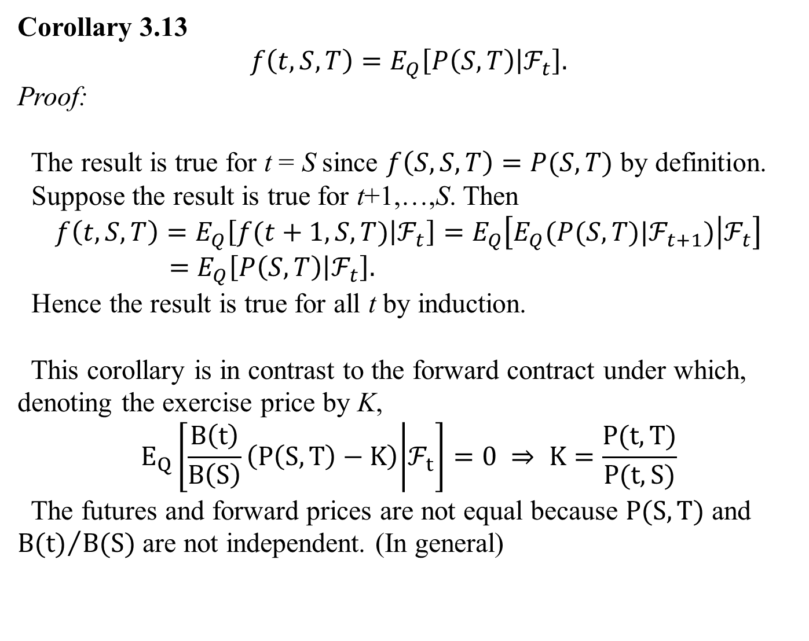
Corollary 3.13
$$f\left(t,S,T\right)=E_{Q}\left[P\left(S,T\right) | ℱ_{t}\right].$$
Proof:
The result is true for t = S since $f\left(S,S,T\right)=P(S,T)$ by definition.
Suppose the result is true for t+1,…,S. Then
$$f\left(t,S,T\right)=E_{Q}\left[f(t+1,S,T) | ℱ_{t}\right]=E_{Q}\left[E_{Q}(P(S,T)|ℱ_{t+1}) | ℱ_{t}\right]$$
$=E_{Q}\left[P\left(S,T\right) | ℱ_{t}\right].$
Hence the result is true for all t by induction.
This corollary is in contrast to the forward contract under which, denoting the exercise price by K,
$$E_{Q}\left[\frac{B\left(t\right)}{B\left(S\right)}\left(P\left(S,T\right)−K\right) | ℱ_{t}\right]=0 ⇒ K=\frac{P(t,T)}{P(t,S)}$$
The futures and forward prices are not equal because $P(S,T)$ and ${B(t)}/{B(S)}$ are not independent. (In general)

Slide 29
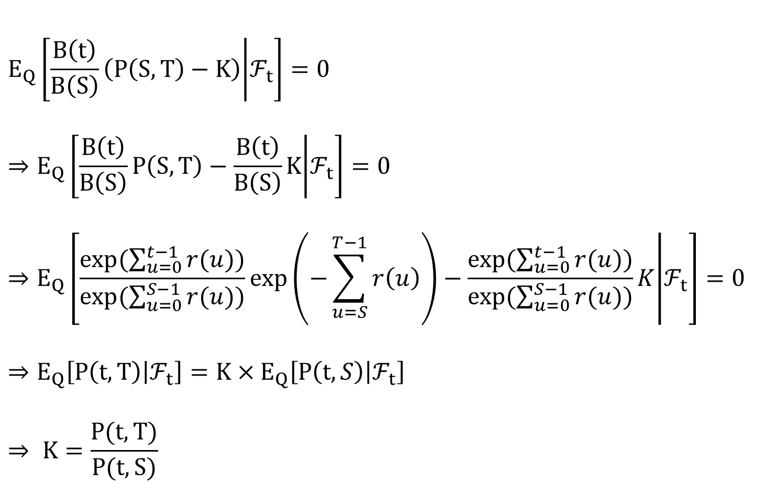
$$E_{Q}\left[\frac{B\left(t\right)}{B\left(S\right)}\left(P\left(S,T\right)−K\right) | ℱ_{t}\right]=0$$
$$⇒E_{Q}\left[\frac{B\left(t\right)}{B\left(S\right)}P\left(S,T\right)−\frac{B\left(t\right)}{B\left(S\right)}K | ℱ_{t}\right]=0$$
$$⇒E_{Q}\left[\frac{exp⁡(\sum_{u=0}^{t−1}{r(u)})}{exp⁡(\sum_{u=0}^{S−1}{r(u)})}\exp\left(−\sum_{u=S}^{T−1}{r\left(u\right)}\right)−\frac{exp⁡(\sum_{u=0}^{t−1}{r(u)})}{exp⁡(\sum_{u=0}^{S−1}{r(u)})}K | ℱ_{t}\right]=0$$
$$⇒E_{Q}\left[P\left(t,T\right) | ℱ_{t}\right]=K×E_{Q}\left[P\left(t,S\right) | ℱ_{t}\right]$$
$$⇒ K=\frac{P(t,T)}{P(t,S)}$$

Slide 30
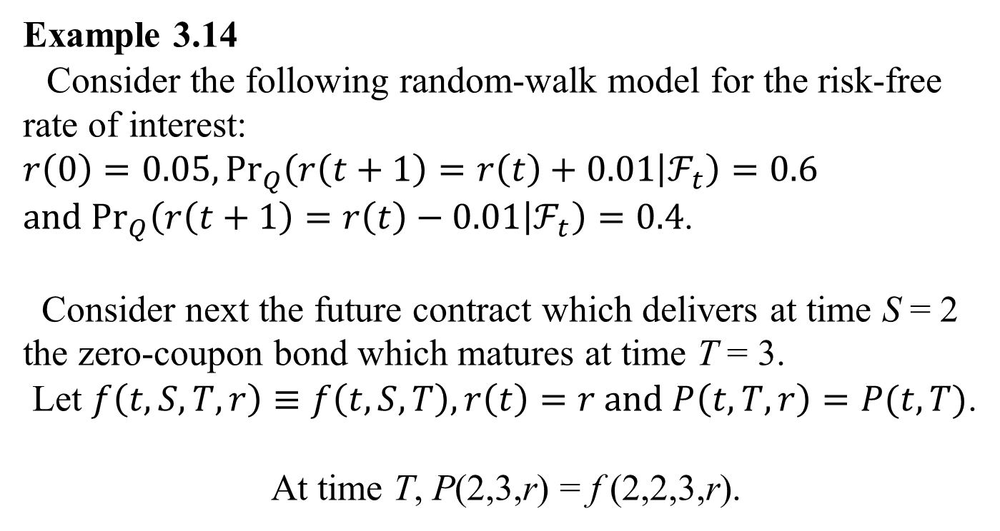
Example 3.14
Consider the following random-walk model for the risk-free rate of interest: $r\left(0\right)=0.05, {Pr}_{Q}\left(r\left(t+1\right)=r\left(t\right)+0.01 | ℱ_{t}\right)=0.6$
$and {Pr}_{Q}\left(r\left(t+1\right)=r\left(t\right)−0.01 | ℱ_{t}\right)=0.4$.
Consider next the future contract which delivers at time S = 2 the zero-coupon bond which matures at time T = 3.
Let $f\left(t,S,T,r\right)≡f\left(t,S,T\right), r\left(t\right)=r and P\left(t,T,r\right)=P(t,T)$.
At time T, P(2,3,r) = f (2,2,3,r).

Slide 31
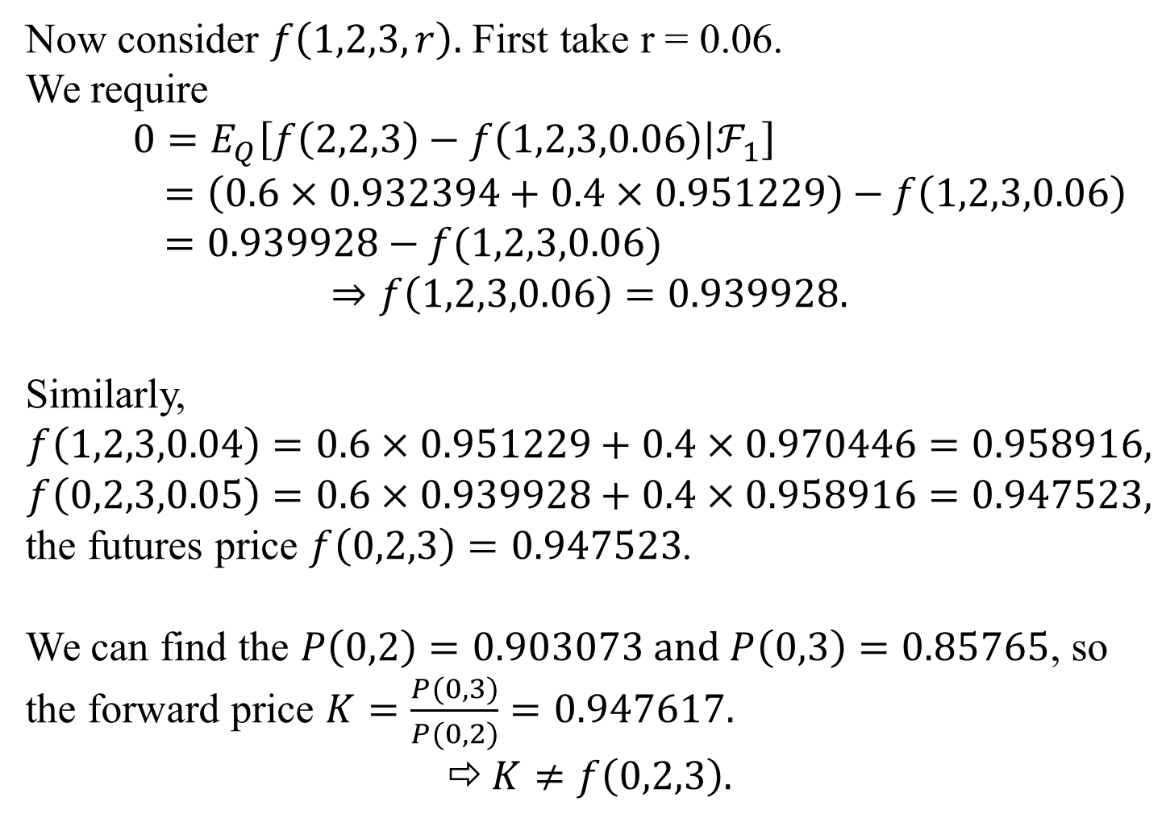
Now consider $f\left(1,2,3,r\right).$ First take r = 0.06.
We require
$$0=E_{Q}\left[f\left(2,2,3\right)−f\left(1,2,3,0.06\right) | ℱ_{1}\right]$$
$=\left(0.6×0.932394+0.4×0.951229\right)−f\left(1,2,3,0.06\right)$
$=0.939928−f(1,2,3,0.06)$
$$⇒f\left(1,2,3,0.06\right)=0.939928.$$
Similarly,
$$f\left(1,2,3,0.04\right)=0.6×0.951229+0.4×0.970446=0.958916,$$
$$f\left(0,2,3,0.05\right)=0.6×0.939928+0.4×0.958916=0.947523,$$
the futures price $f\left(0,2,3\right)=0.947523$.
We can find the $P\left(0,2\right)=0.903073 and P\left(0,3\right)=0.85765$, so the forward price $K=\frac{P(0,3)}{P(0,2)}=0.947617.$
$K≠f\left(0,2,3\right).$

Slide 32







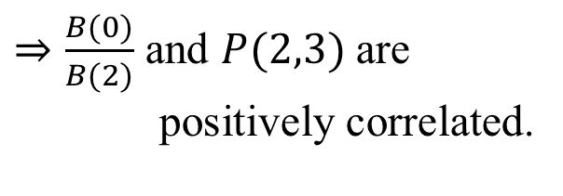
Bond Value Margin account + rate 利息少
Bond Value Margin account - rate 利息多
Claim : $\frac{B(0)}{B(2)}$ and $P(2,3)$ are positively correlated.
(1)利率上升(B(2)較大)$⇒$Bond price較小
(2)利率下降(B(2)較小)$⇒$Bond price較大
Bond Price
(1)
小
rate 上升
$$P\left(2,3\right)=e^{−0.07}$$
$$e^{0.05}e^{0.06}$$
$$P\left(2,3\right)=e^{−0.05}$$
B(2)
$$P\left(2,3\right)=e^{−0.05}$$
$$e^{0.05}e^{0.04}$$
rate 下降
$$P\left(2,3\right)=e^{−0.03}$$
大
(2)
$⇒\frac{B(0)}{B(2)}$ and $P(2,3)$ are
positively correlated.

