Slide 1
Chaper 4: Continuous-time interest rate models
Lin Heng-Li December 5, 2011

Slide 2
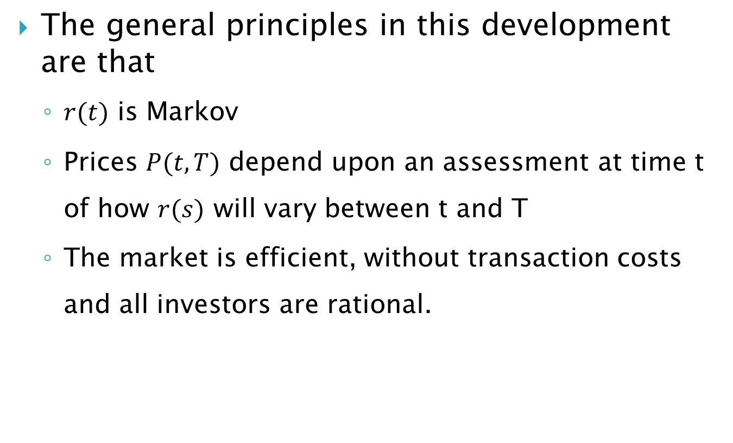
4.3 The PDE Approach to Pricing
The general principles in this development are that
$r(t)$ is Markov
Prices $P(t,T)$ depend upon an assessment at time t of how $r(s)$ will vary between t and T
The market is efficient, without transaction costs and all investors are rational.

Slide 3
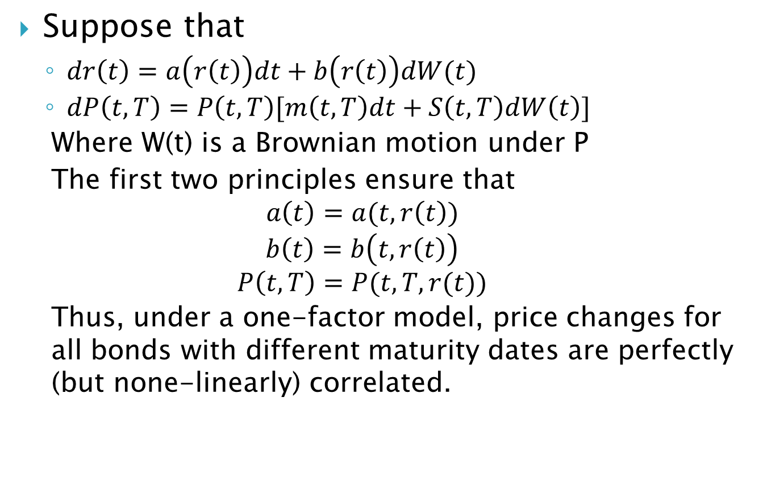
4.3 The PDE Approach to Pricing
Suppose that
$dr\left(t\right)=a\left(r\left(t\right)\right)dt+b\left(r\left(t\right)\right)dW(t)$
$dP\left(t,T\right)=P\left(t,T\right)[m\left(t,T\right)dt+S\left(t,T\right)dW\left(t\right)]$
Where W(t) is a Brownian motion under P
The first two principles ensure that
$$a\left(t\right)=a(t,r\left(t\right))$$
$$b\left(t\right)=b\left(t,r\left(t\right)\right)$$
$$P\left(t,T\right)=P(t,T,r(t))$$
Thus, under a one-factor model, price changes for all bonds with different maturity dates are perfectly (but none-linearly) correlated.
Notes:
課本page 60

Slide 4
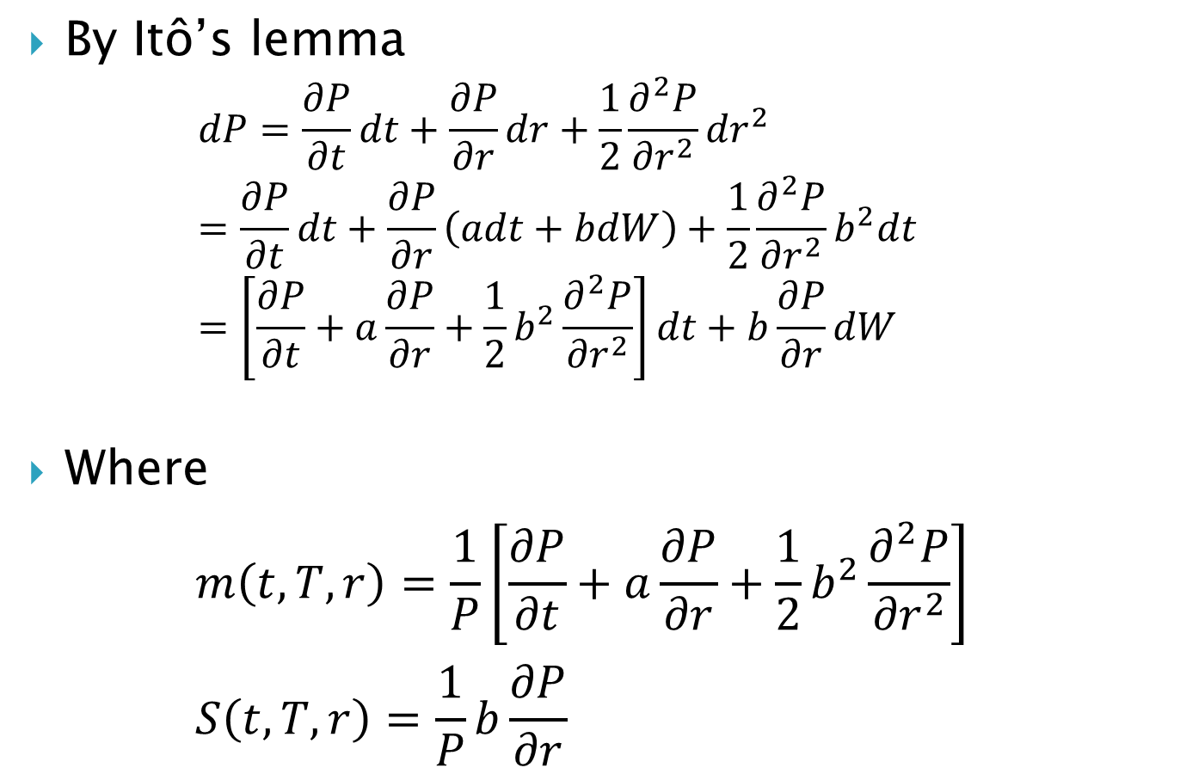
4.3 The PDE Approach to Pricing
By Itô’s lemma
$$dP=\frac{∂P}{∂t}dt+\frac{∂P}{∂r}dr+\frac{1}{2}\frac{∂^{2}P}{{∂r}^{2}}{dr}^{2} \\ =\frac{∂P}{∂t}dt+\frac{∂P}{∂r}\left(adt+bdW\right)+\frac{1}{2}\frac{∂^{2}P}{{∂r}^{2}}b^{2}dt \\ =\left[\frac{∂P}{∂t}+a\frac{∂P}{∂r}+\frac{1}{2}b^{2}\frac{∂^{2}P}{{∂r}^{2}}\right]dt+b\frac{∂P}{∂r}dW$$
Where $m\left(t,T,r\right)=\frac{1}{P}\left[\frac{∂P}{∂t}+a\frac{∂P}{∂r}+\frac{1}{2}b^{2}\frac{∂^{2}P}{{∂r}^{2}}\right]$ $S\left(t,T,r\right)=\frac{1}{P}b\frac{∂P}{∂r}$
(a.1)
(a.2)
Notes:
m(t,T,r)與S(t,T,r)之所以會有1/P可對照前一張投影片

Slide 5
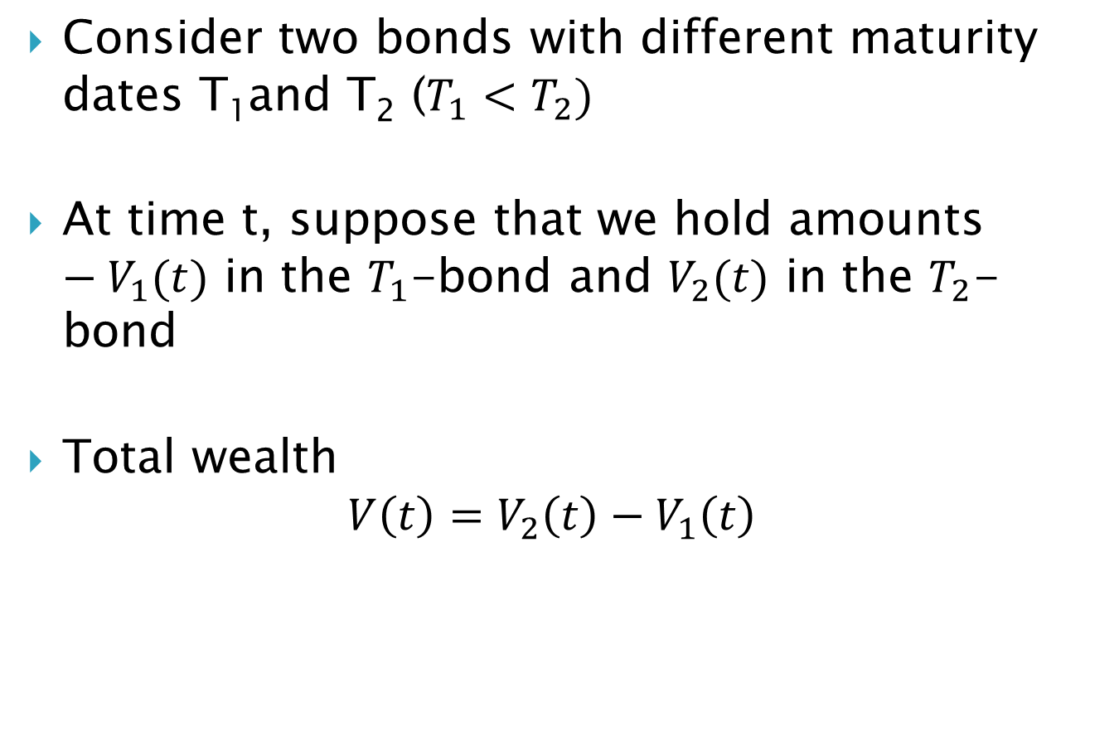
4.3 The PDE Approach to Pricing
Consider two bonds with different maturity dates T₁and T₂ ($T_{1}<T_{2})$
At time t, suppose that we hold amounts $−V_{1}(t)$ in the $T_{1}$-bond and $V_{2}(t)$ in the $T_{2}$-bond
Total wealth $V\left(t\right)=V_{2}\left(t\right)−V_{1}\left(t\right)$
(1)
Notes:
Begin to consider the market price of risk

Slide 6
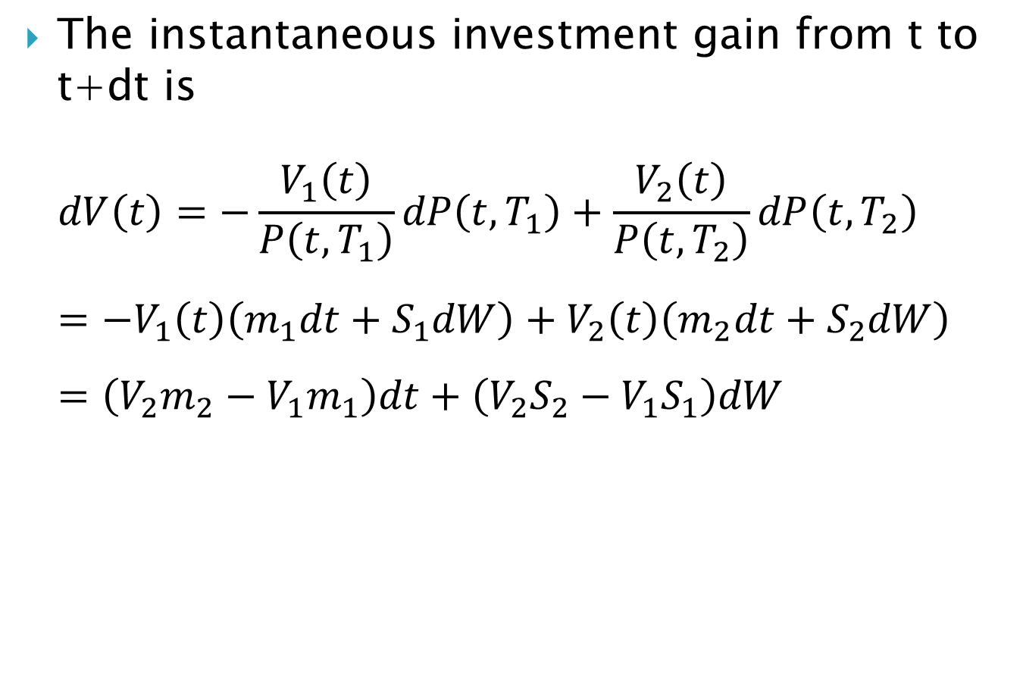
4.3 The PDE Approach to Pricing
The instantaneous investment gain from t to t+dt is
$$dV\left(t\right)=−\frac{V_{1}\left(t\right)}{P\left(t,T_{1}\right)}dP\left(t,T_{1}\right)+\frac{V_{2}\left(t\right)}{P\left(t,T_{2}\right)}dP\left(t,T_{2}\right) \\ =−V_{1}\left(t\right)\left(m_{1}dt+S_{1}dW\right)+V_{2}\left(t\right)\left(m_{2}dt+S_{2}dW\right) \\ =\left(V_{2}m_{2}−V_{1}m_{1}\right)dt+\left(V_{2}S_{2}−V_{1}S_{1}\right)dW$$
Notes:
for notational compactness, we write mi=m(t,Ti,r(t))

Slide 7
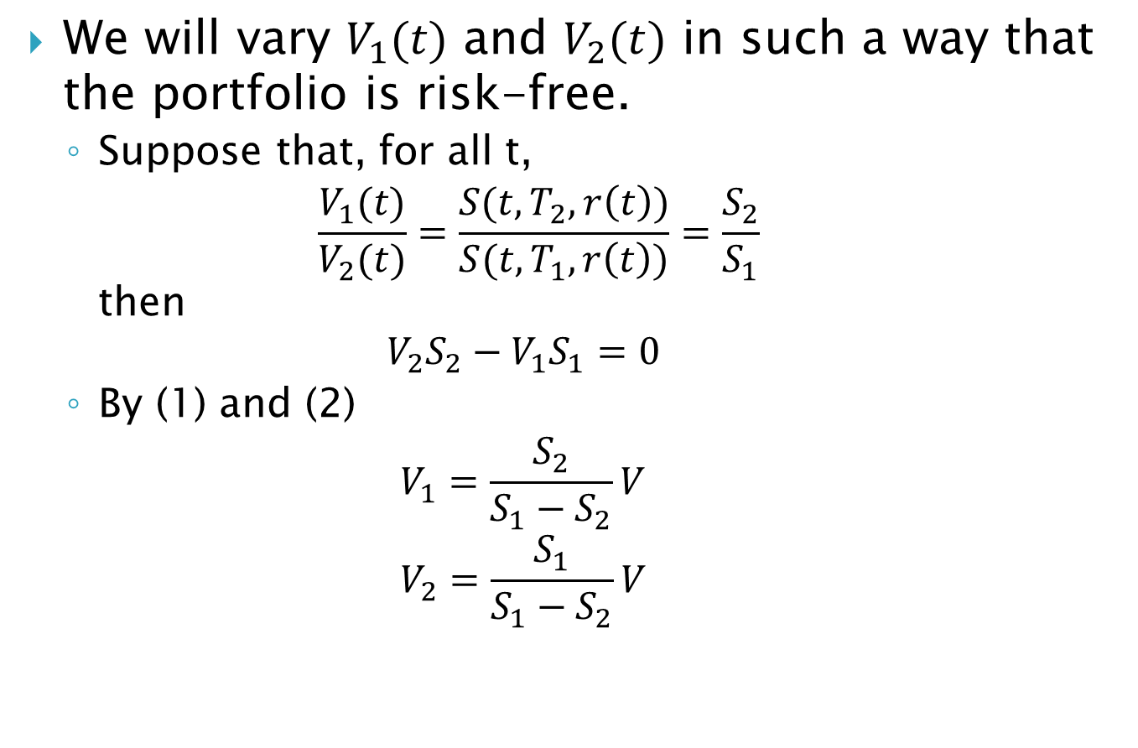
4.3 The PDE Approach to Pricing
We will vary $V_{1}(t)$ and $V_{2}(t)$ in such a way that the portfolio is risk-free.
Suppose that, for all t, $\frac{V_{1}(t)}{V_{2}(t)}=\frac{S(t,T_{2},r\left(t\right))}{S(t,T_{1},r\left(t\right))}=\frac{S_{2}}{S_{1}}$ then $V_{2}S_{2}−V_{1}S_{1}=0$
By (1) and (2) $V_{1}=\frac{S_{2}}{S_{1}−S_{2}}V$ $V_{2}=\frac{S_{1}}{S_{1}−S_{2}}V$
(2)

Slide 8
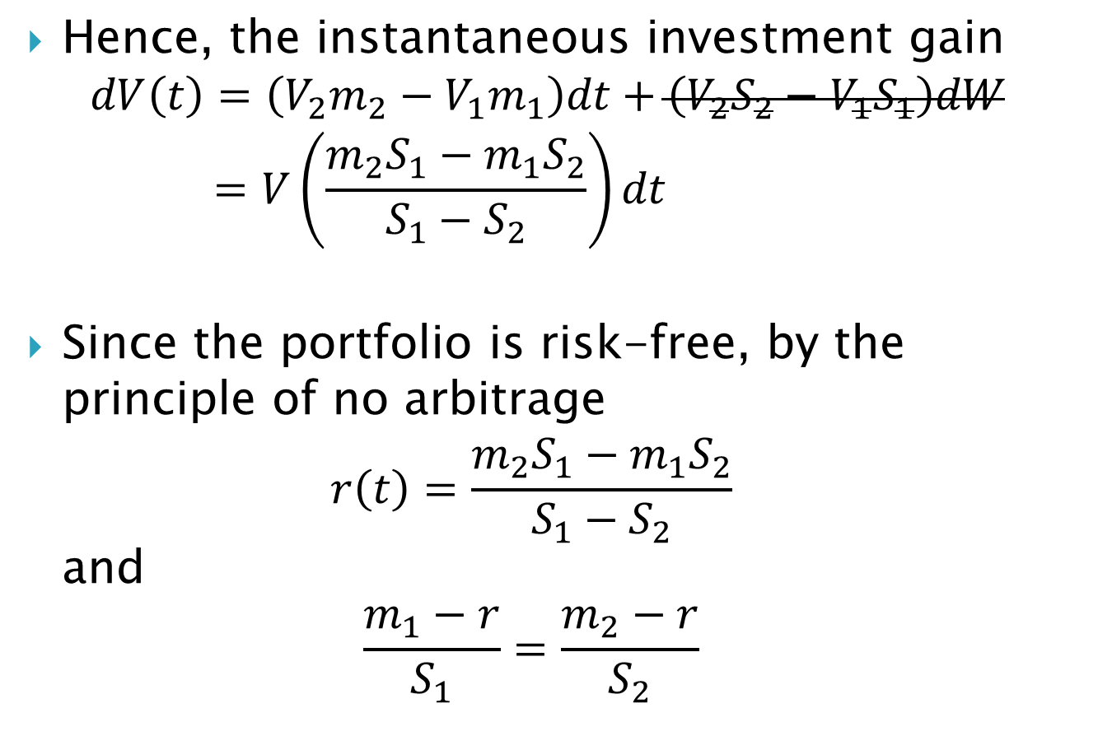
4.3 The PDE Approach to Pricing
Hence, the instantaneous investment gain $dV\left(t\right)=\left(V_{2}m_{2}−V_{1}m_{1}\right)dt+\left(V_{2}S_{2}−V_{1}S_{1}\right)dW$ $=V\left(\frac{m_{2}S_{1}−m_{1}S_{2}}{S_{1}−S_{2}}\right)dt$
Since the portfolio is risk-free, by the principle of no arbitrage $r\left(t\right)=\frac{m_{2}S_{1}−m_{1}S_{2}}{S_{1}−S_{2}}$ and $\frac{m_{1}−r}{S_{1}}=\frac{m_{2}−r}{S_{2}}$

Slide 9
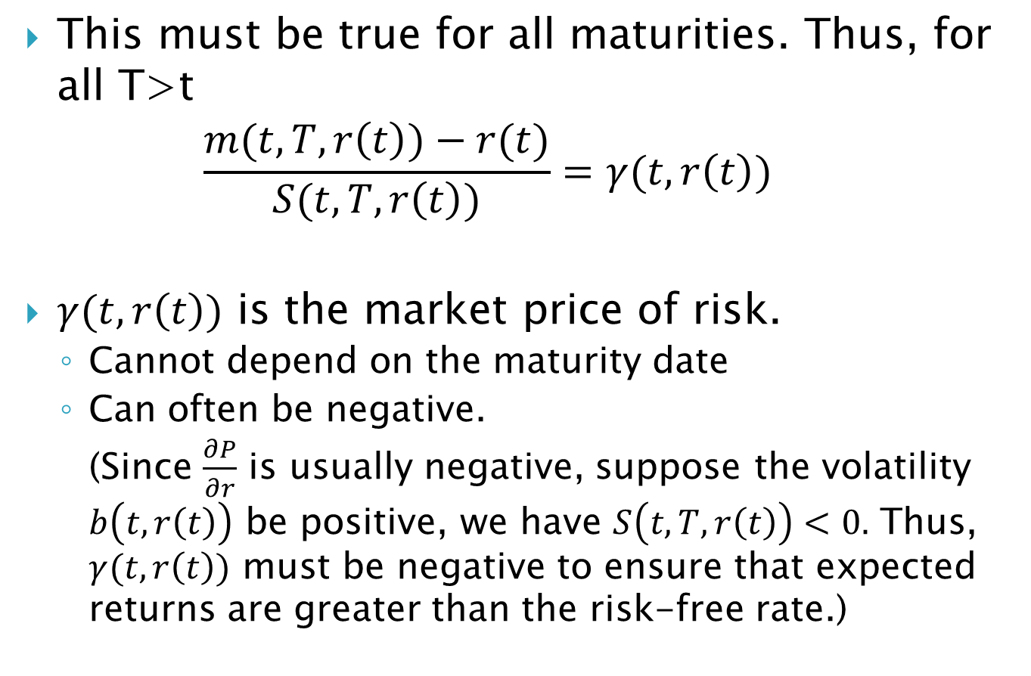
4.3 The PDE Approach to Pricing
This must be true for all maturities. Thus, for all T>t $\frac{m(t,T,r\left(t\right))−r(t)}{S(t,T,r\left(t\right))}=γ(t,r\left(t\right))$
$γ(t,r\left(t\right))$ is the market price of risk.
Cannot depend on the maturity date
Can often be negative. (Since $\frac{∂P}{∂r}$ is usually negative, suppose the volatility $b\left(t,r\left(t\right)\right)$ be positive, we have $S\left(t,T,r\left(t\right)\right)<0.$ Thus, $γ(t,r\left(t\right))$ must be negative to ensure that expected returns are greater than the risk-free rate.)
(b)

Slide 10
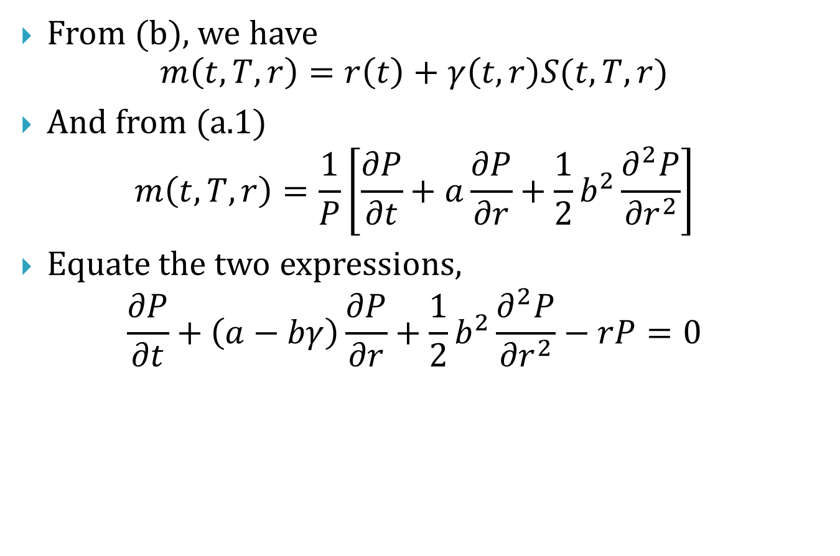
4.3 The PDE Approach to Pricing
From (b), we have $m\left(t,T,r\right)=r\left(t\right)+γ\left(t,r\right)S(t,T,r)$
And from (a.1) $m\left(t,T,r\right)=\frac{1}{P}\left[\frac{∂P}{∂t}+a\frac{∂P}{∂r}+\frac{1}{2}b^{2}\frac{∂^{2}P}{{∂r}^{2}}\right]$
Equate the two expressions, $\frac{∂P}{∂t}+\left(a−bγ\right)\frac{∂P}{∂r}+\frac{1}{2}b^{2}\frac{∂^{2}P}{{∂r}^{2}}−rP=0$

Slide 11
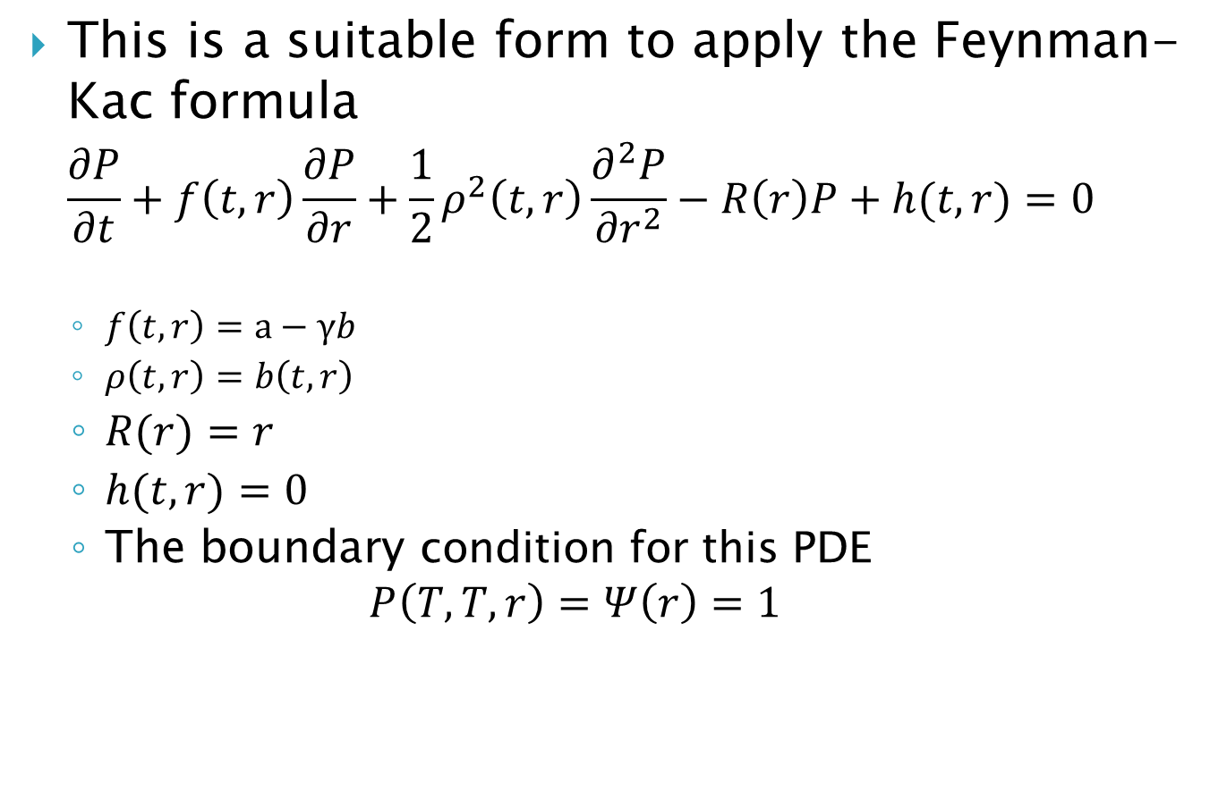
4.3 The PDE Approach to Pricing
This is a suitable form to apply the Feynman-Kac formula $\frac{∂P}{∂t}+f\left(t,r\right)\frac{∂P}{∂r}+\frac{1}{2}ρ^{2}\left(t,r\right)\frac{∂^{2}P}{{∂r}^{2}}−R\left(r\right)P+h(t,r)=0$
$f\left(t,r\right)=a−γb$
$ρ\left(t,r\right)=b\left(t,r\right)$
$R(r)=r$
$h(t,r)=0$
The boundary condition for this PDE $P\left(T,T,r\right)=Ψ\left(r\right)=1$

Slide 12
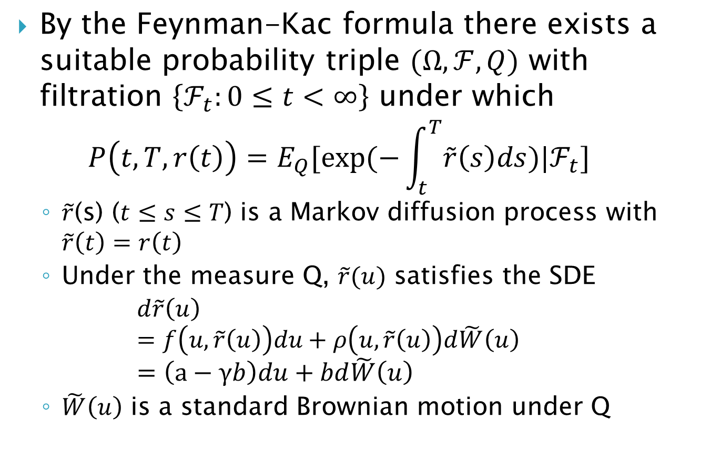
4.3 The PDE Approach to Pricing
By the Feynman-Kac formula there exists a suitable probability triple $(Ω,ℱ,Q)$ with filtration $\left\{ℱ_{t}:0≤t<∞\right\}$ under which $P\left(t,T,r\left(t\right)\right)=E_{Q}[exp⁡(−\int_{t}^{T}{\tilde{r}\left(s\right)ds})|ℱ_{t}]$
$\tilde{r}$(s) ($t≤s≤T$) is a Markov diffusion process with $\tilde{r}\left(t\right)=r\left(t\right)$
Under the measure Q, $\tilde{r}(u)$ satisfies the SDE $d\tilde{r}\left(u\right)$ $=f\left(u,\tilde{r}\left(u\right)\right)du+ρ\left(u,\tilde{r}\left(u\right)\right)d\tilde{W}\left(u\right)$ $=\left(a−γb\right)du+bd\tilde{W}\left(u\right)$
$\tilde{W}\left(u\right)$ is a standard Brownian motion under Q
Notes:
課本246~248頁

Slide 13
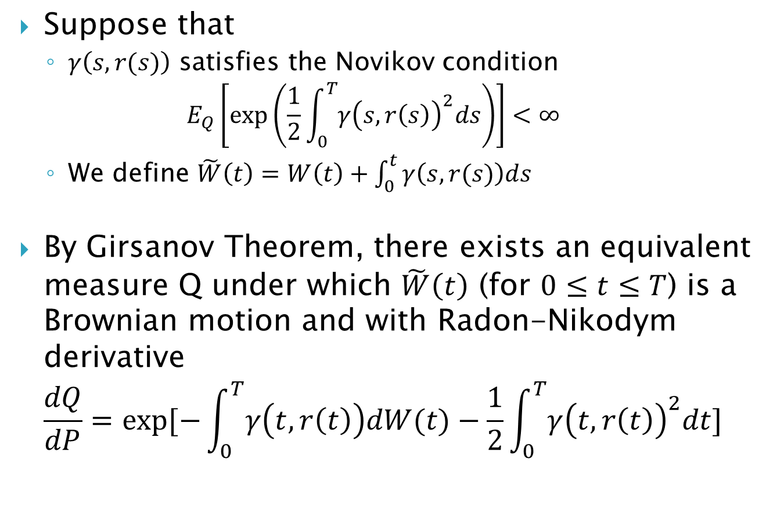
4.3 The PDE Approach to Pricing
Suppose that
$γ\left(s,r(s)\right)$ satisfies the Novikov condition $E_{Q}\left[\exp\left(\frac{1}{2}\int_{0}^{T}{{γ\left(s,r\left(s\right)\right)}^{2}ds}\right)\right]<∞$
We define $\tilde{W}\left(t\right)=W\left(t\right)+\int_{0}^{t}{γ\left(s,r(s)\right)ds}$
By Girsanov Theorem, there exists an equivalent measure Q under which $\tilde{W}\left(t\right)$ (for $0≤t≤T$) is a Brownian motion and with Radon-Nikodym derivative $\frac{dQ}{dP}=exp⁡[−\int_{0}^{T}{γ\left(t,r\left(t\right)\right)dW(t)}−\frac{1}{2}\int_{0}^{T}{{γ\left(t,r\left(t\right)\right)}^{2}dt}]$
Notes:
原本的模型 r= a dt + b dW 是在P測度底下的 我們必須證明P Q 兩種測度約當(等價) 才能進行套用

Slide 14
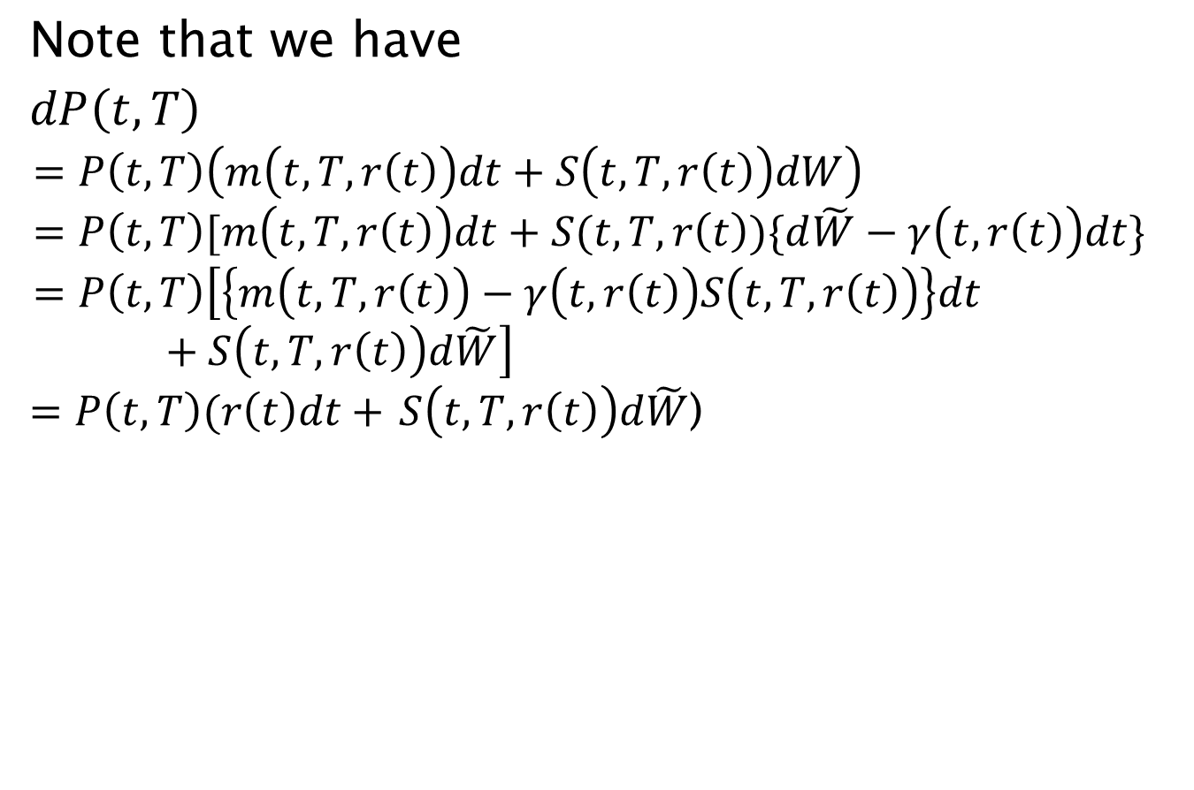
4.3 The PDE Approach to Pricing
Note that we have
$dP\left(t,T\right)$ $$=P\left(t,T\right)\left(m\left(t,T,r\left(t\right)\right)dt+S\left(t,T,r\left(t\right)\right)dW\right) \\ =P\left(t,T\right)[m\left(t,T,r\left(t\right)\right)dt+S(t,T,r\left(t\right))\{d\tilde{W}−γ\left(t,r\left(t\right)\right)dt\} \\ =P\left(t,T\right)\left[\left\{m\left(t,T,r\left(t\right)\right)−γ\left(t,r\left(t\right)\right)S\left(t,T,r\left(t\right)\right)\right\}dt+S\left(t,T,r\left(t\right)\right)d\tilde{W}\right]$$ $=P\left(t,T\right)(r\left(t\right)dt+$ $S\left(t,T,r\left(t\right)\right)d\tilde{W}$)
Notes:
因此 在側度Q底下 任何債券的期望報酬皆等於無風險利率 rf Q是一個風險中立測度

Slide 15
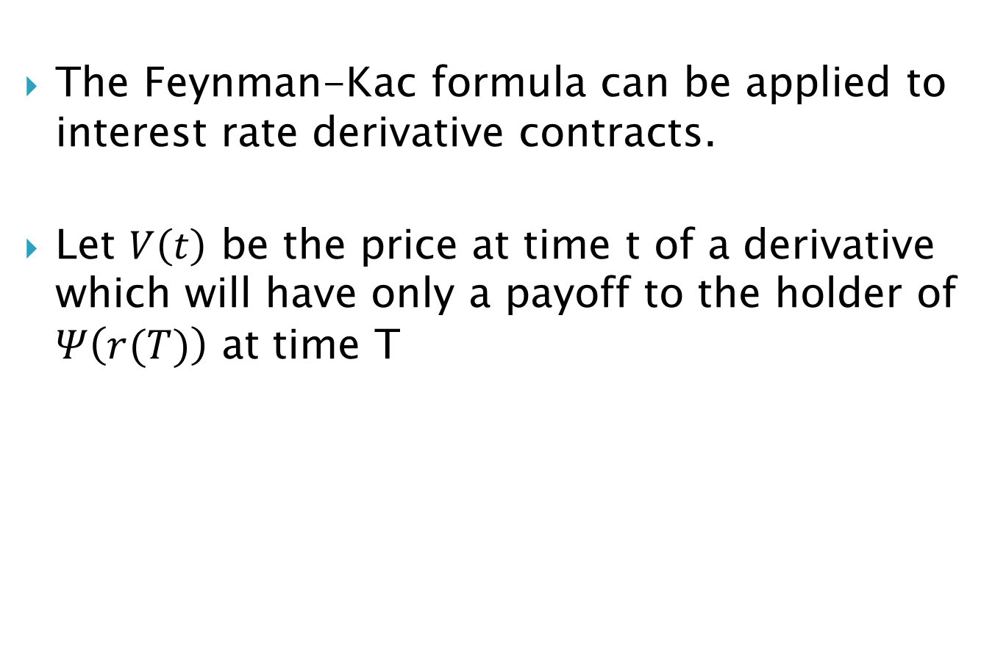
4.3 The PDE Approach to Pricing
The Feynman-Kac formula can be applied to interest rate derivative contracts.
Let $V\left(t\right)$ be the price at time t of a derivative which will have only a payoff to the holder of $Ψ\left(r(T)\right)$ at time T

Slide 16
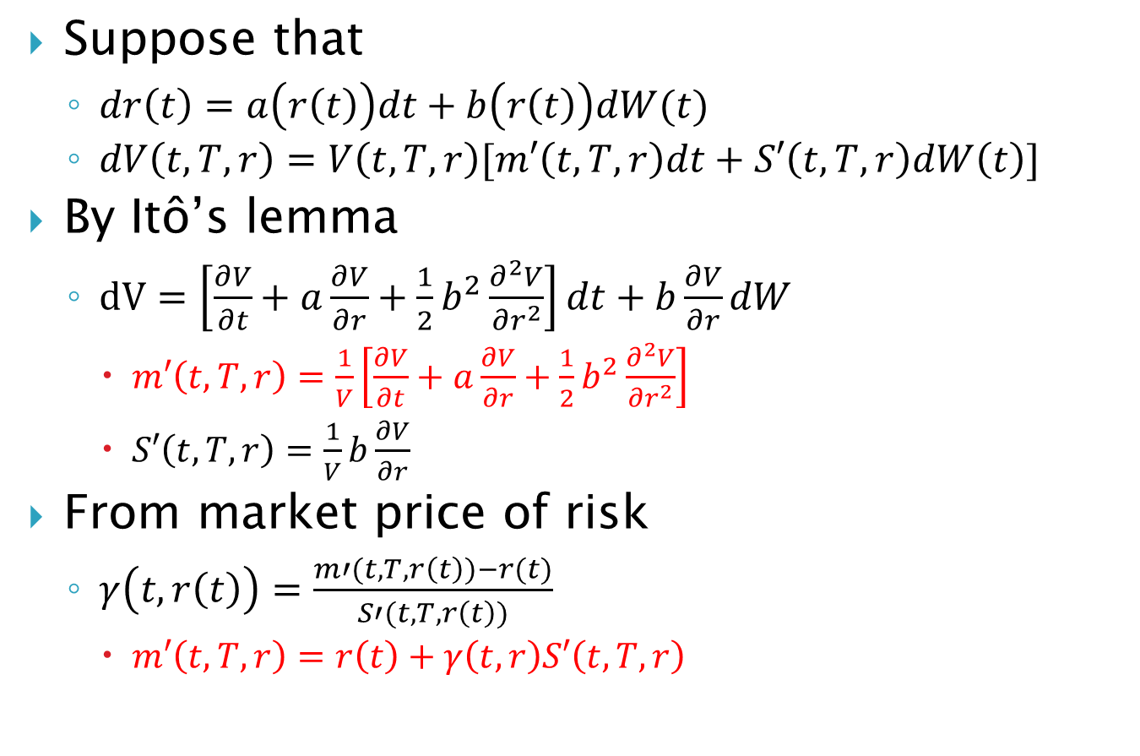
4.3 The PDE Approach to Pricing
Suppose that
$dr\left(t\right)=a\left(r\left(t\right)\right)dt+b\left(r\left(t\right)\right)dW(t)$
$dV\left(t,T,r\right)=V\left(t,T,r\right)[m′\left(t,T,r\right)dt+S′\left(t,T,r\right)dW\left(t\right)]$
By Itô’s lemma
$dV=\left[\frac{∂V}{∂t}+a\frac{∂V}{∂r}+\frac{1}{2}b^{2}\frac{∂^{2}V}{{∂r}^{2}}\right]dt+b\frac{∂V}{∂r}dW$
$m′\left(t,T,r\right)=\frac{1}{V}\left[\frac{∂V}{∂t}+a\frac{∂V}{∂r}+\frac{1}{2}b^{2}\frac{∂^{2}V}{{∂r}^{2}}\right]$
$S′\left(t,T,r\right)=\frac{1}{V}b\frac{∂V}{∂r}$
From market price of risk
$γ\left(t,r\left(t\right)\right)=\frac{m′(t,T,r\left(t\right))−r(t)}{S′(t,T,r\left(t\right))}$
$m′\left(t,T,r\right)=r\left(t\right)+γ\left(t,r\right)S′\left(t,T,r\right)$

Slide 17
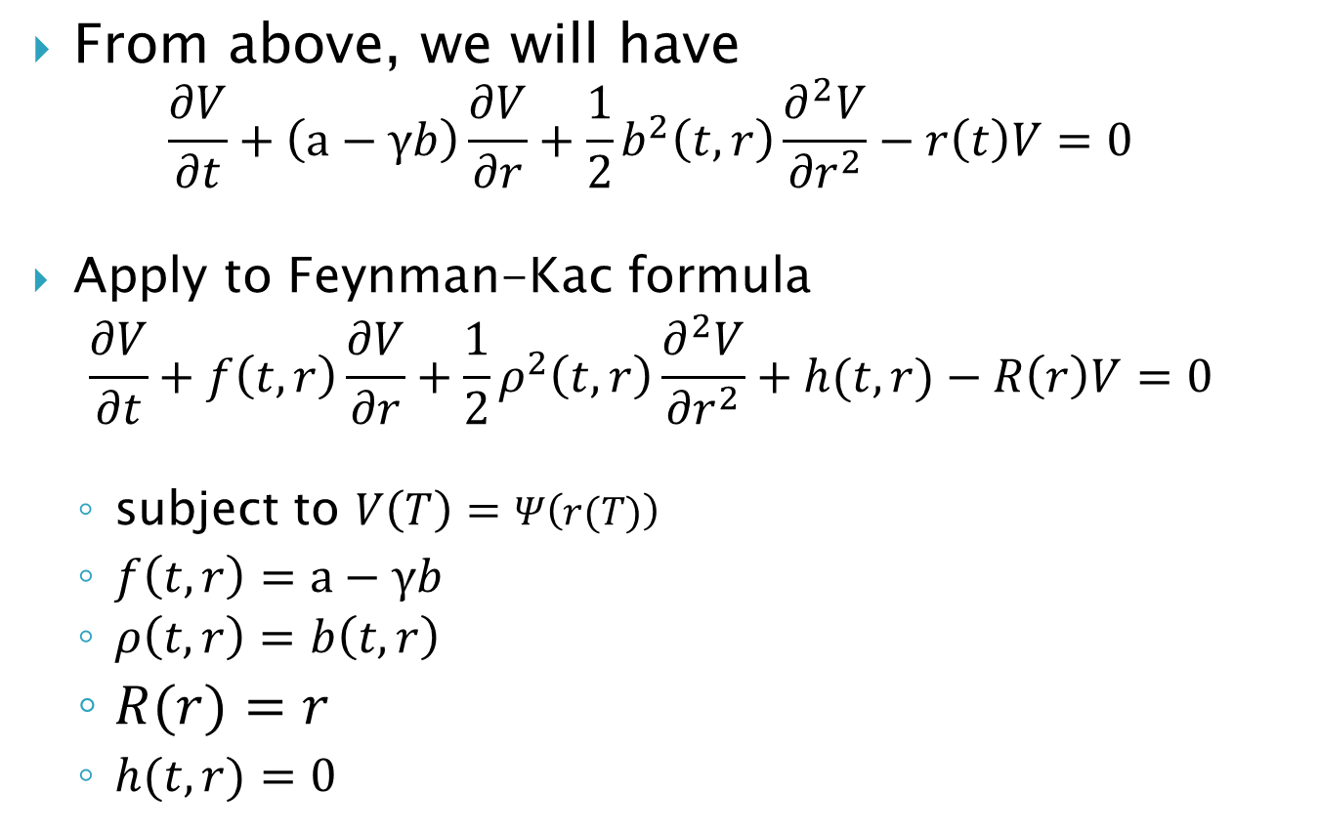
4.3 The PDE Approach to Pricing
From above, we will have $\frac{∂V}{∂t}+\left(a−γb\right)\frac{∂V}{∂r}+\frac{1}{2}b^{2}\left(t,r\right)\frac{∂^{2}V}{{∂r}^{2}}−r\left(t\right)V=0$
Apply to Feynman-Kac formula
$$\frac{∂V}{∂t}+f\left(t,r\right)\frac{∂V}{∂r}+\frac{1}{2}ρ^{2}\left(t,r\right)\frac{∂^{2}V}{{∂r}^{2}}+h(t,r)−R\left(r\right)V=0$$
subject to $V\left(T\right)=Ψ\left(r(T)\right)$
$f\left(t,r\right)=a−γb$
$ρ\left(t,r\right)=b\left(t,r\right)$
$R(r)=r$
$h(t,r)=0$

Slide 18
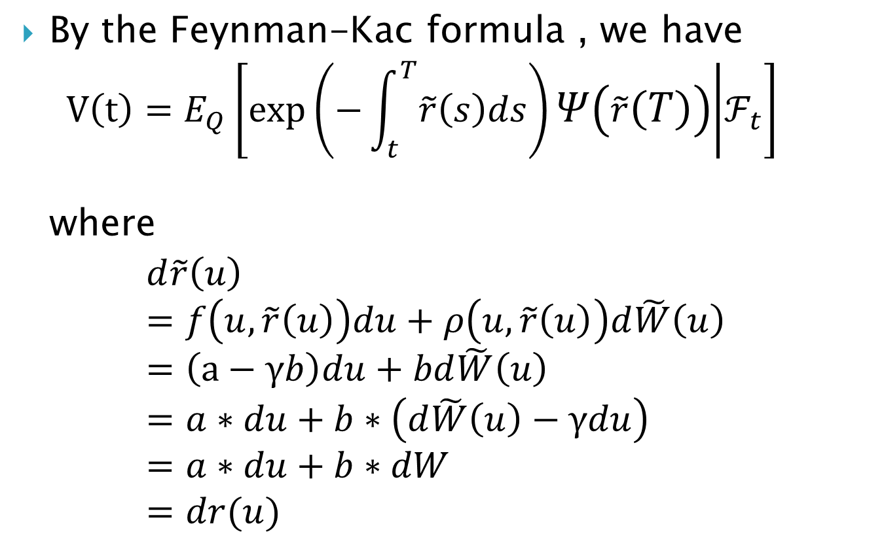
4.3 The PDE Approach to Pricing
By the Feynman-Kac formula , we have $V\left(t\right)=E_{Q}\left[\exp\left(−\int_{t}^{T}{\tilde{r}\left(s\right)ds}\right)Ψ\left(\tilde{r}\left(T\right)\right) | ℱ_{t}\right]$ where
$$d\tilde{r}\left(u\right) \\ =f\left(u,\tilde{r}\left(u\right)\right)du+ρ\left(u,\tilde{r}\left(u\right)\right)d\tilde{W}\left(u\right) \\ =\left(a−γb\right)du+bd\tilde{W}\left(u\right) \\ =a∗du+b∗\left(d\tilde{W}\left(u\right)−γdu\right) \\ =a∗du+b∗dW \\ =dr(u)$$

