Slide 1
Chapter 2
Arbitrage-Free Pricing

Slide 2
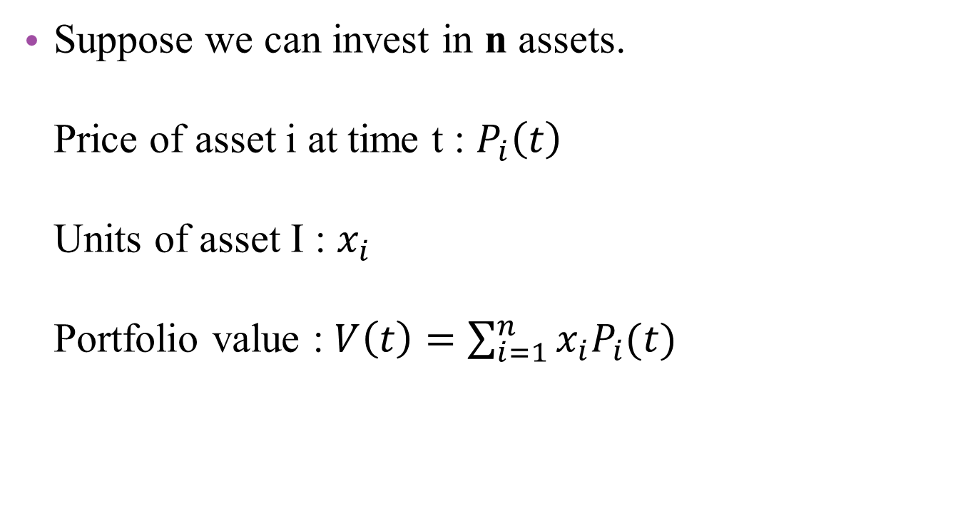
Definition of Arbitrage
Suppose we can invest in n assets. Price of asset i at time t : $P_{i}\left(t\right)$ Units of asset I : $x_{i}$ Portfolio value : $V\left(t\right)=\sum_{i=1}^{n}{x_{i}P_{i}(t)}$

Slide 3
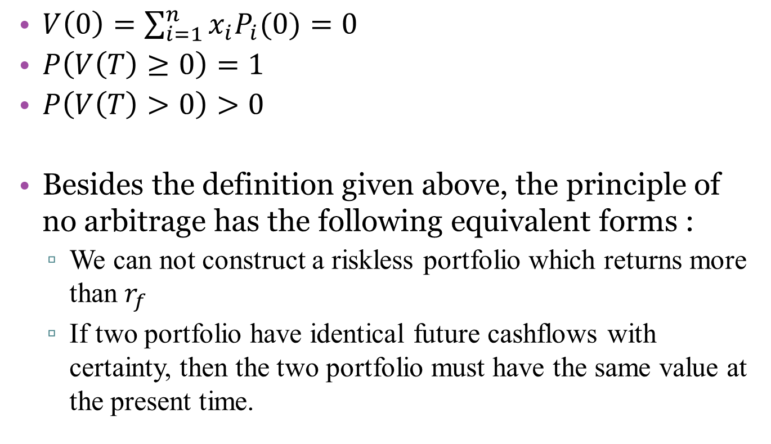
Definition of Arbitrage
$V\left(0\right)=\sum_{i=1}^{n}{x_{i}P_{i}(0)}=0$
$P\left(V\left(T\right)≥0\right)=1$
$P\left(V\left(T\right)>0\right)>0$
Besides the definition given above, the principle of no arbitrage has the following equivalent forms :
We can not construct a riskless portfolio which returns more than $r_{f}$
If two portfolio have identical future cashflows with certainty, then the two portfolio must have the same value at the present time.
套利的定義，條件缺一不可

Slide 4
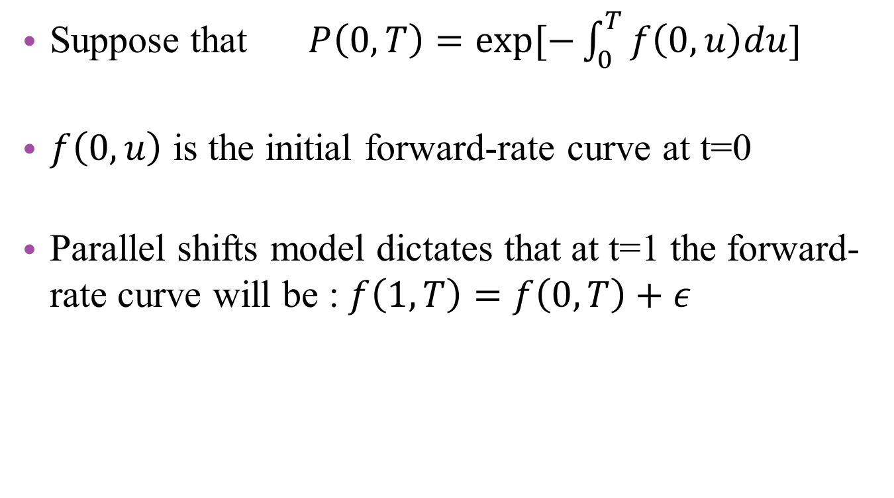
2.1 Example of Arbitrage parallel yield curve shifts
Suppose that $P\left(0,T\right)=exp⁡[−\int_{0}^{T}{f\left(0,u\right)du}]$
$f\left(0,u\right)$ is the initial forward-rate curve at t=0
Parallel shifts model dictates that at t=1 the forward-rate curve will be : $f\left(1,T\right)=f\left(0,T\right)+ε$
Notes:
首先 先定義符號 還有遠期利率的平行移動模式

Slide 5
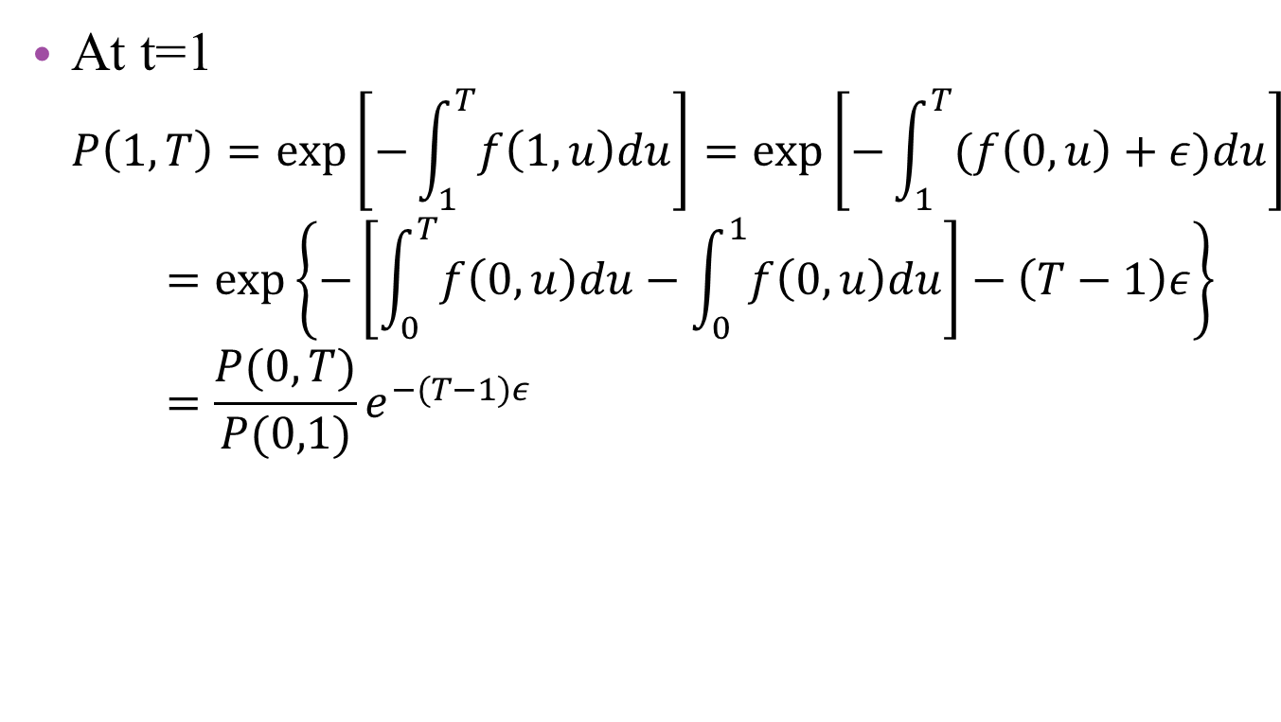
2.1 Example of Arbitrage parallel yield curve shifts
At t=1 $P\left(1,T\right)=\exp\left[−\int_{1}^{T}{f\left(1,u\right)du}\right]=\exp\left[−\int_{1}^{T}{(f\left(0,u\right)+ε)du}\right]=\exp\left\{−\left[\int_{0}^{T}{f\left(0,u\right)du}−\int_{0}^{1}{f\left(0,u\right)du}\right]−\left(T−1\right)ε\right\}=\frac{P(0,T)}{P(0,1)}e^{−(T−1)ε}$
此處的結果會在之後的投影片中用到

Slide 6
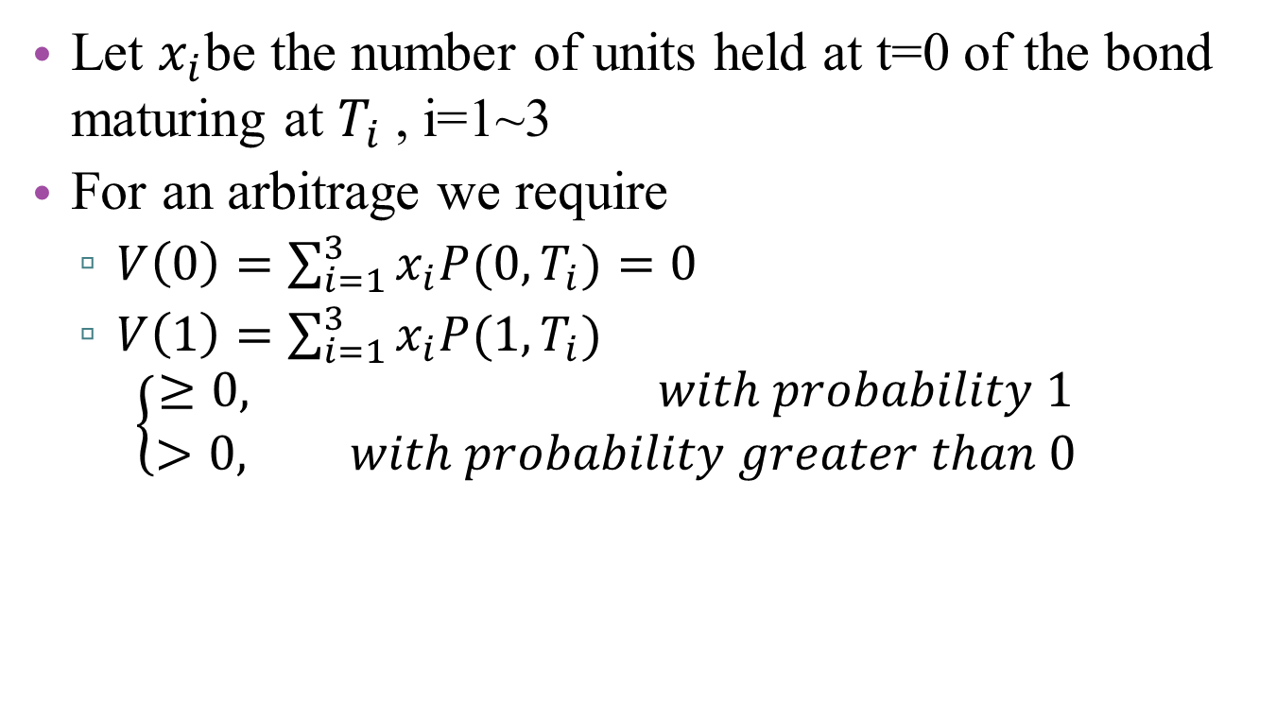
2.1 Example of Arbitrage parallel yield curve shifts
Let $x_{i}$be the number of units held at t=0 of the bond maturing at $T_{i}$ , i=1~3
For an arbitrage we require
$V\left(0\right)=\sum_{i=1}^{3}{x_{i}P(0,T_{i})}=0$
$V\left(1\right)=\sum_{i=1}^{3}{x_{i}P(1,T_{i})}$ $\left\{\begin{aligned}≥0, with probability 1 \\ >0, with probability greater than 0\end{aligned}\right.$
Notes:
開始建構可套利機會

Slide 7

2.1 Example of Arbitrage parallel yield curve shifts
The value of portfolio at t=1 is
$V_{1}\left(ε\right)=\sum_{i=1}^{3}{x_{i}P\left(1,T_{i}\right)}=\frac{e^{−ε\left(T_{2}−1\right)}}{P\left(0,1\right)}g(ε)$
$g\left(ε\right)=\sum_{i=1}^{3}{x_{i}P\left(0,T_{i}\right)e^{−ε(T_{i}−T_{2})}}$
此處乃應用稍早第5張投影片的結果而求得之結果，
至於把T2獨立出來的目的，則是為了方便之後的運算。 且由於V1(ε)中，左邊分數之分子分母皆大於零，表示V1(ε)的正負、 大小僅與g(ε)有關
Notes:
$V\left(ε\right)與g(ε)$有正向關係

Slide 8
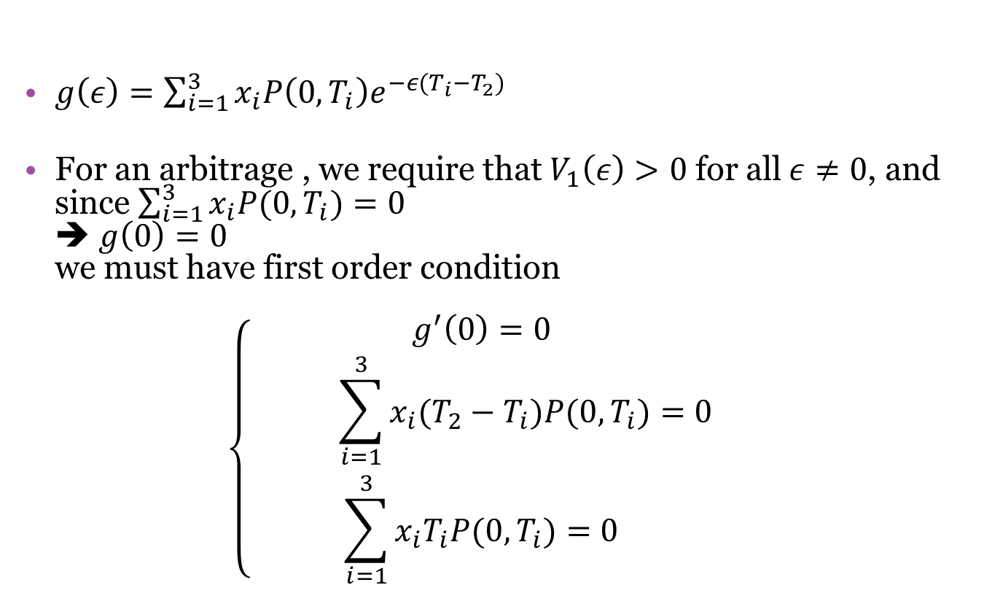
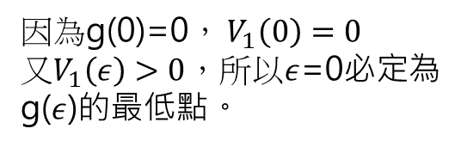
2.1 Example of Arbitrage parallel yield curve shifts
$g\left(ε\right)=\sum_{i=1}^{3}{x_{i}P\left(0,T_{i}\right)e^{−ε(T_{i}−T_{2})}}$
For an arbitrage , we require that $V_{1}\left(ε\right)>0$ for all$ε≠0$, and since $\sum_{i=1}^{3}{x_{i}P(0,T_{i})}=0$ ➔ $g\left(0\right)=0$ we must have first order condition $\left\{\begin{aligned}g^{′}\left(0\right)=0 \\ \sum_{i=1}^{3}{x_{i}(T_{2}−T_{i})P(0,T_{i})}=0 \\ \sum_{i=1}^{3}{x_{i}T_{i}P(0,T_{i})}=0\end{aligned}\right.$
因為g(0)=0， $V_{1}\left(0\right)=0$ 又$V_{1}\left(ε\right)>0$，所以$ε$=0必定為 g($ε$)的最低點。
Notes:
對g(ε)進行微分運算

Slide 9

2.1 Example of Arbitrage parallel yield curve shifts
And S.O.C $g^{′′}(0)≥0$ $g^{′′}\left(ε\right)=\sum_{i=1}^{3}{x_{i}{(T_{2}−T_{i})}^{2}P(0,T_{i})e^{−ε(T_{i}−T_{2})}}$

Slide 10
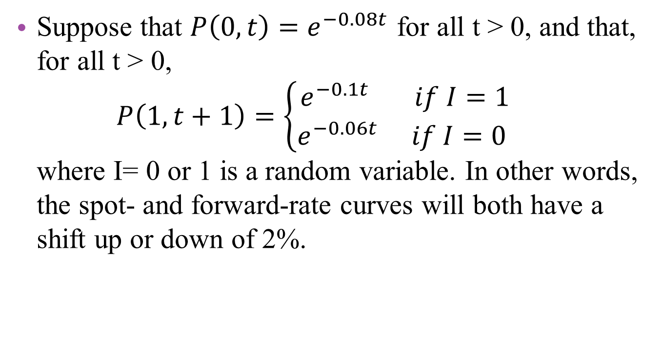
Example 2.1
Suppose that $P\left(0,t\right)=e^{−0.08t}$ for all t > 0, and that, for all t > 0, $P\left(1,t+1\right)=\left\{\begin{aligned}e^{−0.1t} if I=1 \\ e^{−0.06t} if I=0 \end{aligned}\right.$ where I= 0 or 1 is a random variable. In other words, the spot- and forward-rate curves will both have a shift up or down of 2%.
Notes:
該範例為2.1 遠期利率平行移動之套利機會的例題

Slide 11

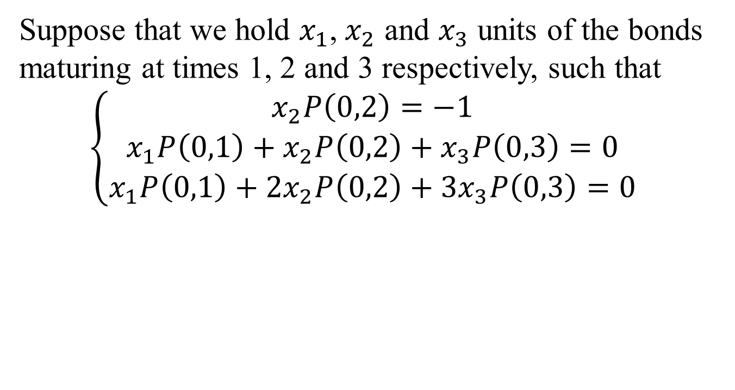
Example 2.1
Suppose that we hold $x_{1}$, $x_{2}$ and $x_{3}$ units of the bonds maturing at times 1, 2 and 3 respectively, such that
$$\left\{\begin{aligned}x_{2}P\left(0,2\right)=−1 \\ x_{1}P\left(0,1\right)+x_{2}P\left(0,2\right)+x_{3}P\left(0,3\right)=0 \\ x_{1}P\left(0,1\right)+2x_{2}P\left(0,2\right)+3x_{3}P\left(0,3\right)=0\end{aligned}\right.$$
運用到的條件： 1. 假定$x_{2}P\left(0,2\right)=−1$ 2. $\sum_{i=1}^{3}{x_{i}P(0,T_{i})}=0$ 3. F.O.C. $$\sum_{i=1}^{3}{x_{i}T_{i}P(0,T_{i})}=0$$

Slide 12
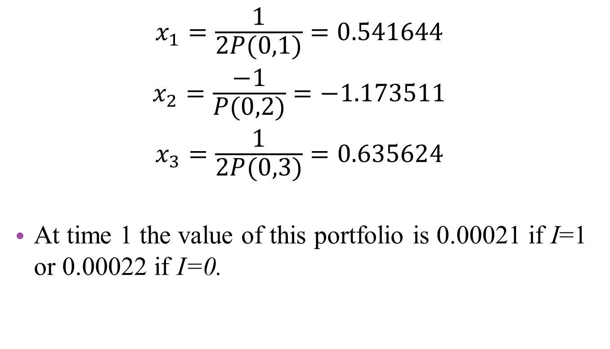
Example 2.1
$${x_{1}=\frac{1}{2P(0,1)}=0.541644 \atop \begin{aligned}x_{2}=\frac{−1}{P(0,2)}=−1.173511 \\ x_{3}=\frac{1}{2P(0,3)}=0.635624\end{aligned}}$$
At time 1 the value of this portfolio is 0.00021 if I=1 or 0.00022 if I=0.

Slide 13
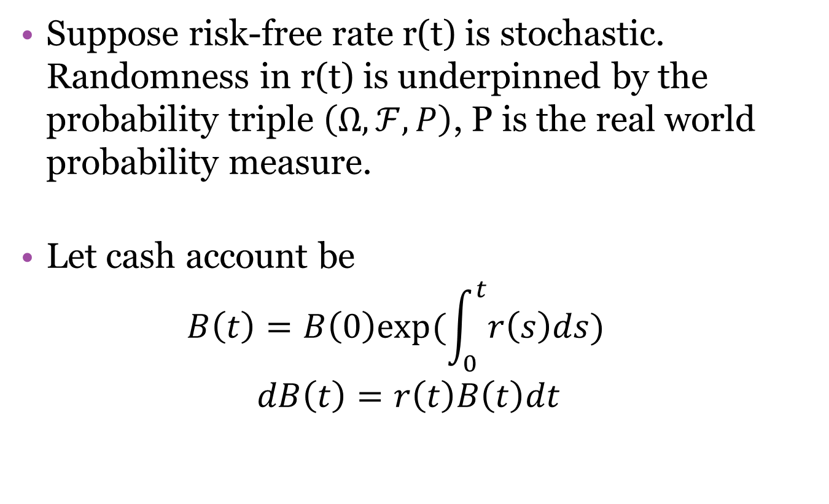
2.2 Fundamental Theorem of Asset Pricing
Suppose risk-free rate r(t) is stochastic. Randomness in r(t) is underpinned by the probability triple $\left(Ω,ℱ,P\right)$, P is the real world probability measure.
Let cash account be $B\left(t\right)=B\left(0\right)exp⁡(\int_{0}^{t}{r\left(s\right)ds})$
$$dB\left(t\right)=r\left(t\right)B\left(t\right)dt$$
Notes:
dB(t)不含隨機向 故極短時間內的cash-account process 可視為無風險的

Slide 14
2.2 Fundamental Theorem of Asset Pricing
Theorem 2.2
Bond price evolve in a way that is arbitrage free if and only if there exists a measure Q, equivalent to P, under which, for each T, the discounted price process P(t,T)/B(t) is a martingale for all t: 0<t<T
If 1. holds, then the market is complete if and only if Q is the unique measure under which the P(t ,T)/B(t) are martingales.
The measure Q is often referred to, consequently, as the equivalent martingale measure.

Slide 15
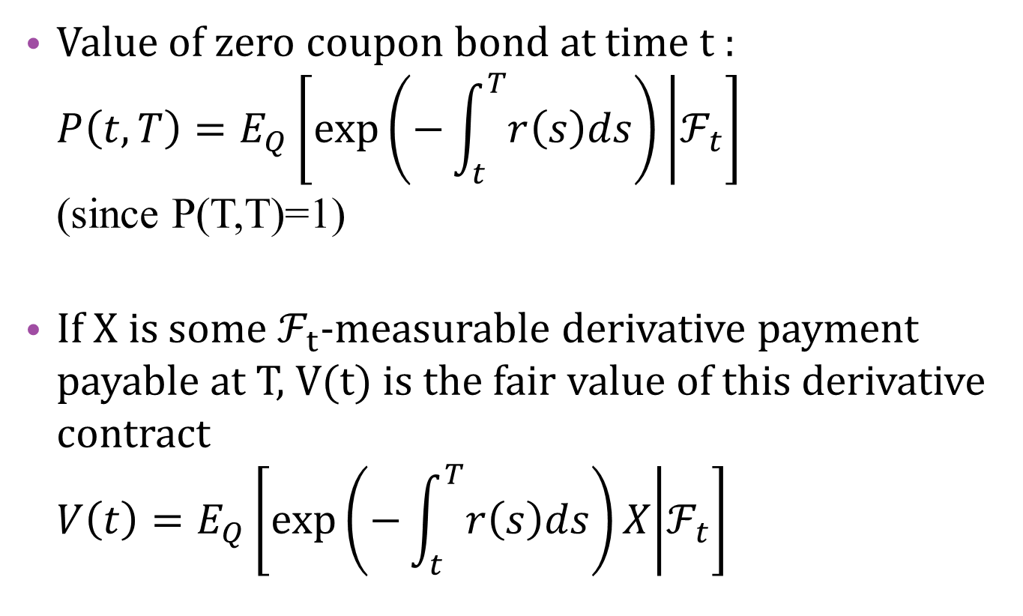
2.2 Fundamental Theorem of Asset Pricing
Value of zero coupon bond at time t : $P\left(t,T\right)=E_{Q}\left[\exp\left(−\int_{t}^{T}{r\left(s\right)ds}\right) | ℱ_{t}\right]$ (since P(T,T)=1)
If X is some $ℱ_{t}$-measurable derivative payment payable at T, V(t) is the fair value of this derivative contract $V\left(t\right)=E_{Q}\left[\exp\left(−\int_{t}^{T}{r\left(s\right)ds}\right)X | ℱ_{t}\right]$
Notes:
Chapter 1 P(t,t)=1

Slide 16
Example 2.5 forward pricing
A forward contract has been arranged in which a price K will be paid at time T in return for a repayment of 1 at time S (T<S). Equivalently, K is paid at T in return for delivery at the same time T of the S-bond which has a value at that time of P(T,S). How much is this contract worth at time t<T ?

Slide 17
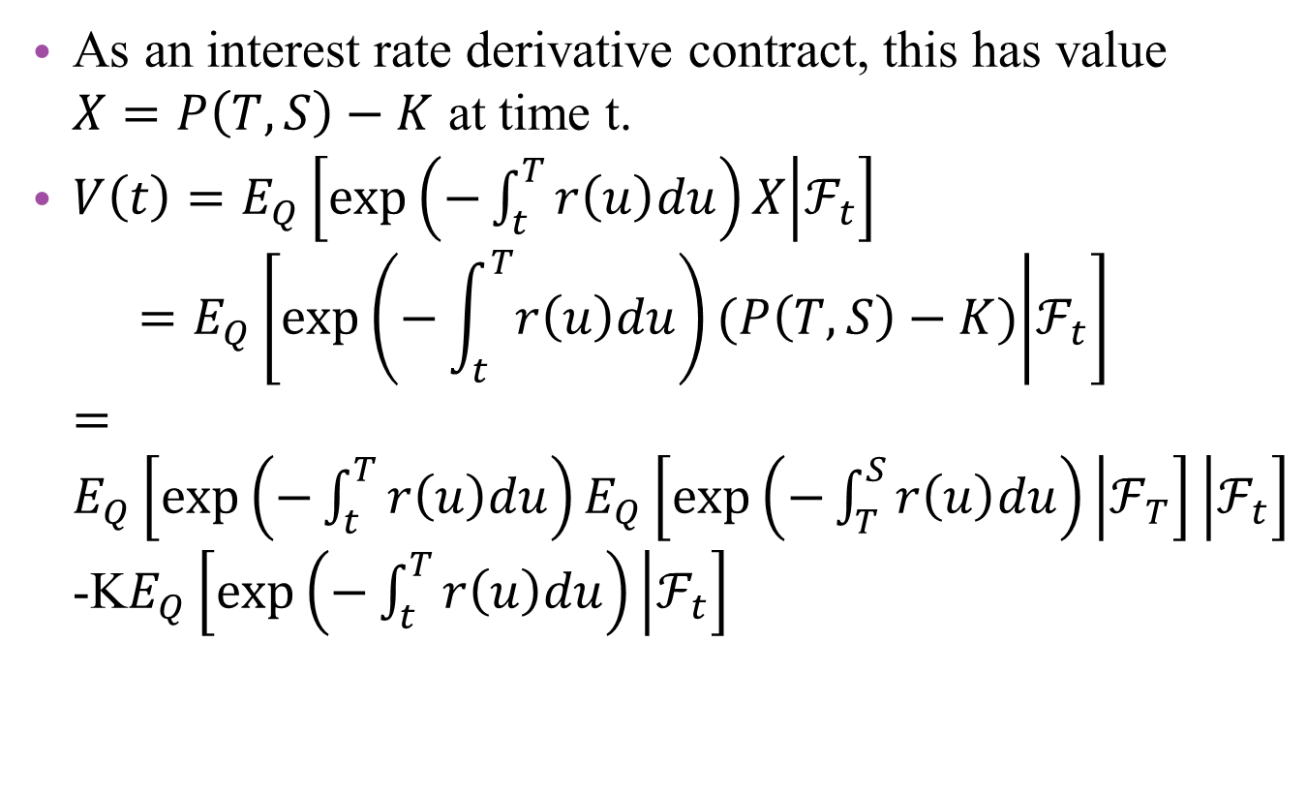
Example 2.5 forward pricing
As an interest rate derivative contract, this has value $X=P\left(T,S\right)−K$ at time t.
$V\left(t\right)=E_{Q}\left[\exp\left(−\int_{t}^{T}{r\left(u\right)du}\right)X | ℱ_{t}\right]$ $=E_{Q}\left[\exp\left(−\int_{t}^{T}{r\left(u\right)du}\right)(P\left(T,S\right)−K) | ℱ_{t}\right]$ $=E_{Q}\left[\exp\left(−\int_{t}^{T}{r\left(u\right)du}\right)E_{Q}\left[\exp\left(−\int_{T}^{S}{r\left(u\right)du}\right) | ℱ_{T}\right] | ℱ_{t}\right]$-K$E_{Q}\left[\exp\left(−\int_{t}^{T}{r\left(u\right)du}\right) | ℱ_{t}\right]$

Slide 18
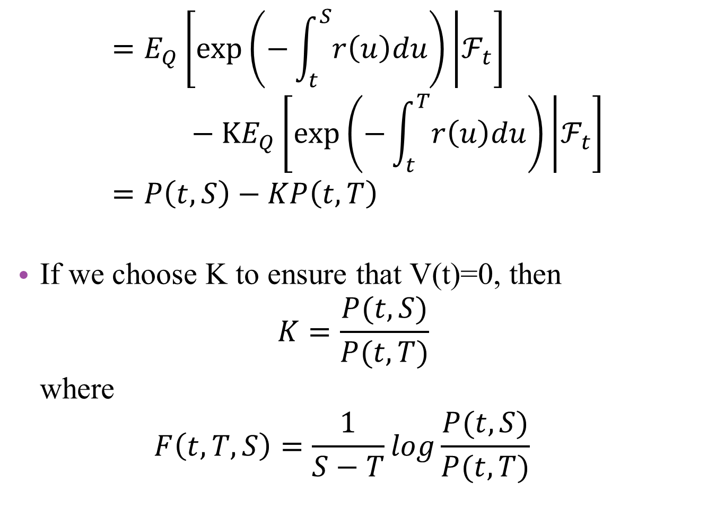
$$=E_{Q}\left[\exp\left(−\int_{t}^{S}{r\left(u\right)du}\right) | ℱ_{t}\right]−KE_{Q}\left[\exp\left(−\int_{t}^{T}{r\left(u\right)du}\right) | ℱ_{t}\right] \\ =P\left(t,S\right)−KP\left(t,T\right)$$
If we choose K to ensure that V(t)=0, then $K=\frac{P(t,S)}{P(t,T)}$ where $F\left(t,T,S\right)=\frac{1}{S−T}log\frac{P(t,S)}{P(t,T)}$

Slide 19
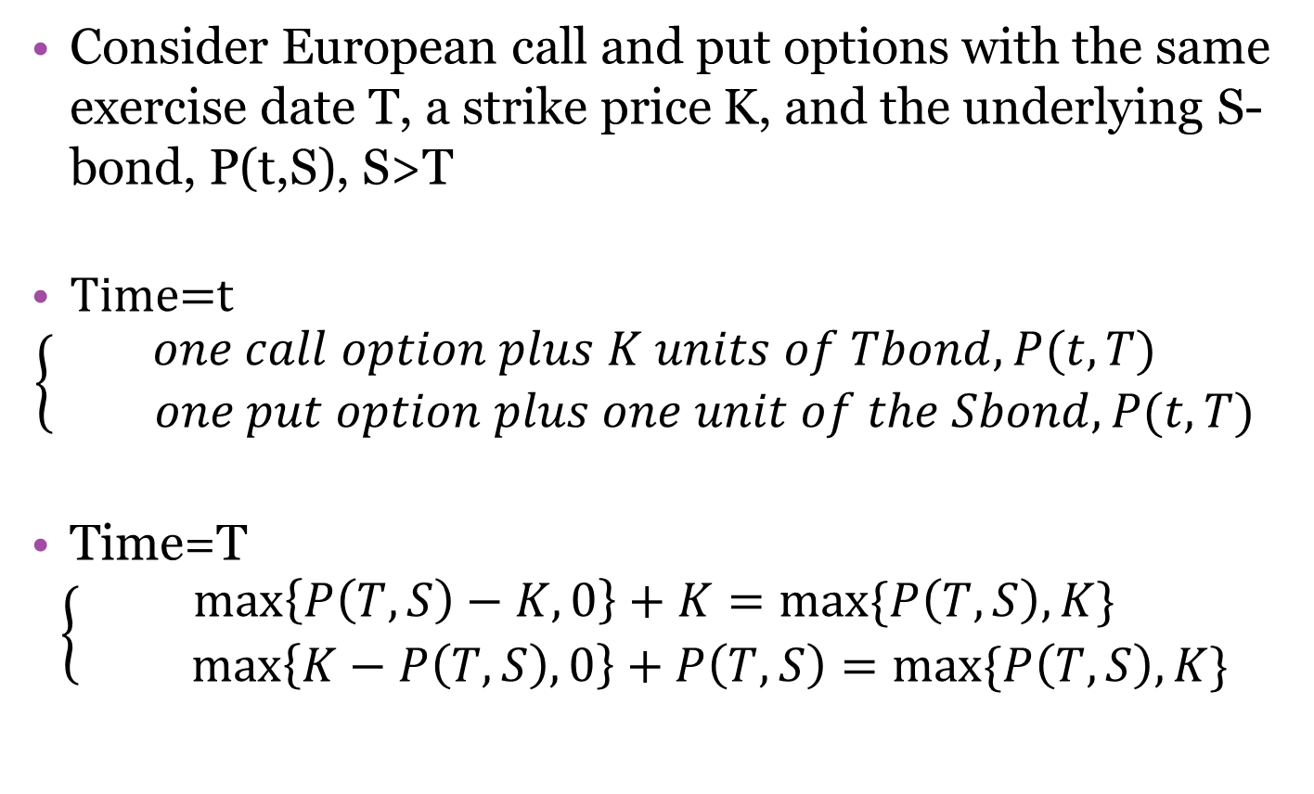
2.6 Put-Call Parity
Consider European call and put options with the same exercise date T, a strike price K, and the underlying S-bond, P(t,S), S>T
Time=t
$$\left\{\begin{aligned}one call option plus K units of Tbond, P(t,T) \\ one put option plus one unit of the Sbond, P(t,T)\end{aligned}\right.$$
Time=T
$$\left\{\begin{aligned}\max\left\{P\left(T,S\right)−K,0\right\}+K=max⁡\{P\left(T,S\right),K\} \\ \max\left\{K−P\left(T,S\right),0\right\}+P\left(T,S\right)=max⁡\{P\left(T,S\right),K\}\end{aligned}\right.$$

Slide 20

2.6 Put-Call Parity
By the law of one price, the values of the two portfolio at any earlier time must also be equal ➔ $c\left(t\right)+KP\left(t,T\right)=p\left(t\right)+P(t,S)$

