Slide 1

http://quantlib.org/index.shtml
碩一 謝昌宏
2010/1/26

Slide 2
Outline
Introduction
Prepare
  Download QuantLib, Boost
Boost Installation
Boost Configuration
QuantLib Installation
Demo
Reference Documentation

Slide 3
Introduction
The QuantLib project is aimed at providing a comprehensive software framework for quantitative finance. QuantLib is a free/open-source library for modeling, trading, and risk management in real-life.
QuantLib is written in C++ with a clean object model, and is then exported to different languages such as C#, Objective Caml, Java, Perl, Python, GNU R, Ruby, and Scheme.

Slide 4
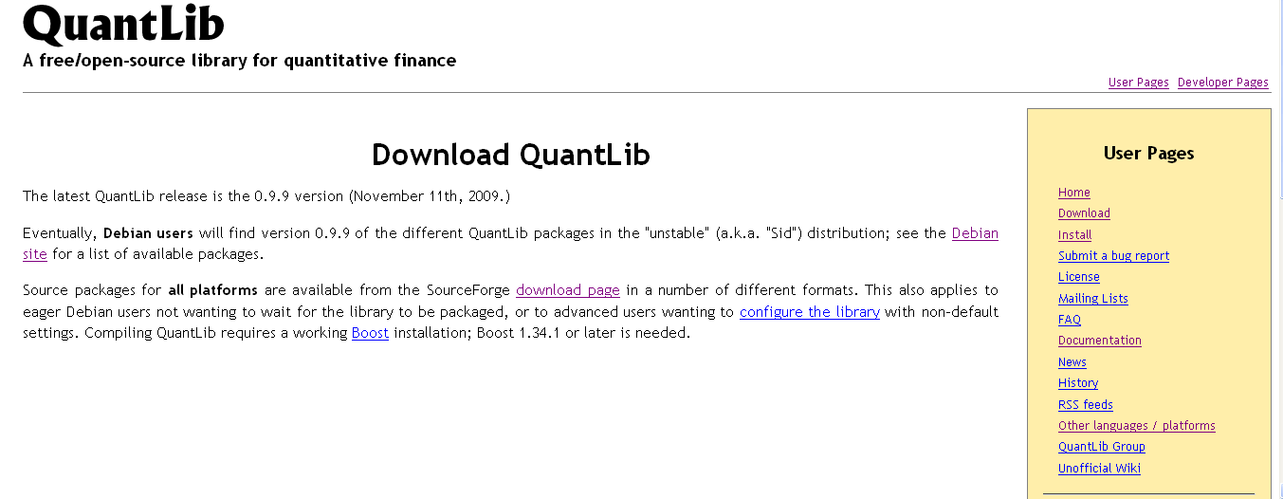
Prepare – Download QuantLib

Slide 5
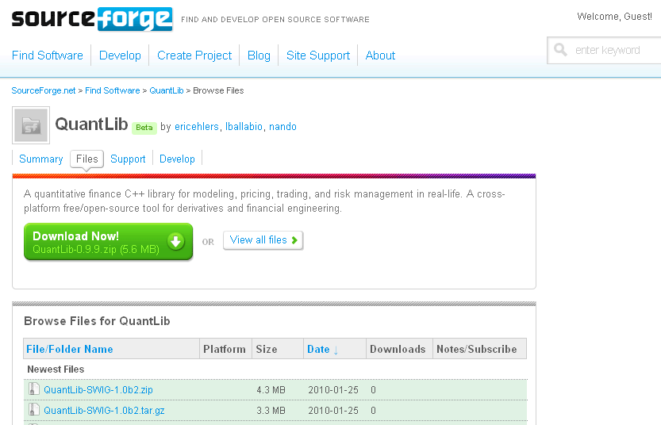
Prepare – Download QuantLib

Slide 6
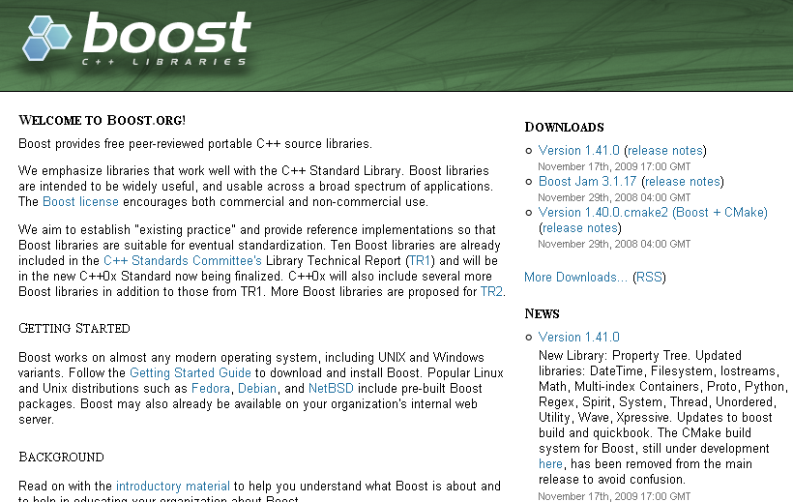
The Base of QuantLib - Boost

Slide 7
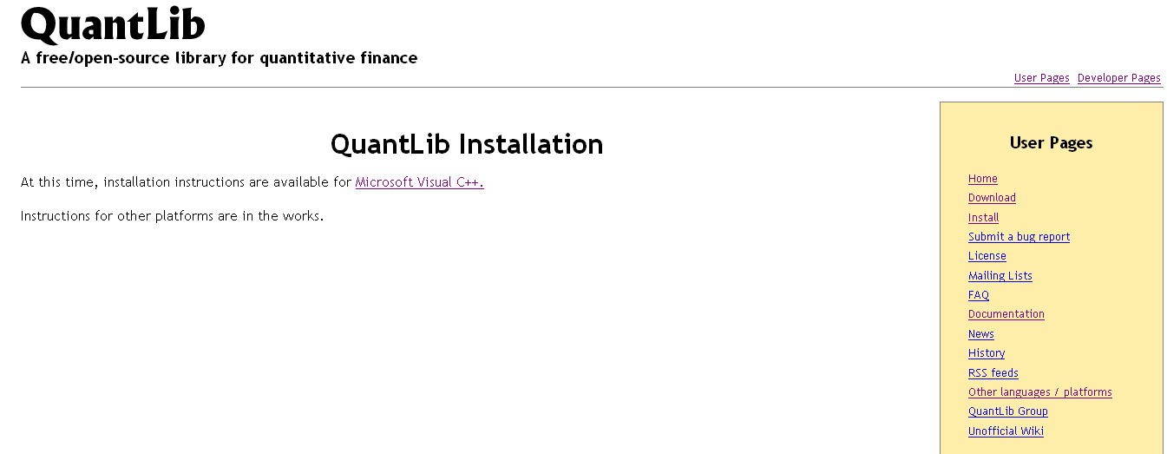
Install

Slide 8
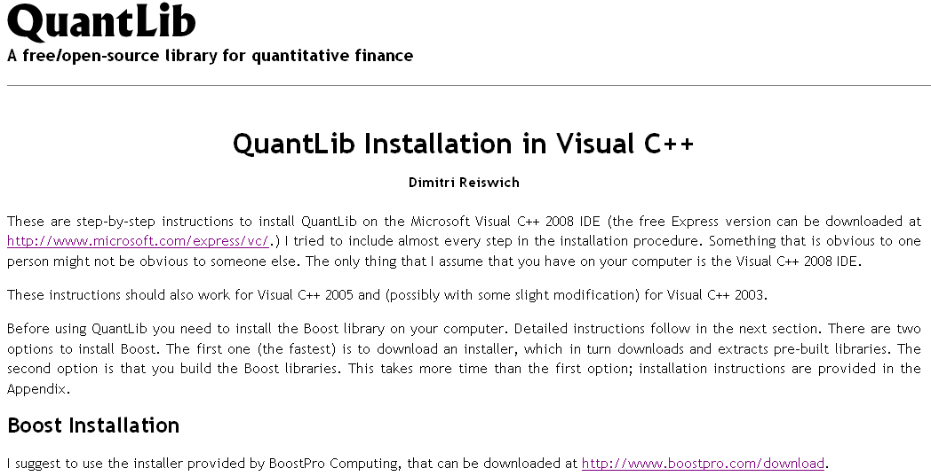
Boost Installation

Slide 9

Boost Installation

Slide 10
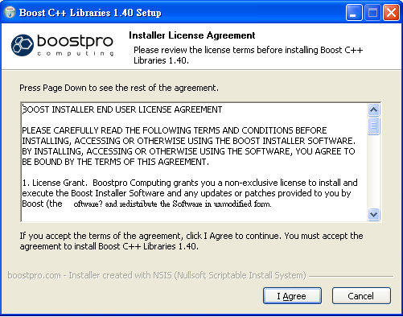
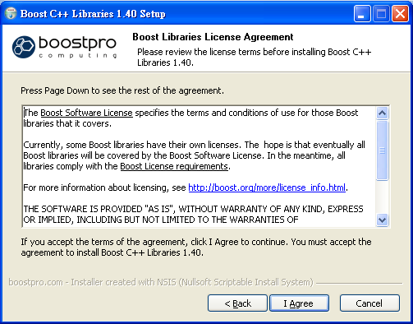
Boost Installation

Slide 11
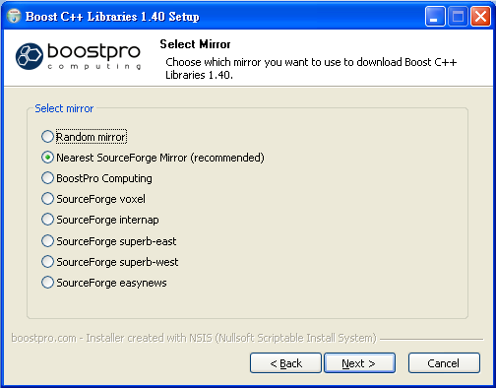
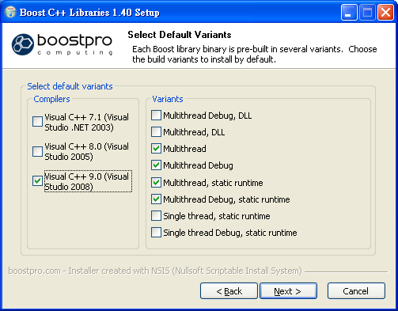
Boost Installation
Download boost source code
Fit your version of VS

Slide 12
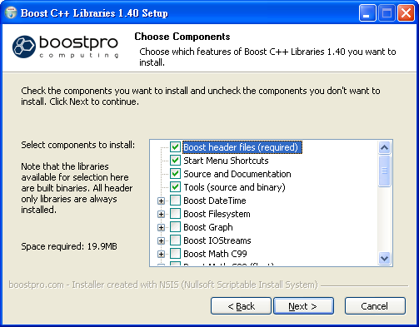
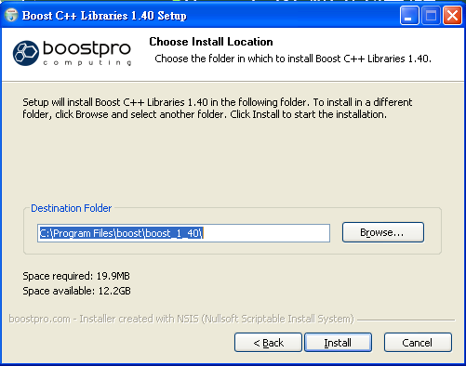
Boost Installation

Slide 13
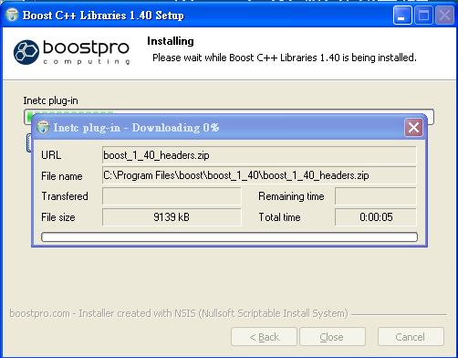
Boost Installation

Slide 14
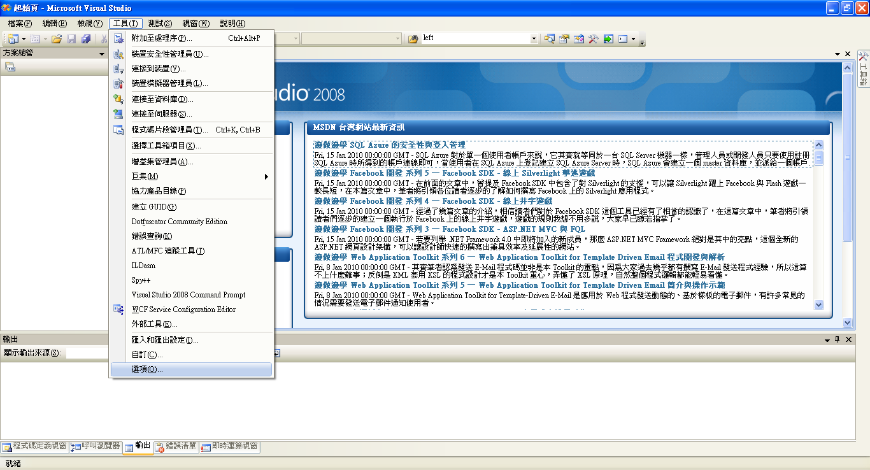
Boost Configuration

Slide 15
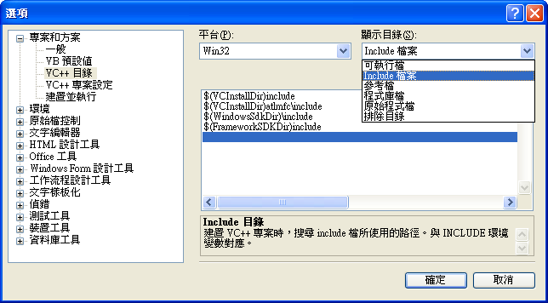
Boost Configuration

Slide 16
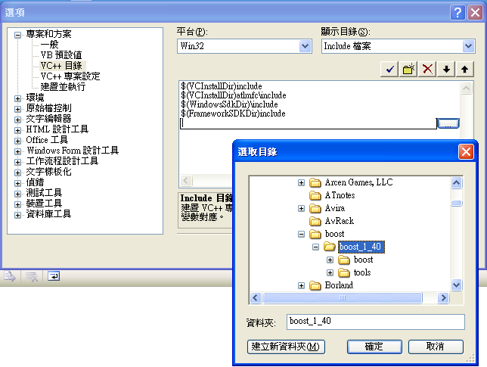
Boost Configuration

Slide 17
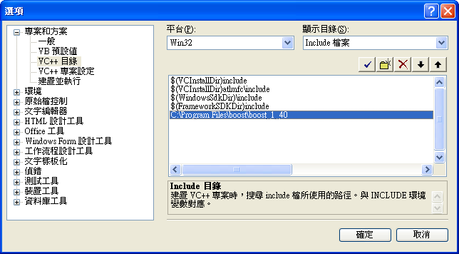
Boost Configuration

Slide 18
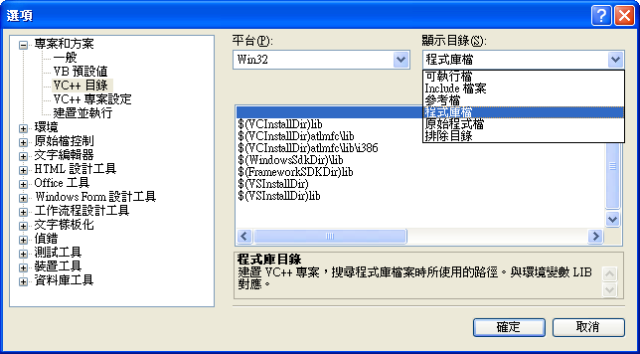
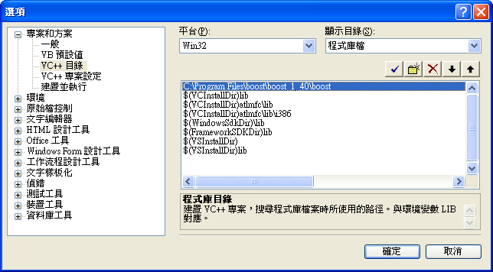
Boost Configuration
..\boost\boost_140\boost

Slide 19
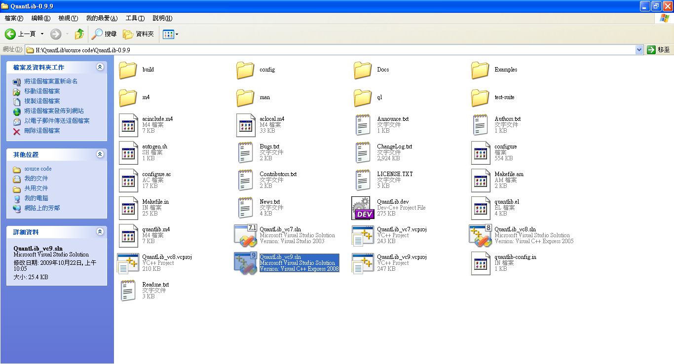
QuantLib Installation
Fit your version of VS.
Vs2003 => vc7.sln
Vs2005 => vc8.sln
Vs2008 => vc9.sln

Slide 20
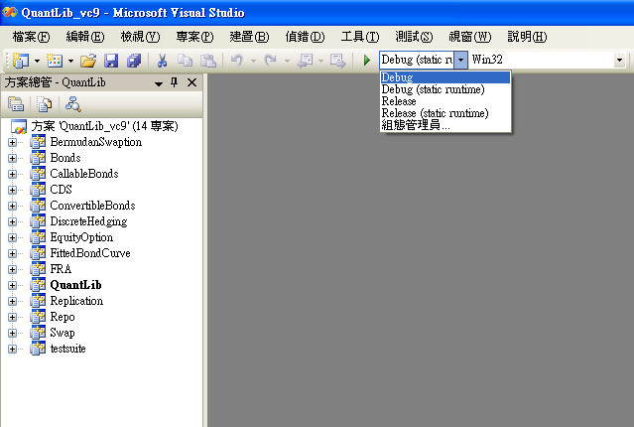
QuantLib Installation
Choice mode that you want compile.
Note: you can’t use QuantLib with some mode that without compile.

Slide 21
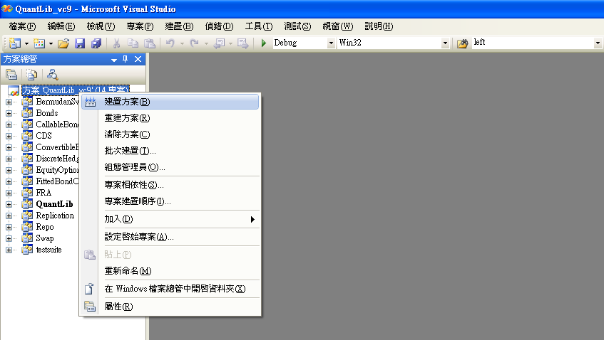
QuantLib Installation

Slide 22
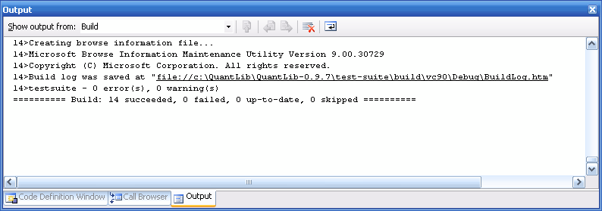
QuantLib Installation
Result

Slide 23
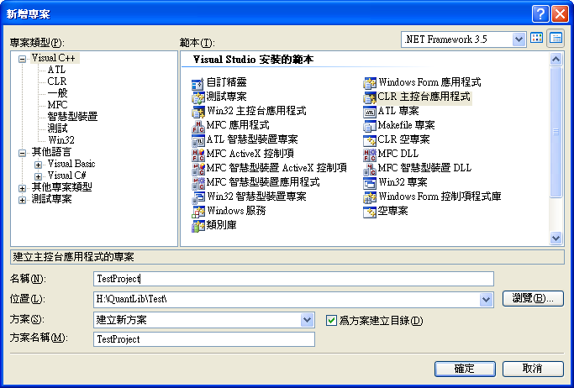
Demo - Configuration

Slide 24
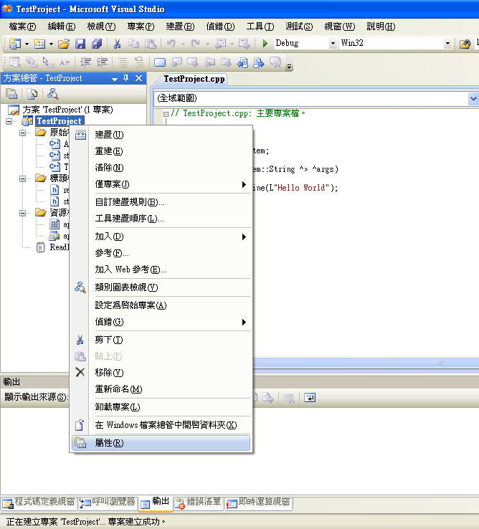
Demo - Configuration

Slide 25
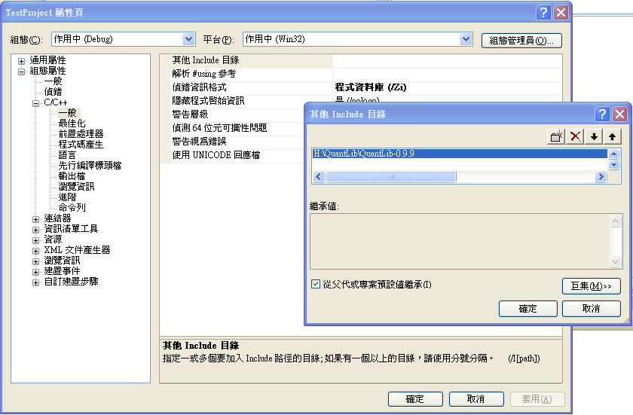
Demo - Configuration

Slide 26
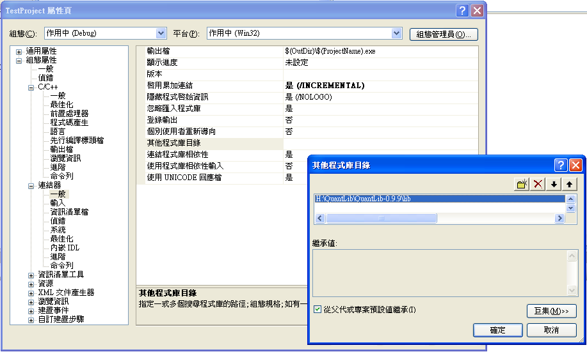
Demo - Configuration

Slide 27
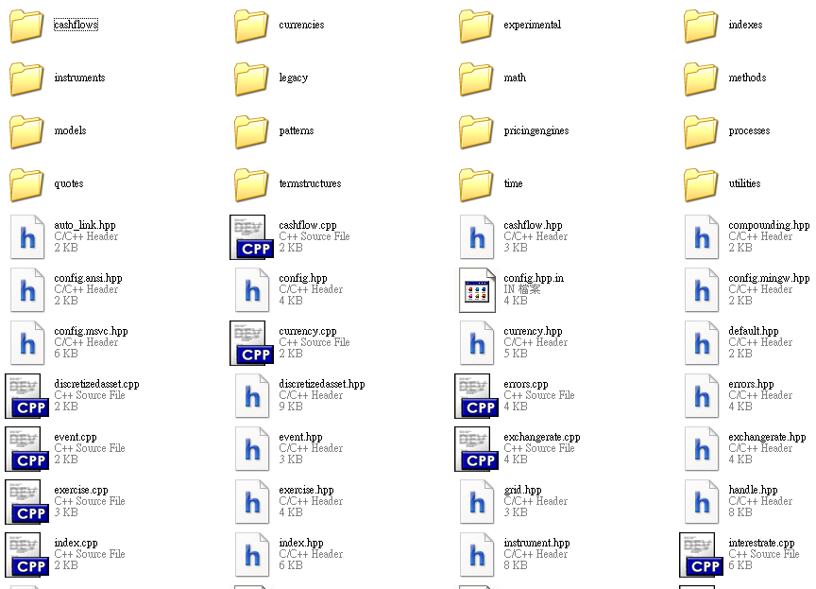
Demo – contents of ql

Slide 28
Demo – Day Counter
#include "stdafx.h"
#include <ql/quantlib.hpp>
#include <iostream>
int main(array<System::String ^> ^args)
{
QuantLib::Calendar myCal=QuantLib::UnitedKingdom();
QuantLib::Date newYearsEve(31,QuantLib::Dec,2008);
std::cout << "Name: " << myCal.name()<< std::endl;
std::cout << "New Year is Holiday: " << myCal.isHoliday(newYearsEve)<< std::endl;
std::cout << "New Year is Business Day: " << myCal.isBusinessDay(newYearsEve)<< std::endl;
std::cout << "--------------- Date Counter --------------------" << std::endl;
QuantLib::Date date1(28,QuantLib::Dec,2008);
QuantLib::Date date2(04,QuantLib::Jan,2009);
std::cout << "First Date: " << date1 << std::endl;
std::cout << "Second Date: " << date2 << std::endl;
std::cout << "Business Days Betweeen: "<< myCal.businessDaysBetween(date1,date2) << std::endl;
std::cout << "End of Month 1. Date: " << myCal.endOfMonth(date1) << std::endl;
std::cout << "End of Month 2. Date: " << myCal.endOfMonth(date2) << std::endl;
return 0;
}

Slide 29
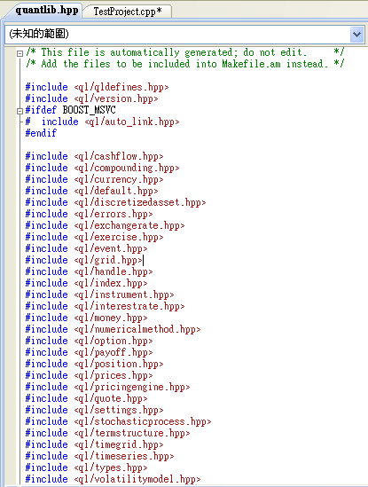
Demo – Day Counter

Slide 30
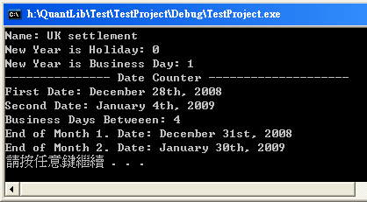
Demo – Day Counter
#include "stdafx.h"
#include <ql/quantlib.hpp>
#include <iostream>
int main(array<System::String ^> ^args)
{
QuantLib::Calendar myCal=QuantLib::UnitedKingdom();
QuantLib::Date newYearsEve(31,QuantLib::Dec,2008);
std::cout << "Name: " << myCal.name()<< std::endl;
std::cout << "New Year is Holiday: " << myCal.isHoliday(newYearsEve)<< std::endl;
std::cout << "New Year is Business Day: " << myCal.isBusinessDay(newYearsEve)<< std::endl;
std::cout << "--------------- Date Counter --------------------" << std::endl;
QuantLib::Date date1(28,QuantLib::Dec,2008);
QuantLib::Date date2(04,QuantLib::Jan,2009);
std::cout << "First Date: " << date1 << std::endl;
std::cout << "Second Date: " << date2 << std::endl;
std::cout << "Business Days Betweeen: "<< myCal.businessDaysBetween(date1,date2) << std::endl;
std::cout << "End of Month 1. Date: " << myCal.endOfMonth(date1) << std::endl;
std::cout << "End of Month 2. Date: " << myCal.endOfMonth(date2) << std::endl;
return 0;
}
country name
( \ql\time\calendars )
Specific day

Slide 31
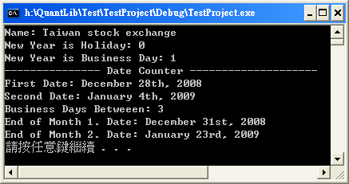
Demo – Day Counter modificatory
This program is distributed in the hope that it will be useful, but WITHOUT
ANY WARRANTY; without even the implied warranty of MERCHANTABILITY or FITNESS
FOR A PARTICULAR PURPOSE. See the license for more details.
#include "stdafx.h“
#include <ql/qldefines.hpp>
#include <ql/version.hpp>
#ifdef BOOST_MSVC
# include <ql/auto_link.hpp>
#endif
#include <ql/time/all.hpp>
#include <iostream>
using namespace std;
using namespace QuantLib;
int main(array<System::String ^> ^args)
{
Calendar myCal=Taiwan();
Date newYearsEve(31,Dec,2008);
cout << "Name: " << myCal.name()<< endl;
cout << "New Year is Holiday: " << myCal.isHoliday(newYearsEve)<< endl;
cout << "New Year is Business Day: " << myCal.isBusinessDay(newYearsEve)<< endl;
cout << "--------------- Date Counter --------------------" << endl;
Date date1(28,Dec,2008);
Date date2(04,Jan,2009);
cout << "First Date: " << date1 << endl;
cout << "Second Date: " << date2 << endl;
cout << "Business Days Betweeen: "<< myCal.businessDaysBetween(date1,date2) << endl;
cout << "End of Month 1. Date: " << myCal.endOfMonth(date1) << endl;
cout << "End of Month 2. Date: " << myCal.endOfMonth(date2) << endl;
system("pause");
return 0;
}

Slide 32
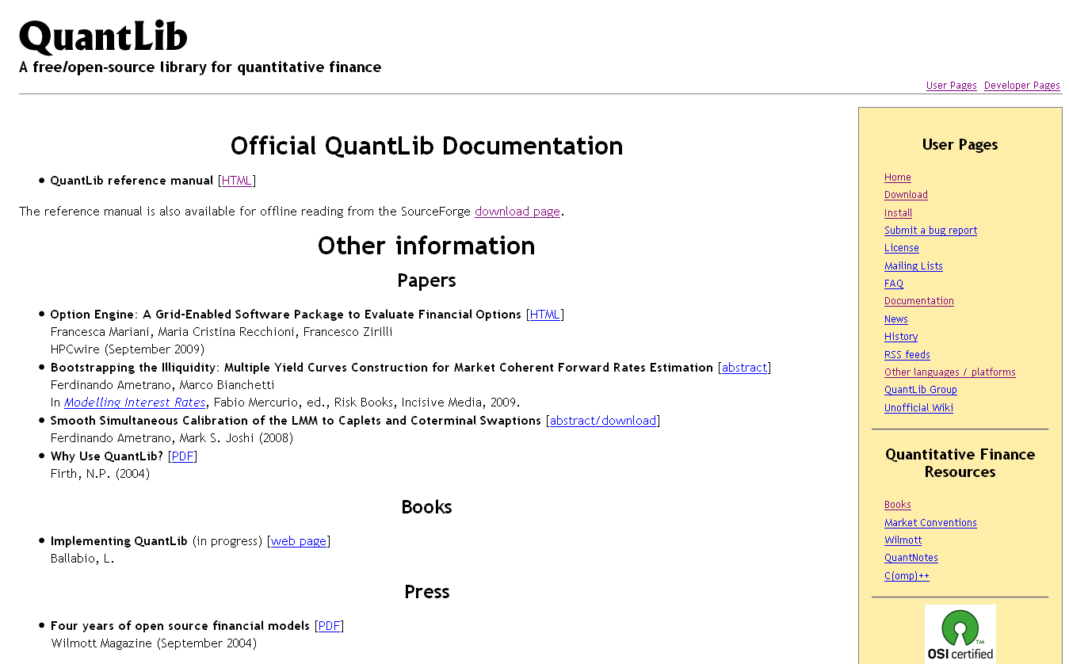
Reference Documentation

Slide 33
End
Thanks for you listen.

