Slide 1
Credit enhancement through financial engineering: Freeport McMoRan’s gold-denominated depositary shares

Slide 2
Abstract
1993~1994，McMoRan issued two series of gold-denominated depositary shares.
Enhance the credit quality and reduce the costs.
Two superiorities:
1. Avoid wealth transfer to senior bondholders.
2. Mitigate the asset substitution problem.

Slide 3
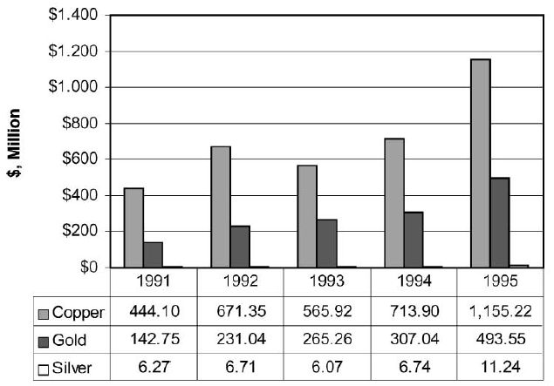
Freeport McMoRan Copper and Gold Inc.

Slide 4
Introduction
Freeport McMoRan Copper and Gold Inc.(FCX) needed to invest heavily to expand mine capacity.
FCX management did not want to issue new equity.
New debt issues would put further pressure on FCX’s debt rating(low B1 by Moody).

Slide 5
Introduction
The Gold depositary shares issued by FCX are similar to a debt instrument that has all interest and principal payments in gold.
The positive correlation between the value of the firm and the value of the securities.
An embedded derivative that serves to hedge the exposure to gold price risk.

Slide 6
Introduction
Enhance the credit quality and enable FCX to finance its expansion at a lower cost.(Scenario D)
Gold depositary shares can not be replicated by conventional hedging strategies. (Scenario E)
Prevent wealth transfers to senior bondholders that arise in the case of a conventional hedge. (Scenario D & Scenario E)

Slide 7
Introduction
Shareholders have an ex-post incentive for asset substitution in the case of a conventional hedge.(Scenario F)
A bundled hedge significantly reduces asset substitution problem.(Scenario G)

Slide 8
Scenario set
The gold mining firm has 1.97 million ounces of gold reserves and plans to expand to 3 million ounces.
The firm’s value is linear in the price of gold.
Gold prices are distributed uniformly over the range of $100 to $500 per ounce.
The firm has $500 million in senior debt and need to raise $251 million for the expansion.
Bankruptcy cost = $50 million
Risk free rate = 0

Slide 9
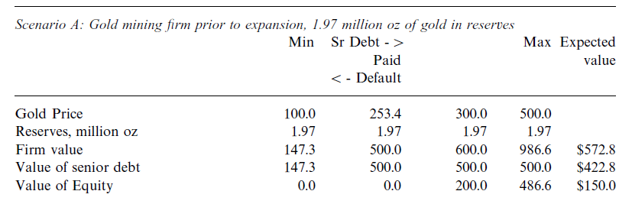
Prior to expansion
100.0

Slide 10
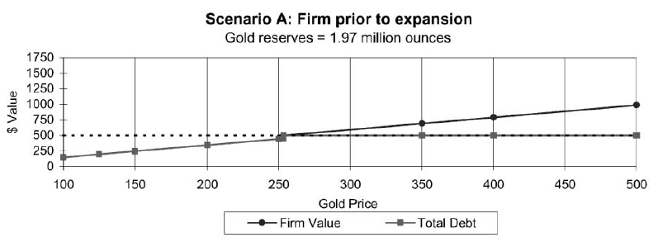
Scenario A
253.4

Slide 11
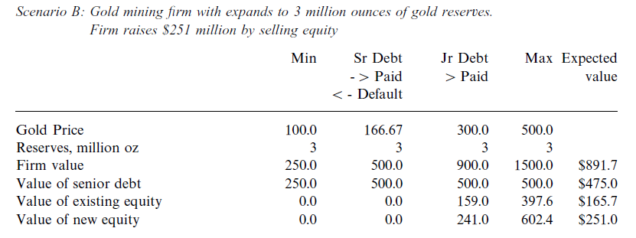
Scenario B

Slide 12
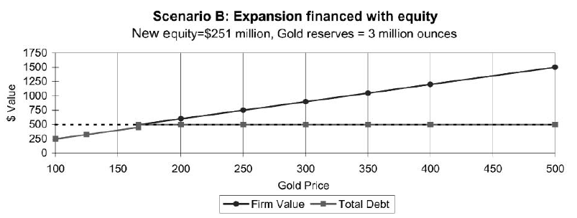
Scenario B
166.67

Slide 13
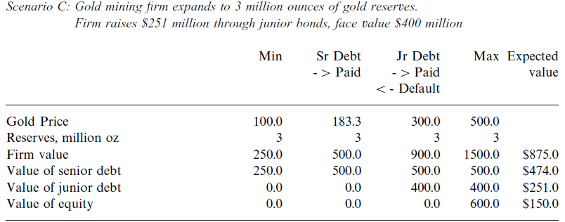
Scenario C

Slide 14
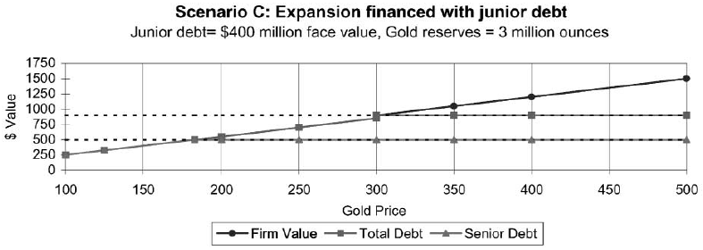
Scenario C
183.3

Slide 15
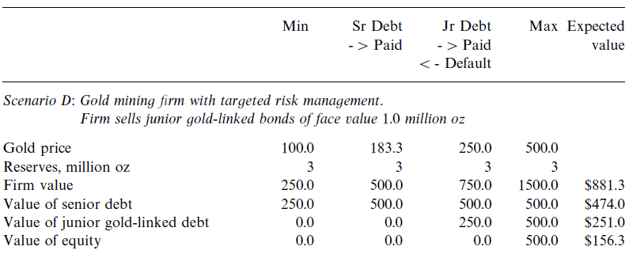
Scenario D (gold-linked bond)
Gold-linked bonds of face value 1.0 million oz
250 < 300

Slide 16
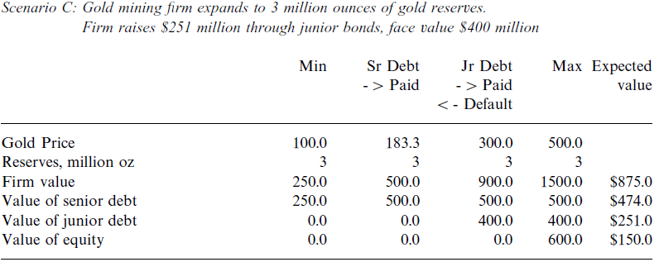
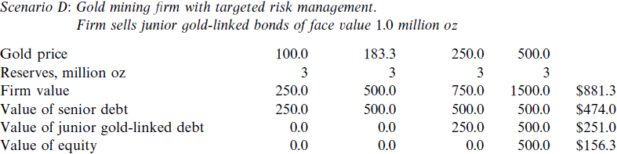

Slide 17
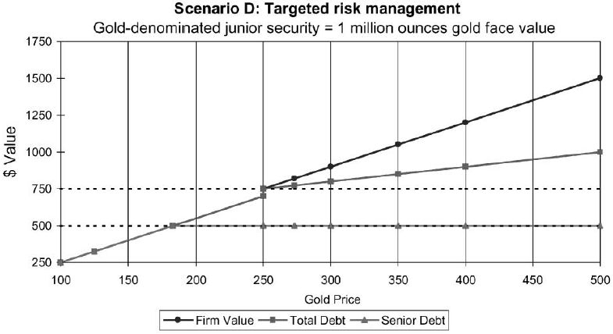
Scenario D (gold-linked bond)

Slide 18
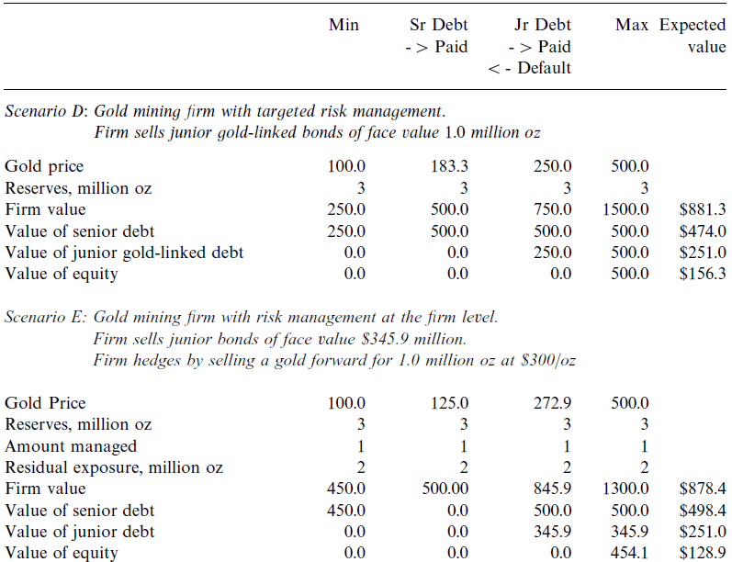
Scenario E
500.0

Slide 19
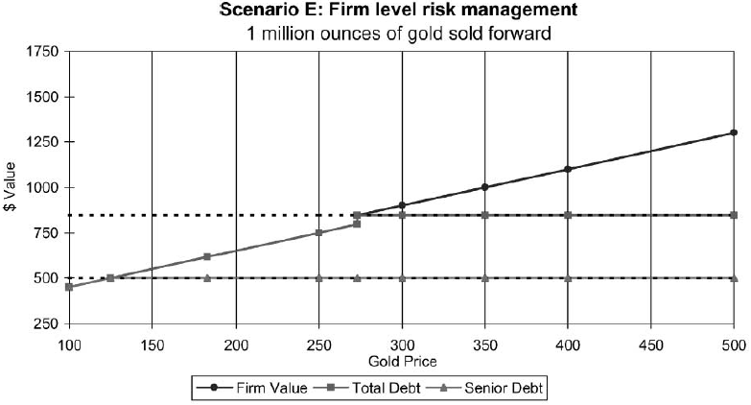
Scenario E (Firm level risk management)

Slide 20
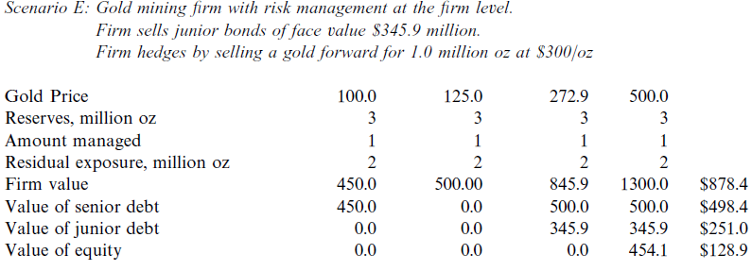

Slide 21
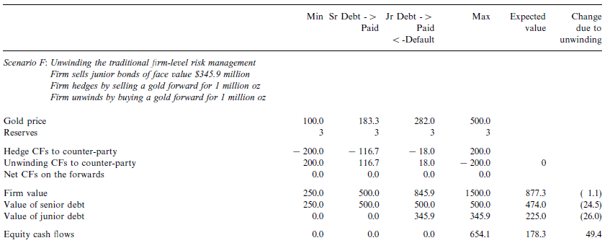
Gains from ex post unwinding of the hedge

Slide 22

