Slide 1
Chapter 2
Arbitrage-Free Pricing

Slide 2
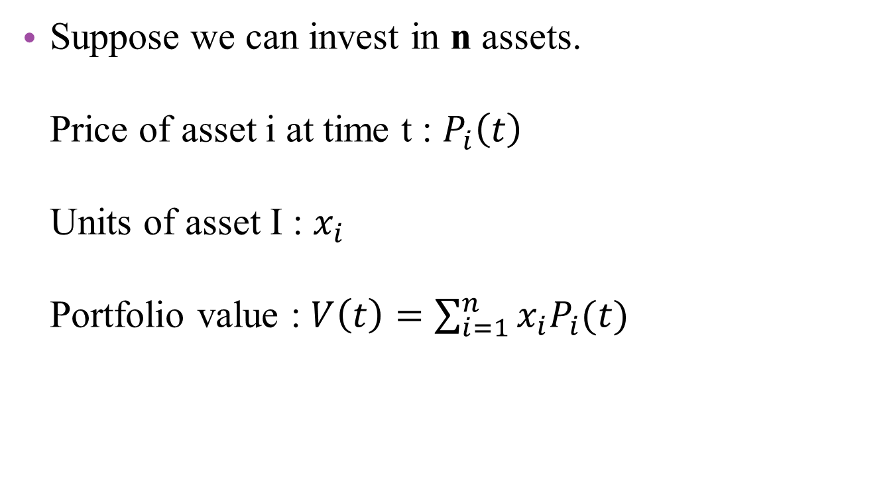
Definition of Arbitrage
Suppose we can invest in n assets. Price of asset i at time t : $P_{i}\left(t\right)$ Units of asset I : $x_{i}$ Portfolio value : $V\left(t\right)=\sum_{i=1}^{n}{x_{i}P_{i}(t)}$

Slide 3
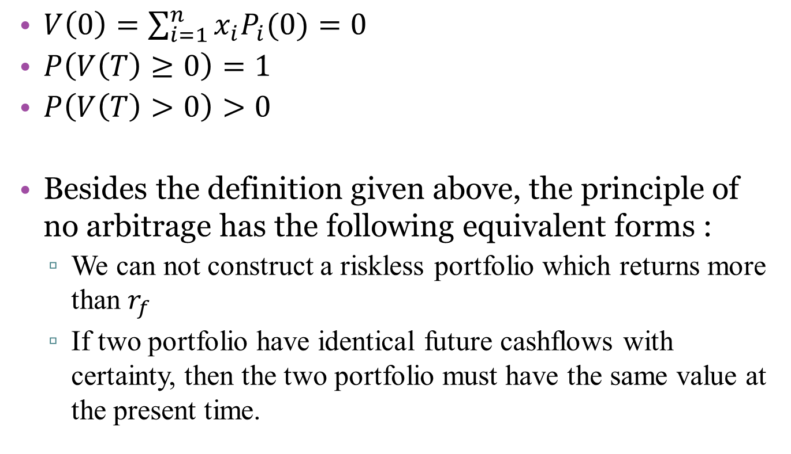
Definition of Arbitrage
$V\left(0\right)=\sum_{i=1}^{n}{x_{i}P_{i}(0)}=0$
$P\left(V\left(T\right)≥0\right)=1$
$P\left(V\left(T\right)>0\right)>0$
Besides the definition given above, the principle of no arbitrage has the following equivalent forms :
We can not construct a riskless portfolio which returns more than $r_{f}$
If two portfolio have identical future cashflows with certainty, then the two portfolio must have the same value at the present time.
套利的定義，條件缺一不可

Slide 4
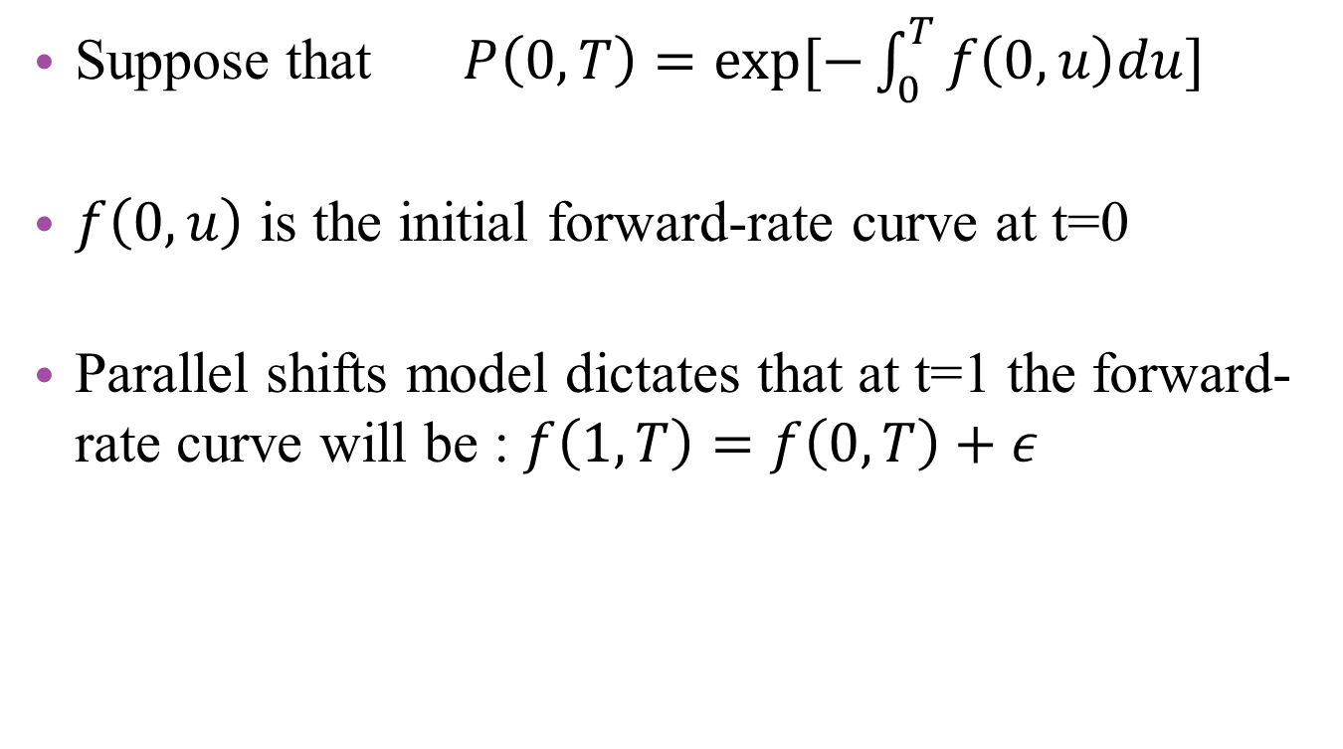
2.1 Example of Arbitrage parallel yield curve shifts
Suppose that $P\left(0,T\right)=exp⁡[−\int_{0}^{T}{f\left(0,u\right)du}]$
$f\left(0,u\right)$ is the initial forward-rate curve at t=0
Parallel shifts model dictates that at t=1 the forward-rate curve will be : $f\left(1,T\right)=f\left(0,T\right)+ε$
Notes:
首先 先定義符號 還有遠期利率的平行移動模式

Slide 5
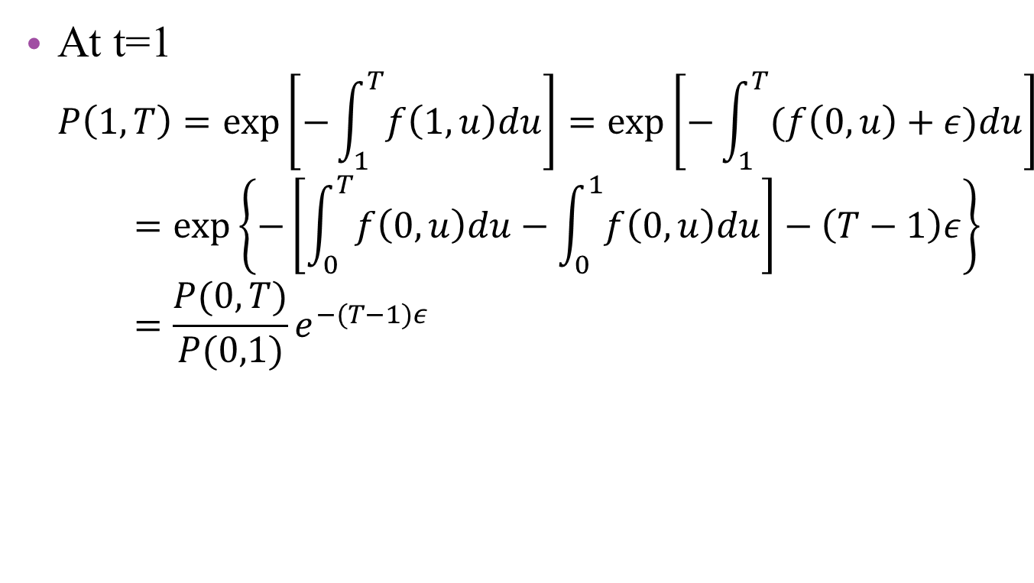
2.1 Example of Arbitrage parallel yield curve shifts
At t=1 $P\left(1,T\right)=\exp\left[−\int_{1}^{T}{f\left(1,u\right)du}\right]=\exp\left[−\int_{1}^{T}{(f\left(0,u\right)+ε)du}\right]=\exp\left\{−\left[\int_{0}^{T}{f\left(0,u\right)du}−\int_{0}^{1}{f\left(0,u\right)du}\right]−\left(T−1\right)ε\right\}=\frac{P(0,T)}{P(0,1)}e^{−(T−1)ε}$
此處的結果會在之後的投影片中用到

Slide 6
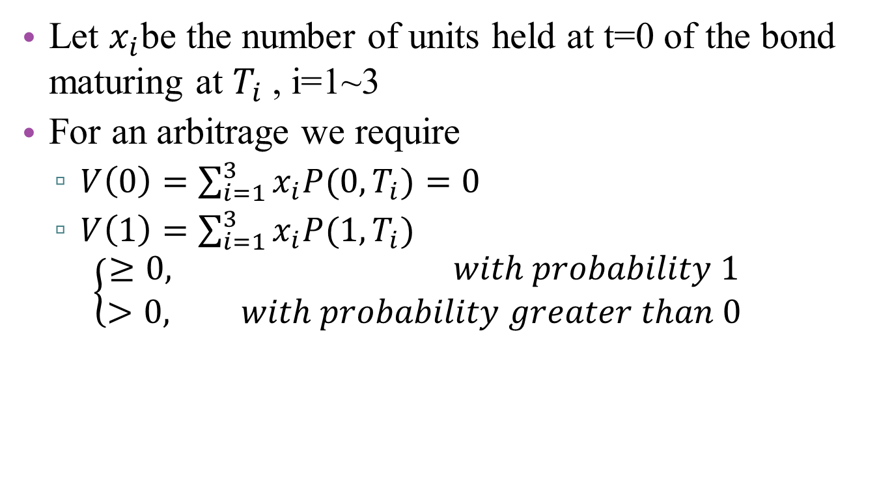
2.1 Example of Arbitrage parallel yield curve shifts
Let $x_{i}$be the number of units held at t=0 of the bond maturing at $T_{i}$ , i=1~3
For an arbitrage we require
$V\left(0\right)=\sum_{i=1}^{3}{x_{i}P(0,T_{i})}=0$
$V\left(1\right)=\sum_{i=1}^{3}{x_{i}P(1,T_{i})}$ $\left\{\begin{aligned}≥0, with probability 1 \\ >0, with probability greater than 0\end{aligned}\right.$
Notes:
開始建構可套利機會

Slide 7

2.1 Example of Arbitrage parallel yield curve shifts
The value of portfolio at t=1 is
$V_{1}\left(ε\right)=\sum_{i=1}^{3}{x_{i}P\left(1,T_{i}\right)}=\frac{e^{−ε\left(T_{2}−1\right)}}{P\left(0,1\right)}g(ε)$
$g\left(ε\right)=\sum_{i=1}^{3}{x_{i}P\left(0,T_{i}\right)e^{−ε(T_{i}−T_{2})}}$
此處乃應用稍早第5張投影片的結果而求得之結果，
至於把T2獨立出來的目的，則是為了方便之後的運算。 且由於V1(ε)中，左邊分數之分子分母皆大於零，表示V1(ε)的正負、 大小僅與g(ε)有關
Notes:
$V\left(ε\right)與g(ε)$有正向關係

Slide 8
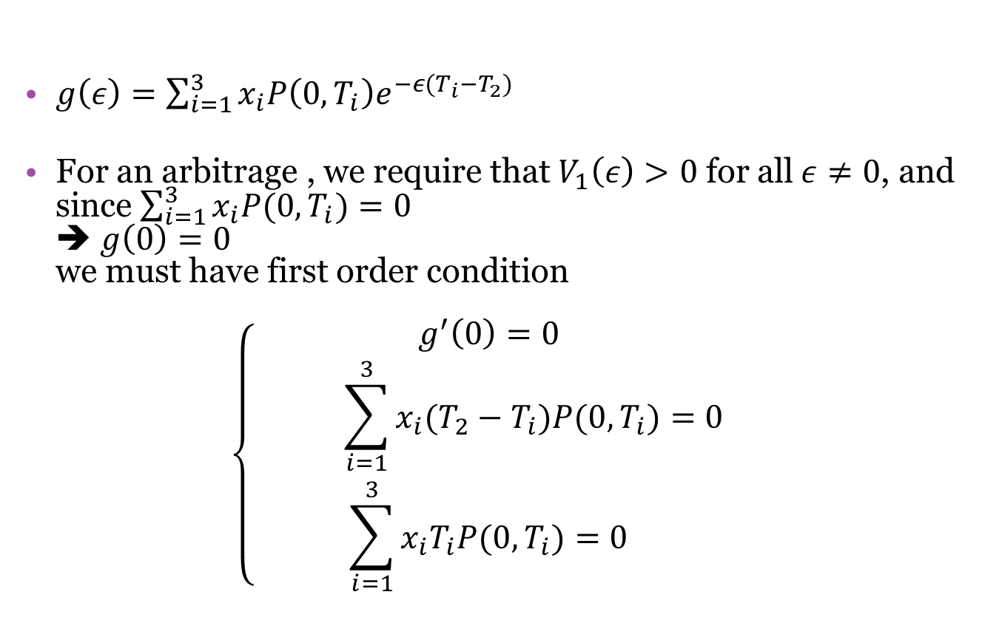
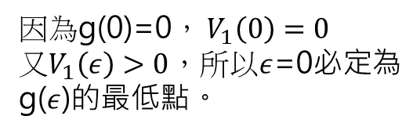
2.1 Example of Arbitrage parallel yield curve shifts
$g\left(ε\right)=\sum_{i=1}^{3}{x_{i}P\left(0,T_{i}\right)e^{−ε(T_{i}−T_{2})}}$
For an arbitrage , we require that $V_{1}\left(ε\right)>0$ for all$ε≠0$, and since $\sum_{i=1}^{3}{x_{i}P(0,T_{i})}=0$ ➔ $g\left(0\right)=0$ we must have first order condition $\left\{\begin{aligned}g^{′}\left(0\right)=0 \\ \sum_{i=1}^{3}{x_{i}(T_{2}−T_{i})P(0,T_{i})}=0 \\ \sum_{i=1}^{3}{x_{i}T_{i}P(0,T_{i})}=0\end{aligned}\right.$
因為g(0)=0， $V_{1}\left(0\right)=0$ 又$V_{1}\left(ε\right)>0$，所以$ε$=0必定為 g($ε$)的最低點。
Notes:
對g(ε)進行微分運算

Slide 9

2.1 Example of Arbitrage parallel yield curve shifts
And S.O.C $g^{′′}(0)≥0$ $g^{′′}\left(ε\right)=\sum_{i=1}^{3}{x_{i}{(T_{2}−T_{i})}^{2}P(0,T_{i})e^{−ε(T_{i}−T_{2})}}$

Slide 10
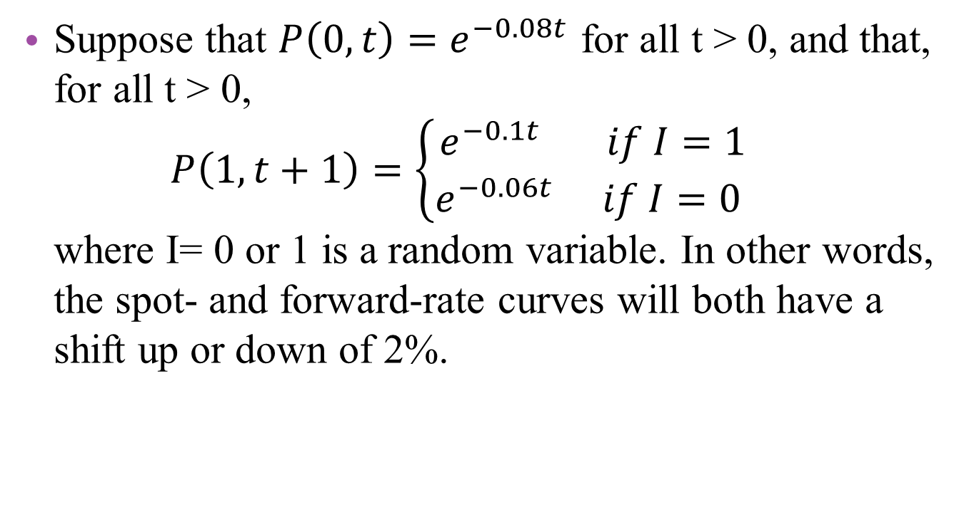
Example 2.1
Suppose that $P\left(0,t\right)=e^{−0.08t}$ for all t > 0, and that, for all t > 0, $P\left(1,t+1\right)=\left\{\begin{aligned}e^{−0.1t} if I=1 \\ e^{−0.06t} if I=0 \end{aligned}\right.$ where I= 0 or 1 is a random variable. In other words, the spot- and forward-rate curves will both have a shift up or down of 2%.
Notes:
該範例為2.1 遠期利率平行移動之套利機會的例題

Slide 11

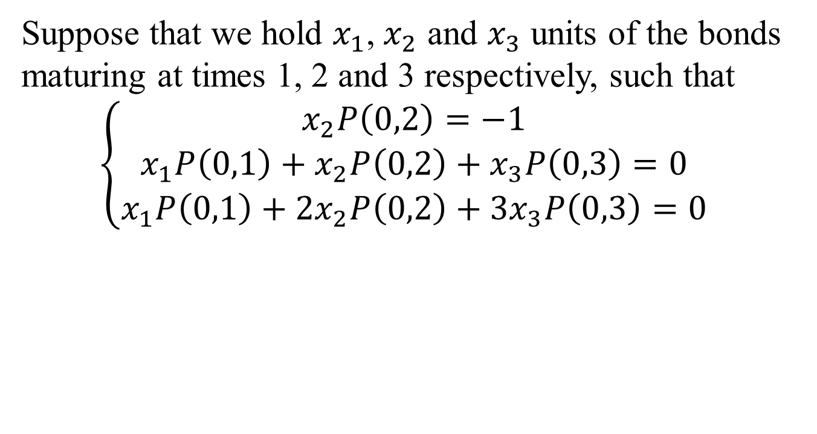
Example 2.1
Suppose that we hold $x_{1}$, $x_{2}$ and $x_{3}$ units of the bonds maturing at times 1, 2 and 3 respectively, such that
$$\left\{\begin{aligned}x_{2}P\left(0,2\right)=−1 \\ x_{1}P\left(0,1\right)+x_{2}P\left(0,2\right)+x_{3}P\left(0,3\right)=0 \\ x_{1}P\left(0,1\right)+2x_{2}P\left(0,2\right)+3x_{3}P\left(0,3\right)=0\end{aligned}\right.$$
運用到的條件： 1. 假定$x_{2}P\left(0,2\right)=−1$ 2. $\sum_{i=1}^{3}{x_{i}P(0,T_{i})}=0$ 3. F.O.C. $$\sum_{i=1}^{3}{x_{i}T_{i}P(0,T_{i})}=0$$

Slide 12
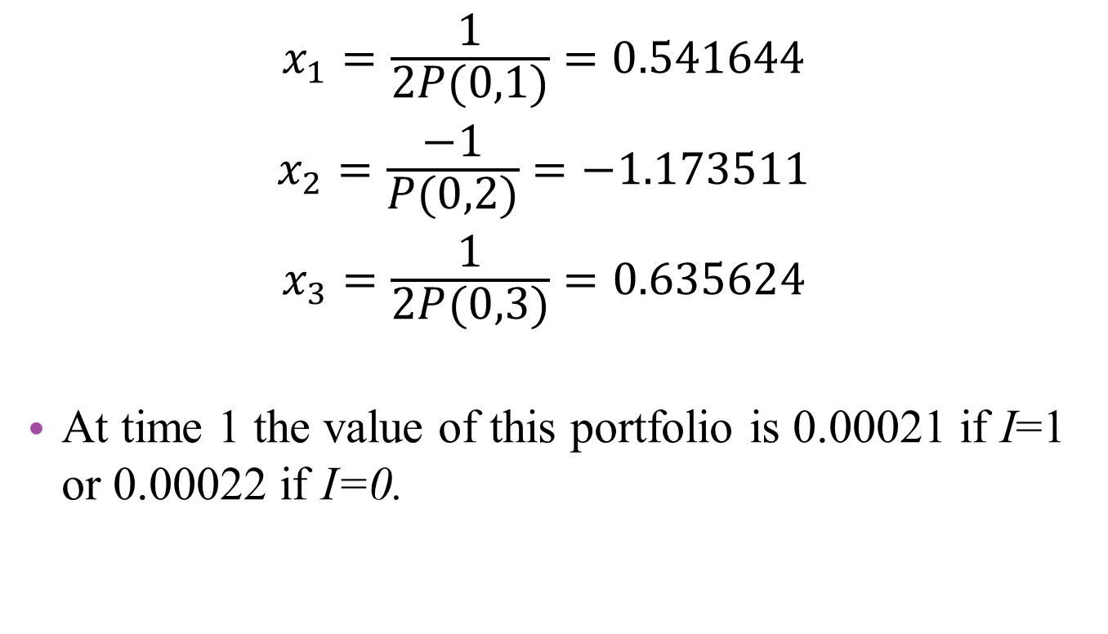
Example 2.1
$${x_{1}=\frac{1}{2P(0,1)}=0.541644 \atop \begin{aligned}x_{2}=\frac{−1}{P(0,2)}=−1.173511 \\ x_{3}=\frac{1}{2P(0,3)}=0.635624\end{aligned}}$$
At time 1 the value of this portfolio is 0.00021 if I=1 or 0.00022 if I=0.

Slide 13
Example 2.1
The model is not arbitrage free.
Hence, parallel shifts in the yield curve cannot occur at any time in the future.

Slide 14
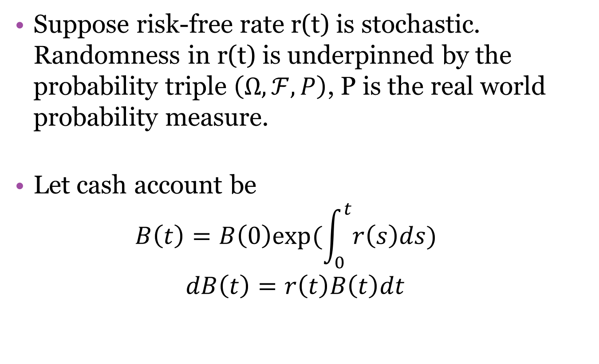
2.2 Fundamental Theorem of Asset Pricing
Suppose risk-free rate r(t) is stochastic. Randomness in r(t) is underpinned by the probability triple $\left(Ω,ℱ,P\right)$, P is the real world probability measure.
Let cash account be $B\left(t\right)=B\left(0\right)exp⁡(\int_{0}^{t}{r\left(s\right)ds})$
$$dB\left(t\right)=r\left(t\right)B\left(t\right)dt$$
Notes:
dB(t)不含隨機向 故極短時間內的cash-account process 可視為無風險的

Slide 15
2.2 Fundamental Theorem of Asset Pricing
Theorem 2.2
Bond price evolve in a way that is arbitrage free if and only if there exists a measure Q, equivalent to P, under which, for each T, the discounted price process P(t,T)/B(t) is a martingale for all t: 0<t<T
If 1. holds, then the market is complete if and only if Q is the unique measure under which the P(t ,T)/B(t) are martingales.
The measure Q is often referred to, consequently, as the equivalent martingale measure.

Slide 16
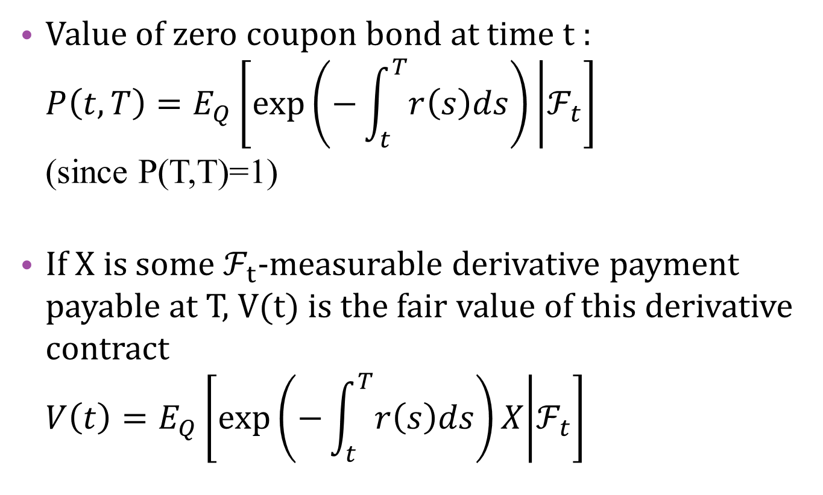
2.2 Fundamental Theorem of Asset Pricing
Value of zero coupon bond at time t : $P\left(t,T\right)=E_{Q}\left[\exp\left(−\int_{t}^{T}{r\left(s\right)ds}\right) | ℱ_{t}\right]$ (since P(T,T)=1)
If X is some $ℱ_{t}$-measurable derivative payment payable at T, V(t) is the fair value of this derivative contract $V\left(t\right)=E_{Q}\left[\exp\left(−\int_{t}^{T}{r\left(s\right)ds}\right)X | ℱ_{t}\right]$
Notes:
Chapter 1 P(t,t)=1

Slide 17
Example 2.5 forward pricing
A forward contract has been arranged in which a price K will be paid at time T in return for a repayment of 1 at time S (T<S). Equivalently, K is paid at T in return for delivery at the same time T of the S-bond which has a value at that time of P(T,S). How much is this contract worth at time t<T ?

Slide 18
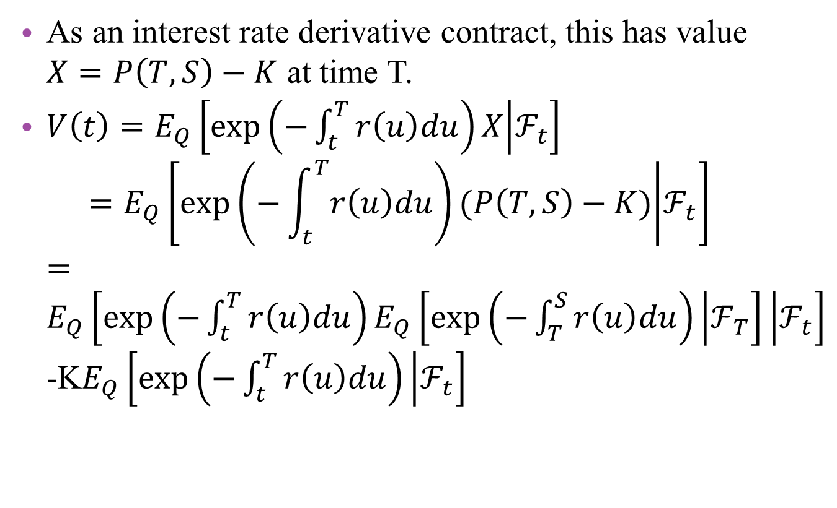
Example 2.5 forward pricing
As an interest rate derivative contract, this has value $X=P\left(T,S\right)−K$ at time T.
$V\left(t\right)=E_{Q}\left[\exp\left(−\int_{t}^{T}{r\left(u\right)du}\right)X | ℱ_{t}\right]$ $=E_{Q}\left[\exp\left(−\int_{t}^{T}{r\left(u\right)du}\right)(P\left(T,S\right)−K) | ℱ_{t}\right]$ $=E_{Q}\left[\exp\left(−\int_{t}^{T}{r\left(u\right)du}\right)E_{Q}\left[\exp\left(−\int_{T}^{S}{r\left(u\right)du}\right) | ℱ_{T}\right] | ℱ_{t}\right]$-K$E_{Q}\left[\exp\left(−\int_{t}^{T}{r\left(u\right)du}\right) | ℱ_{t}\right]$

Slide 19
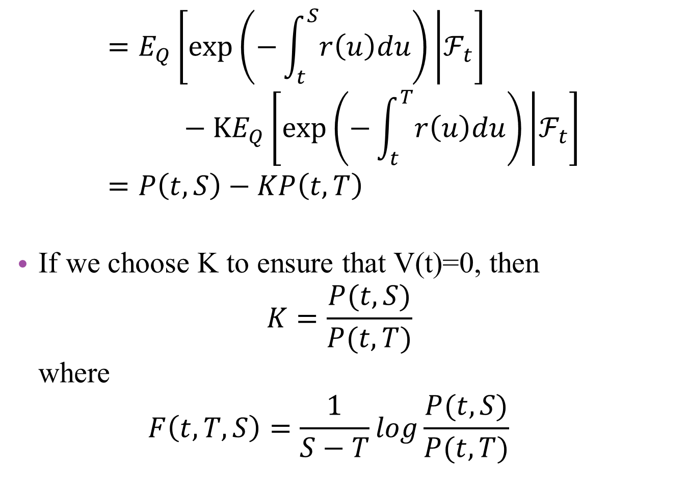
$$=E_{Q}\left[\exp\left(−\int_{t}^{S}{r\left(u\right)du}\right) | ℱ_{t}\right]−KE_{Q}\left[\exp\left(−\int_{t}^{T}{r\left(u\right)du}\right) | ℱ_{t}\right] \\ =P\left(t,S\right)−KP\left(t,T\right)$$
If we choose K to ensure that V(t)=0, then $K=\frac{P(t,S)}{P(t,T)}$ where $F\left(t,T,S\right)=\frac{1}{S−T}log\frac{P(t,S)}{P(t,T)}$

Slide 20
2.3 The Long-Term Spot Rate
, the long term spot rate.
Empirical research (Cairns 1998) suggests that l(t) fluctuates substantially over long periods of time.
None of the models we will examine later in this book allow l(t) to decrease over time.
Almost all arbitrage-free models result in a constant value for l(t) over time.
This suggest that a fluctuating l(t) is not consistent with no arbitrage.
Notes:
Chapter 1 P(t,t)=1

Slide 21
Theorem2.6 (Dybvig-Ingersoll-Ross Theorem)
Suppose that the dynamics of term structure are arbitrage free. Then l(t) in non-decreasing almost surely.
proof
At time 0, we invest an amount 1/[T(T+1)] in the bond maturing at time T.

Slide 22
Dybvig-Ingersoll-Ross Theorem
Assume
Goal: check V(1).

Slide 23
Dybvig-Ingersoll-Ross Theorem

Slide 24
Dybvig-Ingersoll-Ross Theorem
Since dynamics are arbitrage free, there exists an equivalent martingale measure, , such that V(1)/B(1) is a martingale (Theorem 2.2)
where is the cash account.
is a.e. real-valued.

Slide 25
Dybvig-Ingersoll-Ross Theorem
(equivalent measure)
is non-decreasing almost surely under the real world measure P.
What the D-I-R Theorem tell us is that we will not be able to construct an arbitrage-free model for the term structure that allows the long-term rate l(t) to go down.

Slide 26
Example 2.7
This example is included here to demonstrate that we can construct models under which l(t) may increase over time.
In practice, many models we consider have a recurrent stochastic structure which ensures that l(t) is constant. In other models l(t) is infinite for all t > 0.

Slide 27
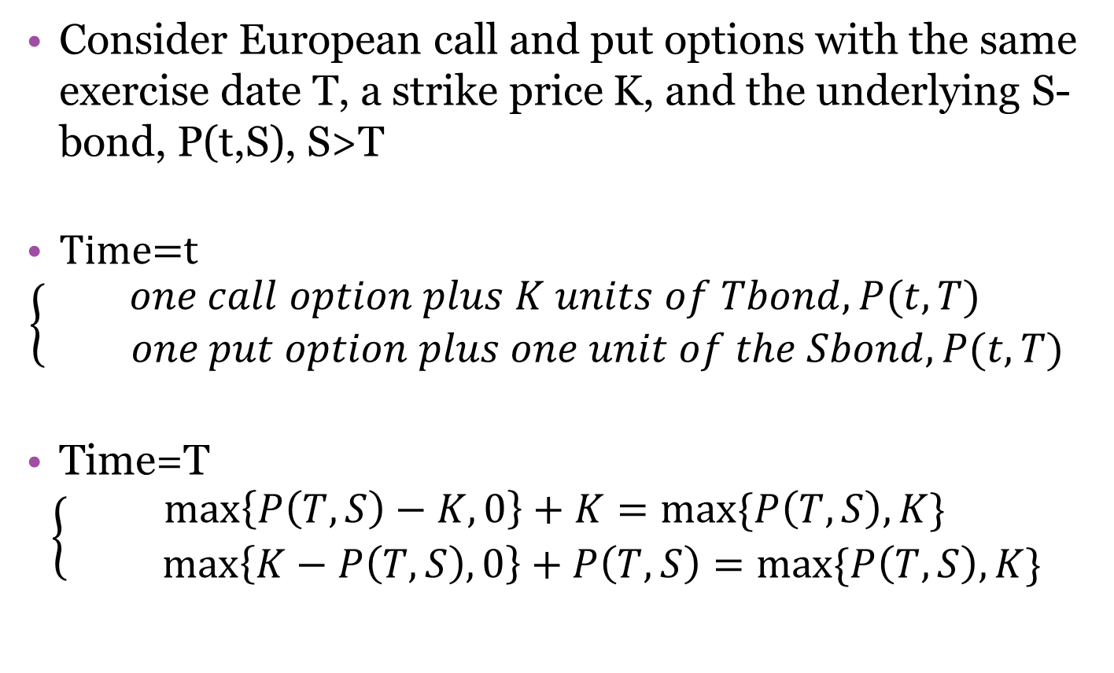
2.6 Put-Call Parity
Consider European call and put options with the same exercise date T, a strike price K, and the underlying S-bond, P(t,S), S>T
Time=t
$$\left\{\begin{aligned}one call option plus K units of Tbond, P(t,T) \\ one put option plus one unit of the Sbond, P(t,T)\end{aligned}\right.$$
Time=T
$$\left\{\begin{aligned}\max\left\{P\left(T,S\right)−K,0\right\}+K=max⁡\{P\left(T,S\right),K\} \\ \max\left\{K−P\left(T,S\right),0\right\}+P\left(T,S\right)=max⁡\{P\left(T,S\right),K\}\end{aligned}\right.$$

Slide 28

2.6 Put-Call Parity
By the law of one price, the values of the two portfolio at any earlier time must also be equal ➔ $c\left(t\right)+KP\left(t,T\right)=p\left(t\right)+P(t,S)$

Slide 29
Example 2.7
Suppose under the equivalent martingale measure that

Slide 30
Example 2.7

