Slide 1
Chapter 3 Brownian Motion
3.2 Scaled random Walks

Slide 2
3.2.1 Symmetric Random Walk
To construct a symmetric random walk, we toss a fair coin (p, the probability of H on each toss, and q, the probability of T on each toss)

Slide 3
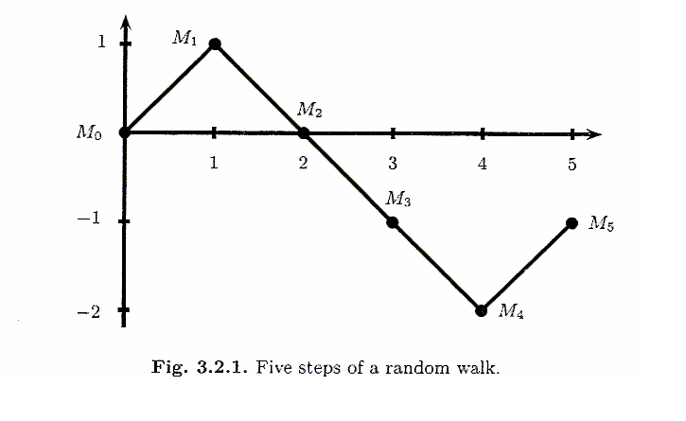

3.2.1 Symmetric Random Walk
Define $M_{0}=0$
$M_{k}=\sum_{j=1}^{k}{X_{j}}$ ,
k=1,2,…..

Slide 4
3.2.2 Increments of the Symmetric Random Walk
A random walk has independent increments
．If we choose nonnegative integers
0 = , the random variables are independent
Each is called increment of the random walk

Slide 5
3.2.2 Increments of the Symmetric Random Walk
Each increment has expected value 0 and variance

Slide 6
3.2.2 Increments of the Symmetric Random Walk

Slide 7
3.2.3 Martingale Property for the Symmetric Random Walk
Choose nonnegative integers k < l , then

Slide 8
3.2.4 Quadratic Variation for the Symmetric Random Walk
The quadratic variation up to time k is defined to be
Note :
．this is computed path-by-path and
．by taking all the one-step increments
along that path, squaring
these increments, and then summing them

Slide 9
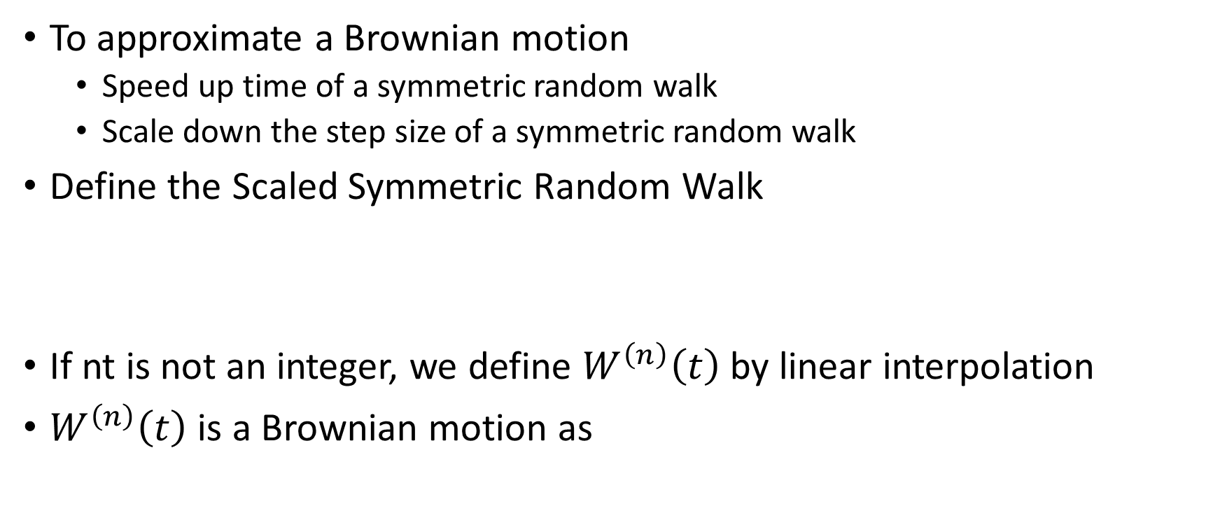
3.2.5 Scaled Symmetric Random Walk
To approximate a Brownian motion
Speed up time of a symmetric random walk
Scale down the step size of a symmetric random walk
Define the Scaled Symmetric Random Walk
If nt is not an integer, we define $W^{\left(n\right)}\left(t\right)$ by linear interpolation
$W^{\left(n\right)}\left(t\right)$ is a Brownian motion as

Slide 10
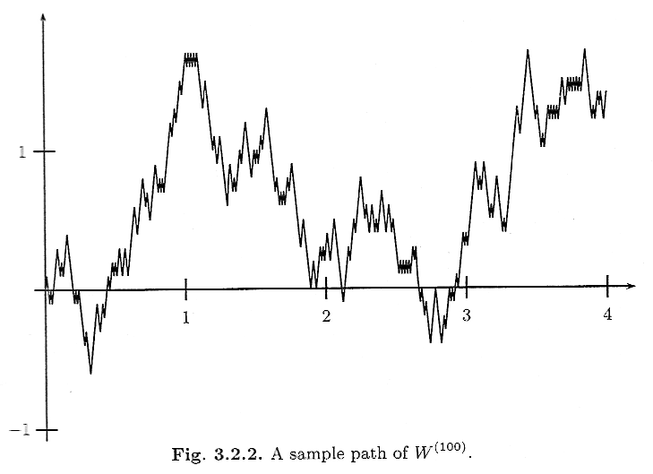
3.2.5 Scaled Symmetric Random Walk
Consider
n=100 ,
t=4

Slide 11
3.2.5 Scaled Symmetric Random Walk
The scaled random walk has independent increments
If 0 = are such that each
is an integer, then
are independent
If are such that ns and nt are integers, then

Slide 12
3.2.5 Scaled Symmetric Random Walk
Scaled Symmetric Random Walk is Martingale
Let be given and s , t are chosen so that ns and nt are integers

Slide 13
3.2.5 Scaled Symmetric Random Walk
Quadratic Variation

Slide 14
3.2.6 Limiting Distribution of the Scaled Random Walk
We fix the time t and consider the set of all possible paths evaluated at that time t
Example
Set t = 0.25 and consider the set of possible values of
We have values:
-2.5,-2.3,…,-0.3,-0.1,0.1,0.3,…2.3,2.5
The probability of this is

Slide 15
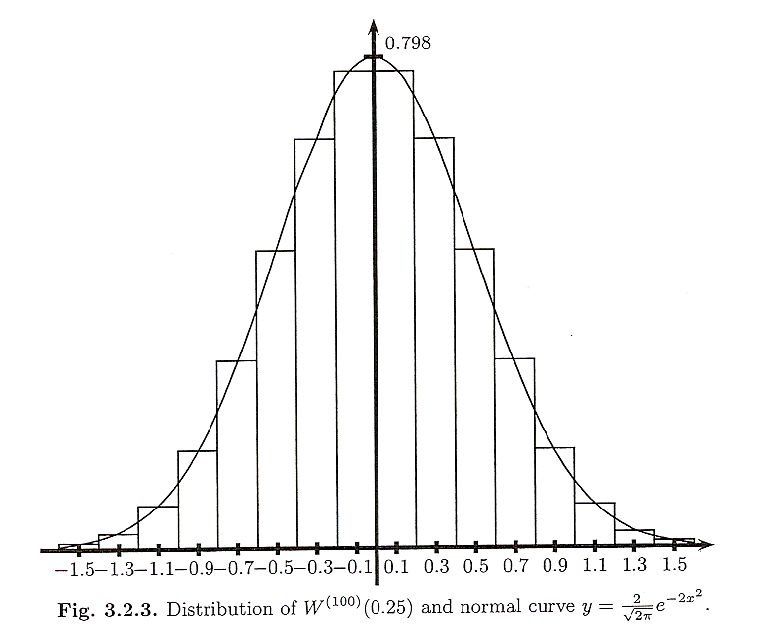
3.2.6 Limiting Distribution of the Scaled Random Walk
The limiting distribution of
Converges to Normal

Slide 16
3.2.6 Limiting Distribution of the Scaled Random Walk
Given a continuous bounded function g(x)

Slide 17
3.2.6 Limiting Distribution of the Scaled Random Walk
Theorem 3.2.1 (Central limit)
藉由MGF的唯一性來判斷r.v.屬於何種分配

Slide 18
3.2.6 Limiting Distribution of the Scaled Random Walk
Let f(x) be Normal density function with mean=0, variance=t

Slide 19
3.2.6 Limiting Distribution of the Scaled Random Walk
If t is such that nt is an integer, then the m.g.f. for is

Slide 20
3.2.6 Limiting Distribution of the Scaled Random Walk
To show that
Then,

Slide 21
3.2.6 Limiting Distribution of the Scaled Random Walk

Slide 22
3.2.7 Log-Normal Distribution as the Limit of the Binomial Model
The Central Limit Theorem, (Theorem3.2.1), can be used to show that the limit of a properly scaled binomial asset-pricing model leads to a stock price with a log-normal distribution
Assume that n and t are chosen so that nt is an integer
Up factor to be
Down factor to be
is a positive constant

Slide 23
3.2.7 Log-Normal Distribution as the Limit of the Binomial Model
The risk-neutral probability and we assume r=0

Slide 24
3.2.7 Log-Normal Distribution as the Limit of the Binomial Model
The stock price at time t is determined by the initial stock price S(0) and the result of first nt coin tosses
: the sum of the number of heads
: the sum of the number of tails

Slide 25
3.2.7 Log-Normal Distribution as the Limit of the Binomial Model
The random walk is the number of heads minus the number of tails in these nt coin tosses

Slide 26
3.2.7 Log-Normal Distribution as the Limit of the Binomial Model
We wish to identify the distribution of this random variables as
Where W(t) is a normal random variable with mean 0 amd variance t

Slide 27
3.2.7 Log-Normal Distribution as the Limit of the Binomial Model
We take log for equation
To show that it converges to distribution of

Slide 28
3.2.7 Log-Normal Distribution as the Limit of the Binomial Model
Taylor series expansion
Expansion at 0
Let log(1+x)=f(x)

Slide 29
3.2.7 Log-Normal Distribution as the Limit of the Binomial Model

Slide 30
3.2.7 Log-Normal Distribution as the Limit of the Binomial Model
Then
Hence

