Slide 1
4.3 Ito’s Integral for General Intrgrands
徐健勳

Slide 2
Review
Construction of the Integral

Slide 3
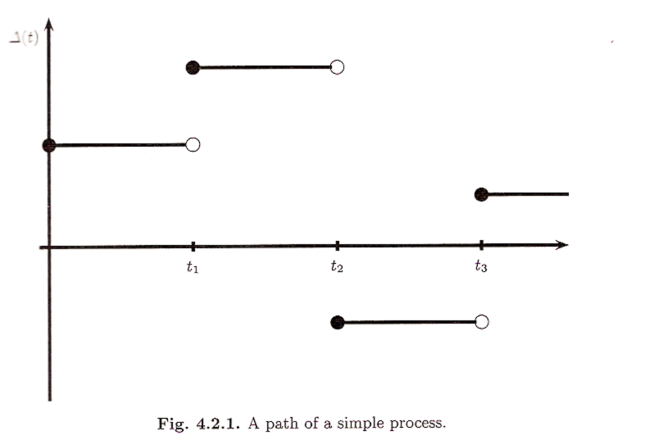

Slide 4
Martingale
Ito Isometry
Quadratic Variation

Slide 5
4.3 Ito Integral for General Integrands
In this section, the Ito Integral for integrands that allowed to vary continuously with time and jump
Assume
is adapted to the filtration
Also assume

Slide 6
In order to define , we approximate by simple process.
it is possible to choose a sequence of simple processes such that as these processes converge to the continuously varying .
By “converge”, we mean that

Slide 7
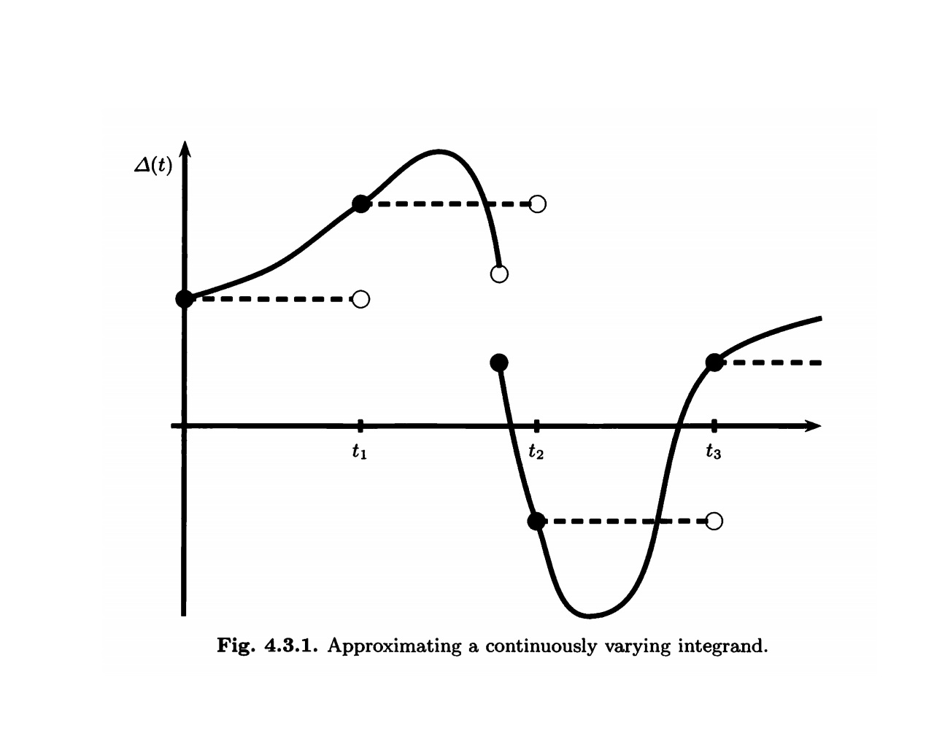

Slide 8
Theorem 4.3.1 Let T be a positive constant and let
be adapted to the filtration F(t) and be an adapted stochastic process that satisfies Then
has the following properties.
(1)(Continuity) As a function of the upper limit of integration t, the paths of I(t) are continuous.
(2)(Adaptivity)For each t, I(t) is F(t)-measurable.

Slide 9
(3)(Linearity) If and
then
furthermore, for every constant c,
(4)(Martingale) I(t) is a martingale.
(5)(Ito isometry)
(6)(Quadratic variation)

Slide 10
Example 4.3.2 Computing We choose a large integer n and approximate the integrand by the simple process

Slide 11
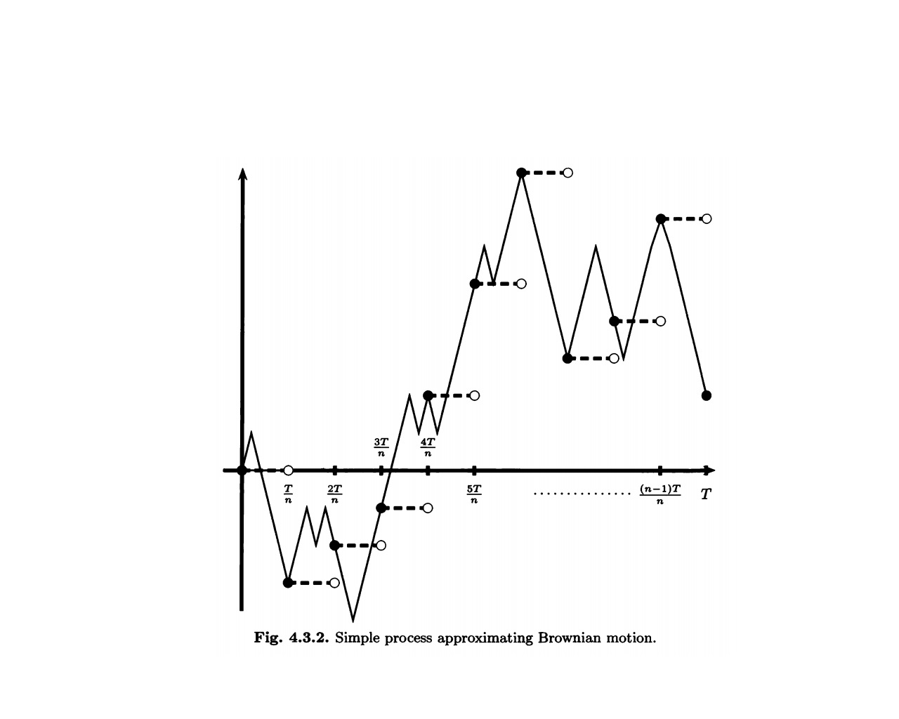

Slide 12
As shown in Figure 4.3.2. Then
By definition,
To simplify notation, we denote

Slide 14
We conclude that
In the original notation, this is

Slide 15
As , we get
Compare with ordinary calculus. If g is a differentiable function with g(0)=0, then

Slide 16
If we evaluated
then we would not have gotten ,this term.
In other words,

Slide 17
To simplify notation, we denote and

Slide 18
---①
---②
Then, ①-②
We conclude that

Slide 20
We conclude that and
, So
We have

Slide 21
is called the Stratonovich integral.
Stratonovich integral is inappropriate for finance.
In finance, the integrand represents a position in an asset and the integrator represents the price of that asset.

Slide 22
The upper limit of integrand T is arbitrary, then
By Theorem4.3.1
At t = 0, this martingale is 0 and its expectation is 0.
At t > 0, if the term is not present and EW²(t) = t, it is not martingale.

