Slide 1
Catastrophe Equity Put(CatEPut) (巨災股權賣權)
指導教授:戴天時教授
報告者: 王靖雅

Slide 2
CatEPut (Catastrophe Equity Put) (巨災股權賣權)
為一種以股票為交易標的物之選擇權
保險公司購買賣權：支付賣權之權利金向市場投資者或風險承擔者
約定：當公司所承保之巨災(L(T)-L(t))發生超過約定之額度(L)時，公司得行使賣權
賣權：以預定價格(K)將公司之股份(S(T))賣給投資者或風險承擔者，立即取得資金，作為災後融通之用。
投資者取得公司股票後，須持有股票一定時間。
註: L(t): 到時間點t時的累計損失

Slide 3
CatEPut 的Payoff
S(t): 股票價格
L(t): 災難累計損失
K: 預定履約價格

Slide 4
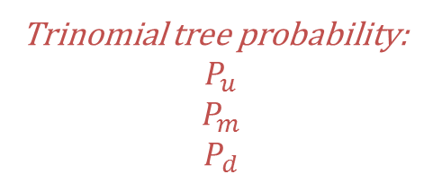
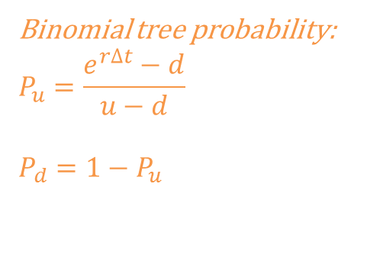
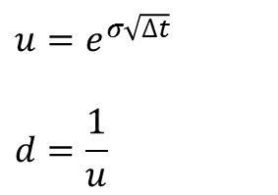
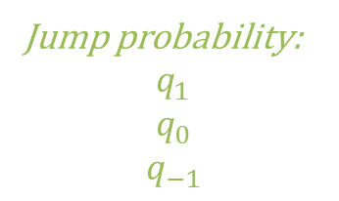


Jump –Diffusion Tree
$$u=e^{σ\sqrt{∆t}}$$
$$d=\frac{1}{u}$$
Binomial tree probability:
$$P_{u}=\frac{e^{r∆t}−d}{u−d}$$
$$P_{d}=1−P_{u}$$
$$2σ\sqrt{∆t}$$
$$\sqrt{γ^{2}+δ^{2}}$$
Jump probability:
$$q_{1}$$
$$q_{0}$$
$$q_{−1}$$
Trinomial tree probability:
$$P_{u}$$
$$P_{m}$$
$$P_{d}$$

Slide 5
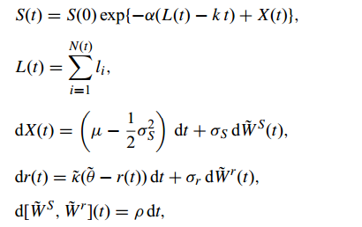
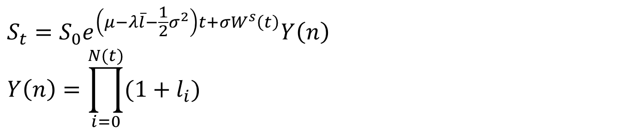
Jump-diffusion model
$$S_{t}=S_{0}e^{\left(μ−λ\overline{l}−\frac{1}{2}σ^{2}\right)t+σW^{s}\left(t\right)}Y\left(n\right)$$
$$Y\left(n\right)=\prod_{i=0}^{N(t)}{(1+l_{i})}$$
根據Dai et. al. 2009的 An efficient and accurate lattice for pricing derivatives under a jump-diffusion process
Catastrophe model
根據Wang et. al. 2005的 Catastrophe options with stochastic interest rates and compound Poisson losses

Slide 6
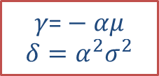
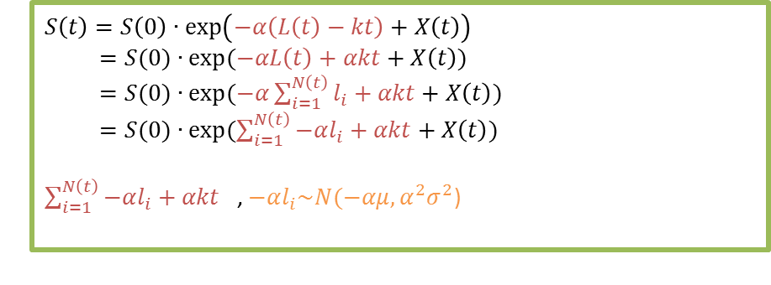
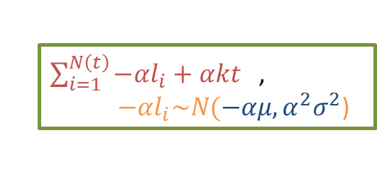
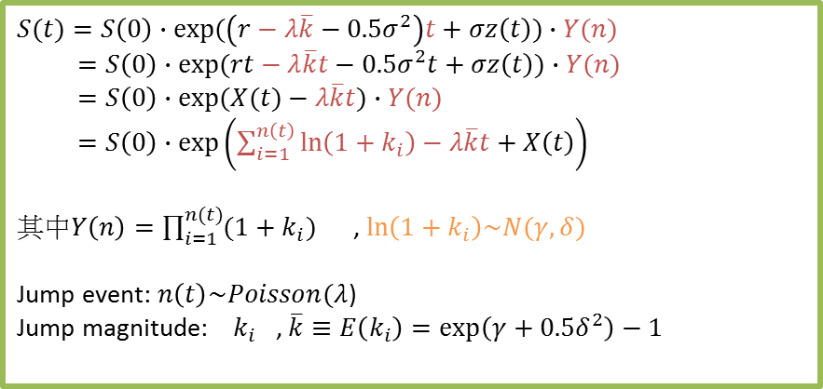
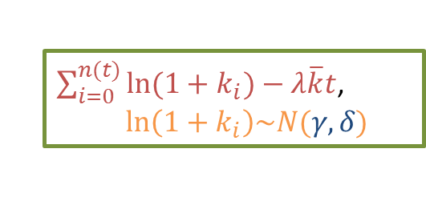
Comparison
$$S(t)=S\left(0\right)∙exp⁡(\left(r−λ\overline{k}−0.5σ^{2}\right)t+σz\left(t\right))∙Y(n)$$
$=S\left(0\right)∙exp⁡(rt−λ\overline{k}t−0.5σ^{2}t+σz\left(t\right))∙Y(n)$
$=S\left(0\right)∙exp⁡(X(t)−λ\overline{k}t)∙Y(n)$
$=S\left(0\right)∙\exp\left(\sum_{i=1}^{n\left(t\right)}{\ln\left(1+k_{i}\right)}−λ\overline{k}t+X\left(t\right)\right)$
其中$Y\left(n\right)=\prod_{i=1}^{n(t)}{(1+k_{i})}$ , $ln\left(1+k_{i}\right)\sim N(γ,δ)$
Jump event: $n\left(t\right)\sim Poisson(λ$)
Jump magnitude: $k_{i}$ , $\overline{k}≡E\left(k_{i}\right)=\exp\left(γ+0.5δ^{2}\right)−1$
$\sum_{i=0}^{n(t)}{ln⁡(1+k_{i})}−λ\overline{k}t$,
$ln\left(1+k_{i}\right)\sim N(γ,δ)$
$$S\left(t\right)=S\left(0\right)∙\exp\left(−α\left(L\left(t\right)−kt\right)+X\left(t\right)\right)$$
$=S(0)∙exp⁡(−αL\left(t\right)+αkt+X\left(t\right))$
$=S(0)∙exp⁡(−α\sum_{i=1}^{N\left(t\right)}{l_{i}}+αkt+X\left(t\right))$
$=S(0)∙exp⁡(\sum_{i=1}^{N\left(t\right)}{−αl_{i}}+αkt+X\left(t\right))$
$\sum_{i=1}^{N\left(t\right)}{−αl_{i}}+αkt$ , $−αl_{i}\sim N(−αμ,α^{2}σ^{2}\text{)}$
$\sum_{i=1}^{N\left(t\right)}{−αl_{i}}+αkt$ ,
$−αl_{i}\sim N(−αμ,α^{2}σ^{2}\text{)}$
$$γ\text{=}−αμ$$
$$δ=α^{2}σ^{2}$$

Slide 8


根據Wang et. al. 2005的 Catastrophe options with stochastic interest rates and compound Poisson losses
Notes:
加入調整項：股價的報酬率才會是無風險利率

Slide 9
CatEPut Tree
+2
+1
+1
0
+2,+1,0,-1,-2
+1
0
-1
+2,+1,0
+1,0,-1
+1
0,-1,-2
0
+2,+1,0,-1,-2
-1
+1
0
-1
+2,+1,0
+1,0,-1
+1
0,-1,-2
+2,+1,0,-1,-2
0
-1
+1
0
-1
+2,+1,0
+1,0,-1
0,-1,-2
+2,+1,0,-1,-2
0
-1
-1
期數 | 0 | jump | 1 | jump | 2 | jump | n | n的jump
值域 |  | -1~1 | -1~1 | -2~2 | -2~2 | -3~3 | -(n-1)~(n-1) | -n~n
State個數 |  | 3 | 3 | 3+2 | 3+2 | 3+2+2 | 3+2*(n-1) | 3+2*n
State個數 |  | JN | JN | JN+ (JN-1) | JN+ (JN-1) | JN+ (JN-1)*2 | JN+ (JN-1)*(n-1) | JN+ (JN-1)*n
-2
n=0
n=1

Slide 10
State的個數
n=0 state# of each diffusion node: 1
state# of each jump node: JN+(JN-1)*n=JN
n=1 state# of each diffusion node: JN+(JN-1)*(n-1)=JN
state# of each jump node: JN+(JN-1)*n=JN+(JN-1)
如果JN=3，jump 和 diffusion 才是差2，如果 JN=5，會差 4

Slide 11
程式檢驗
歐式的CatEPut檢驗數據
Monte Carlo Simulation
10000筆資料,95%信賴區間
Tree的input data要讓Lamda*T/n 夠小,才符合rare event
改為美式
將原本Jump diffusion改為美式做比較
上呂育道老師的網頁查如何更改input data讓結果差異變大

Slide 12
A數據-Year
S=100.000000,X=90.000000,B=0.000100,I=0.200000,Sigma=0.500000,Year=1.900000,Lamda=0.010000,CMean=4.000000,CSigma=1.046000,N=50,Put=1,loss=0.300000,alpha=0.800000,ANS=1.030954
S=100.000000,X=90.000000,B=0.000100,I=0.200000,Sigma=0.500000,Year=1.800000,Lamda=0.010000,CMean=4.000000,CSigma=1.046000,N=50,Put=1,loss=0.300000,alpha=0.800000,ANS=0.998169
S=100.000000,X=90.000000,B=0.000100,I=0.200000,Sigma=0.500000,Year=1.700000,Lamda=0.010000,CMean=4.000000,CSigma=1.046000,N=50,Put=1,loss=0.300000,alpha=0.800000,ANS=0.963438
S=100.000000,X=90.000000,B=0.000100,I=0.200000,Sigma=0.500000,Year=1.600000,Lamda=0.010000,CMean=4.000000,CSigma=1.046000,N=50,Put=1,loss=0.300000,alpha=0.800000,ANS=0.926655
S=100.000000,X=90.000000,B=0.000100,I=0.200000,Sigma=0.500000,Year=1.500000,Lamda=0.010000,CMean=4.000000,CSigma=1.046000,N=50,Put=1,loss=0.300000,alpha=0.800000,ANS=0.887776
S=100.000000,X=90.000000,B=0.000100,I=0.200000,Sigma=0.500000,Year=1.400000,Lamda=0.010000,CMean=4.000000,CSigma=1.046000,N=50,Put=1,loss=0.300000,alpha=0.800000,ANS=0.846731
S=100.000000,X=90.000000,B=0.000100,I=0.200000,Sigma=0.500000,Year=1.300000,Lamda=0.010000,CMean=4.000000,CSigma=1.046000,N=50,Put=1,loss=0.300000,alpha=0.800000,ANS=0.803439
S=100.000000,X=90.000000,B=0.000100,I=0.200000,Sigma=0.500000,Year=1.200000,Lamda=0.010000,CMean=4.000000,CSigma=1.046000,N=50,Put=1,loss=0.300000,alpha=0.800000,ANS=0.757834

Slide 13
E數據-Year
S=100.000000,X=90.000000,B=0.000100,I=0.200000,Sigma=0.500000,Year=1.900000,Lamda=0.010000,CMean=4.000000,CSigma=1.046000,N=50,Put=1,loss=0.300000,alpha=0.800000,ANS=1.030964
S=100.000000,X=90.000000,B=0.000100,I=0.200000,Sigma=0.500000,Year=1.800000,Lamda=0.010000,CMean=4.000000,CSigma=1.046000,N=50,Put=1,loss=0.300000,alpha=0.800000,ANS=0.998177
S=100.000000,X=90.000000,B=0.000100,I=0.200000,Sigma=0.500000,Year=1.700000,Lamda=0.010000,CMean=4.000000,CSigma=1.046000,N=50,Put=1,loss=0.300000,alpha=0.800000,ANS=0.963445
S=100.000000,X=90.000000,B=0.000100,I=0.200000,Sigma=0.500000,Year=1.600000,Lamda=0.010000,CMean=4.000000,CSigma=1.046000,N=50,Put=1,loss=0.300000,alpha=0.800000,ANS=0.926661
S=100.000000,X=90.000000,B=0.000100,I=0.200000,Sigma=0.500000,Year=1.500000,Lamda=0.010000,CMean=4.000000,CSigma=1.046000,N=50,Put=1,loss=0.300000,alpha=0.800000,ANS=0.887781
S=100.000000,X=90.000000,B=0.000100,I=0.200000,Sigma=0.500000,Year=1.400000,Lamda=0.010000,CMean=4.000000,CSigma=1.046000,N=50,Put=1,loss=0.300000,alpha=0.800000,ANS=0.846735
S=100.000000,X=90.000000,B=0.000100,I=0.200000,Sigma=0.500000,Year=1.300000,Lamda=0.010000,CMean=4.000000,CSigma=1.046000,N=50,Put=1,loss=0.300000,alpha=0.800000,ANS=0.803443
S=100.000000,X=90.000000,B=0.000100,I=0.200000,Sigma=0.500000,Year=1.200000,Lamda=0.010000,CMean=4.000000,CSigma=1.046000,N=50,Put=1,loss=0.300000,alpha=0.800000,ANS=0.757837

Slide 14
A數據-CMean
S=100.000000,X=90.000000,B=0.000100,I=0.200000,Sigma=0.500000,Year=2.000000,Lamda=0.010000,CMean=4.000000,CSigma=1.046000,N=50,Put=1,ACC=0.300000,alpha=0.800000,ANS=1.061817
S=100.000000,X=90.000000,B=0.000100,I=0.200000,Sigma=0.500000,Year=2.000000,Lamda=0.010000,CMean=4.100000,CSigma=1.046000,N=50,Put=1,ACC=0.300000,alpha=0.800000,ANS=1.069256
S=100.000000,X=90.000000,B=0.000100,I=0.200000,Sigma=0.500000,Year=2.000000,Lamda=0.010000,CMean=4.300000,CSigma=1.046000,N=50,Put=1,ACC=0.300000,alpha=0.800000,ANS=1.082648
S=100.000000,X=90.000000,B=0.000100,I=0.200000,Sigma=0.500000,Year=2.000000,Lamda=0.010000,CMean=4.600000,CSigma=1.046000,N=50,Put=1,ACC=0.300000,alpha=0.800000,ANS=1.099536
S=100.000000,X=90.000000,B=0.000100,I=0.200000,Sigma=0.500000,Year=2.000000,Lamda=0.010000,CMean=5.000000,CSigma=1.046000,N=50,Put=1,ACC=0.300000,alpha=0.800000,ANS=1.117214
S=100.000000,X=90.000000,B=0.000100,I=0.200000,Sigma=0.500000,Year=2.000000,Lamda=0.010000,CMean=5.500000,CSigma=1.046000,N=50,Put=1,ACC=0.300000,alpha=0.800000,ANS=1.133476
S=100.000000,X=90.000000,B=0.000100,I=0.200000,Sigma=0.500000,Year=2.000000,Lamda=0.010000,CMean=6.100000,CSigma=1.046000,N=50,Put=1,ACC=0.300000,alpha=0.800000,ANS=1.146998
S=100.000000,X=90.000000,B=0.000100,I=0.200000,Sigma=0.500000,Year=2.000000,Lamda=0.010000,CMean=6.800000,CSigma=1.046000,N=50,Put=1,ACC=0.300000,alpha=0.800000,ANS=1.157379

Slide 15
A數據-alpha
S=100.000000,X=90.000000,B=0.000100,I=0.200000,Sigma=0.500000,Year=2.000000,Lamda=0.010000,CMean=4.000000,CSigma=1.046000,N=50,Put=1,ACC=0.300000,alpha=0.750000,ANS=1.050701
S=100.000000,X=90.000000,B=0.000100,I=0.200000,Sigma=0.500000,Year=2.000000,Lamda=0.010000,CMean=4.000000,CSigma=1.046000,N=50,Put=1,ACC=0.300000,alpha=0.700000,ANS=1.035281
S=100.000000,X=90.000000,B=0.000100,I=0.200000,Sigma=0.500000,Year=2.000000,Lamda=0.010000,CMean=4.000000,CSigma=1.046000,N=50,Put=1,ACC=0.300000,alpha=0.650000,ANS=1.014664
S=100.000000,X=90.000000,B=0.000100,I=0.200000,Sigma=0.500000,Year=2.000000,Lamda=0.010000,CMean=4.000000,CSigma=1.046000,N=50,Put=1,ACC=0.300000,alpha=0.600000,ANS=0.987812
S=100.000000,X=90.000000,B=0.000100,I=0.200000,Sigma=0.500000,Year=2.000000,Lamda=0.010000,CMean=4.000000,CSigma=1.046000,N=50,Put=1,ACC=0.300000,alpha=0.550000,ANS=0.953570
S=100.000000,X=90.000000,B=0.000100,I=0.200000,Sigma=0.500000,Year=2.000000,Lamda=0.010000,CMean=4.000000,CSigma=1.046000,N=50,Put=1,ACC=0.300000,alpha=0.500000,ANS=0.910749
S=100.000000,X=90.000000,B=0.000100,I=0.200000,Sigma=0.500000,Year=2.000000,Lamda=0.010000,CMean=4.000000,CSigma=1.046000,N=50,Put=1,ACC=0.300000,alpha=0.450000,ANS=0.858295
S=100.000000,X=90.000000,B=0.000100,I=0.200000,Sigma=0.500000,Year=2.000000,Lamda=0.010000,CMean=4.000000,CSigma=1.046000,N=50,Put=1,ACC=0.300000,alpha=0.400000,ANS=0.795545

Slide 16
A數據-strike price
S=100.000000,X=91.000000,B=0.000100,I=0.200000,Sigma=0.500000,Year=2.000000,Lamda=0.010000,CMean=4.000000,CSigma=1.046000,N=50,Put=1,loss=0.300000,alpha=0.800000,ANS=1.074385
S=100.000000,X=92.000000,B=0.000100,I=0.200000,Sigma=0.500000,Year=2.000000,Lamda=0.010000,CMean=4.000000,CSigma=1.046000,N=50,Put=1,loss=0.300000,alpha=0.800000,ANS=1.086953
S=100.000000,X=93.000000,B=0.000100,I=0.200000,Sigma=0.500000,Year=2.000000,Lamda=0.010000,CMean=4.000000,CSigma=1.046000,N=50,Put=1,loss=0.300000,alpha=0.800000,ANS=1.099523
S=100.000000,X=94.000000,B=0.000100,I=0.200000,Sigma=0.500000,Year=2.000000,Lamda=0.010000,CMean=4.000000,CSigma=1.046000,N=50,Put=1,loss=0.300000,alpha=0.800000,ANS=1.112092
S=100.000000,X=95.000000,B=0.000100,I=0.200000,Sigma=0.500000,Year=2.000000,Lamda=0.010000,CMean=4.000000,CSigma=1.046000,N=50,Put=1,loss=0.300000,alpha=0.800000,ANS=1.124662
S=100.000000,X=96.000000,B=0.000100,I=0.200000,Sigma=0.500000,Year=2.000000,Lamda=0.010000,CMean=4.000000,CSigma=1.046000,N=50,Put=1,loss=0.300000,alpha=0.800000,ANS=1.137232
S=100.000000,X=97.000000,B=0.000100,I=0.200000,Sigma=0.500000,Year=2.000000,Lamda=0.010000,CMean=4.000000,CSigma=1.046000,N=50,Put=1,loss=0.300000,alpha=0.800000,ANS=1.149803
S=100.000000,X=98.000000,B=0.000100,I=0.200000,Sigma=0.500000,Year=2.000000,Lamda=0.010000,CMean=4.000000,CSigma=1.046000,N=50,Put=1,loss=0.300000,alpha=0.800000,ANS=1.162373

Slide 17

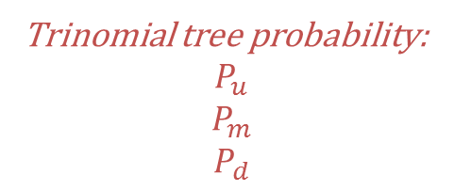
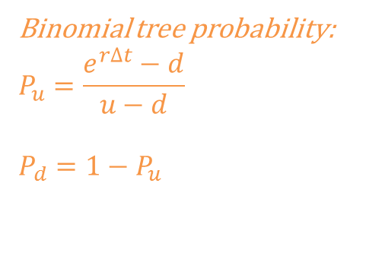
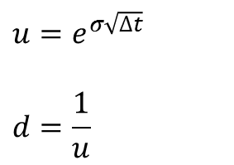


Jump –Diffusion Tree
$$u=e^{σ\sqrt{∆t}}$$
$$d=\frac{1}{u}$$
Binomial tree probability:
$$P_{u}=\frac{e^{r∆t}−d}{u−d}$$
$$P_{d}=1−P_{u}$$
$$2σ\sqrt{∆t}$$
$$\sqrt{γ^{2}+δ^{2}}$$
Jump probability:
$$q_{1}$$
$$q_{0}$$
$$q_{−1}$$
Trinomial tree probability:
$$P_{u}$$
$$P_{m}$$
$$P_{d}$$

