Slide 1
A Novel Error-Reducing Approach on the Fast Fourier Transform Option Valuation

Slide 2
Agenda
Abstract
Preliminaries － Carr and Madan's Option Pricing Method － Merton's Jump-Diusion Model
Error Reduction with a Proxy
Numerical Results
Conclusions

Slide 3
Abstract
A famous method for pricing derivatives ：
Fast Fourier Transform (FFT)
Carr and Madan (1999) ： FFT-based approach (price vanilla options given that the characteristic function of the underlying asset's return is analytically known)
Defect of Carr and Madan approach ： － converge slowly － negative for deep-out-of-the-money options
This paper’s approach ： decomposes the option value into the proxy and residual terms
Advantage of this paper’s approach ： － efficiently reduces the pricing error － alleviates the negative price problem

Slide 4
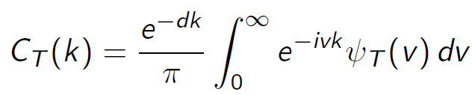
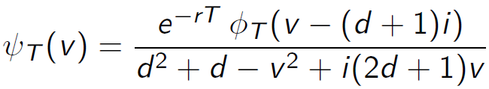



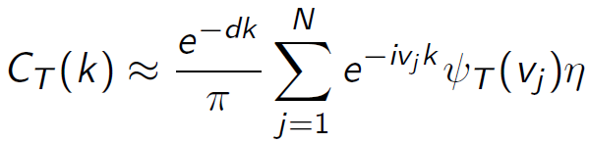
Preliminaries
Carr and Madan (1999) suggest that ： where d>0 ; where is the is Fourier transform of the damped call price risk-neutral characteristic function of
Using the trapezoid rule for the integral

Slide 5
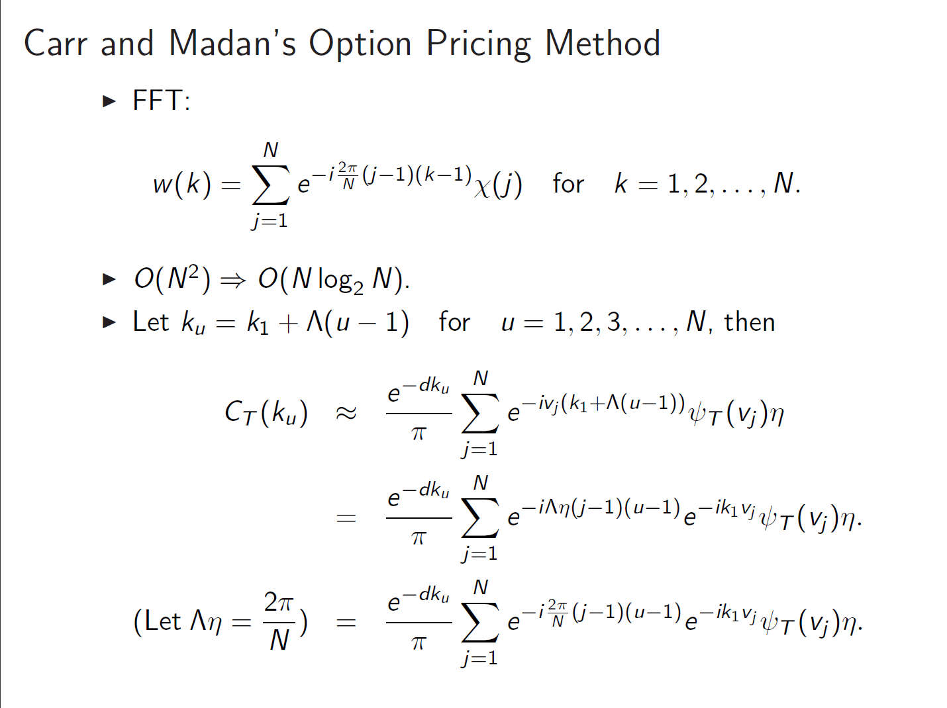

Slide 6
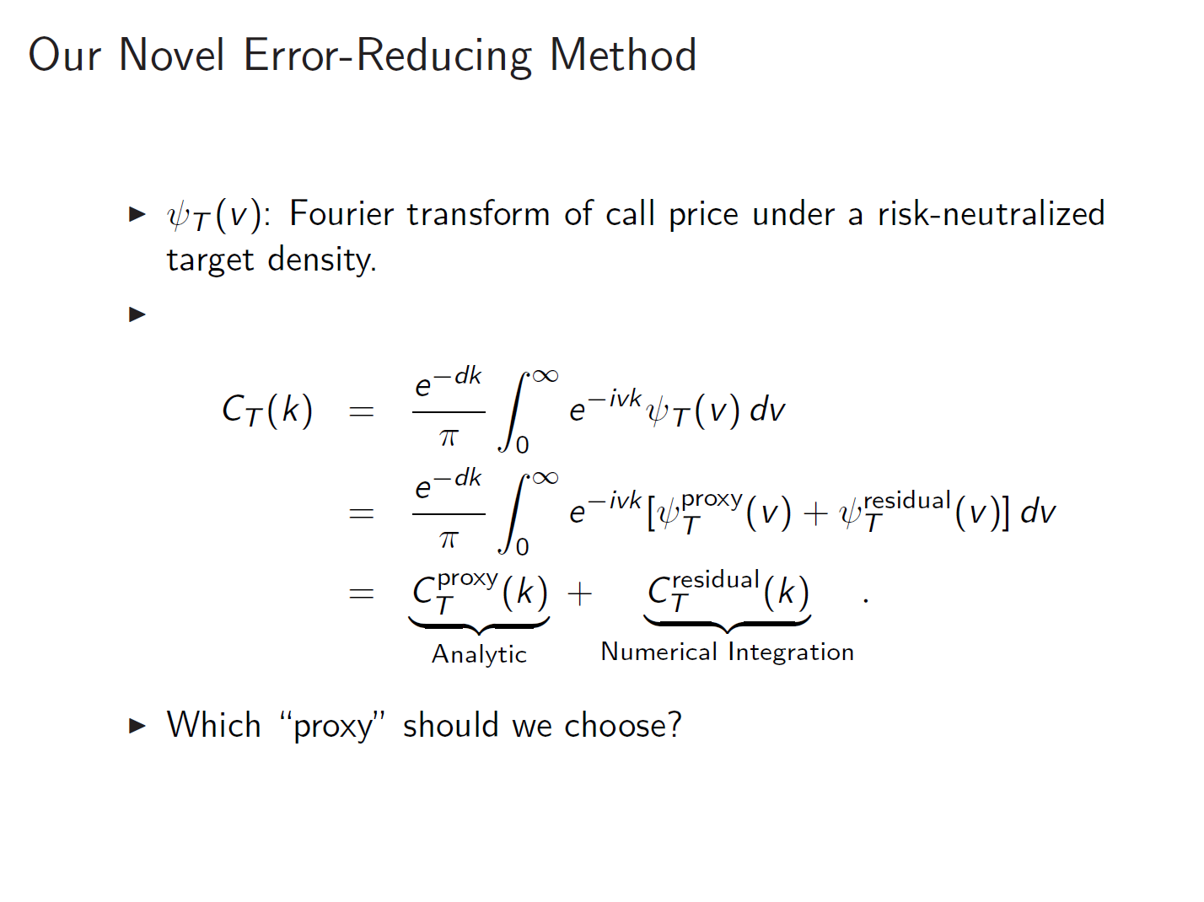

Slide 7
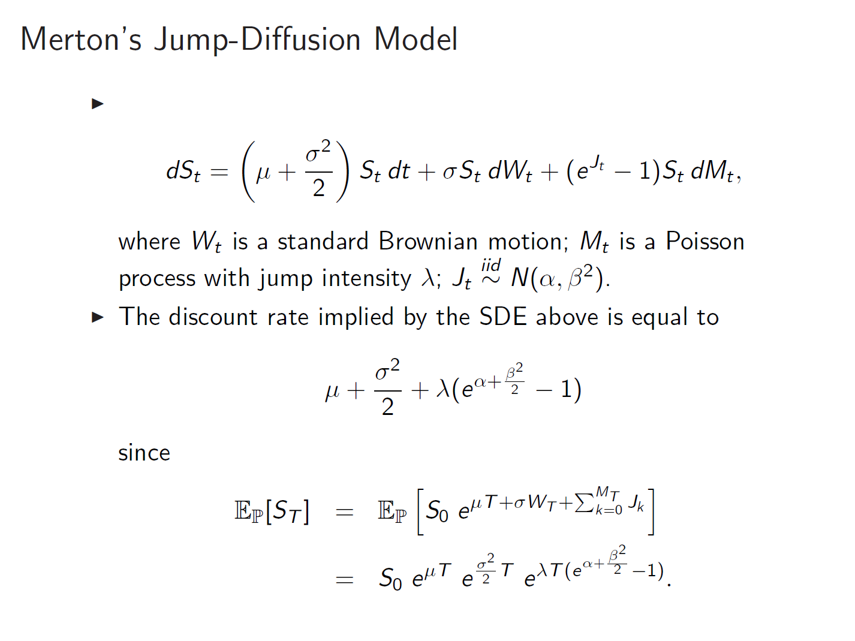

Slide 8
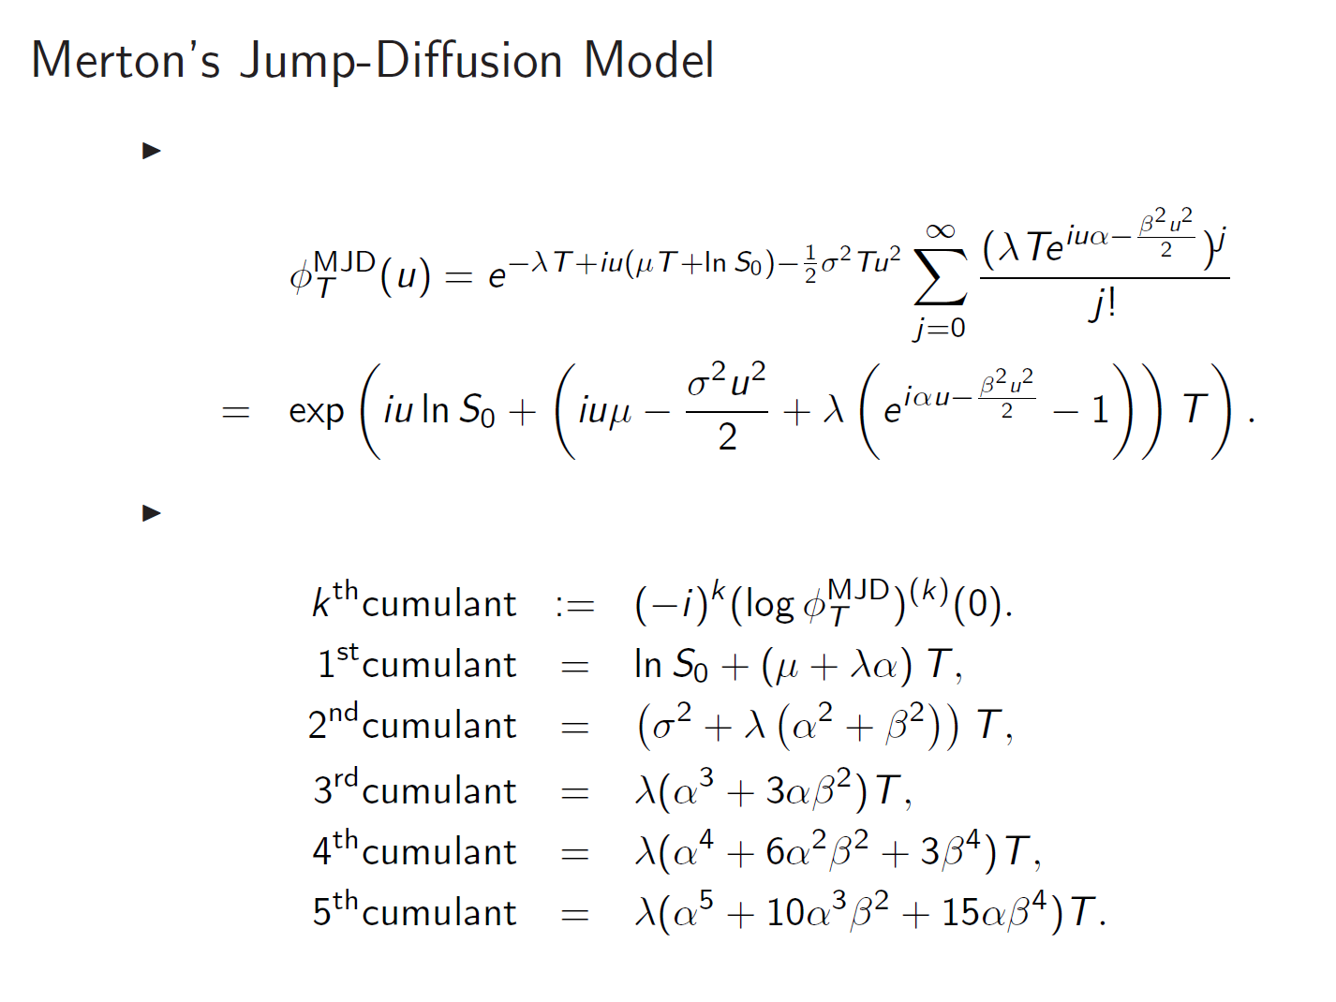

Slide 9
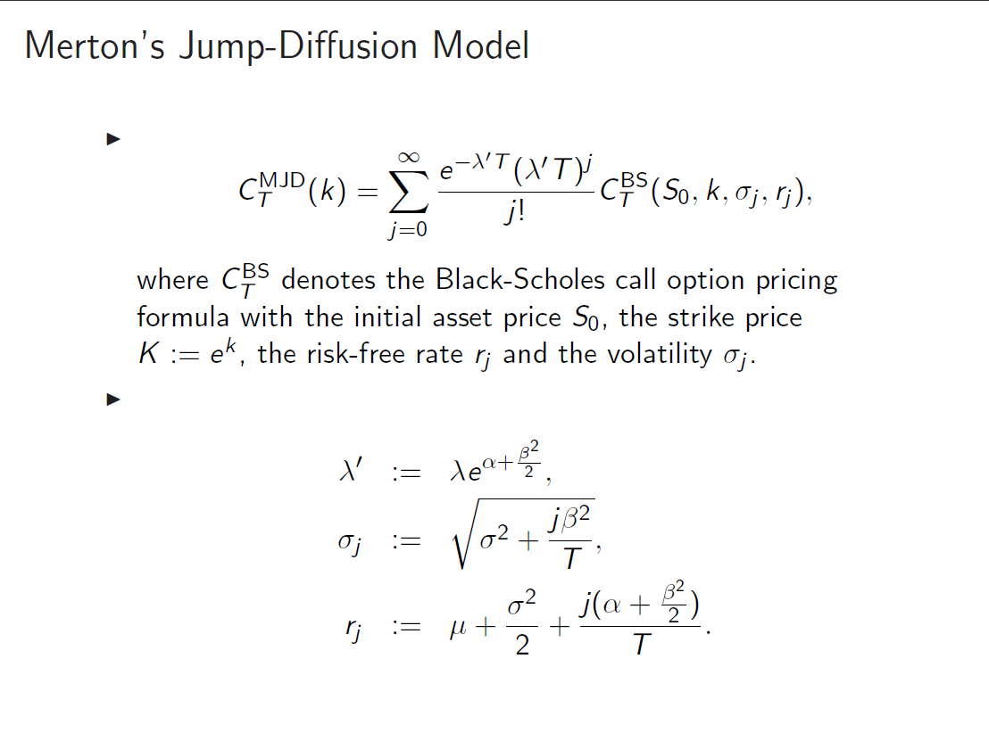

Slide 10
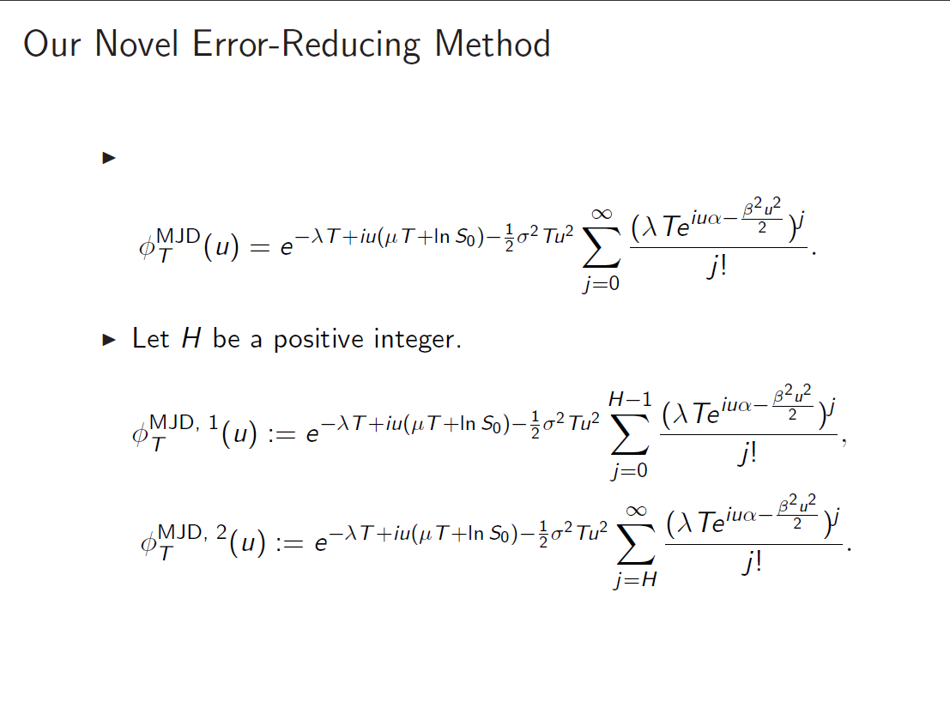

Slide 11
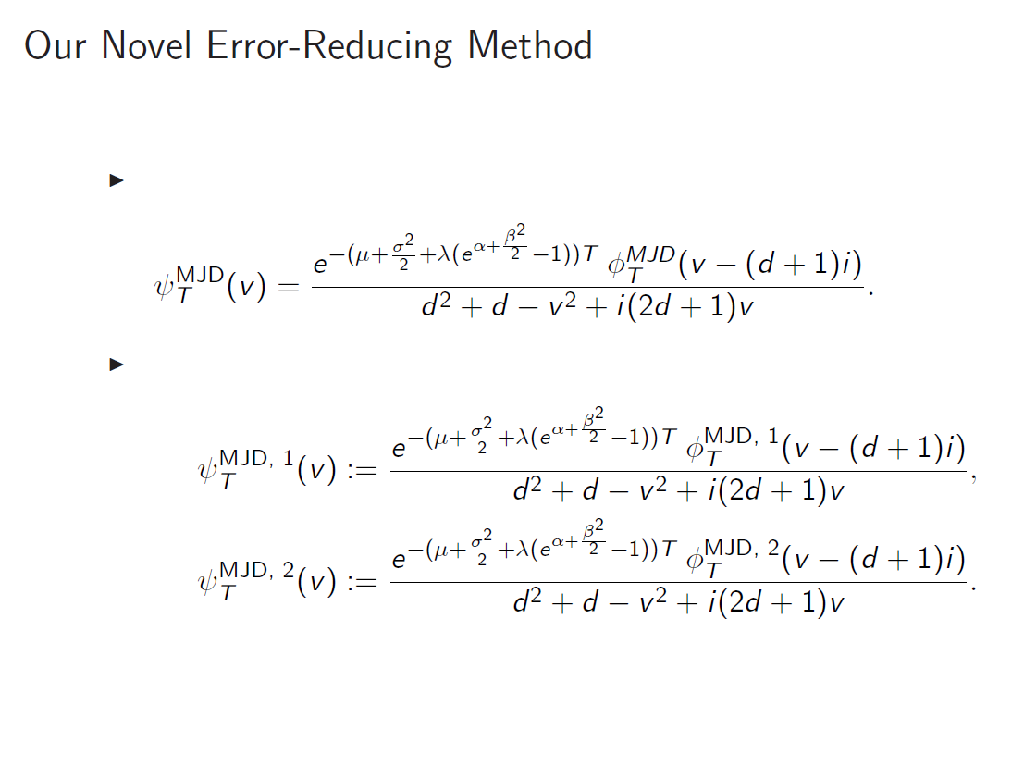

Slide 12
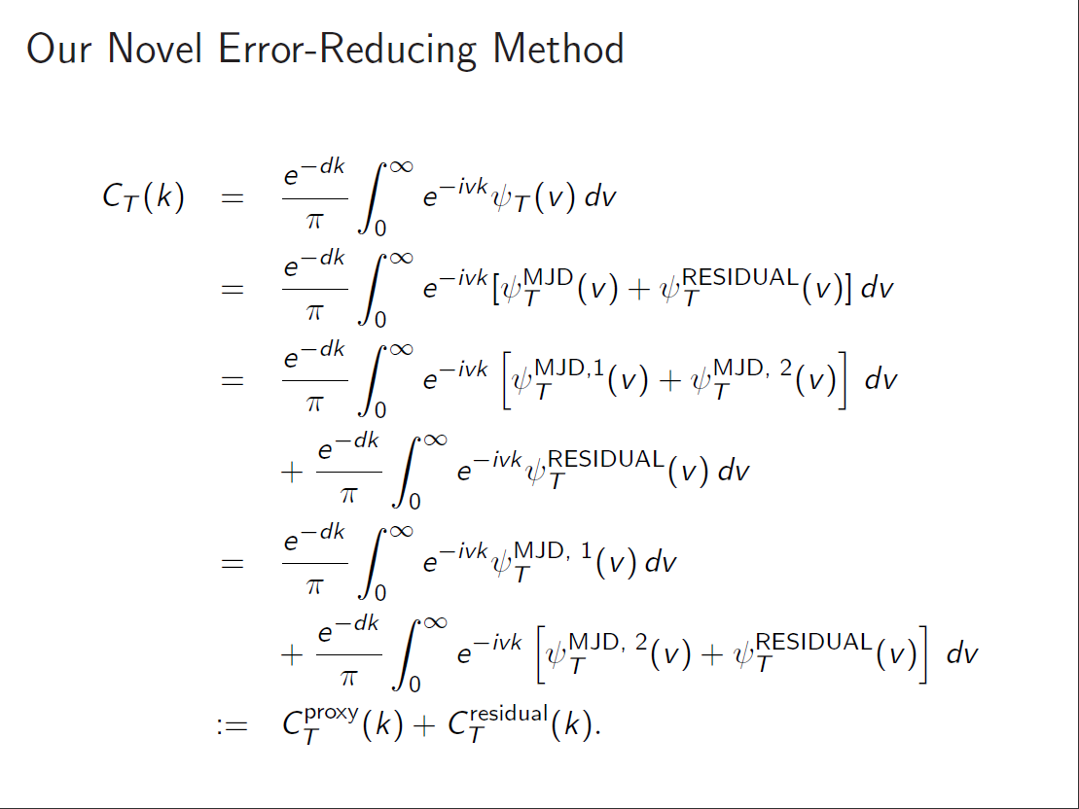

Slide 13
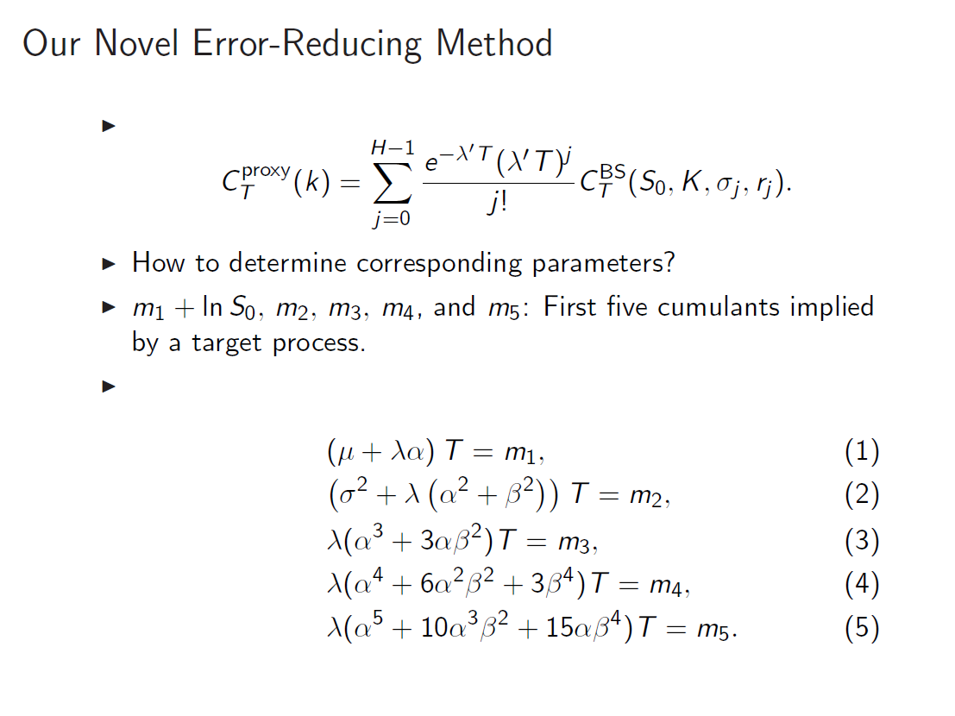

Slide 14
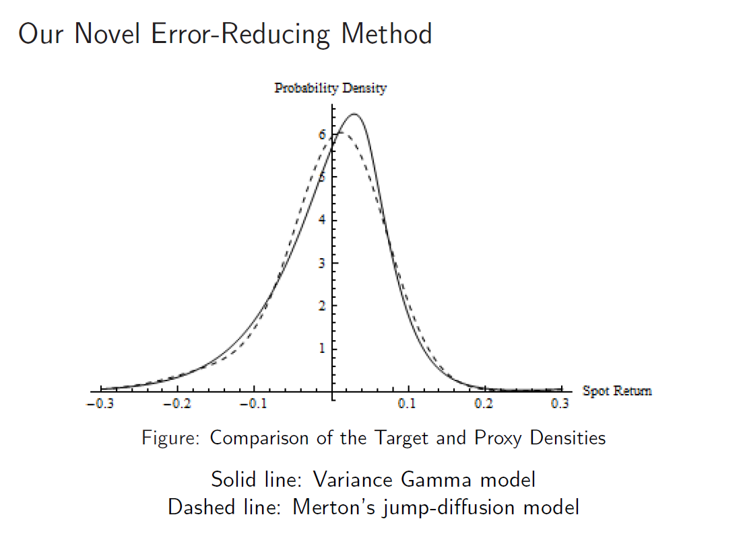

Slide 15
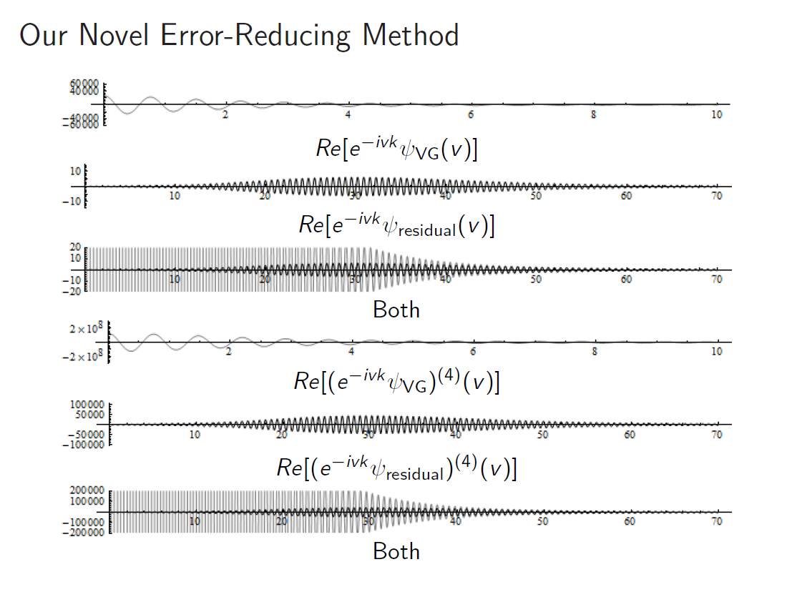

Slide 16
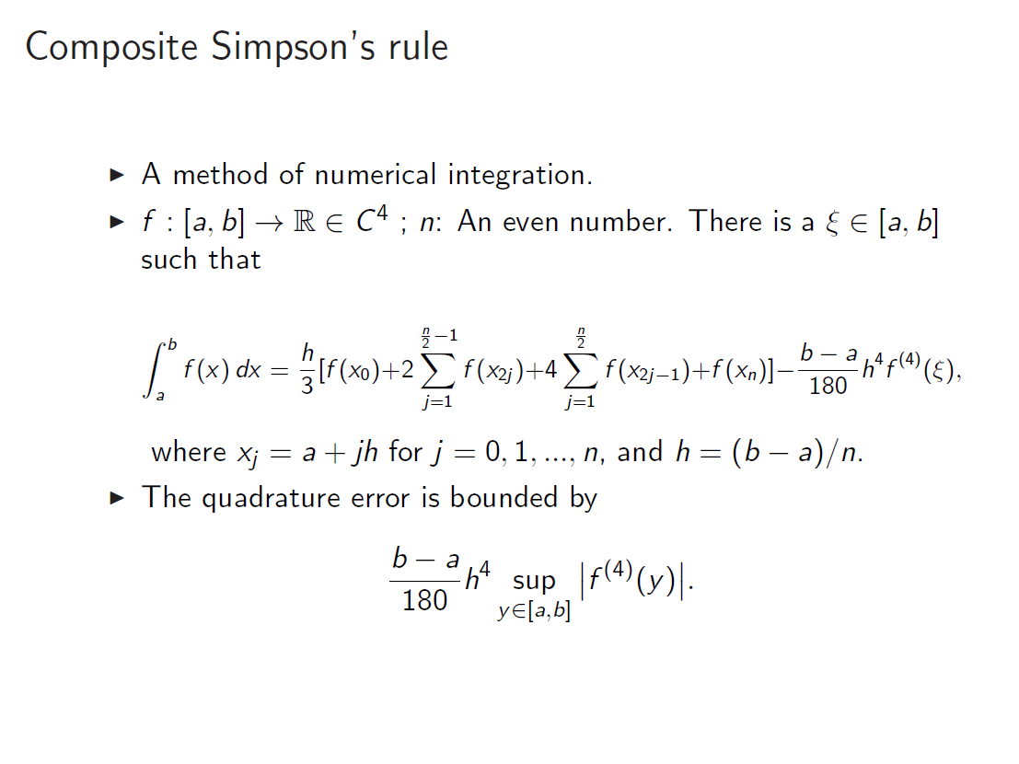

Slide 17
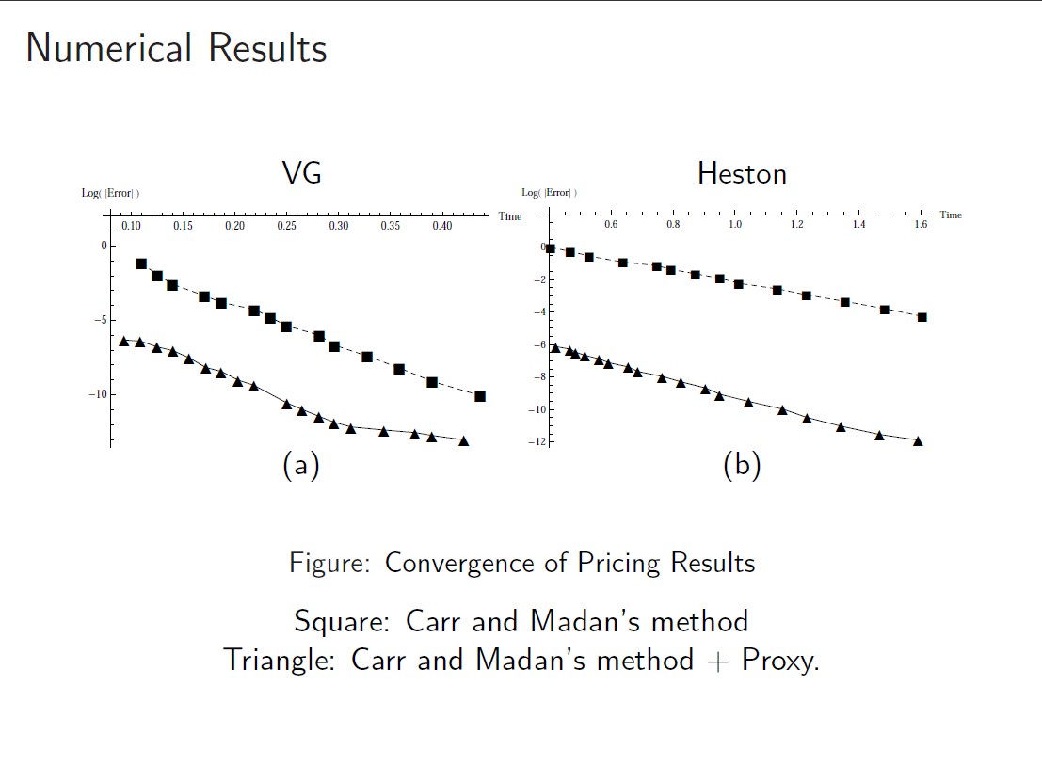

Slide 18
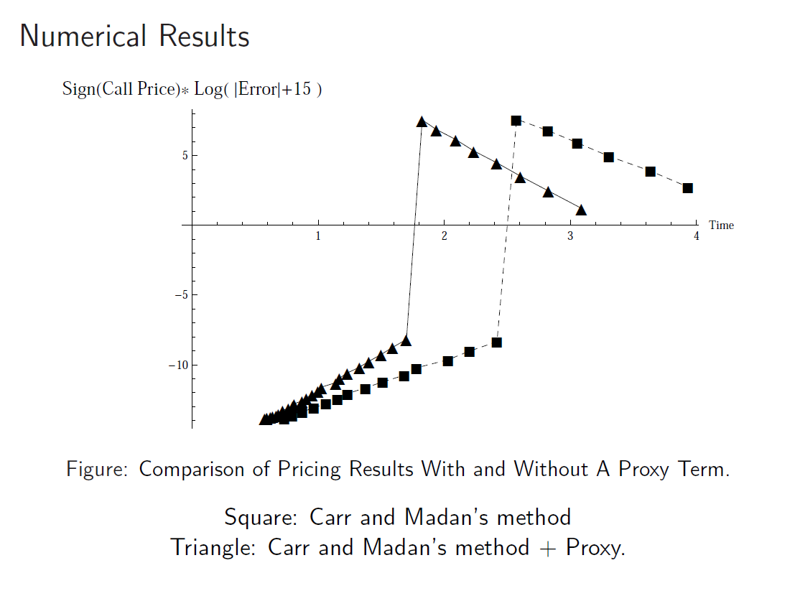

Slide 19
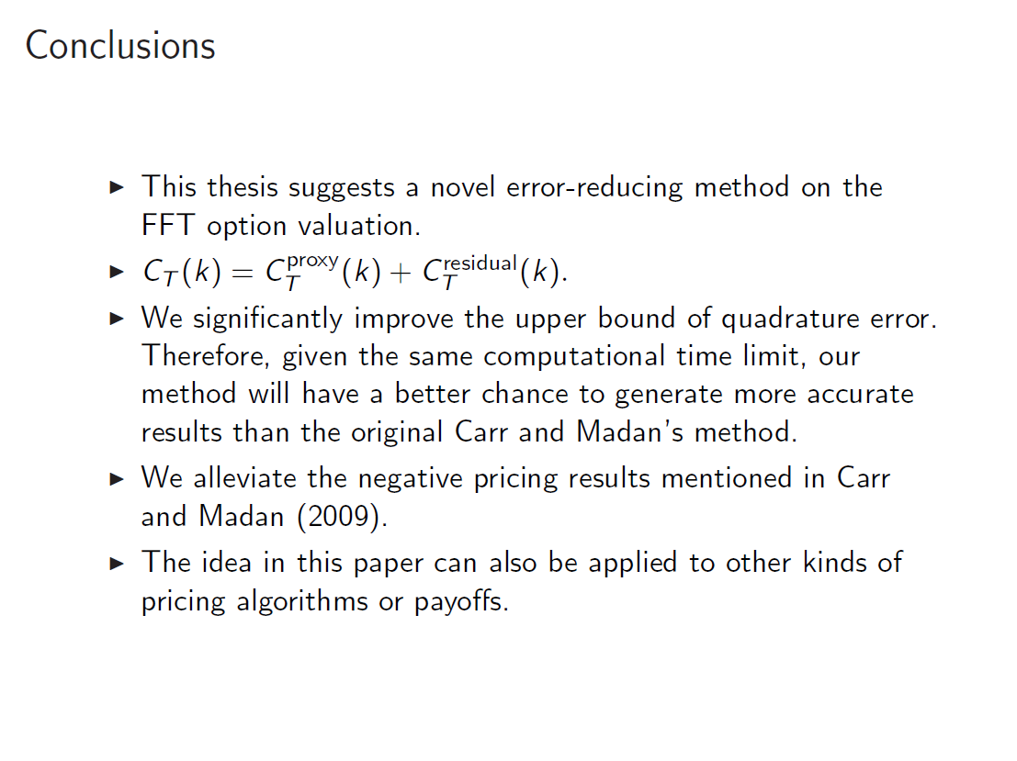

Slide 20
