Slide 1
論文進度報告
王偉丞
2015/12/22

Slide 2
信用增強效果、債權稀釋、財富移轉問題
優先順位債券:SB 次順位債券:JB
黃金連結債券(GB):債券面額為某個單位到期時黃金價格
反轉可轉換債券(RC):當到期時自己公司股價低於門檻值時，發行公司可將發行的債券轉換為自己公司的股票
反轉可替換債券(RE):當到期時標的物價值低於門檻值時，發行公司可將發行的債券轉換為指定標的資產(例如黃金)
信用增強:當發行JB時，使SB的風險下降
債權稀釋:當發新債的時候，破產風險增加，讓舊債價值下降
財富轉移:當發行JB時造成SB、JB、equity之間價值的轉換
SB + JB
將避險部位效果消除
代理問題中的資產替代問題
SB + JB +
Short Forward
SB + JB + Short
Forward + Unwind
(Long Forward)
SB + JB + Short
Forward + Unwind
(Short Put Option)
SB + Short Forward + JB
SB + Short Forward +
JB + Unwind
(Long Forward)
SB + Short Forward
+ JB + Unwind
(Short Put Option)
SB
SB + GB
SB + GB +
Long Forward
SB + GB + Short Put Option
本次所做的部份
SB + RE
SB + RE +
Long Forward
SB + RE + Short Put Option
SB + RC
SB + RC +
Long Forward
SB + RC + Short Put Option
SB + CC
Notes:
討論的是公司的舉債策略，現在公司要發行一張次順位債券。所謂次順位債券就是當公司原先已經有發行一張債券且註明此債券有優先償還的順位時，之後公司在舉的債就叫做次順位債券

Slide 3
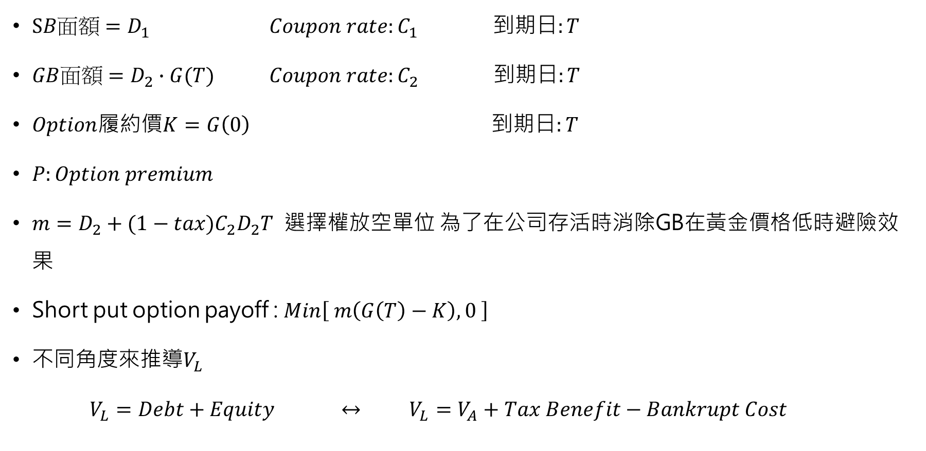
SB+GB+Short put option
$SB面額=D_{1}$ $Coupon rate:C_{1}$ 到期日$:T$
$GB面額=D_{2}∙G(T)$ $Coupon rate:C_{2}$ 到期日$:T$
$Option$履約價$K=G\left(0\right)$ 到期日$:T$
$P:Option premium$
$m=D_{2}+{(1−tax)C}_{2}D_{2}T$ 選擇權放空單位 為了在公司存活時消除GB在黃金價格低時避險效果
Short put option payoff : $Min\left[ m\left(G\left(T\right)−K\right), 0 \right]$
不同角度來推導$V_{L}$
$V_{L}=Debt+Equity ↔ V_{L}=V_{A}+Tax Benefit−Bankrupt Cost$

Slide 4
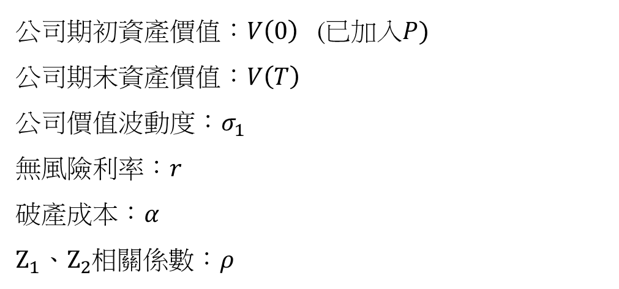

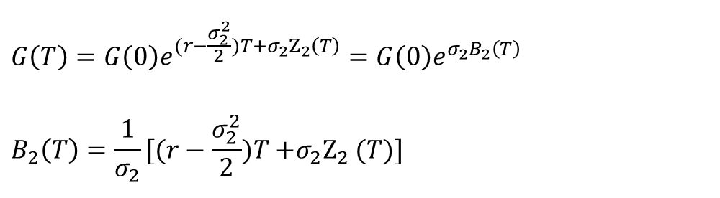
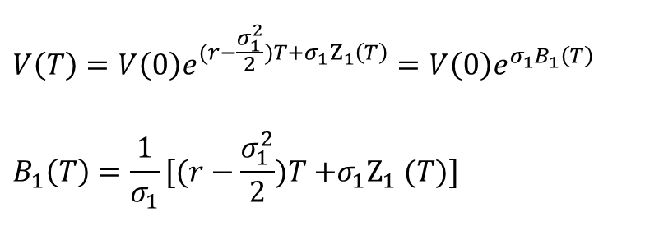
基本假設
公司期初資產價值：$V\left(0\right)$ (已加入$P)$
公司期末資產價值：$V\left(T\right)$
公司價值波動度：$σ_{1}$
無風險利率：$r$
破產成本：𝛼
$Z_{1}{、Z}_{2}$相關係數：𝜌
黃金期初價格： $G\left(0\right)$
黃金期末價格：$G(T)$
黃金價格波動度：$σ_{2}$
營業所得稅率： 𝑡𝑎𝑥
標準維納過程：$Z_{1}{、Z}_{2}$
$$V\left(T\right)=V\left(0\right)e^{{(r−\frac{σ_{1}^{2}}{2})T+σ}_{1}Z_{1}\left(T\right)}=V\left(0\right)e^{σ_{1}B_{1}\left(T\right)}$$
$$B_{1}\left(T\right)=\frac{1}{σ_{1}}[(r−\frac{σ_{1}^{2}}{2})T{+σ_{1}Z}_{1}(T)]$$
$$G\left(T\right)=G\left(0\right)e^{{(r−\frac{σ_{2}^{2}}{2})T+σ}_{2}Z_{2}\left(T\right)}=G\left(0\right)e^{σ_{2}B_{2}\left(T\right)}$$
$$B_{2}\left(T\right)=\frac{1}{σ_{2}}[(r−\frac{σ_{2}^{2}}{2})T{+σ_{2}Z}_{2}(T)]$$

Slide 5
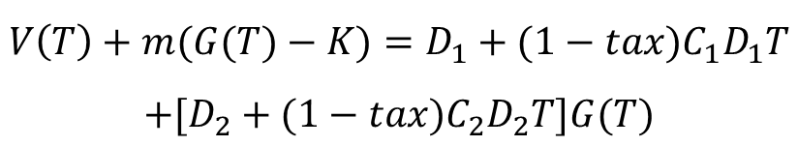



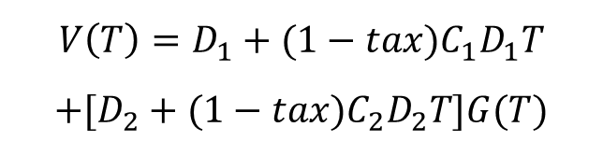

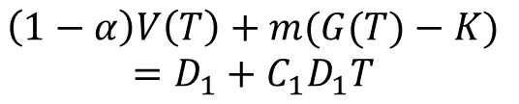
SB+GB+Short put option
$$G(T)$$
$$\left(1−α\right)V\left(T\right)=D_{1}+C_{1}D_{1}T$$
$$V\left(T\right)=D_{1}+{(1−tax)C}_{1}D_{1}T$$
$$+[D_{2}+{(1−tax)C}_{2}D_{2}T]G(T)$$
破產 SB部份
GB無
(未履約)
破產 SB全拿
GB部份
存活(未履約)
$$G(0)$$
(選擇權履約 足夠支付)
存活 (選擇權履約)
選擇權
不足支付
$$\left(1−α\right)V\left(T\right)+m(G(T)−K)$$
$$=D_{1}+C_{1}D_{1}T$$
$$V(T)$$
$$\left(1−α\right)V\left(T\right)+m\left(G\left(T\right)−K\right)=0$$
$$V\left(T\right)+m(G(T)−K)=D_{1}+{(1−tax)C}_{1}D_{1}T$$
$$+[D_{2}+{(1−tax)C}_{2}D_{2}T]G(T)$$

Slide 6

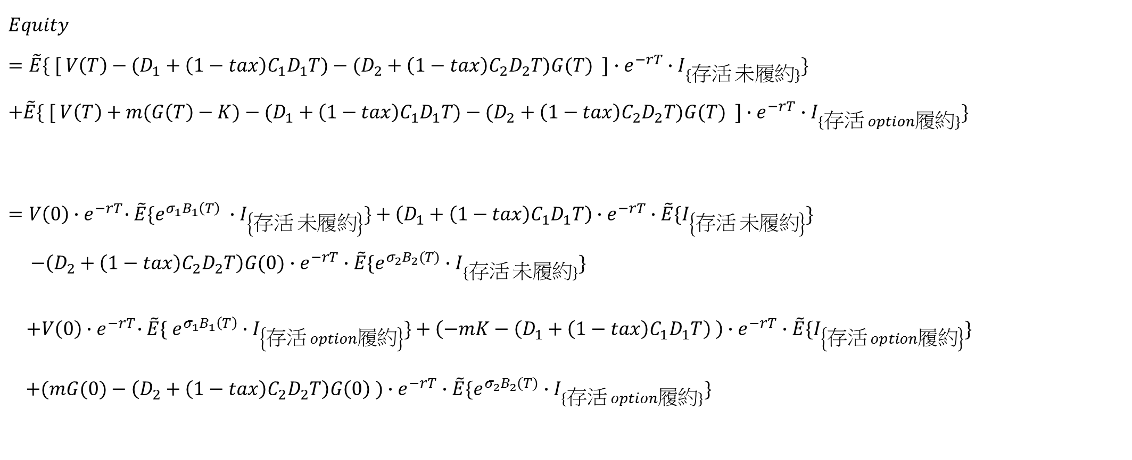
$$Equity$$
$$Equity$$
$$=\tilde{E}\{ [ V\left(T\right)−(D_{1}+{\left(1−tax\right)C}_{1}D_{1}T)−(D_{2}+{\left(1−tax\right)C}_{2}D_{2}T)G(T) ]∙e^{−rT}∙I_{\{存活 未履約\}}\}$$
$$+\tilde{E}\{ [ V\left(T\right)+m(G\left(T\right)−K)−(D_{1}+{\left(1−tax\right)C}_{1}D_{1}T)−(D_{2}+{\left(1−tax\right)C}_{2}D_{2}T)G(T) ]∙e^{−rT}∙I_{\{存活 option履約\}}\}$$
$$=V\left(0\right){∙e}^{−rT}∙\tilde{E}\{{e^{σ_{1}B_{1}\left(T\right)} ∙I}_{\left\{存活 未履約\right\}}\}+\left(D_{1}+{\left(1−tax\right)C}_{1}D_{1}T\right)∙e^{−rT}∙\tilde{E}\{I_{\left\{存活 未履約\right\}}\}$$
$$−\left(D_{2}+{\left(1−tax\right)C}_{2}D_{2}T\right)G(0)∙e^{−rT}∙\tilde{E}\{{e^{σ_{2}B_{2}(T)}∙I}_{\{存活 未履約\}}\}$$
$+V\left(0\right){∙e}^{−rT}∙\tilde{E}\{{ e^{σ_{1}B_{1}\left(T\right)}∙I}_{\left\{存活 option履約\right\}}\}+\left(−mK−\left(D_{1}+{\left(1−tax\right)C}_{1}D_{1}T\right) \right)∙e^{−rT}∙\tilde{E}\{I_{\left\{存活 option履約\right\}}\}$
$+(mG(0)−\left(D_{2}+{\left(1−tax\right)C}_{2}D_{2}T\right)G\left(0\right) )∙e^{−rT}∙\tilde{E}\{{e^{σ_{2}B_{2}(T)}∙I}_{\{存活 option履約\}}\}$

Slide 7
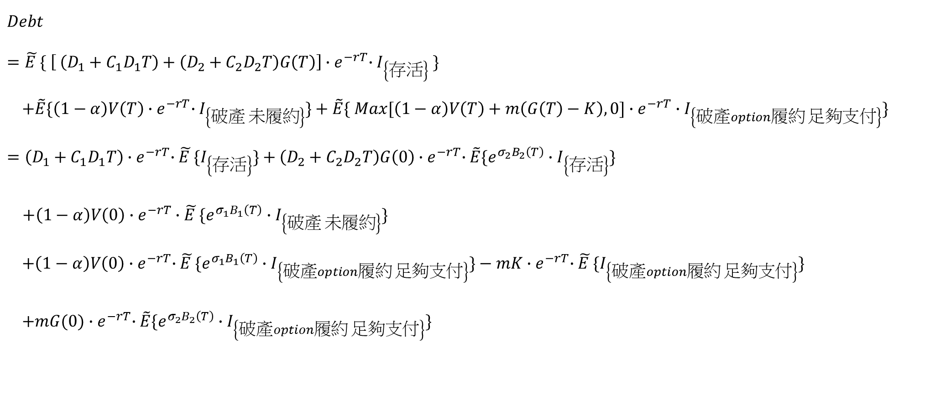

$$Debt$$
$$Debt$$
$$=\tilde{E }\{ \left[ \left(D_{1}+C_{1}D_{1}T\right)+\left(D_{2}+C_{2}D_{2}T\right)G\left(T\right)\right]{∙e}^{−rT}∙I_{\left\{存活\right\}} \}$$
$$+\tilde{E}\{\left(1−α\right)V\left(T\right){∙e}^{−rT}∙I_{\left\{破產 未履約\right\}}\}+\tilde{E}\{ Max[\left(1−α\right)V\left(T\right)+m\left(G\left(T\right)−K\right),0]∙e^{−rT}∙I_{\left\{破產option履約 足夠支付\right\}}\}$$
$$=\left(D_{1}+C_{1}D_{1}T\right){∙e}^{−rT}∙\tilde{E }\{I_{\left\{存活\right\}}\}+\left(D_{2}+C_{2}D_{2}T\right)G\left(0\right){∙e}^{−rT}∙\tilde{E}\{{e^{σ_{2}B_{2}\left(T\right)}∙I}_{\left\{存活\right\}}\}$$
$+{\left(1−α\right)V\left(0\right)∙e}^{−rT}∙\tilde{E }\{{e^{σ_{1}B_{1}\left(T\right)}∙I}_{\left\{破產 未履約\right\}}\}$
$$+\left(1−α\right)V\left(0\right){∙e}^{−rT}∙\tilde{E }\{{e^{σ_{1}B_{1}\left(T\right)}∙I}_{\left\{破產option履約 足夠支付\right\}}\}−mK{∙e}^{−rT}∙\tilde{E }\{I_{\left\{破產option履約 足夠支付\right\}}\}$$
$+mG(0){∙e}^{−rT}∙\tilde{E}\{{e^{σ_{2}B_{2}\left(T\right)}∙I}_{\left\{破產option履約 足夠支付\right\}}\}$

Slide 8
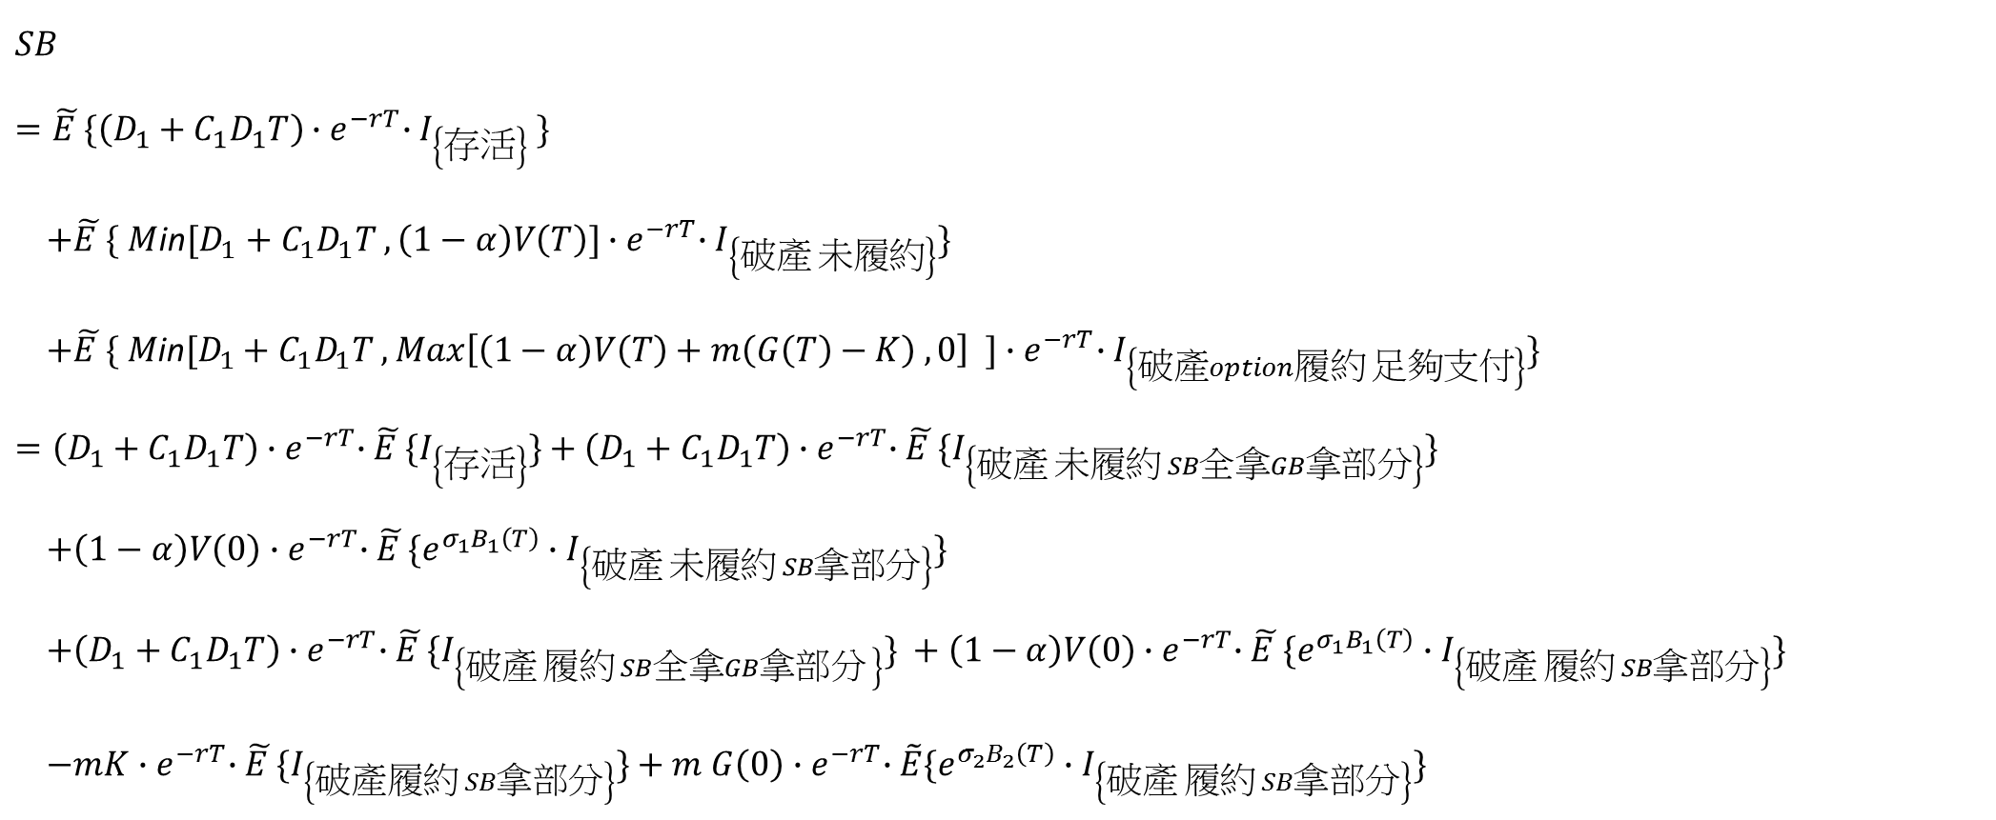
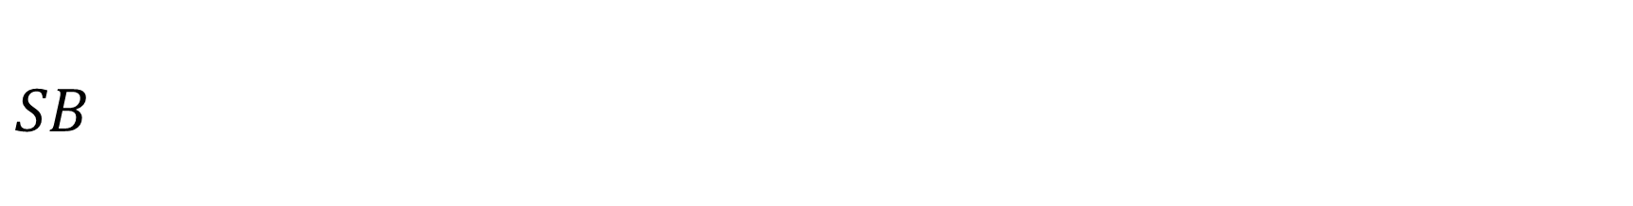
$$SB$$
$$SB$$
$$=\tilde{E }\{\left(D_{1}+C_{1}D_{1}T\right){∙e}^{−rT}∙I_{\left\{存活\right\}} \}$$
$+\tilde{E }\{ M$in$[D_{1}+C_{1}D_{1}T ,\left(1−α\right)V\left(T\right)]{∙e}^{−rT}∙I_{\left\{破產 未履約\right\}}\}$
$+\tilde{E }\{ M\text{in}[D_{1}+C_{1}D_{1}T , Max\left[\left(1−α\right)V\left(T\right)+m\left(G\left(T\right)−K\right) ,0\right] ]{∙e}^{−rT}∙I_{\left\{破產option履約 足夠支付\right\}}\}$
$$=\left(D_{1}+C_{1}D_{1}T\right){∙e}^{−rT}∙\tilde{E }\{I_{\left\{存活\right\}}\}+\left(D_{1}+C_{1}D_{1}T\right){∙e}^{−rT}∙\tilde{E }\{I_{\left\{破產 未履約 SB全拿GB拿部分\right\}}\}$$
$$+\left(1−α\right)V\left(0\right){∙e}^{−rT}∙\tilde{E }\{{e^{σ_{1}B_{1}\left(T\right)}∙I}_{\left\{破產 未履約 SB拿部分\right\}}\}$$
$$+\left(D_{1}+C_{1}D_{1}T\right){∙e}^{−rT}∙\tilde{E }\{I_{\left\{破產 履約 SB全拿GB拿部分 \right\}}\} +\left(1−α\right)V\left(0\right){∙e}^{−rT}∙\tilde{E }\{{e^{σ_{1}B_{1}\left(T\right)}∙I}_{\left\{破產 履約 SB拿部分\right\}}\}$$
$−mK{∙e}^{−rT}∙\tilde{E }\{I_{\left\{破產履約 SB拿部分\right\}}\}+m$ $G\left(0\right){∙e}^{−rT}∙\tilde{E}\{{e^{σ_{2}B_{2}\left(T\right)}∙I}_{\left\{破產 履約 SB拿部分\right\}}\}$

Slide 9
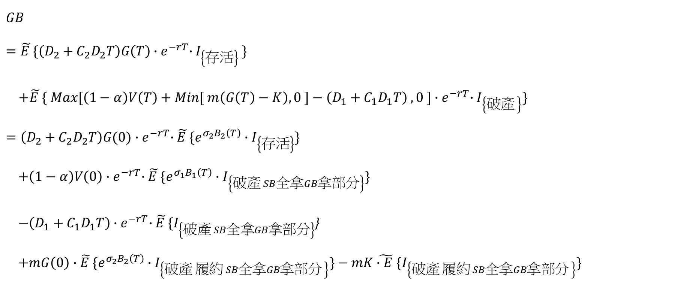
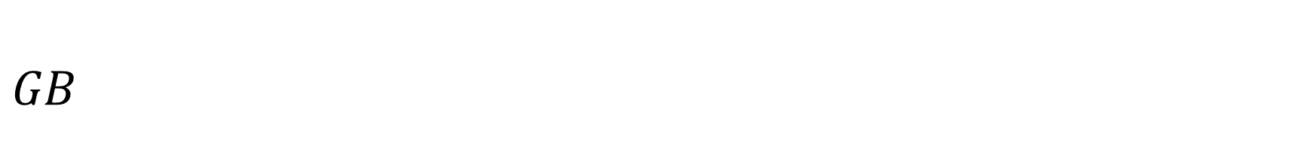
$$GB$$
$$GB$$
$$=\tilde{E }\{\left(D_{2}+C_{2}D_{2}T\right)G\left(T\right){∙e}^{−rT}∙I_{\left\{存活\right\}} \}$$
$+\tilde{E }\{ Max[\left(1−α\right)V\left(T\right)+Min[ m\left(G\left(T\right)−K\right), 0 ]−\left(D_{1}+C_{1}D_{1}T\right) , 0 ]{∙e}^{−rT}∙I_{\left\{破產 \right\}}\}$
$$=\left(D_{2}+C_{2}D_{2}T\right)G(0){∙e}^{−rT}∙\tilde{E }\{{e^{σ_{2}B_{2}\left(T\right)}∙I}_{\left\{存活\right\}}\}$$
$$+\left(1−α\right)V\left(0\right){∙e}^{−rT}∙\tilde{E }\{{e^{σ_{1}B_{1}\left(T\right)}∙I}_{\left\{破產 SB全拿GB拿部分\right\}}\}$$
$−\left(D_{1}+C_{1}D_{1}T\right){∙e}^{−rT}∙\tilde{E }\{I_{\left\{破產 SB全拿GB拿部分\right\}}$}
$$+mG\left(0\right)∙\tilde{E }\{e^{σ_{2}B_{2}\left(T\right)}∙I_{\left\{破產 履約 SB全拿GB拿部分 \right\}}\}−mK\tilde{∙E }\{I_{\left\{破產 履約 SB全拿GB拿部分 \right\}}\}$$
選擇權履約部分

Slide 10

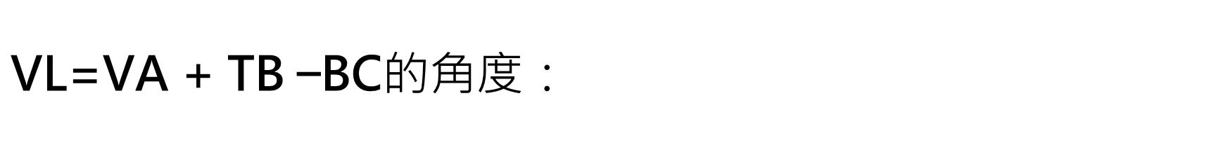
$$\text{VL}\text{=}\text{VA}\text{ + }\text{TB}\text{ −}\text{BC}\text{的角度：}$$
$$V_{A}=Call\left(K=0\right)$$
$$TB$$
$$=\tilde{E }\left\{{tax∙[C}_{1}D_{1}T+C_{2}D_{2}T∙G\left(T\right)\right]{∙e}^{−rT}∙I_{\left\{存活\right\}}\}$$
$$={tax∙C}_{1}D_{1}T{∙e}^{−rT}∙\tilde{E}\{I_{\left\{存活\right\}}\}$$
$$+tax∙C_{2}D_{2}T∙G\left(0\right){∙e}^{−rT}∙\tilde{E}\{{e^{σ_{2}B_{2}\left(T\right)}∙I}_{\left\{存活 \right\}}\}$$
$$BC$$
$$=\tilde{E }\{α∙V(T){∙e}^{−rT}∙\tilde{E}\{I_{\left\{破產\right\}}\}$$
$$=α∙V(0){∙e}^{−rT}∙\tilde{E}\{{e^{σ_{1}B_{1}\left(T\right)}∙I}_{\left\{破產\right\}}\}$$

Slide 11
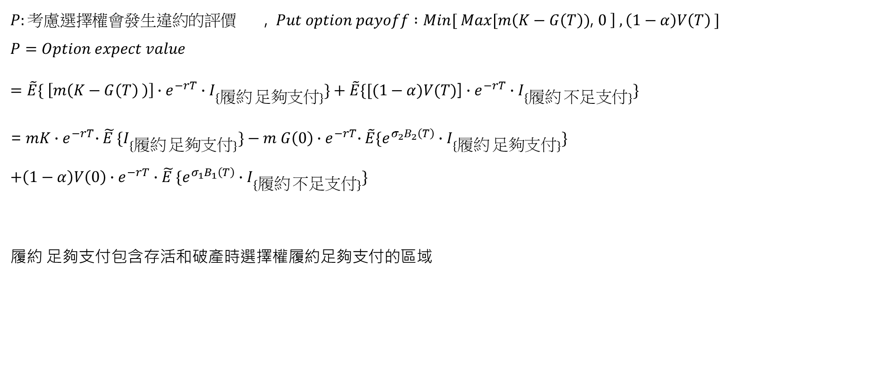
Option Premium
$P:考慮選擇權會發生違約的評價$ , $Put option payoff :Min[ Max[m\left(K−G\left(T\right)\text{)}\text{, }0 \right] , \left(1−α\right)V\left(T\right) ]$
$$P=Option expect value$$
$=\tilde{E}\{ \left[m\left(K−G\left(T\right) \right)\right]∙e^{−rT}∙I_{\{履約 足夠支付\}}\}+\tilde{E}\{[(1−α)V(T)$] $∙e^{−rT}∙I_{\{履約 不足支付\}}\}$
= $mK{∙e}^{−rT}∙\tilde{E }\{I_{\{履約 足夠支付\}}\}−m G\left(0\right){∙e}^{−rT}∙\tilde{E}\{{e^{σ_{2}B_{2}\left(T\right)}∙I}_{\{履約 足夠支付\}}\}$
$$+{\left(1−α\right)V\left(0\right)∙e}^{−rT}∙\tilde{E }\{{e^{σ_{1}B_{1}\left(T\right)}∙I}_{\{履約 不足支付\}}\}$$
履約 足夠支付包含存活和破產時選擇權履約足夠支付的區域
$$G(T)$$
破產 SB全拿
GB部份
破產 SB部份
GB無
(未履約)
存活(未履約)
$$G(0)$$
(選擇權履約 足夠支付)
存活 (選擇權履約)
選擇權
不足支付
$$V(T)$$
$$\left(1−α\right)V\left(T\right)+m\left(G\left(T\right)−K\right)=0$$

Slide 12
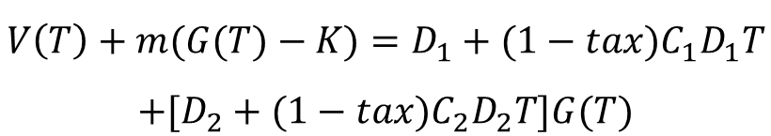

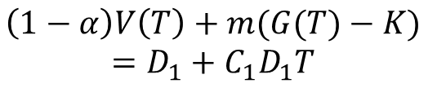
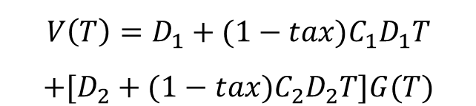
將V(T)、G(T)軸，經座標變換成B1(T)、 B2(T) 考慮轉換前、後的邊界與交點 設定積分區域
$$G(T)$$
$$\left(1−α\right)V\left(T\right)=D_{1}+C_{1}D_{1}T$$
$$V\left(T\right)=D_{1}+{(1−tax)C}_{1}D_{1}T$$
$$+[D_{2}+{(1−tax)C}_{2}D_{2}T]G(T)$$
破產 SB部份
GB無
(未履約)
破產 SB全拿
GB部份
存活(未履約)
$$G(0)$$
(選擇權履約 足夠支付)
存活 (選擇權履約)
選擇權
不足支付
$$\left(1−α\right)V\left(T\right)+m(G(T)−K)$$
$$=D_{1}+C_{1}D_{1}T$$
$$V(T)$$
$$\left(1−α\right)V\left(T\right)+m\left(G\left(T\right)−K\right)=0$$
$$V\left(T\right)+m(G(T)−K)=D_{1}+{(1−tax)C}_{1}D_{1}T$$
$$+[D_{2}+{(1−tax)C}_{2}D_{2}T]G(T)$$

Slide 13

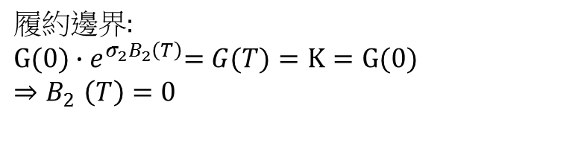
(一) 存活與破產的邊界(未履約)：
設$A=D_{1}+{\left(1−tax\right)C}_{1}D_{1}T , m=D_{2}+{\left(1−tax\right)C}_{2}D_{2}T$
$$未履約:V\left(T\right)=D_{1}+{(1−tax)C}_{1}D_{1}T+\left[D_{2}+{\left(1−tax\right)C}_{2}D_{2}T\right]∙G\left(T\right)$$
$$⇒V\left(0\right){∙e}^{σ_{1}B_{1}\left(T\right)}=A+m∙G(0){∙e}^{σ_{2}B_{2}\left(T\right)}$$
$⇒ m∙G\left(0\right){∙e}^{σ_{2}B_{2}\left(T\right)}=$ $V\left(0\right){∙e}^{σ_{1}B_{1}\left(T\right)}−A$
${⇒B}_{2}\left(T\right)=\frac{1}{σ_{2}}\ln{[ \frac{V\left(0\right){∙e}^{σ_{1}B_{1}\left(T\right)}−\text{A} }{m∙G\left(0\right)} }] →以d_{1}代表此方程式，$當$B_{2}\left(T\right)=0⇒ \frac{V\left(0\right){∙e}^{σ_{1}B_{1}\left(T\right)}−\text{A} }{m∙G\left(0\right)}=1 ⇒B_{1}\left(T\right)=\frac{1}{σ_{1}}\ln{[ \frac{A+m∙G(0)}{V(0)} }]$
$$A>0 ,當V\left(0\right){∙e}^{σ_{1}B_{1}\left(T\right)}−\text{A}→0$$
${ B}_{1}\left(T\right)→\frac{1}{σ_{1}}\ln\left[ \frac{A}{V\left(0\right)} \right]from the right⇒B_{2}\left(T\right)→−∞$
則$B_{1}\left(T\right)=\frac{1}{σ_{1}}\ln\left[ \frac{A}{V\left(0\right)} \right]為d_{1}$在$B_{1}\left(T\right)之漸近線→d_{1_b_{1}_asym}$
$$履約邊界:$$
$$G(0){∙e}^{σ_{2}B_{2}\left(T\right)}=G(T)=K=G(0)$$
$${⇒B}_{2}\left(T\right)=0$$

Slide 14






(二) 存活與破產的邊界(Option履約)：
$\text{設}A=D_{1}+\left(1−tax\right)C_{1}D_{1}T , m=D_{2}+{\left(1−tax\right)C}_{2}D_{2}T , K=G(0)$
$$履約:V\left(T\right)+m\left(G\left(T\right)−K\right)=D_{1}+{\left(1−tax\right)C}_{1}D_{1}T+\left[D_{2}+{\left(1−tax\right)C}_{2}D_{2}T\right]∙G\left(T\right)$$
$$⇒V\left(0\right){∙e}^{σ_{1}B_{1}\left(T\right)}+m\left(G\left(0\right){∙e}^{σ_{2}B_{2}\left(T\right)}−G(0)\right)=A+m∙G(0){∙e}^{σ_{2}B_{2}\left(T\right)}$$
(以放空賣權消除GB在黃金價格低時的避險效果才令$m=D_{2}+{\left(1−tax\right)C}_{2}D_{2}T )$
$$⇒ V\left(0\right){∙e}^{σ_{1}B_{1}\left(T\right)}=A+m∙G\left(0\right)$$
$⇒B_{1}\left(T\right)=\frac{1}{σ_{1}}\ln{[ \frac{A+m∙G(0)}{V(0)} }]→以d_{2}$代表此方程式
$$(A+m∙G\left(0\right)=$$
$D_{1}+\left(1−tax\right)C_{1}D_{1}T+m∙G\left(0\right)>0)$
$$b_{2}$$
$$d_{1_b_{1}_asym}$$
破產
$$d_{1}$$
$b_{1 }(履約邊界b_{2}=0$)
存活
$$d_{2}$$

Slide 15





(三) 破產、SB拿全部、GB拿部分與破產、SB拿部分、GB分不到邊界(未履約)
$$\text{設}A=D_{1}+{\left(1−tax\right)C}_{1}D_{1}T , m=D_{2}+{\left(1−tax\right)C}_{2}D_{2}T$$
$$未履約: \left(1−α\right)V\left(T\right)=D_{1}+C_{1}D_{1}T$$
$$⇒\left(1−α\right)V\left(0\right){∙e}^{σ_{1}B_{1}\left(T\right)}=A+tax{∙C}_{1}D_{1}T$$
$⇒B_{1}\left(T\right)=\frac{1}{σ_{1}}\ln{[ \frac{A+tax{∙C}_{1}D_{1}T }{(1−α)V(0)} }]→以d_{3}$代表此方程式
$$A+tax{∙C}_{1}D_{1}T=D_{1}+C_{1}D_{1}T>0$$
$$\{ If A+tax{∙C}_{1}D_{1}T>(1−α)(A+m∙G\left(0\right))$$
$$\frac{1}{σ_{1}}\ln{[ \frac{A+tax{∙C}_{1}D_{1}T }{(1−α)V(0)} }]>\frac{1}{σ_{1}}\ln{[ \frac{A+m∙G(0)}{V(0)} ]} \}$$
$${⇒d}_{3}在d_{2}右方$$
$$b_{2}$$
$$d_{1_b_{1}_asym}$$
破產
SB全拿
GB部份
$$d_{3}$$
破產
SB部分
GB無
$$d_{1}$$
$b_{1 }(履約邊界b_{2}=0$)
存活
$$d_{2}$$

Slide 16
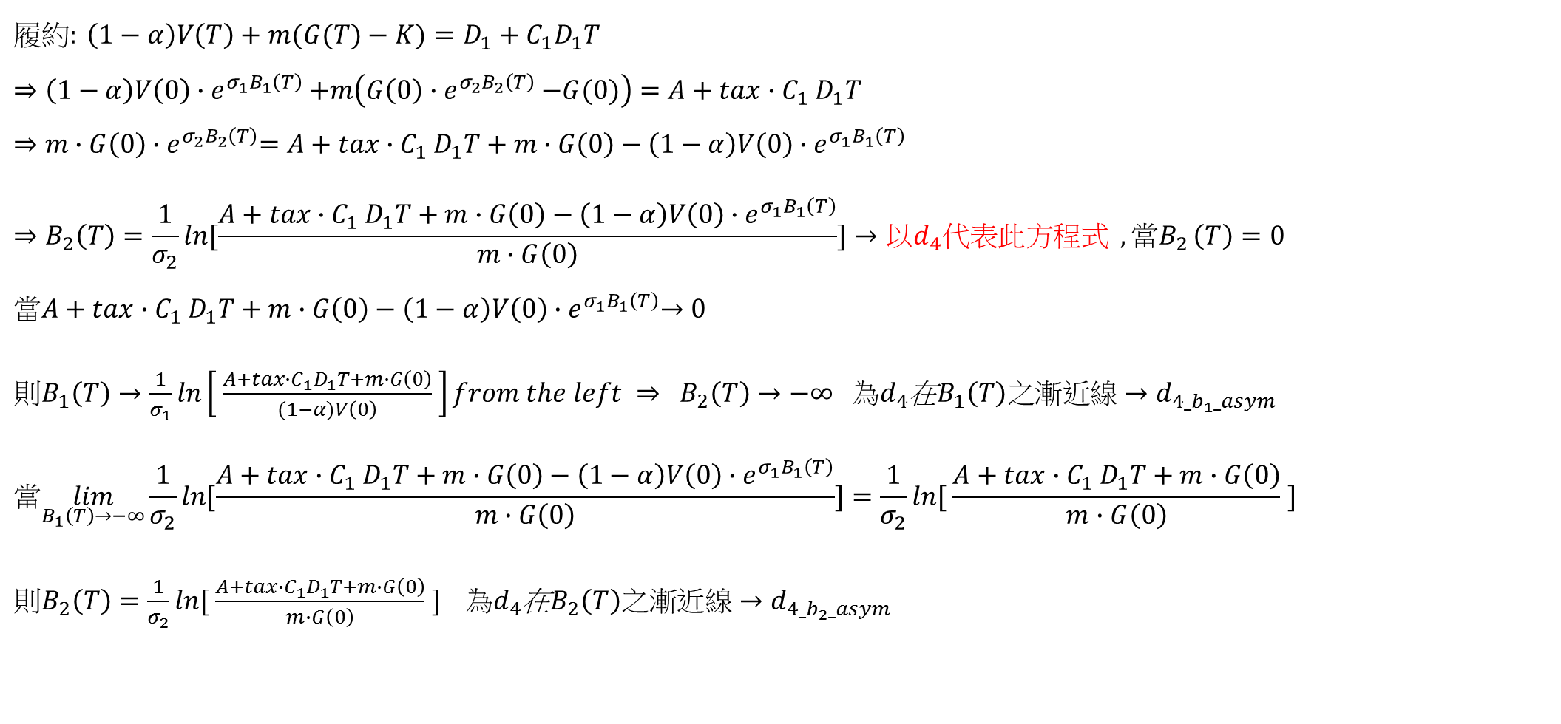
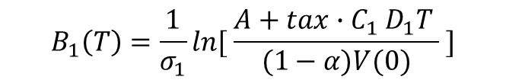
(四) 破產、SB拿全部、GB拿部分與破產、SB拿部分、GB分不到邊界(Option履約)
$$履約: \left(1−α\right)V\left(T\right)+m(G(T)−K)=D_{1}+C_{1}D_{1}T$$
$$⇒\left(1−α\right)V\left(0\right){∙e}^{σ_{1}B_{1}\left(T\right)}+m\left(G\left(0\right){∙e}^{σ_{2}B_{2}\left(T\right)}−G(0)\right)=A+tax{∙C}_{1}D_{1}T$$
$$⇒m∙G\left(0\right){∙e}^{σ_{2}B_{2}\left(T\right)}=A+tax{∙C}_{1}D_{1}T+m∙G\left(0\right)−\left(1−α\right)V\left(0\right){∙e}^{σ_{1}B_{1}\left(T\right)}$$
$$⇒B_{2}\left(T\right)=\frac{1}{σ_{2}}\ln{[\frac{A+tax{∙C}_{1}D_{1}T+m∙G\left(0\right)−\left(1−α\right)V\left(0\right){∙e}^{σ_{1}B_{1}\left(T\right)}}{m∙G\left(0\right)}}]→以d_{4}\text{代表此方程式} {,當B}_{2}\left(T\right)=0$$
$$當A+tax{∙C}_{1}D_{1}T+m∙G\left(0\right)−\left(1−α\right)V\left(0\right){∙e}^{σ_{1}B_{1}\left(T\right)}→0$$
${則B}_{1}\left(T\right)→\frac{1}{σ_{1}}\ln\left[ \frac{A+tax{∙C}_{1}D_{1}T+m∙G\left(0\right)}{(1−α)V\left(0\right)} \right]from the left ⇒ B_{2}\left(T\right)→−∞$ $為d_{4}$在$B_{1}\left(T\right)之漸近線→d_{4_b_{1}_asym}$
$$當\lim_{B_{1}\left(T\right)→−∞}{\frac{1}{σ_{2}}\ln{[\frac{A+tax{∙C}_{1}D_{1}T+m∙G\left(0\right)−\left(1−α\right)V\left(0\right){∙e}^{σ_{1}B_{1}\left(T\right)}}{m∙G\left(0\right)}}]=\frac{1}{σ_{2}}\ln{[ \frac{A+tax{∙C}_{1}D_{1}T+m∙G\left(0\right)}{m∙G\left(0\right)} }] }$$
$則B_{2}\left(T\right)=\frac{1}{σ_{2}}\ln{[ \frac{A+tax{∙C}_{1}D_{1}T+m∙G\left(0\right)}{m∙G\left(0\right)} }] 為d_{4}$在$B_{2}\left(T\right)之漸近線→d_{4_b_{2}_asym}$
$$B_{1}\left(T\right)=\frac{1}{σ_{1}}\ln{[ \frac{A+tax{∙C}_{1}D_{1}T }{(1−α)V(0)} }]$$

Slide 17
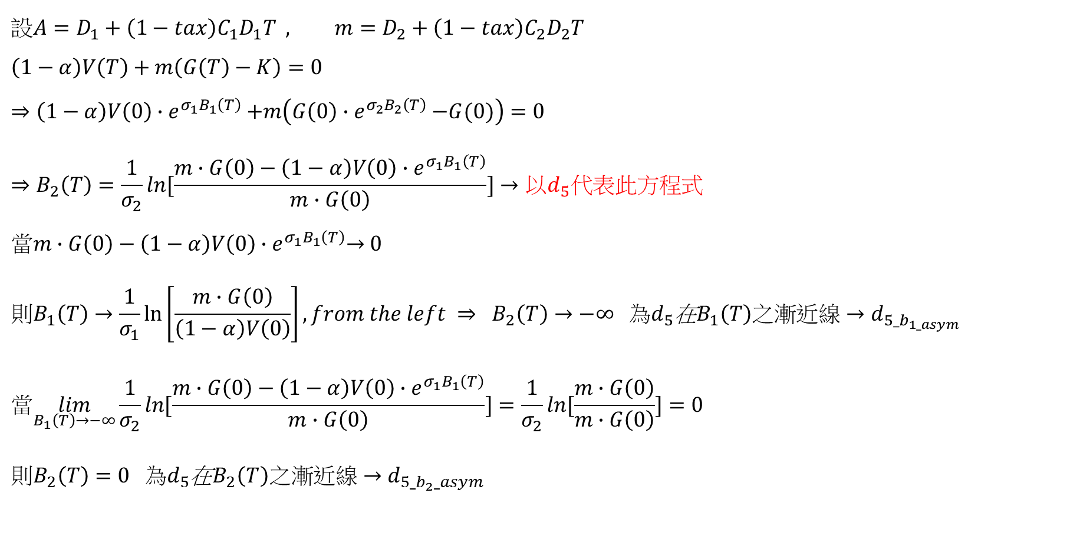
(五)破產、SB拿部分、GB分不到(Option履約)與選擇權不足支付邊界
$$\text{設}A=D_{1}+{\left(1−tax\right)C}_{1}D_{1}T , m=D_{2}+{\left(1−tax\right)C}_{2}D_{2}T \\ \left(1−α\right)V\left(T\right)+m\left(G\left(T\right)−K\right)=0$$
$$⇒\left(1−α\right)V\left(0\right){∙e}^{σ_{1}B_{1}\left(T\right)}+m\left(G\left(0\right){∙e}^{σ_{2}B_{2}\left(T\right)}−G(0)\right)=0$$
$$⇒B_{2}\left(T\right)=\frac{1}{σ_{2}}\ln{[\frac{m∙G\left(0\right)−\left(1−α\right)V\left(0\right){∙e}^{σ_{1}B_{1}\left(T\right)}}{m∙G\left(0\right)}}]→以d_{5}\text{代表此方程式}$$
$$當m∙G\left(0\right)−\left(1−α\right)V\left(0\right){∙e}^{σ_{1}B_{1}\left(T\right)}→0$$
$${則B}_{1}\left(T\right)→\frac{1}{σ_{1}}\ln\left[\frac{m∙G\left(0\right)}{\left(1−α\right)V\left(0\right)}\right],from the left ⇒ B_{2}\left(T\right)→−∞ 為d_{5}\text{在}B_{1}\left(T\right)之漸近線→d_{5_b_{1_asym}}$$
$$當\lim_{B_{1}\left(T\right)→−∞}\frac{1}{σ_{2}}\ln{[\frac{m∙G\left(0\right)−\left(1−α\right)V\left(0\right){∙e}^{σ_{1}B_{1}\left(T\right)}}{m∙G\left(0\right)}}]=\frac{1}{σ_{2}}\ln{[\frac{m∙G\left(0\right)}{m∙G\left(0\right)}}]=0$$
$則B_{2}\left(T\right)=0 為d_{5}$在$B_{2}\left(T\right)之漸近線→d_{5_b_{2}_asym}$

Slide 18
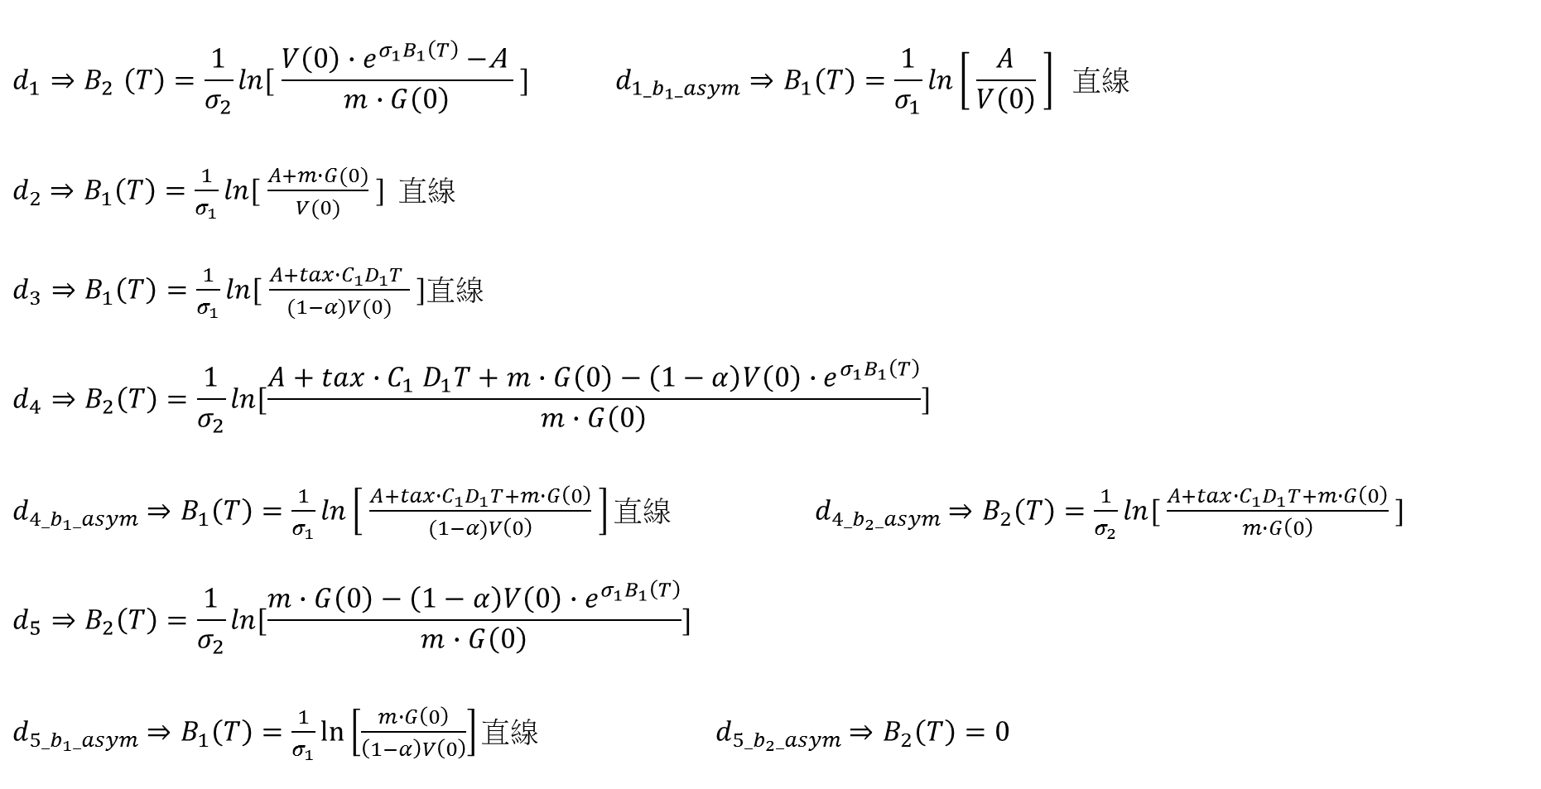
邊界和漸近線之大小關係
$$d_{1}{⇒B}_{2}\left(T\right)=\frac{1}{σ_{2}}\ln{[ \frac{V\left(0\right){∙e}^{σ_{1}B_{1}\left(T\right)}−\text{A} }{m∙G\left(0\right)} }] d_{1_b_{1}_asym}⇒B_{1}\left(T\right)=\frac{1}{σ_{1}}\ln\left[ \frac{A}{V\left(0\right)} \right] 直線$$
$d_{2}$ $⇒B_{1}\left(T\right)=\frac{1}{σ_{1}}\ln{[ \frac{A+m∙G(0)}{V(0)} }]$ 直線
$d_{3}⇒B_{1}\left(T\right)=\frac{1}{σ_{1}}\ln{[ \frac{A+tax{∙C}_{1}D_{1}T }{(1−α)V(0)} }]$直線
$$d_{4}⇒B_{2}\left(T\right)=\frac{1}{σ_{2}}\ln{[\frac{A+tax{∙C}_{1}D_{1}T+m∙G\left(0\right)−\left(1−α\right)V\left(0\right){∙e}^{σ_{1}B_{1}\left(T\right)}}{m∙G\left(0\right)}}]$$
$d_{4_b_{1}_asym}$ $⇒B_{1}\left(T\right)=\frac{1}{σ_{1}}\ln\left[ \frac{A+tax{∙C}_{1}D_{1}T+m∙G\left(0\right)}{(1−α)V\left(0\right)} \right]\text{直線} d_{4_b_{2}_asym}$ $⇒B_{2}\left(T\right)=\frac{1}{σ_{2}}\ln{[ \frac{A+tax{∙C}_{1}D_{1}T+m∙G\left(0\right)}{m∙G\left(0\right)} }]$
$$d_{5}⇒B_{2}\left(T\right)=\frac{1}{σ_{2}}\ln{[\frac{m∙G\left(0\right)−\left(1−α\right)V\left(0\right){∙e}^{σ_{1}B_{1}\left(T\right)}}{m∙G\left(0\right)}}]$$
$d_{5_b_{1}_asym}$ $⇒B_{1}\left(T\right)=\frac{1}{σ_{1}}\ln\left[\frac{m∙G\left(0\right)}{\left(1−α\right)V\left(0\right)}\right]\text{直線} d_{5_b_{2}_asym}$ $⇒B_{2}\left(T\right)=0$

Slide 19
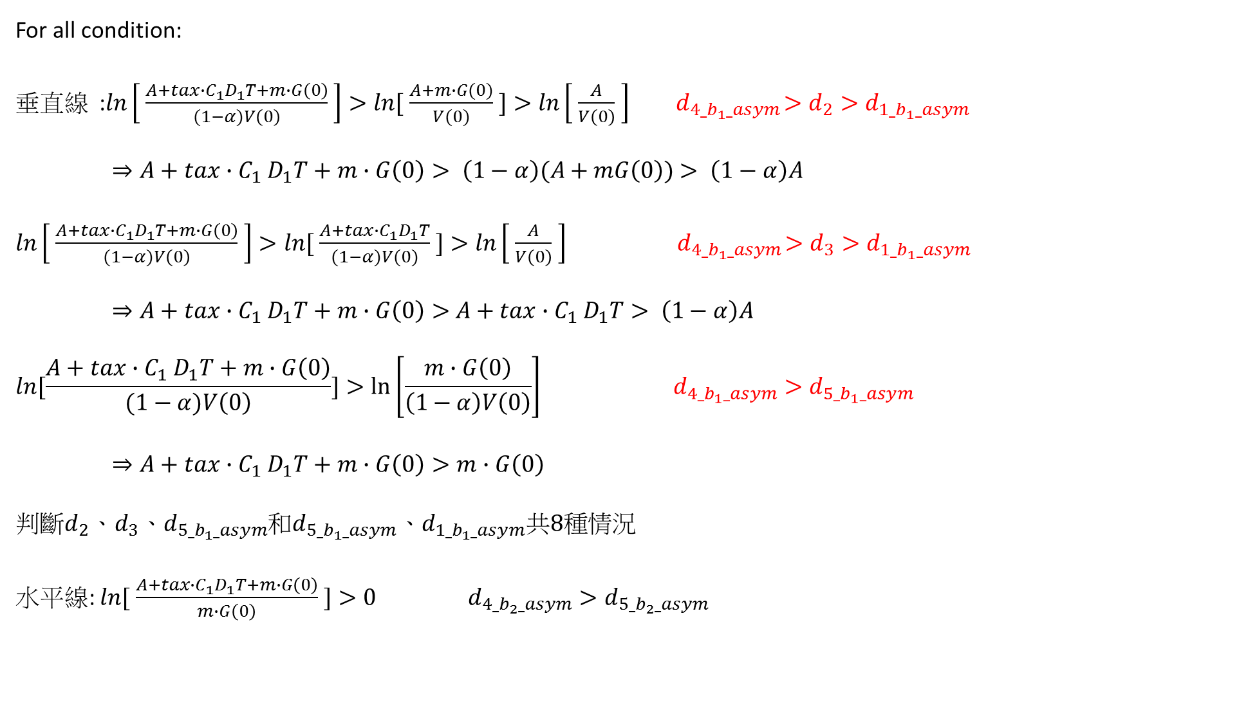
For all condition:
垂直線 :$\ln\left[ \frac{A+tax{∙C}_{1}D_{1}T+m∙G\left(0\right)}{(1−α)V\left(0\right)} \right]>\ln{[ \frac{A+m∙G(0)}{V(0)} }]>\ln\left[ \frac{A}{V\left(0\right)} \right] { d}_{4_b_{1}_asym}>d_{2}>d_{1_b_{1}_asym}$
$⇒A+tax{∙C}_{1}D_{1}T+m∙G\left(0\right)> \left(1−α\right)(A+mG\left(0\right))$ $> \left(1−α\right)A$
${\ln\left[ \frac{A+tax{∙C}_{1}D_{1}T+m∙G\left(0\right)}{(1−α)V\left(0\right)} \right]>\ln{[ \frac{A+tax{∙C}_{1}D_{1}T}{(1−α)V(0)} }]>\ln\left[ \frac{A}{V\left(0\right)} \right] { d}_{4_b_{1}_asym}>d}_{3}>d_{1_b_{1}_asym}$
$⇒A+tax{∙C}_{1}D_{1}T+m∙G\left(0\right)>$ $A+tax{∙C}_{1}D_{1}T> \left(1−α\right)A$
$$\ln{[\frac{A+tax{∙C}_{1}D_{1}T+m∙G\left(0\right)}{(1−α)V\left(0\right)}]}>\ln\left[\frac{m∙G\left(0\right)}{\left(1−α\right)V\left(0\right)}\right] d_{4_b_{1}_asym}>d_{5_b_{1}_asym}$$
$⇒A+tax{∙C}_{1}D_{1}T+m∙G\left(0\right)>m∙G\left(0\right)$
判斷$d_{2}{、d}_{3}、d_{5_b_{1}_asym}$和$d_{5_b_{1}_asym}{、d}_{1_b_{1}_asym}共8種情況$
水平線: $\ln{[ \frac{A+tax{∙C}_{1}D_{1}T+m∙G\left(0\right)}{m∙G\left(0\right)} }]>0 d_{4_b_{2}_asym}>d_{5_b_{2}_asym}$

Slide 20
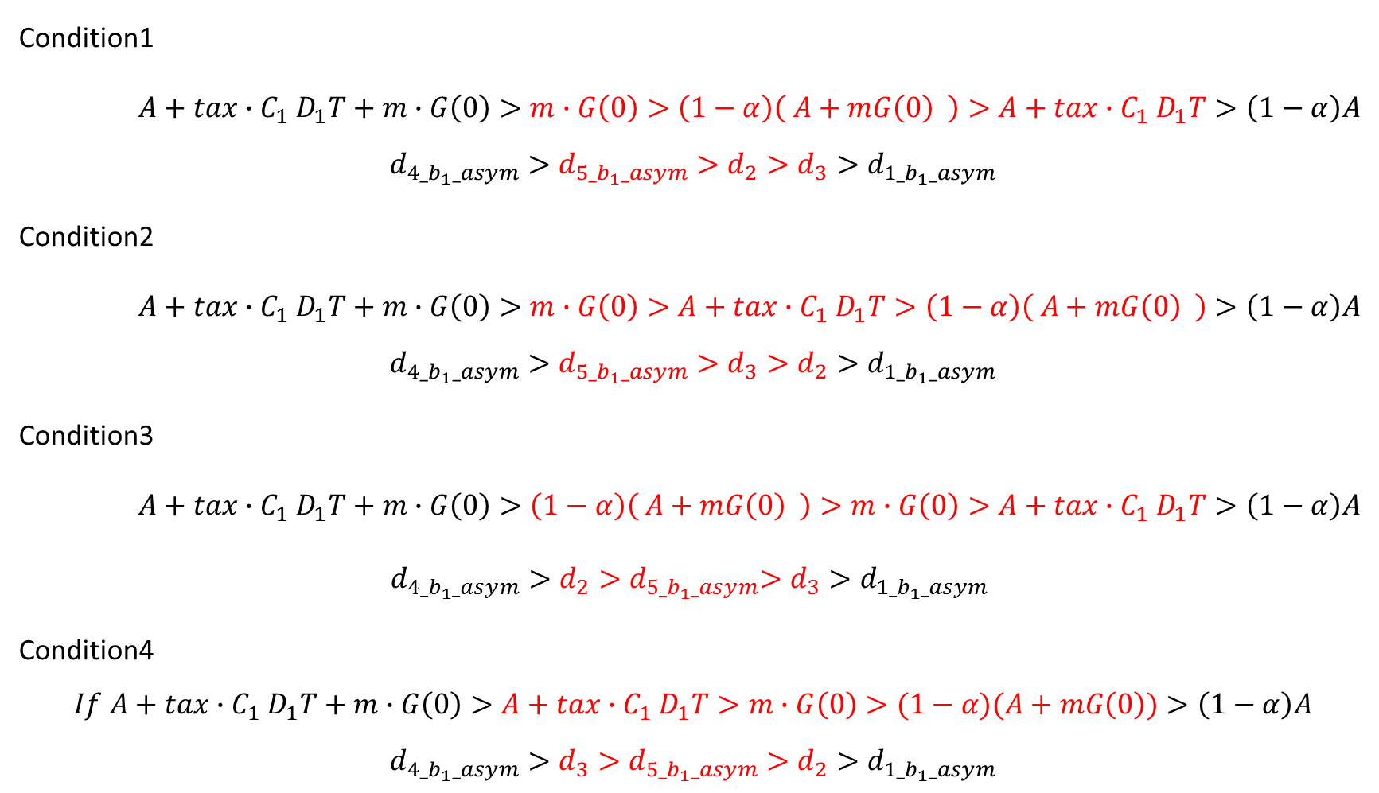
Condition1
$A+tax{∙C}_{1}D_{1}T+m∙G\left(0\right)>m∙G\left(0\right)>\left(1−α\right)\left( A+mG\left(0\right) \right)>A+tax{∙C}_{1}D_{1}T>\left(1−α\right)A$
$${d_{4_b_{1}_asym}>d_{5_b_{1}_asym}>d}_{2}>d_{3}>d_{1_b_{1}_asym}$$
Condition2
$A+tax{∙C}_{1}D_{1}T+m∙G\left(0\right)>m∙G\left(0\right)>A+tax{∙C}_{1}D_{1}T>\left(1−α\right)\left( A+mG\left(0\right) \right)>\left(1−α\right)A$
$${d_{4_b_{1}_asym}>d_{5_b_{1}_asym}>d}_{3}>d_{2}>d_{1_b_{1}_asym}$$
Condition3
$A+tax{∙C}_{1}D_{1}T+m∙G\left(0\right)>\left(1−α\right)\left( A+mG\left(0\right) \right)>m∙G\left(0\right)>A+tax{∙C}_{1}D_{1}T>\left(1−α\right)A$
${d_{4_b_{1}_asym}>d}_{2}{>d}_{5_b_{1}_asym}>d_{3}>d_{1_b_{1}_asym}$
Condition4
$$If A+tax{∙C}_{1}D_{1}T+m∙G\left(0\right)>A+tax{∙C}_{1}D_{1}T>m∙G\left(0\right)>(1−α)(A+mG\left(0\right))>\left(1−α\right)A$$
$${d_{4_b_{1}_asym}>d}_{3}>{d_{5_b_{1}_asym}>d}_{2}>d_{1_b_{1}_asym}$$

Slide 21
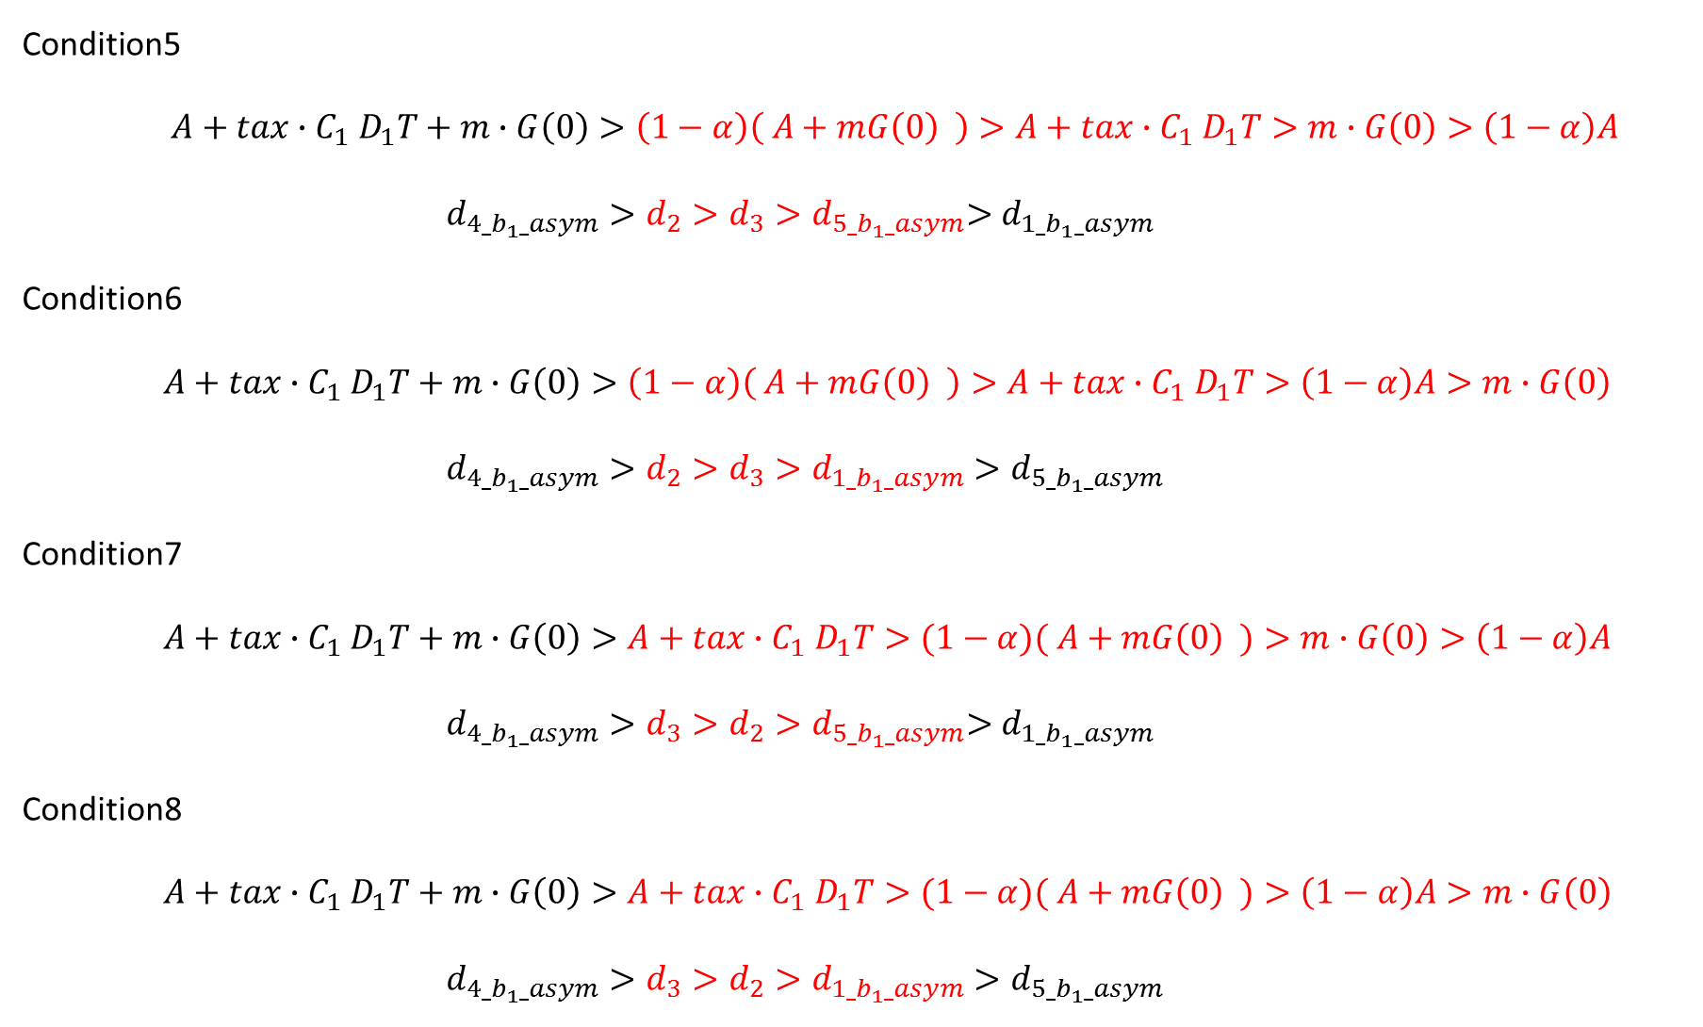
$$\text{Condition}\text{5}$$
$A+tax{∙C}_{1}D_{1}T+m∙G\left(0\right)>\left(1−α\right)\left( A+mG\left(0\right) \right)>A+tax{∙C}_{1}D_{1}T>m∙G\left(0\right)>\left(1−α\right)A$
${d_{4_b_{1}_asym}>d}_{2}>d_{3}{>d}_{5_b_{1}_asym}>d_{1_b_{1}_asym}$
Condition6
$A+tax{∙C}_{1}D_{1}T+m∙G\left(0\right)>\left(1−α\right)\left( A+mG\left(0\right) \right)>A+tax{∙C}_{1}D_{1}T>\left(1−α\right)A>m∙G\left(0\right)$
${d_{4_b_{1}_asym}>d}_{2}>d_{3}{>d_{1_b_{1}_asym}>d}_{5_b_{1}_asym}$
Condition7
$A+tax{∙C}_{1}D_{1}T+m∙G\left(0\right)>A+tax{∙C}_{1}D_{1}T>(1−α)( A+mG\left(0\right) )>m∙G\left(0\right)>\left(1−α\right)A$
${d_{4_b_{1}_asym}>d}_{3}>d_{2}{>d}_{5_b_{1}_asym}>d_{1_b_{1}_asym}$
Condition8
$A+tax{∙C}_{1}D_{1}T+m∙G\left(0\right)>A+tax{∙C}_{1}D_{1}T>(1−α)( A+mG\left(0\right) )>\left(1−α\right)A>m∙G\left(0\right)$
${d_{4_b_{1}_asym}>d}_{3}>d_{2}{>d_{1_b_{1}_asym}>d}_{5_b_{1}_asym}$

Slide 22




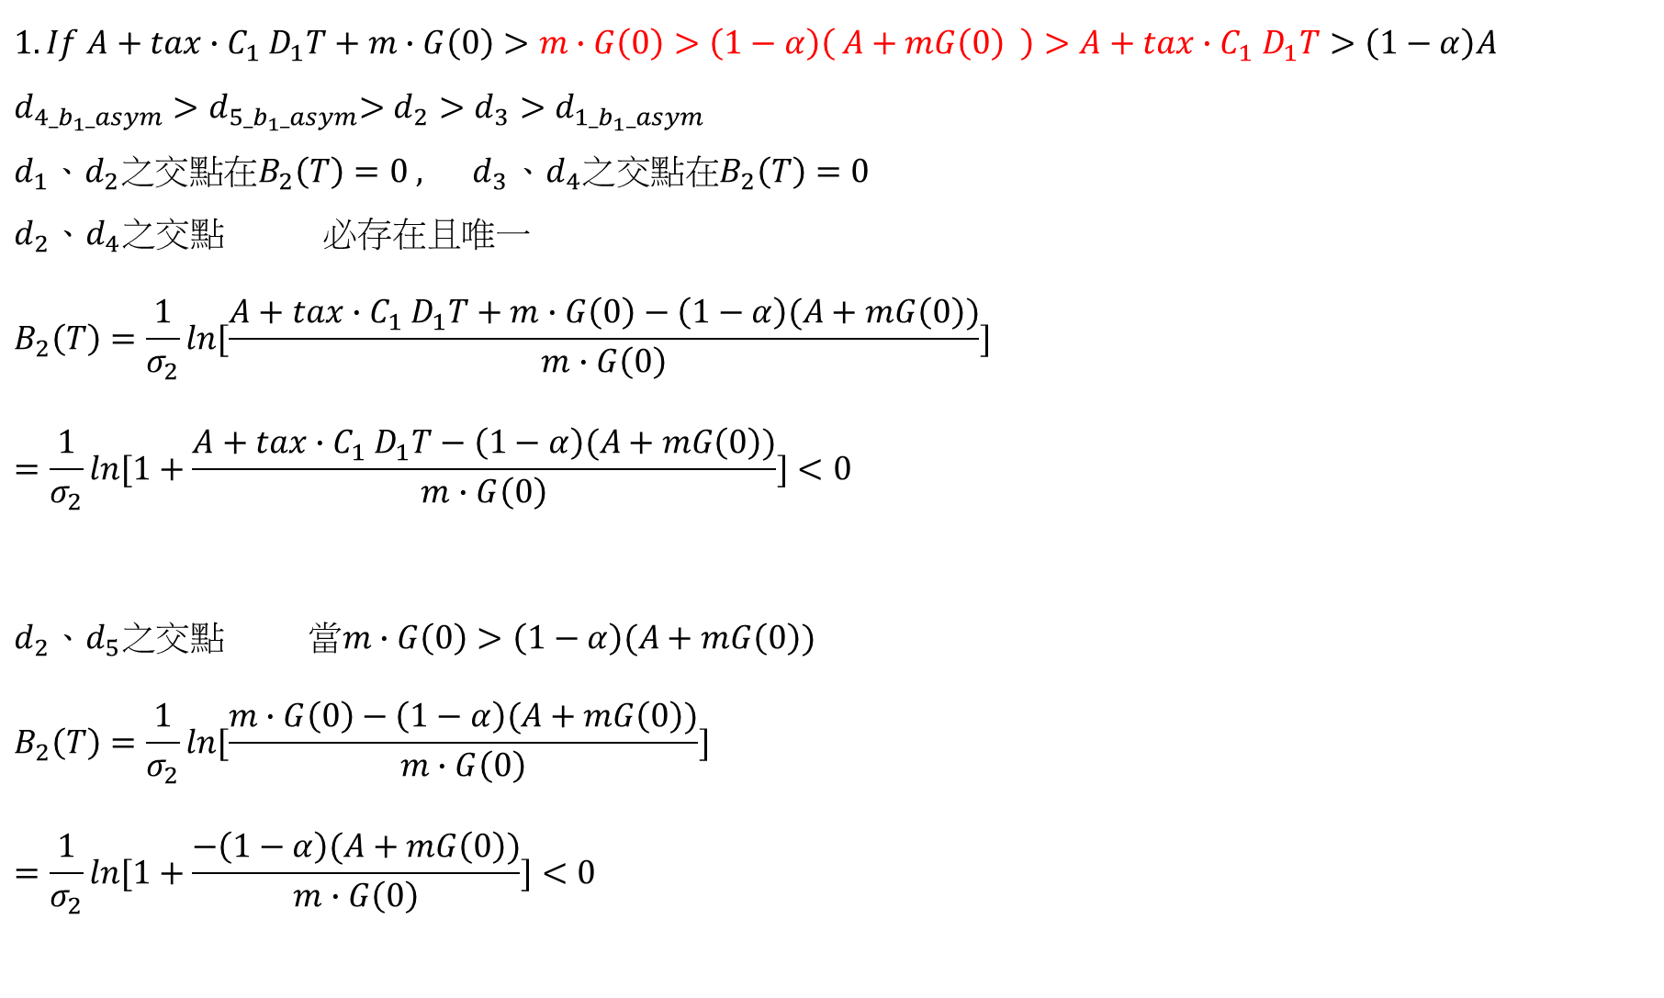
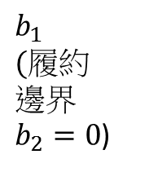







$$1.If A+tax{∙C}_{1}D_{1}T+m∙G\left(0\right)>m∙G\left(0\right)>\left(1−α\right)\left( A+mG\left(0\right) \right)>A+tax{∙C}_{1}D_{1}T>\left(1−α\right)A$$
$${d_{4_b_{1}_asym}{>d}_{5_b_{1}_asym}>d}_{2}>d_{3}>d_{1_b_{1}_asym}$$
$$d_{1}{、d}_{2}之交點在B_{2}\left(T\right)=0 , { d}_{3}{、d}_{4}之交點在B_{2}\left(T\right)=0$$
$$d_{2}{、d}_{4}之交點 必存在且唯一$$
$$B_{2}\left(T\right)=\frac{1}{σ_{2}}\ln{[\frac{A+tax{∙C}_{1}D_{1}T+m∙G\left(0\right)−\left(1−α\right)(A+mG\left(0\right))}{m∙G\left(0\right)}}]$$
$$=\frac{1}{σ_{2}}ln[1+\frac{A+tax{∙C}_{1}D_{1}T−\left(1−α\right)(A+mG\left(0\right))}{m∙G\left(0\right)}]<0$$
$$d_{2}{、d}_{5}之交點 當m∙G\left(0\right)>\left(1−α\right)(A+mG\left(0\right))$$
$$B_{2}\left(T\right)=\frac{1}{σ_{2}}\ln{[\frac{m∙G\left(0\right)−\left(1−α\right)(A+mG\left(0\right))}{m∙G\left(0\right)}}]$$
$$=\frac{1}{σ_{2}}\ln{[1+\frac{−\left(1−α\right)(A+mG\left(0\right))}{m∙G\left(0\right)}}]<0$$
$$d_{1_b_{1}_asym}$$
$$d_{4_b_{1}_asym}$$
$$b_{2}$$
破產
SB部分
GB無
未履約
破產 SB全拿
GB部份 未履約
$$d_{3}$$
$$d_{1}$$
$$d_{4_b_{2}_asym}$$
存活(未履約)
$$b_{1 }$$
$$(履約$$
$$邊界$$
$b_{2}=0$)
$$d_{5_b_{2}_asym}$$
破產SB部分
GB無 履約
$$d_{5}$$
$$d_{4}$$
破產
不足支付
存活 (履約)
$$d_{2}$$
$$d_{5_b_{1}_asym}$$

Slide 23













$$1.If A+tax{∙C}_{1}D_{1}T+m∙G\left(0\right)>m∙G\left(0\right)>\left(1−α\right)\left( A+mG\left(0\right) \right)>A+tax{∙C}_{1}D_{1}T>\left(1−α\right)A$$
$$d_{1_b_{1}_asym}$$
$$d_{4_b_{1}_asym}$$
$${d_{4_b_{1}_asym}{>d}_{5_b_{1}_asym}>d}_{2}>d_{3}>d_{1_b_{1}_asym}$$
$$b_{2}$$
$$d_{4_b_{2}_asym}>d_{5_b_{2}_asym}$$
破產
SB部分
GB無
未履約
破產 SB全拿
GB部份 未履約
$$d_{3}$$
$$d_{1}$$
$$d_{4_b_{2}_asym}$$
存活(未履約)
$$G(T)$$
$$d_{5_b_{2}_asym}$$
$$b_{1 }$$
$$(履約邊界$$
$b_{2}=0$)
破產 SB全拿 GB部份
(未履約)
破產SB部分
GB無 履約
破產 SB部份
GB無
(未履約)
$$d_{5}$$
$$d_{4}$$
破產
不足支付
存活 (履約)
$$d_{2}$$
存活(未履約)
$$G(0)$$
破產 SB全拿 GB部份(履約)
$$d_{5_b_{1}_asym}$$
破產 SB部份
GB無(履約)
存活 (履約)
破產(履約)
不足支付
破產 SB全拿 GB部份(履約)
$$V(T)$$

Slide 24
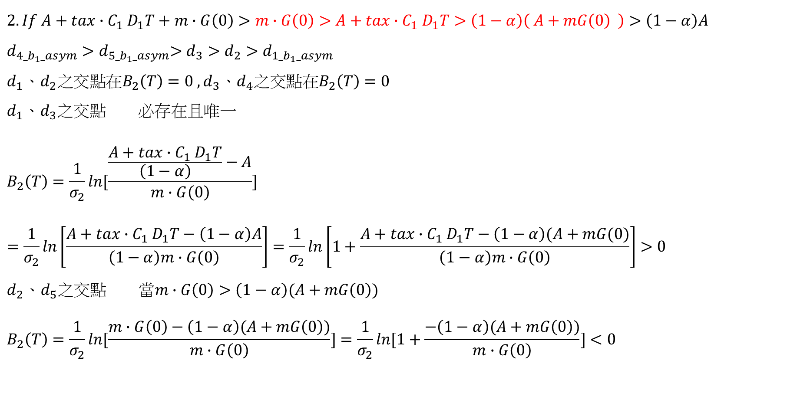
$2.If A+tax{∙C}_{1}D_{1}T+m∙G\left(0\right)>m∙G\left(0\right)>A+tax{∙C}_{1}D_{1}T>\left(1−α\right)\left( A+mG\left(0\right) \right)>\left(1−α\right)A$
$${d_{4_b_{1}_asym}{>d}_{5_b_{1}_asym}>d}_{3}>d_{2}>d_{1_b_{1}_asym}$$
$$d_{1}{、d}_{2}之交點在B_{2}\left(T\right)=0 , d_{3}{、d}_{4}之交點在B_{2}\left(T\right)=0$$
$$d_{1}{、d}_{3}之交點 必存在且唯一$$
$$B_{2}\left(T\right)=\frac{1}{σ_{2}}\ln{[\frac{\frac{A+tax{∙C}_{1}D_{1}T}{\left(1−α\right)}−A}{m∙G\left(0\right)}}]$$
$$=\frac{1}{σ_{2}}ln\left[\frac{A+tax{∙C}_{1}D_{1}T−\left(1−α\right)A}{\left(1−α\right)m∙G\left(0\right)}\right]=\frac{1}{σ_{2}}ln\left[1+\frac{A+tax{∙C}_{1}D_{1}T−\left(1−α\right)(A+mG(0)}{\left(1−α\right)m∙G\left(0\right)}\right]>0$$
$$d_{2}{、d}_{5}之交點 當m∙G\left(0\right)>\left(1−α\right)(A+mG\left(0\right))$$
$$B_{2}\left(T\right)=\frac{1}{σ_{2}}\ln{[\frac{m∙G\left(0\right)−\left(1−α\right)(A+mG\left(0\right))}{m∙G\left(0\right)}}]=\frac{1}{σ_{2}}\ln{[1+\frac{−\left(1−α\right)(A+mG\left(0\right))}{m∙G\left(0\right)}}]<0$$

Slide 25








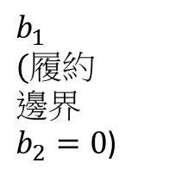


$2.If A+tax{∙C}_{1}D_{1}T+m∙G\left(0\right)>m∙G\left(0\right)>A+tax{∙C}_{1}D_{1}T>\left(1−α\right)\left( A+mG\left(0\right) \right)>\left(1−α\right)A$
$${d_{4_b_{1}_asym}{>d}_{5_b_{1}_asym}>d}_{3}>d_{2}>d_{1_b_{1}_asym}$$
$$d_{1_b_{1}_asym}$$
$$b_{2}$$
$$d_{4_b_{1}_asym}$$
$$d_{4_b_{2}_asym}>d_{5_b_{2}_asym}$$
破產
SB部分
GB無
未履約
破產 SB全拿
GB部份 未履約
$$d_{3}$$
$$d_{1}$$
$$d_{4_b_{2}_asym}$$
存活(未履約)
$$d_{5_b_{2}_asym}$$
$$b_{1 }$$
$$(履約$$
$$邊界$$
$b_{2}=0$)
$$d_{5}$$
破產SB部分
GB無 履約
$$G(T)$$
破產 SB全拿 GB部份
(未履約)
破產 SB部份
GB無
(未履約)
破產
不足支付
存活 (履約)
$$d_{4}$$
$$d_{2}$$
存活(未履約)
$$G(0)$$
破產 SB部份
GB無(履約)
$$d_{5_b_{1}_asym}$$
破產(履約)
不足支付
存活 (履約)
$$V(T)$$

Slide 26











$$3.If A+tax{∙C}_{1}D_{1}T+m∙G\left(0\right)>\left(1−α\right)\left( A+mG\left(0\right) \right)>m∙G\left(0\right)>A+tax{∙C}_{1}D_{1}T>\left(1−α\right)A$$
$${d_{4_b_{1}_asym}>d}_{2}{>d}_{5_b_{1}_asym}>d_{3}>d_{1_b_{1}_asym}$$
$$d_{1}{、d}_{2}之交點在B_{2}\left(T\right)=0 , d_{3}{、d}_{4}之交點在B_{2}\left(T\right)=0$$
$$d_{2}{、d}_{4}之交點 必存在且唯一$$
$$⇒B_{2}\left(T\right)=\frac{1}{σ_{2}}\ln{[\frac{A+tax{∙C}_{1}D_{1}T+m∙G\left(0\right)−\left(1−α\right)(A+mG\left(0\right))}{m∙G\left(0\right)}}]$$
$$=\frac{1}{σ_{2}}ln[1+\frac{A+tax{∙C}_{1}D_{1}T−\left(1−α\right)(A+mG\left(0\right))}{m∙G\left(0\right)}]<0$$
$$d_{1_b_{1}_asym}$$
$$b_{2}$$
$$d_{4_b_{1}_asym}$$
破產
SB部分
GB無
未履約
破產
SB全拿
GB部份
未履約
$$d_{3}$$
$$d_{1}$$
$$d_{4_b_{2}_asym}$$
$$G(T)$$
存活(未履約)
破產 SB全拿 GB部份
(未履約)
$$d_{5_b_{2}_asym}$$
$$b_{1 }$$
$$(履約$$
$$邊界$$
$b_{2}=0$)
破產 SB部份
GB無
(未履約)
破產SB部分
GB無 履約
$$d_{5}$$
$$d_{4}$$
存活 (履約)
存活(未履約)
破產
不足支付
$$G(0)$$
破產 SB全拿 GB部份(履約)
破產 SB部份
GB無(履約)
$$d_{2}$$
存活 (履約)
破產(履約)
不足支付
$$V(T)$$
破產 SB全拿 GB部份(履約)
$$d_{5_b_{1}_asym}$$

Slide 27




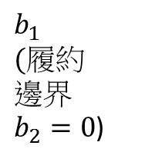




$$4.If A+tax{∙C}_{1}D_{1}T+m∙G\left(0\right)>A+tax{∙C}_{1}D_{1}T>m∙G\left(0\right)>(1−α)(A+mG\left(0\right))>\left(1−α\right)A$$
$${d_{4_b_{1}_asym}>d}_{3}>{d_{5_b_{1}_asym}>d}_{2}>d_{1_b_{1}_asym}$$
$$d_{1}{、d}_{2}之交點在B_{2}\left(T\right)=0 , d_{3}{、d}_{4}之交點在B_{2}\left(T\right)=0$$
$$d_{1}{、d}_{3}之交點 必存在且唯一$$
$$B_{2}\left(T\right)=\frac{1}{σ_{2}}ln\left[1+\frac{A+tax{∙C}_{1}D_{1}T−\left(1−α\right)(A+mG(0)}{\left(1−α\right)m∙G\left(0\right)}\right]>0$$
$d_{2}{、d}_{5}之交點 當m∙G\left(0\right)>\left(1−α\right)(A+mG\left(0\right)$)
$$B_{2}\left(T\right)=\frac{1}{σ_{2}}\ln{[1+\frac{−\left(1−α\right)(A+mG\left(0\right))}{m∙G\left(0\right)}}]<0$$
$$d_{1_b_{1}_asym}$$
$$d_{4_b_{1}_asym}$$
$$b_{2}$$
破產
SB全拿
GB部份
未履約
破產
SB部分
GB無
未履約
$$d_{3}$$
$$d_{1}$$
$$d_{4_b_{2}_asym}$$
存活(未履約)
$$d_{5_b_{2}_asym}$$
$$b_{1 }$$
$$(履約$$
$$邊界$$
$b_{2}=0$)
破產SB部分
GB無 履約
$$d_{5}$$
$$d_{2}$$
存活 (履約)
破產 不足支付
$$d_{4}$$
$$d_{5_b_{1}_asym}$$

Slide 28
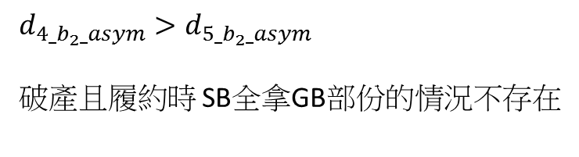
$$4.If A+tax{∙C}_{1}D_{1}T+m∙G\left(0\right)>A+tax{∙C}_{1}D_{1}T>m∙G\left(0\right)>(1−α)(A+mG\left(0\right))>\left(1−α\right)A$$
$${d_{4_b_{1}_asym}>d}_{3}>{d_{5_b_{1}_asym}>d}_{2}>d_{1_b_{1}_asym}$$
$$d_{1_b_{1}_asym}$$
$$d_{4_b_{1}_asym}$$
$$b_{2}$$
$$d_{4_b_{2}_asym}>d_{5_b_{2}_asym}$$
破產且履約時 SB全拿GB部份的情況不存在
破產
SB全拿
GB部份
未履約
破產
SB部分
GB無
未履約
$$d_{3}$$
$$d_{1}$$
$$d_{4_b_{2}_asym}$$
存活(未履約)
$$d_{5_b_{2}_asym}$$
$$b_{1 }$$
$$(履約$$
$$邊界$$
$b_{2}=0$)
破產SB部分
GB無 履約
$$G(T)$$
破產 SB全拿 GB部份
(未履約)
$$d_{5}$$
$$d_{2}$$
存活 (履約)
破產 SB部份
GB無
(未履約)
破產 不足支付
$$d_{4}$$
存活(未履約)
$$G(0)$$
$$d_{5_b_{1}_asym}$$
破產 SB部份
GB無(履約)
破產(履約)
不足支付
存活 (履約)
$$V(T)$$

Slide 29






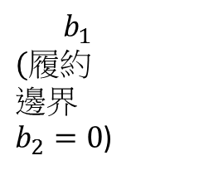

$$5.If A+tax{∙C}_{1}D_{1}T+m∙G\left(0\right)>\left(1−α\right)\left( A+mG\left(0\right) \right)>A+tax{∙C}_{1}D_{1}T>m∙G\left(0\right)>\left(1−α\right)A$$
$${d_{4_b_{1}_asym}>d}_{2}>d_{3}{>d}_{5_b_{1}_asym}>d_{1_b_{1}_asym}$$
$$d_{1}{、d}_{2}之交點在B_{2}\left(T\right)=0 , d_{3}{、d}_{4}之交點在B_{2}\left(T\right)=0$$
$$d_{2}{、d}_{4}之交點 必存在且唯一$$
$$⇒B_{2}\left(T\right)=\frac{1}{σ_{2}}\ln{[\frac{A+tax{∙C}_{1}D_{1}T+m∙G\left(0\right)−\left(1−α\right)(A+mG\left(0\right))}{m∙G\left(0\right)}}]$$
$$=\frac{1}{σ_{2}}ln[1+\frac{A+tax{∙C}_{1}D_{1}T−\left(1−α\right)(A+mG\left(0\right))}{m∙G\left(0\right)}]<0$$
$$d_{1_b_{1}_asym}$$
$$b_{2}$$
$$d_{4_b_{1}_asym}$$
破產
SB部分
GB無
未履約
破產
SB全拿
GB部份
未履約
$$d_{3}$$
$$d_{1}$$
$$G(T)$$
$$d_{4_b_{2}_asym}$$
存活(未履約)
破產 SB全拿 GB部份
(未履約)
$$d_{5_b_{2}_asym}$$
破產 SB部份
GB無
(未履約)
$${ b}_{1 }$$
$$(履約$$
$$邊界$$
$b_{2}=0$)
破產SB部分
GB無 履約
存活(未履約)
$$d_{5}$$
$$d_{4}$$
存活 (履約)
$$G(0)$$
破產
不足支付
破產 SB全拿 GB部份(履約)
存活 (履約)
$$d_{2}$$
破產 SB部份
GB無(履約)
破產 SB全拿 GB部份(履約)
破產(履約)
不足支付
$$d_{5_b_{1}_asym}$$
$$V(T)$$

Slide 30








$$6.If A+tax{∙C}_{1}D_{1}T+m∙G\left(0\right)>\left(1−α\right)\left( A+mG\left(0\right) \right)>A+tax{∙C}_{1}D_{1}T>\left(1−α\right)A>m∙G\left(0\right)$$
$${d_{4_b_{1}_asym}>d}_{2}>d_{3}{>d_{1_b_{1}_asym} >d}_{5_b_{1}_asym}$$
$$d_{1}{、d}_{2}之交點在B_{2}\left(T\right)=0 , d_{3}{、d}_{4}之交點在B_{2}\left(T\right)=0$$
$$d_{2}{、d}_{4}之交點 必存在且唯一$$
$$⇒B_{2}\left(T\right)=\frac{1}{σ_{2}}\ln{[\frac{A+tax{∙C}_{1}D_{1}T+m∙G\left(0\right)−\left(1−α\right)(A+mG\left(0\right))}{m∙G\left(0\right)}}]$$
$$=\frac{1}{σ_{2}}ln[1+\frac{A+tax{∙C}_{1}D_{1}T−\left(1−α\right)(A+mG\left(0\right))}{m∙G\left(0\right)}]<0$$
$$d_{1_b_{1}_asym}$$
$$b_{2}$$
$$d_{4_b_{1}_asym}$$
破產
SB全拿
GB部份
未履約
破產
SB部分
GB無
未履約
$$d_{3}$$
$$d_{1}$$
$$G(T)$$
$$d_{4_b_{2}_asym}$$
存活(未履約)
破產 SB部份
GB無
(未履約)
破產 SB全拿 GB部份
(未履約)
$$d_{5_b_{2}_asym}$$
$${ b}_{1 }$$
$$(履約$$
$$邊界$$
$b_{2}=0$)
存活(未履約)
$$d_{5}$$
破產SB部分
GB無 履約
$$d_{4}$$
存活 (履約)
$$G(0)$$
破產
不足支付
破產 SB全拿 GB部份(履約)
存活 (履約)
破產 SB部份
GB無(履約)
$$d_{2}$$
破產(履約)
不足支付
破產 SB全拿 GB部份(履約)
$$V(T)$$
$$d_{5_b_{1}_asym}$$

Slide 31




$$7.If A+tax{∙C}_{1}D_{1}T+m∙G\left(0\right)>A+tax{∙C}_{1}D_{1}T>(1−α)( A+mG\left(0\right) )>m∙G\left(0\right)>\left(1−α\right)A$$
$${d_{4_b_{1}_asym}>d}_{3}>d_{2}{>d}_{5_b_{1}_asym}>d_{1_b_{1}_asym}$$
$$d_{1}{、d}_{2}之交點在B_{2}\left(T\right)=0 , d_{3}{、d}_{4}之交點在B_{2}\left(T\right)=0$$
$$d_{1}{、d}_{3}之交點 必存在且唯一$$
$$B_{2}\left(T\right)=\frac{1}{σ_{2}}ln\left[1+\frac{A+tax{∙C}_{1}D_{1}T−\left(1−α\right)(A+mG(0)}{\left(1−α\right)m∙G\left(0\right)}\right]>0$$
$$d_{1_b_{1}_asym}$$
$$d_{4_b_{1}_asym}$$
$$b_{2}$$
破產
SB全拿
GB部份
未履約
破產
SB部分
GB無
未履約
$$d_{3}$$
$$d_{1}$$
$$d_{4_b_{2}_asym}$$
存活(未履約)
$$G(T)$$
$$d_{5_b_{2}_asym}$$
$$b_{1 }$$
$$(履約$$
$$邊界$$
$b_{2}=0$)
破產 SB全拿 GB部份
(未履約)
破產 SB部份
GB無
(未履約)
破產SB部分
GB無 履約
$$d_{5}$$
$$d_{2}$$
存活 (履約)
存活(未履約)
破產 不足支付
$$d_{4}$$
$$G(0)$$
破產 SB部份
GB無(履約)
$$d_{5_b_{1}_asym}$$
破產(履約)
不足支付
存活 (履約)
$$V(T)$$

Slide 32




$$8.If A+tax{∙C}_{1}D_{1}T+m∙G\left(0\right)>A+tax{∙C}_{1}D_{1}T>(1−α)( A+mG\left(0\right) )>\left(1−α\right)A>m∙G\left(0\right)$$
$${d_{4_b_{1}_asym}>d}_{3}>d_{2}{>d_{1_b_{1}_asym}>d}_{5_b_{1}_asym}$$
$$d_{1}{、d}_{2}之交點在B_{2}\left(T\right)=0 , d_{3}{、d}_{4}之交點在B_{2}\left(T\right)=0$$
$$d_{1}{、d}_{3}之交點 必存在且唯一$$
$$B_{2}\left(T\right)=\frac{1}{σ_{2}}ln\left[1+\frac{A+tax{∙C}_{1}D_{1}T−\left(1−α\right)(A+mG(0)}{\left(1−α\right)m∙G\left(0\right)}\right]>0$$
$$d_{1_b_{1}_asym}$$
$$d_{4_b_{1}_asym}$$
$$b_{2}$$
破產
SB全拿
GB部份
未履約
破產
SB部分
GB無
未履約
$$d_{3}$$
$$d_{1}$$
$$d_{4_b_{2}_asym}$$
存活(未履約)
$$d_{5_b_{2}_asym}$$
$$b_{1 }$$
$$(履約$$
$$邊界$$
$b_{2}=0$)
$$G(T)$$
破產 SB全拿 GB部份
(未履約)
破產SB部分
GB無 履約
破產 SB部份
GB無
(未履約)
$$d_{5}$$
$$d_{2}$$
存活 (履約)
存活(未履約)
$$d_{4}$$
破產 不足支付
$$G(0)$$
破產 SB部份
GB無(履約)
$$d_{5_b_{1}_asym}$$
破產(履約)
不足支付
存活 (履約)
$$V(T)$$

Slide 33






積分區域(condition1)
$$d_{1_b_{1}_asym}$$
$$d_{4_b_{1}_asym}$$
$$\tilde{E}\{g∙I_{\left\{存活 未履約\right\}}\}=\int_{d_{2}}^{∞}{\int_{0}^{d_{1}}{g∙f_{B_{1},B_{2}}(b_{1},b_{2})db_{2}db_{1}}}$$
$$\tilde{E}\{{g∙I}_{\left\{存活 Option履約\right\}}\}=\int_{d_{2}}^{∞}{\int_{−∞}^{0}{g∙f_{B_{1},B_{2}}(b_{1},b_{2})db_{2}db_{1}}}$$
$$\tilde{E }\{{g∙I}_{\left\{破產 未履約 SB全拿GB拿部分 \right\}}\}=$$
$$\int_{d_{3}}^{∞}{\int_{0}^{∞}{g∙f_{B_{1},B_{2}}\left(b_{1},b_{2}\right)db_{2}db_{1}}}−\tilde{E}\{g∙I_{\left\{存活 未履約\right\}}\}$$
$$\tilde{E }\{{g∙I}_{\left\{破產 履約 SB全拿GB拿部分 \right\}}\}=\int_{d_{3}}^{d_{2}}{\int_{d_{4}}^{0}{g∙f_{B_{1},B_{2}}(b_{1},b_{2})db_{2}db_{1}}}$$
$$\tilde{E }\{g∙I_{\left\{破產 未履約 SB部分 GB無\right\}}\}=\int_{−∞}^{d_{3}}{\int_{0}^{∞}{g∙f_{B_{1},B_{2}}(b_{1},b_{2})db_{2}db_{1}}}$$
$$\tilde{E }\{{g∙I}_{\left\{破產 履約 SB部分 GB無\right\}}\}=\int_{−∞}^{d_{2}}{\int_{d_{5}}^{0}{g∙f_{B_{1},B_{2}}\left(b_{1},b_{2}\right)db_{2}db_{1}}}−\tilde{E }\{{g∙I}_{\left\{破產 履約 SB全拿GB拿部分 \right\}}\}$$
$\tilde{E }\{{g∙I}_{\left\{破產 履約 option不足支付\right\}}\}=\int_{−∞}^{d_{2}}{\int_{−∞}^{d_{5}}{g∙f_{B_{1},B_{2}}\left(b_{1},b_{2}\right)db_{2}db_{1}}}$ $(g可為{1、e}^{σ_{1}B_{1}\left(T\right)}、e^{σ_{2}B_{2}\left(T\right)})$
$$b_{2}$$
破產
SB部分
GB無
未履約
破產 SB全拿
GB部份 未履約
$$d_{3}$$
$$d_{1}$$
$$d_{4_b_{2}_asym}$$
存活(未履約)
$$d_{5_b_{2}_asym}$$
破產SB部分
GB無 履約
$${ b}_{1 }$$
$$(履約$$
$$邊界$$
$b_{2}=0$)
$$d_{5}$$
$$d_{4}$$
破產
不足支付
存活 (履約)
$$d_{2}$$
$$d_{5_b_{1}_asym}$$

Slide 34
END

Slide 35


Merton 結構式信用風險模型
以公司各項財務變數加入稅盾和破產成本，組合出公司資產價值及process
判斷債券到期時公司破產(違約)的機率

Slide 36




Slide 37






$$d_{2}{、d}_{4}之交點$$
將$d_{2}$代入$d_{4}$
$$⇒B_{2}\left(T\right)=\frac{1}{σ_{2}}\ln{[\frac{A+tax{∙C}_{1}D_{1}T+m∙G\left(0\right)−\left(1−α\right)(A+mG\left(0\right))}{m∙G\left(0\right)}}]$$
因為$A+tax{∙C}_{1}D_{1}T+m∙G\left(0\right)>\left(1−α\right)(A+mG\left(0\right))$ for all condition 則$D_{1}≠0時$ 此交點必存在且唯一
$d_{2}{、d}_{5}之交點$ 將$d_{2}$代入$d_{5}$
$$⇒B_{2}\left(T\right)=\frac{1}{σ_{2}}\ln{[\frac{m∙G\left(0\right)−\left(1−α\right)(A+mG\left(0\right))}{m∙G\left(0\right)}}] 當m∙G\left(0\right)>\left(1−α\right)\left(A+mG\left(0\right)\right)\text{,}\text{此交點存在且唯一}\text{(}B_{2}\left(T\right)<0)$$
$d_{1}{、d}_{3}之交點$ 將$d_{3}$代入$d_{1}$
$$⇒B_{2}\left(T\right)=\frac{1}{σ_{2}}\ln{[\frac{\frac{A+tax{∙C}_{1}D_{1}T}{\left(1−α\right)}−A}{m∙G\left(0\right)}}]\text{因為}A+tax{∙C}_{1}D_{1}T>\left(1−α\right)A \text{for} \text{all} \text{condition}\text{,}\text{此交點}必\text{存在且唯一}$$
$d_{2}$ $⇒B_{1}\left(T\right)=\frac{1}{σ_{1}}\ln{[ \frac{A+m∙G(0)}{V(0)} }]$
$$d_{4}⇒B_{2}\left(T\right)=\frac{1}{σ_{2}}\ln{[\frac{A+tax{∙C}_{1}D_{1}T+m∙G\left(0\right)−\left(1−α\right)V\left(0\right){∙e}^{σ_{1}B_{1}\left(T\right)}}{m∙G\left(0\right)}}]$$
$${ (B}_{2}\left(T\right)<0交點才有意義)$$
$d_{2}$ $⇒B_{1}\left(T\right)=\frac{1}{σ_{1}}\ln{[ \frac{A+m∙G(0)}{V(0)} }]$
$$d_{5}⇒B_{2}\left(T\right)=\frac{1}{σ_{2}}\ln{[\frac{m∙G\left(0\right)−\left(1−α\right)V\left(0\right){∙e}^{σ_{1}B_{1}\left(T\right)}}{m∙G\left(0\right)}}]$$
$$d_{1}{⇒B}_{2}\left(T\right)=\frac{1}{σ_{2}}\ln{[ \frac{V\left(0\right){∙e}^{σ_{1}B_{1}\left(T\right)}−\text{A} }{m∙G\left(0\right)} }]$$
$$d_{3}⇒B_{1}\left(T\right)=\frac{1}{σ_{1}}\ln{[ \frac{A+tax{∙C}_{1}D_{1}T }{(1−α)V(0)} }]$$
$${ (B}_{2}\left(T\right)≥0交點才有意義)$$

