Slide 1
LU Decomposition & Cholesky Decomposition
2018/10/30 You-Jia Sun

Slide 2
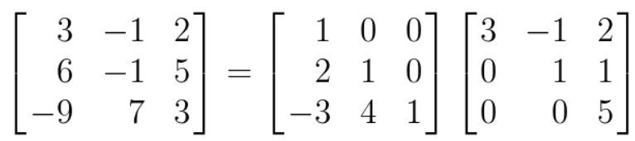
LU Decomposition
A is a n-by-n matrix
A=LU
L is lower triangular matrix; U is upper triangular matrix.
A
L
U

Slide 3
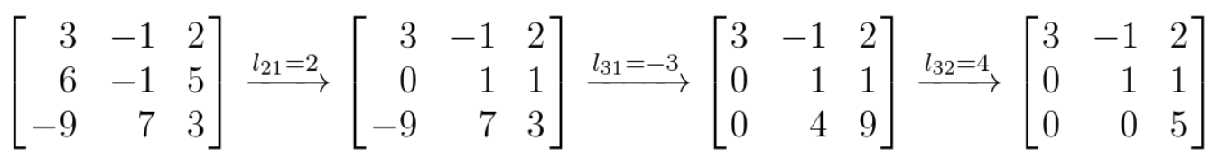
Elementary row operation
Row switching: Row_{i} <-> Row_{j}
Row multiplication: kRow_{i} -> Row_{i}, where k ≠ 0
Row substitution: Replace: Row_{i} - lRow_{j} -> Row_{i} , where i ≠ j
The row calculation result, called U mtarix, is an upper matrix.
If all of the diagonal elements of U matrix is not zero, A is nonsingular matrix.
U

Slide 4
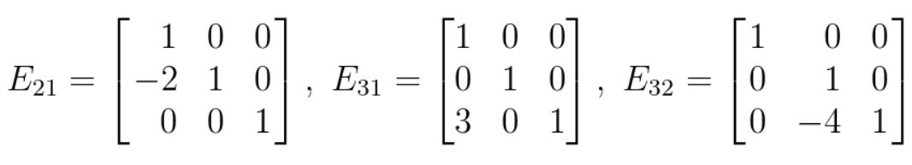


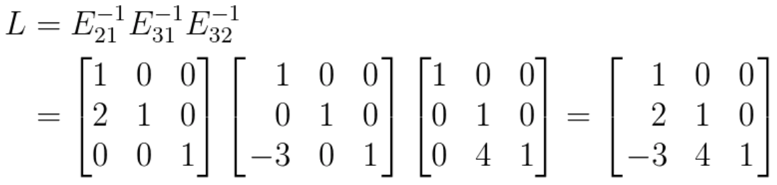
Elementary matrix E_{ij}(i,j) = -l_{ij}
L is an unitriangular matrix and its elements below diagonal are -l_{ij}

Slide 5
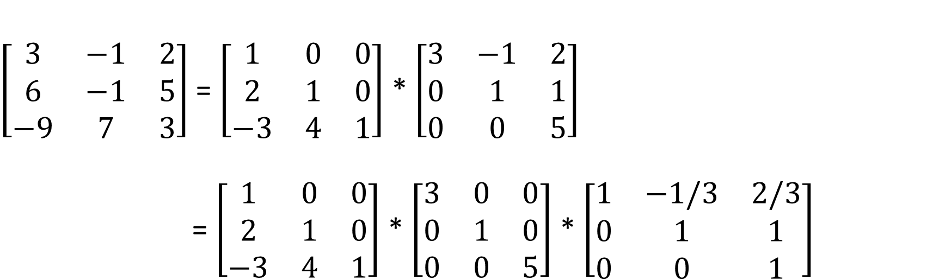
LDU decomposition
A
L
U
$\left[\begin{matrix}3 & −1 & 2 \\ 6 & −1 & 5 \\ −9 & 7 & 3\end{matrix}\right]$ = $\left[\begin{matrix}1 & 0 & 0 \\ 2 & 1 & 0 \\ −3 & 4 & 1\end{matrix}\right]$ * $\left[\begin{matrix}3 & −1 & 2 \\ 0 & 1 & 1 \\ 0 & 0 & 5\end{matrix}\right]$
= $\left[\begin{matrix}1 & 0 & 0 \\ 2 & 1 & 0 \\ −3 & 4 & 1\end{matrix}\right]$ * $\left[\begin{matrix}3 & 0 & 0 \\ 0 & 1 & 0 \\ 0 & 0 & 5\end{matrix}\right]$ * $\left[\begin{matrix}1 & −1/3 & 2/3 \\ 0 & 1 & 1 \\ 0 & 0 & 1\end{matrix}\right]$
L
D
U

Slide 6
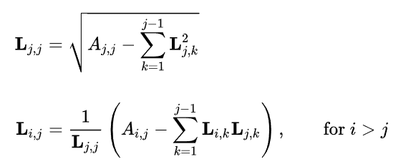

Cholesky Decomposition
A = LL^{T} = $\left[\begin{matrix}a & 0 & 0 \\ b & c & 0 \\ d & e & f\end{matrix}\right]$ * $\left[\begin{matrix}a & b & d \\ 0 & c & e \\ 0 & 0 & f\end{matrix}\right]$
= $\left[\begin{matrix}a2 & ab & ad \\ ab & b2+c2 & bd+ce \\ ad & bd+ce & d2+e2+f2\end{matrix}\right]$
symmetric

Slide 7
Change a vector of independent r.v. into dependent variables
A random vector Z, satisfied cov(Z) = I
We want to get vector X = (x₁,…,x_{n})^{T} satisfied cov(X) = ∑
By Cholesky Decomposition, ∑ = LL^{T} , X=LZ
Cov(X) = cov(LZ) = Lcov(Z)L^{T} = LL^{T} = ∑

