Slide 1
Credit Risk Models IV：
Understanding and pricing CDOs
Abel Elizalde
CEMFI and UPNA
Presented by: Zhihaolyu

Slide 2
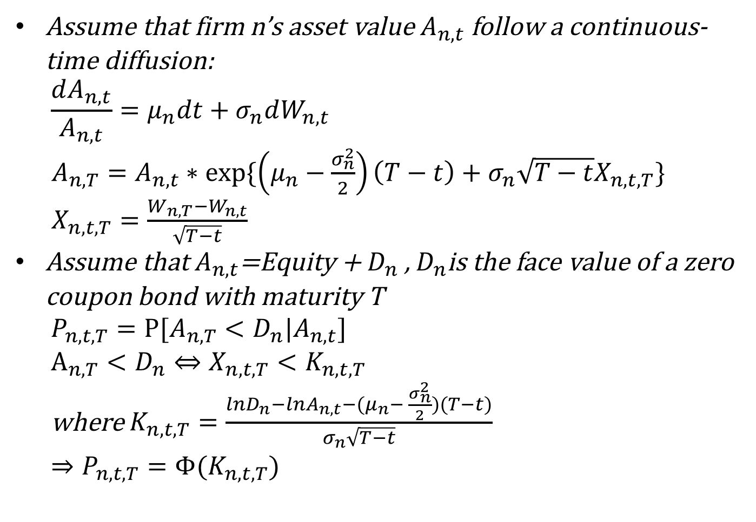
Structural model for credit risk: Merton
Assume that firm n’s asset value $A_{n,t}$ follow a continuous-time diffusion:
$$\frac{dA_{n,t}}{A_{n,t}}=μ_{n}dt+σ_{n}dW_{n,t}$$
$A_{n,T}=A_{n,t}∗exp⁡\{\left(μ_{n}−\frac{σ_{n}^{2}}{2}\right)\left(T−t\right)+σ_{n}\sqrt{T−t}X_{n,t,T}\}$
$X_{n,t,T}=\frac{W_{n,T}−W_{n,t}}{\sqrt{T−t}}$
Assume that $A_{n,t}$=Equity + $D_{n}$ , $D_{n}$is the face value of a zero coupon bond with maturity T
$P_{n,t,T}=Ρ[A_{n,T}<D_{n}|A_{n,t}]$
$A_{n,T}<D_{n}⇔X_{n,t,T}<K_{n,t,T}$
where $K_{n,t,T}=\frac{lnD_{n}−lnA_{n,t}−(μ_{n}− \frac{σ_{n}^{2}}{2})(T−t)}{σ_{n}\sqrt{T−t}}$
$⇒P_{n,t,T}=Φ(K_{n,t,T})$

Slide 3
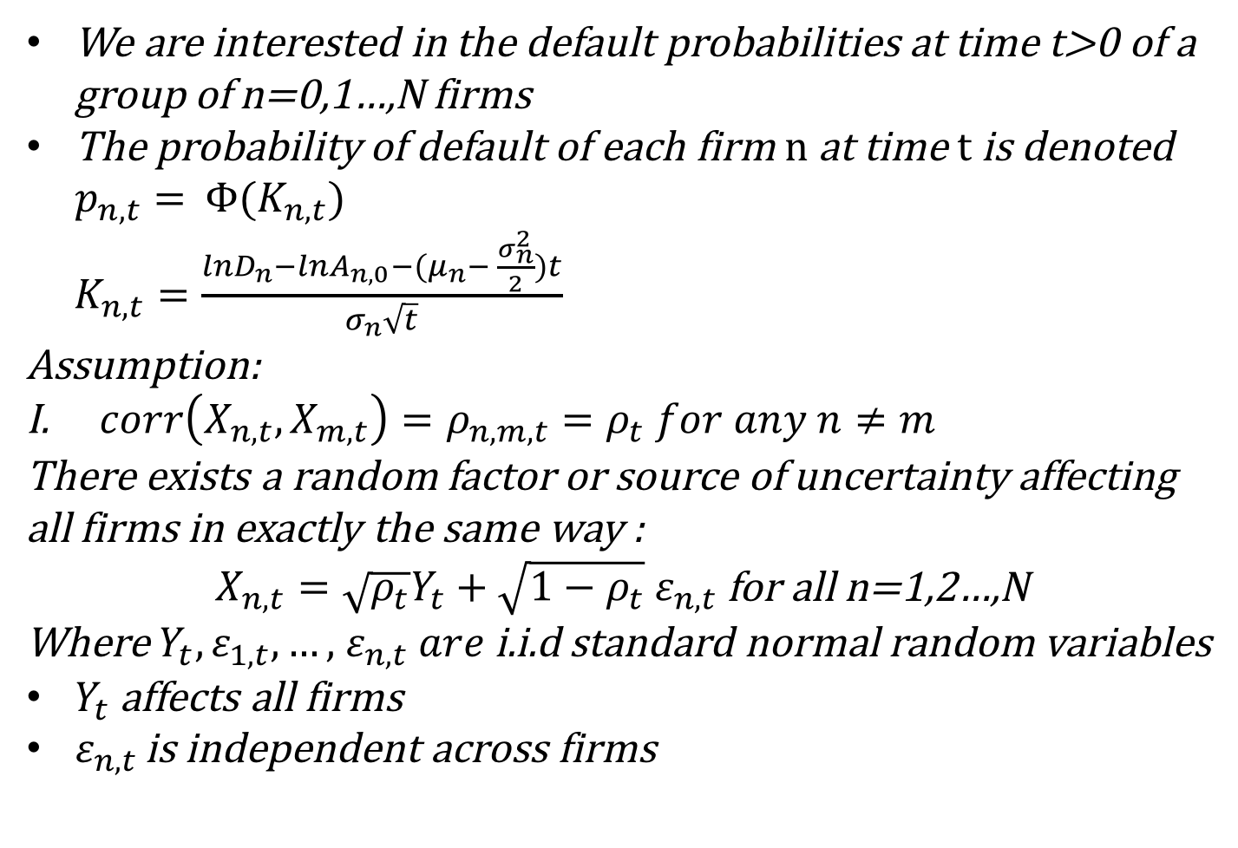
Vasicek asymptotic single factor model
We are interested in the default probabilities at time t>0 of a group of n=0,1…,N firms
The probability of default of each firm n at time t is denoted $p_{n,t}=$ $Φ(K_{n,t})$
$K_{n,t}=\frac{lnD_{n}−lnA_{n,0}−(μ_{n}− \frac{σ_{n}^{2}}{2})t}{σ_{n}\sqrt{t}}$
Assumption:
$corr\left(X_{n,t},X_{m,t}\right)=ρ_{n,m,t}=ρ_{t} for any n≠m$
There exists a random factor or source of uncertainty affecting all firms in exactly the same way :
$X_{n,t}=\sqrt{ρ_{t}}Y_{t}+\sqrt{1−ρ_{t}}{ ε}_{n,t}$ for all n=1,2…,N
Where $Y_{t},ε_{1,t},…,$ $ε_{n,t} are$i.i.d standard normal random variables
$Y_{t}$affects all firms
$ε_{n,t }$is independent across firms

Slide 4
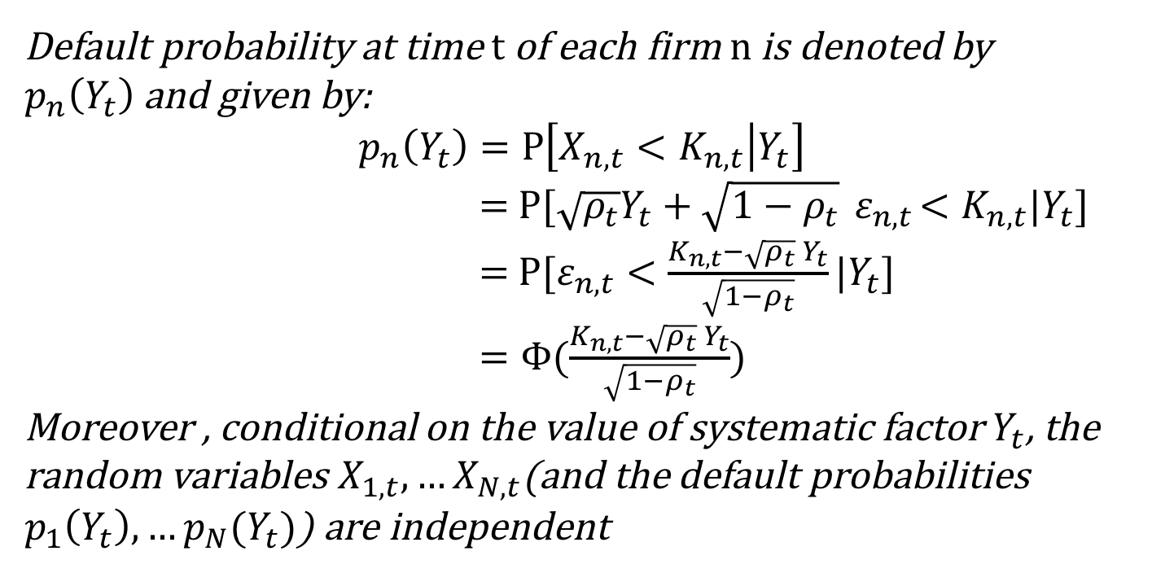
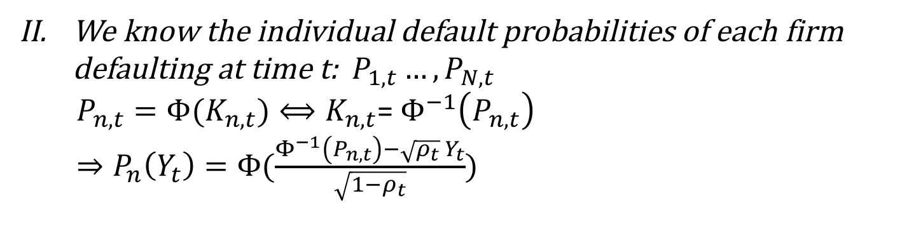
Default probability at time t of each firm n is denoted by $p_{n}\left(Y_{t}\right)$and given by:
$$p_{n}\left(Y_{t}\right)=Ρ\left[X_{n,t}<K_{n,t} | Y_{t}\right]$$
$=$ $Ρ[\sqrt{ρ_{t}}Y_{t}+\sqrt{1−ρ_{t}}{ ε}_{n,t}<K_{n,t}|Y_{t}]$
$=$ $Ρ[ε_{n,t}<\frac{K_{n,t}−\sqrt{ρ_{t}}{ Y}_{t}}{\sqrt{1−ρ_{t}}}|Y_{t}]$
$=Φ(\frac{K_{n,t}−\sqrt{ρ_{t}}{ Y}_{t}}{\sqrt{1−ρ_{t}}})$
Moreover , conditional on the value of systematic factor $Y_{t}$, the random variables $X_{1,t},…X_{N,t}$(and the default probabilities $p_{1}\left(Y_{t}\right),…p_{N}(Y_{t})$) are independent
We know the individual default probabilities of each firm defaulting at time t: $P_{1,t}…,P_{N,t}$
$P_{n,t}=Φ(K_{n,t})⟺K_{n,t}$= $Φ^{−1}\left(P_{n,t}\right)$
$⇒P_{n}\left(Y_{t}\right)=Φ(\frac{Φ^{−1}\left(P_{n,t}\right)−\sqrt{ρ_{t}}{ Y}_{t}}{\sqrt{1−ρ_{t}}})$

Slide 5
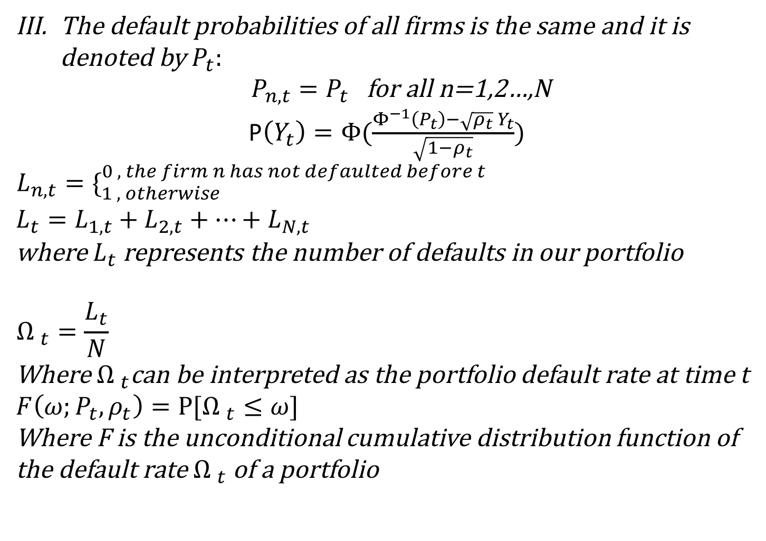
The default probabilities of all firms is the same and it is denoted by $P_{t}:$
$P_{n,t}=P_{t}$ for all n=1,2…,N
P$\left(Y_{t}\right)=Φ(\frac{Φ^{−1}\left(P_{t}\right)−\sqrt{ρ_{t}}{ Y}_{t}}{\sqrt{1−ρ_{t}}})$
$$L_{n,t}=\{_{1 , otherwise}^{0 , the firm n has not defaulted before t }$$
$L_{t}=L_{1,t}+L_{2,t}+…+L_{N,t}$
where $L_{t}$ represents the number of defaults in our portfolio
$${Ω }_{t}=\frac{L_{t}}{N}$$
Where ${Ω }_{t}$can be interpreted as the portfolio default rate at time t
$$F\left(ω;P_{t},ρ_{t}\right)=Ρ[{Ω }_{t}≤ω]$$
Where F is the unconditional cumulative distribution function of the default rate ${Ω }_{t}$ of a portfolio

Slide 6
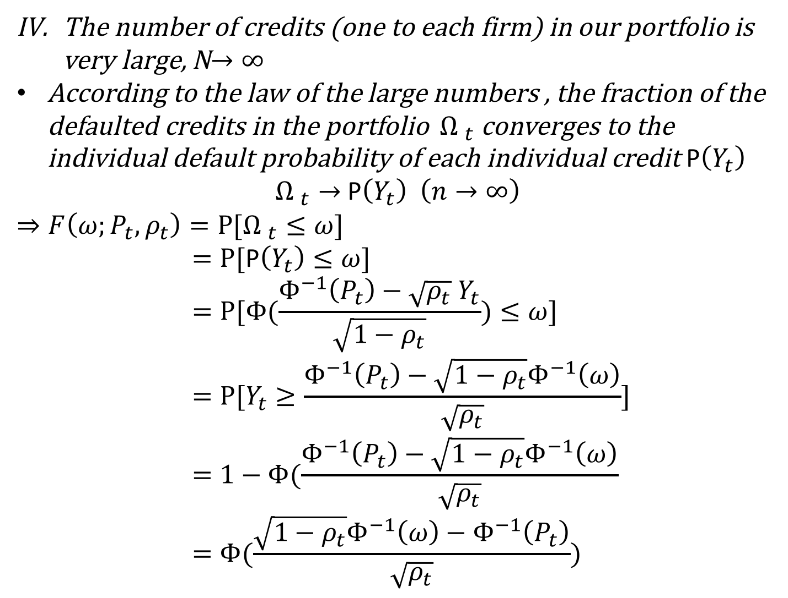
The number of credits (one to each firm) in our portfolio is very large, N$→∞$
According to the law of the large numbers , the fraction of the defaulted credits in the portfolio ${Ω }_{t}$ converges to the individual default probability of each individual credit P$\left(Y_{t}\right)$
${Ω }_{t}→$ P$\left(Y_{t}\right) \left(n→∞\right)$
$$⇒F\left(ω;P_{t},ρ_{t}\right)=Ρ[{Ω }_{t}≤ω]$$
$=Ρ[\text{P}\left(Y_{t}\right)≤ω]$
$$=Ρ[Φ(\frac{Φ^{−1}\left(P_{t}\right)−\sqrt{ρ_{t}}{ Y}_{t}}{\sqrt{1−ρ_{t}}})≤ω]$$
$$=Ρ[Y_{t}≥\frac{Φ^{−1}\left(P_{t}\right)−\sqrt{1−ρ_{t}}Φ^{−1}\left(ω\right)}{\sqrt{ρ_{t}}}]$$
$$=1−Φ(\frac{Φ^{−1}\left(P_{t}\right)−\sqrt{1−ρ_{t}}Φ^{−1}\left(ω\right)}{\sqrt{ρ_{t}}}$$
$$=Φ(\frac{\sqrt{1−ρ_{t}}Φ^{−1}\left(ω\right)−Φ^{−1}\left(P_{t}\right)}{\sqrt{ρ_{t}}})$$

Slide 7
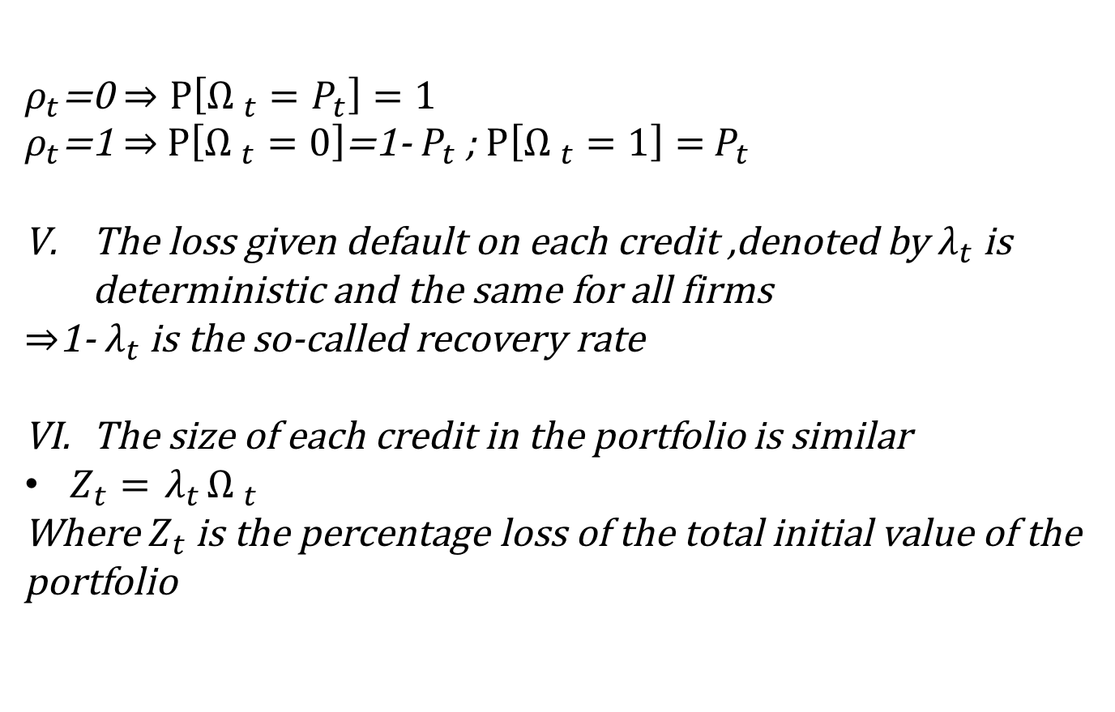
$ρ_{t}$=0$⇒Ρ\left[{Ω }_{t}=P_{t}\right]=1$
$ρ_{t}$=1 $⇒$ $Ρ\left[{Ω }_{t}=0\right]$=1-${ P}_{t}$ ; $Ρ\left[{Ω }_{t}=1\right]={ P}_{t}$
The loss given default on each credit ,denoted by $λ_{t}$ is deterministic and the same for all firms
$⇒$1-${ λ}_{t}$ is the so-called recovery rate
The size of each credit in the portfolio is similar
$Z_{t}={ λ}_{t}{Ω }_{t}$
Where $Z_{t}$ is the percentage loss of the total initial value of the portfolio

Slide 8
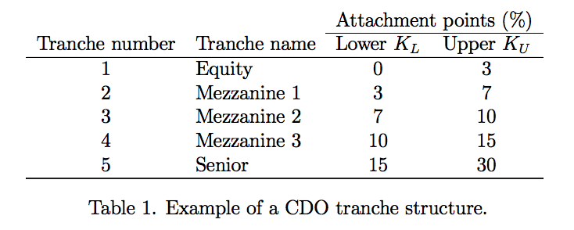
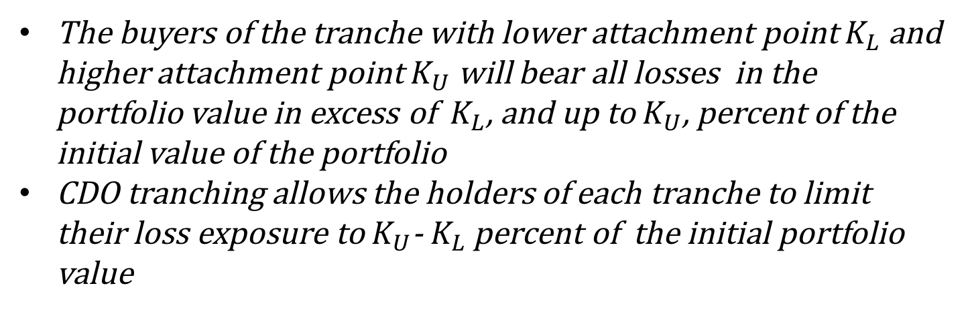
Mechanics of CDOs
The buyers of the tranche with lower attachment point $K_{L}$ and higher attachment point $K_{U}$ will bear all losses in the portfolio value in excess of ${ K}_{L}$, and up to $K_{U}$, percent of the initial value of the portfolio
CDO tranching allows the holders of each tranche to limit their loss exposure to $K_{U}$-${ K}_{L}$ percent of the initial portfolio value

Slide 9
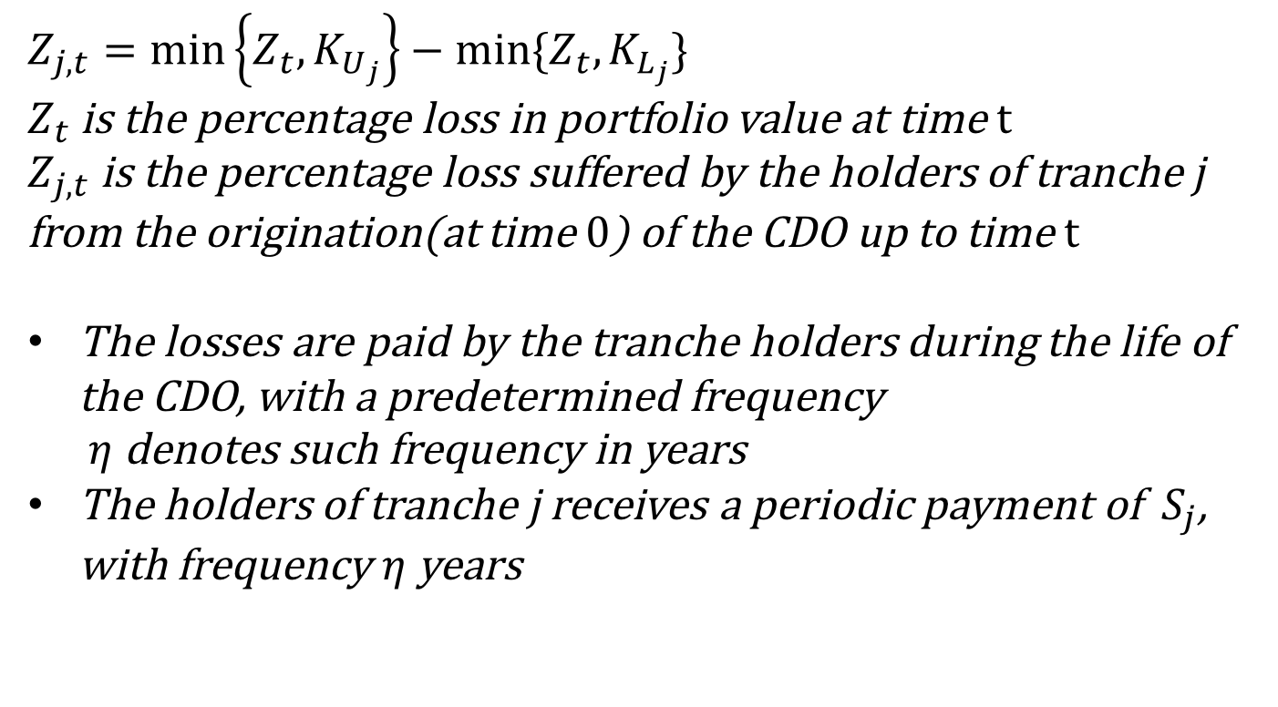
$$Z_{j,t}=\min\left\{Z_{t},K_{U_{j}}\right\}−min⁡\{Z_{t},K_{L_{j}}\}$$
$Z_{t}$ is the percentage loss in portfolio value at time t
$Z_{j,t}$ is the percentage loss suffered by the holders of tranche j from the origination(at time 0) of the CDO up to time t
The losses are paid by the tranche holders during the life of the CDO, with a predetermined frequency
$η$denotes such frequency in years
The holders of tranche j receives a periodic payment of ${ S}_{j}$, with frequency $η$ years

Slide 10
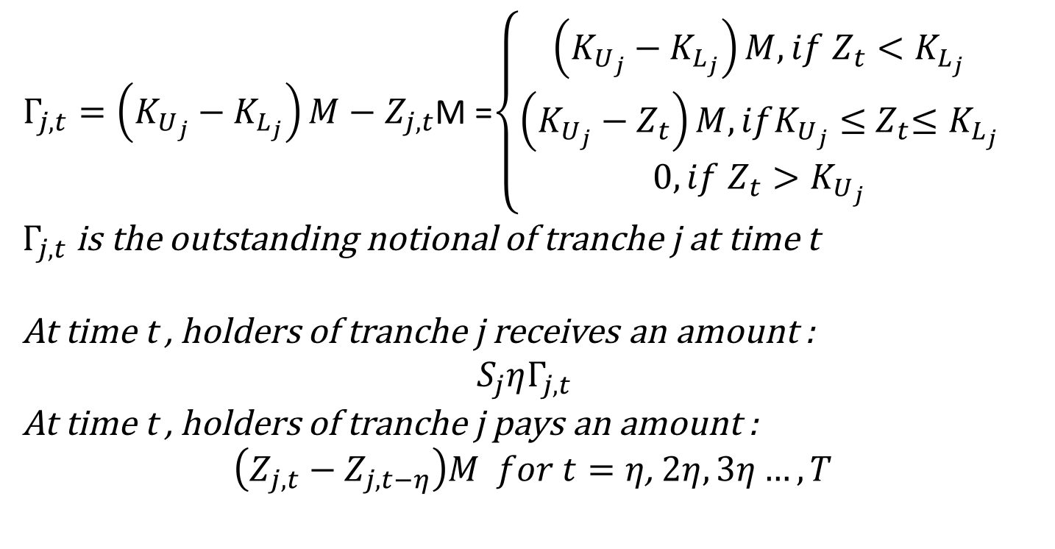
$Γ_{j,t}=\left(K_{U_{j}}−K_{L_{j}}\right)M−Z_{j,t}$M =$\left\{\begin{aligned}\left(K_{U_{j}}−K_{L_{j}}\right)M, if{ Z}_{t}<K_{L_{j}} \\ \left(K_{U_{j}}−{ Z}_{t}\right)M, ifK_{U_{j}}≤{ Z}_{t}≤K_{L_{j}} \\ 0, if{ Z}_{t}>K_{U_{j}}\end{aligned}\right.$
$Γ_{j,t}$ is the outstanding notional of tranche j at time t
At time t , holders of tranche j receives an amount :
$${ S}_{j}ηΓ_{j,t}$$
At time t , holders of tranche j pays an amount :
$\left(Z_{j,t}−Z_{j,t−η}\right)M for t=η$, $2η,3η…,T$

Slide 11
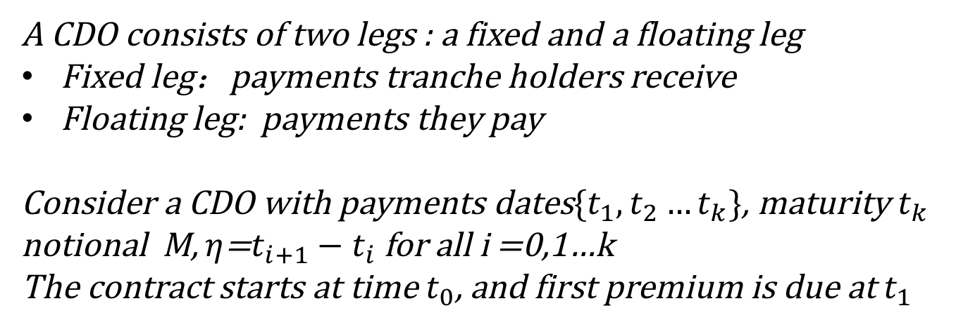
Pricing of CDOs
Complete market and absence of arbitrage opportunities
Independence of the firms’ credit risk and the default-free interest rate under the risk neutral probability measure
A CDO consists of two legs : a fixed and a floating leg
Fixed leg：payments tranche holders receive
Floating leg: payments they pay
Consider a CDO with payments dates$\{t_{1},t_{2}…t_{k}\}$, maturity${ t}_{k}$
notional M, $η$=$t_{i+1}−t_{i}$ for all i =0,1…k
The contract starts at time $t_{0}$, and first premium is due at $t_{1}$

Slide 12
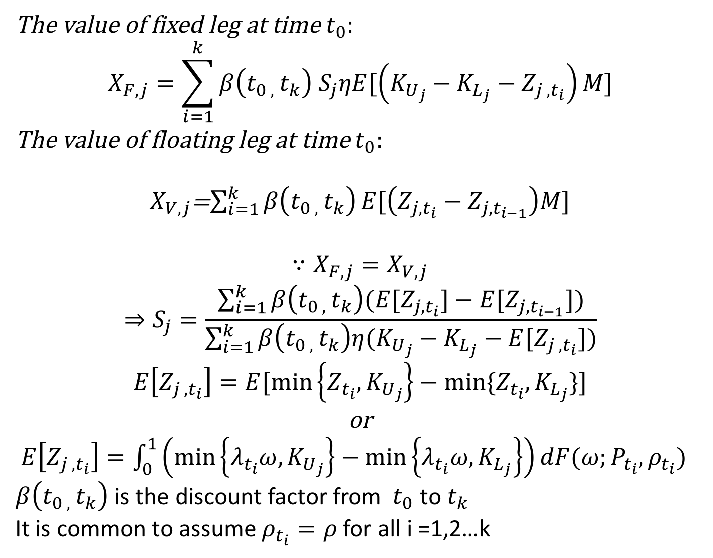
The value of fixed leg at time $t_{0}:$
$$X_{F,j}=\sum_{i=1}^{k}{β\left(t_{0 , }t_{k}\right){ S}_{j}ηE[\left(K_{U_{j}}−K_{L_{j}}−Z_{j , t_{i}}\right)M]}$$
The value of floating leg at time $t_{0}:$
$X_{V,j}$=$\sum_{i=1}^{k}{β\left(t_{0 , }t_{k}\right)}E[\left(Z_{j,t_{i}}−Z_{j,t_{i−1}}\right)M]$
$$∵X_{F,j}=X_{V,j}$$
$$⇒S_{j}=\frac{\sum_{i=1}^{k}{β\left(t_{0 , }t_{k}\right)(E[Z_{j,t_{i}}]−E[Z_{j,t_{i−1}}])}}{\sum_{i=1}^{k}{β\left(t_{0 , }t_{k}\right)η(K_{U_{j}}−K_{L_{j}}−E[Z_{j , t_{i}}])}}$$
$$E\left[Z_{j , t_{i}}\right]=E[\min\left\{Z_{t_{i}},K_{U_{j}}\right\}−min⁡\{Z_{t_{i}},K_{L_{j}}\}]$$
or
$E\left[Z_{j , t_{i}}\right]=\int_{0}^{1}{\left(\min\left\{λ_{t_{i}}ω,K_{U_{j}}\right\}−\min\left\{λ_{t_{i}}ω,K_{L_{j}}\right\}\right)}dF(ω;P_{t_{i}},ρ_{t_{i}})$
$β\left(t_{0 , }t_{k}\right)$ is the discount factor from${ t}_{0}$ to $t_{k}$
It is common to assume $ρ_{t_{i}}=ρ$ for all i =1,2…k

