Slide 1
Linear-Time Combinatorial Option Pricing Algorithms on the Trinomial Lattice Model
Jr-Yan Wan$g^{\text{∗}}$, Chuan-Ju Wan$g^{\text{†}}$, Tian-Shyr Da$i^{\text{‡}}$, and Tzu-Chun Che$n^{\text{§} }$

Slide 2
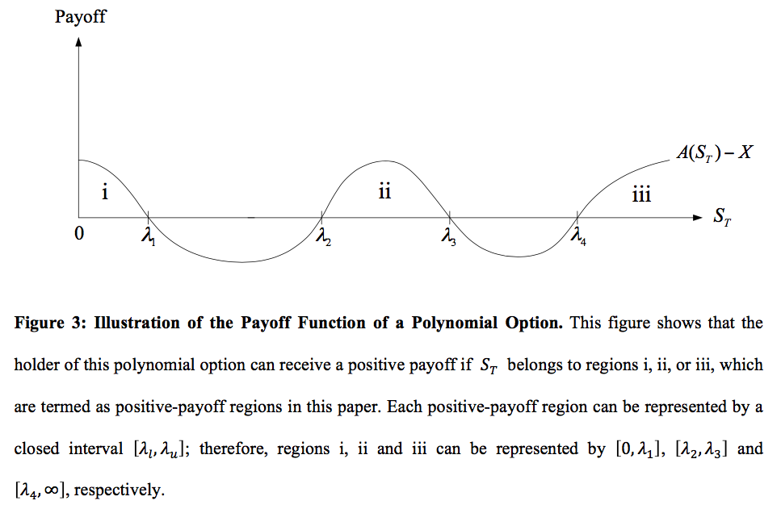

Slide 3
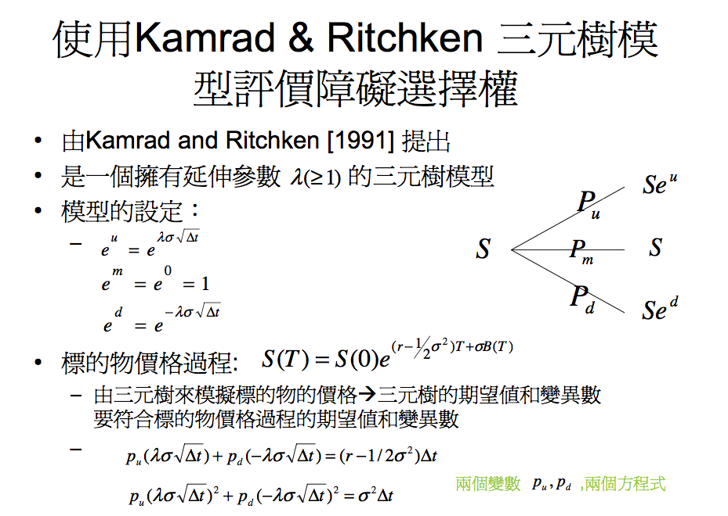


$$Su$$
$$u$$
m
d
Sd

Slide 4
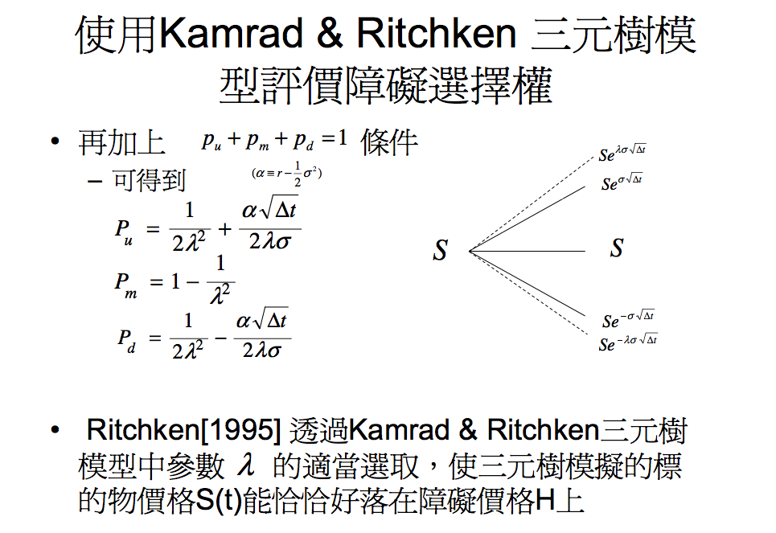
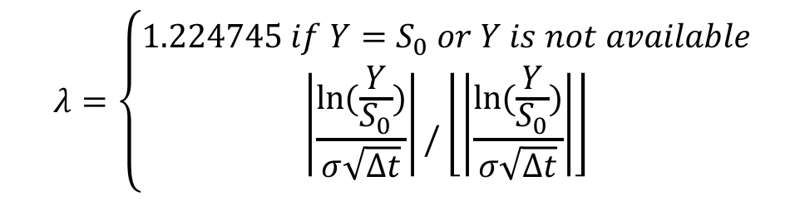
$$λ=\left\{\begin{aligned}1.224745 if Y=S_{0} or Y is not available \\ \left|\frac{ln⁡(\frac{Y}{S_{0}})}{σ\sqrt{∆t}}\right|/\left\lfloor \left|\frac{ln⁡(\frac{Y}{S_{0}})}{σ\sqrt{∆t}}\right|\right\rfloor \end{aligned}\right.$$
O/W

Slide 5
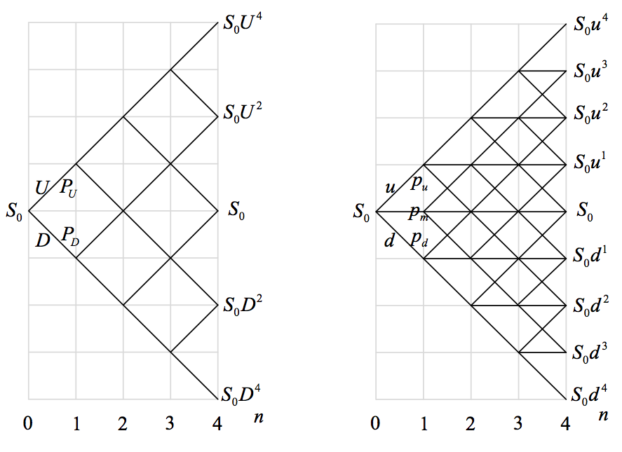
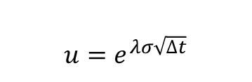
$$u=e^{λσ\sqrt{∆t}}$$

Slide 6
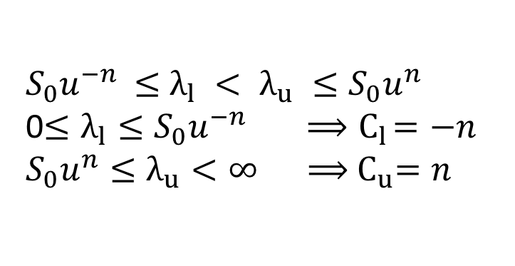
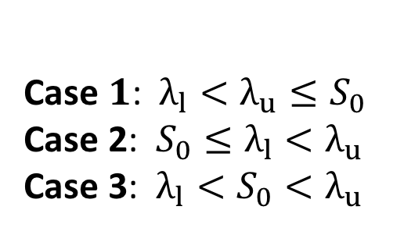
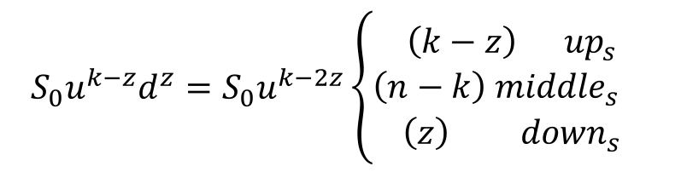

$\left[λ_{l},λ_{u}\right]⟹ C_{l}=\left\lceil \frac{ln⁡(λ_{l}/S_{0})}{ln⁡(u)} \right\rceil$ and $C_{u}=\left\lfloor \frac{ln⁡(λ_{u}/S_{0})}{ln⁡(u)} \right\rfloor$
${ S}_{0}u^{−n}$ $≤$ $λ_{l} < λ_{u} ≤S_{0}u^{n}$
0$≤λ_{l}≤S_{0}u^{−n} { ⟹C}_{l}=−n$
$S_{0}u^{n}≤λ_{u}<∞ ⟹{ C}_{u}=n$
Case $1$:$λ_{l}<λ_{u}≤S_{0}$
Case 2: $S_{0}≤λ_{l}<λ_{u}$
Case 3: $λ_{l}<S_{0}<λ_{u}$
$$S_{0}u^{k−z}d^{z}=S_{0}u^{k−2z}\left\{\begin{aligned}\left(k−z\right) { up}_{s} \\ \left(n−k\right) {middle}_{s} \\ \left(z\right) { down}_{s}\end{aligned}\right.$$

Slide 7
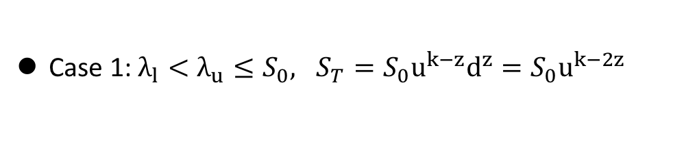
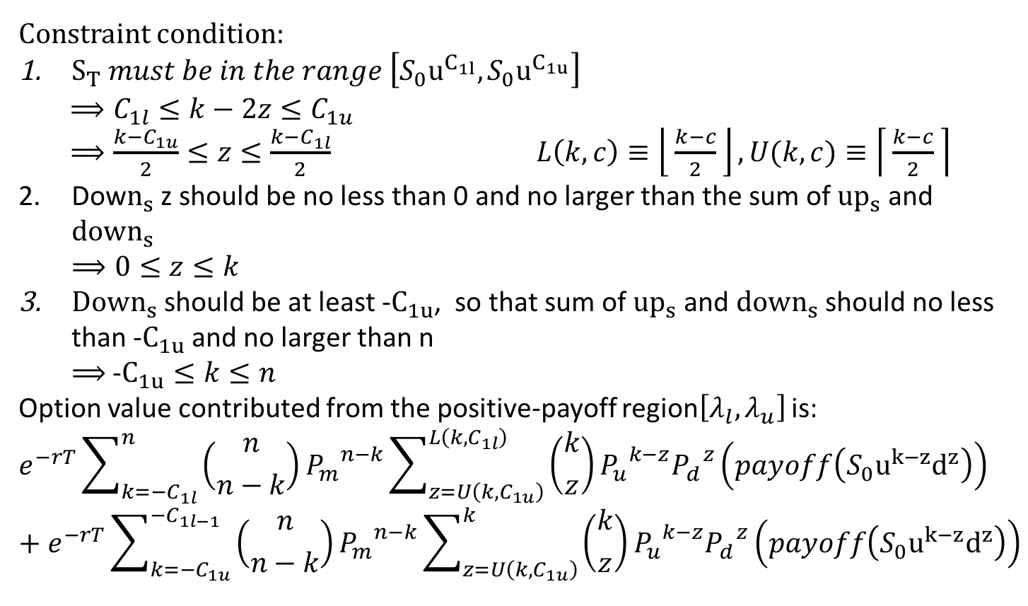
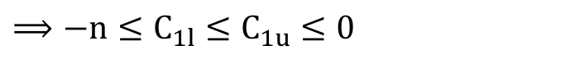
Case 1: $λ_{l}<λ_{u}≤S_{0}, S_{T}=S_{0}u^{k−z}d^{z}=S_{0}u^{k−2z}$
$$⟹−n≤C_{1l}≤C_{1u}≤0$$
Constraint condition:
$S_{T} must be in the range \left[S_{0}u^{C_{1l}},S_{0}u^{C_{1u}}\right]$
$$⟹C_{1l}≤k−2z≤C_{1u}$$
$⟹\frac{k−C_{1u}}{2}≤z≤\frac{k−C_{1l}}{2}$ $L\left(k,c\right)≡\left\lfloor \frac{k−c}{2} \right\rfloor , U(k,c)≡\left\lceil \frac{k−c}{2} \right\rceil$
Dow$n_{s}$ z should be no less than 0 and no larger than the sum of ${up}_{s}$ and ${down}_{s}$
$⟹0≤z≤k$
${Down}_{s}$ should be at least -$C_{1u}$, so that sum of ${up}_{s}$ and ${down}_{s}$ should no less than -$C_{1u}$and no larger than n
$⟹$ -$C_{1u}≤k≤n$
Option value contributed from the positive-payoff region$\left[λ_{l},λ_{u}\right]$ is:
$$e^{−rT}\sum_{k=−C_{1l}}^{n}{\left({n \atop n−k}\right)}{P_{m}}^{n−k}\sum_{z=U\left(k,C_{1u}\right)}^{L\left(k,C_{1l}\right)}{\left({k \atop z}\right)}{P_{u}}^{k−z}{P_{d}}^{z}\left(payoff\left(S_{0}u^{k−z}d^{z}\right)\right)+e^{−rT}\sum_{k=−C_{1u}}^{−C_{1l−1}}{\left({n \atop n−k}\right){P_{m}}^{n−k}\sum_{z=U\left(k,C_{1u}\right)}^{k}{\left({k \atop z}\right){P_{u}}^{k−z}{P_{d}}^{z}\left(payoff\left(S_{0}u^{k−z}d^{z}\right)\right)}}$$

Slide 8

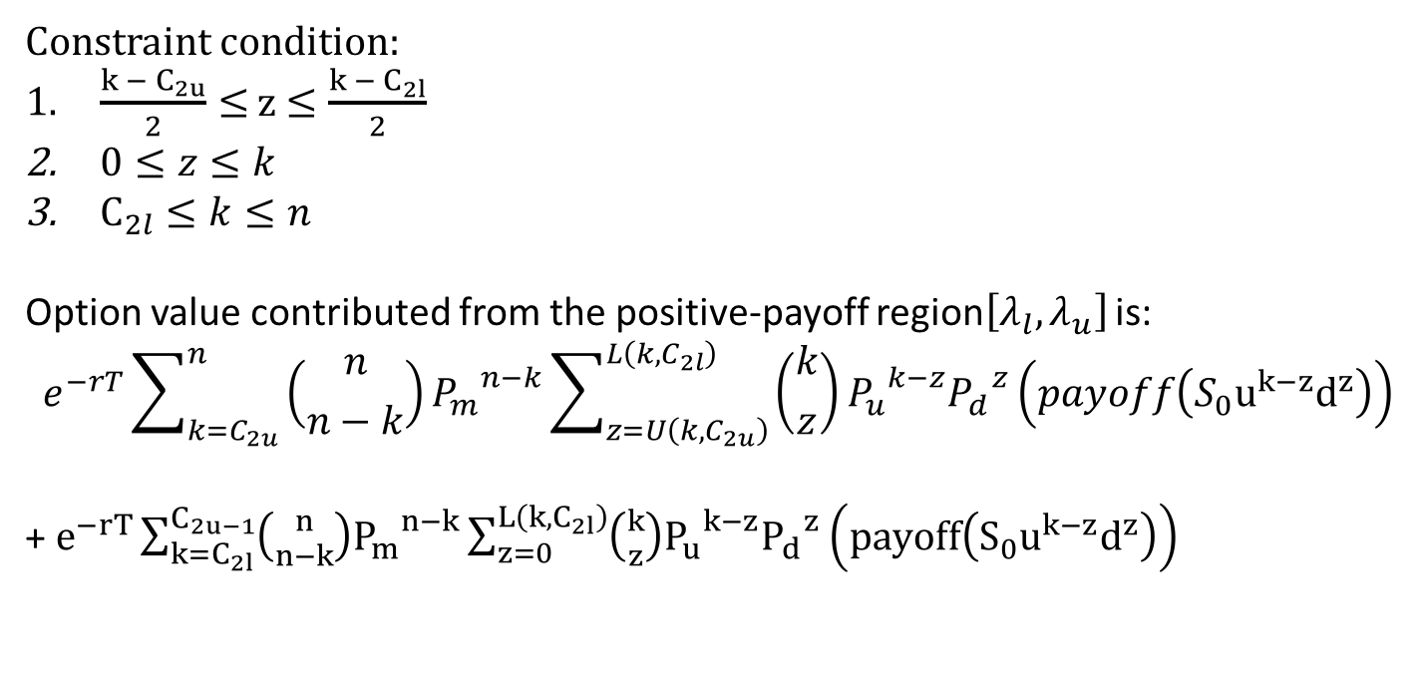
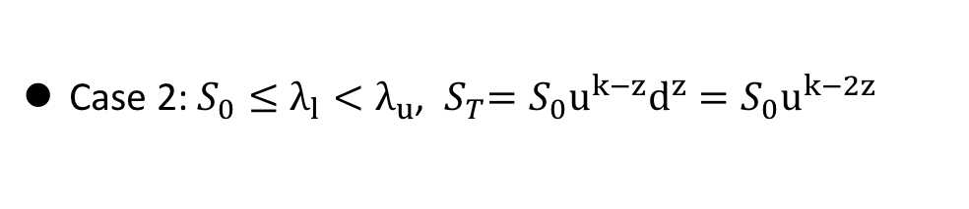
Case 2: $S_{0}≤λ_{l}<λ_{u}$, ${ S}_{T}=S_{0}u^{k−z}d^{z}=S_{0}u^{k−2z}$
$⟹$ 0$≤C_{2l}≤C_{2u}≤n$
Constraint condition:
$\frac{k − C_{2u}}{2}≤$ z$≤\frac{k −{ C}_{2l}}{2}$
$0≤z≤k$
$C_{2l}≤k≤n$
Option value contributed from the positive-payoff region$\left[λ_{l},λ_{u}\right]$ is:
$$e^{−rT}\sum_{k=C_{2u}}^{n}{\left({n \atop n−k}\right)}{P_{m}}^{n−k}\sum_{z=U\left(k,C_{2u}\right)}^{L\left(k,C_{2l}\right)}{\left({k \atop z}\right)}{P_{u}}^{k−z}{P_{d}}^{z}\left(payoff\left(S_{0}u^{k−z}d^{z}\right)\right)$$
+$e^{−rT}\sum_{k=C_{2l}}^{C_{2u−1}}{\left({n \atop n−k}\right){P_{m}}^{n−k}\sum_{z=0}^{L\left(k,C_{2l}\right)}{\left({k \atop z}\right){P_{u}}^{k−z}{P_{d}}^{z}\left(payoff\left(S_{0}u^{k−z}d^{z}\right)\right)}}$

Slide 9
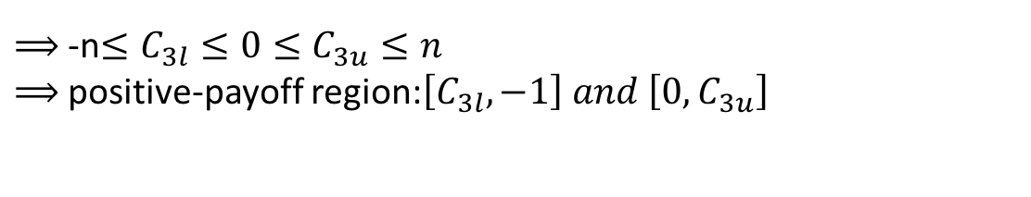
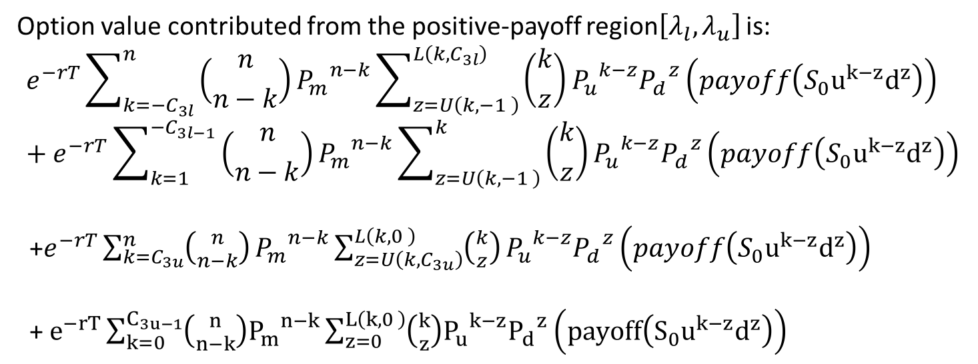
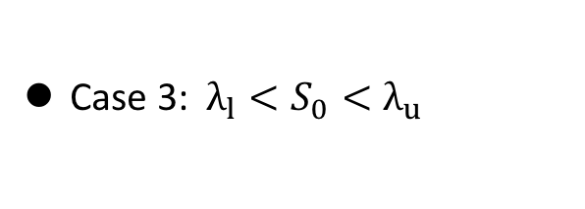
Case 3:$λ_{l}<S_{0}<λ_{u}$
$⟹$ -n$≤C_{3l}≤0≤C_{3u}≤n$
$⟹$ positive-payoff region:$\left[C_{3l},−1\right] and \left[0,C_{3u}\right]$
Option value contributed from the positive-payoff region$\left[λ_{l},λ_{u}\right]$ is:
$$e^{−rT}\sum_{k=−C_{3l}}^{n}{\left({n \atop n−k}\right)}{P_{m}}^{n−k}\sum_{z=U\left(k,−1 \right)}^{L\left(k,C_{3l}\right)}{\left({k \atop z}\right)}{P_{u}}^{k−z}{P_{d}}^{z}\left(payoff\left(S_{0}u^{k−z}d^{z}\right)\right)+e^{−rT}\sum_{k=1}^{−C_{3l−1}}{\left({n \atop n−k}\right){P_{m}}^{n−k}\sum_{z=U\left(k,−1 \right)}^{k}{\left({k \atop z}\right){P_{u}}^{k−z}{P_{d}}^{z}\left(payoff\left(S_{0}u^{k−z}d^{z}\right)\right)}}$$
+$e^{−rT}\sum_{k=C_{3u}}^{n}{\left({n \atop n−k}\right)}{P_{m}}^{n−k}\sum_{z=U\left(k,C_{3u}\right)}^{L\left(k,0 \right)}{\left({k \atop z}\right)}{P_{u}}^{k−z}{P_{d}}^{z}\left(payoff\left(S_{0}u^{k−z}d^{z}\right)\right)$
+$e^{−rT}\sum_{k=0}^{C_{3u−1}}{\left({n \atop n−k}\right){P_{m}}^{n−k}\sum_{z=0}^{L\left(k,0 \right)}{\left({k \atop z}\right){P_{u}}^{k−z}{P_{d}}^{z}\left(payoff\left(S_{0}u^{k−z}d^{z}\right)\right)}}$

Slide 10
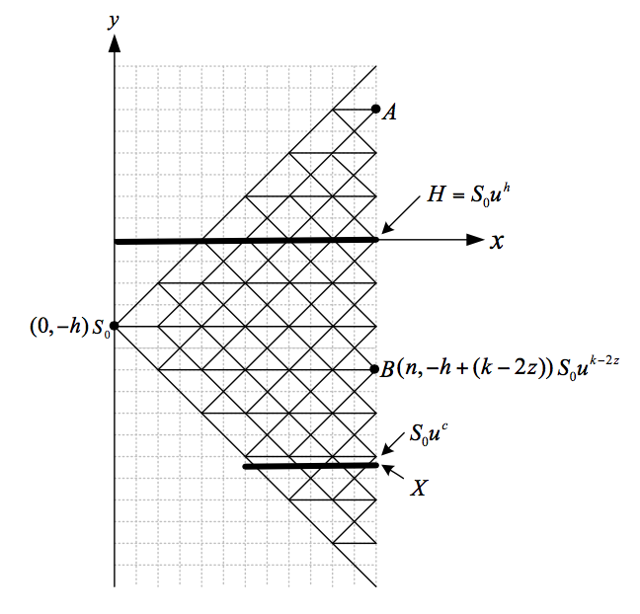

Linear-Time Algorithm for Barrier Options on the KRL Model
Define C=min$\left\{i|i∈ℤ,S_{0}u^{i}≥X\right\}$

Slide 11
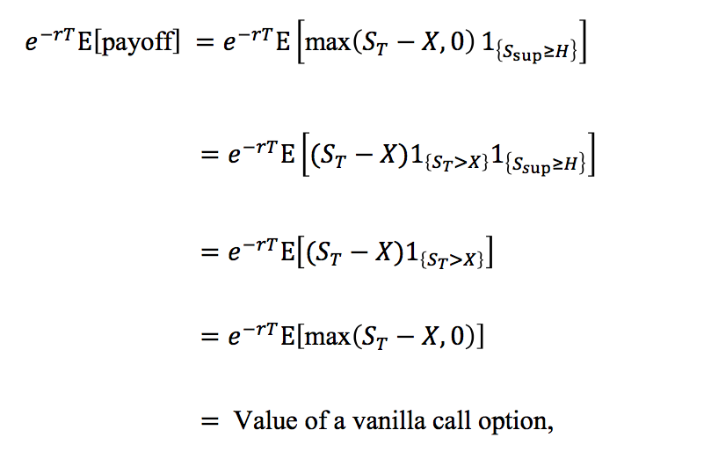

Case 1: X$≥H$

Slide 12

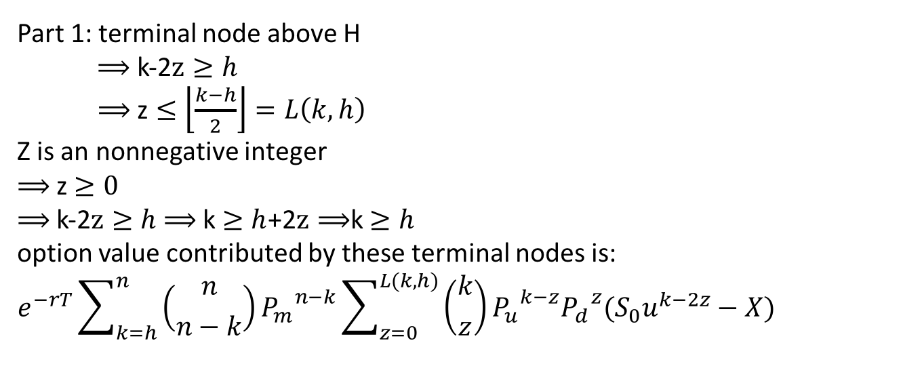
Case 2: X$<H$
Part 1: terminal node above H
$⟹$ k-2$z≥h$
$⟹$ z$≤\left\lfloor \frac{k−h}{2}\right\rfloor =L\left(k,h\right)$
Z is an nonnegative integer
$⟹$ z$≥0$
$⟹$ k-2$z≥h$ $⟹$ k $≥h$+2$z⟹$k$≥h$
option value contributed by these terminal nodes is:
$$e^{−rT}\sum_{k=h}^{n}{\left({n \atop n−k}\right){P_{m}}^{n−k}\sum_{z=0}^{L(k,h)}{\left({k \atop z}\right){P_{u}}^{k−z}{P_{d}}^{z}(S_{0}u^{k−2z}−X)}}$$

Slide 13

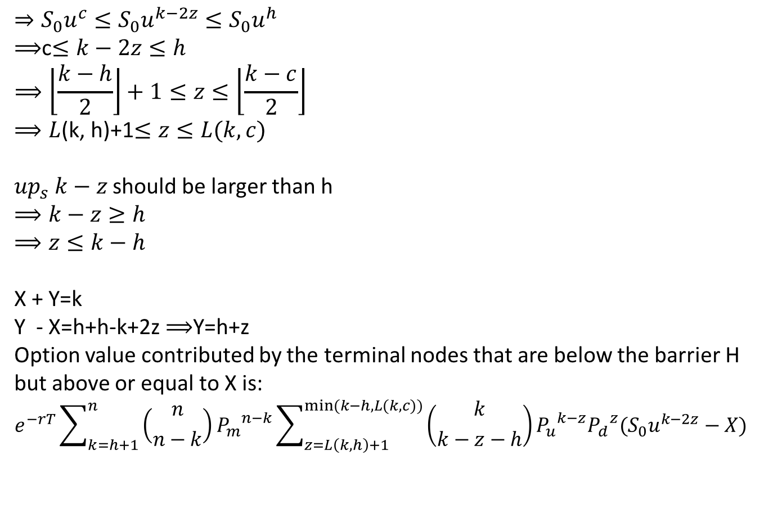
Case 2: X$<H$
Part 2: terminal node below H
$$⇒{S_{0}u}^{c}≤{S_{0}u}^{k−2z}≤{S_{0}u}^{h}$$
$⟹$c$≤k−2z≤h$
$$⟹\left\lfloor \frac{k−h}{2}\right\rfloor +1≤z≤\left\lfloor \frac{k−c}{2}\right\rfloor$$
$⟹L$(k, h)+1$≤z≤L(k,c)$
${up}_{s} k−z$ should be larger than h
$$⟹k−z≥h$$
$$⟹z≤k−h$$
X + Y=k
Y - X=h+h-k+2z$⟹$Y=h+z
Option value contributed by the terminal nodes that are below the barrier H but above or equal to X is:
$$e^{−rT}\sum_{k=h+1}^{n}{\left({n \atop n−k}\right)}{P_{m}}^{n−k}\sum_{z=L\left(k,h\right)+1}^{min⁡(k−h,L(k,c))}{\left({k \atop k−z−h}\right){P_{u}}^{k−z}{P_{d}}^{z}(S_{0}u^{k−2z}−X)}$$

Slide 14
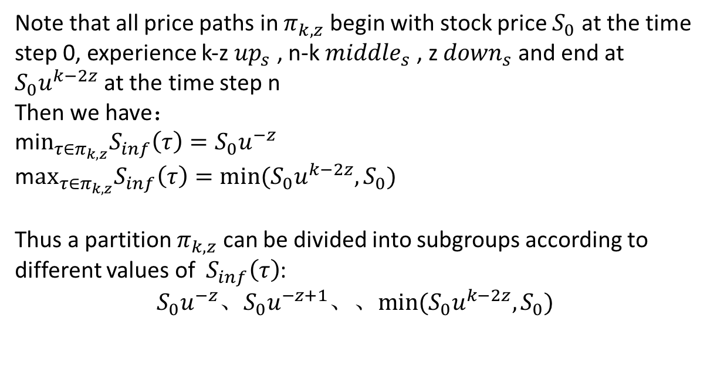
Linear-Time Algorithm for Lookback Options on the KRL Model
Note that all price paths in $π_{k,z}$ begin with stock price $S_{0}$ at the time step 0, experience k-z ${up}_{s}$ , n-k ${middle}_{s}$ , z ${down}_{s}$ and end at $S_{0}u^{k−2z}$ at the time step n
Then we have：
mi$n_{τ∈π_{k,z}}S_{inf}\left(τ\right)=S_{0}u^{−z}$
m$ax_{τ∈π_{k,z}}S_{inf}\left(τ\right)=min⁡({S_{0}u^{k−2z},S}_{0})$
Thus a partition $π_{k,z}$ can be divided into subgroups according to different values of $S_{inf}\left(τ\right)$:
$$S_{0}u^{−z}、S_{0}u^{−z+1}、、min⁡({S_{0}u^{k−2z},S}_{0})$$

Slide 15
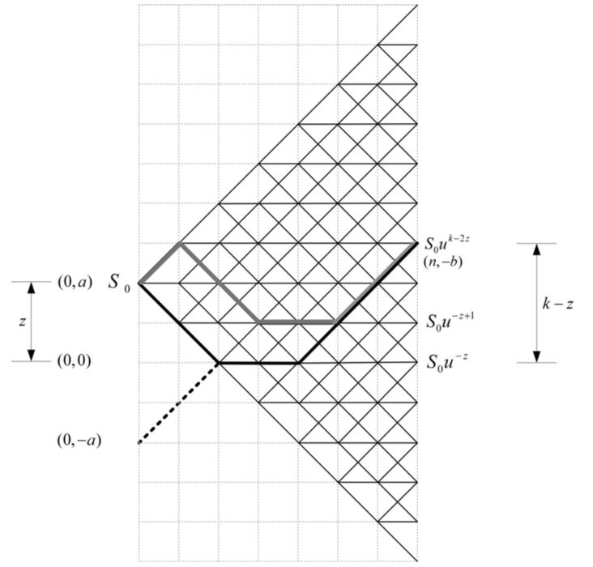

Slide 16
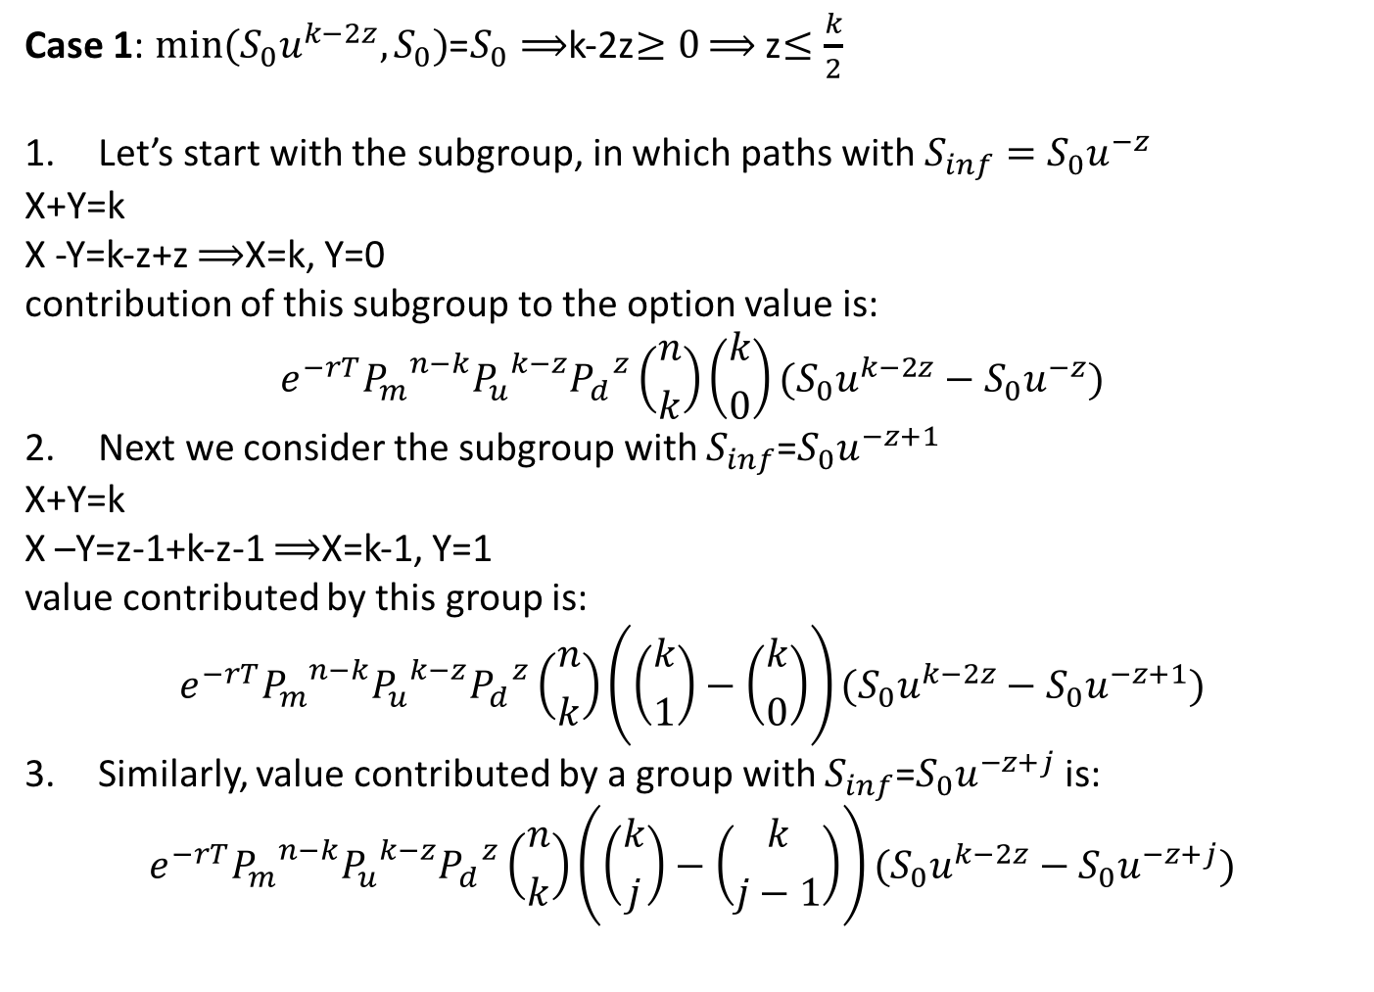
Case 1: $min⁡({S_{0}u^{k−2z},S}_{0})$=$S_{0}⟹$k-2z$≥0$ $⟹$ z$≤\frac{k}{2}$
Let’s start with the subgroup, in which paths with $S_{inf}=S_{0}u^{−z}$
X+Y=k
X -Y=k-z+z $⟹$X=k, Y=0
contribution of this subgroup to the option value is:
$$e^{−rT}{P_{m}}^{n−k}{P_{u}}^{k−z}{P_{d}}^{z}\left({n \atop k}\right)\left({k \atop 0}\right)(S_{0}u^{k−2z}−S_{0}u^{−z})$$
Next we consider the subgroup with $S_{inf}$=$S_{0}u^{−z+1}$
X+Y=k
X –Y=z-1+k-z-1 $⟹$X=k-1, Y=1
value contributed by this group is:
$$e^{−rT}{P_{m}}^{n−k}{P_{u}}^{k−z}{P_{d}}^{z}\left({n \atop k}\right)\left(\left({k \atop 1}\right)−\left({k \atop 0}\right)\right)(S_{0}u^{k−2z}−S_{0}u^{−z+1})$$
Similarly, value contributed by a group with $S_{inf}$=$S_{0}u^{−z+j}$ is:
$$e^{−rT}{P_{m}}^{n−k}{P_{u}}^{k−z}{P_{d}}^{z}\left({n \atop k}\right)\left(\left({k \atop j}\right)−\left({k \atop j−1}\right)\right)(S_{0}u^{k−2z}−S_{0}u^{−z+j})$$

Slide 17

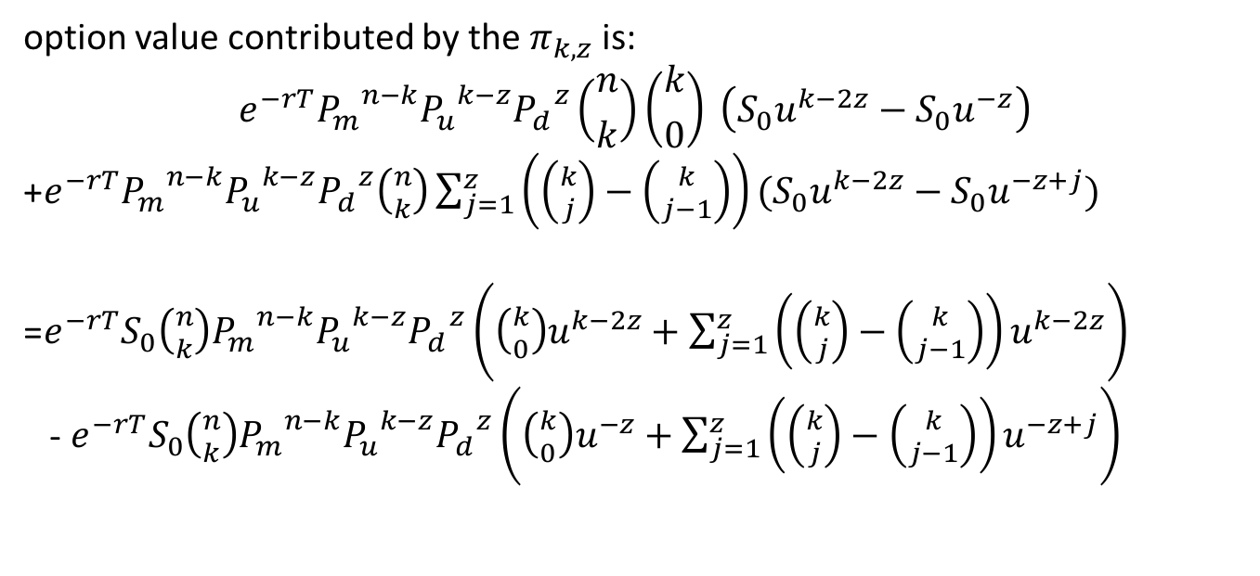
Note that j$≤z$, because $min⁡({S_{0}u^{k−2z},S}_{0})$=$S_{0}$
option value contributed by the $π_{k,z}$ is:
$$e^{−rT}{P_{m}}^{n−k}{P_{u}}^{k−z}{P_{d}}^{z}\left({n \atop k}\right)\left({k \atop 0}\right) \left(S_{0}u^{k−2z}−S_{0}u^{−z}\right)$$
+$e^{−rT}{P_{m}}^{n−k}{P_{u}}^{k−z}{P_{d}}^{z}\left({n \atop k}\right)\sum_{j=1}^{z}{\left(\left({k \atop j}\right)−\left({k \atop j−1}\right)\right)(S_{0}u^{k−2z}−S_{0}u^{−z+j})}$
=$e^{−rT}S_{0}\left({n \atop k}\right){P_{m}}^{n−k}{P_{u}}^{k−z}{P_{d}}^{z}\left(\left({k \atop 0}\right)u^{k−2z}+\sum_{j=1}^{z}{\left(\left({k \atop j}\right)−\left({k \atop j−1}\right)\right)u^{k−2z}}\right)$
- $e^{−rT}S_{0}\left({n \atop k}\right){P_{m}}^{n−k}{P_{u}}^{k−z}{P_{d}}^{z}\left(\left({k \atop 0}\right)u^{−z}+\sum_{j=1}^{z}{\left(\left({k \atop j}\right)−\left({k \atop j−1}\right)\right)u^{−z+j}}\right)$

Slide 18
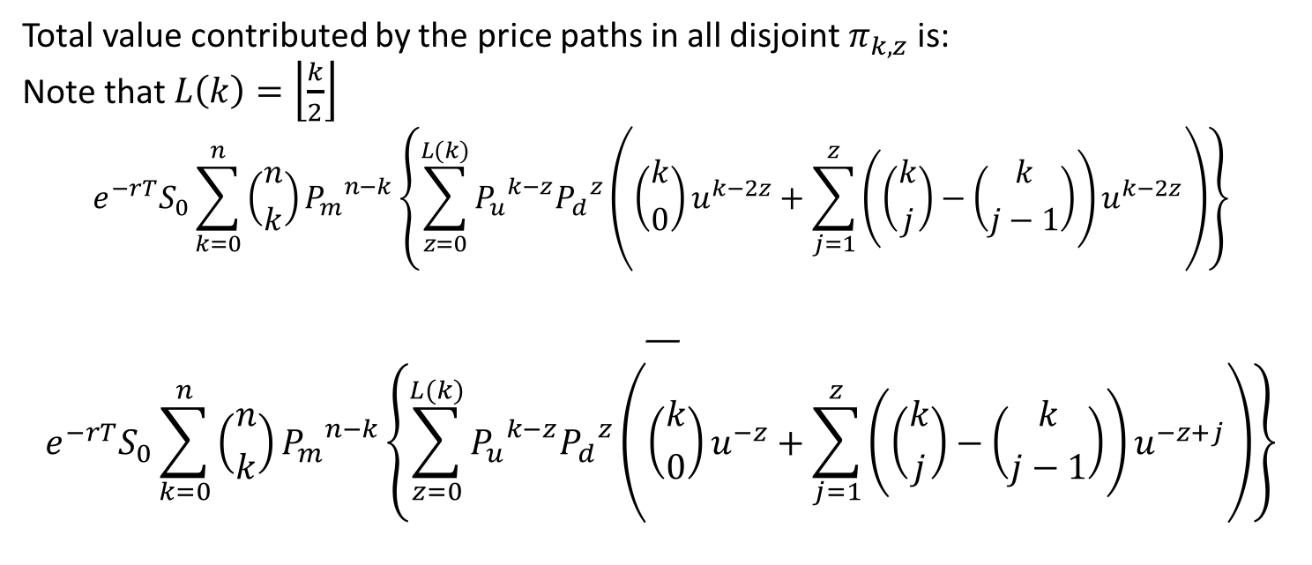
Total value contributed by the price paths in all disjoint $π_{k,z}$ is:
Note that $L\left(k\right)=\left\lfloor \frac{k}{2}\right\rfloor$
$$e^{−rT}S_{0}\sum_{k=0}^{n}{\left({n \atop k}\right)}{P_{m}}^{n−k}\left\{\sum_{z=0}^{L(k)}{{P_{u}}^{k−z}{P_{d}}^{z}\left(\left({k \atop 0}\right)u^{k−2z}+\sum_{j=1}^{z}{\left(\left({k \atop j}\right)−\left({k \atop j−1}\right)\right)u^{k−2z}}\right)}\right\}$$
—
$$e^{−rT}S_{0}\sum_{k=0}^{n}{\left({n \atop k}\right)}{P_{m}}^{n−k}\left\{\sum_{z=0}^{L(k)}{{P_{u}}^{k−z}{P_{d}}^{z}\left(\left({k \atop 0}\right)u^{−z}+\sum_{j=1}^{z}{\left(\left({k \atop j}\right)−\left({k \atop j−1}\right)\right)u^{−z+j}}\right)}\right\}$$

Slide 19
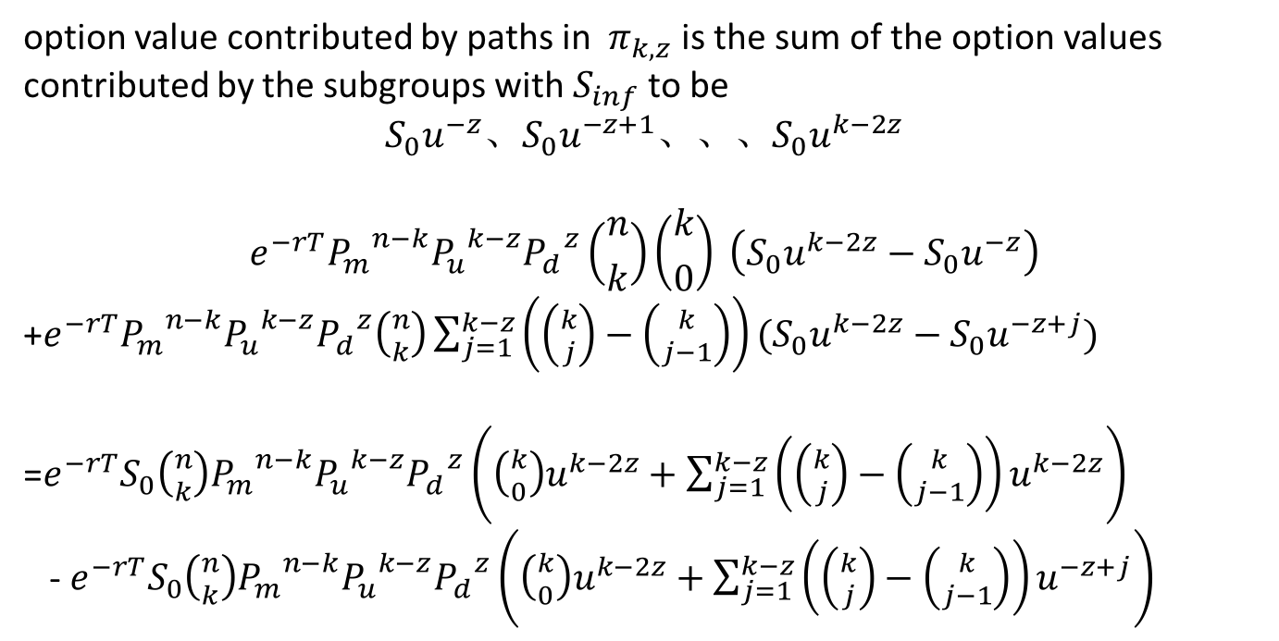
Case 2: $min⁡({S_{0}u^{k−2z},S}_{0})$=$S_{0}u^{k−2z}$ $⟹$k-2z<0 $⟹ \frac{k}{2}<z≤k$
option value contributed by paths in $π_{k,z}$ is the sum of the option values contributed by the subgroups with $S_{inf}$ to be
$$S_{0}u^{−z}、S_{0}u^{−z+1}、、、S_{0}u^{k−2z}$$
$$e^{−rT}{P_{m}}^{n−k}{P_{u}}^{k−z}{P_{d}}^{z}\left({n \atop k}\right)\left({k \atop 0}\right) \left(S_{0}u^{k−2z}−S_{0}u^{−z}\right)$$
+$e^{−rT}{P_{m}}^{n−k}{P_{u}}^{k−z}{P_{d}}^{z}\left({n \atop k}\right)\sum_{j=1}^{k−z}{\left(\left({k \atop j}\right)−\left({k \atop j−1}\right)\right)(S_{0}u^{k−2z}−S_{0}u^{−z+j})}$
=$e^{−rT}S_{0}\left({n \atop k}\right){P_{m}}^{n−k}{P_{u}}^{k−z}{P_{d}}^{z}\left(\left({k \atop 0}\right)u^{k−2z}+\sum_{j=1}^{k−z}{\left(\left({k \atop j}\right)−\left({k \atop j−1}\right)\right)u^{k−2z}}\right)$
- $e^{−rT}S_{0}\left({n \atop k}\right){P_{m}}^{n−k}{P_{u}}^{k−z}{P_{d}}^{z}\left(\left({k \atop 0}\right)u^{k−2z}+\sum_{j=1}^{k−z}{\left(\left({k \atop j}\right)−\left({k \atop j−1}\right)\right)u^{−z+j}}\right)$

Slide 20
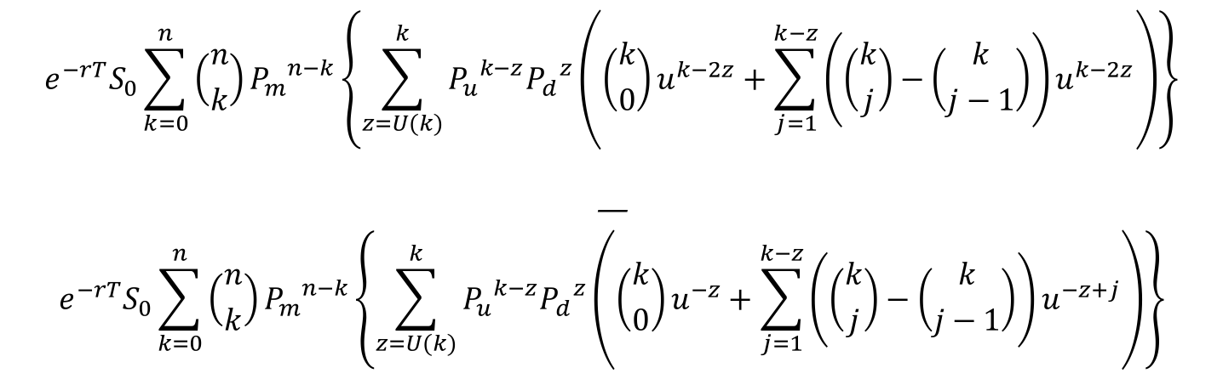
Define that $U(k)≡\left\lceil \frac{k}{2}\right\rceil$, and we have $U(k)≤z≤k$
$$e^{−rT}S_{0}\sum_{k=0}^{n}{\left({n \atop k}\right)}{P_{m}}^{n−k}\left\{\sum_{z=U(k)}^{k}{{P_{u}}^{k−z}{P_{d}}^{z}\left(\left({k \atop 0}\right)u^{k−2z}+\sum_{j=1}^{k−z}{\left(\left({k \atop j}\right)−\left({k \atop j−1}\right)\right)u^{k−2z}}\right)}\right\}$$
—
$$e^{−rT}S_{0}\sum_{k=0}^{n}{\left({n \atop k}\right)}{P_{m}}^{n−k}\left\{\sum_{z=U(k)}^{k}{{P_{u}}^{k−z}{P_{d}}^{z}\left(\left({k \atop 0}\right)u^{−z}+\sum_{j=1}^{k−z}{\left(\left({k \atop j}\right)−\left({k \atop j−1}\right)\right)u^{−z+j}}\right)}\right\}$$

Slide 21
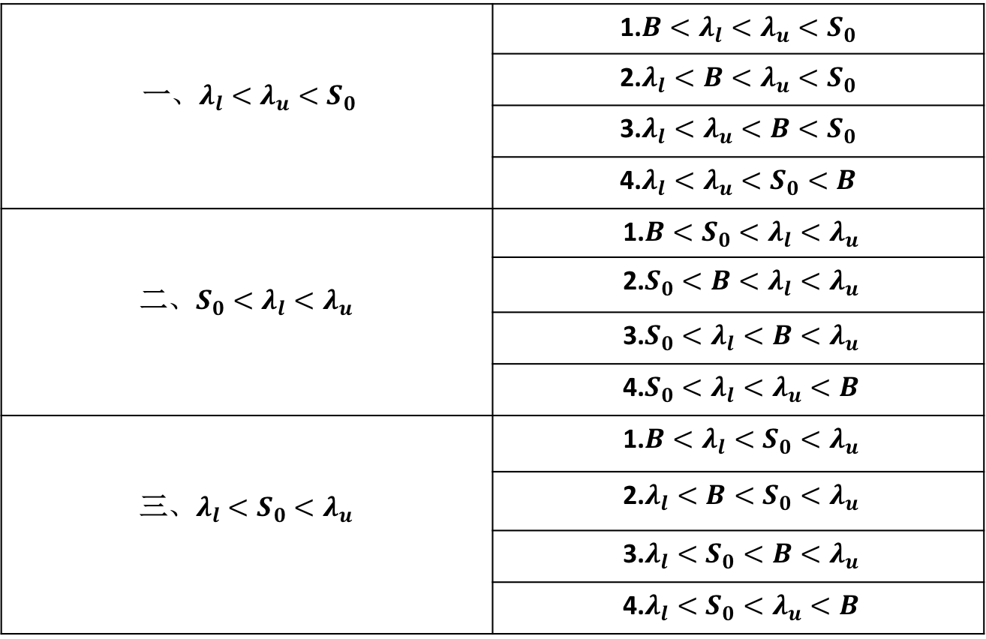
Polynomial Barrier Options on the KRL Model
一$、λ_{l}<λ_{u}<S_{0}$ | 1.$B<λ_{l}<λ_{u}<S_{0}$
 | 2.$λ_{l}<B<λ_{u}<S_{0}$
 | 3.$λ_{l}<λ_{u}<B<S_{0}$
 | 4.$λ_{l}<λ_{u}<S_{0}<B$
二$、S_{0}<λ_{l}<λ_{u}$ | 1.$B<S_{0}<λ_{l}<λ_{u}$
 | 2.${S_{0}<B<λ}_{l}<λ_{u}$
 | 3.${S_{0}<λ}_{l}<B<λ_{u}$
 | 4.${S_{0}<λ}_{l}<λ_{u}<B$
三$、λ_{l}<S_{0}<λ_{u}$ | 1.$B<λ_{l}<S_{0}<λ_{u}$
 | 2.$λ_{l}<B<S_{0}<λ_{u}$
 | 3.$λ_{l}<S_{0}<B<λ_{u}$
 | 4.$λ_{l}<S_{0}<λ_{u}<B$

Slide 22
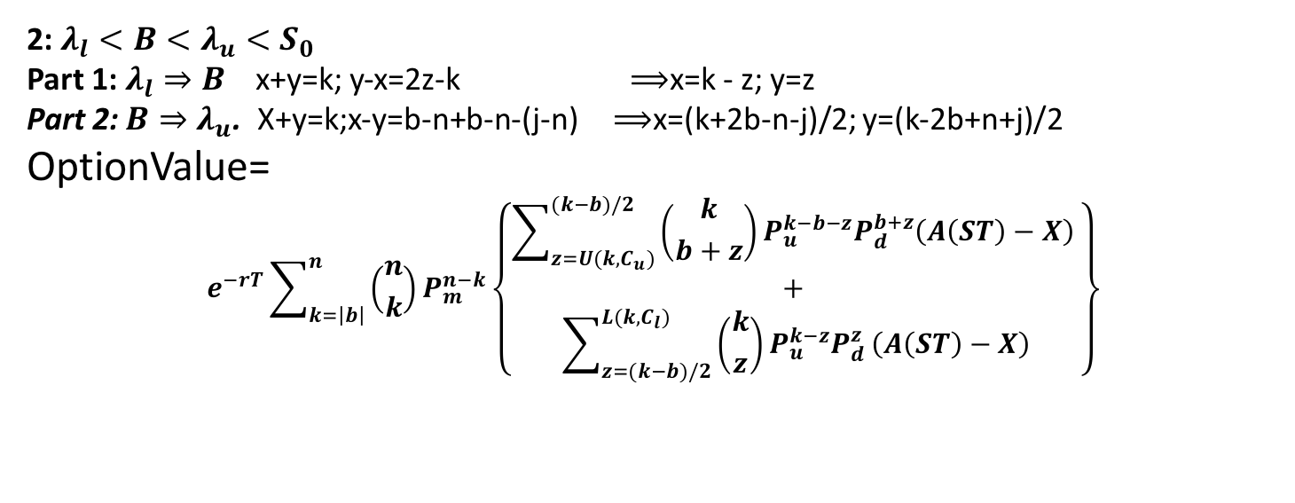

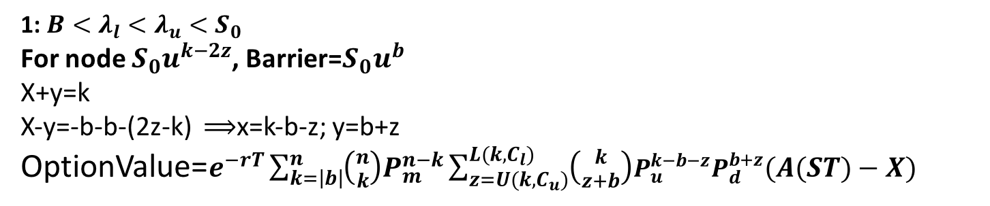
Case 1 :$λ_{l}<λ_{u}<S_{0}$
1: $B<λ_{l}<λ_{u}<S_{0}$
For node $S_{0}u^{k−2z}$, Barrier=$S_{0}u^{b}$
X+y=k
X-y=-b-b-(2z-k) $⟹$x=k-b-z; y=b+z
OptionValue=$e^{−rT}\sum_{k=\left|b\right|}^{n}{\left({n \atop k}\right)P_{m}^{n−k}\sum_{z=U(k,C_{u})}^{L(k,C_{l})}{\left({k \atop z+b}\right)P_{u}^{k−b−z}P_{d}^{b+z}(A(ST)−X)}}$
2: $λ_{l}<B<λ_{u}<S_{0}$
Part 1: $λ_{l}⇒B$ x+y=k; y-x=2z-k$⟹$x=k - z; y=z
Part 2:$B⇒λ_{u}$. X+y=k;x-y=b-n+b-n-(j-n) $⟹$x=(k+2b-n-j)/2; y=(k-2b+n+j)/2
OptionValue=
$$e^{−rT}\sum_{k=\left|b\right|}^{n}{\left({n \atop k}\right)P_{m}^{n−k}\left\{\begin{aligned}\sum_{z=U(k,C_{u})}^{(k−b)/2}{\left({k \atop b+z}\right)}P_{u}^{k−b−z}P_{d}^{b+z}\left(A\left(ST\right)−X\right) \\ + \\ \sum_{z=(k−b)/2}^{L(k,C_{l})}{\left({k \atop z}\right)P_{u}^{k−z}P_{d}^{z}}\left(A\left(ST\right)−X\right)\end{aligned}\right\}}$$

Slide 23
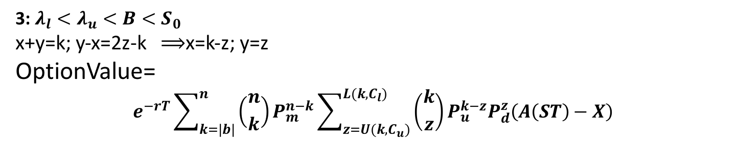
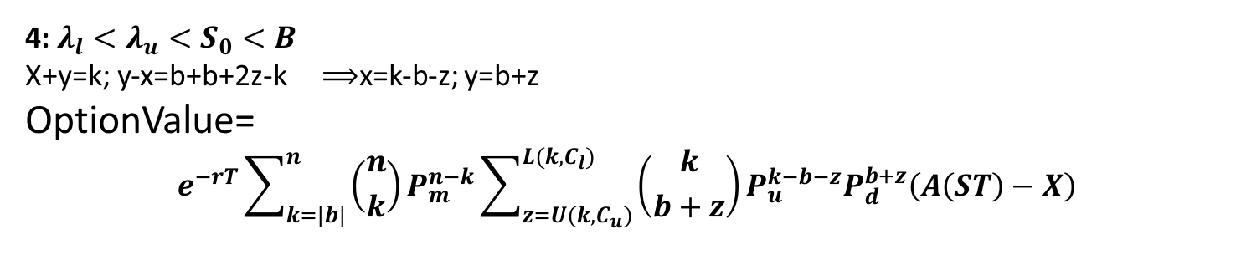
3: $λ_{l}<λ_{u}<B<S_{0}$
x+y=k; y-x=2z-k $⟹$x=k-z; y=z
OptionValue=
$$e^{−rT}\sum_{k=\left|b\right|}^{n}{\left({n \atop k}\right)P_{m}^{n−k}\sum_{z=U(k,C_{u})}^{L(k,C_{l})}{\left({k \atop z}\right)P_{u}^{k−z}P_{d}^{z}\left(A\left(ST\right)−X\right)}}$$
4: $λ_{l}<λ_{u}<S_{0}<B$
X+y=k; y-x=b+b+2z-k$⟹$x=k-b-z; y=b+z
OptionValue=
$$e^{−rT}\sum_{k=\left|b\right|}^{n}{\left({n \atop k}\right)P_{m}^{n−k}\sum_{z=U(k,C_{u})}^{L(k,C_{l})}{\left({k \atop b+z}\right)P_{u}^{k−b−z}P_{d}^{b+z}\left(A\left(ST\right)−X\right)}}$$

Slide 24
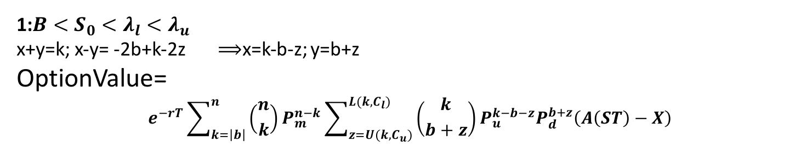
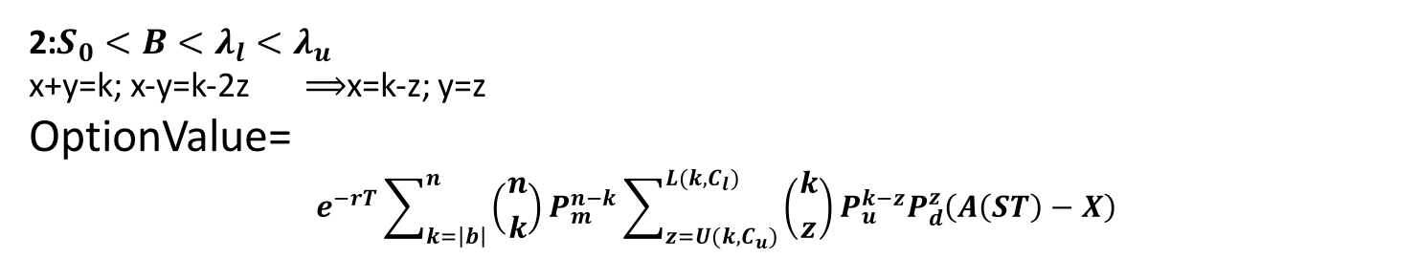
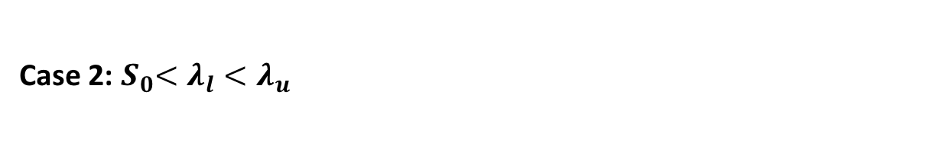
Case 2:${ S}_{0}<λ_{l}<λ_{u}$
1:$B<S_{0}<λ_{l}<λ_{u}$
x+y=k; x-y= -2b+k-2z$⟹$x=k-b-z; y=b+z
OptionValue=
$$e^{−rT}\sum_{k=\left|b\right|}^{n}{\left({n \atop k}\right)P_{m}^{n−k}\sum_{z=U(k,C_{u})}^{L(k,C_{l})}{\left({k \atop b+z}\right)P_{u}^{k−b−z}P_{d}^{b+z}\left(A\left(ST\right)−X\right)}}$$
2:${S_{0}<B<λ}_{l}<λ_{u}$
x+y=k; x-y=k-2z $⟹$x=k-z; y=z
OptionValue=
$$e^{−rT}\sum_{k=\left|b\right|}^{n}{\left({n \atop k}\right)P_{m}^{n−k}\sum_{z=U(k,C_{u})}^{L(k,C_{l})}{\left({k \atop z}\right)P_{u}^{k−z}P_{d}^{z}\left(A\left(ST\right)−X\right)}}$$

Slide 25
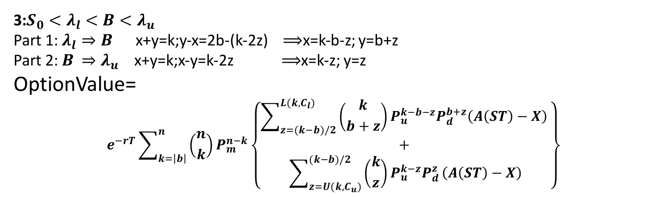
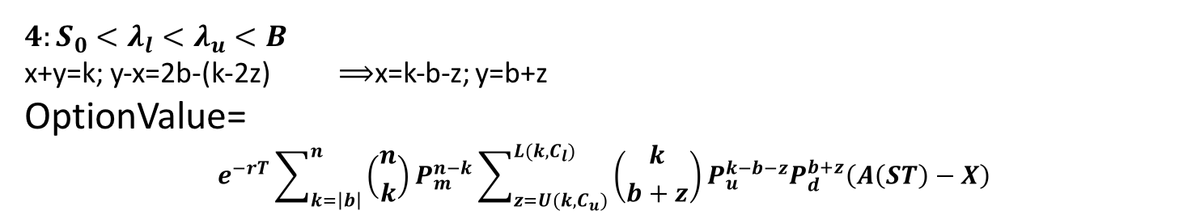
3:${S_{0}<λ}_{l}<B<λ_{u}$
Part 1: $λ_{l}⇒B$ x+y=k;y-x=2b-(k-2z)$⟹$x=k-b-z; y=b+z
Part 2: $B{ ⇒λ}_{u}$ x+y=k;x-y=k-2z $⟹$x=k-z; y=z
OptionValue=
$$e^{−rT}\sum_{k=\left|b\right|}^{n}{\left({n \atop k}\right)P_{m}^{n−k}\left\{\begin{aligned}\sum_{z=(k−b)/2}^{L(k,C_{l})}{\left({k \atop b+z}\right)}P_{u}^{k−b−z}P_{d}^{b+z}\left(A\left(ST\right)−X\right) \\ + \\ \sum_{z=U(k,C_{u})}^{(k−b)/2}{\left({k \atop z}\right)P_{u}^{k−z}P_{d}^{z}}\left(A\left(ST\right)−X\right)\end{aligned}\right\}}$$
$$4:{S_{0}<λ}_{l}<λ_{u}<B$$
x+y=k; y-x=2b-(k-2z)$⟹$x=k-b-z; y=b+z
OptionValue=
$$e^{−rT}\sum_{k=\left|b\right|}^{n}{\left({n \atop k}\right)P_{m}^{n−k}\sum_{z=U(k,C_{u})}^{L(k,C_{l})}{\left({k \atop b+z}\right)P_{u}^{k−b−z}P_{d}^{b+z}\left(A\left(ST\right)−X\right)}}$$

Slide 26
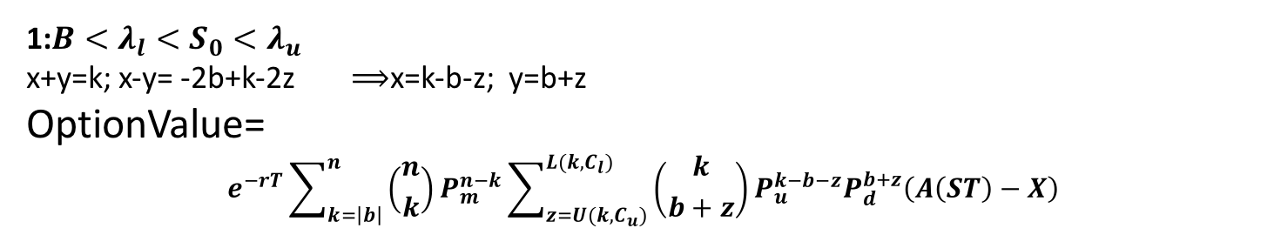
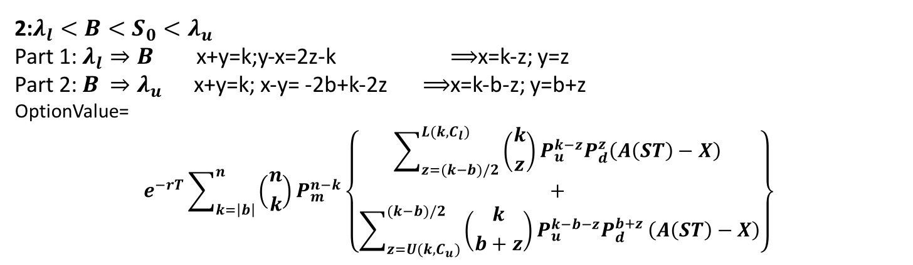

Case 3: $λ_{l}<S_{0}<λ_{u}$
1:$B<λ_{l}<S_{0}<λ_{u}$
x+y=k; x-y= -2b+k-2z $⟹$x=k-b-z; y=b+z
OptionValue=
$$e^{−rT}\sum_{k=\left|b\right|}^{n}{\left({n \atop k}\right)P_{m}^{n−k}\sum_{z=U(k,C_{u})}^{L(k,C_{l})}{\left({k \atop b+z}\right)P_{u}^{k−b−z}P_{d}^{b+z}\left(A\left(ST\right)−X\right)}}$$
2:$λ_{l}<B<S_{0}<λ_{u}$
Part 1: $λ_{l}⇒B$ x+y=k;y-x=2z-k $⟹$x=k-z; y=z
Part 2: $B$ $⇒λ_{u}$x+y=k; x-y= -2b+k-2z $⟹$x=k-b-z; y=b+z
OptionValue=
$$e^{−rT}\sum_{k=\left|b\right|}^{n}{\left({n \atop k}\right)P_{m}^{n−k}\left\{\begin{aligned}\sum_{z=(k−b)/2}^{L(k,C_{l})}{\left({k \atop z}\right)}P_{u}^{k−z}P_{d}^{z}\left(A\left(ST\right)−X\right) \\ + \\ \sum_{z=U(k,C_{u})}^{(k−b)/2}{\left({k \atop b+z}\right)P_{u}^{k−b−z}P_{d}^{b+z}}\left(A\left(ST\right)−X\right)\end{aligned}\right\}}$$

Slide 27
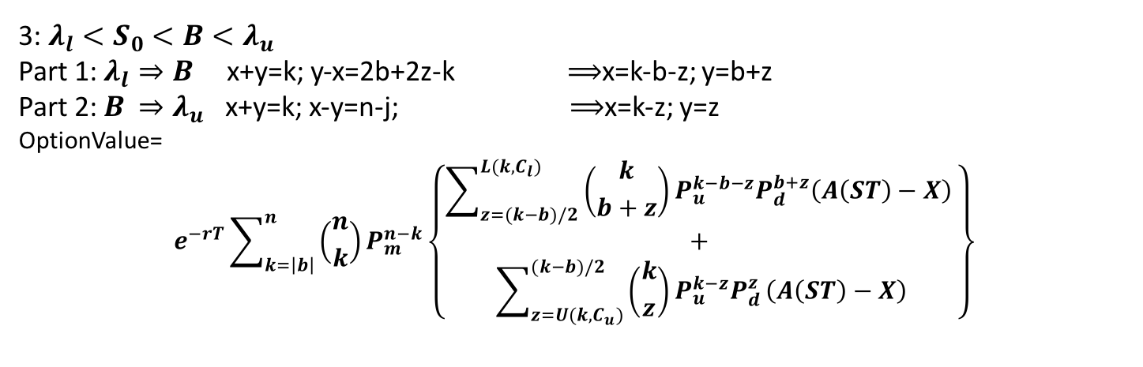
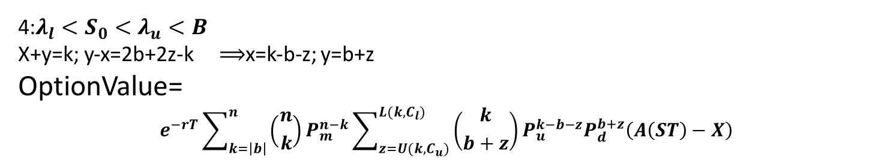
3: $λ_{l}<S_{0}<B<λ_{u}$
Part 1: $λ_{l}⇒B$ x+y=k; y-x=2b+2z-k $⟹$x=k-b-z; y=b+z
Part 2: $B$ $⇒λ_{u}$ x+y=k; x-y=n-j; $⟹$x=k-z; y=z
OptionValue=
$$e^{−rT}\sum_{k=\left|b\right|}^{n}{\left({n \atop k}\right)P_{m}^{n−k}\left\{\begin{aligned}\sum_{z=(k−b)/2}^{L(k,C_{l})}{\left({k \atop b+z}\right)}P_{u}^{k−b−z}P_{d}^{b+z}\left(A\left(ST\right)−X\right) \\ + \\ \sum_{z=U(k,C_{u})}^{(k−b)/2}{\left({k \atop z}\right)P_{u}^{k−z}P_{d}^{z}}\left(A\left(ST\right)−X\right)\end{aligned}\right\}}$$
4:$λ_{l}<S_{0}<λ_{u}<B$
X+y=k; y-x=2b+2z-k$⟹$x=k-b-z; y=b+z
OptionValue=
$$e^{−rT}\sum_{k=\left|b\right|}^{n}{\left({n \atop k}\right)P_{m}^{n−k}\sum_{z=U(k,C_{u})}^{L(k,C_{l})}{\left({k \atop b+z}\right)P_{u}^{k−b−z}P_{d}^{b+z}\left(A\left(ST\right)−X\right)}}$$

Slide 28
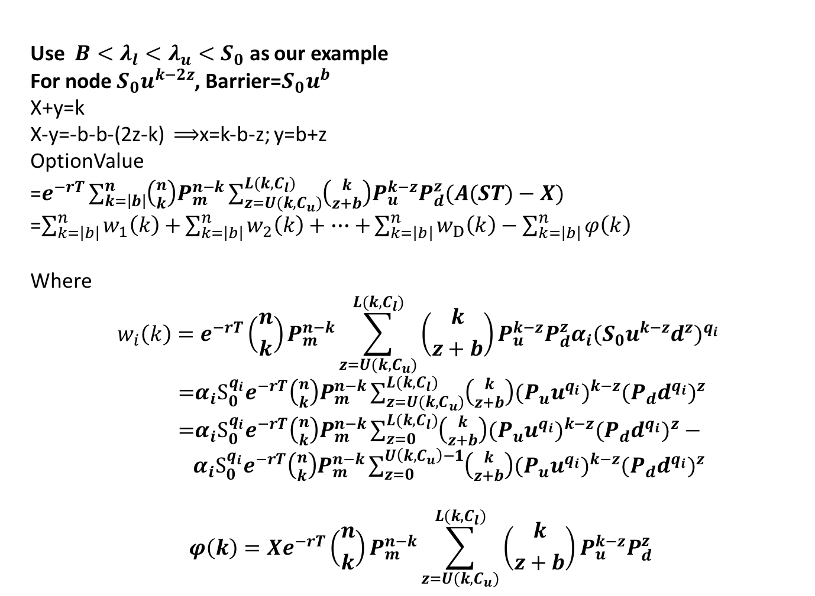
Use $B<λ_{l}<λ_{u}<S_{0}$ as our example
For node $S_{0}u^{k−2z}$, Barrier=$S_{0}u^{b}$
X+y=k
X-y=-b-b-(2z-k) $⟹$x=k-b-z; y=b+z
OptionValue
=$e^{−rT}\sum_{k=\left|b\right|}^{n}{\left({n \atop k}\right)P_{m}^{n−k}\sum_{z=U(k,C_{u})}^{L(k,C_{l})}{\left({k \atop z+b}\right)P_{u}^{k−z}P_{d}^{z}(A(ST)−X)}}$
=$\sum_{k=\left|b\right|}^{n}{w_{1}\left(k\right)+}\sum_{k=\left|b\right|}^{n}{w_{2}\left(k\right)+}∙∙∙+\sum_{k=\left|b\right|}^{n}{w_{D}\left(k\right)−\sum_{k=\left|b\right|}^{n}{φ\left(k\right)}}$
Where
$$w_{i}\left(k\right)=e^{−rT}\left({n \atop k}\right)P_{m}^{n−k}\sum_{z=U(k,C_{u})}^{L(k,C_{l})}{\left({k \atop z+b}\right)P_{u}^{k−z}P_{d}^{z}α_{i}(S_{0}u^{k−z}d^{z})^{q_{i}}}$$
=$α_{i}S_{0}^{q_{i}}e^{−rT}\left({n \atop k}\right)P_{m}^{n−k}\sum_{z=U(k,C_{u})}^{L(k,C_{l})}{\left({k \atop z+b}\right)(P_{u}u^{q_{i}})^{k−z}(P_{d}d^{q_{i}})^{z}}$
=$α_{i}S_{0}^{q_{i}}e^{−rT}\left({n \atop k}\right)P_{m}^{n−k}\sum_{z=0 }^{L(k,C_{l})}{\left({k \atop z+b}\right)(P_{u}u^{q_{i}})^{k−z}(P_{d}d^{q_{i}})^{z}}−$ $α_{i}S_{0}^{q_{i}}e^{−rT}\left({n \atop k}\right)P_{m}^{n−k}\sum_{z=0 }^{U\left(k,C_{u}\right)−1}{\left({k \atop z+b}\right)(P_{u}u^{q_{i}})^{k−z}(P_{d}d^{q_{i}})^{z}}$
$$φ\left(k\right)=Xe^{−rT}\left({n \atop k}\right)P_{m}^{n−k}\sum_{z=U(k,C_{u})}^{L(k,C_{l})}{\left({k \atop z+b}\right)P_{u}^{k−z}P_{d}^{z}}$$

Slide 29
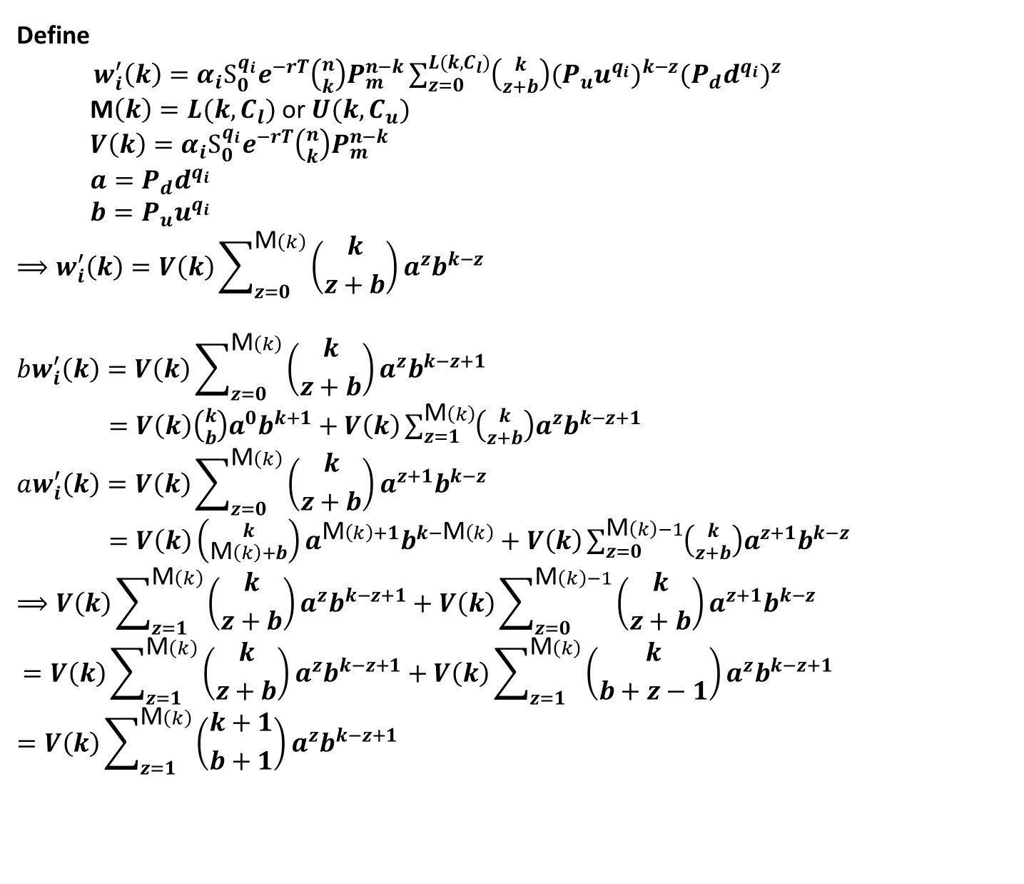
Define
$w_{i}^{′}\left(k\right)=α_{i}S_{0}^{q_{i}}e^{−rT}\left({n \atop k}\right)P_{m}^{n−k}\sum_{z=0 }^{L(k,C_{l})}{\left({k \atop z+b}\right)(P_{u}u^{q_{i}})^{k−z}(P_{d}d^{q_{i}})^{z}}$
M$\left(k\right)=L(k,C_{l})$ or $U(k,C_{u})$
$V\left(k\right)=α_{i}S_{0}^{q_{i}}e^{−rT}\left({n \atop k}\right)P_{m}^{n−k}$
$a=P_{d}d^{q_{i}}$
$b=P_{u}u^{q_{i}}$
$$⟹w_{i}^{′}\left(k\right)=V\left(k\right)\sum_{z=0}^{\text{M}\left(k\right)}{\left({k \atop z+b}\right)a^{z}b^{k−z}}$$
$$bw_{i}^{′}\left(k\right)=V\left(k\right)\sum_{z=0}^{\text{M}\left(k\right)}{\left({k \atop z+b}\right)a^{z}b^{k−z+1}}$$
$=V\left(k\right)\left({k \atop b}\right)a^{0}b^{k+1}+V\left(k\right)\sum_{z=1}^{\text{M}\left(k\right)}{\left({k \atop z+b}\right)a^{z}b^{k−z+1}}$
$$aw_{i}^{′}\left(k\right)=V\left(k\right)\sum_{z=0}^{\text{M}\left(k\right)}{\left({k \atop z+b}\right)a^{z+1}b^{k−z}}$$
$=V\left(k\right)\left({k \atop \text{M}\left(k\right)+b}\right)a^{\text{M}\left(k\right)+1}b^{k−\text{M}\left(k\right)}+V\left(k\right)\sum_{z=0}^{\text{M}\left(k\right)−1}{\left({k \atop z+b}\right)a^{z+1}b^{k−z}}$
$$⟹V\left(k\right)\sum_{z=1}^{\text{M}\left(k\right)}{\left({k \atop z+b}\right)a^{z}b^{k−z+1}}+V\left(k\right)\sum_{z=0}^{\text{M}\left(k\right)−1}{\left({k \atop z+b}\right)a^{z+1}b^{k−z}}$$
$$=V\left(k\right)\sum_{z=1}^{\text{M}\left(k\right)}{\left({k \atop z+b}\right)a^{z}b^{k−z+1}}+V\left(k\right)\sum_{z=1}^{\text{M}\left(k\right)}{\left({k \atop b+z−1}\right)a^{z}b^{k−z+1}}$$
$$=V\left(k\right)\sum_{z=1}^{\text{M}\left(k\right)}{\left({k+1 \atop b+1}\right)a^{z}b^{k−z+1}}$$

Slide 30
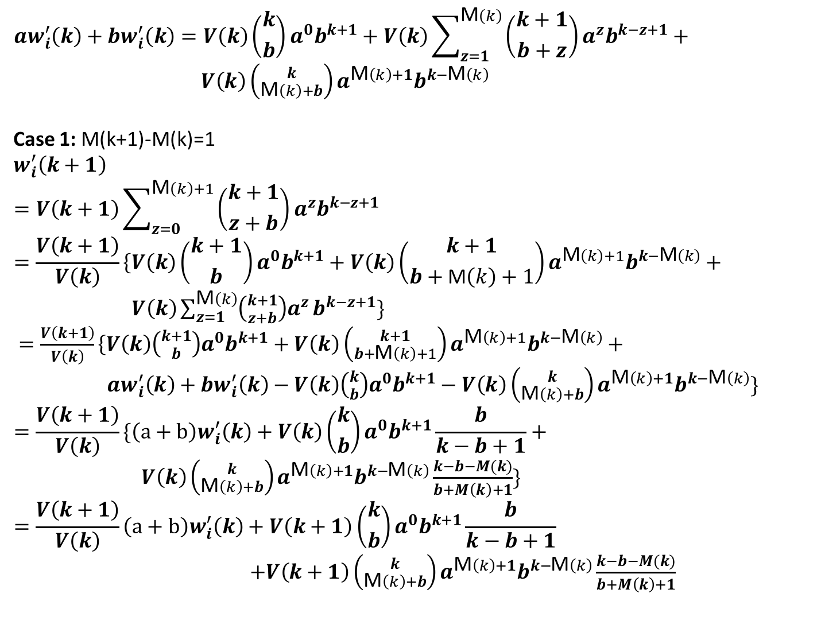
$$aw_{i}^{′}\left(k\right)+bw_{i}^{′}\left(k\right)=V\left(k\right)\left({k \atop b}\right)a^{0}b^{k+1}+V\left(k\right)\sum_{z=1}^{\text{M}\left(k\right)}{\left({k+1 \atop b+z}\right)a^{z}b^{k−z+1}}+$$
$V\left(k\right)\left({k \atop \text{M}\left(k\right)+b}\right)a^{\text{M}\left(k\right)+1}b^{k−\text{M}\left(k\right)}$
Case 1: M(k+1)-M(k)=1
$$w_{i}^{′}\left(k+1\right)$$
$$=V\left(k+1\right)\sum_{z=0}^{\text{M}\left(k\right)+1}{\left({k+1 \atop z+b}\right)a^{z}b^{k−z+1}}=\frac{V\left(k+1\right)}{V\left(k\right)}\left\{V\left(k\right)\right.\left({k+1 \atop b}\right)a^{0}b^{k+1}+V\left(k\right)\left({k+1 \atop b+\text{M}\left(k\right)+1}\right)a^{\text{M}\left(k\right)+1}b^{k−\text{M}\left(k\right)}+$$
$V\left(k\right)\sum_{z=1}^{\text{M}\left(k\right)}{\left({k+1 \atop z+b}\right)a^{z}}b^{k−z+1}\}$
$=\frac{V\left(k+1\right)}{V\left(k\right)}\left\{V\left(k\right)\right.\left({k+1 \atop b}\right)a^{0}b^{k+1}+V\left(k\right)\left({k+1 \atop b+\text{M}\left(k\right)+1}\right)a^{\text{M}\left(k\right)+1}b^{k−\text{M}\left(k\right)}+$
$aw_{i}^{′}\left(k\right)+bw_{i}^{′}\left(k\right)−V\left(k\right)\left({k \atop b}\right)a^{0}b^{k+1}−V\left(k\right)\left({k \atop \text{M}\left(k\right)+b}\right)a^{\text{M}\left(k\right)+1}b^{k−\text{M}\left(k\right)}\}$
$$=\frac{V\left(k+1\right)}{V\left(k\right)}\{\left(a+b\right)w_{i}^{′}\left(k\right)+V\left(k\right)\left({k \atop b}\right)a^{0}b^{k+1}\frac{b}{k−b+1}+$$
$V\left(k\right)\left({k \atop \text{M}\left(k\right)+b}\right)a^{\text{M}\left(k\right)+1}b^{k−\text{M}\left(k\right)}\frac{k−b−M(k)}{b+M\left(k\right)+1}\}$
$$=\frac{V\left(k+1\right)}{V\left(k\right)}\left(a+b\right)w_{i}^{′}\left(k\right)+V\left(k+1\right)\left({k \atop b}\right)a^{0}b^{k+1}\frac{b}{k−b+1}$$
$+V\left(k+1\right)\left({k \atop \text{M}\left(k\right)+b}\right)a^{\text{M}\left(k\right)+1}b^{k−\text{M}\left(k\right)}\frac{k−b−M(k)}{b+M\left(k\right)+1}$

Slide 31
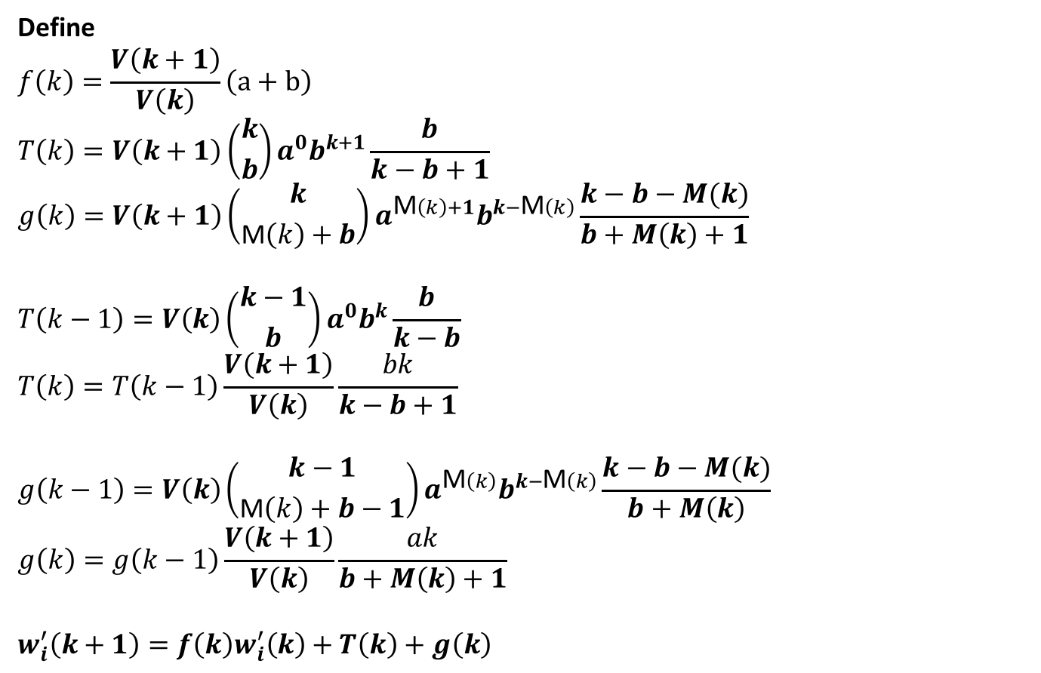
Define
$$f\left(k\right)=\frac{V\left(k+1\right)}{V\left(k\right)}\left(a+b\right)$$
$$T\left(k\right)=V\left(k+1\right)\left({k \atop b}\right)a^{0}b^{k+1}\frac{b}{k−b+1}$$
$$g\left(k\right)=V\left(k+1\right)\left({k \atop \text{M}\left(k\right)+b}\right)a^{\text{M}\left(k\right)+1}b^{k−\text{M}\left(k\right)}\frac{k−b−M(k)}{b+M\left(k\right)+1}$$
$$T\left(k−1\right)=V\left(k\right)\left({k−1 \atop b}\right)a^{0}b^{k}\frac{b}{k−b}$$
$$T\left(k\right)=T\left(k−1\right)\frac{V\left(k+1\right)}{V\left(k\right)}\frac{bk}{k−b+1}$$
$$g\left(k−1\right)=V\left(k\right)\left({k−1 \atop \text{M}\left(k\right)+b−1}\right)a^{\text{M}\left(k\right)}b^{k−\text{M}\left(k\right)}\frac{k−b−M(k)}{b+M\left(k\right)}$$
$$g\left(k\right)=g\left(k−1\right)\frac{V\left(k+1\right)}{V\left(k\right)}\frac{ak}{b+M\left(k\right)+1}$$
$$w_{i}^{′}\left(k+1\right)=f\left(k\right)w_{i}^{′}\left(k\right)+T\left(k\right)+g\left(k\right)$$

Slide 32
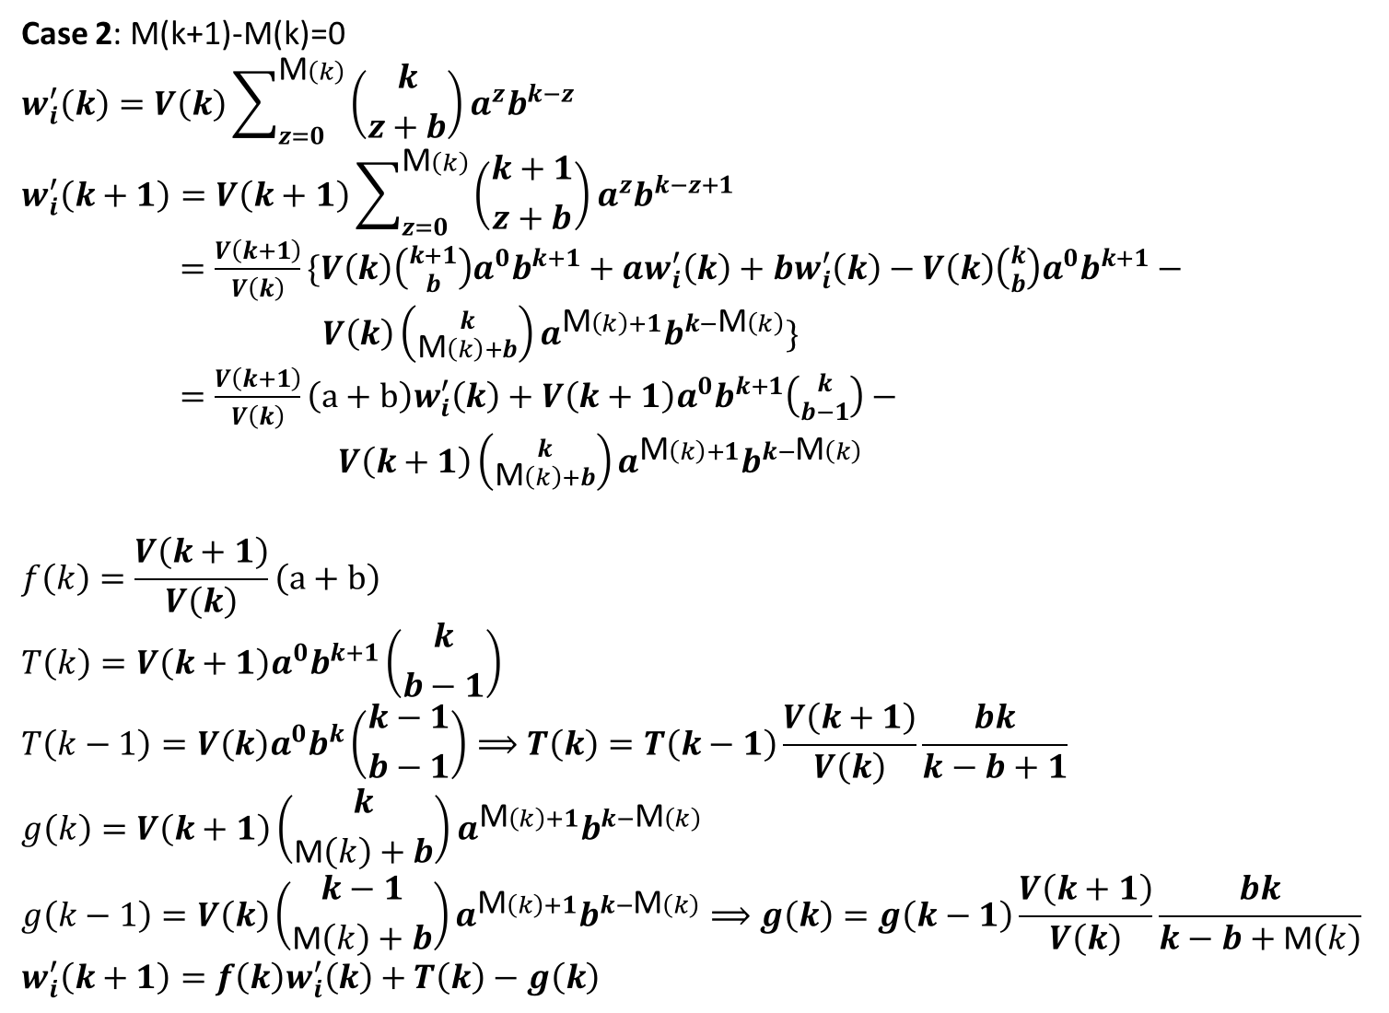
Case 2: M(k+1)-M(k)=0
$$w_{i}^{′}\left(k\right)=V\left(k\right)\sum_{z=0}^{\text{M}\left(k\right)}{\left({k \atop z+b}\right)a^{z}b^{k−z}}$$
$$w_{i}^{′}\left(k+1\right)=V\left(k+1\right)\sum_{z=0}^{\text{M}\left(k\right)}{\left({k+1 \atop z+b}\right)a^{z}b^{k−z+1}}$$
$=\frac{V\left(k+1\right)}{V\left(k\right)}\{V\left(k\right)\left({k+1 \atop b}\right)a^{0}b^{k+1}+aw_{i}^{′}\left(k\right)+bw_{i}^{′}\left(k\right)−V\left(k\right)\left({k \atop b}\right)a^{0}b^{k+1}−$
$V\left(k\right)\left({k \atop \text{M}\left(k\right)+b}\right)a^{\text{M}\left(k\right)+1}b^{k−\text{M}\left(k\right)}\}$
$=\frac{V\left(k+1\right)}{V\left(k\right)}\left(a+b\right)w_{i}^{′}\left(k\right)+V\left(k+1\right)a^{0}b^{k+1}\left({k \atop b−1}\right)−$
$V\left(k+1\right)\left({k \atop \text{M}\left(k\right)+b}\right)a^{\text{M}\left(k\right)+1}b^{k−\text{M}\left(k\right)}$
$$f\left(k\right)=\frac{V\left(k+1\right)}{V\left(k\right)}\left(a+b\right)$$
$$T\left(k\right)=V\left(k+1\right)a^{0}b^{k+1}\left({k \atop b−1}\right)$$
$$T\left(k−1\right)=V\left(k\right)a^{0}b^{k}\left({k−1 \atop b−1}\right)⟹T\left(k\right)=T\left(k−1\right)\frac{V\left(k+1\right)}{V\left(k\right)}\frac{bk}{k−b+1}$$
$$g\left(k\right)=V\left(k+1\right)\left({k \atop \text{M}\left(k\right)+b}\right)a^{\text{M}\left(k\right)+1}b^{k−\text{M}\left(k\right)}$$
$$g\left(k−1\right)=V\left(k\right)\left({k−1 \atop \text{M}\left(k\right)+b}\right)a^{\text{M}\left(k\right)+1}b^{k−\text{M}\left(k\right)}⟹g\left(k\right)=g\left(k−1\right)\frac{V\left(k+1\right)}{V\left(k\right)}\frac{bk}{k−b+\text{M}\left(k\right)}$$
$$w_{i}^{′}\left(k+1\right)=f\left(k\right)w_{i}^{′}\left(k\right)+T\left(k\right)−g\left(k\right)$$

