Slide 1
On the valuation of reverse mortgages with regular tenure payments
作者：Yung-Tsung Lee , Chou-Wen Wang , Hong-Chih Huang (2012)
交大財金所 張宇豐

Slide 2
目錄
簡介
模型假設
評價方法
比較結果
結論

Slide 3
簡介
反向抵押貸款(Reverse Mortgage)，簡稱RM，可提供高齡化人口所帶來的財政及社會福利問題之解決方案。
老年人可利用擁有的房屋抵押向銀行借貸金錢。
RM支付型態可分為6種：
Lump-sum(一次給付型）
Line of credit(信用帳戶型）
Term(定期給付型）
Tenure(終身給付型）
Modified term(信用帳戶型+定期給付型）
Modified tenure(信用帳戶型+終身給付型）
本篇研究的是Reverse Annuity Mortgage，簡稱RAM，為一種Tenure型的RM。
Notes:
1. Lump sum payment：一次性給付；在期初就給付所有金額，只需在到期時還款。
2. Line of credit：信用帳戶型；金融機構將金額存在特定帳戶內，並建立一個最高貸款限額，借款人只要不超過最高限額，皆能夠隨時提領。
3. Term：定期給付型；在契約內訂好總期數，在約定的期間內給予每期年金，即使房價下跌，每期給付金額不變。
4. Tenure：終身給付型；在契約內定好每期年金金額，給付到屋主死亡、銷售房屋或者搬離房屋。
http://www.reversemortgage.org/About/Types-of-Reverse-Mortgages/HECM-Payment-Options

Slide 4

模型假設
利率採用CIR model，可以避免產生負的利率。
其中：
$κ_{r}$為回復速度
$θ_{r}$為長期利率
$σ_{r}$為瞬時波動度
$$dr\left(t\right)=κ_{r}\left(θ_{r}−r\left(t\right)\right)dt+σ_{r}\sqrt{r\left(t\right)}dW_{r}(t)$$

Slide 5
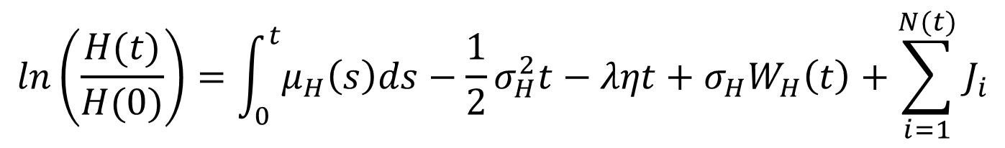


模型假設
假設房價服從具有Jump process的對數常態分配。
其中：
$μ_{H}(t)$為房屋的年報酬率
$σ_{H}$為波動度
$N(t)$為強度=$λ$的卜瓦松過程
$\left\{J_{i}\right\}$為獨立同分配於N($θ_{J}$,${σ_{J}}^{2}$)的隨機變數數列
$η$為一修正項，其值為 $e^{θ_{J}\text{+}\frac{1}{2}{σ_{J}}^{2}}−1$
$$ln\left(\frac{H(t)}{H(0)}\right)=\int_{0}^{t}{μ_{H}\left(s\right)ds}−\frac{1}{2}σ_{H}^{2}t−ληt+σ_{H}W_{H}\left(t\right)+\sum_{i=1}^{N(t)}{J_{i}}$$
$e^{\sum_{i=1}^{N(t)}{J_{i}}−ληt}$ 滿足martingale性質，見下頁證明

Slide 6


$e^{\sum_{i=1}^{N(t)}{J_{i}}−ληt}$ is martingale, where $M_{J}\left(u\right){=e}^{θ_{J}u\text{+}\frac{1}{2}{σ_{J}}^{2}u^{2}}$ is mgf of $J_{i}$
proof:
Let $Q\left(t\right)=\sum_{i=1}^{N(t)}{J_{i}}$
$$E\left(e^{\sum_{i=1}^{N(t)}{J_{i}}−ληt} | F_{s}\right)=E\left(e^{Q\left(t\right)−ληt} | F_{s}\right)$$
$$=E\left(e^{Q\left(t\right)} | F_{s}\right)∙e^{−ληt}$$
$$=E\left(e^{Q\left(t\right)−Q\left(s\right)} | F_{s}\right)∙e^{−ληt}∙e^{Q\left(s\right)}$$
$$=E(e^{Q\left(t−s\right)})∙e^{−ληt}∙e^{Q\left(s\right)}=\left[1∗P\left(N\left(t−s\right)=0\right)+\sum_{k=1}^{∞}{E\left(e^{\sum_{i=1}^{k}{J_{i}}} | N\left(t−s\right)=k\right)∗}P\left(N\left(t−s\right)=k\right)\right]∙e^{−ληt}∙e^{Q\left(s\right)}=\left[\frac{{\left(λ∙\left(t−s\right)\right)}^{k}}{k!}e^{−λ∙\left(t−s\right)}|_{k=0}+\sum_{k=1}^{∞}{{\left(M_{J}\left(1\right)\right)}^{k}∗}\frac{{\left(λ∙\left(t−s\right)\right)}^{k}}{k!}e^{−λ∙\left(t−s\right)}\right]∙e^{−ληt}∙e^{Q\left(s\right)}$$
$N\left(t_{n}\right)−N\left(t_{n−1}\right)⊥F_{t_{n−1}}$，$F_{s}$可移除
$Q\left(t\right)−Q\left(s\right)和Q(t−s)$相同分配

Slide 7


$$=\left[e^{−λ∙\left(t−s\right)}+\sum_{k=1}^{∞}{\frac{{\left(M_{J}\left(1\right)∙λ∙\left(t−s\right)\right)}^{k}}{k!}}e^{−λ∙\left(t−s\right)}\right]∙e^{−ληt}∙e^{Q\left(s\right)}=\left[e^{−λ∙\left(t−s\right)}\sum_{k=0}^{∞}{\frac{{\left(M_{J}\left(1\right)∙λ∙\left(t−s\right)\right)}^{k}}{k!}}\right]∙e^{−ληt}∙e^{Q\left(s\right)}$$
$$=e^{−λ∙\left(t−s\right)}∙e^{M_{J}\left(1\right)∙λ∙\left(t−s\right)}∙e^{−ληt}∙e^{Q\left(s\right)}$$
$$=e^{Q\left(s\right)}∙e^{−λ∙\left(t−s\right)}∙e^{M_{J}\left(1\right)∙λ∙\left(t−s\right)}∙e^{−λ\left(M_{J}\left(1\right)−1\right)t}$$
$$=e^{Q\left(s\right)}∙e^{−λ\left(M_{J}\left(1\right)−1\right)s}$$
$$=e^{Q\left(s\right)}∙e^{−ληs}$$
$η=e^{θ_{J}\text{+}\frac{1}{2}{σ_{J}}^{2}}−1=M_{J}\left(1\right)−1$帶入

Slide 8
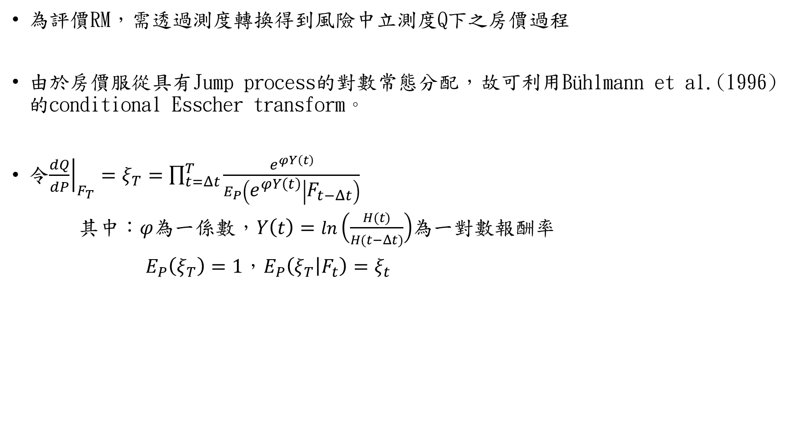
為評價RM，需透過測度轉換得到風險中立測度Q下之房價過程
由於房價服從具有Jump process的對數常態分配，故可利用Bühlmann et al.(1996)的conditional Esscher transform。
令${\left.\frac{dQ}{dP}\right|}_{F_{T}}=ξ_{T}=\prod_{t=Δt}^{T}{\frac{e^{φY\left(t\right)}}{E_{P}\left(e^{φY\left(t\right)} | F_{t−Δt}\right)}}$
其中：$φ$為一係數，$Y\left(t\right)=ln\left(\frac{H(t)}{H(t−Δt)}\right)$為一對數報酬率
$E_{P}\left(ξ_{T}\right)=1，E_{P}\left(ξ_{T} | F_{t}\right)=ξ_{t}$

Slide 9
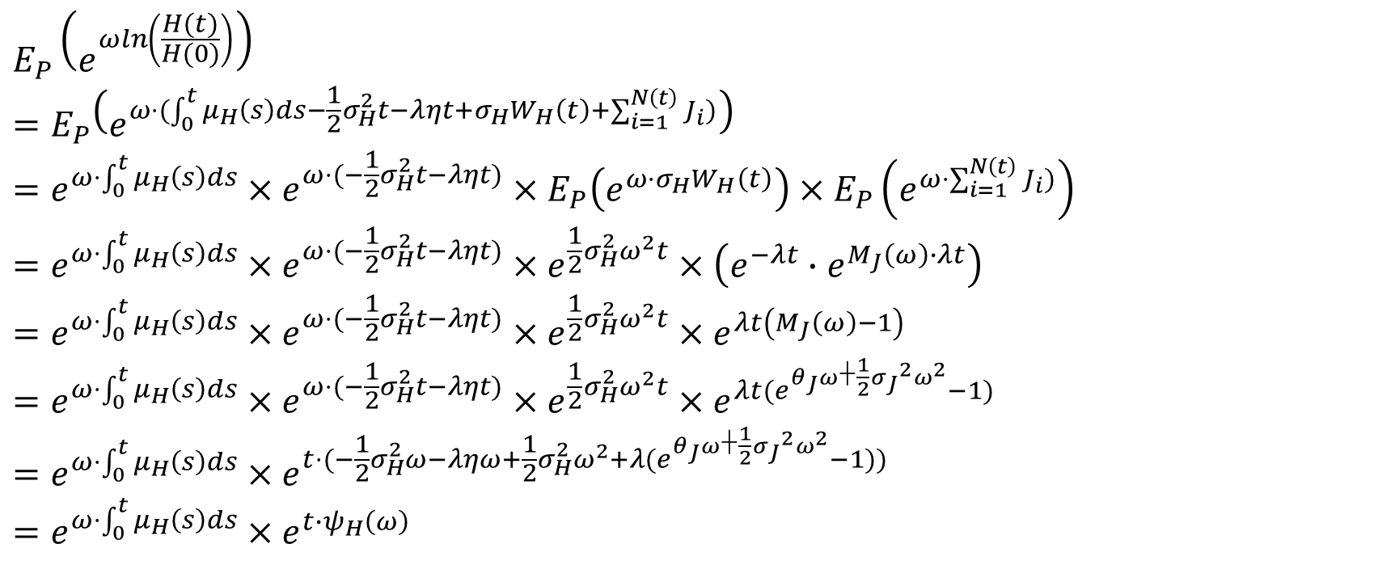
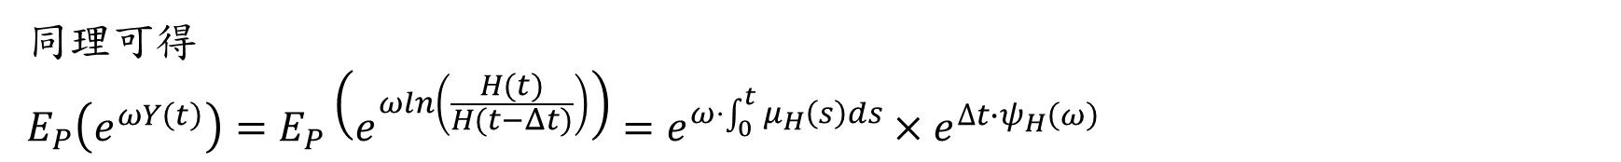
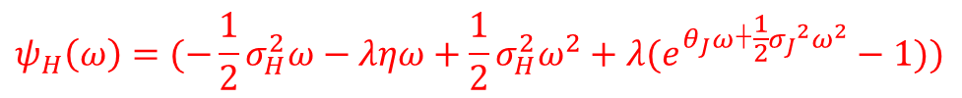
$$E_{P}\left(e^{ωln\left(\frac{H(t)}{H(0)}\right)}\right)$$
$$=E_{P}\left(e^{ω⋅(\int_{0}^{t}{μ_{H}\left(s\right)ds}−\frac{1}{2}σ_{H}^{2}t−ληt+σ_{H}W_{H}\left(t\right)+\sum_{i=1}^{N\left(t\right)}{J_{i}})}\right)=e^{ω⋅\int_{0}^{t}{μ_{H}\left(s\right)ds}}×e^{ω⋅(−\frac{1}{2}σ_{H}^{2}t−ληt)}×E_{P}\left(e^{ω⋅σ_{H}W_{H}\left(t\right)}\right)×E_{P}\left(e^{ω⋅\sum_{i=1}^{N\left(t\right)}{J_{i}})}\right)=e^{ω⋅\int_{0}^{t}{μ_{H}\left(s\right)ds}}×e^{ω⋅(−\frac{1}{2}σ_{H}^{2}t−ληt)}×e^{\frac{1}{2}σ_{H}^{2}ω^{2}t}×\left(e^{−λt}∙e^{M_{J}\left(ω\right)∙λt}\right)$$
$$=e^{ω⋅\int_{0}^{t}{μ_{H}\left(s\right)ds}}×e^{ω⋅(−\frac{1}{2}σ_{H}^{2}t−ληt)}×e^{\frac{1}{2}σ_{H}^{2}ω^{2}t}×e^{λt\left(M_{J}\left(ω\right)−1\right)}$$
$$=e^{ω⋅\int_{0}^{t}{μ_{H}\left(s\right)ds}}×e^{ω⋅(−\frac{1}{2}σ_{H}^{2}t−ληt)}×e^{\frac{1}{2}σ_{H}^{2}ω^{2}t}×e^{λt(e^{θ_{J}ω\text{+}\frac{1}{2}{σ_{J}}^{2}ω^{2}}−1)}=e^{ω⋅\int_{0}^{t}{μ_{H}\left(s\right)ds}}×e^{t⋅(−\frac{1}{2}σ_{H}^{2}ω−ληω+\frac{1}{2}σ_{H}^{2}ω^{2}+λ(e^{θ_{J}ω\text{+}\frac{1}{2}{σ_{J}}^{2}ω^{2}}−1))}$$
$$=e^{ω⋅\int_{0}^{t}{μ_{H}\left(s\right)ds}}×e^{t∙ψ_{H}\left(ω\right)}$$
引入動差生成函數
$$ψ_{H}\left(ω\right)=(−\frac{1}{2}σ_{H}^{2}ω−ληω+\frac{1}{2}σ_{H}^{2}ω^{2}+λ(e^{θ_{J}ω\text{+}\frac{1}{2}{σ_{J}}^{2}ω^{2}}−1))$$
同理可得
$$E_{P}\left(e^{ωY\left(t\right)}\right)=E_{P}\left(e^{ωln\left(\frac{H(t)}{H(t−Δt)}\right)}\right)=e^{ω⋅\int_{0}^{t}{μ_{H}\left(s\right)ds}}×e^{∆t∙ψ_{H}\left(ω\right)}$$

Slide 10


在Q測度下，資產相對價格是一martingale，故可得出下式：
$$H\left(t−Δt\right)$$
$$=E_{Q}\left(\frac{B\left(t−Δt\right)}{B\left(t\right)}H(t) | F_{t−Δt}\right)$$
$$=E_{Q}\left(e^{−\int_{t−Δt}^{t}{r\left(u\right)du}}H(t) | F_{t−Δt}\right)$$
$$=e^{−r(t−Δt)Δt}E_{Q}\left(H(t) | F_{t−Δt}\right)$$
$$=e^{−r(t−Δt)Δt}E_{P}\left(\frac{ξ_{t}}{ξ_{t−Δt}}H(t) | F_{t−Δt}\right)$$
$$=e^{−r(t−Δt)Δt}E_{P}\left(\frac{e^{φY\left(t\right)}}{E_{P}\left(e^{φY\left(t\right)} | F_{t−Δt}\right)}×H(t−∆t)e^{Y(t)} | F_{t−Δt}\right)$$
$$=H\left(t−∆t\right)e^{−r\left(t−Δt\right)Δt}×\frac{E_{P}\left(e^{\left(φ+1\right)Y\left(t\right)} | F_{t−Δt}\right)}{E_{P}\left(e^{φY\left(t\right)} | F_{t−Δt}\right)}$$
$$=H(t−∆t)e^{\int_{t−∆t}^{t}{μ_{H}\left(s\right)ds}−r(t−Δt)Δt}×e^{Δt\left(ψ_{H}\left(φ+1\right)−ψ_{H}\left(φ\right)\right)}$$
假設介於$t−Δt$與$t$的即期利率固定為$r(t−Δt)$
此項必須為1，可得出$r(t−Δt)Δt=\int_{t−∆t}^{t}{μ_{H}\left(s\right)ds}+Δt\left(ψ_{H}\left(φ+1\right)−ψ_{H}\left(φ\right)\right)$

Slide 11

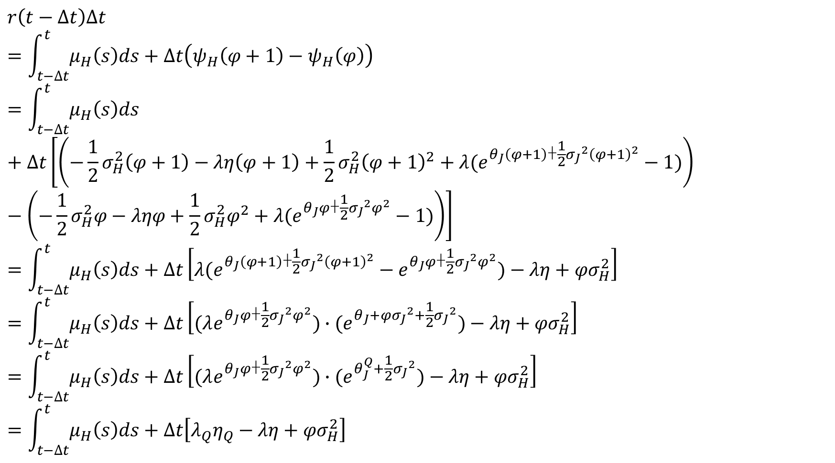
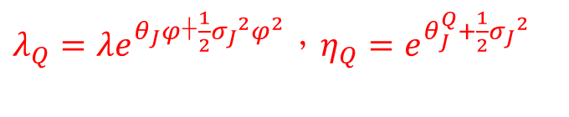
$$r\left(t−Δt\right)Δt$$
$$=\int_{t−∆t}^{t}{μ_{H}\left(s\right)ds}+Δt\left(ψ_{H}\left(φ+1\right)−ψ_{H}\left(φ\right)\right)$$
$$=\int_{t−∆t}^{t}{μ_{H}\left(s\right)ds}+Δt\left[\left(−\frac{1}{2}σ_{H}^{2}\left(φ+1\right)−λη\left(φ+1\right)+\frac{1}{2}σ_{H}^{2}{\left(φ+1\right)}^{2}+λ(e^{θ_{J}\left(φ+1\right)\text{+}\frac{1}{2}{σ_{J}}^{2}{\left(φ+1\right)}^{2}}−1)\right)−\left(−\frac{1}{2}σ_{H}^{2}φ−ληφ+\frac{1}{2}σ_{H}^{2}φ^{2}+λ(e^{θ_{J}φ\text{+}\frac{1}{2}{σ_{J}}^{2}φ^{2}}−1)\right)\right]=\int_{t−∆t}^{t}{μ_{H}\left(s\right)ds}+Δt\left[λ(e^{θ_{J}\left(φ+1\right)\text{+}\frac{1}{2}{σ_{J}}^{2}{\left(φ+1\right)}^{2}}−e^{θ_{J}φ\text{+}\frac{1}{2}{σ_{J}}^{2}φ^{2}})−λη+{φσ}_{H}^{2}\right]=\int_{t−∆t}^{t}{μ_{H}\left(s\right)ds}+Δt\left[(λe^{θ_{J}φ\text{+}\frac{1}{2}{σ_{J}}^{2}φ^{2}})∙(e^{θ_{J}{+{φσ}_{J}}^{2}+\frac{1}{2}{σ_{J}}^{2}})−λη+{φσ}_{H}^{2}\right]$$
$$=\int_{t−∆t}^{t}{μ_{H}\left(s\right)ds}+Δt\left[(λe^{θ_{J}φ\text{+}\frac{1}{2}{σ_{J}}^{2}φ^{2}})∙(e^{θ_{J}^{Q}+\frac{1}{2}{σ_{J}}^{2}})−λη+{φσ}_{H}^{2}\right]=\int_{t−∆t}^{t}{μ_{H}\left(s\right)ds}+Δt\left[λ_{Q}η_{Q}−λη+{φσ}_{H}^{2}\right]$$
$$θ_{J}^{Q}=θ_{J}{+{φσ}_{J}}^{2}$$
$λ_{Q}=λe^{θ_{J}φ\text{+}\frac{1}{2}{σ_{J}}^{2}φ^{2}}$，$η_{Q}=e^{θ_{J}^{Q}+\frac{1}{2}{σ_{J}}^{2}}$

Slide 12
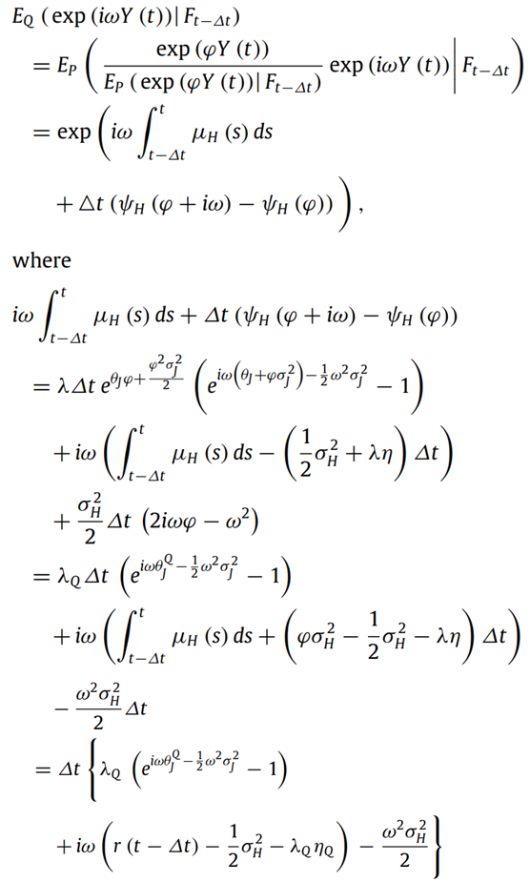
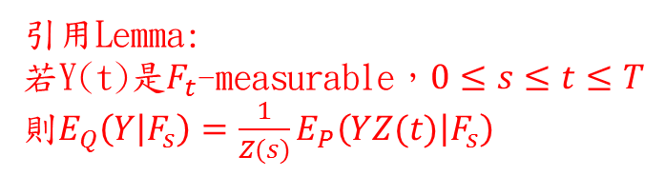
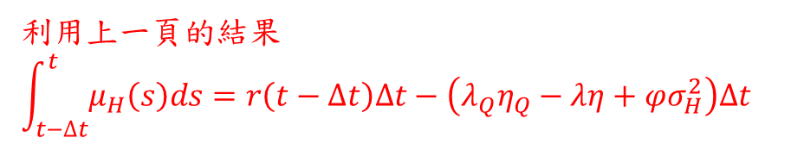
引用Lemma: 若Y(t)是$F_{t}$-measurable，$0≤s≤t≤T$
則$E_{Q}\left(Y | F_{s}\right)={\frac{1}{Z(s)}E}_{P}\left(YZ(t) | F_{s}\right)$
利用上一頁的結果
$$\int_{t−∆t}^{t}{μ_{H}\left(s\right)ds}=r\left(t−∆t\right)∆t−\left(λ_{Q}η_{Q}−λη+φσ_{H}^{2}\right)Δt$$
卜瓦松分配之特徵函數
常態分配之特徵函數

Slide 13

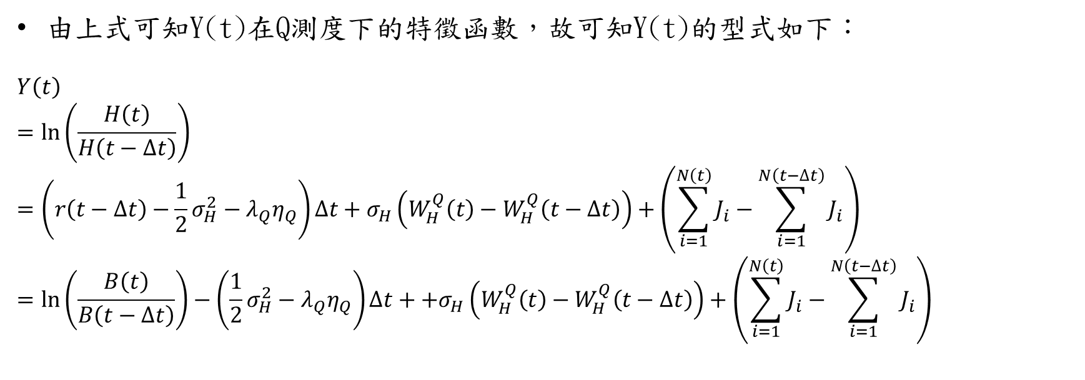
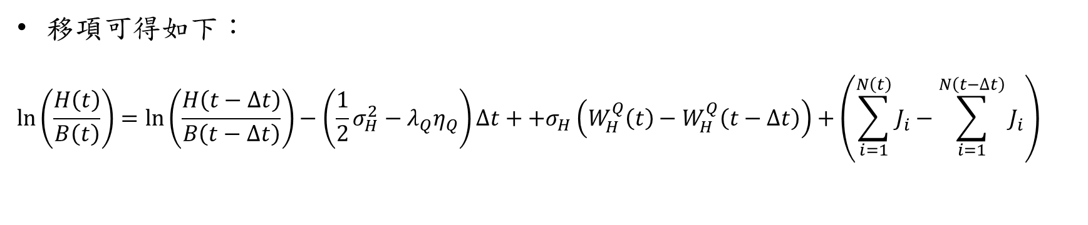
由上式可知Y(t)在Q測度下的特徵函數，故可知Y(t)的型式如下：
$$Y\left(t\right)$$
$$=\ln\left(\frac{H\left(t\right)}{H\left(t−∆t\right)}\right)$$
$$=\left(r\left(t−∆t\right)−\frac{1}{2}σ_{H}^{2}−λ_{Q}η_{Q}\right)∆t+σ_{H}\left(W_{H}^{Q}\left(t\right)−W_{H}^{Q}\left(t−∆t\right)\right)+\left(\sum_{i=1}^{N\left(t\right)}{J_{i}}−\sum_{i=1}^{N\left(t−∆t\right)}{J_{i}}\right)$$
$$=ln\left(\frac{B\left(t\right)}{B\left(t−∆t\right)}\right)−\left(\frac{1}{2}σ_{H}^{2}−λ_{Q}η_{Q}\right)∆t++σ_{H}\left(W_{H}^{Q}\left(t\right)−W_{H}^{Q}\left(t−∆t\right)\right)+\left(\sum_{i=1}^{N\left(t\right)}{J_{i}}−\sum_{i=1}^{N\left(t−∆t\right)}{J_{i}}\right)$$
$$B\left(t\right)=B(t−∆t)e^{r\left(t−∆t\right)∆t}$$
移項可得如下：
$$\ln\left(\frac{H\left(t\right)}{B\left(t\right)}\right)=\ln\left(\frac{H\left(t−∆t\right)}{B\left(t−∆t\right)}\right)−\left(\frac{1}{2}σ_{H}^{2}−λ_{Q}η_{Q}\right)∆t++σ_{H}\left(W_{H}^{Q}\left(t\right)−W_{H}^{Q}\left(t−∆t\right)\right)+\left(\sum_{i=1}^{N\left(t\right)}{J_{i}}−\sum_{i=1}^{N\left(t−∆t\right)}{J_{i}}\right)$$

Slide 14
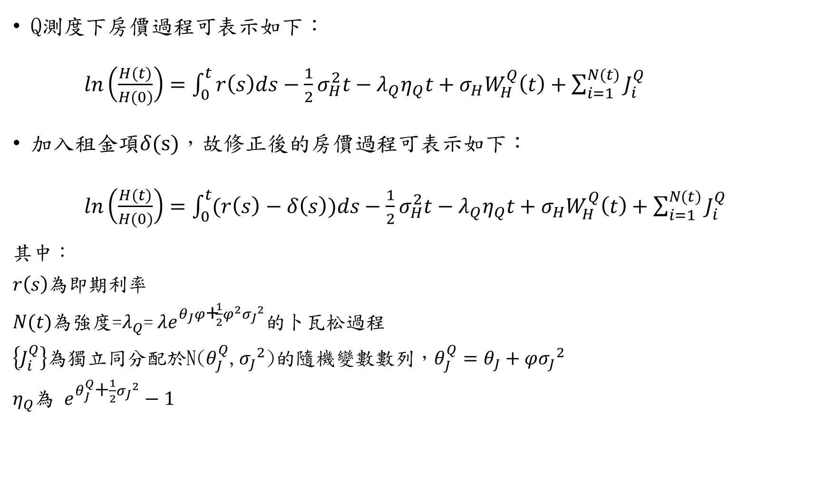
Q測度下房價過程可表示如下：
$ln\left(\frac{H(t)}{H(0)}\right)=\int_{0}^{t}{r\left(s\right)ds}−\frac{1}{2}σ_{H}^{2}t−λ_{Q}η_{Q}t+σ_{H}W_{H}^{Q}\left(t\right)+\sum_{i=1}^{N(t)}{J_{i}^{Q}}$
加入租金項$δ(s)$，故修正後的房價過程可表示如下：
$ln\left(\frac{H(t)}{H(0)}\right)=\int_{0}^{t}{(r\left(s\right)−δ\left(s\right))ds}−\frac{1}{2}σ_{H}^{2}t−λ_{Q}η_{Q}t+σ_{H}W_{H}^{Q}\left(t\right)+\sum_{i=1}^{N(t)}{J_{i}^{Q}}$
其中：
$r\left(s\right)$為即期利率
$N(t)$為強度=$λ_{Q}$= $λe^{θ_{J}φ\text{+}\frac{1}{2}φ^{2}{σ_{J}}^{2}}$的卜瓦松過程
$\left\{J_{i}^{Q}\right\}$為獨立同分配於N($θ_{J}^{Q}$,${σ_{J}}^{2}$)的隨機變數數列，$θ_{J}^{Q}=θ_{J}+φ{σ_{J}}^{2}$
$η_{Q}$為 $e^{θ_{J}^{Q}\text{+}\frac{1}{2}{σ_{J}}^{2}}−1$

Slide 15
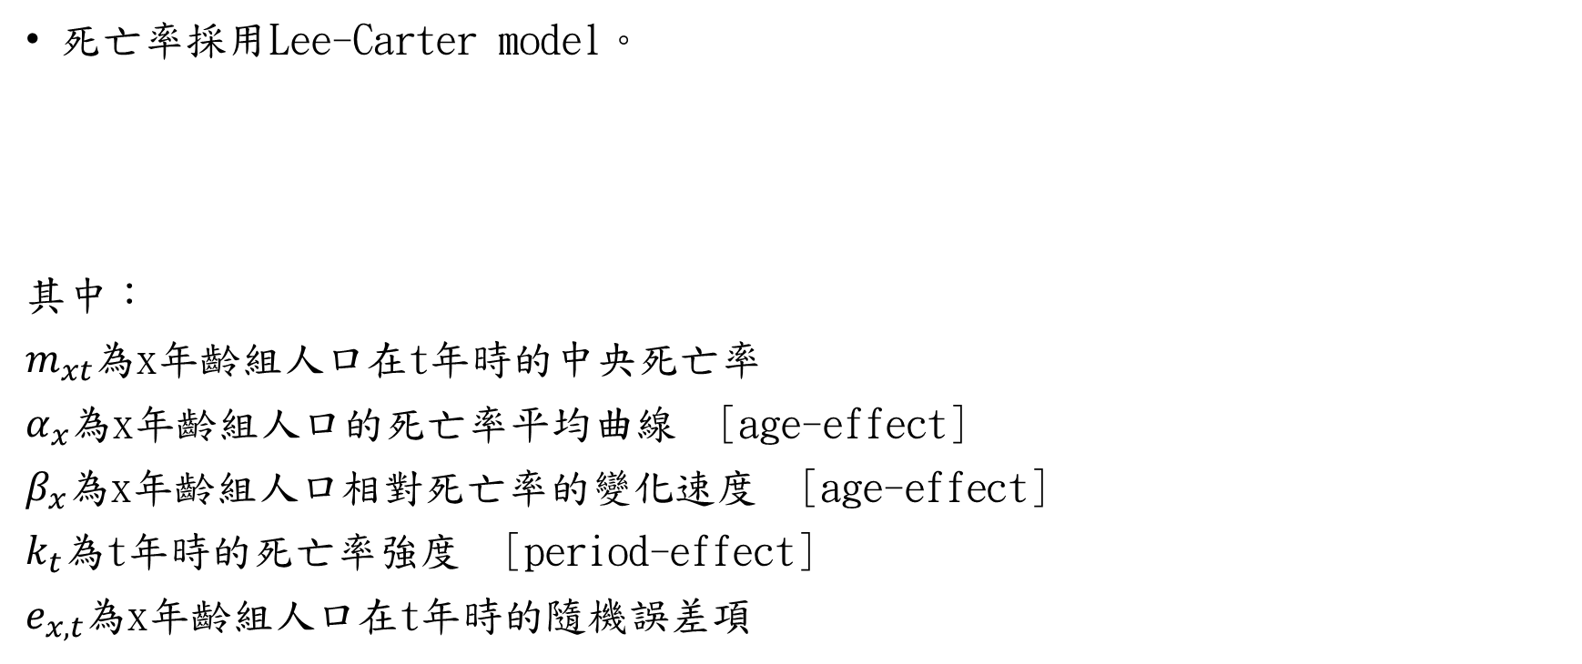

模型假設
死亡率採用Lee-Carter model。
其中：
$m_{xt}$為x年齡組人口在t年時的中央死亡率
$α_{x}$為x年齡組人口的死亡率平均曲線 [age-effect]
$β_{x}$為x年齡組人口相對死亡率的變化速度 [age-effect]
$k_{t}$為t年時的死亡率強度 [period-effect]
$e_{x,t}$為x年齡組人口在t年時的隨機誤差項
$$\ln\left(m_{x,t}\right)= α_{x}+ β_{x}k_{t}+ e_{x,t}$$
Notes:
中央死亡率$m\left(x,t\right)=\frac{在t年當年，x歲的死亡人口}{在t年當年，x歲的平均生存人口}$

Slide 16
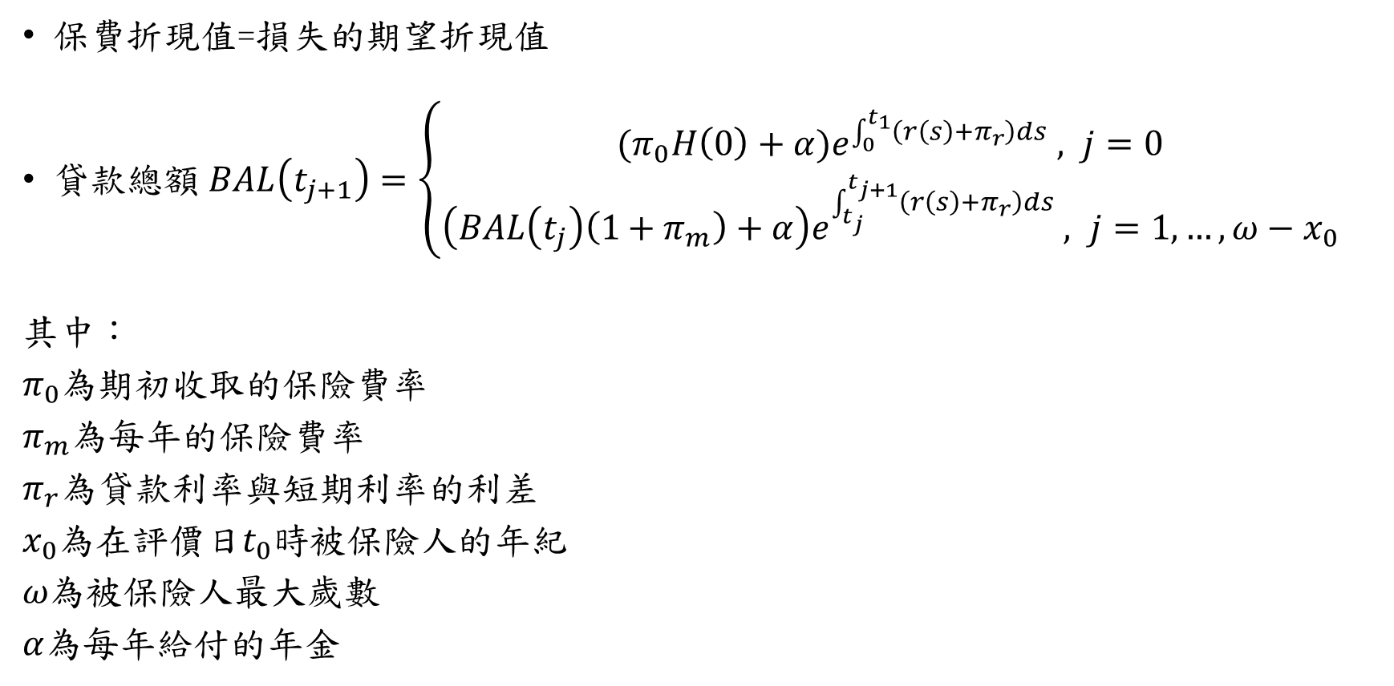
評價方法
保費折現值=損失的期望折現值
貸款總額 $BAL\left(t_{j+1}\right)=\left\{\begin{aligned}{(π}_{0}H\left(0\right)+α)e^{\int_{0}^{t_{1}}{\left(r\left(s\right)+π_{r}\right)ds}} , j=0 \\ \left(BAL\left(t_{j}\right)\left(1+π_{m}\right)+α\right)e^{\int_{t_{j}}^{t_{j+1}}{\left(r\left(s\right)+π_{r}\right)ds}} , j=1,…,ω−x_{0} \end{aligned}\right.$
其中：
$π_{0}$為期初收取的保險費率
$π_{m}$為每年的保險費率
$π_{r}$為貸款利率與短期利率的利差
$x_{0}$為在評價日$t_{0}$時被保險人的年紀
$ω為$被保險人最大歲數
$α$為每年給付的年金

Slide 17
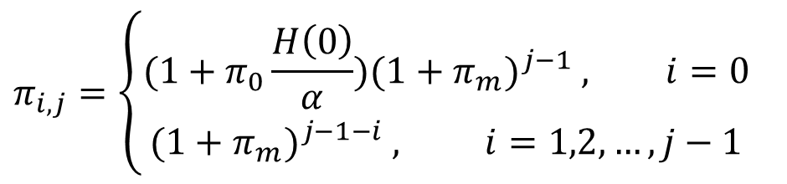

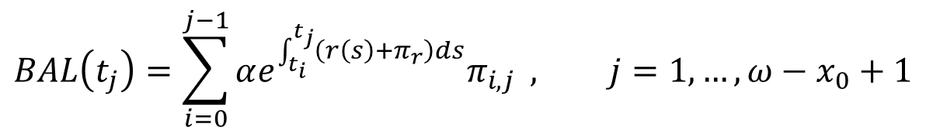
評價方法
$BAL\left(t_{j}\right)$又可在改寫成下式：
其中：
$$BAL\left(t_{j}\right)=\sum_{i=0}^{j−1}{αe^{\int_{t_{i}}^{t_{j}}{\left(r\left(s\right)+π_{r}\right)ds}}π_{i,j}} , j=1,…,ω−x_{0}+1$$
$$π_{i,j}=\left\{\begin{aligned}(1+π_{0}\frac{H\left(0\right)}{α}){(1+π_{m})}^{j−1} , i=0 \\ {(1+π_{m})}^{j−1−i} , i=1,2,…,j−1 \end{aligned}\right.$$

Slide 18
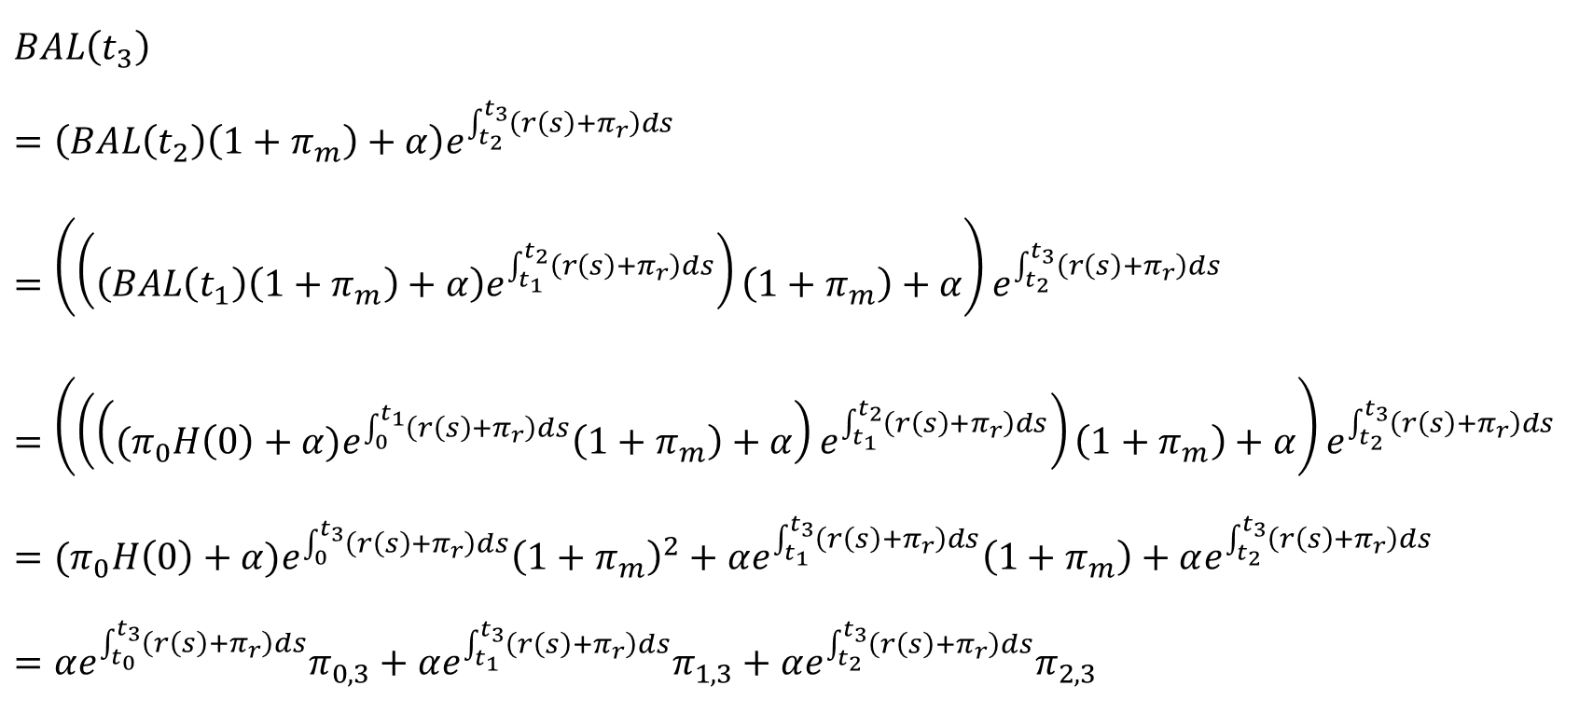
$$BAL\left(t_{3}\right)$$
$$=\left(BAL\left(t_{2}\right)\left(1+π_{m}\right)+α\right)e^{\int_{t_{2}}^{t_{3}}{\left(r\left(s\right)+π_{r}\right)ds}}$$
$$=\left(\left(\left(BAL\left(t_{1}\right)\left(1+π_{m}\right)+α\right)e^{\int_{t_{1}}^{t_{2}}{\left(r\left(s\right)+π_{r}\right)ds}}\right)\left(1+π_{m}\right)+α\right)e^{\int_{t_{2}}^{t_{3}}{\left(r\left(s\right)+π_{r}\right)ds}}$$
$$=\left(\left(\left({(π}_{0}H\left(0\right)+α)e^{\int_{0}^{t_{1}}{\left(r\left(s\right)+π_{r}\right)ds}}\left(1+π_{m}\right)+α\right)e^{\int_{t_{1}}^{t_{2}}{\left(r\left(s\right)+π_{r}\right)ds}}\right)\left(1+π_{m}\right)+α\right)e^{\int_{t_{2}}^{t_{3}}{\left(r\left(s\right)+π_{r}\right)ds}}$$
$$={(π}_{0}H\left(0\right)+α)e^{\int_{0}^{t_{3}}{\left(r\left(s\right)+π_{r}\right)ds}}{\left(1+π_{m}\right)}^{2}+αe^{\int_{t_{1}}^{t_{3}}{\left(r\left(s\right)+π_{r}\right)ds}}\left(1+π_{m}\right)+αe^{\int_{t_{2}}^{t_{3}}{\left(r\left(s\right)+π_{r}\right)ds}}$$
$$=αe^{\int_{t_{0}}^{t_{3}}{\left(r\left(s\right)+π_{r}\right)ds}}π_{0,3}+αe^{\int_{t_{1}}^{t_{3}}{\left(r\left(s\right)+π_{r}\right)ds}}π_{1,3}+αe^{\int_{t_{2}}^{t_{3}}{\left(r\left(s\right)+π_{r}\right)ds}}π_{2,3}$$
示意圖
第0期至第1期 | 第1期至第2期 | 第2期至第3期

Slide 19
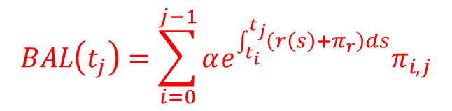


評價方法
保費折現值可表示如下：
$$π_{0}H\left(0\right)+\sum_{j=1}^{ω−x_{0}}{E_{Q}\left[\frac{ _{t_{j}}P_{x_{0},t_{0}}BAL\left(t_{j}\right)π_{m}}{B\left(t_{j}\right)}\right]}$$
$$=π_{0}H\left(0\right)+\sum_{j=1}^{ω−x_{0}}{E_{Q}\left[ _{t_{j}}P_{x_{0},t_{0}}\right]}E_{Q}\left[\frac{BAL\left(t_{j}\right)π_{m}}{B\left(t_{j}\right)}\right]$$
$$=π_{0}H\left(0\right)+\sum_{j=1}^{ω−x_{0}}{S\left(t_{j}\right)}E_{Q}\left[\frac{\sum_{i=0}^{j−1}{αe^{\int_{t_{i}}^{t_{j}}{\left(r\left(s\right)+π_{r}\right)ds}}π_{i,j}π_{m}}}{e^{\int_{0}^{t_{j}}{r\left(s\right)ds}}}\right]$$
死亡率過程與利率過程獨立 可分開取期望值
$$BAL\left(t_{j}\right)=\sum_{i=0}^{j−1}{αe^{\int_{t_{i}}^{t_{j}}{\left(r\left(s\right)+π_{r}\right)ds}}π_{i,j}}$$
$$S\left(t_{j}\right)=E_{Q}\left[ _{t_{j}}P_{x_{0},t_{0}}\right]$$

Slide 20
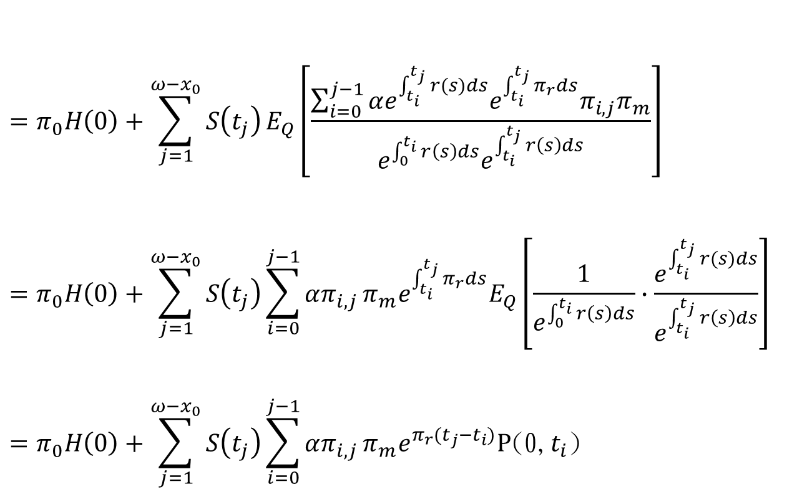


$$=π_{0}H\left(0\right)+\sum_{j=1}^{ω−x_{0}}{S\left(t_{j}\right)}E_{Q}\left[\frac{\sum_{i=0}^{j−1}{αe^{\int_{t_{i}}^{t_{j}}{r(s)ds}}e^{\int_{t_{i}}^{t_{j}}{π_{r}ds}}π_{i,j}π_{m}}}{e^{\int_{0}^{t_{i}}{r\left(s\right)ds}}e^{\int_{t_{i}}^{t_{j}}{r\left(s\right)ds}}}\right]$$
$$=π_{0}H\left(0\right)+\sum_{j=1}^{ω−x_{0}}{S\left(t_{j}\right)}\sum_{i=0}^{j−1}{απ_{i,j}}π_{m}e^{\int_{t_{i}}^{t_{j}}{π_{r}ds}}E_{Q}\left[\frac{1}{e^{\int_{0}^{t_{i}}{r\left(s\right)ds}}}∙\frac{e^{\int_{t_{i}}^{t_{j}}{r(s)ds}}}{e^{\int_{t_{i}}^{t_{j}}{r\left(s\right)ds}}}\right]$$
$$=π_{0}H\left(0\right)+\sum_{j=1}^{ω−x_{0}}{S\left(t_{j}\right)}\sum_{i=0}^{j−1}{απ_{i,j}}π_{m}e^{π_{r}(t_{j}−t_{i})}P\text{(0,}t_{i}\text{)}$$
0~$t_{j}$拆解成0~$t_{i}$與$t_{i}$~$t_{j}$
兩兩相消
其中：
$B\left(t_{j}\right)$為在時間$t_{j}$的 money market account
$P\text{(0,}t_{i}\text{)}$為零息債券在$t_{i}$到期時的價格
$_{t_{j}}P_{x_{0},t_{0}}$為$t_{0}$年$x_{0}$歲存活到$t_{j}$期之機率

Slide 21

評價方法
損失的期望折現值則可表示如下：
$$\sum_{j=1}^{ω−x_{0}+1}{E_{Q}\left[\frac{[ _{t_{j−1}}P_{x_{0},t_{0}}− _{t_{j}}P_{x_{0},t_{0}}]{[BAL\left(t_{j}\right)−H\left(t_{j}\right)]}^{+}}{B\left(t_{j}\right)}\right]}$$
$$=\sum_{j=1}^{ω−x_{0}+1}{E_{Q}\left[ _{t_{j−1}}P_{x_{0},t_{0}}− _{t_{j}}P_{x_{0},t_{0}}\right]∙E_{Q}\left[\frac{{[BAL\left(t_{j}\right)−H\left(t_{j}\right)]}^{+}}{B\left(t_{j}\right)}\right]} \\ =\sum_{j=1}^{ω−x_{0}+1}{\left(S\left(t_{j−1}\right)−S\left(t_{j}\right)\right)C}\left(t_{j}\right)$$
計算此項

Slide 22
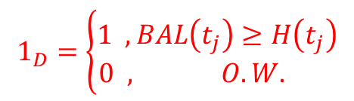


證明推導
$$1_{D}=\left\{\begin{aligned}1 ,BAL\left(t_{j}\right)≥H\left(t_{j}\right) \\ 0 , O.W. \end{aligned}\right.$$
$C\left(t_{j}\right)=E_{Q}\left[\frac{{\left[BAL\left(t_{j}\right)−H\left(t_{j}\right)\right]}^{+}}{B\left(t_{j}\right)}\right]=E_{Q}\left[\frac{BAL\left(t_{j}\right)1_{D}}{B\left(t_{j}\right)}\right]−E_{Q}\left[\frac{H\left(t_{j}\right)1_{D}}{B\left(t_{j}\right)}\right]$
先計算第一項，可改寫成下式：
$$E_{Q}\left[\frac{BAL\left(t_{j}\right)1_{D}}{B\left(t_{j}\right)}\right]=E_{Q}\left[E_{Q}\left(\frac{BAL\left(t_{j}\right)1_{D}}{B\left(t_{j}\right)} | \frac{BAL\left(t_{j}\right)}{B\left(t_{j}\right)}\right)\right]=\int_{0}^{∞}{E_{Q}\left({x1}_{D} | \frac{BAL\left(t_{j}\right)}{B\left(t_{j}\right)}=x\right)f_{\frac{BAL\left(t_{j}\right)}{B\left(t_{j}\right)}}\left(x\right) dx}≈\lim_{M→∞}\frac{1}{M}\sum_{m=1}^{M}{E_{Q}\left({x_{mj}1}_{D} | \frac{BAL\left(t_{j}\right)}{B\left(t_{j}\right)}=x_{mj}\right)}$$
應用雙重期望值定理
計算此項

Slide 23

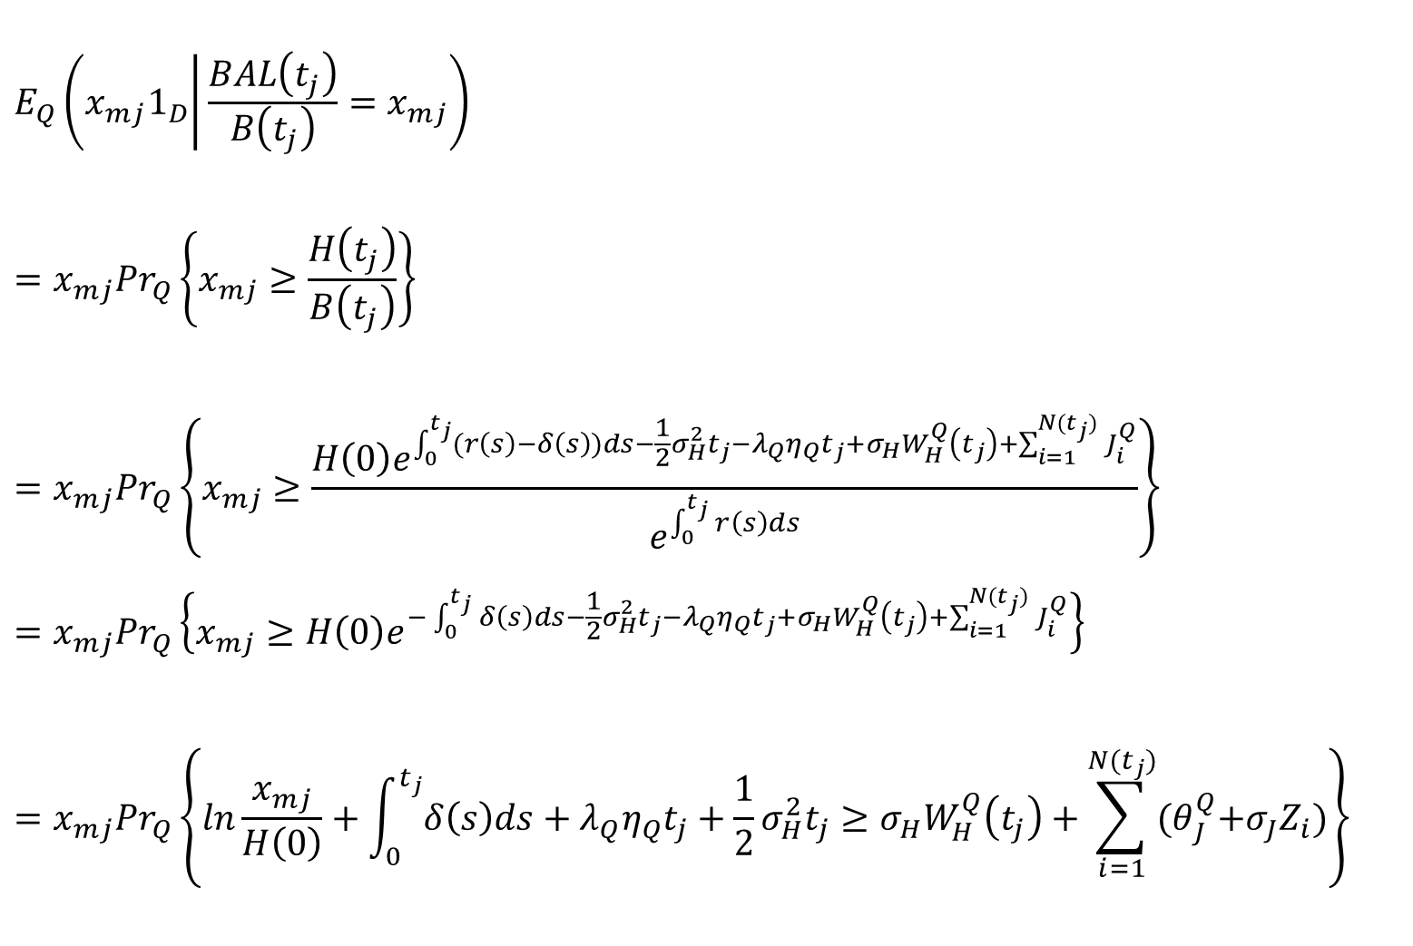
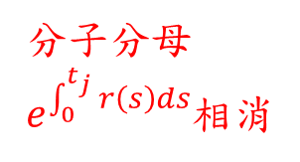
$$E_{Q}\left({x_{mj}1}_{D} | \frac{BAL\left(t_{j}\right)}{B\left(t_{j}\right)}=x_{mj}\right)$$
$$=x_{mj}{Pr}_{Q}\left\{x_{mj}≥\frac{H\left(t_{j}\right)}{B\left(t_{j}\right)}\right\}$$
$$=x_{mj}{Pr}_{Q}\left\{x_{mj}≥\frac{H\left(0\right)e^{\int_{0}^{t_{j}}{(r\left(s\right)−δ\left(s\right))ds}−\frac{1}{2}σ_{H}^{2}t_{j}−λ_{Q}η_{Q}t_{j}+σ_{H}W_{H}^{Q}\left(t_{j}\right)+\sum_{i=1}^{N(t_{j})}{J_{i}^{Q}}}}{e^{\int_{0}^{t_{j}}{r\left(s\right)ds}}}\right\}$$
$$=x_{mj}{Pr}_{Q}\left\{x_{mj}≥H\left(0\right)e^{−\int_{0}^{t_{j}}{δ\left(s\right)ds}−\frac{1}{2}σ_{H}^{2}t_{j}−λ_{Q}η_{Q}t_{j}+σ_{H}W_{H}^{Q}\left(t_{j}\right)+\sum_{i=1}^{N(t_{j})}{J_{i}^{Q}}}\right\}$$
$$=x_{mj}{Pr}_{Q}\left\{ln\frac{x_{mj}}{H\left(0\right)}+\int_{0}^{t_{j}}{δ\left(s\right)ds+λ_{Q}η_{Q}t_{j}}+\frac{1}{2}σ_{H}^{2}t_{j}≥σ_{H}W_{H}^{Q}\left(t_{j}\right)+\sum_{i=1}^{N(t_{j})}{{(θ}_{J}^{Q}+σ_{J}Z_{i})}\right\}$$
Q測度下的房價過程
分子分母$e^{\int_{0}^{t_{j}}{r\left(s\right)ds}}$相消
$J_{i}^{Q}\sim N(θ_{J}^{Q},σ_{J}^{2})$，以${ θ}_{J}^{Q}+σ_{J}Z_{i}$代換，$Z_{i}$服從標準常態分配

Slide 24

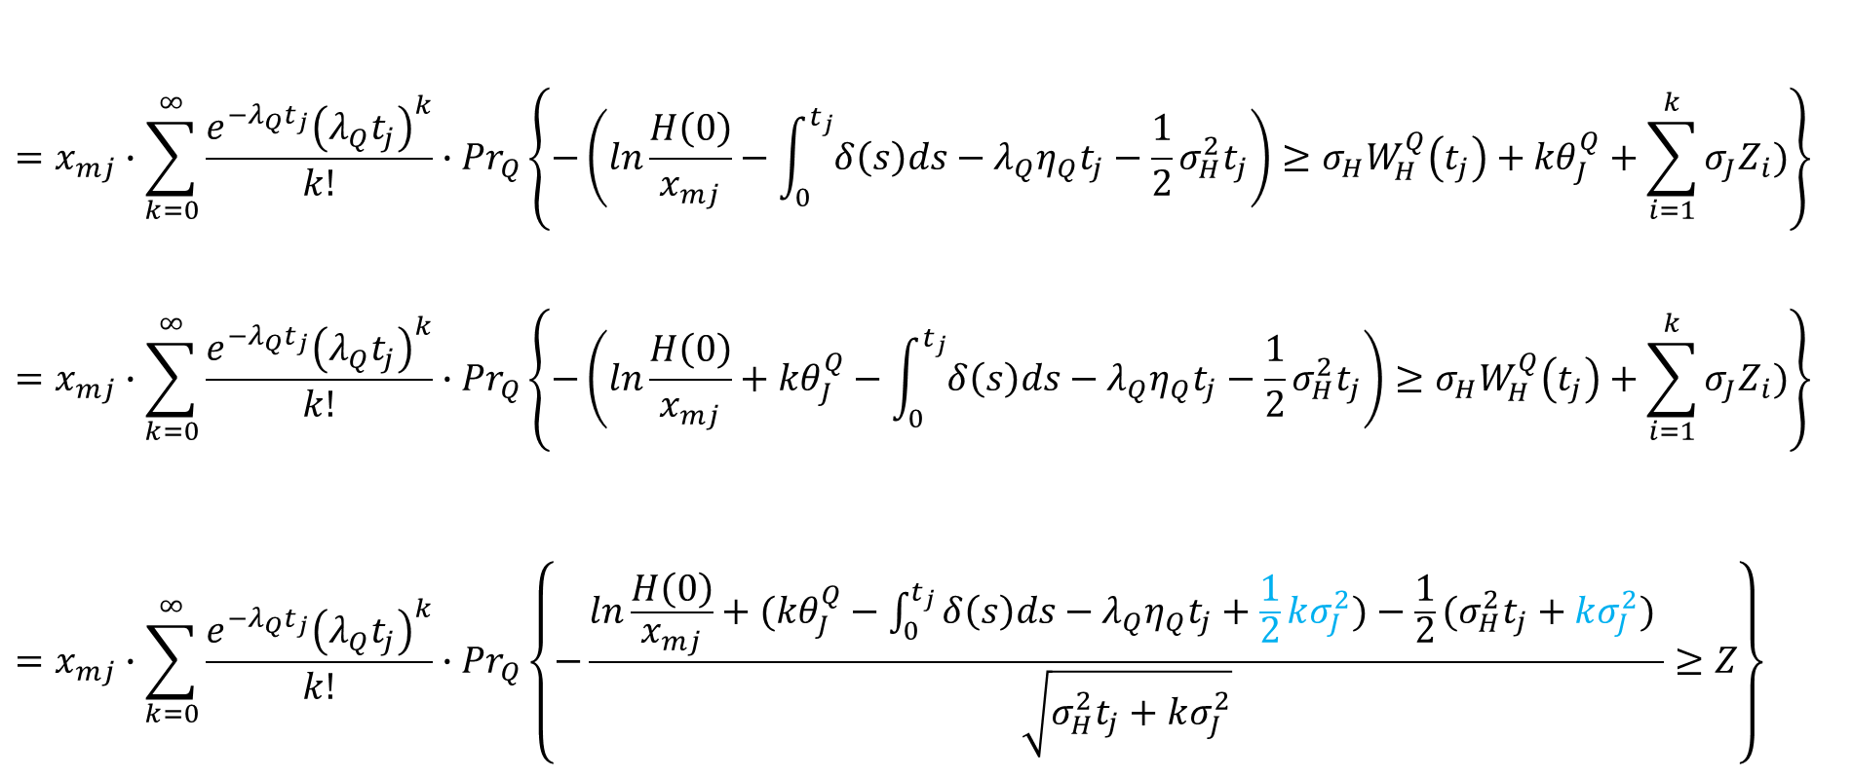

$$=x_{mj}∙\sum_{k=0}^{∞}{\frac{e^{−λ_{Q}t_{j}}{\left(λ_{Q}t_{j}\right)}^{k}}{k!}}∙{Pr}_{Q}\left\{−\left(ln\frac{H\left(0\right)}{x_{mj}}−\int_{0}^{t_{j}}{δ\left(s\right)ds−λ_{Q}η_{Q}t_{j}}−\frac{1}{2}σ_{H}^{2}t_{j}\right)≥σ_{H}W_{H}^{Q}\left(t_{j}\right)+{kθ}_{J}^{Q}+\sum_{i=1}^{k}{σ_{J}Z_{i})}\right\}$$
$$=x_{mj}∙\sum_{k=0}^{∞}{\frac{e^{−λ_{Q}t_{j}}{\left(λ_{Q}t_{j}\right)}^{k}}{k!}}∙{Pr}_{Q}\left\{−\left(ln\frac{H\left(0\right)}{x_{mj}}+{kθ}_{J}^{Q}−\int_{0}^{t_{j}}{δ\left(s\right)ds−λ_{Q}η_{Q}t_{j}}−\frac{1}{2}σ_{H}^{2}t_{j}\right)≥σ_{H}W_{H}^{Q}\left(t_{j}\right)+\sum_{i=1}^{k}{σ_{J}Z_{i})}\right\}$$
$$=x_{mj}∙\sum_{k=0}^{∞}{\frac{e^{−λ_{Q}t_{j}}{\left(λ_{Q}t_{j}\right)}^{k}}{k!}}∙{Pr}_{Q}\left\{−\frac{ln\frac{H\left(0\right)}{x_{mj}}+({kθ}_{J}^{Q}−\int_{0}^{t_{j}}{δ\left(s\right)ds−λ_{Q}η_{Q}t_{j}}+\frac{1}{2}kσ_{J}^{2})−\frac{1}{2}(σ_{H}^{2}t_{j}+kσ_{J}^{2}) }{\sqrt{σ_{H}^{2}t_{j}+kσ_{J}^{2}}}≥Z\right\}$$
$N(t_{j})=k$之機率
常數項移至不等式左邊
服從常態分配
因為$W_{H}^{Q}\left(t_{j}\right)⊥Z_{i}$，故變異數可直接相加

Slide 25
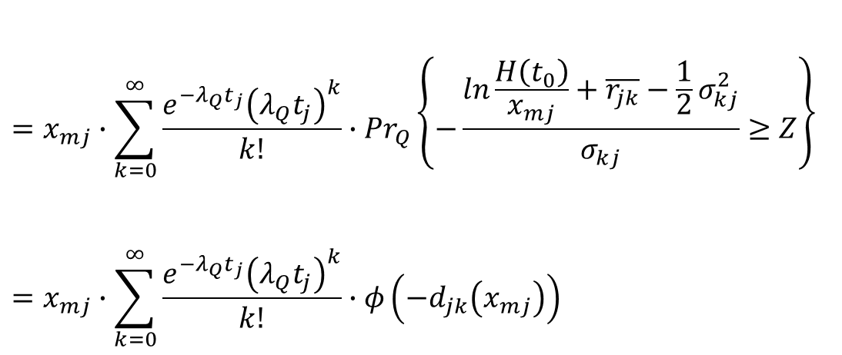
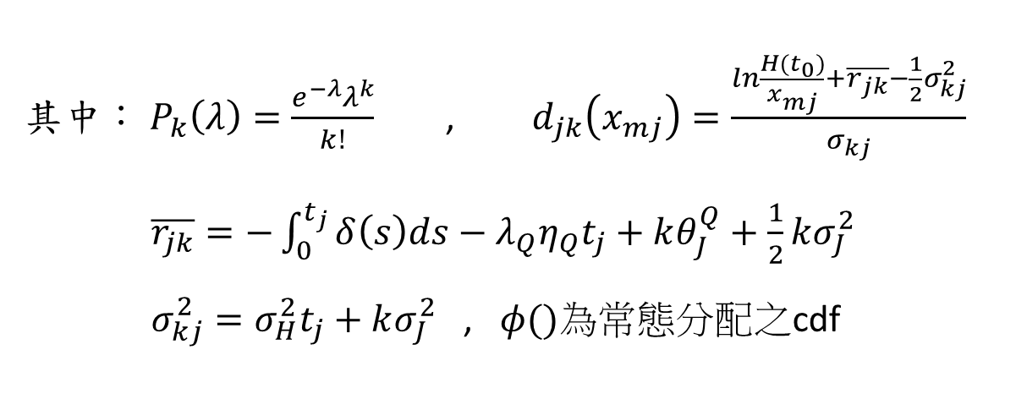
$$=x_{mj}∙\sum_{k=0}^{∞}{\frac{e^{−λ_{Q}t_{j}}{\left(λ_{Q}t_{j}\right)}^{k}}{k!}}∙{Pr}_{Q}\left\{−\frac{ln\frac{H\left(t_{0}\right)}{x_{mj}}+\overline{r_{jk}}−\frac{1}{2}σ_{kj}^{2}}{σ_{kj}}≥Z\right\}$$
$$=x_{mj}∙\sum_{k=0}^{∞}{\frac{e^{−λ_{Q}t_{j}}{\left(λ_{Q}t_{j}\right)}^{k}}{k!}}∙φ\left({−d}_{jk}\left(x_{mj}\right)\right)$$
其中：$P_{k}\left(λ\right)=\frac{e^{−λ}λ^{k}}{k!}$ , $d_{jk}\left(x_{mj}\right)=\frac{ln\frac{H(t_{0})}{x_{mj}}+\overline{r_{jk}}−\frac{1}{2}σ_{kj}^{2}}{σ_{kj}}$ $\overline{r_{jk}}=−\int_{0}^{t_{j}}{δ\left(s\right)ds}−λ_{Q}η_{Q}t_{j}+kθ_{J}^{Q}+\frac{1}{2}kσ_{J}^{2}$ $σ_{kj}^{2}=σ_{H}^{2}t_{j}+kσ_{J}^{2}$ , $φ()$為常態分配之cdf
Notes:
第一部份推導 結束

Slide 26

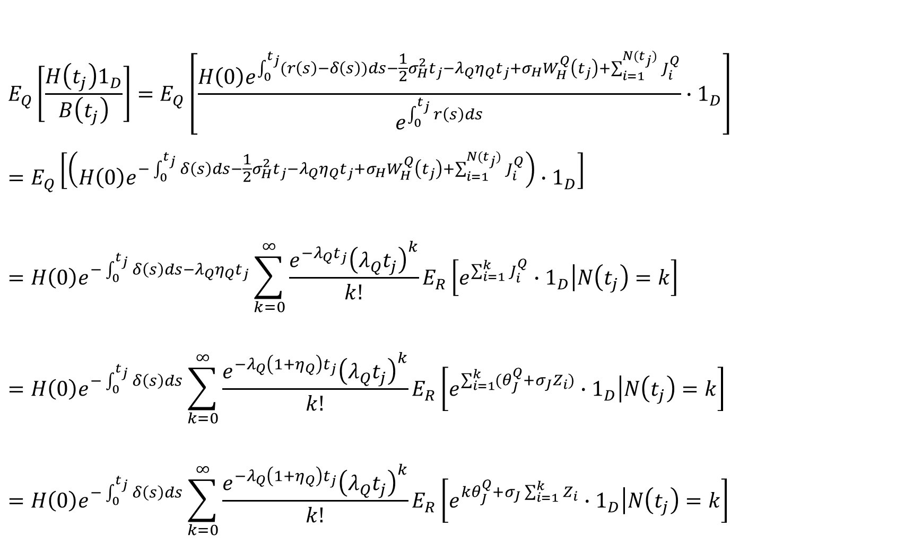

$$E_{Q}\left[\frac{H\left(t_{j}\right)1_{D}}{B\left(t_{j}\right)}\right]=E_{Q}\left[\frac{H\left(0\right)e^{\int_{0}^{t_{j}}{(r\left(s\right)−δ\left(s\right))ds}−\frac{1}{2}σ_{H}^{2}t_{j}−λ_{Q}η_{Q}t_{j}+σ_{H}W_{H}^{Q}\left(t_{j}\right)+\sum_{i=1}^{N(t_{j})}{J_{i}^{Q}}}}{e^{\int_{0}^{t_{j}}{r\left(s\right)ds}}}∙1_{D}\right]=E_{Q}\left[\left(H\left(0\right)e^{−\int_{0}^{t_{j}}{δ\left(s\right)ds}−\frac{1}{2}σ_{H}^{2}t_{j}−λ_{Q}η_{Q}t_{j}+σ_{H}W_{H}^{Q}\left(t_{j}\right)+\sum_{i=1}^{N(t_{j})}{J_{i}^{Q}}}\right)∙1_{D}\right]=H\left(0\right)e^{−\int_{0}^{t_{j}}{δ\left(s\right)ds}−λ_{Q}η_{Q}t_{j}}\sum_{k=0}^{∞}{\frac{e^{−λ_{Q}t_{j}}{\left(λ_{Q}t_{j}\right)}^{k}}{k!}}E_{R}\left[e^{\sum_{i=1}^{k}{J_{i}^{Q}}}∙1_{D}\left|N\left(t_{j}\right)=k\right.\right]=H\left(0\right)e^{−\int_{0}^{t_{j}}{δ\left(s\right)ds}}\sum_{k=0}^{∞}{\frac{e^{−λ_{Q}\left(1+η_{Q}\right)t_{j}}{\left(λ_{Q}t_{j}\right)}^{k}}{k!}}E_{R}\left[e^{\sum_{i=1}^{k}{{(θ}_{J}^{Q}+σ_{J}Z_{i})}}∙1_{D}\left|N\left(t_{j}\right)=k\right.\right]$$
$$=H\left(0\right)e^{−\int_{0}^{t_{j}}{δ\left(s\right)ds}}\sum_{k=0}^{∞}{\frac{e^{−λ_{Q}\left(1+η_{Q}\right)t_{j}}{\left(λ_{Q}t_{j}\right)}^{k}}{k!}}E_{R}\left[e^{{kθ}_{J}^{Q}+σ_{J}\sum_{i=1}^{k}{Z_{i}}}∙1_{D}\left|N\left(t_{j}\right)=k\right.\right]$$
計算第二項，可改寫如下：
$Q$測度轉$R$測度
$$\frac{dR}{dQ}=e^{σ_{H}W_{H}^{Q}\left(t_{j}\right)−\frac{1}{2}σ_{H}^{2}t_{j}}$$
$$dW_{H}^{R}\left(t\right)=dW_{H}^{Q}\left(t\right)−σ_{H}dt$$
$\left(1+η_{Q}\right)$移至此處

Slide 27

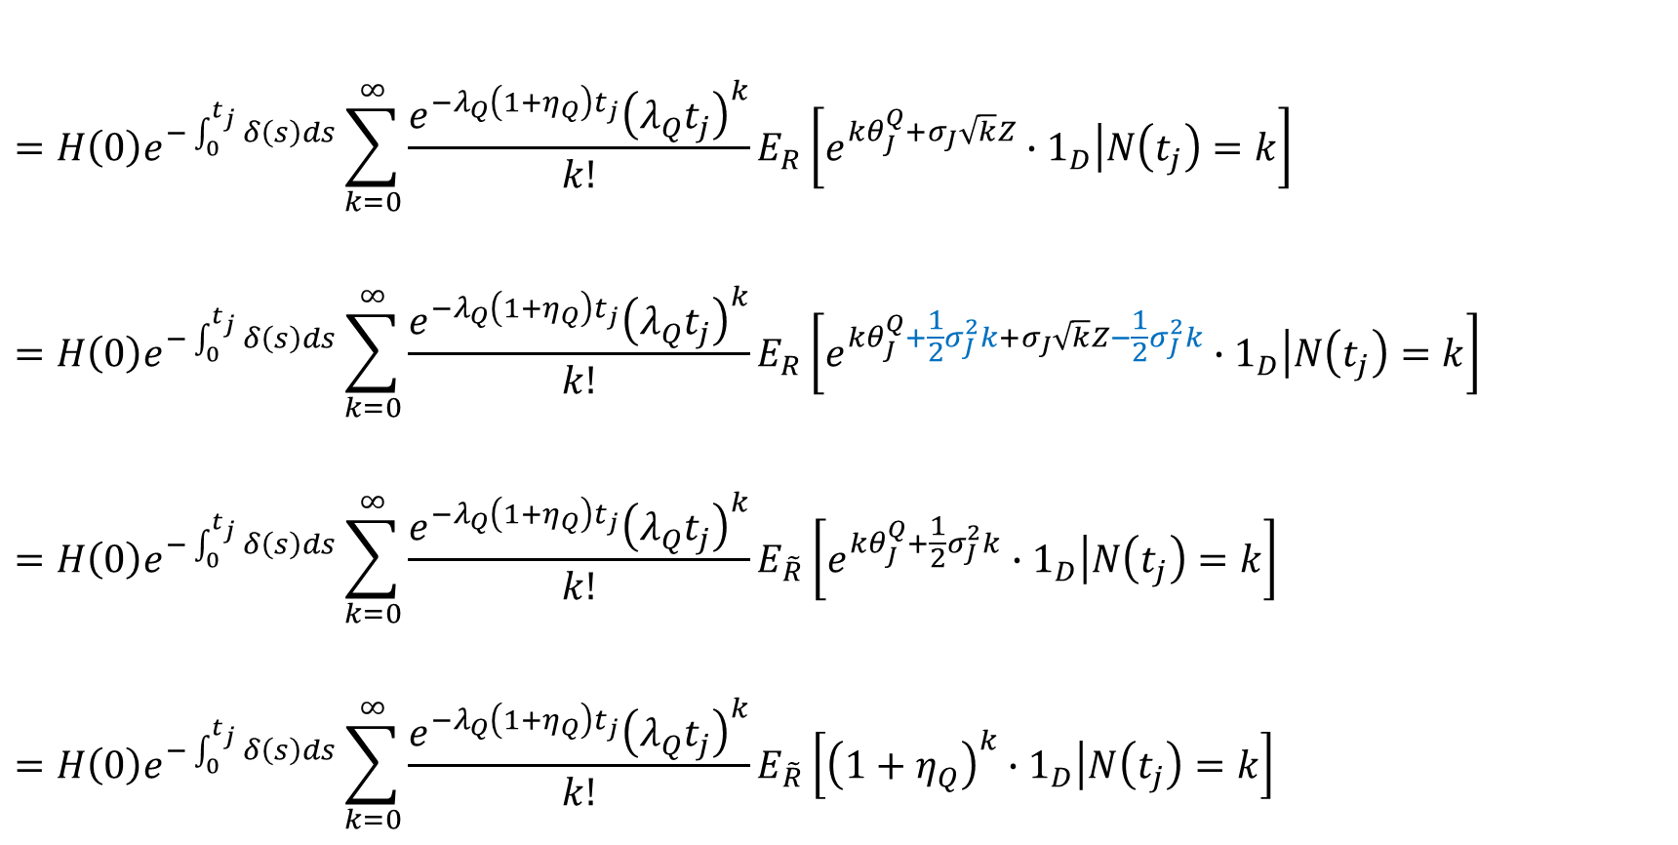

$$=H\left(0\right)e^{−\int_{0}^{t_{j}}{δ\left(s\right)ds}}\sum_{k=0}^{∞}{\frac{e^{−λ_{Q}\left(1+η_{Q}\right)t_{j}}{\left(λ_{Q}t_{j}\right)}^{k}}{k!}}E_{R}\left[e^{{kθ}_{J}^{Q}+σ_{J}\sqrt{k}Z}∙1_{D}\left|N\left(t_{j}\right)=k\right.\right]$$
$$=H\left(0\right)e^{−\int_{0}^{t_{j}}{δ\left(s\right)ds}}\sum_{k=0}^{∞}{\frac{e^{−λ_{Q}\left(1+η_{Q}\right)t_{j}}{\left(λ_{Q}t_{j}\right)}^{k}}{k!}}E_{R}\left[e^{{kθ}_{J}^{Q}+\frac{1}{2}σ_{J}^{2}k+σ_{J}\sqrt{k}Z−\frac{1}{2}σ_{J}^{2}k}∙1_{D}\left|N\left(t_{j}\right)=k\right.\right]$$
$$=H\left(0\right)e^{−\int_{0}^{t_{j}}{δ\left(s\right)ds}}\sum_{k=0}^{∞}{\frac{e^{−λ_{Q}\left(1+η_{Q}\right)t_{j}}{\left(λ_{Q}t_{j}\right)}^{k}}{k!}}E_{\tilde{R}}\left[e^{{kθ}_{J}^{Q}+\frac{1}{2}σ_{J}^{2}k}∙1_{D}\left|N\left(t_{j}\right)=k\right.\right]$$
$$=H\left(0\right)e^{−\int_{0}^{t_{j}}{δ\left(s\right)ds}}\sum_{k=0}^{∞}{\frac{e^{−λ_{Q}\left(1+η_{Q}\right)t_{j}}{\left(λ_{Q}t_{j}\right)}^{k}}{k!}}E_{\tilde{R}}\left[{\left(1+η_{Q}\right)}^{k}∙1_{D}\left|N\left(t_{j}\right)=k\right.\right]$$
$R$測度轉$\tilde{R}$測度
$$\frac{d\tilde{R}}{dR}=e^{σ_{j}\sqrt{k}Z−\frac{1}{2}σ_{J}^{2}k}$$
$$dW_{H}^{\tilde{R}}\left(t\right)=dW_{H}^{R}\left(t\right)$$
$$η_{Q}=e^{θ_{J}^{Q}\text{+}\frac{1}{2}{σ_{J}}^{2}}−1$$

Slide 28
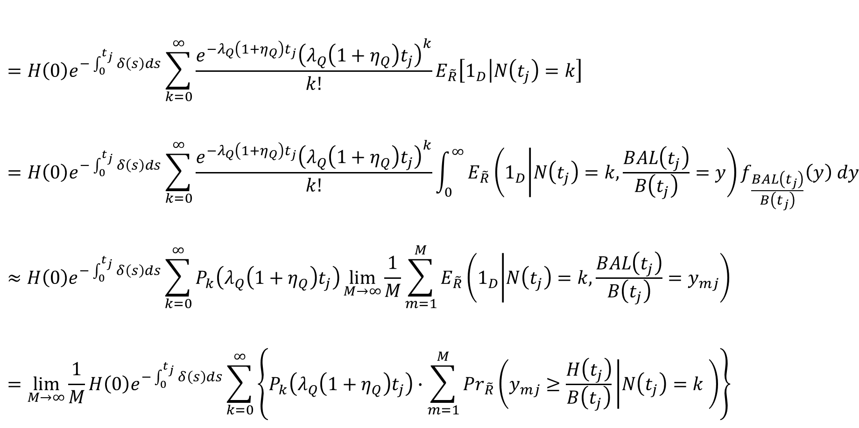
$$=H\left(0\right)e^{−\int_{0}^{t_{j}}{δ\left(s\right)ds}}\sum_{k=0}^{∞}{\frac{e^{−λ_{Q}\left(1+η_{Q}\right)t_{j}}{\left(λ_{Q}\left(1+η_{Q}\right)t_{j}\right)}^{k}}{k!}}E_{\tilde{R}}\left[1_{D}\left|N\left(t_{j}\right)=k\right.\right]$$
$$=H\left(0\right)e^{−\int_{0}^{t_{j}}{δ\left(s\right)ds}}\sum_{k=0}^{∞}{\frac{e^{−λ_{Q}\left(1+η_{Q}\right)t_{j}}{\left(λ_{Q}\left(1+η_{Q}\right)t_{j}\right)}^{k}}{k!}}\int_{0}^{∞}{E_{\tilde{R}}\left(1_{D} | N\left(t_{j}\right)=k,\frac{BAL\left(t_{j}\right)}{B\left(t_{j}\right)}=y\right)f_{\frac{BAL\left(t_{j}\right)}{B\left(t_{j}\right)}}\left(y\right) dy}≈H\left(0\right)e^{−\int_{0}^{t_{j}}{δ\left(s\right)ds}}\sum_{k=0}^{∞}{P_{k}\left(λ_{Q}\left(1+η_{Q}\right)t_{j}\right)}\lim_{M→∞}\frac{1}{M}\sum_{m=1}^{M}{E_{\tilde{R}}\left(1_{D} | N\left(t_{j}\right)=k,\frac{BAL\left(t_{j}\right)}{B\left(t_{j}\right)}=y_{mj}\right)}$$
$$=\lim_{M→∞}\frac{1}{M}H\left(0\right)e^{−\int_{0}^{t_{j}}{δ\left(s\right)ds}}\sum_{k=0}^{∞}{\left\{P_{k}\left(λ_{Q}\left(1+η_{Q}\right)t_{j}\right)∙\sum_{m=1}^{M}{{Pr}_{\tilde{R}}\left(y_{mj}≥\frac{H\left(t_{j}\right)}{B\left(t_{j}\right)} | N\left(t_{j}\right)=k \right)}\right\}}$$
應用雙重期望值定理
計算此項

Slide 29

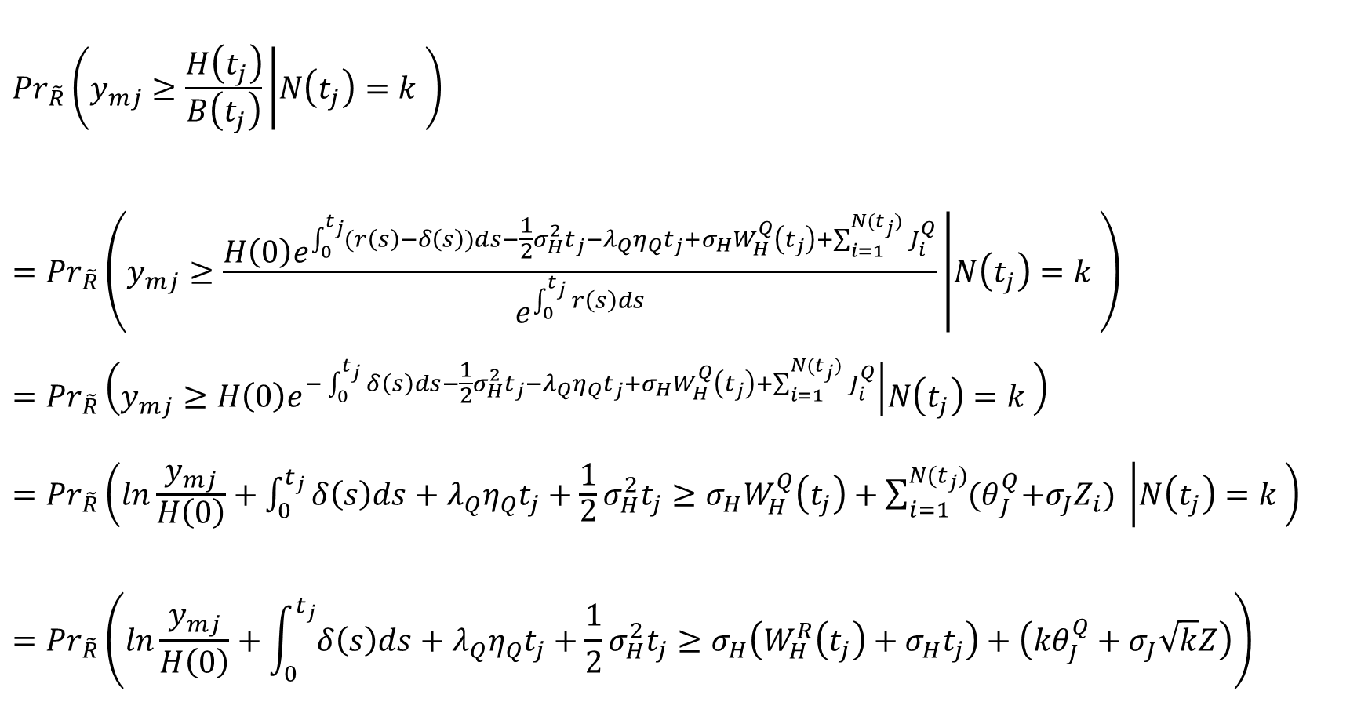


$${Pr}_{\tilde{R}}\left(y_{mj}≥\frac{H\left(t_{j}\right)}{B\left(t_{j}\right)} | N\left(t_{j}\right)=k \right)={Pr}_{\tilde{R}}\left(y_{mj}≥\frac{H\left(0\right)e^{\int_{0}^{t_{j}}{(r\left(s\right)−δ\left(s\right))ds}−\frac{1}{2}σ_{H}^{2}t_{j}−λ_{Q}η_{Q}t_{j}+σ_{H}W_{H}^{Q}\left(t_{j}\right)+\sum_{i=1}^{N(t_{j})}{J_{i}^{Q}}}}{e^{\int_{0}^{t_{j}}{r\left(s\right)ds}}} | N\left(t_{j}\right)=k \right)$$
$$={Pr}_{\tilde{R}}\left(y_{mj}≥H\left(0\right)e^{−\int_{0}^{t_{j}}{δ\left(s\right)ds}−\frac{1}{2}σ_{H}^{2}t_{j}−λ_{Q}η_{Q}t_{j}+σ_{H}W_{H}^{Q}\left(t_{j}\right)+\sum_{i=1}^{N(t_{j})}{J_{i}^{Q}}} | N\left(t_{j}\right)=k \right)$$
$$={Pr}_{\tilde{R}}\left(ln\frac{y_{mj}}{H\left(0\right)}+\int_{0}^{t_{j}}{δ\left(s\right)ds+λ_{Q}η_{Q}t_{j}}+\frac{1}{2}σ_{H}^{2}t_{j}≥σ_{H}W_{H}^{Q}\left(t_{j}\right)+\sum_{i=1}^{N(t_{j})}{{(θ}_{J}^{Q}+σ_{J}Z_{i})} | N\left(t_{j}\right)=k \right)={Pr}_{\tilde{R}}\left(ln\frac{y_{mj}}{H\left(0\right)}+\int_{0}^{t_{j}}{δ\left(s\right)ds+λ_{Q}η_{Q}t_{j}}+\frac{1}{2}σ_{H}^{2}t_{j}≥σ_{H}\left(W_{H}^{R}\left(t_{j}\right)+σ_{H}t_{j}\right)+\left({kθ}_{J}^{Q}+σ_{J}\sqrt{k}Z\right)\right)$$
在R測度下$\sum_{i=1}^{k}{Z_{i}}\sim N(0,k)$
但$\tilde{R}$測度下則否
在R測度下$Z\sim N(0,1)$
但$\tilde{R}$測度下則否
$$dW_{H}^{R}\left(t\right)=dW_{H}^{Q}\left(t\right)−σ_{H}dt$$

Slide 30
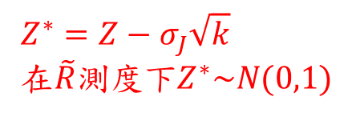
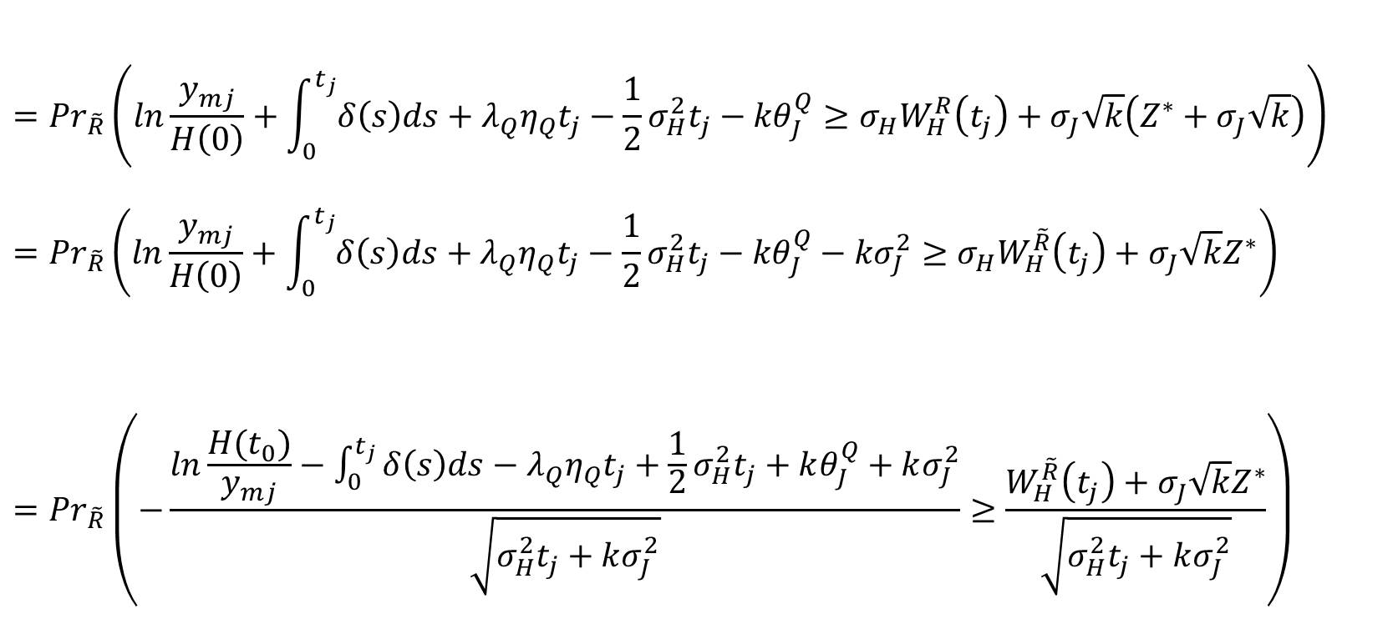


$$Z^{∗}=Z−σ_{J}\sqrt{k}$$
在$\tilde{R}$測度下$Z^{∗}\sim N(0,1)$
$$={Pr}_{\tilde{R}}\left(ln\frac{y_{mj}}{H\left(0\right)}+\int_{0}^{t_{j}}{δ\left(s\right)ds+λ_{Q}η_{Q}t_{j}}−\frac{1}{2}σ_{H}^{2}t_{j}−{kθ}_{J}^{Q}≥{σ_{H}W}_{H}^{R}\left(t_{j}\right)+σ_{J}\sqrt{k}\left(Z^{∗}+σ_{J}\sqrt{k}\right)\right)={Pr}_{\tilde{R}}\left(ln\frac{y_{mj}}{H\left(0\right)}+\int_{0}^{t_{j}}{δ\left(s\right)ds+λ_{Q}η_{Q}t_{j}}−\frac{1}{2}σ_{H}^{2}t_{j}−{kθ}_{J}^{Q}−{kσ}_{J}^{2}≥{σ_{H}W}_{H}^{\tilde{R}}\left(t_{j}\right)+σ_{J}\sqrt{k}Z^{∗}\right)={Pr}_{\tilde{R}}\left(−\frac{ln\frac{H(t_{0})}{y_{mj}}−\int_{0}^{t_{j}}{δ\left(s\right)ds}−λ_{Q}η_{Q}t_{j}+\frac{1}{2}σ_{H}^{2}t_{j}+kθ_{J}^{Q}+kσ_{J}^{2}}{\sqrt{σ_{H}^{2}t_{j}+kσ_{J}^{2}}}≥\frac{W_{H}^{\tilde{R}}\left(t_{j}\right)+σ_{J}\sqrt{k}Z^{∗}}{\sqrt{σ_{H}^{2}t_{j}+kσ_{J}^{2}}}\right)$$
$$dW_{H}^{\tilde{R}}\left(t\right)=dW_{H}^{R}\left(t\right)$$
因為$W_{H}^{\tilde{R}}\left(t_{j}\right)⊥Z^{∗}$，故變異數可直接相加

Slide 31


$$={Pr}_{\tilde{R}}\left(−\frac{ln\frac{H(t_{0})}{y_{mj}}+kθ_{J}^{Q}−\int_{0}^{t_{j}}{δ\left(s\right)ds}−λ_{Q}η_{Q}t_{j}+\frac{1}{2}σ_{H}^{2}t_{j}+kσ_{J}^{2}}{\sqrt{σ_{H}^{2}t_{j}+kσ_{J}^{2}}}≥Z\right)={Pr}_{\tilde{R}}\left(−\frac{ln\frac{H(t_{0})}{y_{mj}}+\left(−\int_{0}^{t_{j}}{δ\left(s\right)ds}−λ_{Q}η_{Q}t_{j}+kθ_{J}^{Q}+\frac{1}{2}kσ_{J}^{2}\right)+\frac{1}{2}(σ_{H}^{2}t_{j}+kσ_{J}^{2})}{\sqrt{σ_{H}^{2}t_{j}+kσ_{J}^{2}}}≥Z\right)$$
$${=Pr}_{\tilde{R}}\left(−\frac{ln\frac{H(t_{0})}{y_{mj}}+\overline{r_{jk}}+\frac{1}{2}σ_{kj}^{2}}{σ_{kj}}≥Z\right)$$
$$=φ\left({−h}_{jk}\left(y_{mj}\right)\right)$$
其中： $P_{k}\left(λ\right)=\frac{e^{−λ}λ^{k}}{k!}$ , $h_{jk}\left(y_{mj}\right)=\frac{ln\frac{H(t_{0})}{y_{mj}}+\overline{r_{jk}}+\frac{1}{2}σ_{kj}^{2}}{σ_{kj}}$
$\overline{r_{jk}}=−\int_{0}^{t_{j}}{δ\left(s\right)ds}−λ_{Q}η_{Q}t_{j}+kθ_{J}^{Q}+\frac{1}{2}kσ_{J}^{2}$
$σ_{kj}^{2}=σ_{H}^{2}t_{j}+kσ_{J}^{2}$ , $φ()$為常態分配之cdf

Slide 32
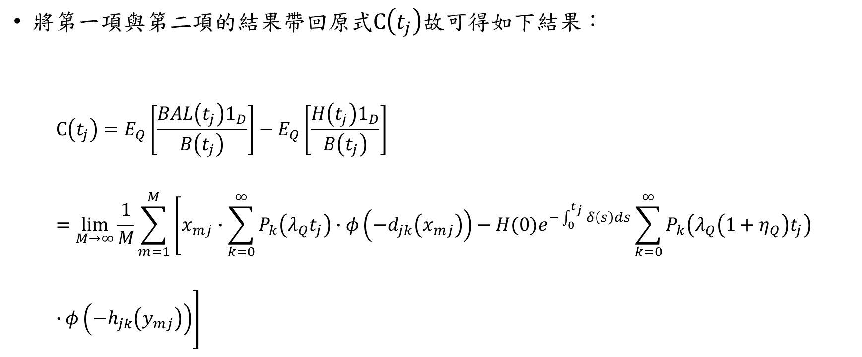
將第一項與第二項的結果帶回原式$C\left(t_{j}\right)$故可得如下結果：
$$C\left(t_{j}\right)=E_{Q}\left[\frac{BAL\left(t_{j}\right)1_{D}}{B\left(t_{j}\right)}\right]−E_{Q}\left[\frac{H\left(t_{j}\right)1_{D}}{B\left(t_{j}\right)}\right]=\lim_{M→∞}\frac{1}{M}\sum_{m=1}^{M}{\left[x_{mj}∙\sum_{k=0}^{∞}{P_{k}\left(λ_{Q}t_{j}\right)}∙φ\left({−d}_{jk}\left(x_{mj}\right)\right)−H(0)e^{−\int_{0}^{t_{j}}{δ\left(s\right)ds}}\sum_{k=0}^{∞}{P_{k}\left(λ_{Q}\left(1+η_{Q}\right)t_{j}\right)}∙φ\left({−h}_{jk}\left(y_{mj}\right)\right)\right]}$$

Slide 33
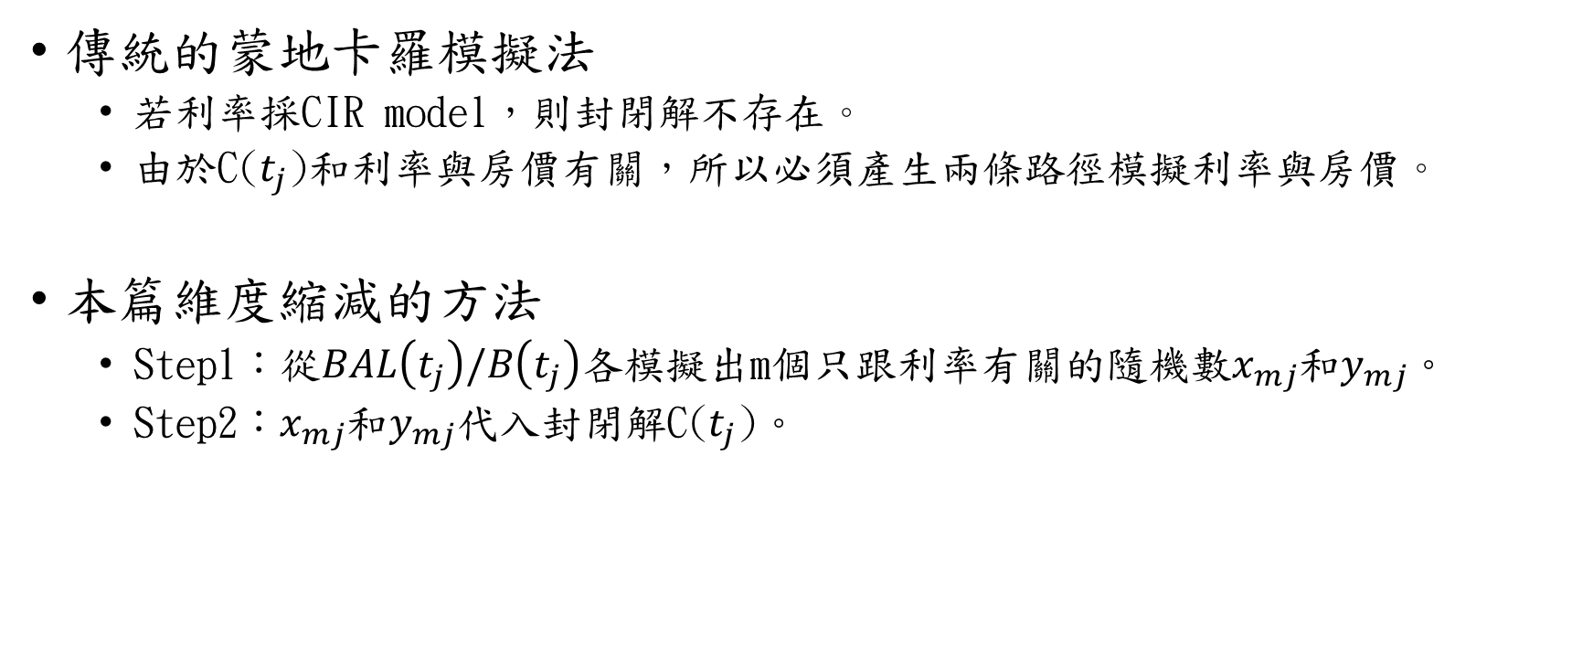
方法比較
傳統的蒙地卡羅模擬法
若利率採CIR model，則封閉解不存在。
由於C($t_{j}$)和利率與房價有關，所以必須產生兩條路徑模擬利率與房價。
本篇維度縮減的方法
Step1：從$BAL\left(t_{j}\right)/B\left(t_{j}\right)$各模擬出m個只跟利率有關的隨機數$x_{mj}$和$y_{mj}$。
Step2：$x_{mj}$和$y_{mj}$代入封閉解C($t_{j}$)。

Slide 34

只跟利率有關
$x_{mj} , y_{mj} \sim \frac{BAL\left(t_{j}\right)}{B\left(t_{j}\right)}=\frac{\sum_{i=0}^{j−1}{αe^{\int_{t_{i}}^{t_{j}}{\left(r\left(s\right)+π_{r}\right)ds}}π_{i,j}}}{e^{\int_{0}^{t_{j}}{r\left(s\right)ds}}}=\sum_{i=0}^{j−1}{απ_{i,j}}e^{π_{r}\left(t_{j}−t_{i}\right)}e^{−\int_{0}^{t_{i}}{r\left(s\right)ds}}$
在風險中立測度Q下，利率的動態過程：
在$\tilde{R}$測度下，利率的動態過程：
透過上述兩式，即可模擬出 $x_{mj}$ , $y_{mj}$
$$r\left(n∆t\right)=r\left((n−1)∆t\right)+\left(κ_{Q}−θ_{Q}r\left(\left(n−1\right)∆t\right)\right)∆t+σ_{r}\sqrt{r\left((n−1)∆t\right)}∙ε_{n}\sqrt{∆t}$$
$$r\left(n∆t\right)=r\left((n−1)∆t\right)+\left(κ_{Q}+ρ_{Hr}σ_{r}σ_{H}\sqrt{r\left((n−1)∆t\right)}−θ_{Q}r\left(\left(n−1\right)∆t\right)\right)∆t+σ_{r}\sqrt{r\left((n−1)∆t\right)}∙ε_{n}^{\tilde{R}}\sqrt{∆t}$$

Slide 35


在風險中立測度Q下，標準布朗運動$dW_{r}^{Q}\left(t\right)=dW_{r}\left(t\right)+\frac{θ_{r}\sqrt{r(t)}}{σ_{r}}dt$
故
利率的動態過程如下：
$$r\left(n∆t\right)=r\left((n−1)∆t\right)+\left(κ_{Q}−θ_{Q}r\left(\left(n−1\right)∆t\right)\right)∆t+σ_{r}\sqrt{r\left((n−1)∆t\right)}∙ε_{n}\sqrt{∆t}$$
其中：
$θ_{r}$為風險溢酬
$κ_{Q}=κ_{r}θ_{r}$
$θ_{Q}=κ_{r}+θ_{r}$
$ε_{n}$為標準常態r.v，n=1,2,…, $\frac{ω−x_{0}+1 }{∆t}$
$$dr\left(t\right)=κ_{r}\left(θ_{r}−r\left(t\right)\right)dt+σ_{r}\sqrt{r\left(t\right)}dW_{r}\left(t\right)=κ_{r}\left(θ_{r}−r\left(t\right)\right)dt+σ_{r}\sqrt{r\left(t\right)}\left(dW_{r}^{Q}\left(t\right)−\frac{θ_{r}\sqrt{r(t)}}{σ_{r}}dt \right) \\ =\left(κ_{r}θ_{r}−(κ_{r}+θ_{r})r\left(t\right)\right)dt+σ_{r}\sqrt{r\left(t\right)}dW_{r}^{Q}\left(t\right) \\ =(κ_{Q}−θ_{Q}r\left(t\right))dt+σ_{r}\sqrt{r\left(t\right)}dW_{r}^{Q}\left(t\right)$$

Slide 36
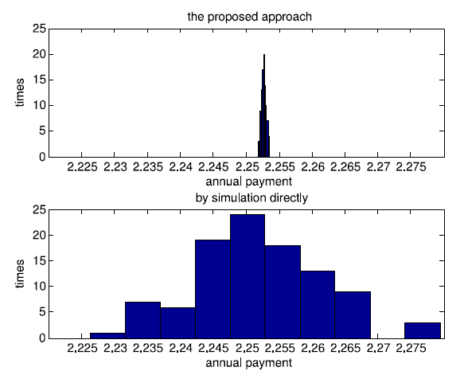
比較結果
Notes:
各使用10,000次的模擬路徑，本篇方法的標準差較小，故本方法較精準

Slide 37

結論
$BAL\left(t_{j}\right)/B\left(t_{j}\right)$只跟利率過程有關，因此本篇方法可將模擬的維度從二維(利率與房價)降至一維(利率)，評價結果較蒙地卡羅法準確。

