Slide 1
Structural break‑aware pairs trading strategy using deep reinforcement learning
Lu, Jing-You, et al.
The Journal of Supercomputing. 2021.
2021/09/20
學生：張維哲

Slide 2
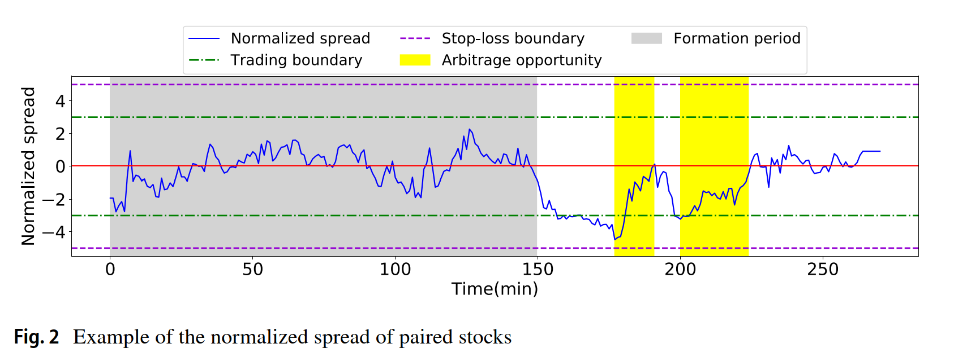
Introduction
Pairs trading strategies are developed to exploit these stable relations as the arbitrage opportunities. Different definitions of meaningful pairs are then proposed, such as distance-based, cointegration-based, stochastic-based, and time series-based.
In this paper, we focus on the cointegration-based pairs trading since the spread of a cointegration-based pair is proved to be more econometrically reliable.

Slide 3
Introduction
In order to optimize pairs trading strategies depending on the positions of open and close, it is crucial to determine the trading and stop-loss boundaries.
If the gap between trading boundaries is narrow→few profit
If the gap between trading boundaries is too wide → miss several arbitrage opportunities and increase the risk
To seize the arbitrage opportunities in intraday trading, our intuition is to design new pairs trading strategies in a fine-grained scale (e.g., minute scale) from the tick data.
On the other hand, the cointegration relationship of spreads is much weaker due to the high sensitivity in the tick data.
The risk, namely the structural break, that the spread could fade away from the historical mean also increases, which would cause dramatic loss if the spread does not revert back.

Slide 4
Introduction
To detect structural breaks, state-of-the-art methods, such as Augmented Dickey–Fuller test and Chow test, require numerous data for statistical examinations. Moreover, they are not applicable to online detection.
In anomaly detection field, likelihood ratio-based and probability-based change-point detection identifies sudden and dramatic pattern changes in time series data.
The structural breaks may lie in slowly changing spreads, which make them undetectable for change-point detection methods.

Slide 5
Introduction
In this paper, we propose a two-phase framework, namely structural break-aware pairs trading strategy (SAPT).
Phase 1: structural break detection
The goal is to estimate the occurrence probability of a structural break in the current timestamp.
we propose spread wavelet-aware hybrid network (SWANet) to jointly extract frequency-domain features from spreads and time-domain features with a continuous wavelet convolutional neural network(CNN) and a long short-term memory (LSTM)
Phase 2: pairs trading strategy optimization
The goal of this phase is to jointly decide the trading shares (i.e., trading amount) in each timestamp, the trading and the stop-loss boundaries.
we propose a novel deep Q-network structural break-aware deep Q-network (SADQN) with a transaction cost-aware objective function and risk-aware definitions of states and rewards.

Slide 6
Related work
Structural break detection
Statistical methods for structural break detection
Augmented Dickey–Fuller test (ADF)
Chow test
These methods are too sensitive to deal with the high variety in intraday trading. In addition, they have difficulty to meet the immediacy of structural break detection since they require enormous data to get reliable results during testing.
Change‑point detection
The goal of change-point detection is to identify the locations where pattern switches or abrupt change happens in the time series data. (e.g., climate change detection and speech recognition.)
The above methods may misclassify abrupt fluctuations in stock markets as breakpoints, such that many arbitrage opportunities would be missed.

Slide 7
Related work
Deep learning for finance
Chen et al. constructed the Filterbank CNN in high-frequency pairs trading to extract long-term and short-term historical volatility information and hence outperformed the rule-based strategies in Taiwan Stock Index Futures and Mini Index Futures.
Zhang et al. proposed to extract the features of limit order books with a CNN to learn the strength of the bid–ask and then predict the trend of the London Stock Exchange with an LSTM.
Fallahpour et al. made the first attempt to adopt a classic Q-learning model.
Kim et al. further proposed the pairs trading deep Q-network (PTDQN) that employed a conventional deep Q-learning model to dynamically choose the open and the stop-loss boundaries over time.

Slide 8
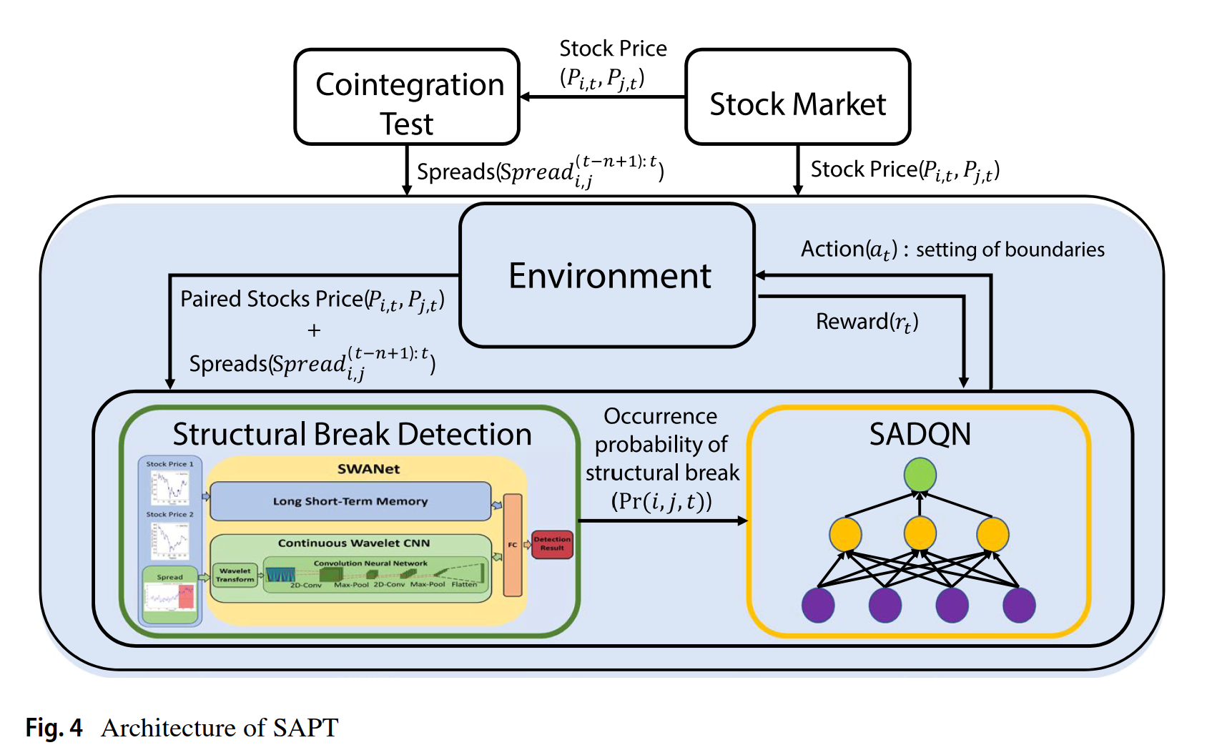
Overview of SAPT

Slide 9







Structural break detection
Consider a cointegrated pair of stocks , where , and let t^{cur} denote the current timestamp.
When the current prices and are available, the goal is to estimate the occurrence probability of a structural break at t^{cur} with a real-time detection model as follows:
Where is the occurrence probability, is the set of learnable parameters of .

Slide 10
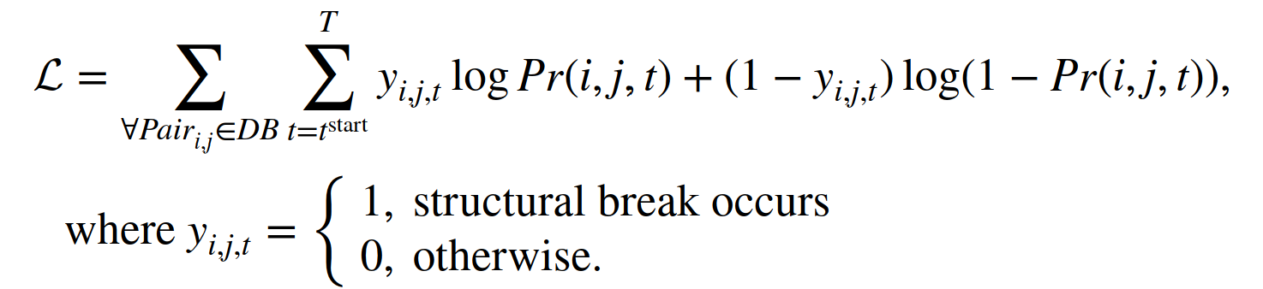
Structural break detection
Accordingly, we further model the detection task as a binary classification problem, where the objective function is defined as follows:
The ground truth of breakpoint can be obtained by [54].
the binary cross-entropy
is the binary ground truth of whether is in a structural break at time t.
[54] Laptev N, Amizadeh S, Flint I (2015) Generic and scalable framework for automated time-series anomaly detection. In: Proceedings of the 21st ACM SIGKDD International Conference on Knowledge Discovery and Data Mining. ACM, pp 1939–1947

Slide 11
Structural break detection
The differences between the proposed SWANet and traditional statistical methods are twofold.
Statistical methods require relatively long time for detection and are designed for offline examinations. SWANet is able to detect structural breaks online and hence reduces the detection delay.
SWANet learns from both time-domain and frequency-domain features, whereas traditional methods do not exploit frequency-domain features.

Slide 12
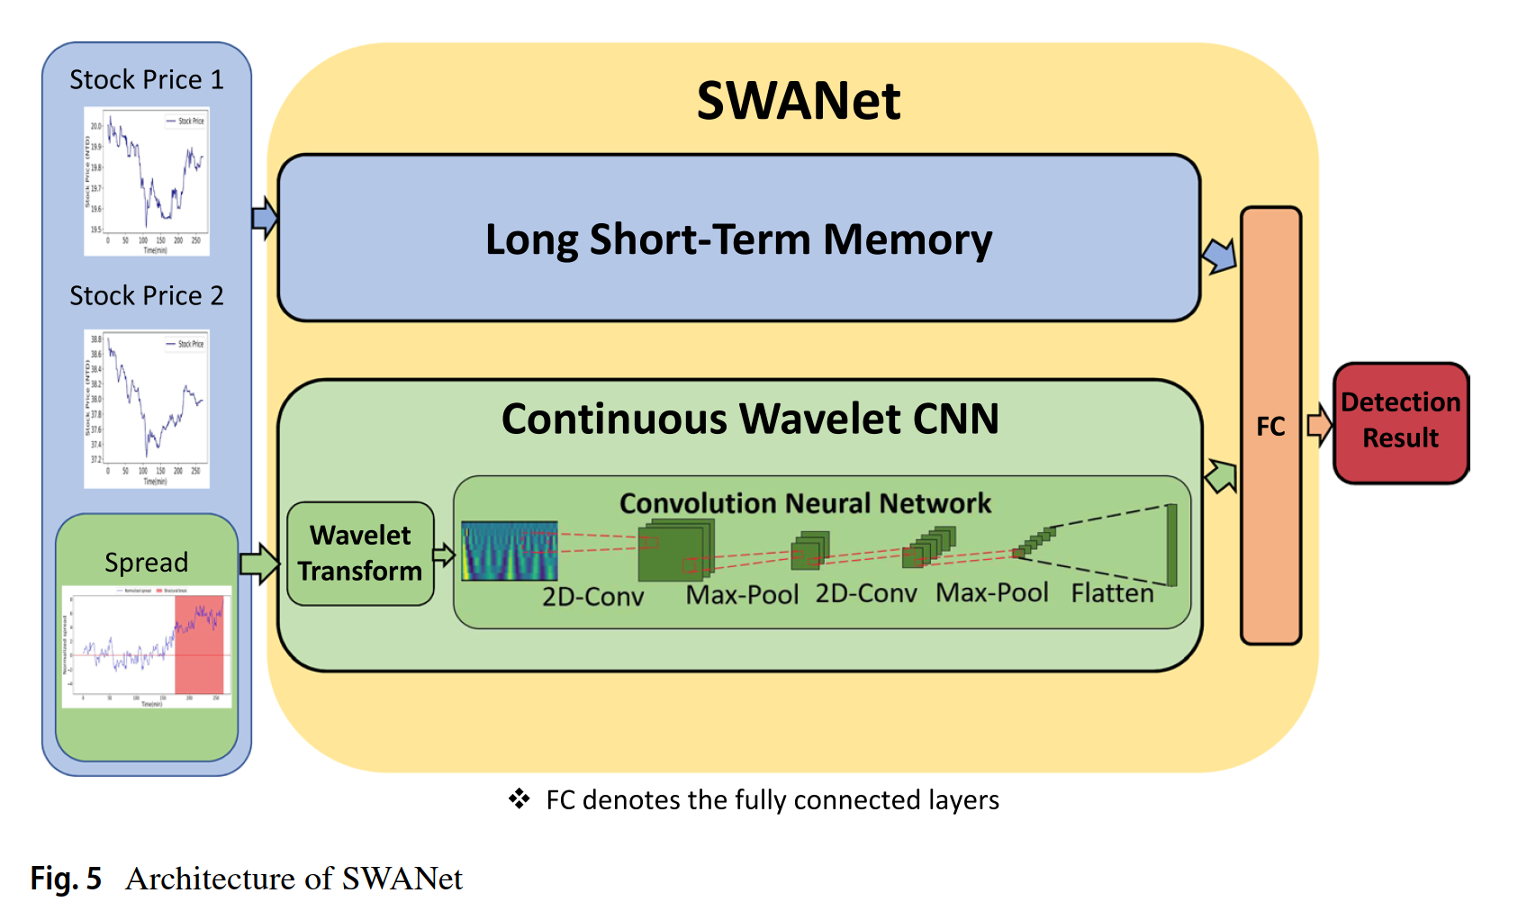
Structural break detection

Slide 13
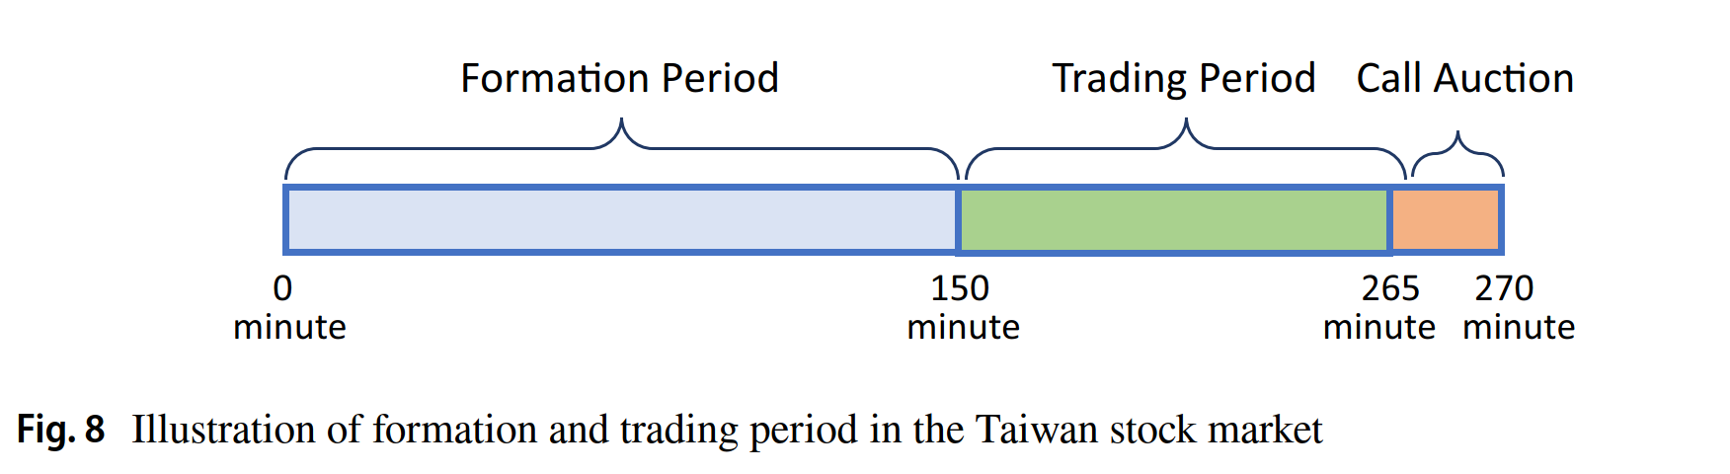
Data preparation
We collect the stock tick data from the top 150 companies in the Taiwan Stock Exchange Capitalization Weighted Stock Index (TAIEX) to ensure the liquidity.
November 1st, 2017 to May 31st, 2020
To approximate the real market environment, stock prices are aggregated to volume-weighted average prices in minute scale.
We apply the VECM to extract the cointegrated pairs every day. There are 19,872 cointegrated pairs extracted in total.

Slide 14
Ground truth labeling
Since labeling ground truth of breakpoints requires experienced experts and is time-consuming, we follow [41] to obtain breakpoints with [54] developed by Yahoo.
75% and 25% of the data are, respectively, used for training and testing, and the last 20% of the training data are for validation. All the time series, including stock prices and spreads, are normalized to eliminate offsets.
[41] Huang C, Min G, Wu Y, Ying Y, Pei K, Xiang Z (2017) Time series anomaly detection for trustworthy services in cloud computing systems. IEEE Trans Big Data 6:66
[54] Laptev N, Amizadeh S, Flint I (2015) Generic and scalable framework for automated time-series anomaly detection. In: Proceedings of the 21st ACM SIGKDD International Conference on Knowledge Discovery and Data Mining. ACM, pp 1939–1947

Slide 15


Evaluation metrics
We define that a true breakpoint at time bp is detected whether the breakpoint alerted by an algorithm is in the time interval [bp− , bp+ ] , where and are given tolerances ranging from 0 to 70 min.
In general, setting a great is more conservative (sensing structural breaks early) and setting a great is more aggressive (allowing late responses to structural breaks).
We set to 0 in order to maximize the profitability.

Slide 16
Evaluation metrics
True Detection Rate: the ratio of the number of detected breakpoints to the number of all breakpoints.
Partial Detection Rate: the ratio of the number of breakpoints that are alerted earlier than bp to the number of all breakpoints.
Missed Rate: the ratio of the number of non-detected breakpoints to the number of all breakpoints.
False Detection Rate: the ratio of the number of spreads without breakpoints but alerted by an algorithm to the number of spreads without breakpoints.
Average Delay: the average time difference between the timestamp of the detected breakpoint and the timestamp of the actual breakpoint (ground truth).

Slide 17
Comparison methods
3-std
ADF
BCD(Bayesian online change-point detection)[1]
LSTM
SWANet
If the derived occurrence probability is greater than 90%, than a breakpoint is returned
SWANet-S
If the derived occurrence probability is greater than 90%, than a breakpoint is returned
[1] Adams RP, MacKay DJ (2007) Bayesian online changepoint detection. arXiv preprint arXiv:0710. 3742

Slide 18
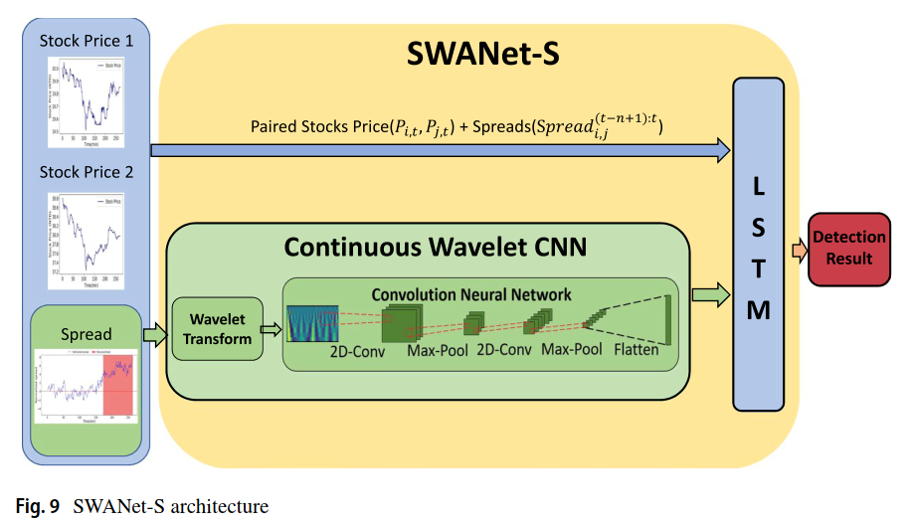
SWANet-S

Slide 19
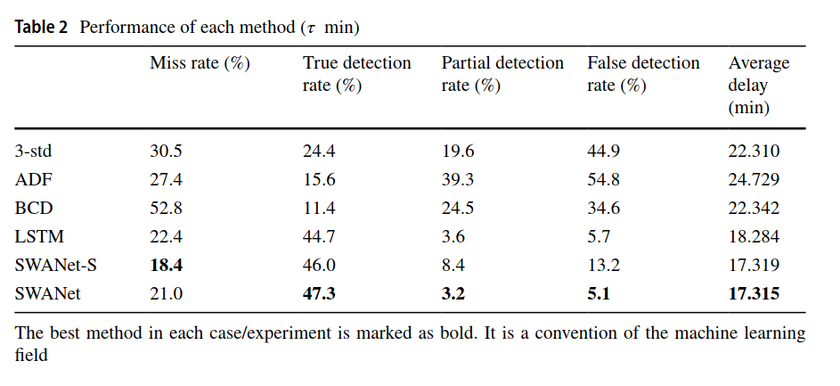
Experimental results

Slide 20
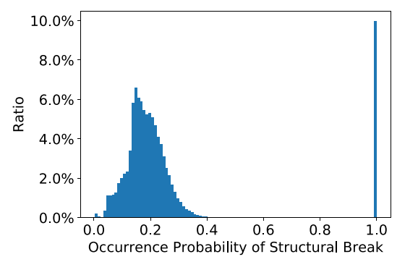

Experimental results
Figure 11 depicts the distribution of output occurrence probability of structural breaks of SWANet. The output is clearly separated into two clusters, where the one with higher probability (≥ 90%) represents those are suspect breakpoints returned by SWANet. As a result, we recommend to set the threshold to be 90% in TAIEX dataset.

Slide 21
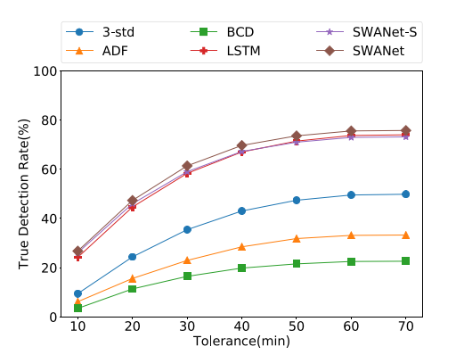

Experimental results
For sensitivity tests, Fig. 12 shows the true detection rates over different delay tolerance in testing data.

Slide 22


Pairs trading strategy optimization
denotes the trading status of the pair at time t.
OPENED if the position has been opened earlier and is waiting for a close.
CLOSED if the position has not been opened yet and is waiting for an open.
The transaction cost:
C =0.15% for day trading securities transaction tax in Taiwan

Slide 23

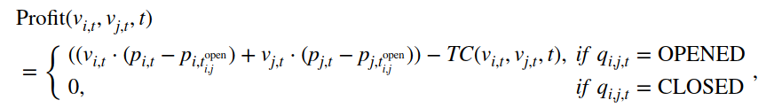
Pairs trading strategy optimization
The transaction cost-aware objective function is defined as follows:
In this paper, we propose SADQN, which adopts a deep Q-network (DQN) to build a Q-function based on historical events and estimates the Q-values with given states and actions.

Slide 24

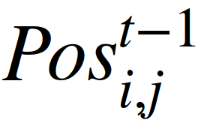
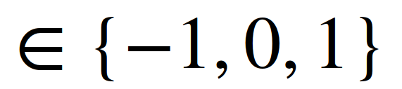
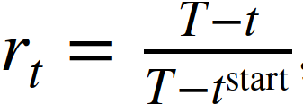

Pairs trading strategy optimization
State
Spread
Previous action
Previous position
1 indicates that the position is opened by meeting the upper trading boundary
-1 indicates that it is opened by meeting the lower trading boundary
0 indicates the position is not opened
The occurrence probability of structural break
Market-closing risk
the ratio of the remaining time to the end of trading period

Slide 25
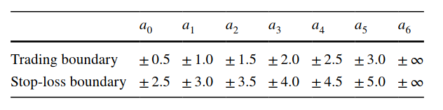
Pairs trading strategy optimization
Action
We propose a hold action by setting both trading boundary and stop-loss boundary as ±∞ to prevent trading from loss.
(1) when a trade has great potential to revert to historical mean quickly, it is not necessary to close the trade even the stop-loss boundary is met. By using the hold action, it is possible for SADQN to suspend the close and hence benefit from those more profitable arbitrage opportunities.
(2) When spreads diverge too far from their historical means, even the widest boundary setting may not stop from opening those risky positions. However, by using the hold action, SADQN is able to forbid those opens to avoid such risks.

Slide 26
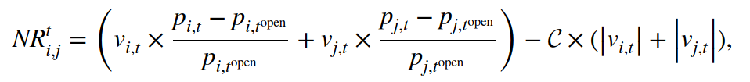
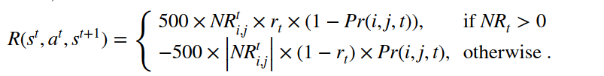
Pairs trading strategy optimization
Reward Function
Normal close
Stop-loss close
Exit

Slide 27
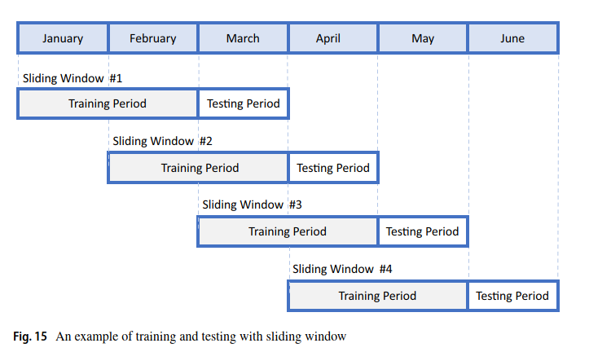
Experiment setup
To mitigate the influence of slippage in TAIEX, we set the maximum trading shares of each stock to 5000 and initial capital to 10 million New Taiwan dollars.
the transactions in two months are used for training and those in the following one month are used for testing. The last two weeks in training data are used for validation.

Slide 28
Evaluation metrics
Cumulative net profit
Maximum drawdown (MDD)
Sharpe ratio
Sortino ratio

Slide 29
Comparison methods
PTDQN [50]
OPT-LSTM [71]
SAPT: The proposed method which factors in the occurrence probability of structure break, the market-closing risk, the transaction cost with a hold action
SAPT w/o Break
SAPT w/o Time
SAPT w/o Hold
SAPT-3-std: SAPT using the structure break probability predicted by 3-std.
SAPT-ADF: SAPT using the structure break probability predicted by ADF.
SAPT-BCD: SAPT using the structure break probability predicted by BCD.
SAPT-LSTM: SAPT using the structure break probability predicted by LSTM.
[50] Kim T, Kim HY (2019) Optimizing the pairs-trading strategy using deep reinforcement learning with trading and stop-loss boundaries. Complexity 6:66
[71]Sarmento SM, Horta N (2020) Enhancing a pairs trading strategy with the application of machine learning. Expert Syst Appl 158:113490. https://doi.org/10.1016/j.eswa.2020.113490

Slide 30
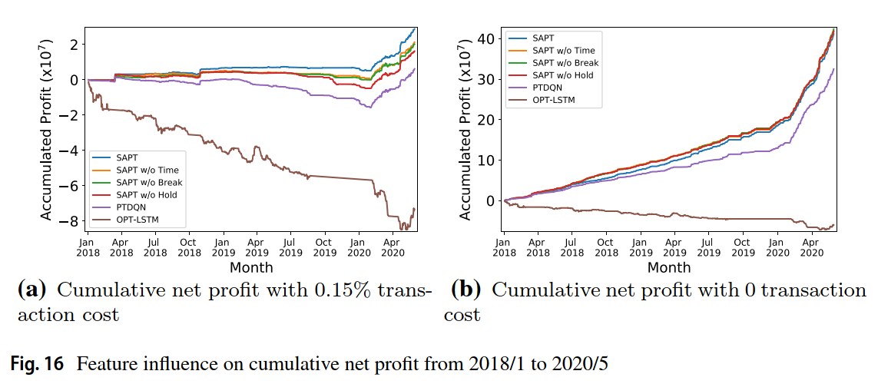
Experimental results

Slide 31
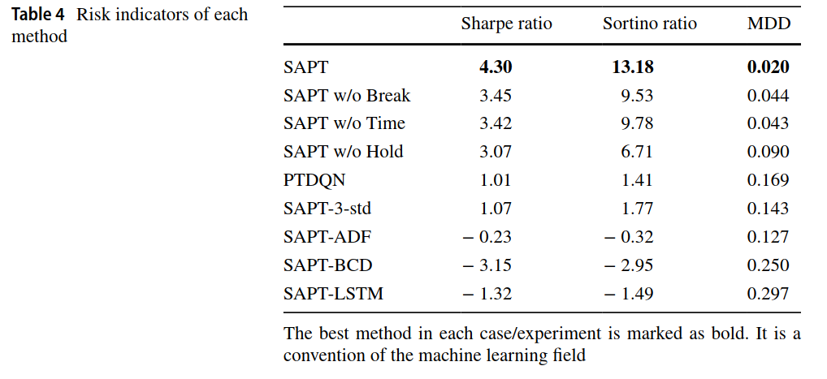
Experimental results

Slide 32
Conclusion
In this paper, to tackle this urgent need, we propose a two-phase framework SAPT. The first-phase SWANet detects structural breaks by extracting not only time-domain features from stock price and spread with an LSTM but also frequency-domain features from scalogrames by using a continuous wavelet CNN. The second-phase SADQN optimizes the structural break-aware pairs trading strategy with a deep Q-network.
(1) SWANet outperforms conventional statistical methods by at least 93.9% in terms of true detection rate.
(2) SADQN, respectively, outperforms the other state-of-the-art methods by at least 456% and 934% in terms of profit and Sortino ratio.
(3) SAPT is robust in volatile market environment caused by COVID-19 pandemic.

