Slide 1
Deep Reinforcement Learning in Pairs Trading
張維哲
2022/01/18

Slide 2

Pairs Trading - Introduction
找出兩檔相關性高的股票，使用統計方法，形成有均值回歸特性的價差序列(spread)
當spread碰觸到開倉門檻時(如A、B)，我們會做多/做空此投資組合，等到回到均值時平倉，以此賺取價差
stock1
stock2
spread
B
開倉門檻
均值
A
開倉門檻

Slide 3
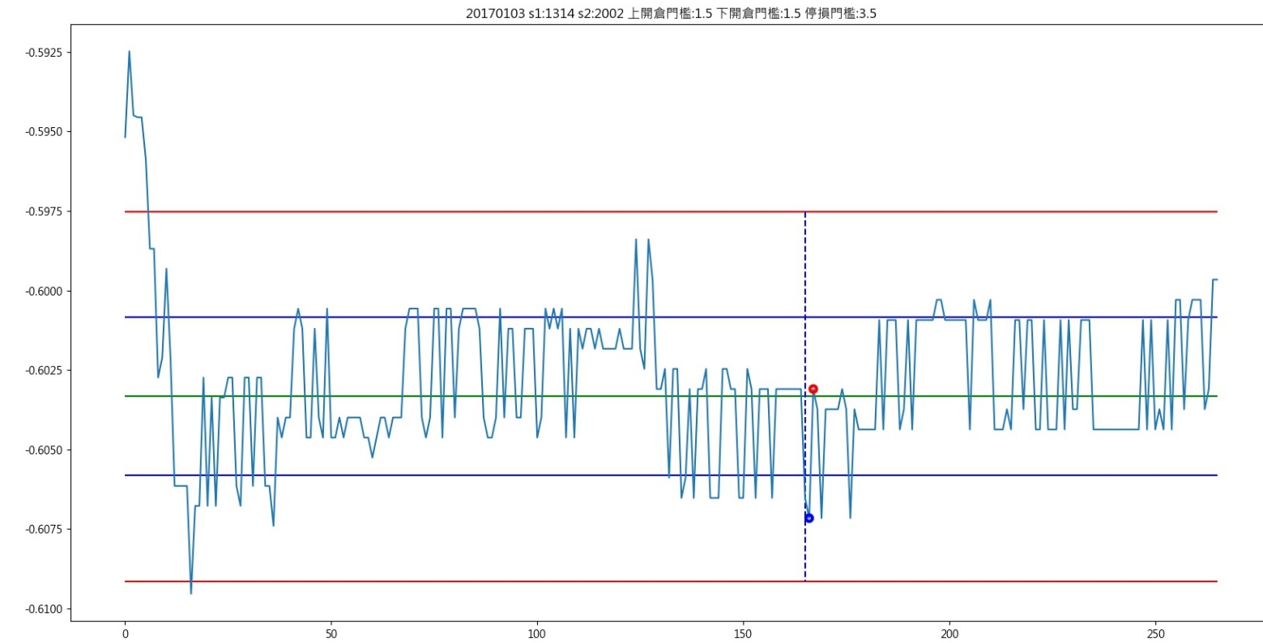
Pairs Trading - Introduction
Formation period
Trading period
停損門檻
開倉門檻
均值
開倉門檻
停損門檻

Slide 4
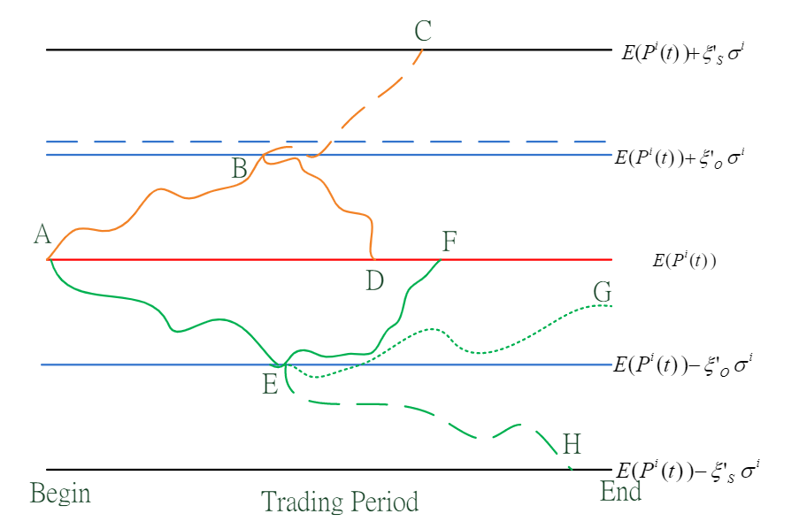
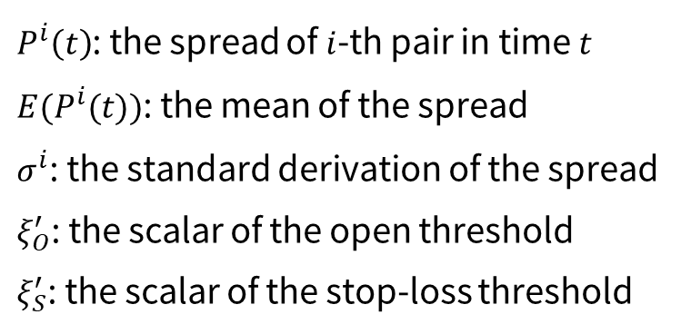
Pairs Trading - Introduction
$P^{i}\left(t\right)$: the spread of $i$-th pair in time $t$
$E(P^{i}(t))$: the mean of the spread
$σ^{i}$: the standard derivation of the spread
$ξ_{O}^{′}$: the scalar of the open threshold
$ξ_{S}^{′}$: the scalar of the stop-loss threshold
Figure 1: Possible Scenarios in the Trading Period

Slide 5
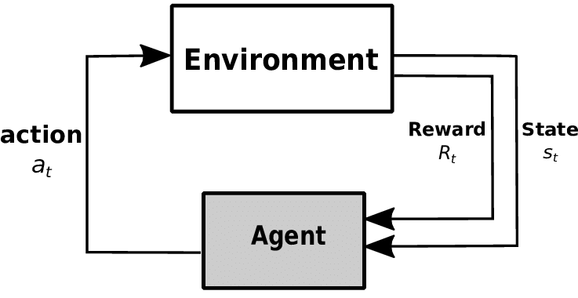
Deep Reinforcement Learning - Introduction

Slide 6
DRL in Pairs Trading - Overview
Agent
Action：
包含開倉門檻與停損門檻
State：價差序列
neural network
network update
RL Algorithm
(DQN)
Reward：交易報酬
Environment
Trading period
有
Formation period
觀察價差序列是否有達到開倉門檻
找尋兩檔股票是否擁有共整合關係

Slide 7
DRL in Pairs Trading - Literature Review
Fallahpour, S., Hakimian, H., Taheri, K., & Ramezanifar, E. (2016). Pairs trading strategy optimization using the reinforcement learning method: a cointegration approach. Soft Computing, 20(12), 5051-5066.
→將問題簡化成單一個state，訓練N-armed bandit選取開倉停損門檻
Kim, T., & Kim, H. Y. (2019). Optimizing the pairs-trading strategy using deep reinforcement learning with trading and stop-loss boundaries. Complexity, 2019.
→訓練DQN選取開倉停損門檻
以上兩篇文獻共通點：每個配對各自訓練一個model
Pros：有效捕捉到個別配對其特有的特徵
Cons：同一配對的資料數量可能過少，或是在測試期間遇到在訓練期間沒看過的配對→overfitting
Kuo, W.-L. (2021). Improving pairs trading strategies using two-stages deep learning methods with labelling mechanism and analyses of time (in)-homogeneous inputs on trading performances.
→重新設計開倉停損門檻，並使用DL來進行訓練
Lu, J. Y., Lai, H. C., Shih, W. Y., Chen, Y. F., Huang, S. H., Chang, H. H., ... & Dai, T. S. (2021). Structural break-aware pairs trading strategy using deep reinforcement learning. The Journal of Supercomputing, 1-40.
→使用DL偵測結構性斷裂的機率，並訓練DQN選取開倉停損門檻
以上兩篇文獻共通點：使用所有配對資料，僅訓練出一個model
Pros：訓練好的模型具有Generalization
Cons：會丟失一些配對其特有的特徵
Transfer learning

Slide 8
Transfer Learning
將訓練好的模型與參數，轉移至另一個新模型上，不須從零開始訓練
Source model
(Pre-trained model)
Trained weights transfer
Target model
Train from scratch
fine-tune
Source data
(Large amount of data)
Target data

Slide 9
Transfer Learning in Pairs Trading - Overview
All Trading data
Training
RL model
Based on pair
Type 1: RL Model for all pairs
RL model
Pair 1
Pair 1 model
Pair 2
Pair 2 model
Pair 3
Pair 3 model
…
…
…
…
Type 2: RL Model for specific pair
RL model
Pair 1 model
Pre-trained model
from type 1
Fine-tune
Pair 2 model
Type 3: Use pre-trained model and then fine-tune to specific pair
Pair 3 model
…
…

Slide 10
Experiment Result
Training: 2015/01/01-2016/10/31
Validation: 2016/11/01-2016/12/31
Testing:2017/01/01-2018/12/31
25個action (HighFreq，從Top N 決定)
Profit
Win Rate/Normal Close Rate
(Normal close number, Stop loss close number, Force close number, Total number)
Sharpe ratio( with per day calculate)
Sharpe ratio( with per pair calculate)
Profit of per open (thousand) && Trade capital (thousand) && MDD
 | Type 2 | Type 1 | Type 3
Top 5 (24 action) | 12.61 95.06%/91.36% (74/0/7/81) 24.0434 1.5113 0.1556/410.75/-0.22 | 12.74 95.29% / 91.76% (78,0,7,85) 23.8629 1.4273 0.1499/410.75/-0.22 | 12.74 95.29%/91.76% (78/0/7/85) 23.8629 1.4273 0.1499/410.75/-0.22
Top 10 | 18.40 91.72%/88.28% (128/4/13/145) 12.6286 0.9238 0.1269/451.64/-1.36 | 23.36 93.87% / 91.41% (149,0,14,163) 18.0456 1.2623 0.1433/484.68/-0.59 | 24.63 95.15%/92.12% (152/0/13/165) 21.8413 1.4710 0.1492/451.64/-0.22
Top 15 | 25.11 92.00%/89.50% (179/4/17/200) 12.2452 0.9083 0.1256/711.26/-1.36 | 30.57 93.67% / 91.40% (202,0,19,221) 17.1134 1.1643 0.1383/600.00/-0.59 | 31.83 94.62%/91.93% (205/0/18/223) 18.9821 1.2931 0.1428/548.06/-0.29
Top 20 | 34.70 91.80%/87.50% (224/5/27/256) 11.6259 0.8752 0.1355/939.89/-1.36 | 41.22 91.78% / 89.04% (260,0,32,292) 11.7632 0.9634 0.1412/893.43/-1.09 | 42.48 92.52%/89.46% (263/0/31/294) 12.4345 1.0284 0.1445/971.18/-1.09
Top 25 | 40.35 90.91%/86.04% (265/9/34/308) 10.9018 0.7750 0.1310/939.89/-1.20 | 48.13 91.32% / 86.83% (310,2,45,357) 10.8084 0.8690 0.1348/1010.50/-1.41 | 52.33 91.94%/88.44% (329/0/43/372) 12.0732 0.9910 0.1407/971.18/-1.08
Top 30 | 46.74 91.71%/87.14% (305/9/36/350) 10.9830 0.8256 0.1335/1084.01/-1.20 | 11.39 88.75% / 85.00% (68,1,11,80) 10.3454 0.8581 0.1424/321.86/-1.04 | 58.01 92.48%/89.08% (367/0/45/412) 12.0796 1.0237 0.1408/1134.77/-1.08
 | Type 2 | Type 1 | Type 3
Top 35 | 53.12 91.00%/86.49% (365/16/41/422) 10.7279 0.7837 0.1259/1234.63/-1.20 | 66.51 91.32% / 87.97% (446,3,58,507) 10.9667 0.8352 0.1312/1232.16/-1.41 | 65.52 92.15%/88.84% (430/1/53/484) 11.6024 0.9053 0.1354/1285.39/-1.02
Top 40 | 66.28 91.22%/87.96% (431/16/43/490) 11.4608 0.8315 0.1353/1234.64/-1.20 | 80.85 91.03% / 89.00% (526,0,65,591) 12.0857 0.9081 0.1368/1346.49/-0.80 | 78.54 91.84%/89.54% (505/1/58/564) 12.1794 0.9230 0.1393/1285.39/-1.02
Top 45 | 72.99 91.03%/87.91% (480/17/49/546) 11.3738 0.8068 0.1337/1234.63/-1.20 | 87.19 91.63% / 90.08% (581,0,64,645) 12.3729 0.9202 0.1352/1427.50/-0.80 | 88.82 92.30%/89.98% (584/1/64/649) 12.3388 0.9235 0.1369/1427.44/-1.02
Top 50 | 76.98 90.16%/87.38% (533/18/59/610) 10.4000 0.7417 0.1262/1234.63/-1.57 | 96.42 91.42% / 89.76% (649,0,74,723) 12.0458 0.8945 0.1334/1427.45/-1.04 | 95.47 92.12%/90.01% (640/1/70/711) 12.1107 0.8959 0.1343/1427.45/-1.02
Top 55 | 92.94 90.39%/87.48% (601/20/66/687) 11.0099 0.7650 0.1353/1410.75/-1.87 | 115.51 91.24% / 89.17% (733,0,89,822) 12.5818 0.8730 0.1405/1477.39/-0.80 | 113.33 91.97%/89.59% (714/1/82/797) 12.7634 0.8953 0.1422/1427.44/-1.02
Top 60 | 96.46 90.09%/87.38% (644/20/73/737) 10.9569 0.7178 0.1309/1517.74/-1.83 | 122.15 91.00% / 88.86% (790,0,99,889) 12.2543 0.8277 0.1374/1584.38/-0.73 | 119.65 91.75%/89.31% (769/1/91/861) 12.4974 0.8454 0.1390/1540.15/-0.98

Slide 11
Experiment Result
Training: 2015/01/01-2016/10/31
Validation: 2016/11/01-2016/12/31
Testing:2017/01/01-2018/12/31
25個action (HighFreq，從Top N 決定)
Profit
Win Rate/Normal Close Rate
(Normal close number, Stop loss close number, Force close number, Total number)
Sharpe ratio( with per day calculate)
Sharpe ratio( with per pair calculate)
Profit of per open (thousand) && Trade capital (thousand) && MDD
 | Type 2 | Type 1 | Type 3
Top 65 | 101.29 89.65%/86.87% (688/20/84/792) 10.7699 0.7046 0.1279/1517.74/-1.83 | 31.62 87.40% / 84.15% (207,2,37,246) 10.2108 0.6616 0.1286/706.25/-1.09 | 124.76 91.28%/88.77% (814/1/102/917) 12.2075 0.8157 0.1361/1655.27/-1.46
Top 70 | 108.69 89.79%/87.01% (750/20/92/862) 10.9948 0.7104 0.1261/1653.70/-1.83 | 108.27 90.81% / 88.07% (709,2,94,805) 12.0262 0.7395 0.1345/1702.87/-0.73 | 132.03 91.28%/88.74% (875/1/110/986) 12.3840 0.8161 0.1339/1655.27/-1.46
Top 75 | 117.96 89.80%/87.33% (813/20/98/931) 11.2332 0.7192 0.1267/1775.95/-1.83 | 132.73 90.45% / 88.26% (887,4,114,1005) 11.8867 0.7660 0.1321/1928.26/-1.44 | 141.30 91.12%/88.86% (941/1/117/1059) 12.6474 0.8143 0.1334/1800.56/-1.46
Top 80 | 126.21 89.35%/87.63% (864/21/101/986) 11.3719 0.7330 0.1280/1961.79/-1.83 | 158.60 90.55% / 88.65% (1023,1,130,1154) 12.0425 0.8061 0.1374/2218.64/-1.46 | 153.32 90.78%/89.10% (1005/1/122/1128) 12.5655 0.8201 0.1359/2154.83/-1.46
Top 85 | 132.38 89.64%/87.91% (916/22/104/1042) 11.1380 0.7313 0.1270/2135.41/-1.83 | 172.72 90.69% / 88.95% (1127,0,140,1267) 12.4351 0.8285 0.1363/2266.48/-1.46 | 165.07 91.11%/89.38% (1086/1/128/1215) 12.6723 0.8442 0.1359/2263.65/-1.46
Top 90 | 136.86 89.58%/87.75% (960/24/110/1094) 11.0146 0.7100 0.1251/2249.94/-1.83 | 176.53 90.38% / 88.50% (1178,1,152,1331) 11.9344 0.7924 0.1326/2351.83/-1.44 | 171.76 91.04%/89.17% (1144/1/138/1283) 12.5459 0.8251 0.1339/2378.08/-1.46
 | Type 2 | Type 1 | Type 3
Top 95 | 149.10 89.39%/87.37% (996/24/120/1140) 10.4813 0.7028 0.1308/2249.94/-1.83 | 201.92 90.56% / 88.50% (1247,0,162,1409) 11.5784 0.8050 0.1433/2681.09/-1.46 | 194.17 90.98%/88.99% (1204/1/148/1353) 12.0407 0.8248 0.1435/2378.08/-1.46
Top 100 | 165.59 89.45%/87.55% (1062/24/127/1213) 10.9673 0.7210 0.1365/2249.94/-1.83 | 217.93 90.46% / 88.57% (1309,0,169,1478) 12.0222 0.8142 0.1474/2680.82/-1.48 | 210.71 90.96%/89.07% (1271/1/155/1427) 12.4789 0.8359 0.1477/2378.08/-1.48
Top 105 | 172.78 89.47%/87.50% (1113/24/135/1272) 11.0860 0.7251 0.1358/2327.31/-1.83 | 223.44 90.39% / 88.10% (1385,10,177,1572) 11.6357 0.7233 0.1421/2813.36/-1.63 | 219.26 90.77%/88.84% (1338/1/167/1506) 12.6751 0.8283 0.1456/2378.07/-1.48
Top 110 | 176.29 89.37%/87.57% (1162/24/141/1327) 10.8508 0.7183 0.1329/2327.31/-1.83 | 232.62 90.18% / 88.83% (1448,0,182,1630) 12.0177 0.8131 0.1427/2886.15/-1.65 | 223.80 90.48%/89.02% (1402/1/172/1575) 12.3755 0.8165 0.1421/2378.08/-1.65
Top 115 | 179.17 88.95%/87.05% (1190/25/152/1367) 10.9310 0.6953 0.1311/2327.32/-1.83 | 235.34 90.01% / 88.58% (1489,0,192,1681) 11.8926 0.7889 0.1400/2886.15/-1.65 | 227.60 90.08%/88.61% (1447/1/185/1633) 12.2010 0.7858 0.1394/2378.07/-1.65
Top 120 | 185.46 88.93%/87.01% (1226/26/157/1409) 10.9624 0.7029 0.1316/2413.81/-1.83 | 226.33 89.68% / 88.28% (1454,6,187,1647) 11.3297 0.7582 0.1374/3010.04/-2.29 | 233.86 89.90%/88.30% (1487/1/196/1684) 12.2364 0.7879 0.1389/2613.05/-1.65

Slide 12
Experiment Result
Training: 2015/01/01-2016/10/31
Validation: 2016/11/01-2016/12/31
Testing:2017/01/01-2018/12/31
25個action (HighFreq，從Top N 決定)
Profit
Win Rate/Normal Close Rate
(Normal close number, Stop loss close number, Force close number, Total number)
Sharpe ratio( with per day calculate)
Sharpe ratio( with per pair calculate)
Profit of per open (thousand) && Trade capital (thousand) && MDD
 | Type 2 | Type 1 | Type 3
Top 125 | 201.13 88.91%/87.01% (1279/26/165/1470) 8.7265 0.6960 0.1368/2659.16/-6.73 | 231.94 89.06% / 87.41% (1430,2,204,1636) 9.3246 0.7345 0.1418/3014.67/-6.17 | 250.38 89.87%/88.27% (1543/1/204/1748) 10.1404 0.7785 0.1432/2851.34/-6.09
Top 128 | 211.36 88.76%/86.98% (1323/26/172/1521) 8.8003 0.6990 0.1390/2659.16/-6.73 | 252.90 89.02% / 87.71% (1534,2,213,1749) 9.6828 0.7504 0.1446/2940.07/-6.17 | 261.13 89.76%/88.26% (1586/1/210/1797) 10.1833 0.7782 0.1453/2851.34/-6.09
績效為 Type 2(個別配對單獨train) < Type 1(N個一起train) < Type 3(使用type 1當pre-train，再單獨train)

