Slide 1


Solving Unconverged Learning of Pairs Trading Strategies with Representation Labeling Mechanism
Wei-Lun Kuo, Tian-Shyr Dai, Wei-Che Chang
National Chiao Tung University

Slide 2

Introduction
A pairs trading strategy(PTS) is a statistical arbitrage strategy.
Instead of guessing at unpredictable financial market trends, a PTS eliminates market risk. A PTS uses the mean reverting property to earn the price difference.
stock1
stock2
spread
mean

Slide 3
Literature Review - Statistical arbitrage PTS
Krauss[5] shows that the techniques for finding stock pairs eligible for PTS can be classified into five approaches.
Rad et al.[6] and Huck and Afawubo[7] argue that co-integration approach is better than other approaches.
Our stock pair generation method is based on the co-integration approach.
In this paper, a business day is divided into a formation period and a trading period
formation period: find PTS-eligible stock pairs
trading period: execute PTS in PTS-eligible stock pairs
[5] C. Krauss, Statistical arbitrage pairs trading strategies: Review and outlook, Journal of Economic Surveys 31 (2017) 513–545
[6] H. Rad, R. K. Y. Low, R. Faff, The profitability of pairs trading strategies: distance, cointegration and copula methods, Quantitative Finance 16 (2016)1541–1558.
[7] N. Huck, K. Afawubo, Pairs trading and selection methods: is cointegration superior?, Applied Economics 47 (2015) 599–613.

Slide 4
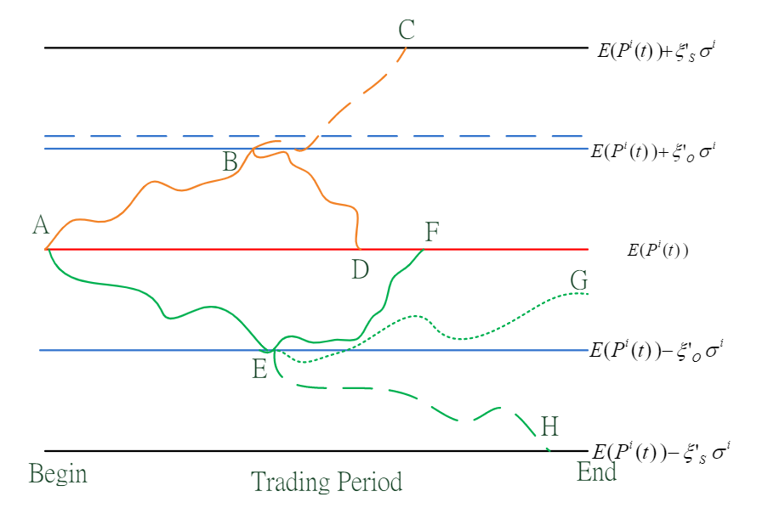
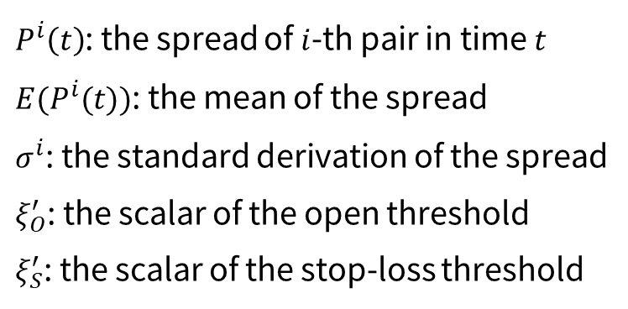
Literature Review - Statistical arbitrage PTS
$P^{i}\left(t\right)$: the spread of $i$-th pair in time $t$
$E(P^{i}(t))$: the mean of the spread
$σ^{i}$: the standard derivation of the spread
$ξ_{O}^{′}$: the scalar of the open threshold
$ξ_{S}^{′}$: the scalar of the stop-loss threshold
Figure 1: Possible Scenarios in the Trading Period

Slide 5
Literature Review - Reinforcement Learning
Fallahpour et al.[2]:
Enumerate 39 actions (i.e.,39 combinations of open and stop-loss thresholds).
Reduce the threshold selection problem to a multi-armed bandit problem solved using a single-state RL model.
Kim and Kim[3]:
Heuristically set 6 overly simplistic actions.
Use a deep Q-network(DQN), which outperforms Fallahpour et al.[2]'s model.
Train each PTS-eligible stock pair with a DQN, which necessitates a large number of DQNs.
[2] S. Fallahpour, H. Hakimian, K. Taheri, E. Ramezanifar, Pairs trading strategy optimization using the reinforcement learning method: a cointegration approach, Soft Computing 20 (2016) 5051–50
[3] T. Kim, H. Y. Kim, Optimizing the pairs-trading strategy using deep reinforcement learning with trading and stop-loss boundaries, Complexity 2019(2019) 1–20

Slide 6
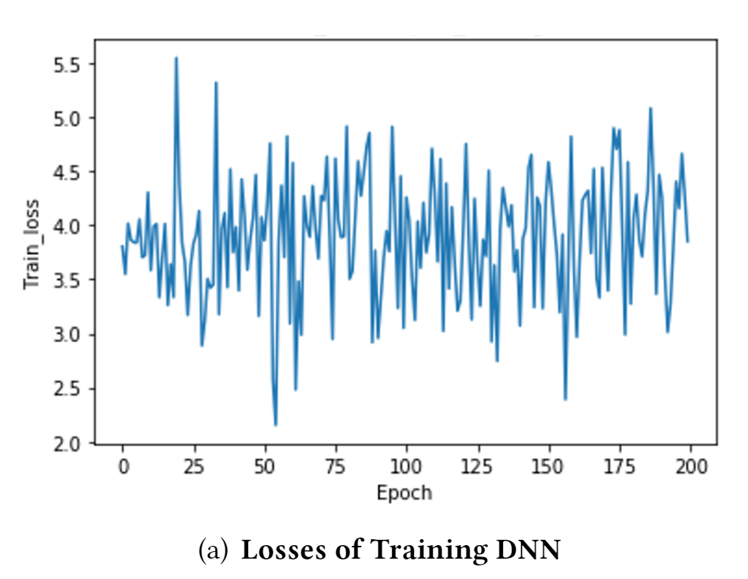
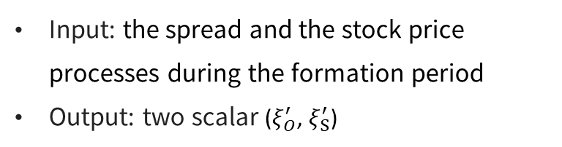

Failure of Naive Regression-based Deep Learning
Both open and stop-loss thresholds are positive real numbers.
predict ($ξ_{O}^{′}$, $ξ_{S}^{′}$) by adopting a regression-based deep neural network (RDNN) directly.
The training loss does not converge as training proceeds, which shows that RDNN does not capture discontinuous relationships.
Input: the spread and the stock price processes during the formation period
Output: two scalar ($ξ_{O}^{′}$, $ξ_{S}^{′}$)

Slide 7
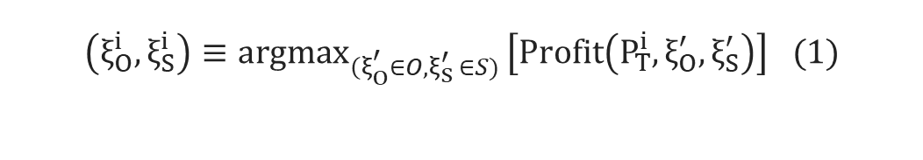
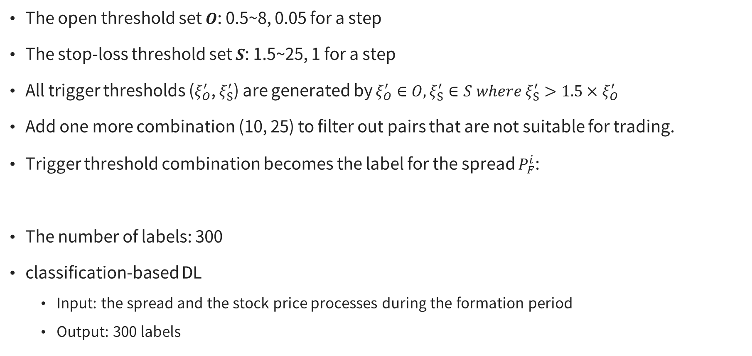
Labeling: Finding the Optimal Trigger Pair
The open threshold set $O$: 0.5~8, 0.05 for a step
The stop-loss threshold set $S$: 1.5~25, 1 for a step
All trigger thresholds ($ξ_{O}^{′}$, $ξ_{S}^{′}$) are generated by $ξ_{O}^{′}∈O, ξ_{S}^{′}∈S where {ξ_{S}^{′}>1.5×ξ}_{O}^{′}$
Add one more combination (10, 25) to filter out pairs that are not suitable for trading.
Trigger threshold combination becomes the label for the spread $P_{F}^{i}$:
The number of labels: 300
classification-based DL
Input: the spread and the stock price processes during the formation period
Output: 300 labels
$$\left(ξ_{O}^{i},ξ_{S}^{i}\right)≡{argmax}_{{\left(ξ\right.}_{O}^{′}∈O, ξ_{S }^{′}∈S) }\left[Profit\left(P_{T}^{i},ξ_{O}^{′},ξ_{S}^{′}\right)\right] (1)$$

Slide 8
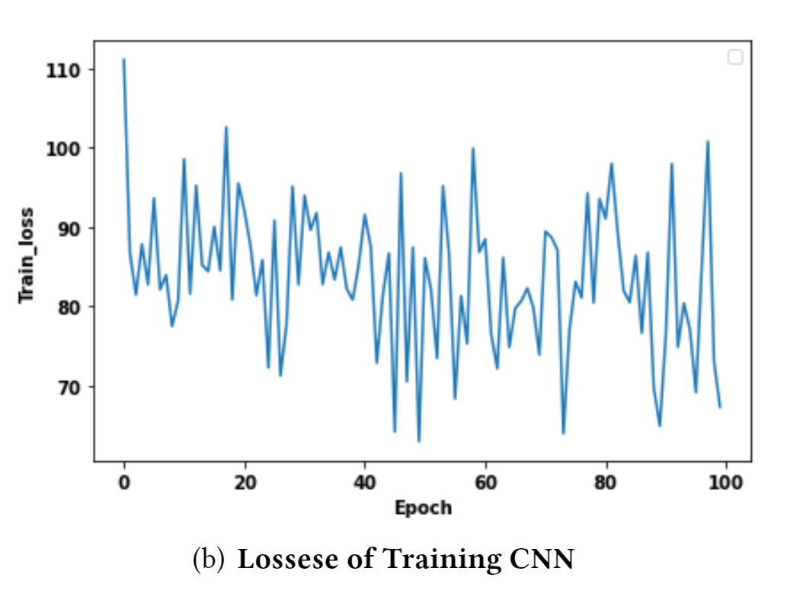
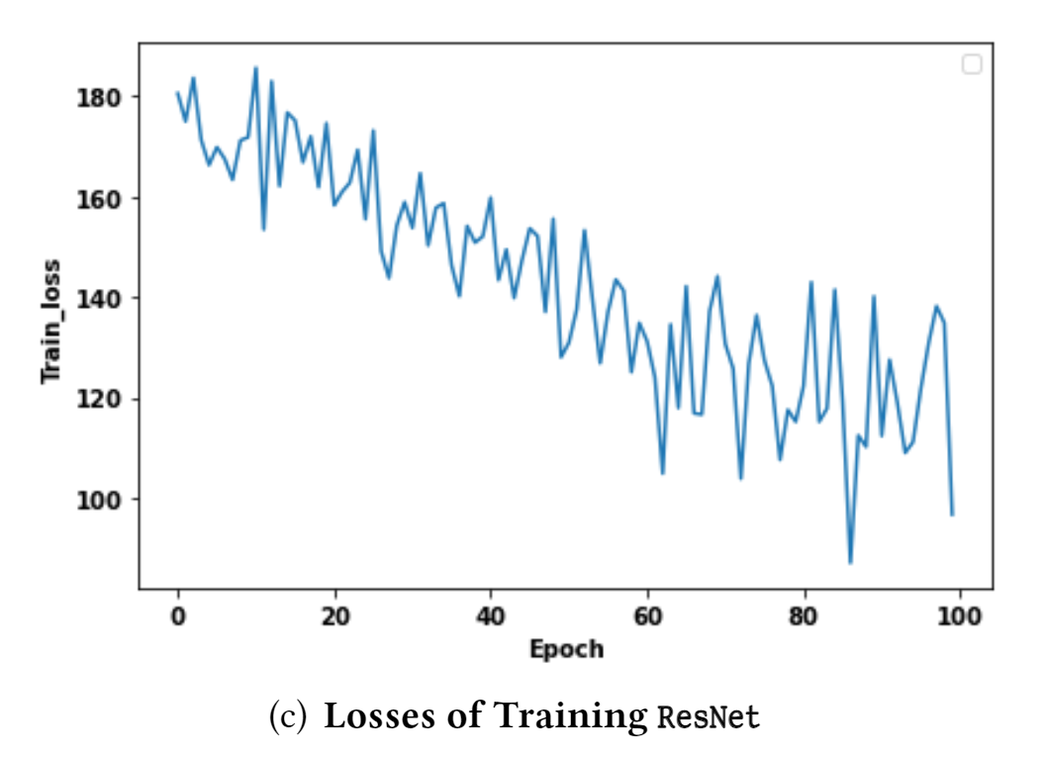
Failure of Classification-based Deep Learning
The CNN training loss fails to converge, and that of ResNet converges only very slowly.
It is difficult to train a reliable CNN or ResNet to recommend each stock pair with one of 300 possible labels.

Slide 9
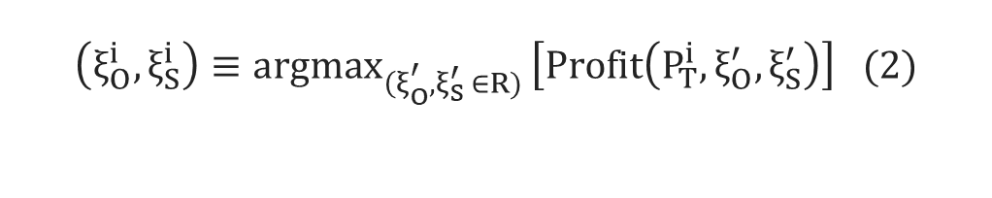
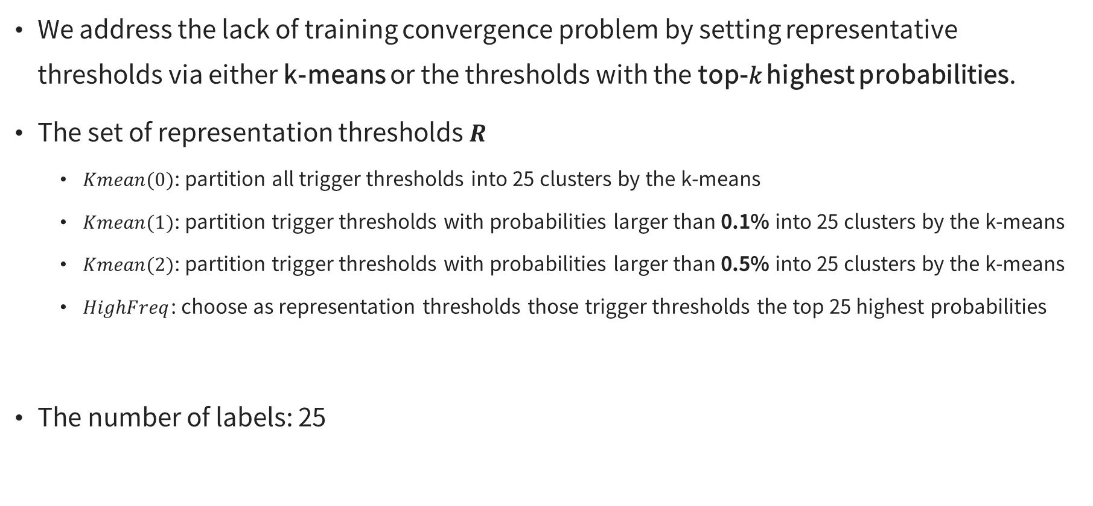
Representation labelling
We address the lack of training convergence problem by setting representative thresholds via either k-means or the thresholds with the top-𝑘 highest probabilities.
The set of representation thresholds $R$
$Kmean(0)$: partition all trigger thresholds into 25 clusters by the k-means
$Kmean(1)$: partition trigger thresholds with probabilities larger than 0.1% into 25 clusters by the k-means
$Kmean(2)$: partition trigger thresholds with probabilities larger than 0.5% into 25 clusters by the k-means
$HighFreq$: choose as representation thresholds those trigger thresholds the top 25 highest probabilities
The number of labels: 25
$$\left(ξ_{O}^{i},ξ_{S}^{i}\right)≡{argmax}_{{\left(ξ\right.}_{O}^{′}, ξ_{S }^{′}∈R) }\left[Profit\left(P_{T}^{i},ξ_{O}^{′},ξ_{S}^{′}\right)\right] (2)$$

Slide 10
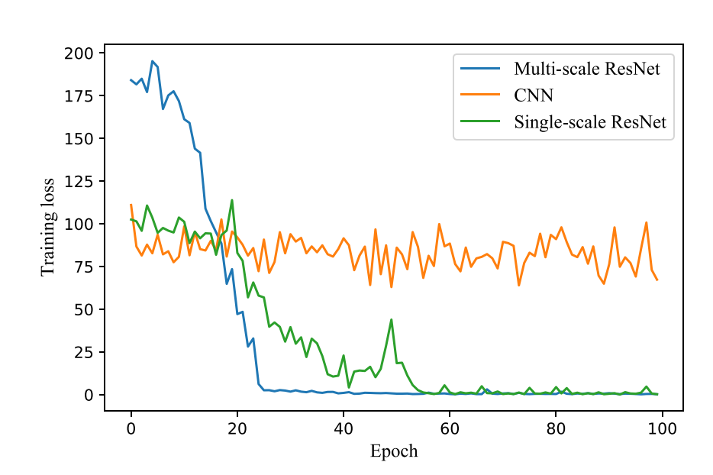
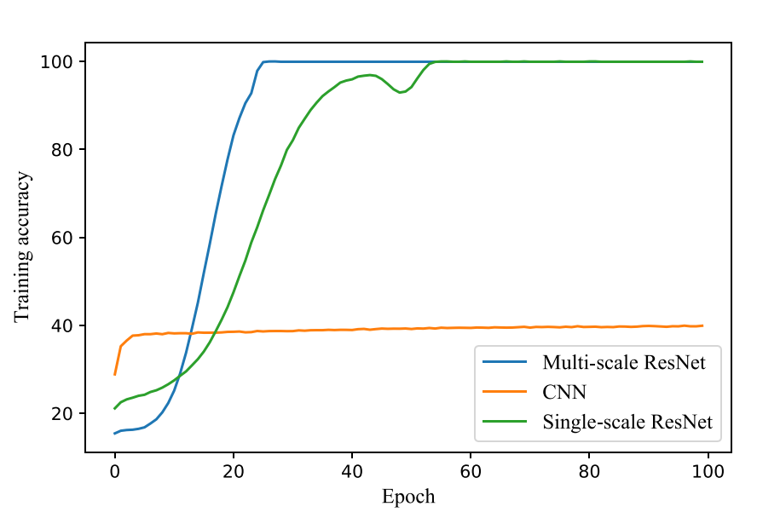
Representation labelling
After doing representation labelling, the Multi-scale ResNet mechanism converges more smoothly and quickly.

Slide 11
Dataset, Preprocessing, Model Construction
The constituent stocks of Taiwan Top 50 ETF (0050)
from January 1, 2013 to December 31, 2018
We adopt a day-trading strategy without holding positions overnight, as day trades provide 50% discounts on transaction costs.
we compare the investment performance of several deep learning models(CNN, single-scale ResNet, multi-scale ResNet)

Slide 12
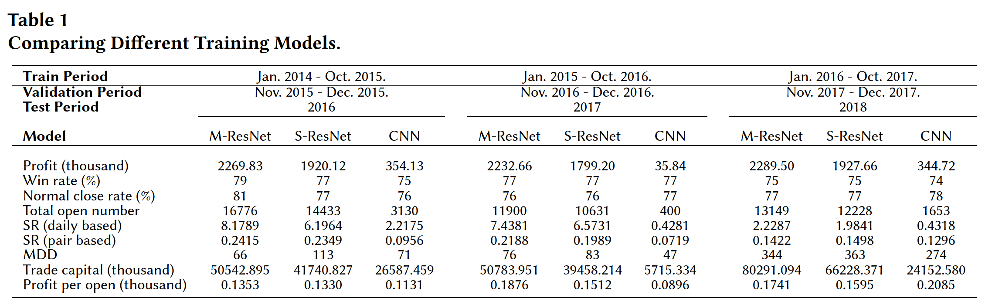
Empirical Tests
Table 1 compares the performance when training with CNN, the single-scale ResNet, and the multi-scale ResNet. The unstable, slow convergence of CNN clearly yields poor results.
Multi-scale ResNet outperforms single-scale ResNet. Accordingly, in subsequent experiments we use the multi-scale ResNet as the training model.

Slide 13
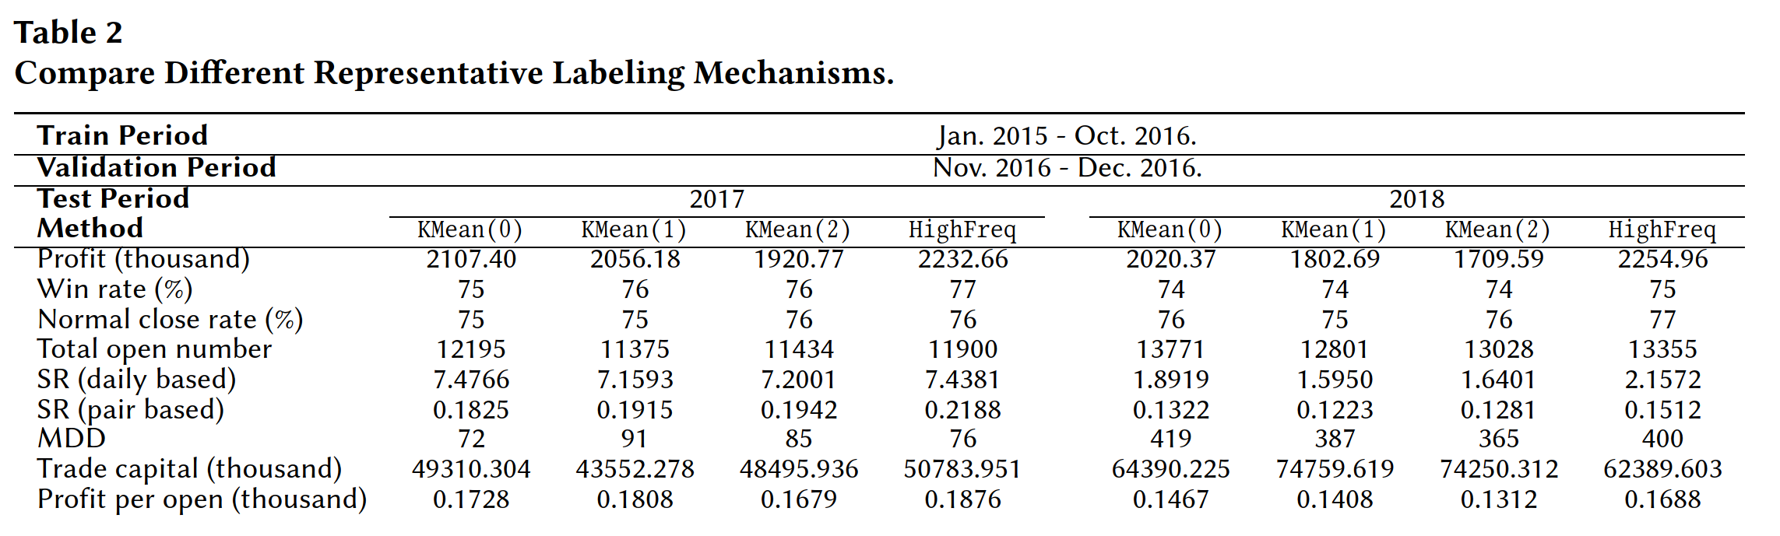

Empirical Tests
The total open number for $KMean(0)$ is the highest of the four mechanisms as it does not exclude information from other trigger thresholds.
$HighFreq$ yields better pair-based results (i.e., SR (pair based) and profit per open) than other 𝑘-mean-based mechanisms.
Since $KMean(0)$ and $HighFreq$ possess advantages in different aspects, subsequent experiments use either $KMean(0)$or $HighFreq$ for comparison.

Slide 14
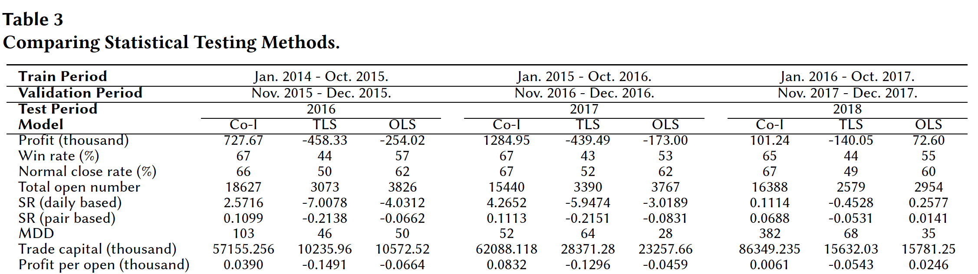
Empirical Tests
Kim and Kim [3] propose the ordinary least squares (OLS) and total least squares (TLS) methods.
The win rate and normal close rate of TLS and OLS are relatively low and the overall profits from 2016 to 2018 and the average profit (for each trade) are nearly all negative.
To fairly compare all ML/RL methods, for subsequent experiments we used the co-integrated method.

Slide 15
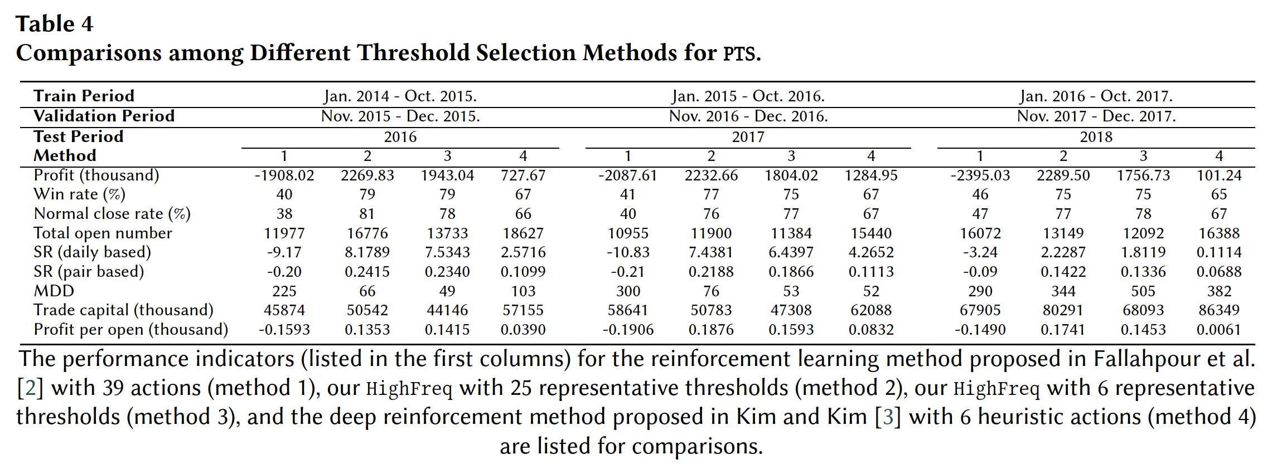

Empirical Tests
$HighFreq$ outperforms other methods in almost every aspect.
Increasing the number of representative thresholds from 6 to 25 increases both the win rate and the total open number, and also improves profit and SR, and reduces risk.
In addition, the naive RL model proposed by Fallahpour et al. [2] performs poorly with a win rate lower than 50% and negative profits. Their model fails to find proper thresholds to filter out unprofitable trades due to transaction costs.
Our proposed representative threshold mechanism outperforms other relevant work.

Slide 16
Conclusions
To improve PTS investment performance, we adopt a supervised learning paradigm to recommend feasible opening and stop-loss triggers that differ greatly from existing RL-based approaches.
To avoid the failure in regression-based DL and a huge number of labels in classification-based DL, we relabel each spread process with our proposed representative labeling mechanism.
Experimental results show that our proposed approach outperforms other existing approaches in terms of investment performance measures.

Slide 17
Thanks for listening !
If you have any question, feel free to contact us.
allenlike20@gmail.com
cameldai@mail.nctu.edu.tw
destiny10191019.cs05@nctu.edu.tw

