Slide 1
3.4 Quadratic Variation

Slide 2
3.4.1 First-Order Variation
3.4.2 Quadratic Variation
3.4.3 Volatility of Geometric Brownian Motion

Slide 3
3.4.1 First-Order Variation
We wish to compute the amount of up and down oscillation undergone by this function between times 0 and T, with the down moves adding to rather than subtracting from the up moves.

Slide 4
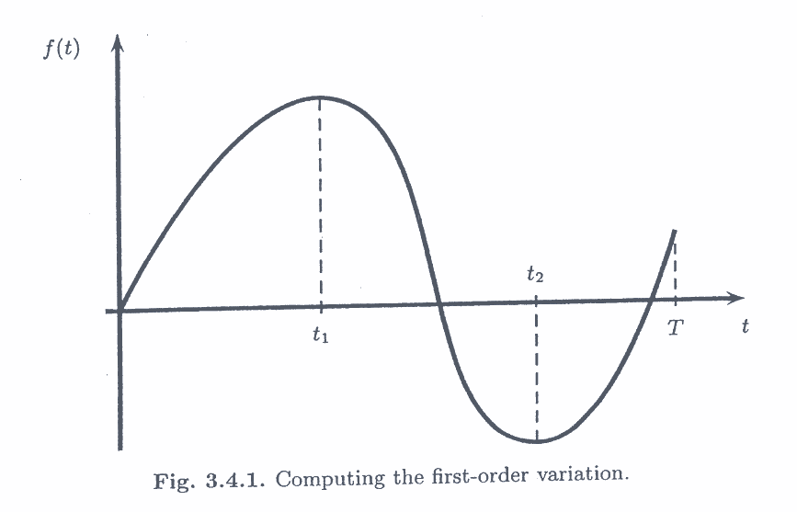

Slide 5
One example

Slide 9
Our first task is to verify that the definition (3.4.3) is consistent with the formula (3.4.2) for the function shown in Figure 3.4.1.
To do this, we use the Mean value Theorem, which applies to any function whose derivative is defined everywhere.

Slide 10
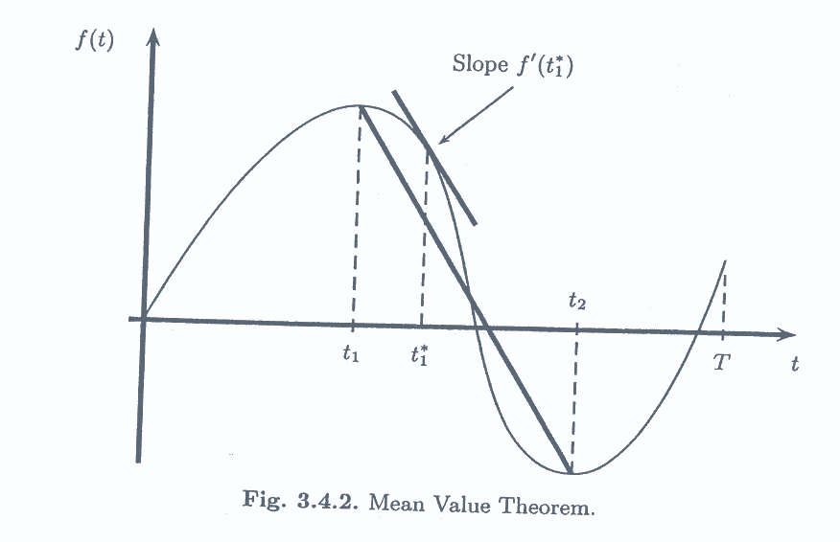

Slide 14
3.4.2 Quadratic Variation

Slide 16
Why f’(t) should be continuous? See word file.

Slide 17
Most functions have continuous derivatives, and hence their quadratic variation are zero. For this reason, one never consider quadratic variation in ordinary calculus.
The paths of Brownian motion, on the other hand, cannot be differentiated with respect to the time variable.

Slide 18
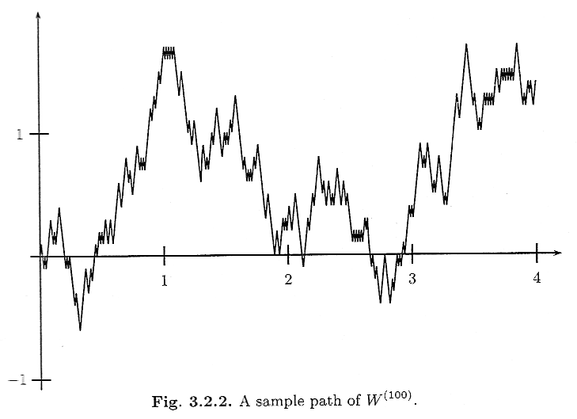

Slide 19
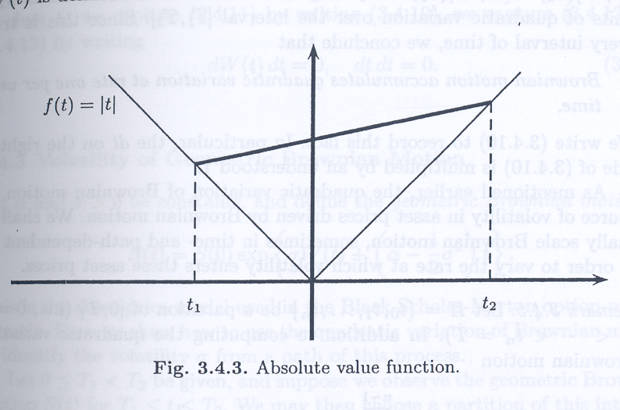

Slide 20
continuous derivative
[f,f](T)=0
[f,f](T)=0
ex: |t|
not continuous derivative
[f,f](T) 0
ex:布朗運動

Slide 22
We must show that this sampled quadratic variation, which is a random variable converges to T as
We shall show that it has expected value T, and its variance converges to zero. Hence, it converges to its expected value T, regardless of the path along which we are doing the computation.

Slide 23
The sampled quadratic variation is the sum of independence random variables. Therefore, its mean and variance are the sums of the means and variances of these random variables. We have

Slide 26
Remark 3.4.4. In the proof above, we derived (3.4.6) and (3.4.7):

Slide 33
The statement is that on an interval [0,T], Brownian motion accumulates T units of quadratic variation.
Brownian motion accumulates quadratic variation at rate one per unit time.
In particular, the dt on the right-hand side of
is multiplied by an understood 1.

Slide 39
3.4.3 Volatility of Geometric Brownian Motion

