Slide 1
4.4 Ito-Doeblin Formula

Slide 2
Definition 4.4.3
Let W(t), t≥0, be a Brownian motion, and let F(t), t≥0, be an associated filtration. An Itô process is a stochastic process of the form
(4.4.16)
Where X(0) is nonrandom and Δ(u) andΘ(u) are adapted stochastic processes.
We assume that and are finite for every t>0 so that the integrals on the right-hand side of (4.4.16) are defined and the Itô integral is a martingale.

Slide 3
Lemma 4.4.4
The quadratic variation of the Itô process (4.4.16) is
(4.4.17)

Slide 4
Lemma 4.4.4
We introduce the notation
Both these processes are continuous in their upper limit of integration t.
To determine the quadratic variation of X on [0,t], we choose a partition ∏={t₀,t₁,…,t_{n}} of [0,t] (i.e, 0=t₀<t₁<…<t_{n}=t) and we write the sampled quadratic variation

Slide 5
Lemma 4.4.4
As ||∏||→0, the first term on the right-hand side, converge to the quadratic variation of I on [0,t], which according to Theorem 4.3.1(vi) is

Slide 6
Lemma 4.4.4
The absolute value of the second term is bounded above by
As ||∏||→0, this has limit because R(t) is continuous.

Slide 7
Lemma 4.4.4
The absolute value of third term is bounded above by
And this has limit as ||∏||→0 because I(t) is continuous.
We conclude that

Slide 8
The conclusion of Lemma 4.4.4 is most easily remembered by first writing (4.4.16) in the differential notation
(4.4.18)
And then using the differential multiplication table to compute

Slide 9
This says that, at each time t, the process X is accumulating quadratic variation at rate Δ²(t) per unit time, and hence the total quadratic variation accumulated on the time interval [0,t] is
This quadratic variation is solely due to the quadratic variation of the Itô integral
The ordinary integral has zero quadratic variation and thus contributes nothing to the quadratic variation of X.

Slide 10
So far we have discussed integrals with respect to time, such as appearing in (4.4.16) and Itô integrals (integrals with respect to Brownian motion) such as also appearing in (4.4.16).

Slide 11
In addition, we shall need integrals with respect to Itô process (i.e., integrals of the form where Γ is some adapted process).
We define such an integral by separating dX(t) into a dW(t) term and a dt term as in (4.4.18).

Slide 12
Def 4.4.5 Let , , be an Ito process as described in Definition 4.4.3, and let , , be an adapted process. We define the integral with respect to an Ito process (We assume that and are finite for every so that the integrals on the right-hand side of (4.4.20) are defined.)
Notes:
4.4.3

Slide 13
Thm 4.4.6 (Ito-Doeblin formula for an Ito process). Let , , be an Ito process as described in Definition 4.4.3, and let be a function for which the partial derivatives , , and are defined and continuous. Then, for every ,

Slide 14
We again work through the sketch of the proof of Theorem 4.4.1, but with the Ito process replacing the Brownian motion . In place of (4.4.9), we now have

Slide 15
Remark 4.4.7(Summary of stochastic calculus). Every term on the right-hand side has a solid definition and in the end the right-hand side reduces to a sum of a nonrandom quantity , three ordinary(Lebesgue) integrals with respect to time, and a Ito integral.

Slide 16
4.4.3 Examples
Example 4.4.8(Generalized geometric Brownian motion) Let , , be a Brownian motion, let , , be an associated filtration, and let and be adapted processes. Define Ito process

Slide 18
Consider an asset price process given by
Where S(0) is nonrandom and positive. We may write
,where , , and
. According to the Ito-Doeblin formula

Slide 19
In the case ,
is a martinglae,
and hence (in the case )
is a martingale.

Slide 20
Thm 4.4.9(Ito integral of a deterministic integrand). Let , , be a Brownian motion, and let be a nonrandom function of time. Define . For each , the random variable is normally distributed with expected value zero and variance .

Slide 21
Proof Thm 4.4.9 1.determine the mean and variance of . Since is a martingale and , we must have . Ito’s isometry implies that 2.show that is normally distributed.

Slide 22
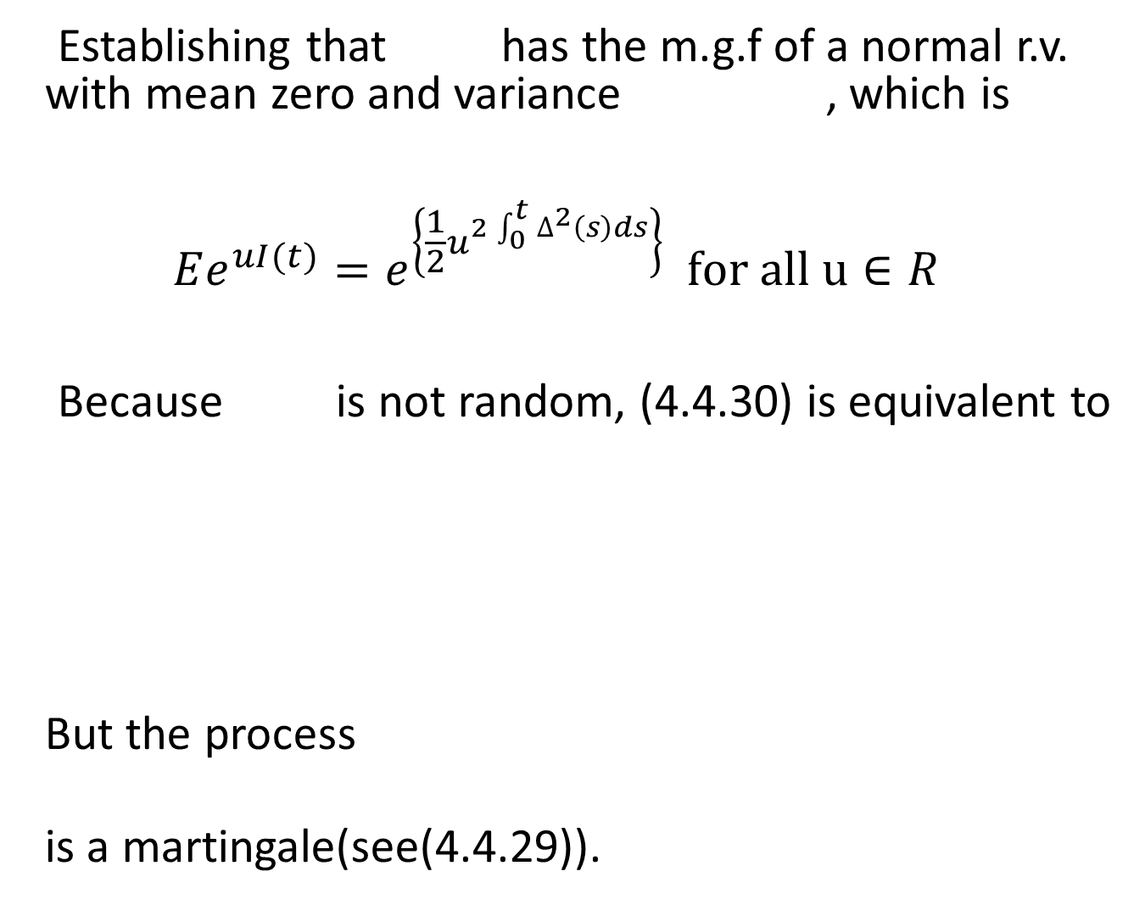
Establishing that has the m.g.f of a normal r.v. with mean zero and variance , which is $$Ee^{uI(t)}=e^{\left\{\frac{1}{2}u^{2\int_{0}^{t}{∆^{2}\left(s\right)ds}}\right\}} for all u∈R$$
Because is not random, (4.4.30) is equivalent to But the process
is a martingale(see(4.4.29)).

Slide 23
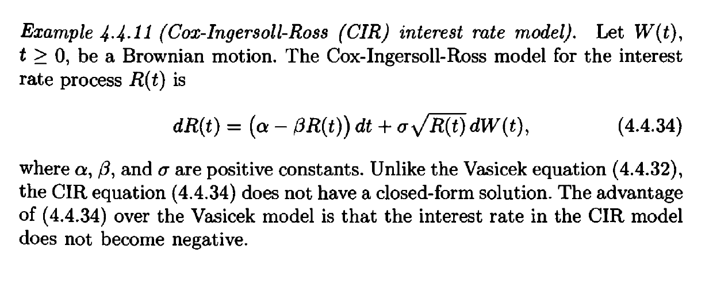

Slide 24
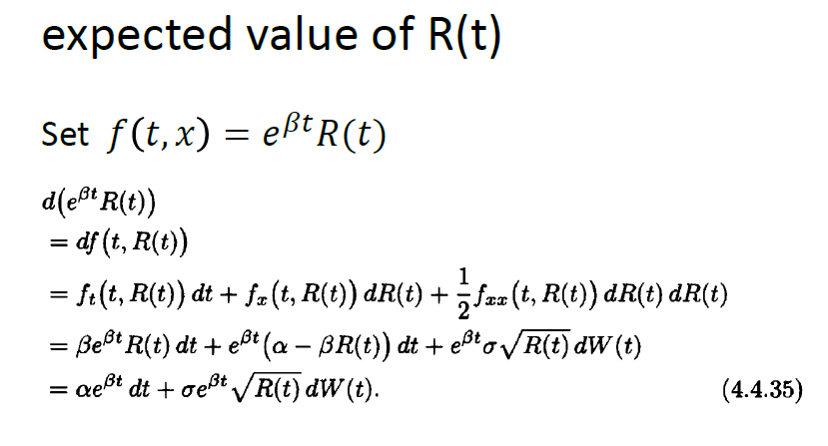

Slide 25

為什麼要令$f\left(t,x\right)=e^{βt}R(t)$?
因為如果R(t)對t作積分時我們不會計算$E\int_{0}^{t}{g(u)R\left(u\right)du}$
而若我們令$f\left(t,x\right)=e^{βt}R(t)$
在使用Ito-Doeblin formula計算時dt項裡的R(t)將會被消掉

Slide 27
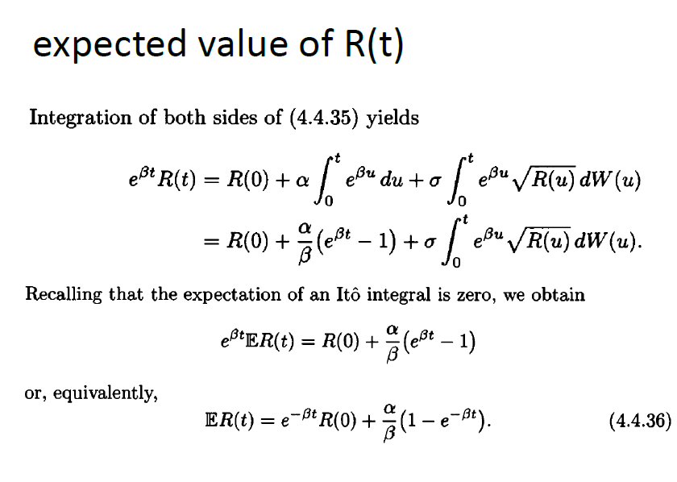

Slide 28
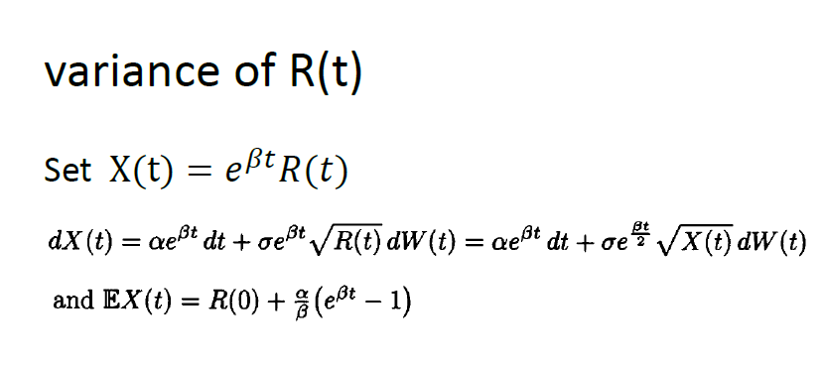




Slide 29
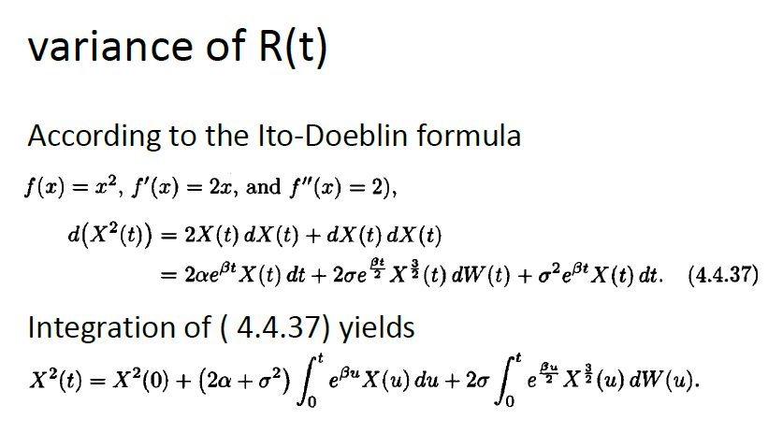



Slide 30
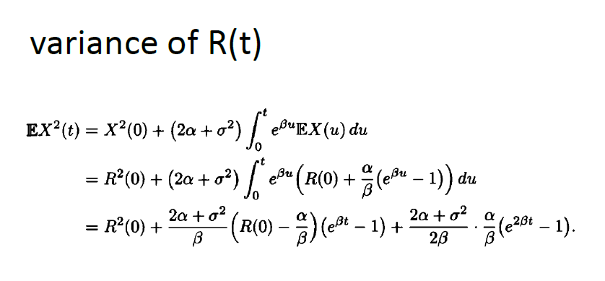


Slide 31
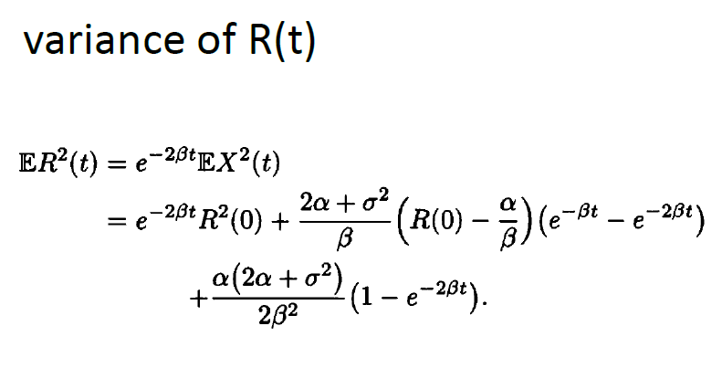

Slide 32
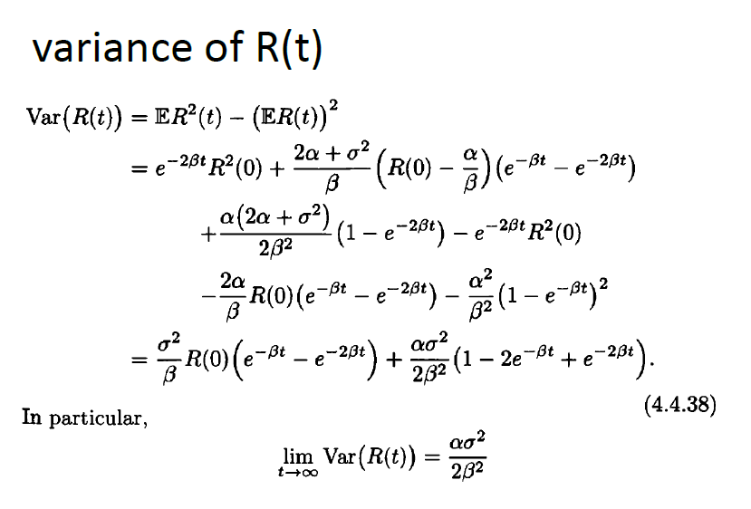

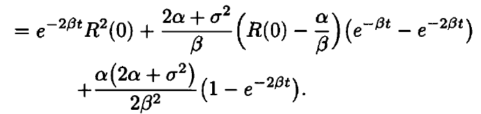

a

Slide 33
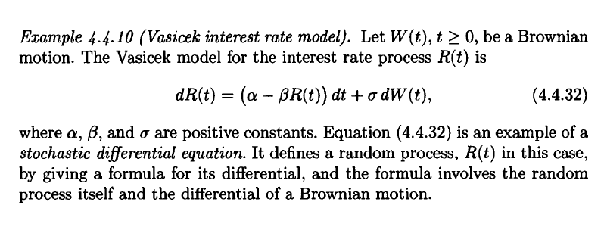
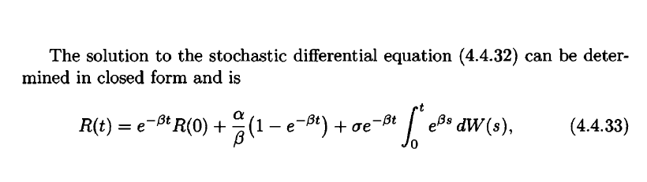

Slide 34
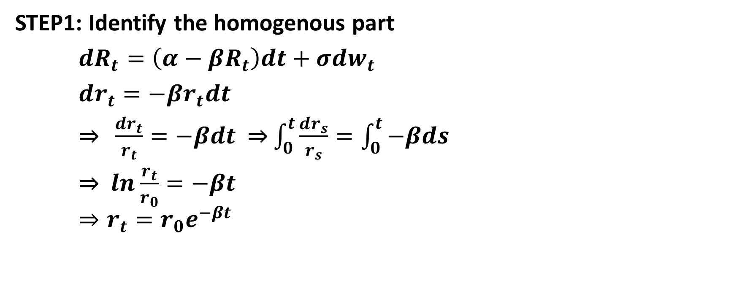
How to solve SDE?
STEP1: Identify the homogenous part
${dR}_{t}=\left(α−βR_{t}\right)dt+σdw_{t}$
$dr_{t}=−βr_{t}dt$
⇒ $\frac{dr_{t}}{r_{t}}=−βdt$ ⇒ $\int_{0}^{t}{\frac{dr_{s}}{r_{s}}=\int_{0}^{t}{−βds}}$
⇒ $ln\frac{r_{t}}{r_{0}}=−βt$ $⇒r_{t}=r_{0}e^{−βt}$

Slide 35

STEP2:Integrating factor and auxiliary function
integrating factor is $q_{t}=\frac{r_{0}}{r_{t}}=e^{βt}$
auxiliary function $Y_{t}=q_{t}R_{t}=R_{t}e^{βt}$

Slide 36
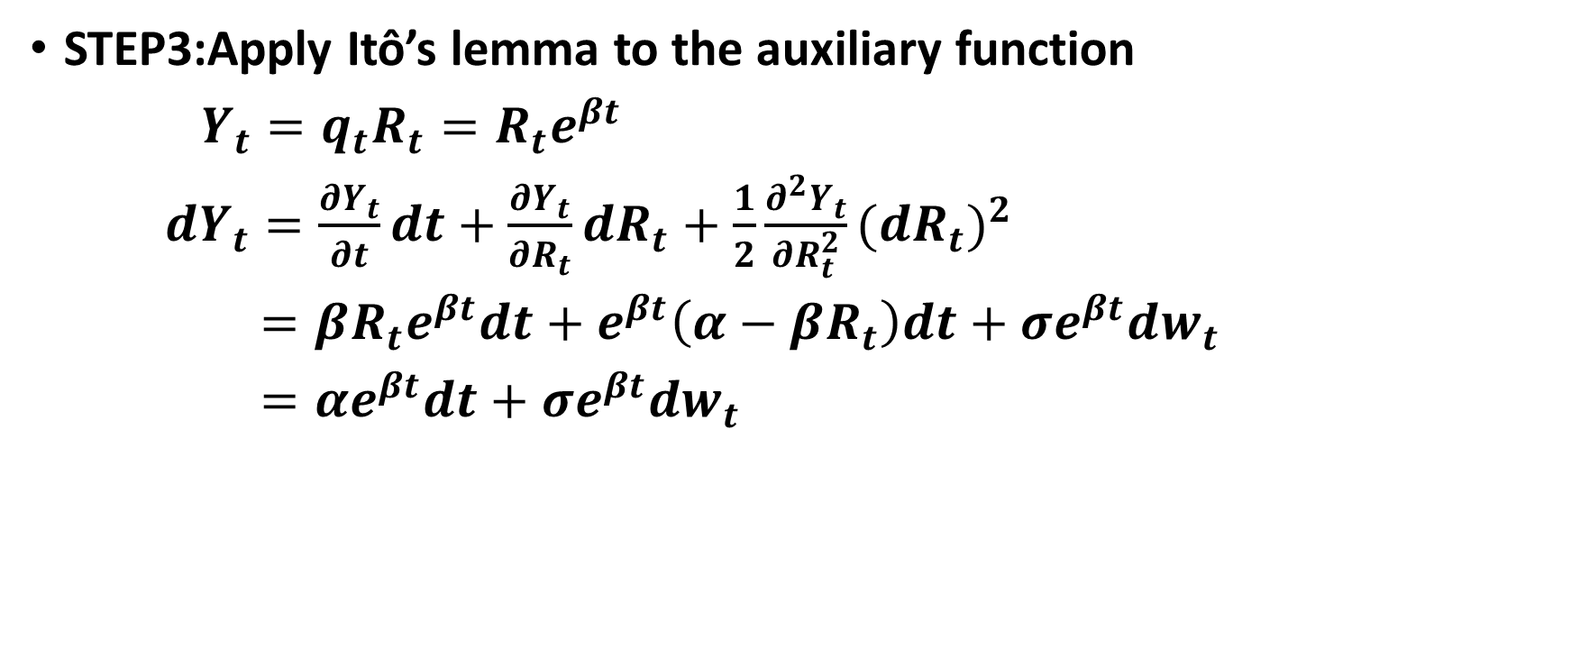
STEP3:Apply Itô’s lemma to the auxiliary function
$Y_{t}=q_{t}R_{t}=R_{t}e^{βt}$
$dY_{t}=\frac{∂Y_{t}}{∂t}dt+\frac{∂Y_{t}}{∂R_{t}}dR_{t}+\frac{1}{2}\frac{∂^{2}Y_{t}}{∂R_{t}^{2}}{(dR_{t})}^{2}$
$=βR_{t}e^{βt}dt+e^{βt}\left(α−βR_{t}\right)dt+σe^{βt}dw_{t}$
$=αe^{βt}dt+σe^{βt}dw_{t}$

Slide 37
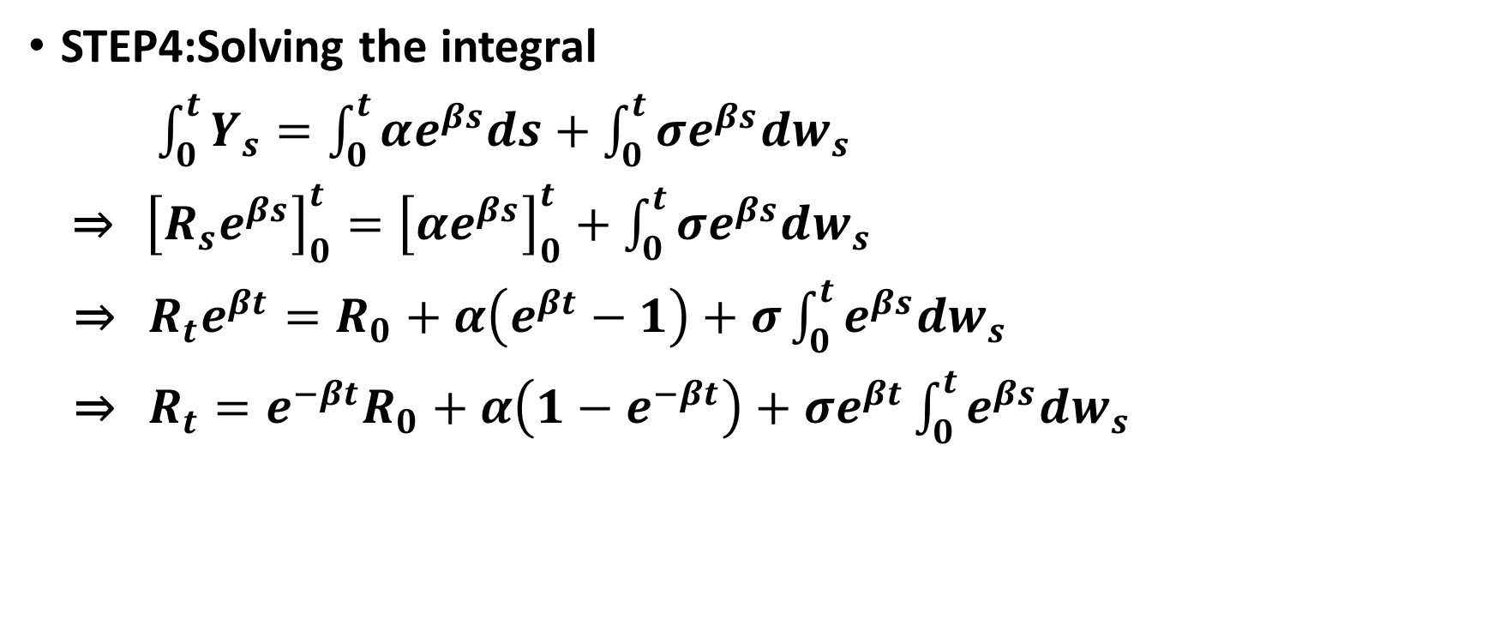
STEP4:Solving the integral
$\int_{0}^{t}{Y_{s}=\int_{0}^{t}{αe^{βs}ds}+\int_{0}^{t}{σe^{βs}dw_{s}}}$
⇒ ${\left[R_{s}e^{βs}\right]}_{0}^{t}={\left[αe^{βs}\right]}_{0}^{t}+\int_{0}^{t}{σe^{βs}dw_{s}}$
⇒ $R_{t}e^{βt}=R_{0}+α\left(e^{βt}−1\right)+σ\int_{0}^{t}{e^{βs}dw_{s}}$
⇒ $R_{t}=e^{−βt}R_{0}+α\left(1−e^{−βt}\right)+σe^{βt}\int_{0}^{t}{e^{βs}dw_{s}}$

