Slide 1
5.2 Risk-Neutral Measure
0653947 朱昭憲

Slide 2
5.2.1 Girsanov’s Theorem for a single Brownian Motion
How to construct the risk-neutral measure in a model with a single underlying security. This step relies on Girsanov’s Theorem. Risk-neutral pricing is a powerful method for computing prices of derivative security.
Notes:
我們利用Girsanov’s theorem 去建構一個利用風險中立測度去評價單一標的資產選擇權的模型。

Slide 3
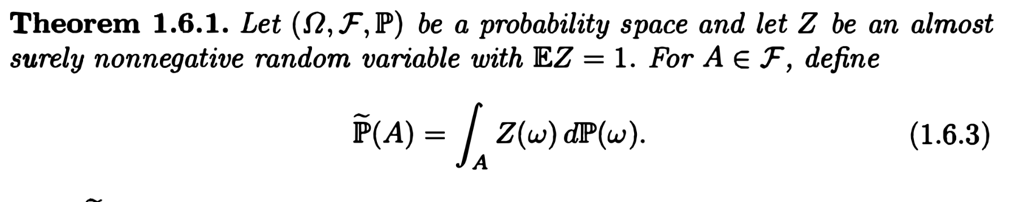
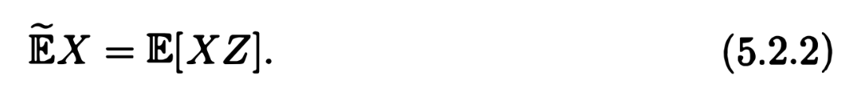
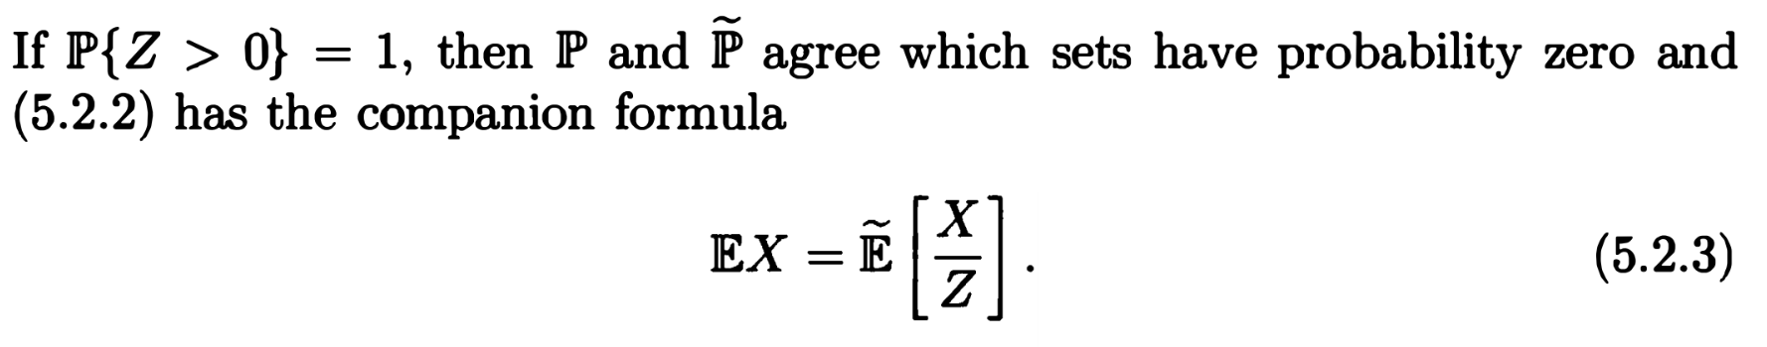
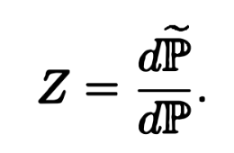
5.2.1 Girsanov’s Theorem for a single Brownian Motion
Review chapter 1.6 (change measure):
Any random variable x has two expectation:
Z is the
Notes:
在風險中立測度下Ａ的機率
Z is like the ratio of these two probability measure.

Slide 4
5.2.1 Girsanov’s Theorem for a single Brownian Motion
In the case of a finite probability model:
If we multiply both side of (5.2.4) by and then sum over in a set A, we obtain
In a general probability, we cannot write (5.2.4) because is typically zero for each individual .
Notes:
機率集合是有限且離散的。

Slide 5
5.2.1 Girsanov’s Theorem for a single Brownian Motion
Suppose further that Z is an almost surely positive random variable satisfying E[Z]=1, and we define by (5.2.1). We can then define the
The (5.2.6) is a martingale because of iterated conditioning (Theorem2.3.2(iii)): for,

Slide 6
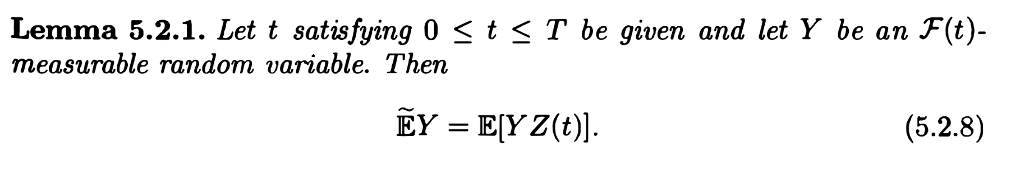
5.2.1 Girsanov’s Theorem for a single Brownian Motion
Proof:

Slide 7
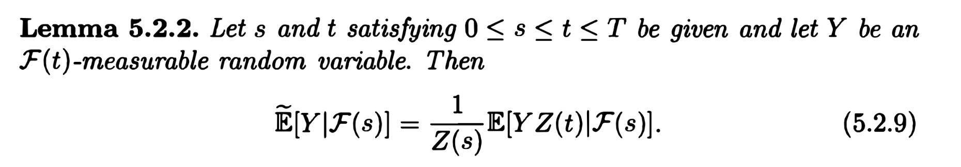
5.2.1 Girsanov’s Theorem for a single Brownian Motion
Proof:
We must check the partial-averaging property:

Slide 8
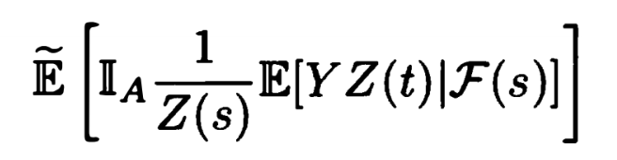
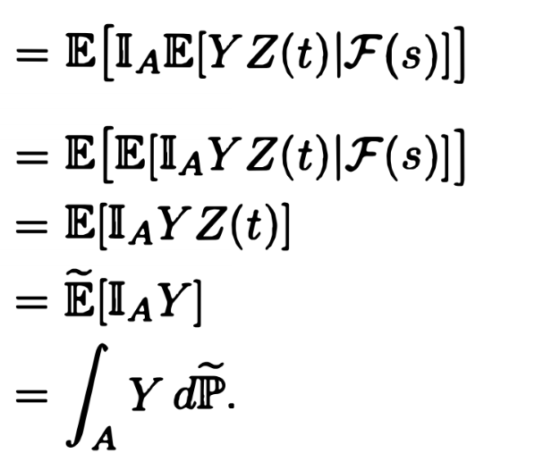
5.2.1 Girsanov’s Theorem for a single Brownian Motion
(Lemma 5.2.1)
(雙重期望值原理)

Slide 9
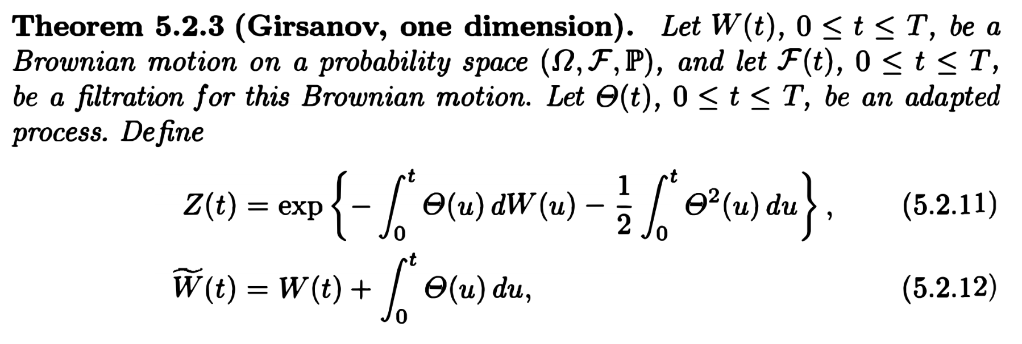
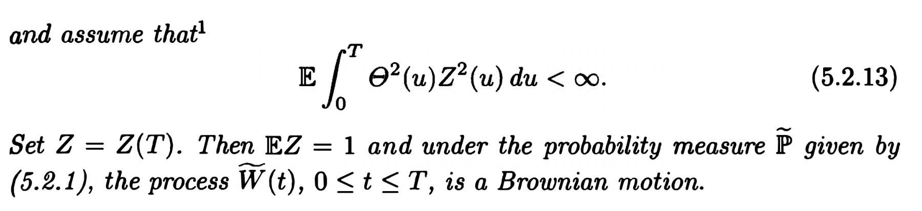
5.2.1 Girsanov’s Theorem for a single Brownian Motion
Notes:
反應目前已知資訊的process
Z(t) 須符合 非負 期望值為1 martingale
證明風險中立測度下的brownian motion 是 martingale的。

Slide 10
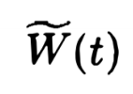
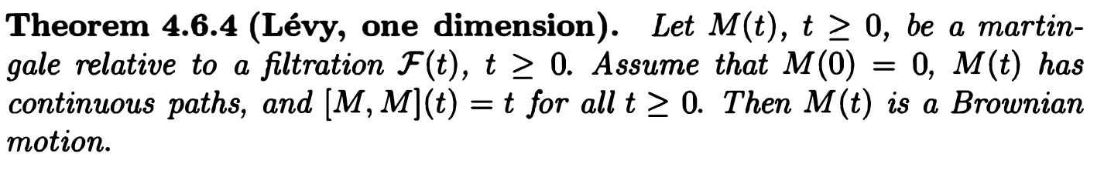
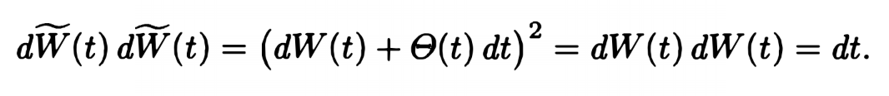
5.2.1 Girsanov’s Theorem for a single Brownian Motion
Proof:
is a Brownian motion:

Slide 11

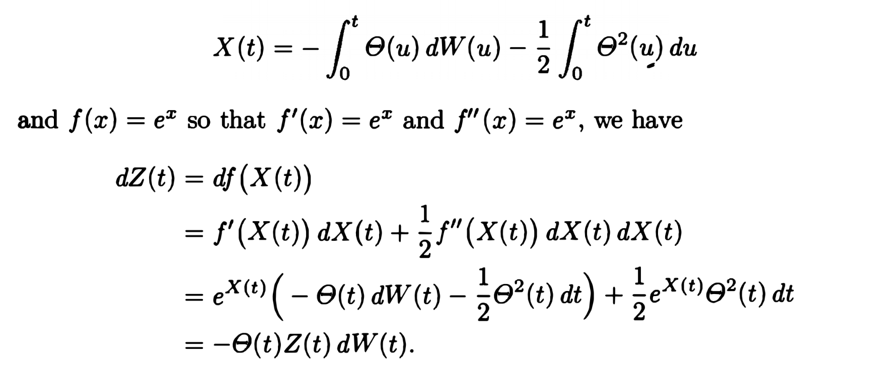

5.2.1 Girsanov’s Theorem for a single Brownian Motion
:
Step 1 : $z\left(t\right)$ is a martingale under :
No drift term → martingale

Slide 12

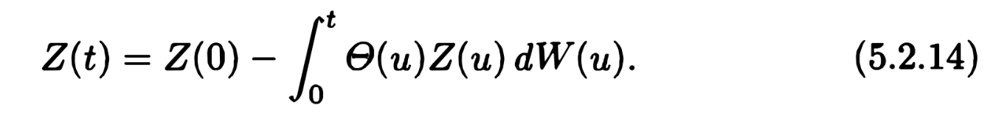
5.2.1 Girsanov’s Theorem for a single Brownian Motion
Z(t) is Ito’ integral → Z(t) is martingale
So ,EZ=EZ(T)=Z(0)=1.
Z(t) is martingale and Z=Z(T),we have
Z(t) is a

Slide 13

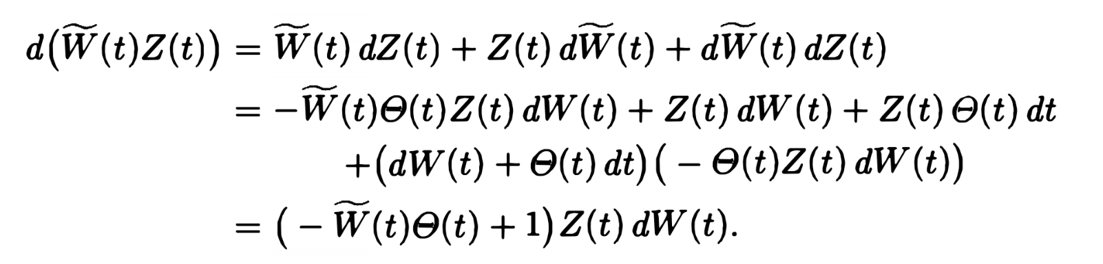
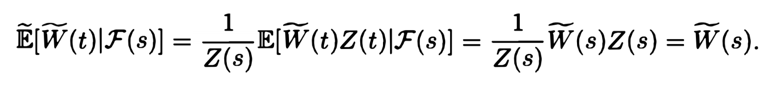
5.2.1 Girsanov’s Theorem for a single Brownian Motion
Step 2 :
(Ito’s product)
No drift term → martingale

