Slide 1
Testing Procedure for VECM model
學生：朱昭憲
指導教授：戴天時 教授

Slide 2
大綱
Estimate VECM parameter by Reduce Rank Regression
4 types 0f VECM model
Trace test simulation results
Selecting VECM model step by step

Slide 3
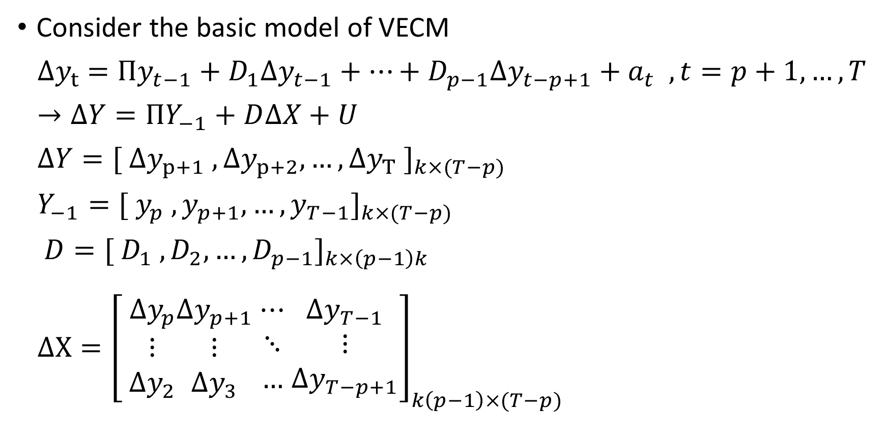
Estimate parameter by Reduce Rank Regression
Consider the basic model of VECM
${∆y}_{t}$ $={Πy}_{t−1}+D_{1}Δy_{t−1}+…+D_{p−1}Δy_{t−p+1}+a_{t} ,t=p+1,…,T$
$→∆Y=ΠY_{−1}+D∆X+U$
$∆Y={[ {∆y}_{p+1} ,{∆y}_{p+2},…,{∆y}_{T} ]}_{k×(T−p)}$
$Y_{−1}={[ y_{p} , y_{p+1},…,y_{T−1}]}_{k×(T−p)}$
$D={[ D_{1} , D_{2},…,D_{p−1}]}_{k×\left(p−1\right)k}$
$∆X={\left[ \begin{matrix}Δy_{p} \\ ⋮ \\ Δy_{2}\end{matrix}\begin{matrix}Δy_{p+1} \\ ⋮ \\ Δy_{3}\end{matrix}\begin{matrix} ⋯ \\ ⋱ \\ … \end{matrix}\begin{matrix}Δy_{T−1} \\ ⋮ \\ Δy_{T−p+1}\end{matrix}\right]}_{k\left(p−1\right)×(T−p)}$
Notes:
考慮一個無截距，無時間趨勢項的VECM模型
為了方便估計，把模型簡化

Slide 4
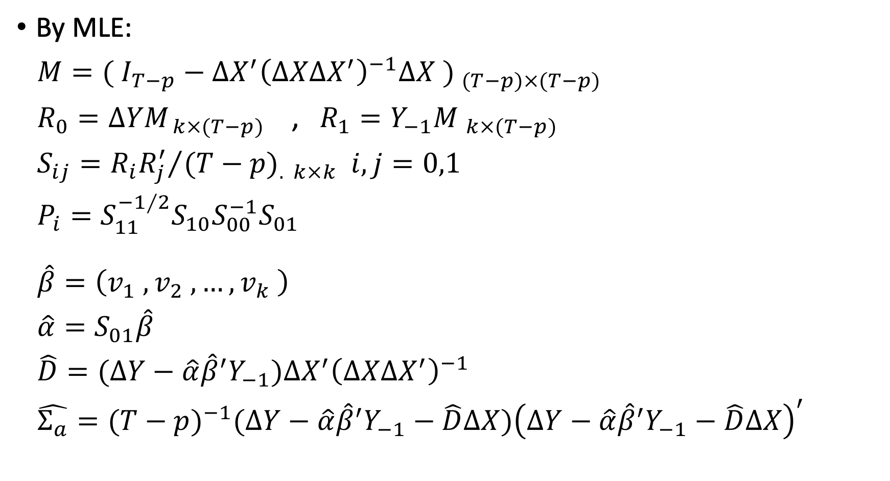

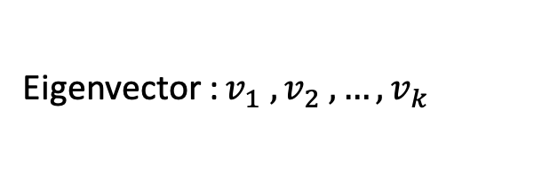
Estimate parameter by Reduce Rank Regression
By MLE:
$M=( {I_{T−p}−{∆X}^{′}{\left(∆X{∆X}^{′}\right)}^{−1}∆X ) }_{(T−p)×(T−p)}$
$R_{0}={∆YM}_{ k×(T−p)}$ , $R_{1}={Y_{−1}M }_{k×(T−p)}$
$S_{ij}={{R_{i}R_{j}^{′}}/{(T}−p)}_{. k×k}$ $i,j=0,1$
$P_{i}=S_{11}^{−1∕2}S_{10}S_{00}^{−1}S_{01}$
$\hat{β}={\left(v_{1} , v_{2} ,…, v_{k} \right)}^{}$
$\hat{α}=S_{01}\hat{β}$
$\hat{D}=(∆Y−\hat{α}{\hat{β}}^{′}Y_{−1}){∆X}^{′}{\left(∆X{∆X}^{′}\right)}^{−1}$
$\hat{Σ_{a}}={(T−p)}^{−1}(∆Y−\hat{α}{\hat{β}}^{′}Y_{−1}−\hat{D}∆X){\left(∆Y−\hat{α}{\hat{β}}^{′}Y_{−1}−\hat{D}∆X\right)}^{′}$
Eigenvalue : $λ_{1}>λ_{2}>…>λ_{k}$
Eigenvector : $v_{1} , v_{2} ,…, v_{k}$

Slide 5
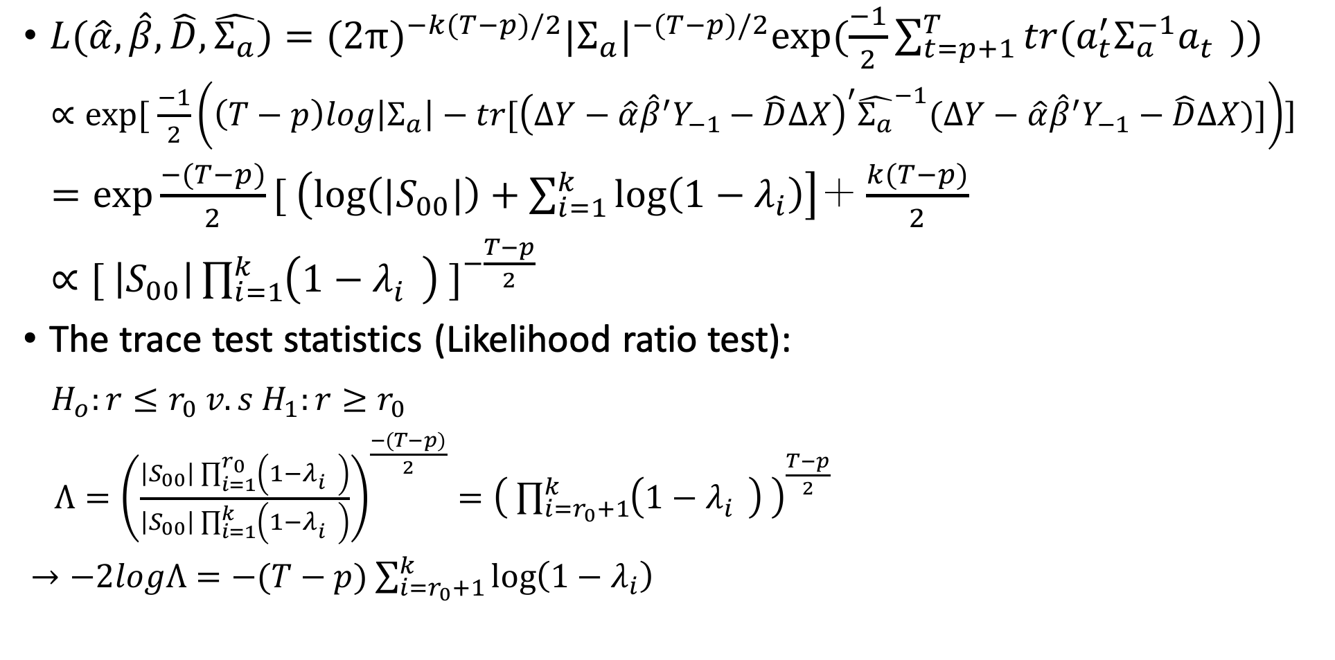
Estimate parameter by Reduce Rank Regression
$L(\hat{α},\hat{β},\hat{D},\hat{Σ_{a}})={(2π)}^{−k(T−p)/2}{|Σ_{a}|}^{−(T−p)/2}exp⁡(\frac{−1}{2}\sum_{t=p+1}^{T}{tr(a_{t}^{′}Σ_{a}^{−1}a_{t}^{}}))$
$∝exp⁡[ \frac{−1}{2}\left(\left(T−p\right)log\left|Σ_{a}\right|−tr[{\left(∆Y−\hat{α}{\hat{β}}^{′}Y_{−1}−\hat{D}∆X\right)}^{′}{\hat{Σ_{a}}}^{−1}(∆Y−\hat{α}{\hat{β}}^{′}Y_{−1}−\hat{D}∆X)]\right)]$
$=exp\frac{−(T−p)}{2}[ \left(log\left(|S_{00}|\right)+\sum_{i=1}^{k}{\log\left(1−λ_{i}\right)}\right]＋\frac{k(T−p)}{2}$
$∝{[ \left|S_{00}\right|\prod_{i=1}^{k}{\left(1−λ_{i}^{}\right)} ]}^{−\frac{T−p}{2}}$
The trace test statistics (Likelihood ratio test):
$H_{o}:r≤r_{0} v.s H_{1}:r≥r_{0}$
$Λ={\left(\frac{\left|S_{00}\right|\prod_{i=1}^{r_{0}}{\left(1−λ_{i}^{}\right)}}{\left|S_{00}\right|\prod_{i=1}^{k}{\left(1−λ_{i}^{}\right)}}\right)}^{\frac{−(T−p)}{2}}={\left( \prod_{i=r_{0}+1}^{k}{\left(1−λ_{i}^{}\right)} \right)}^{\frac{T−p}{2}}$
$→−2logΛ=−(T−p)$ $\sum_{i=r_{0}+1}^{k}{\log\left(1−λ_{i}\right)}$

Slide 6
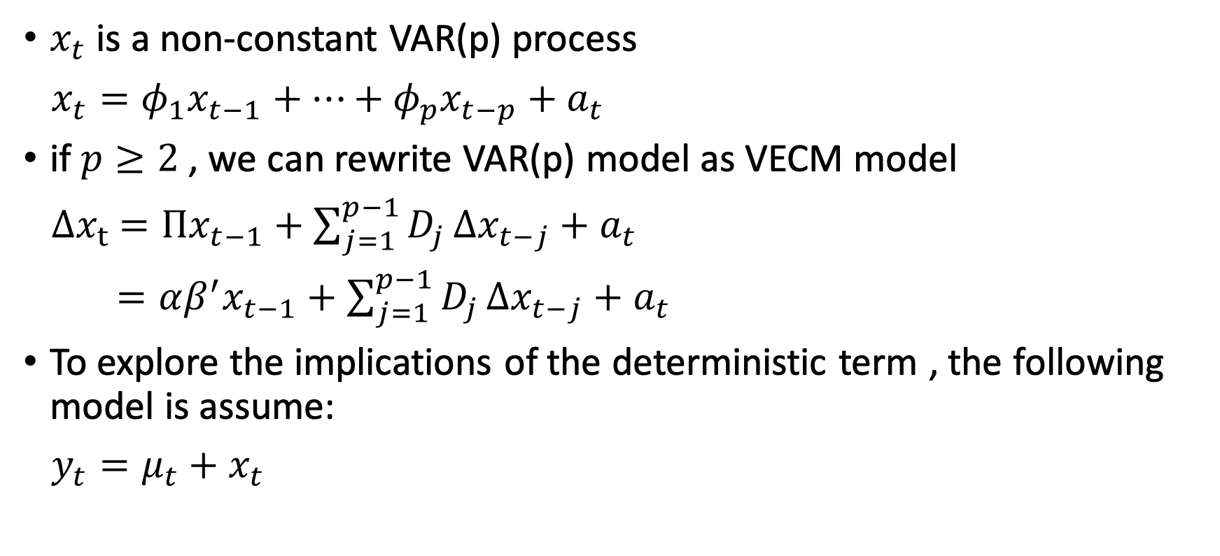
4 types of VECM model
$x_{t}$ is a non-constant VAR(p) process
$x_{t}=φ_{1}x_{t−1}+…+φ_{p}x_{t−p}+a_{t}$
if $p≥2$, we can rewrite VAR(p) model as VECM model
${∆x}_{t}$ $={Πx}_{t−1}+\sum_{j=1}^{p−1}{D_{j}}∆x_{t−j}+a_{t}$
$={αβ^{′}x}_{t−1}+\sum_{j=1}^{p−1}{D_{j}}∆x_{t−j}+a_{t}$
To explore the implications of the deterministic term , the following model is assume:
$y_{t}=μ_{t}+x_{t}$

Slide 7
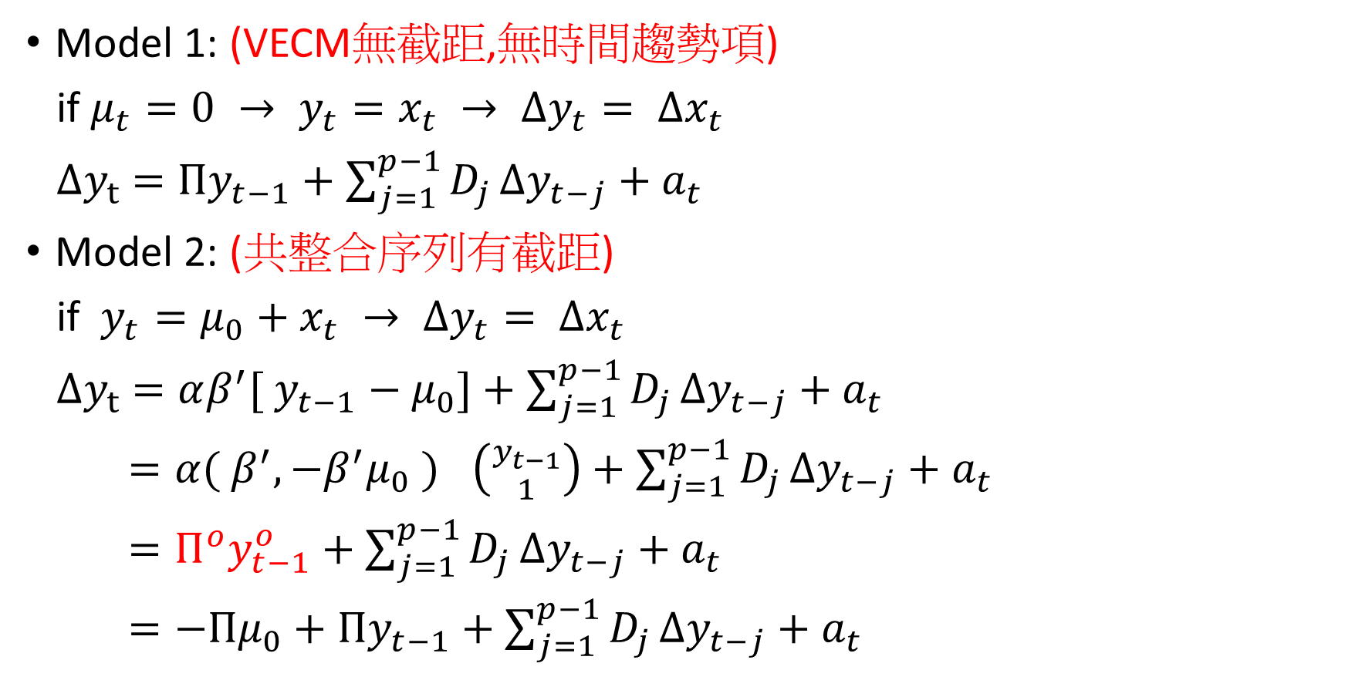
4 types of VECM model
Model 1: (VECM無截距,無時間趨勢項)
if $μ_{t}=0 → y_{t}=x_{t} → ∆y_{t}= ∆x_{t}$
${∆y}_{t}$ $={Πy}_{t−1}+\sum_{j=1}^{p−1}{D_{j}}∆y_{t−j}+a_{t}$
Model 2: (共整合序列有截距)
if $y_{t}=μ_{0}+x_{t} → ∆y_{t}= ∆x_{t}$
${∆y}_{t}$ $={αβ^{′}[ y}_{t−1}−μ_{0}]+\sum_{j=1}^{p−1}{D_{j}}∆y_{t−j}+a_{t}$
$={α( β^{′},{−β}^{′}μ_{0} )}_{}\left({y_{t−1} \atop 1}\right)+\sum_{j=1}^{p−1}{D_{j}}∆y_{t−j}+a_{t}$
$=Π^{o}y_{t−1}^{o}+\sum_{j=1}^{p−1}{D_{j}}∆y_{t−j}+a_{t}$
$=−Πμ_{0}+{Πy}_{t−1}+\sum_{j=1}^{p−1}{D_{j}}∆y_{t−j}+a_{t}$

Slide 8
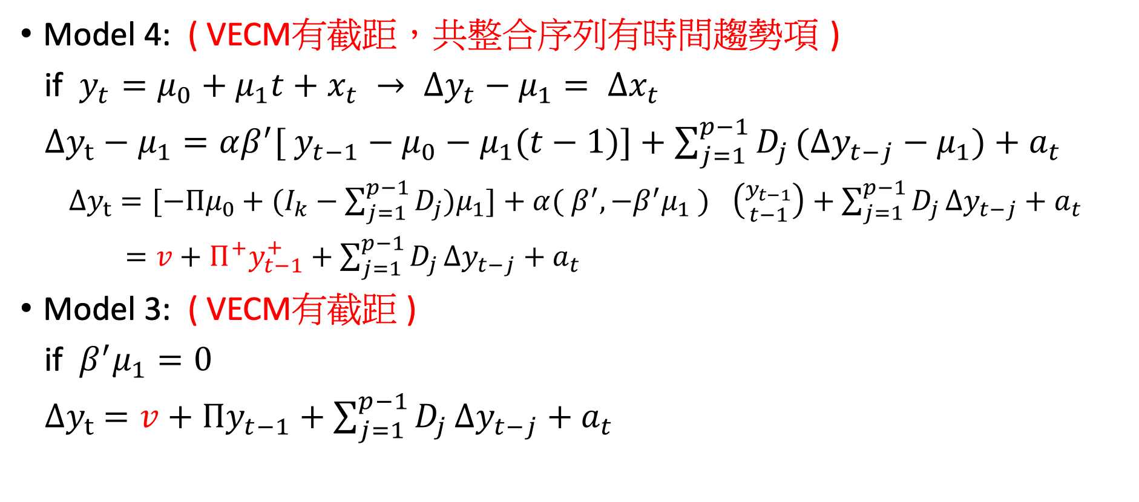
4 types of VECM model
Model 4: ( VECM有截距，共整合序列有時間趨勢項 )
if $y_{t}=μ_{0}+μ_{1}t+x_{t} → ∆y_{t}−μ_{1}= ∆x_{t}$
${∆y}_{t}−μ_{1}={αβ^{′}[ y}_{t−1}−μ_{0}−μ_{1}(t−1)]+\sum_{j=1}^{p−1}{D_{j}}(∆y_{t−j}−μ_{1})+a_{t}$
${∆y}_{t}$ $=[−Πμ_{0}+(I_{k}−\sum_{j=1}^{p−1}{D_{j}})μ_{1}]+{α( β^{′},{−β}^{′}μ_{1} )}_{}\left({y_{t−1} \atop t−1}\right)+\sum_{j=1}^{p−1}{D_{j}}∆y_{t−j}+a_{t}$
$=v+Π^{+}y_{t−1}^{+}+\sum_{j=1}^{p−1}{D_{j}}∆y_{t−j}+a_{t}$
Model 3: ( VECM有截距 )
if $β^{′}μ_{1}=0$
${∆y}_{t} =v+{Πy}_{t−1}+\sum_{j=1}^{p−1}{D_{j}}∆y_{t−j}+a_{t}$

Slide 9

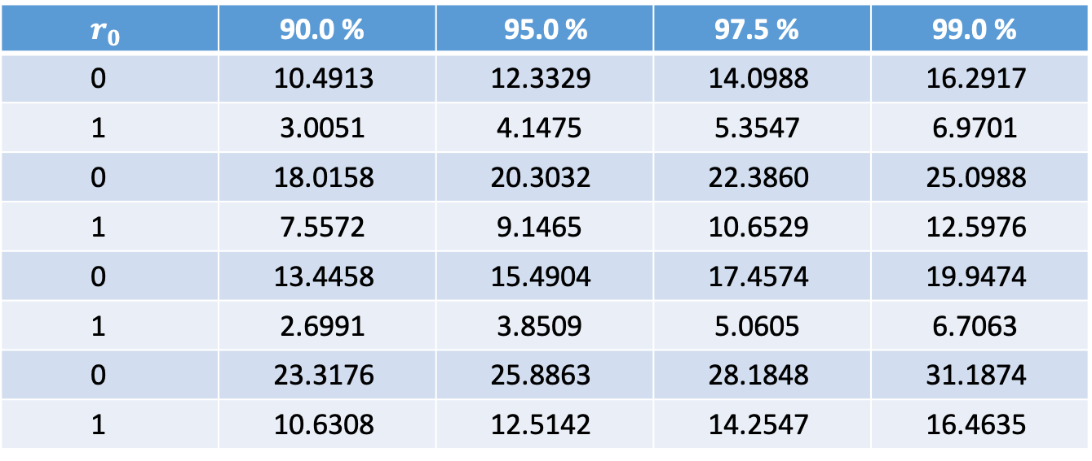
Trace test statistics simulation result
The asymptotic critical value of the trace test is based on 100,000 simulation repetitions and 3600 steps.
For k = 2 : $tr\left\{\int_{0}^{1}{dB(t){F(t)}^{′}}{[\int_{0}^{1}{F(t){F(t)}^{′}dt}]}^{−1}\int_{0}^{1}{{F(t)dB\left(t\right)}^{′}}\right\}$
$r_{0}$ | 90.0 % | 95.0 % | 97.5 % | 99.0 %
0 | 10.4913 | 12.3329 | 14.0988 | 16.2917
1 | 3.0051 | 4.1475 | 5.3547 | 6.9701
0 | 18.0158 | 20.3032 | 22.3860 | 25.0988
1 | 7.5572 | 9.1465 | 10.6529 | 12.5976
0 | 13.4458 | 15.4904 | 17.4574 | 19.9474
1 | 2.6991 | 3.8509 | 5.0605 | 6.7063
0 | 23.3176 | 25.8863 | 28.1848 | 31.1874
1 | 10.6308 | 12.5142 | 14.2547 | 16.4635
Model 1
Model 2
Model 3
Model 4

Slide 10
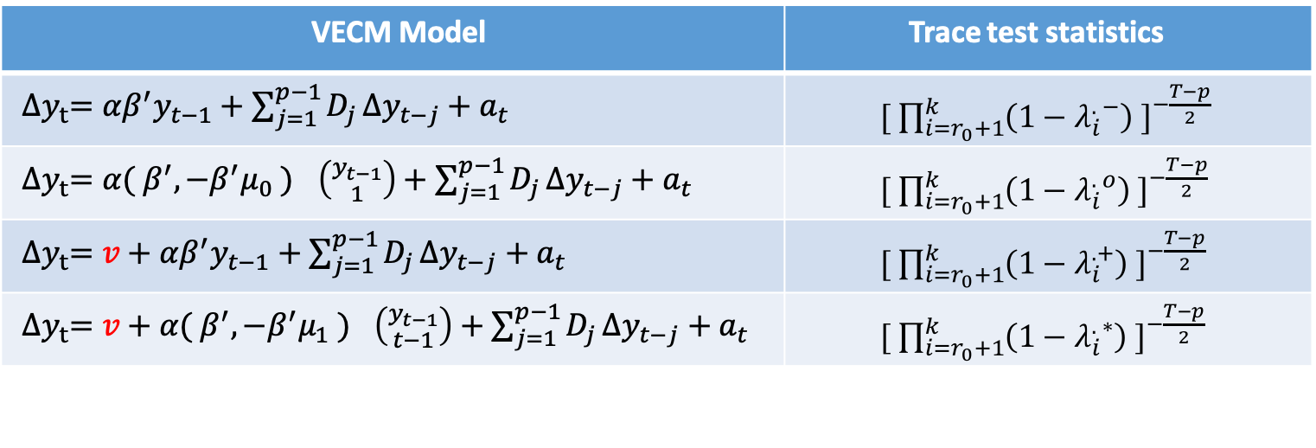
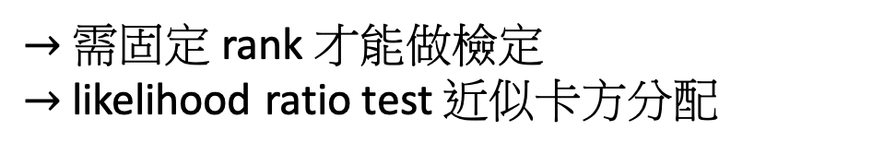
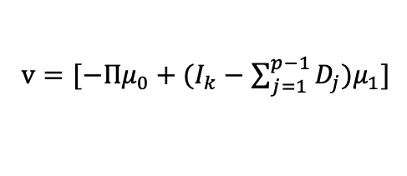
4 types of VECM model
VECM Model | Trace test statistics
${∆y}_{t}={αβ^{′}y}_{t−1}+\sum_{j=1}^{p−1}{D_{j}}∆y_{t−j}+a_{t}$ | ${[ \prod_{i=r_{0}+1}^{k}{\left(1−λ_{i}^{. −}\right)} ]}^{−\frac{T−p}{2}}$
${∆y}_{t}={α( β^{′},{−β}^{′}μ_{0} )}_{}\left({y_{t−1} \atop 1}\right)+\sum_{j=1}^{p−1}{D_{j}}∆y_{t−j}+a_{t}$ | ${[ \prod_{i=r_{0}+1}^{k}{\left(1−λ_{i}^{. o}\right)} ]}^{−\frac{T−p}{2}}$
${∆y}_{t}=v+{αβ^{′}y}_{t−1}+\sum_{j=1}^{p−1}{D_{j}}∆y_{t−j}+a_{t}$ | ${[ \prod_{i=r_{0}+1}^{k}{\left(1−λ_{i}^{. +}\right)} ]}^{−\frac{T−p}{2}}$
${∆y}_{t}=v+{α( β^{′},{−β}^{′}μ_{1} )}_{}\left({y_{t−1} \atop t−1}\right)+\sum_{j=1}^{p−1}{D_{j}}∆y_{t−j}+a_{t}$ | ${[ \prod_{i=r_{0}+1}^{k}{\left(1−λ_{i}^{. ∗}\right)} ]}^{−\frac{T−p}{2}}$
Model 1
Model 2
Model 3
Model 4
$v=[−Πμ_{0}+(I_{k}−\sum_{j=1}^{p−1}{D_{j}})μ_{1}]$
Selecting VECM model step by step
Model 4
Model 3
$→$ 需固定 rank 才能做檢定
$→$ likelihood ratio test 近似卡方分配
Model 2
Model 1

Slide 11
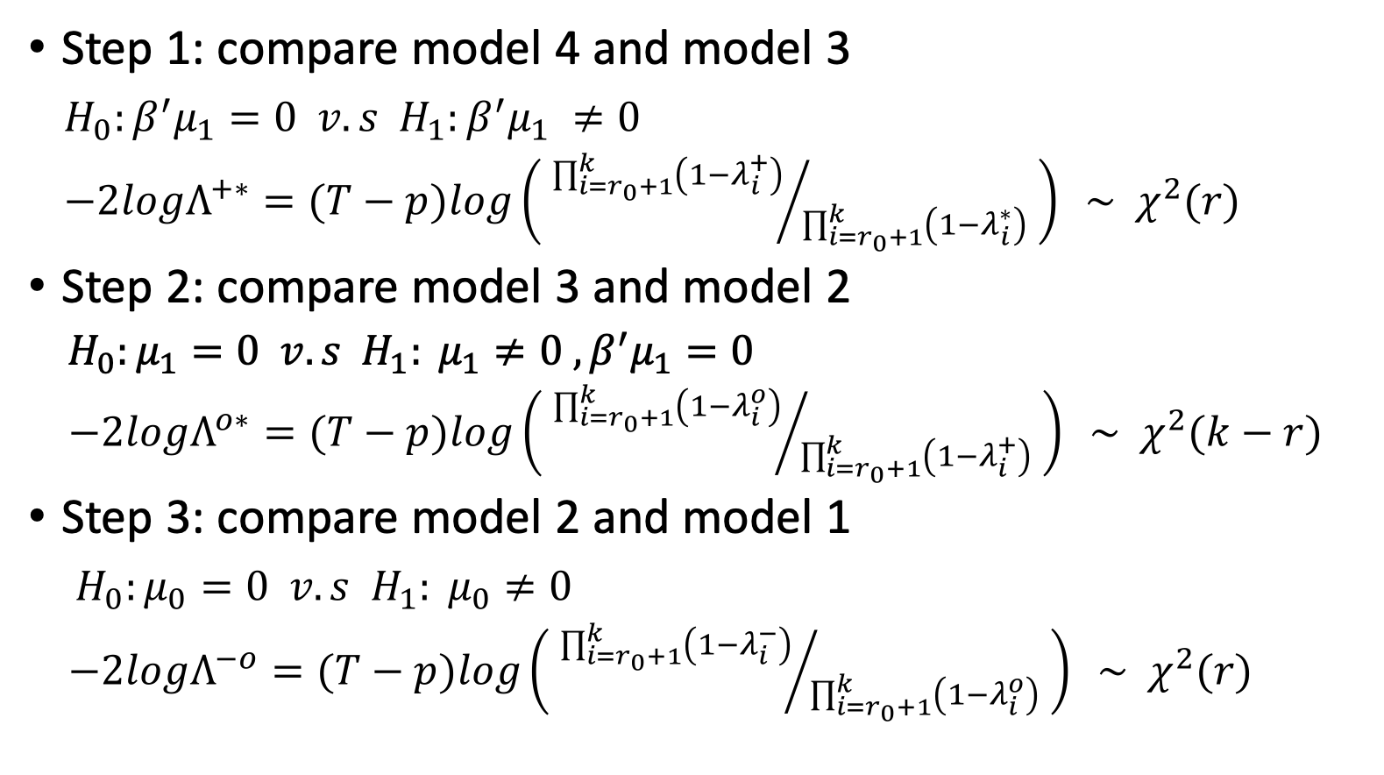
Selecting VECM model step by step
Step 1: compare model 4 and model 3
$H_{0}:β^{′}μ_{1}=0 v.s H_{1}:β^{′}μ_{1} ≠0$
$−2logΛ^{+∗}=(T−p)log\left( {\prod_{i=r_{0}+1}^{k}{\left(1−λ_{i}^{+}\right)}}/{\prod_{i=r_{0}+1}^{k}{\left(1−λ_{i}^{∗}\right)}} \right) \sim χ^{2}(r)$
Step 2: compare model 3 and model 2
$H_{0}:μ_{1}=0 v.s H_{1}: μ_{1}≠0 , β^{′}μ_{1}=0$
$−2logΛ^{o∗}=(T−p)log\left( {\prod_{i=r_{0}+1}^{k}{\left(1−λ_{i}^{o}\right)}}/{\prod_{i=r_{0}+1}^{k}{\left(1−λ_{i}^{+}\right)}} \right) \sim χ^{2}(k−r)$
Step 3: compare model 2 and model 1
$H_{0}:μ_{0}=0 v.s H_{1}: μ_{0}≠0$
$−2logΛ^{−o}=(T−p)log\left( {\prod_{i=r_{0}+1}^{k}{\left(1−λ_{i}^{−}\right)}}/{\prod_{i=r_{0}+1}^{k}{\left(1−λ_{i}^{o}\right)}} \right) \sim χ^{2}(r)$

Slide 12
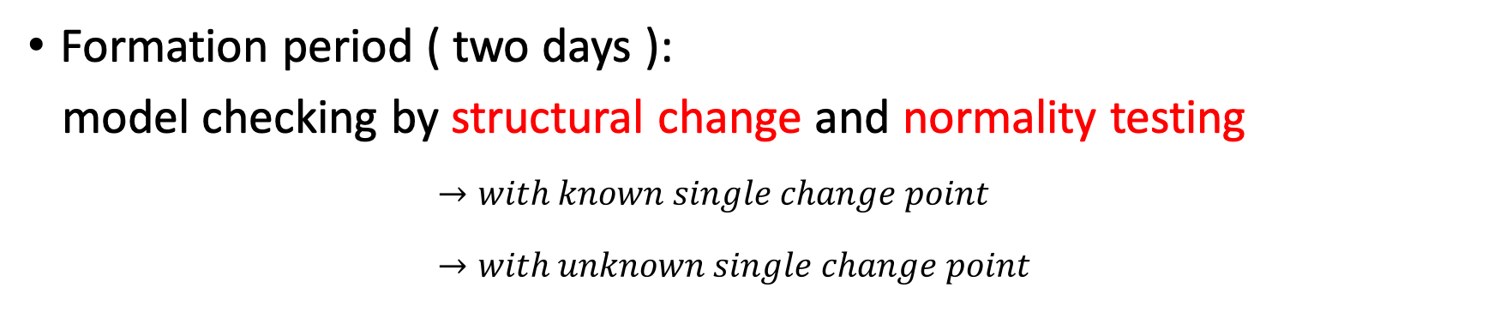
Note
Formation period ( two days ):
model checking by structural change and normality testing
$→with known single change point$
$→with unknown single change point$

