Slide 1
Chapter 3 Brownian Motion
3.2 3.3 賴彥儒

Slide 2
3.1 Introduction
Introduce random walks in section 3.2
Define Brownian motion in section 3.3
Compute the quadratic variation of Brownian motion in section 3.4
Develop its some basic properties and theorems
section 3.5-3.7 develop properties of Brownian motion we shall need later

Slide 3
3.2 Scaled Random Walks
Properties of symmetric random walk
Increments
Martingale
Quadratic Variation
Limiting Distribution

Slide 4
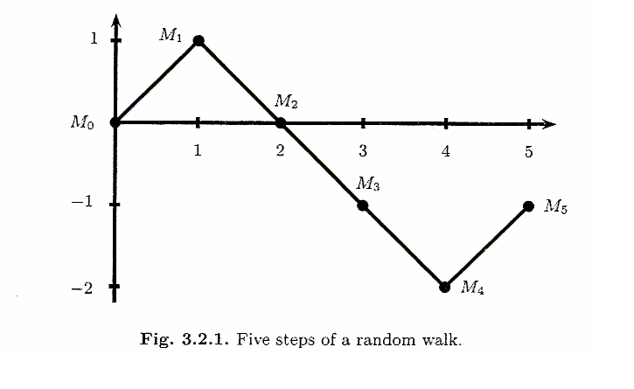
3.2.1 Symmetric Random Walk
Toss a fair coin repeatedly
Define = 0 ,
is a symmetric random walk
With each toss, it either steps up one unit or down one unit, and each of the two probabilities is equally likely
Notes:
Fair: p and q (1-p) are equal 0.5

Slide 5
3.2.2 Increments of the Symmetric Random Walk
A random walk has independent increments
are independent ,
0=
is called an increment of the random walk
E( )=0
Var( )=
ki+1
k1
k2
ki
ki+1

Slide 6
3.2.3 Martingale Property for the Symmetric Random Walk
Choose nonnegative integers k < l , then,
在Fk資訊集合的情況下Ml的期望值為Mk

Slide 7
3.2.4 Quadratic Variation of the Symmetric Random Walk
The quadratic variation up to time k is defined to be
Note :
．This is computed path-by-path
．by taking all the one-step increments along that path, squaring
these increments, and then summing them
(3.2.6)

Slide 8
How to compute the
is computed by taking an average over all paths, taking their probabilities into account
If the random walk were not symmetric, this would affect
Comparison with quadratic variation
Is computed along a single path
Probabilities of up and down steps don’t enter the computation

Slide 9
3.2.5 Scaled Symmetric Random Walk
To approximate a Brownian motion, we speed up time and scale down the step size of a symmetric random walk
t 時間內 每單位時間切n段,可得nt段
Define the scaled symmetric random walk
nt is an integer
If nt isn’t an integer, we define by linear interpolation
Obtain a Brownian motion in the limit as
(3.2.7)

Slide 10
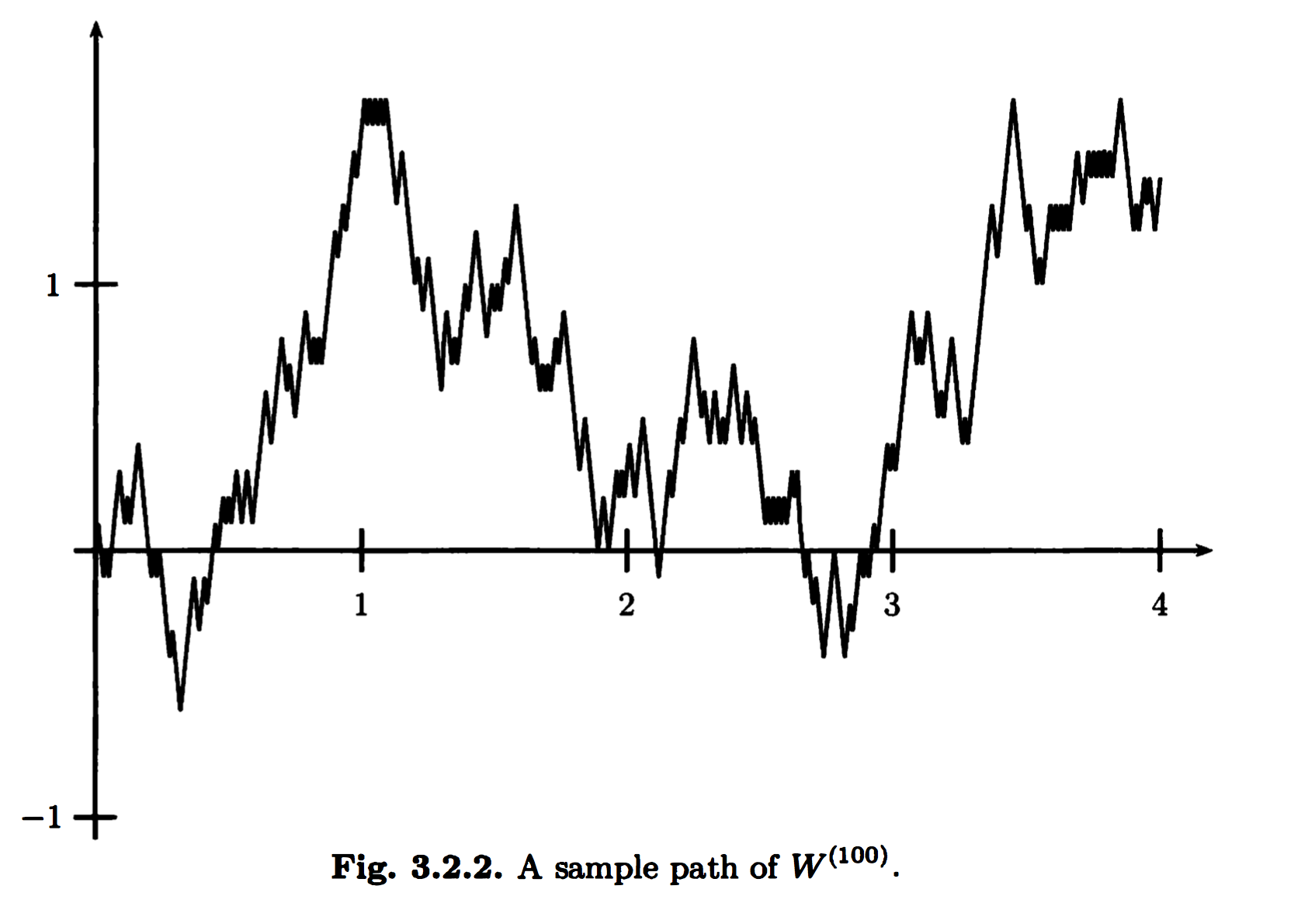

Slide 11
The scaled random walk has independent increments
If 0 = are such that each is an integer, then
are independent
If are such that ns and nt are integers, then

Slide 12
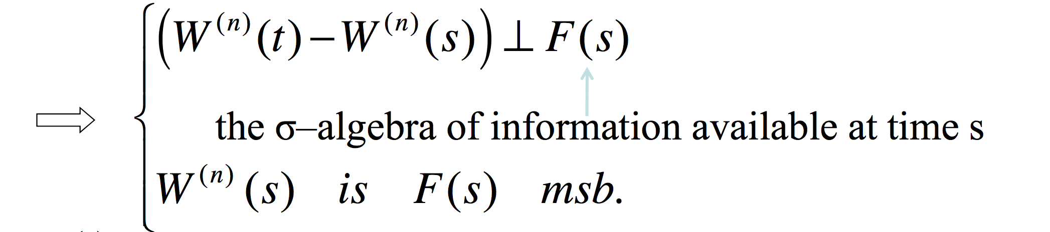
The martingale property for scaled random walk
Let be given, and decompose as
If s and t are chosen so that ns and nt are integers

Slide 13
Prove
Proof:

Slide 14
Quadratic variation of the scaled random walk

Slide 15
3.2.6 Limiting Distribution of the Scaled Random Walk
fixed a sequence of coin tosses
Fix t and consider the set of all possible paths evaluated at that time t
Set t = 0.25 and consider the set of possible values of
can take any any odd integer between -25 and 25 :
-2.5,-2.3,…,-0.3,-0.1,0.1,0.3,…2.3,2.5
In order for to take value 0.1, we must get 13H and 12T in the 25 coin tosses. The probability of this is

Slide 16
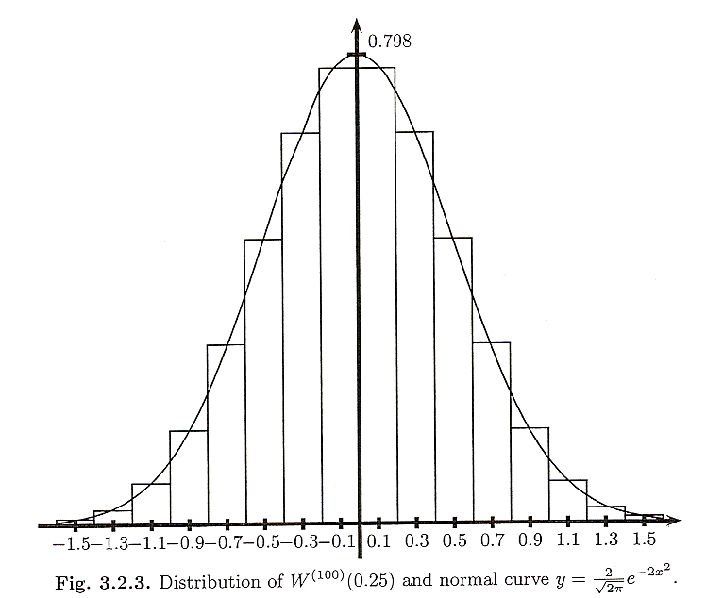
the distribution of
is nearly normal
The bar has width 0.2, its height must be 0.1555 / 0.2 = 0.7775

Slide 17
Approximate the integral
Given a continuous bounded function g(x)
Asked to compute
We can obtain a good approximation
The Central Limit Theorem asserts that the approximation in (3.2.12) is valid
(3.2.12)

Slide 18
Theorem 3.2.1 (Central Limit Theorem)
Outline of proof:
藉由動差生成函數(MGF)的唯一性來判斷r.v.屬於何種分配
( )

Slide 19
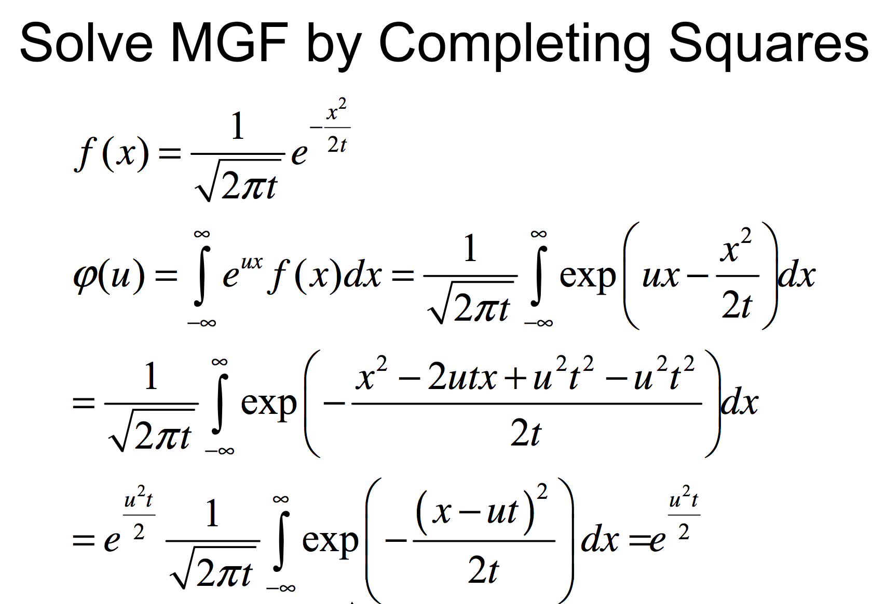

Slide 20
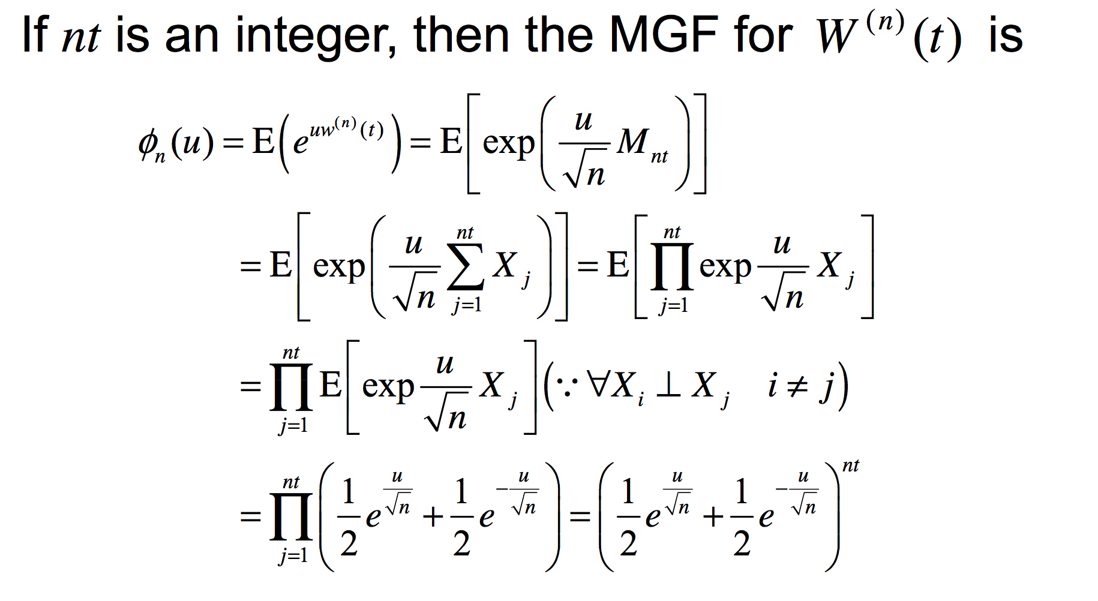

Slide 21
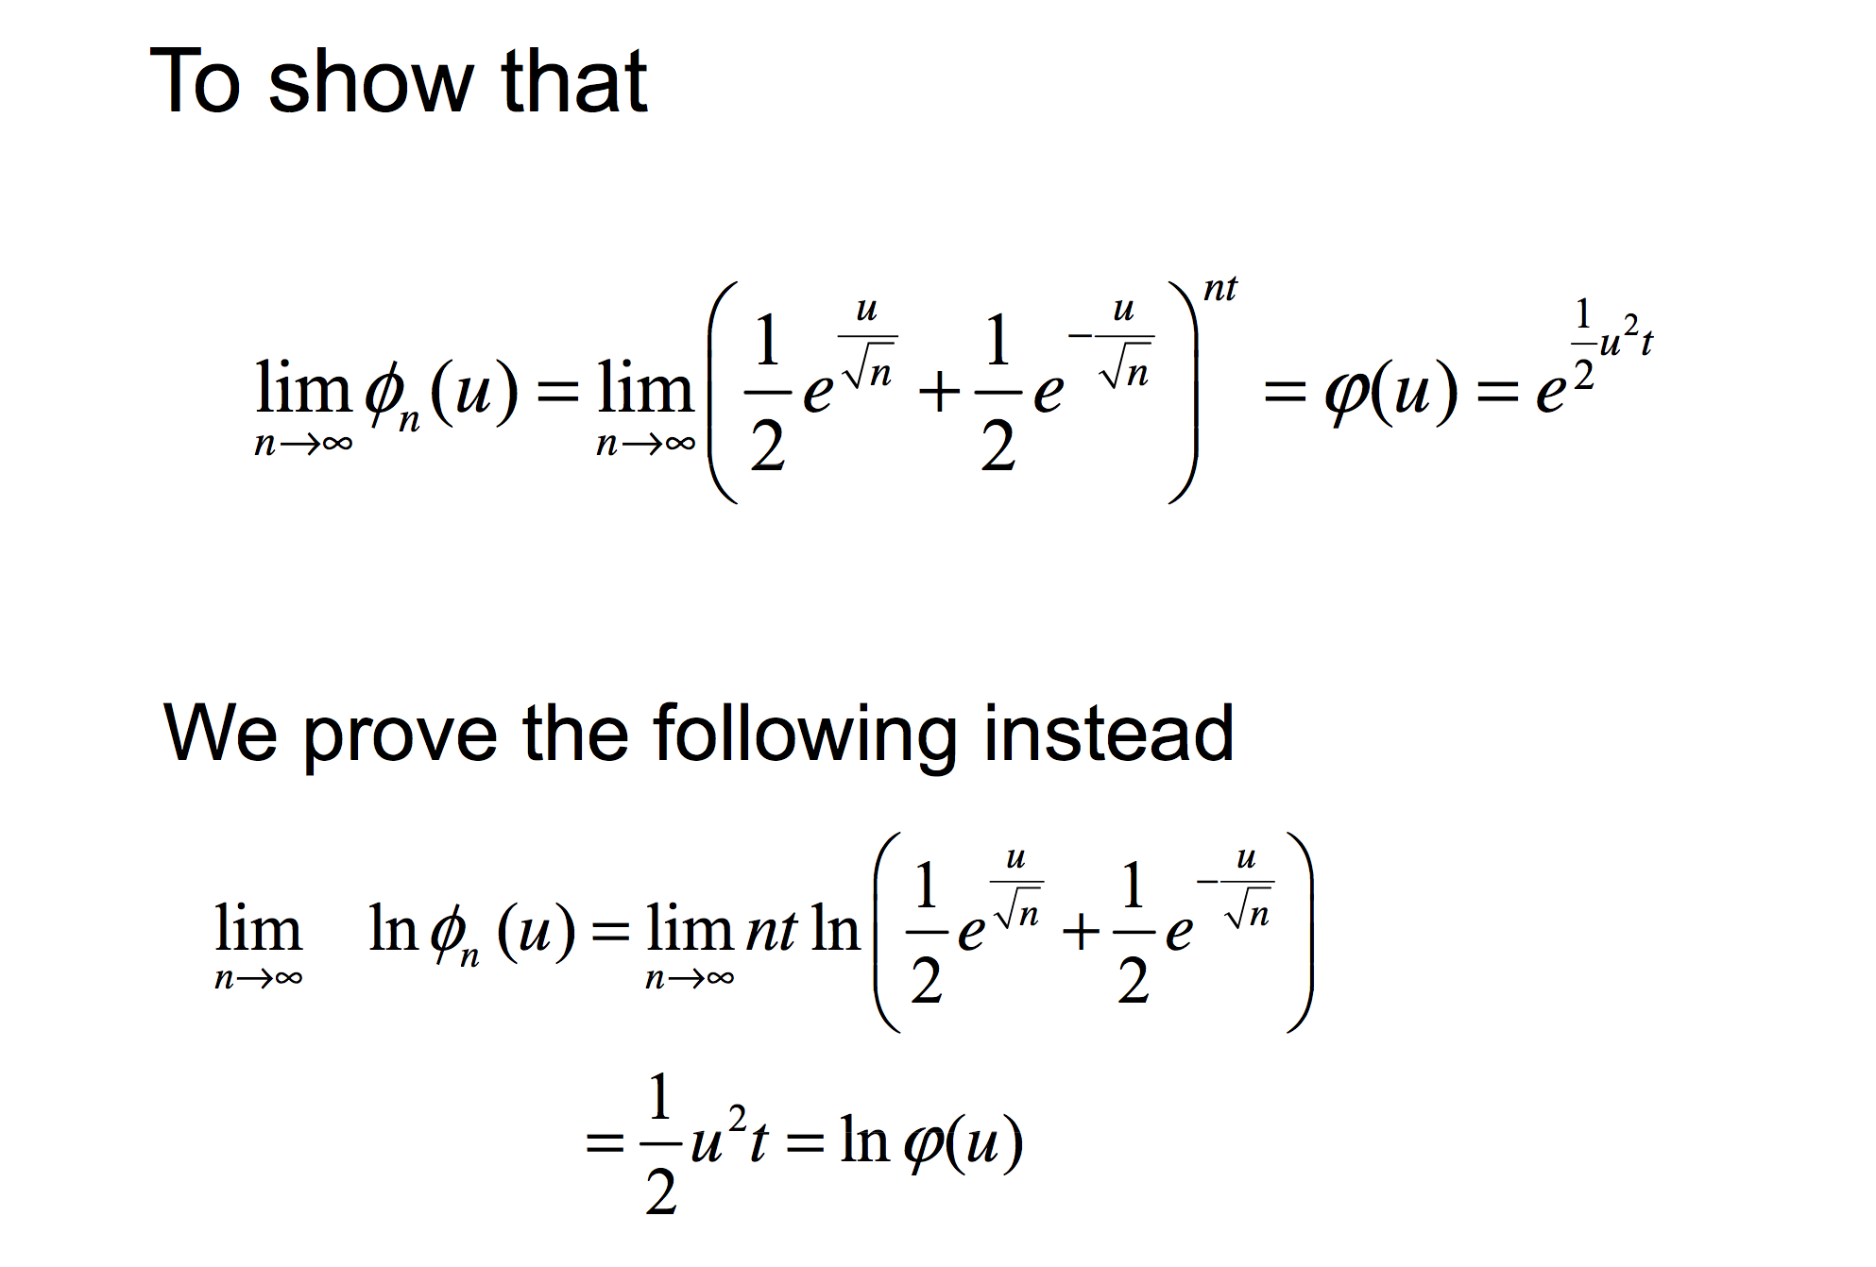

Slide 22
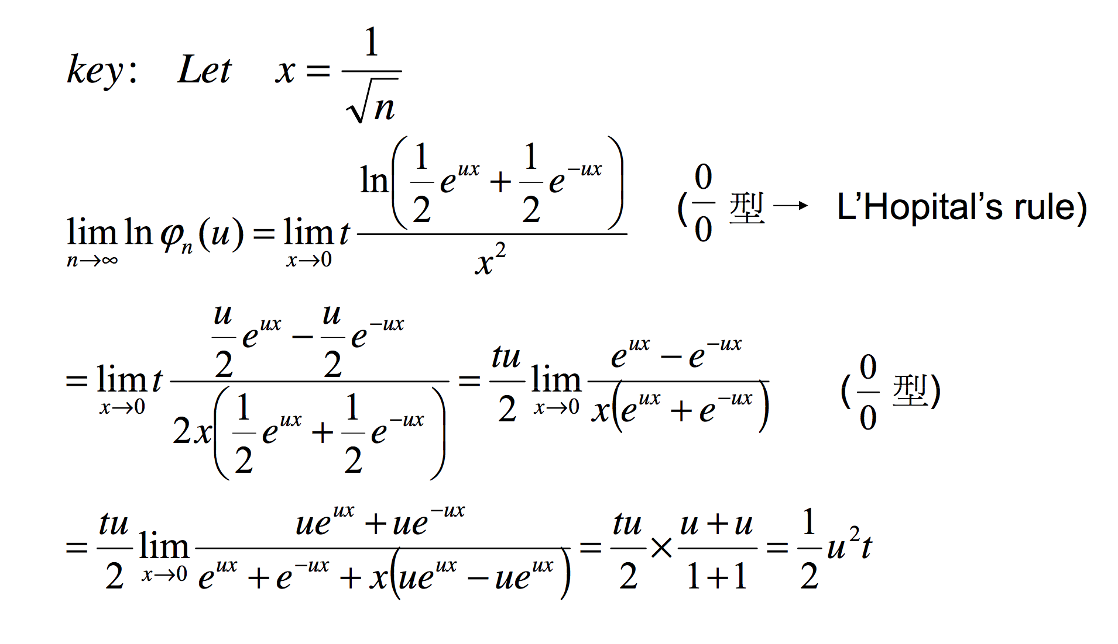

Slide 23
3.3 Brownian Motion

Slide 24
3.3.1 Definition of Brownian Motion
Definition 3.3.1
Let be a probability space.
For each , suppose there is a continuous function of that satisfies and that depends on .
Then , is a Brownian motion if for all
Increments
are independent and each of these increments is normally distributed with
…

Slide 25
3.3.2 Distribution of Brownian Motion
The random variables are jointly normally distributed.
Distribution is determined by their means and covariances.
1. has mean zero.
2. the covariance of and ：
…

Slide 26
The covariance matrix for Brownian motion ( i.e., for the m-dimensional random vector ) is
…
…
…
…
…
…
…

Slide 27
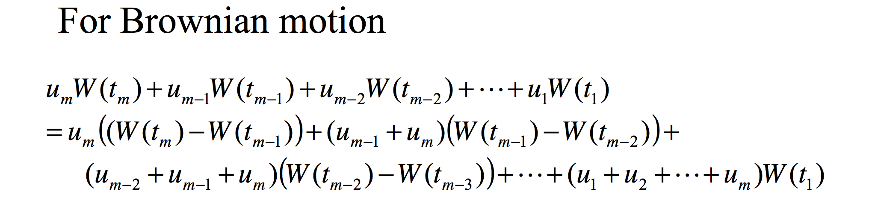
The MGF of this random vector can be computed using the MGF for a zero-mean normal random variable with variance t and the independence of the increments.
PS. the MGF of 1-dim normal r.v ~ N(0,t)

Slide 28
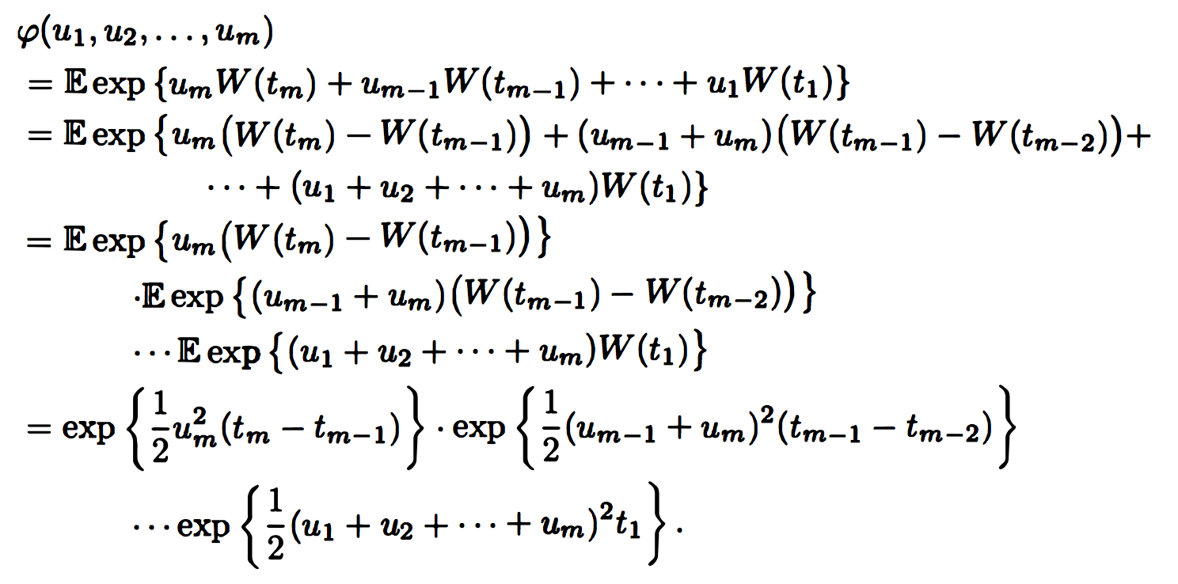
MGF of random vector

Slide 29
Thm3.3.2 Alternative characterizations of Brownian motion
Let be a probability space.
For each , suppose there is a continuous function , that satisfies and that depends on .
For all , The following three properties are equivalent.
1. The increments
are independent and each of these increments is normally distributed with
mean and variance given by and

Slide 30
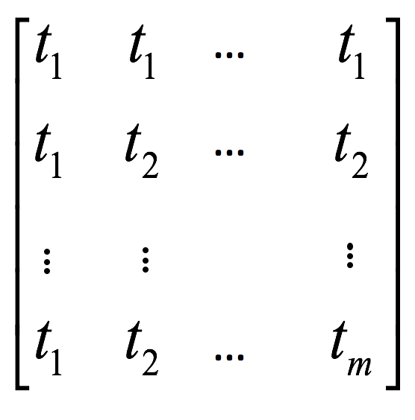
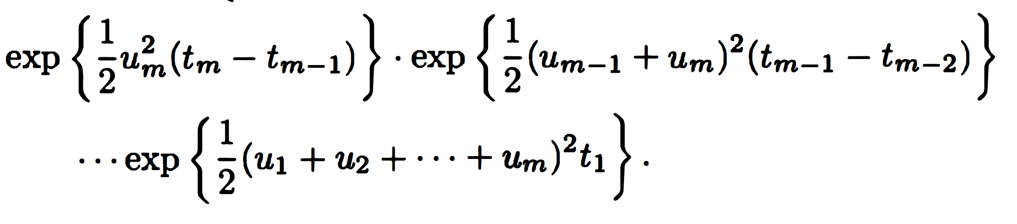
The random variables are jointly normally distributed
with means equal to zero and covariance matrix
3. The random variables have the joint MGF.
…
…
If any of 1, 2, or 3 holds (and hence they all hold), then , is a Brownian motion.

Slide 31
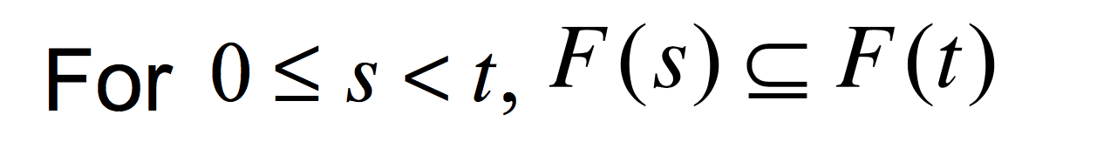
3.3.3 Filtration for Brownian Motion
Definition 3.3.3
Let be a probability space on which is defined a Brownian motion
A filtration for the Brownian motion is a collection of -algebra
, satisfying：
( Information accumulates )
(Adaptivity) W(t) is F(t) msb.
(Independence of future increments)
For the increment W(u)-W(t) is indep. of F(t).

Slide 32
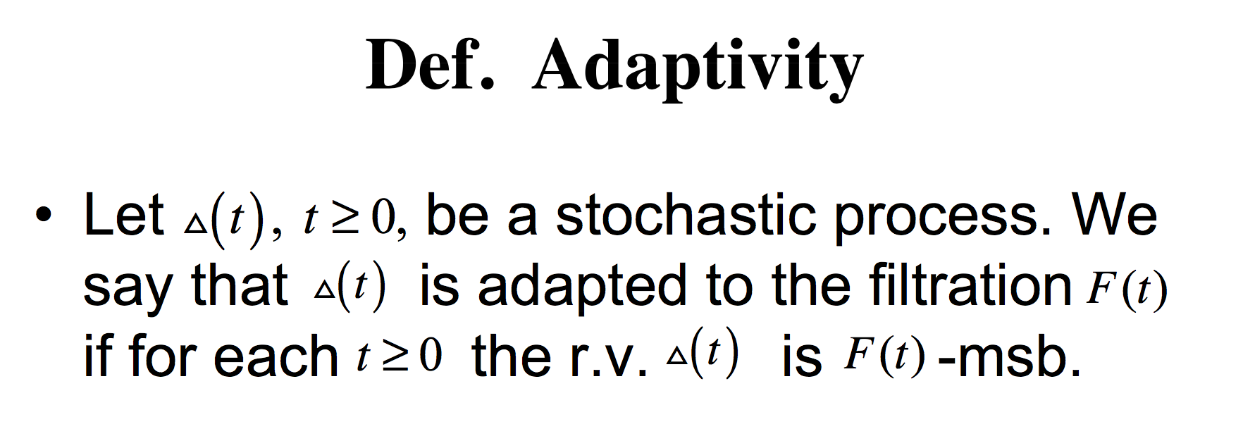

Slide 33
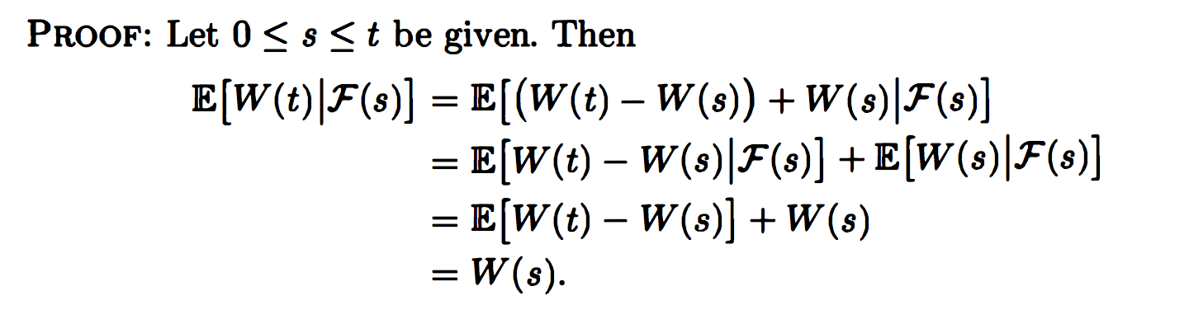
3.3.4 Martingale Property for Brownian Motion
Theorem 3.3.4 Brownian motion is a martingale

