Slide 1
4.4 Itô-Doeblin Formula
0653943 賴彥儒

Slide 2
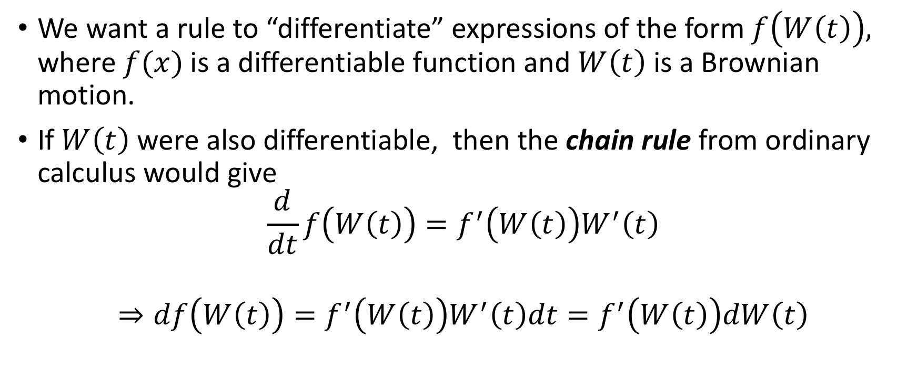
4.4.1 Formula for Brownian Motion
We want a rule to “differentiate” expressions of the form $f\left(W\left(t\right)\right),$ where $f(x)$is a differentiable function and $W\left(t\right)$ is a Brownian motion.
If $W\left(t\right)$ were also differentiable, then the chain rule from ordinary calculus would give
$$\frac{d}{dt}f\left(W\left(t\right)\right)=f^{′}\left(W\left(t\right)\right)W^{′}\left(t\right)$$
$$⇒df\left(W\left(t\right)\right)=f^{′}\left(W\left(t\right)\right)W^{′}\left(t\right)dt=f^{′}\left(W\left(t\right)\right)dW\left(t\right)$$

Slide 3
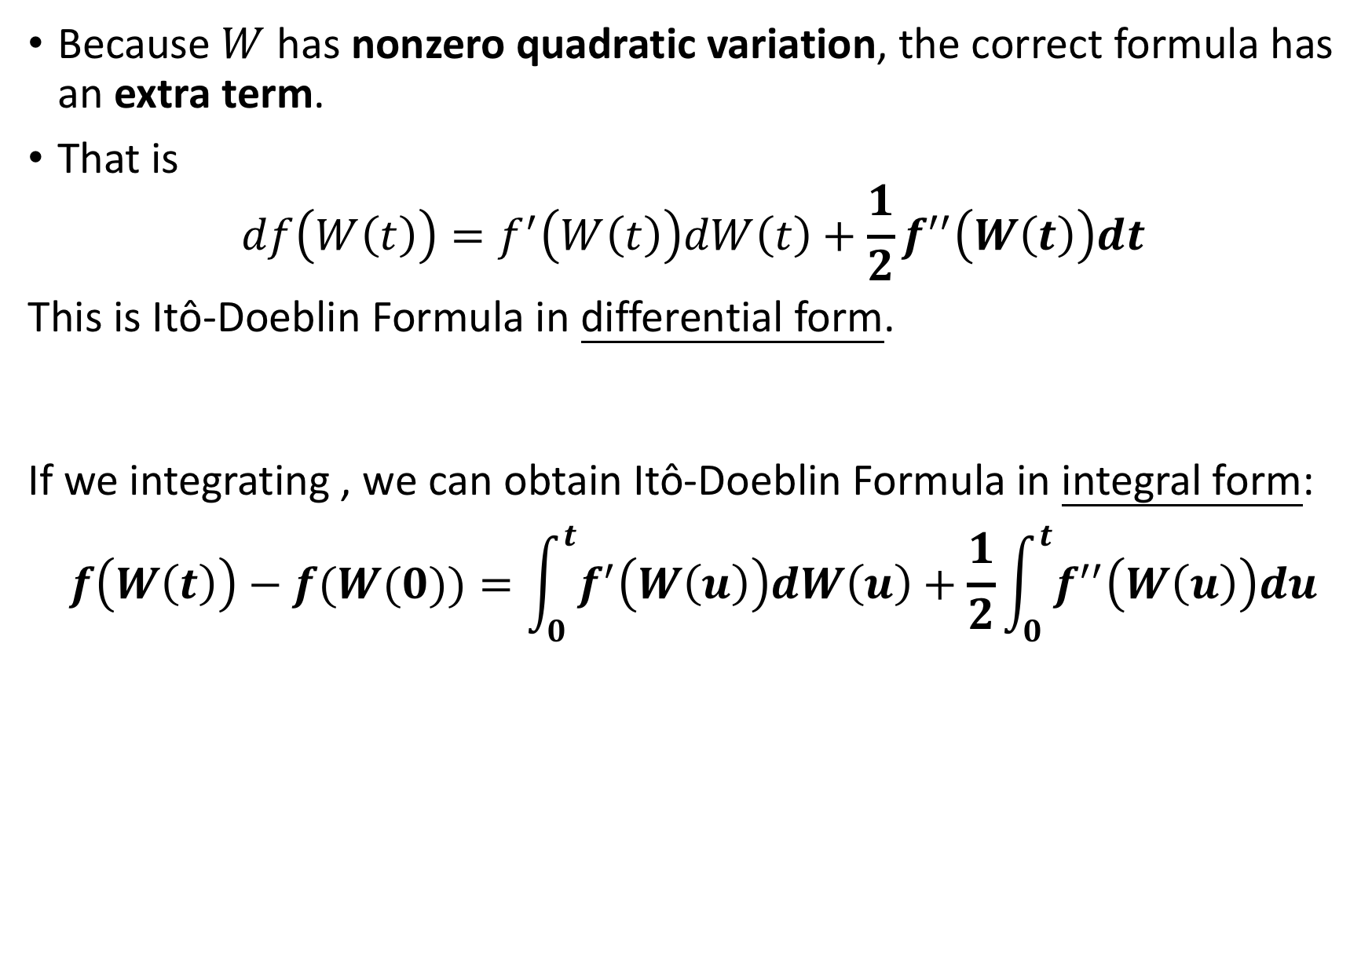
Because $W$has nonzero quadratic variation, the correct formula has an extra term.
That is
$$df\left(W\left(t\right)\right)=f^{′}\left(W\left(t\right)\right)dW\left(t\right)+\frac{1}{2}f^{′′}\left(W\left(t\right)\right)dt$$
This is Itô-Doeblin Formula in differential form.
If we integrating , we can obtain Itô-Doeblin Formula in integral form:
$$f\left(W\left(t\right)\right)−f(W(0))=\int_{0}^{t}{f^{′}\left(W\left(u\right)\right)dW\left(u\right)}+\frac{1}{2}\int_{0}^{t}{f^{′′}\left(W\left(u\right)\right)du}$$
(4.4.1)
(4.4.2)
Itô Integral
Lebesgue Integral

Slide 4
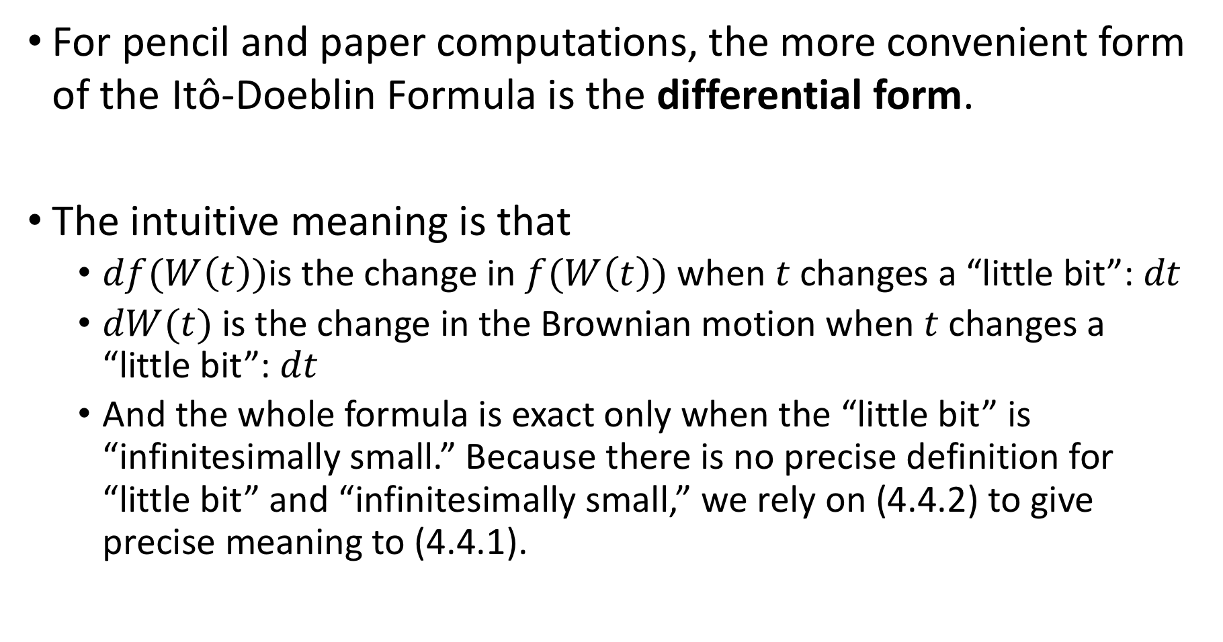
For pencil and paper computations, the more convenient form of the Itô-Doeblin Formula is the differential form.
The intuitive meaning is that
$df(W\left(t\right))$is the change in $f(W\left(t\right))$ when $t$changes a “little bit”: $dt$
$dW(t)$is the change in the Brownian motion when $t$changes a “little bit”: $dt$
And the whole formula is exact only when the “little bit” is “infinitesimally small.” Because there is no precise definition for “little bit” and “infinitesimally small,” we rely on (4.4.2) to give precise meaning to (4.4.1).

Slide 5
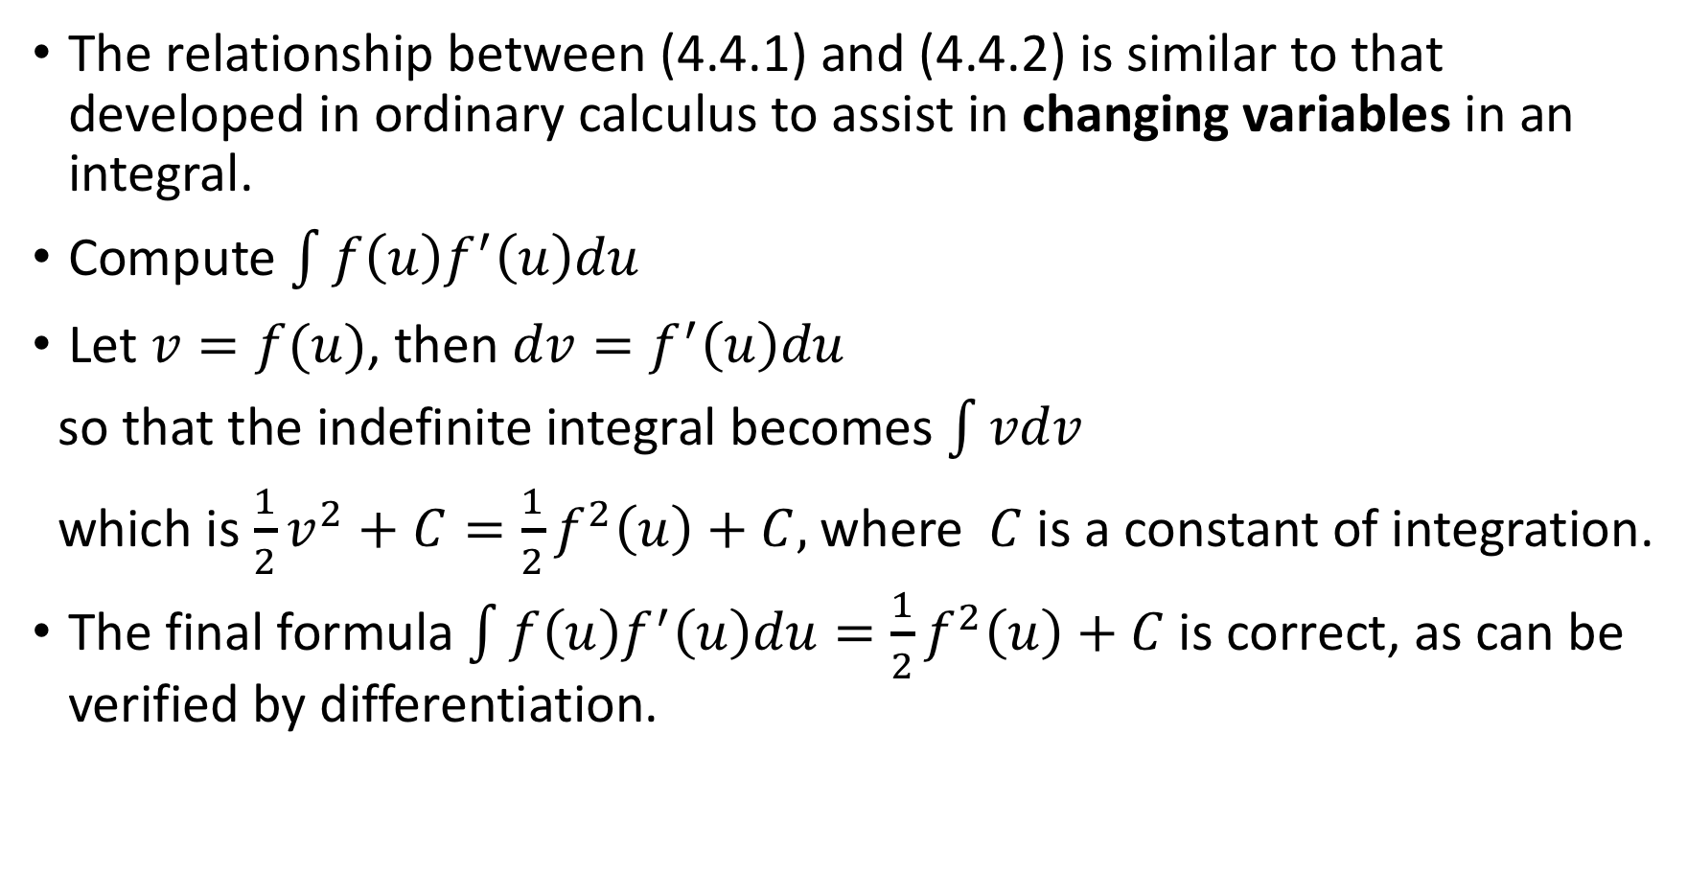
The relationship between (4.4.1) and (4.4.2) is similar to that developed in ordinary calculus to assist in changing variables in an integral.
Compute $\int{f\left(u\right)f^{′}\left(u\right)du}$
Let $v=f(u)$, then $dv=f^{′}\left(u\right)du$
so that the indefinite integral becomes $\int{vdv}$
which is $\frac{1}{2}v^{2}+C=\frac{1}{2}f^{2}\left(u\right)+C,$where $C$is a constant of integration.
The final formula $\int{f\left(u\right)f^{′}\left(u\right)du=\frac{1}{2}f^{2}\left(u\right)+C}$is correct, as can be verified by differentiation.

Slide 6
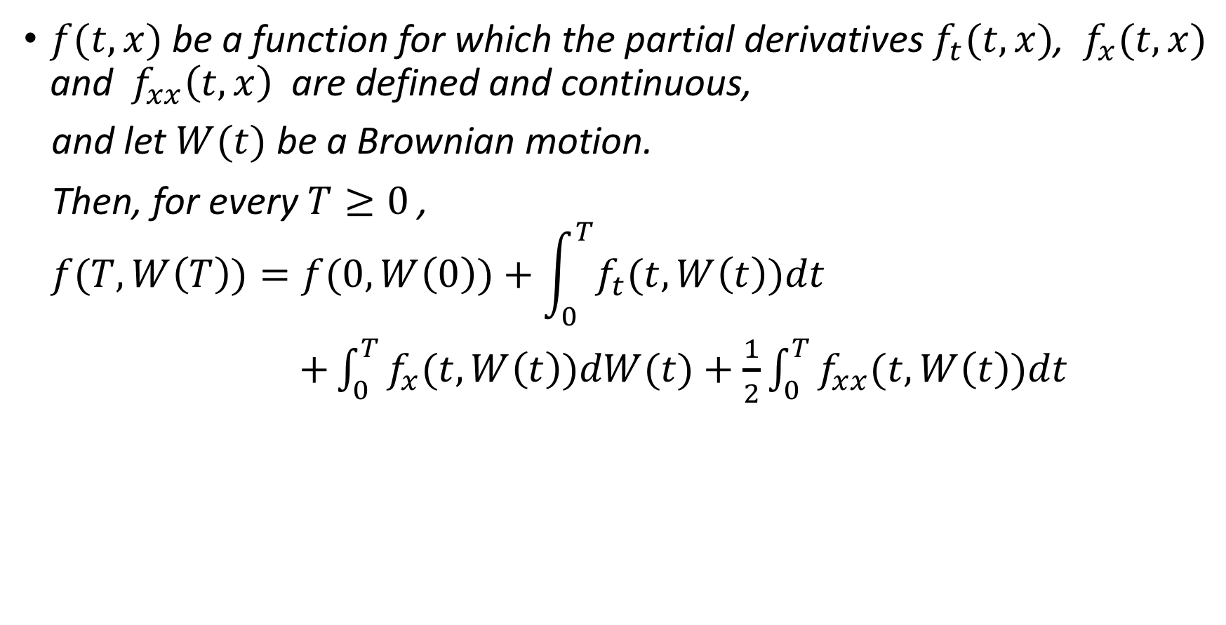
Theorem 4.4.1
$f(t,x)$ be a function for which the partial derivatives $f_{t}(t,x)$, $f_{x}(t,x)$ and $f_{xx}\left(t,x\right)$ are defined and continuous,
and let $W(t)$ be a Brownian motion.
Then, for every $T≥0$ ,
$$f(T,W\left(T\right))=f(0,W\left(0\right))+\int_{0}^{T}{f_{t}(t,W\left(t\right))dt}$$
$+\int_{0}^{T}{f_{x}(t,W\left(t\right))dW(t)}+\frac{1}{2}\int_{0}^{T}{f_{xx}(t,W\left(t\right))dt}$
(4.4.3)

Slide 7

Proof step:
Show (4.4.3) holds when $f\left(x\right)=\frac{1}{2}x^{2}$
For general $f\left(x\right)$
More general function $f\left(x,t\right)$

Slide 8
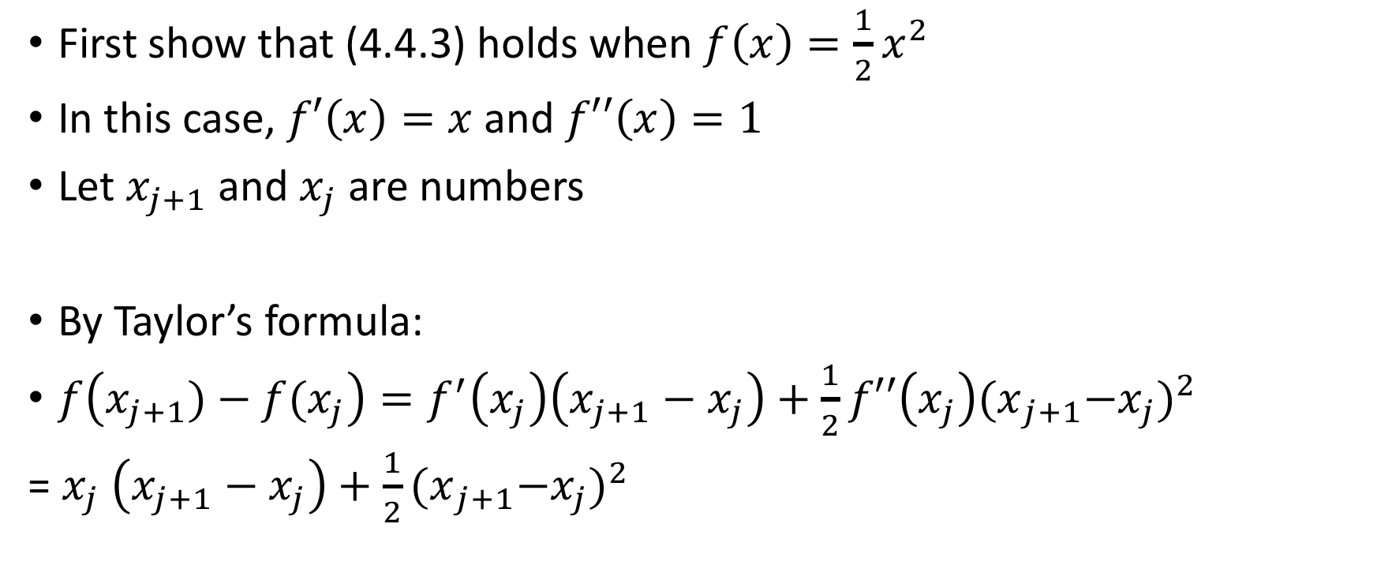
Proof: Theorem 4.4.1 Itô-Doeblin formula for Brownian motion(1)
First show that (4.4.3) holds when $f\left(x\right)=\frac{1}{2}x^{2}$
In this case, $f′\left(x\right)=x$ and $f′′\left(x\right)=1$
Let $x_{j+1}$and $x_{j}$ are numbers
By Taylor’s formula:
$f\left(x_{j+1})−f(x_{j}\right)=f^{′}\left(x_{j}\right)\left(x_{j+1}−x_{j}\right)+\frac{1}{2}{f′′\left(x_{j}\right){(x}_{j+1}−x_{j})}^{2}$
= $x_{j} \left(x_{j+1}−x_{j}\right)+\frac{1}{2}{{(x}_{j+1}−x_{j})}^{2}$
(4.4.4)

Slide 9

Taylor’s Formula
$f\left(x\right)$ is a differentiable function, $a$ is a real number, then
$$f\left(x\right)=f\left(a\right)+f^{′}\left(a\right)\left(x−a\right)+\frac{f′′(a)}{2!}{(x−a)}^{2}+…+\frac{f^{\left(k\right)}\left(a\right)}{k!}{\left(x−a\right)}^{k}+…$$

Slide 10
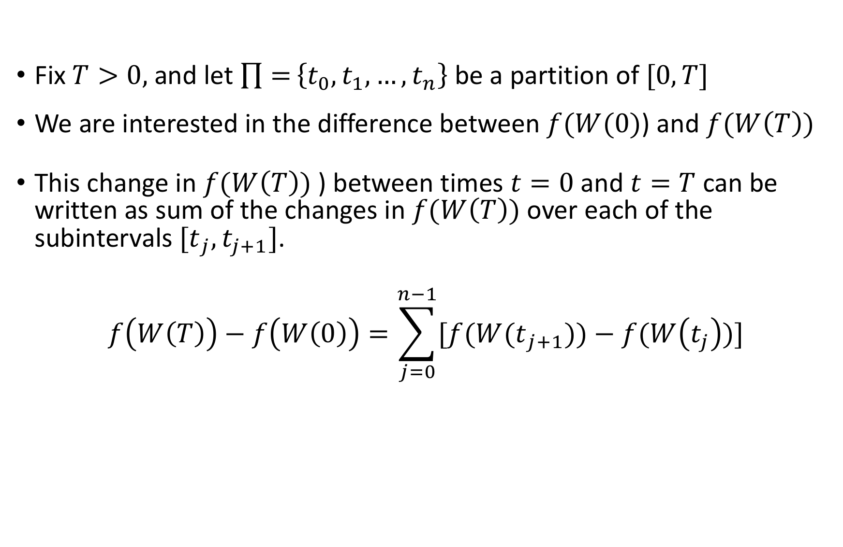
Proof: Theorem 4.4.1 Itô-Doeblin formula for Brownian motion(2)
Fix $T>0,$and let $\prod{=}\left\{t_{0},t_{1},…,t_{n}\right\}$ be a partition of $[0,T]$
We are interested in the difference between $f(W(0)$) and $f(W\left(T\right))$
This change in $f(W\left(T\right))$ ) between times $t=0$ and $t=T$ can be written as sum of the changes in $f(W\left(T\right))$ over each of the subintervals ${[t}_{j},t_{j+1}]$.
$$f\left(W\left(T\right)\right)−f\left(W\left(0\right)\right)=\sum_{j=0}^{n−1}{[f(W{(t}_{j+1}))−f(W\left(t_{j}\right))]}$$

Slide 11
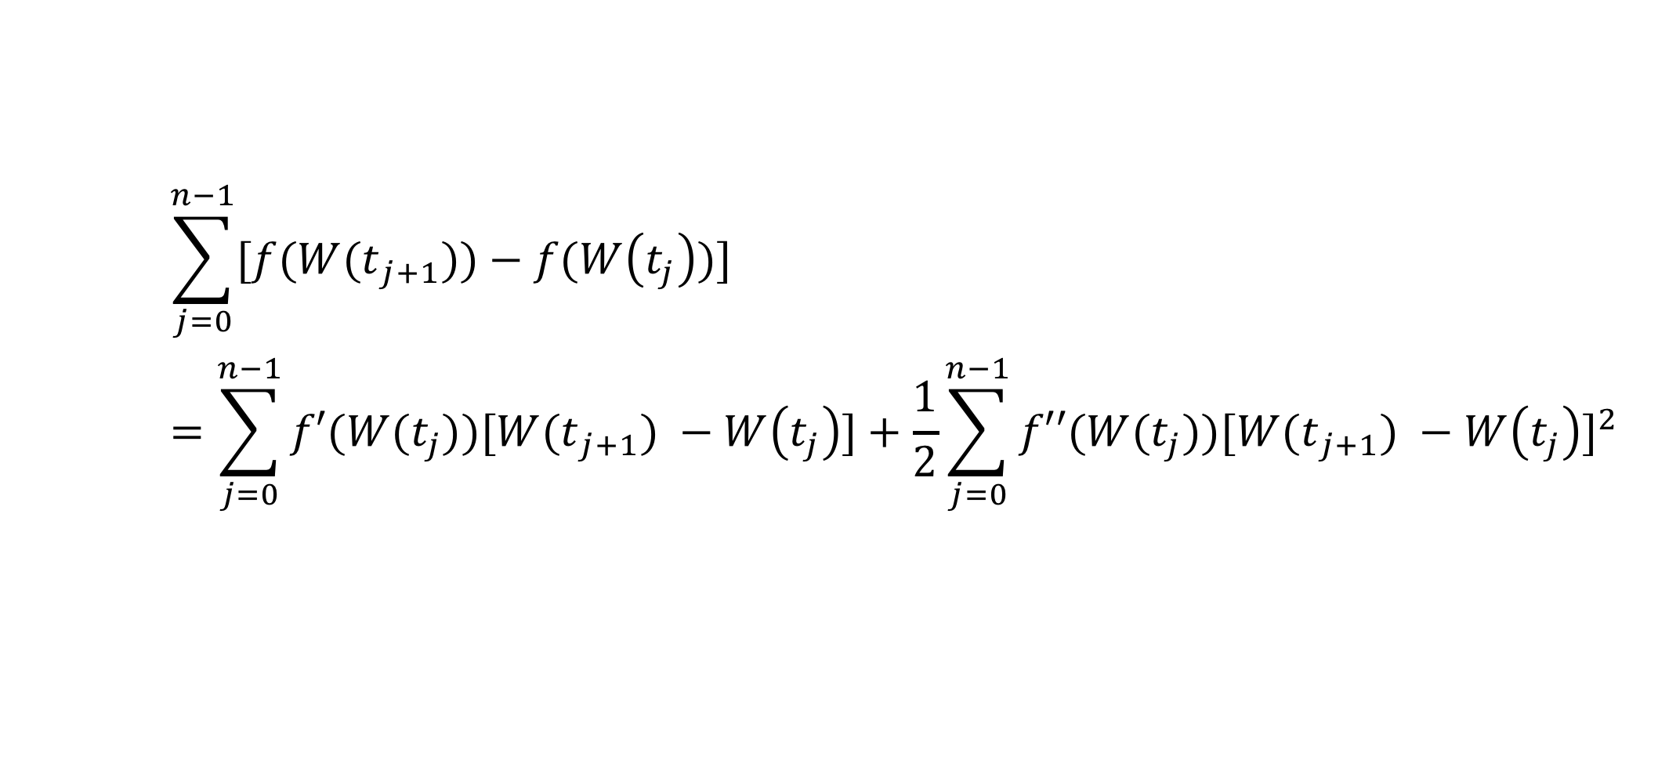
Proof: Theorem 4.4.1 Itô-Doeblin formula for Brownian motion(3)
$$\sum_{j=0}^{n−1}{[f(W{(t}_{j+1}))−f(W\left(t_{j}\right))]}$$
$$=\sum_{j=0}^{n−1}{f′(W(t_{j}))[W{(t}_{j+1}) −W\left(t_{j}\right)]}+\frac{1}{2}\sum_{j=0}^{n−1}{f′′(W(t_{j})){[W{(t}_{j+1}) −W\left(t_{j}\right)]}^{2}}$$
(4.4.5)

Slide 12
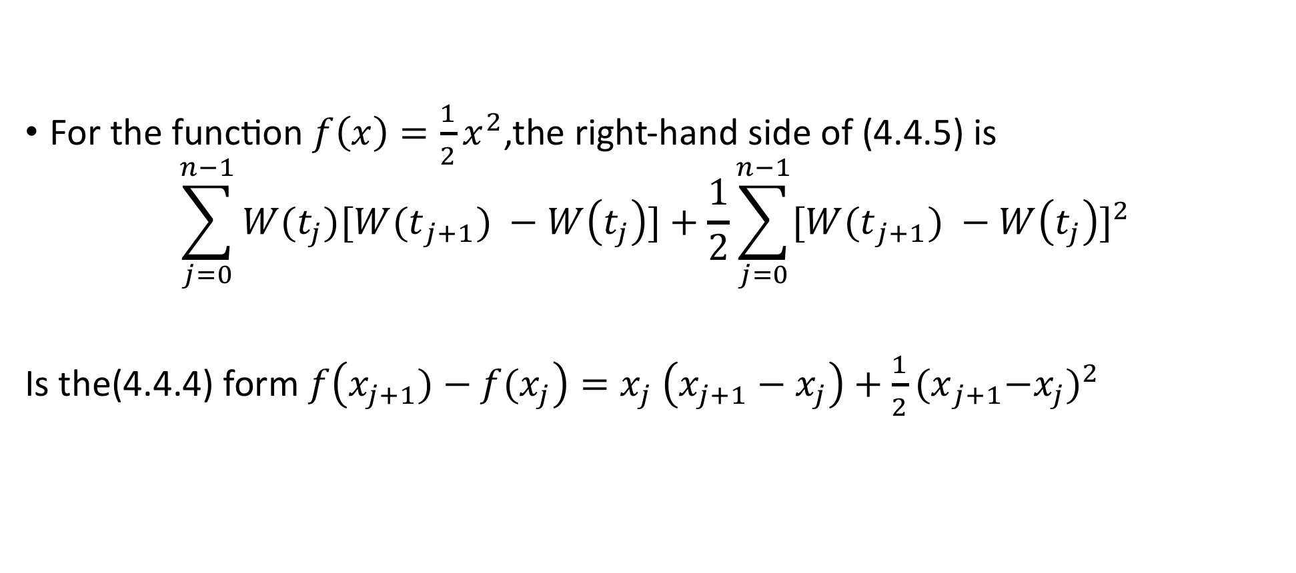
Proof: Theorem 4.4.1 Itô-Doeblin formula for Brownian motion(4)
For the function $f\left(x\right)=\frac{1}{2}x^{2}$,the right-hand side of (4.4.5) is
$$\sum_{j=0}^{n−1}{W(t_{j})[W{(t}_{j+1}) −W\left(t_{j}\right)]}+\frac{1}{2}\sum_{j=0}^{n−1}{{[W{(t}_{j+1}) −W\left(t_{j}\right)]}^{2}}$$
Is the(4.4.4) form $f\left(x_{j+1})−f(x_{j}\right)=x_{j} \left(x_{j+1}−x_{j}\right)+\frac{1}{2}{{(x}_{j+1}−x_{j})}^{2}$
(4.4.6)

Slide 13
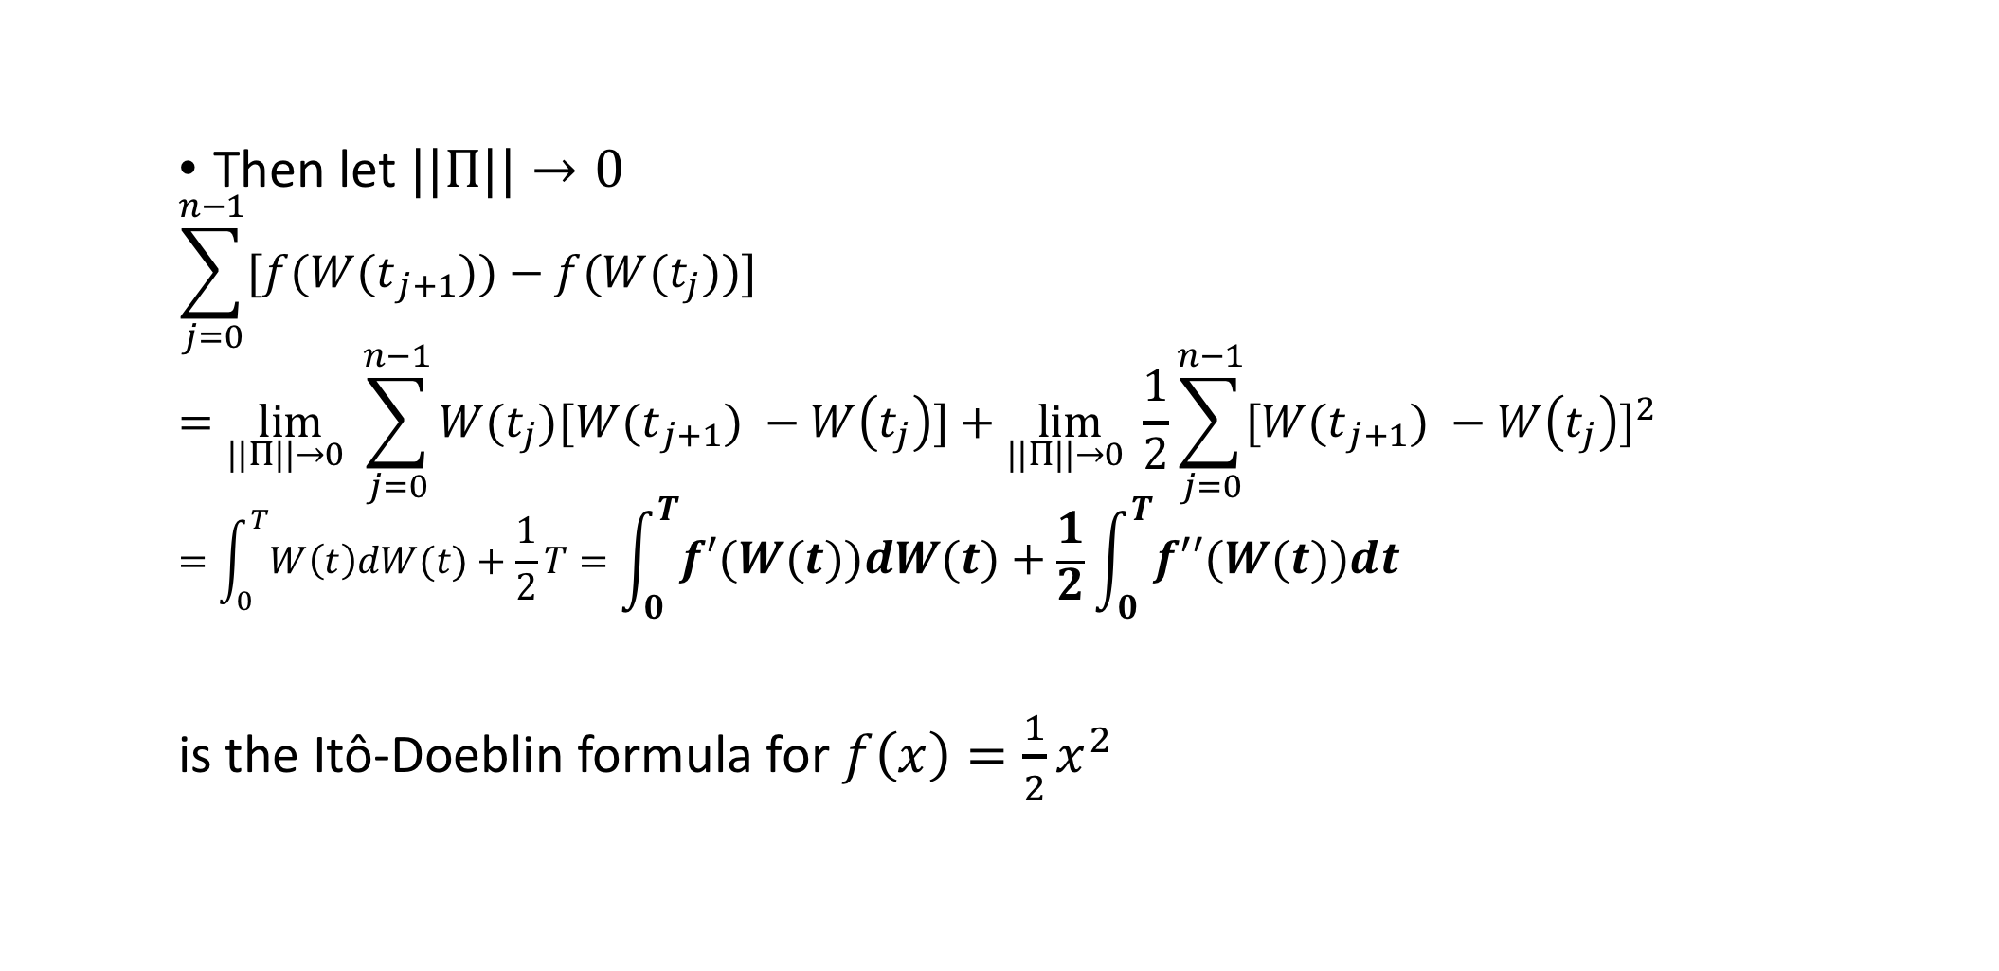
Proof: Theorem 4.4.1 Itô-Doeblin formula for Brownian motion(5)
Then let $||Π||→0$
$$\sum_{j=0}^{n−1}{[f(W{(t}_{j+1}))−f(W(t_{j}))]}$$
$$=\lim_{||Π||→0 }{\sum_{j=0}^{n−1}{W(t_{j})[W{(t}_{j+1}) −W\left(t_{j}\right)]}}+\lim_{||Π||→0 }{\frac{1}{2}\sum_{j=0}^{n−1}{{[W{(t}_{j+1}) −W\left(t_{j}\right)]}^{2}}}$$
$$=\int_{0}^{T}{W\left(t\right)dW(t)}+\frac{1}{2}T=\int_{0}^{T}{f′(W\left(t\right))dW(t)}+\frac{1}{2}\int_{0}^{T}{f′′(W\left(t\right))dt}$$
is the Itô-Doeblin formula for $f\left(x\right)=\frac{1}{2}x^{2}$
(4.4.7)

Slide 14
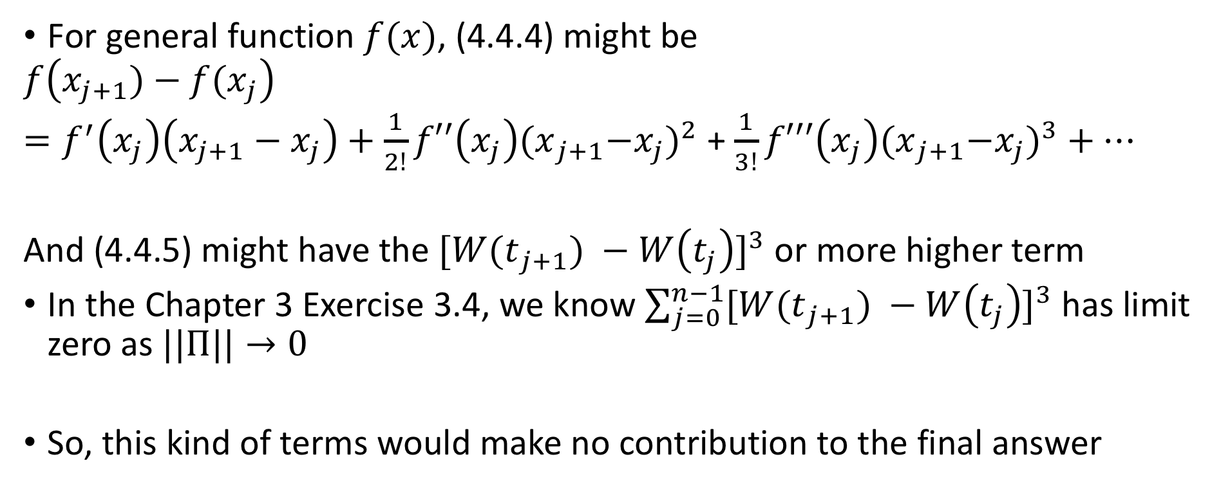
Proof: Theorem 4.4.1 Itô-Doeblin formula for Brownian motion(6)
For general function $f(x)$, (4.4.4) might be
$$f\left(x_{j+1})−f(x_{j}\right)$$
$=f^{′}\left(x_{j}\right)\left(x_{j+1}−x_{j}\right)+\frac{1}{2!}{f′′\left(x_{j}\right){(x}_{j+1}−x_{j})}^{2}$ + $\frac{1}{3!}{f′′′\left(x_{j}\right){(x}_{j+1}−x_{j})}^{3}+…$
And (4.4.5) might have the ${[W{(t}_{j+1}) −W\left(t_{j}\right)]}^{3}$ or more higher term
In the Chapter 3 Exercise 3.4, we know $\sum_{j=0}^{n−1}{{[W{(t}_{j+1}) −W\left(t_{j}\right)]}^{3}}$ has limit zero as $||Π||→0$
So, this kind of terms would make no contribution to the final answer

Slide 15
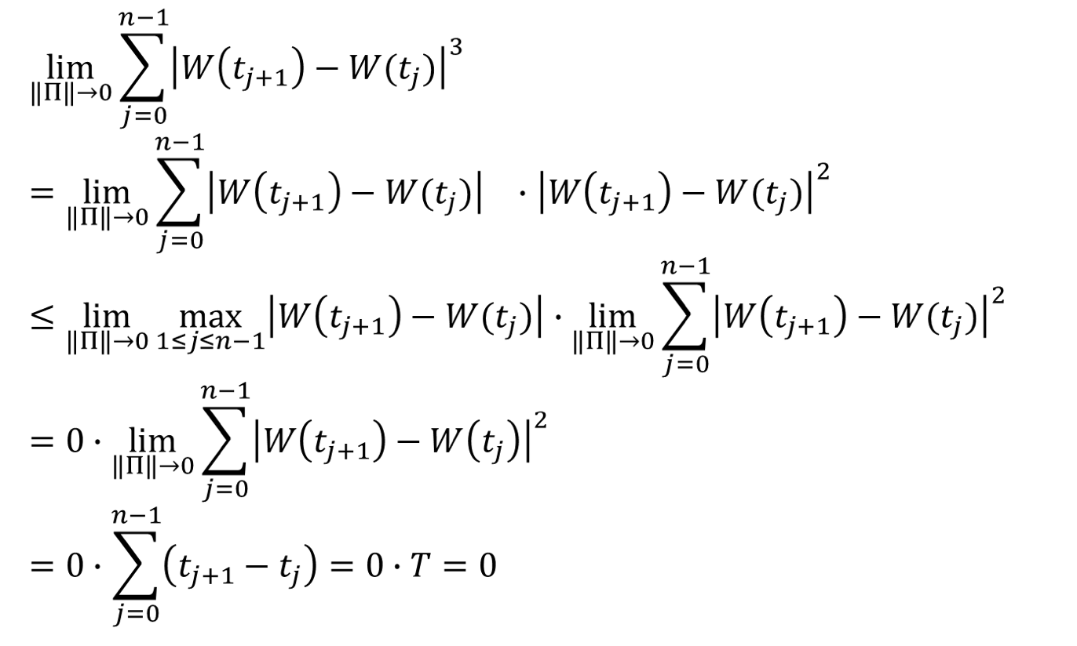
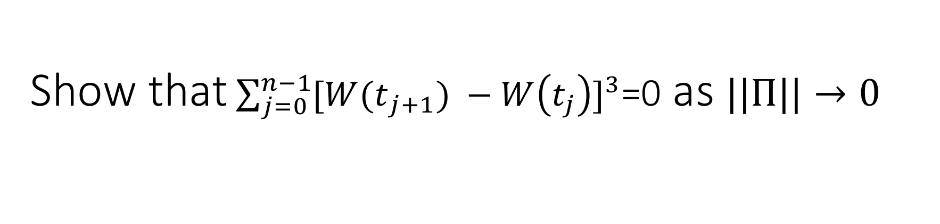
Show that$\sum_{j=0}^{n−1}{{[W{(t}_{j+1}) −W\left(t_{j}\right)]}^{3}}$=0 as $||Π||→0$

Slide 16
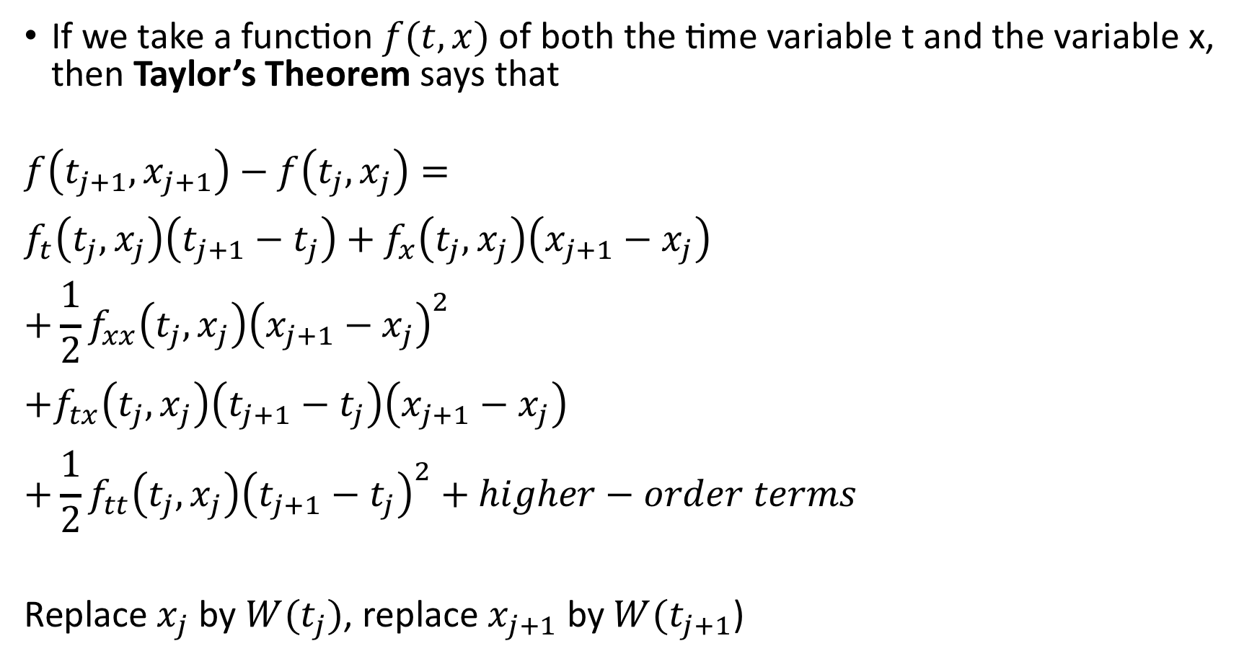
If we take a function $f(t,x)$ of both the time variable t and the variable x, then Taylor’s Theorem says that
$$f\left(t_{j+1},x_{j+1}\right)−f\left(t_{j},x_{j}\right)=$$
$$f_{t}\left(t_{j},x_{j}\right)\left(t_{j+1}−t_{j}\right)+f_{x}\left(t_{j},x_{j}\right)\left(x_{j+1}−x_{j}\right)$$
$$+\frac{1}{2}f_{xx}\left(t_{j},x_{j}\right){\left(x_{j+1}−x_{j}\right)}^{2}$$
$$+f_{tx}\left(t_{j},x_{j}\right)\left(t_{j+1}−t_{j}\right)\left(x_{j+1}−x_{j}\right)$$
$$+\frac{1}{2}f_{tt}\left(t_{j},x_{j}\right){\left(t_{j+1}−t_{j}\right)}^{2}+higher−order terms$$
Replace $x_{j}$ by $W(t_{j})$, replace $x_{j+1}$ by $W(t_{j+1}$)

Slide 17
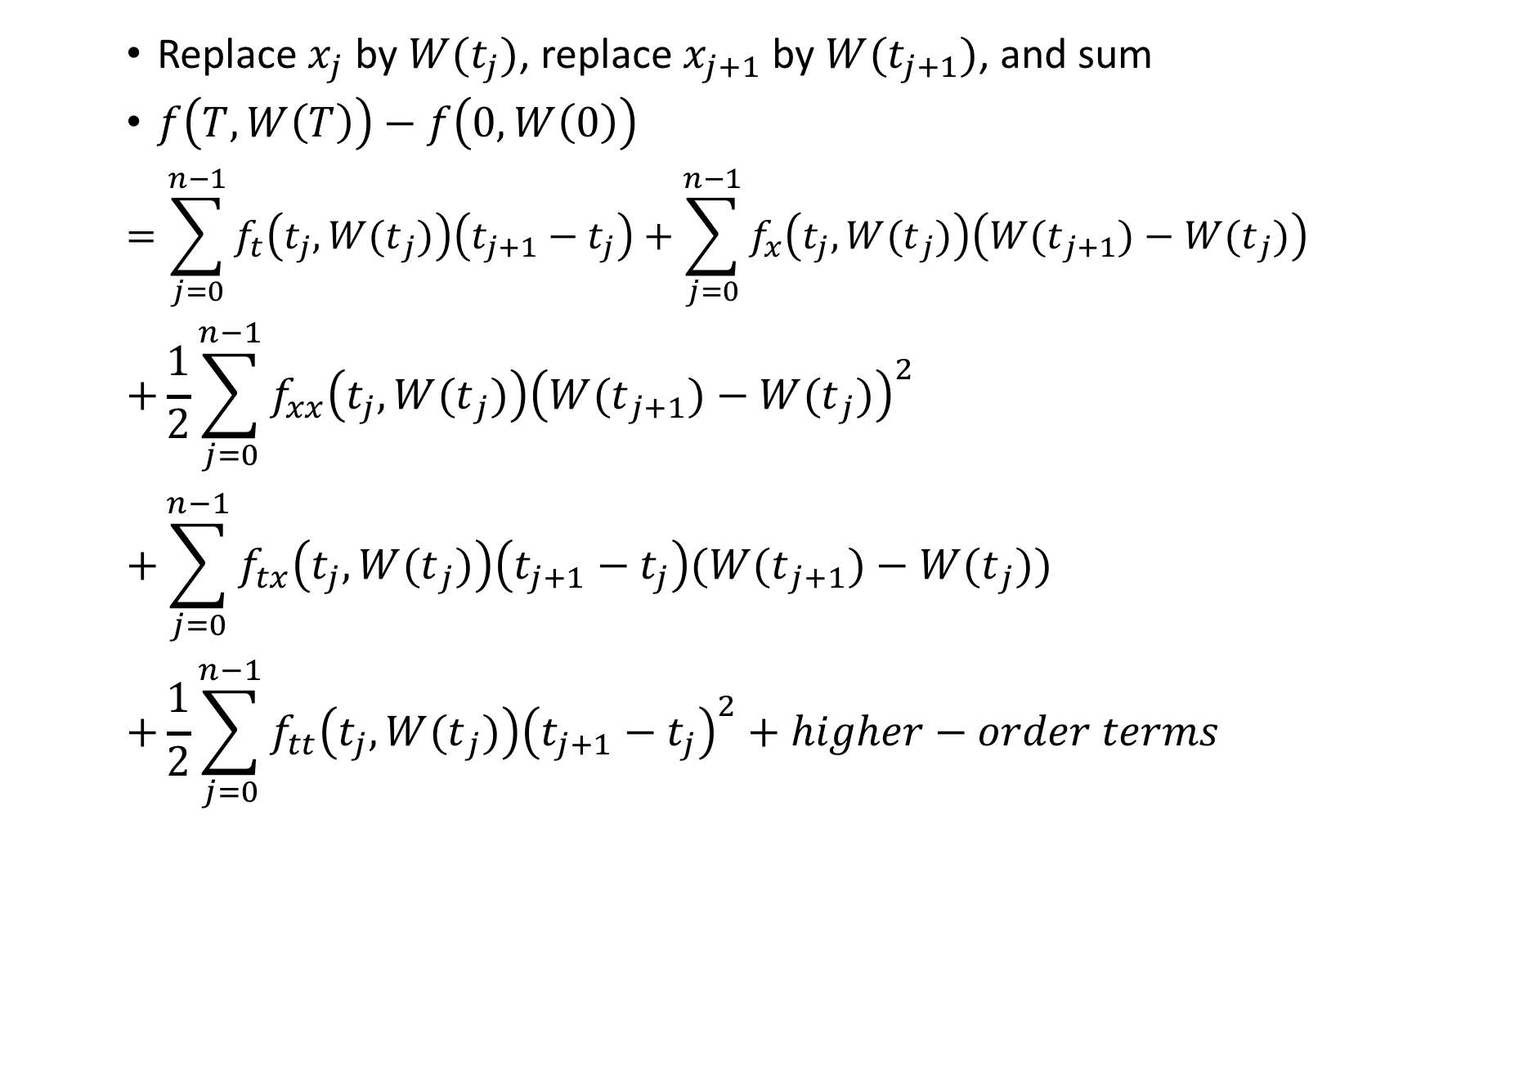
Replace $x_{j}$ by $W(t_{j})$, replace $x_{j+1}$ by $W(t_{j+1})$, and sum
$f\left(T,W\left(T\right)\right)−f\left(0,W\left(0\right)\right)$
$$=\sum_{j=0}^{n−1}{f_{t}\left(t_{j},{W(t}_{j})\right)\left(t_{j+1}−t_{j}\right)+\sum_{j=0}^{n−1}{f_{x}\left(t_{j},{W(t}_{j})\right)\left({W(t}_{j+1})−{W(t}_{j})\right)}}$$
$$+\frac{1}{2}\sum_{j=0}^{n−1}{f_{xx}\left(t_{j},{W(t}_{j})\right){\left({W(t}_{j+1})−{W(t}_{j})\right)}^{2}}$$
$$+\sum_{j=0}^{n−1}{f_{tx}\left(t_{j},{W(t}_{j})\right)\left(t_{j+1}−t_{j}\right)({W(t}_{j+1})−{W(t}_{j}))}$$
$$+\frac{1}{2}\sum_{j=0}^{n−1}{f_{tt}\left(t_{j},{W(t}_{j})\right){\left(t_{j+1}−t_{j}\right)}^{2}}+higher−order terms$$
(4.4.9)

Slide 18
Replace $x_{j}$ by $W(t_{j})$, replace $x_{j+1}$ by $W(t_{j+1})$, and sum
$f\left(T,W\left(T\right)\right)−f\left(0,W\left(0\right)\right)$
$$=\sum_{j=0}^{n−1}{f_{t}\left(t_{j},{W(t}_{j})\right)\left(t_{j+1}−t_{j}\right)+\sum_{j=0}^{n−1}{f_{x}\left(t_{j},{W(t}_{j})\right)\left({W(t}_{j+1})−{W(t}_{j})\right)}}$$
$$+\frac{1}{2}\sum_{j=0}^{n−1}{f_{xx}\left(t_{j},{W(t}_{j})\right){\left({W(t}_{j+1})−{W(t}_{j})\right)}^{2}}$$
$$+\sum_{j=0}^{n−1}{f_{tx}\left(t_{j},{W(t}_{j})\right)\left(t_{j+1}−t_{j}\right)({W(t}_{j+1})−{W(t}_{j}))}$$
$$+\frac{1}{2}\sum_{j=0}^{n−1}{f_{tt}\left(t_{j},{W(t}_{j})\right){\left(t_{j+1}−t_{j}\right)}^{2}}+higher−order terms$$
(4.4.9)

Slide 19
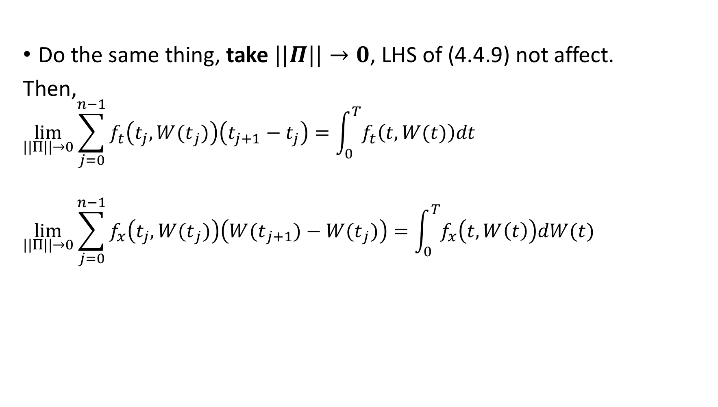
Proof: Theorem 4.4.1 Itô-Doeblin formula for Brownian motion(7)
Do the same thing, take $||Π||→0$, LHS of (4.4.9) not affect.
Then,
$$\lim_{||Π||→0}{\sum_{j=0}^{n−1}{f_{t}\left(t_{j},{W(t}_{j})\right)\left(t_{j+1}−t_{j}\right)=\int_{0}^{T}{f_{t}\left(t,W(t)\right)dt}}}$$
$$\lim_{||Π||→0}\sum_{j=0}^{n−1}{f_{x}\left(t_{j},{W(t}_{j})\right)\left({W(t}_{j+1})−{W(t}_{j})\right)=\int_{0}^{T}{f_{x}\left(t,W\left(t\right)\right)dW(t)}}$$
Lebesgue Integral
Itô Integral

Slide 20
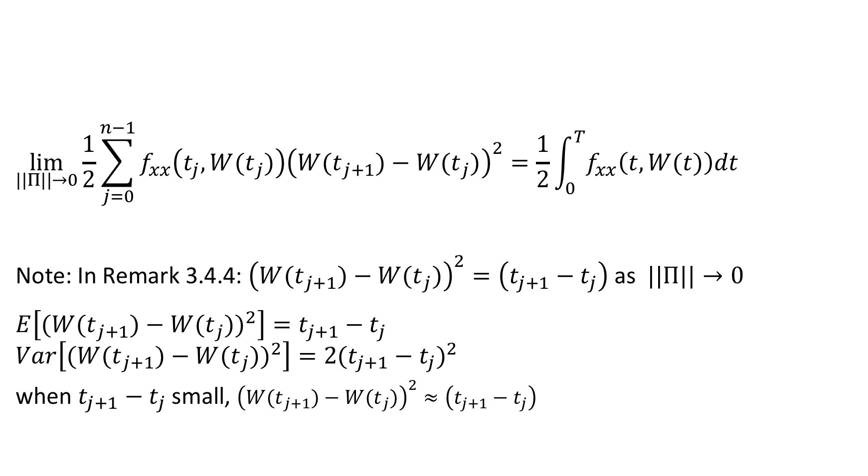
Proof: Theorem 4.4.1 Itô-Doeblin formula for Brownian motion(8)
$$\lim_{||Π||→0}\frac{1}{2}\sum_{j=0}^{n−1}{f_{xx}\left(t_{j},{W(t}_{j})\right){\left({W(t}_{j+1})−{W(t}_{j})\right)}^{2}=\frac{1}{2}\int_{0}^{T}{f_{xx}\left(t,W(t)\right)dt}}$$
Note: In Remark 3.4.4: ${\left({W(t}_{j+1})−{W(t}_{j})\right)}^{2}=\left(t_{j+1}−t_{j}\right)$ as $||Π||→0$
$$E\left[{{(W(t}_{j+1})−{W(t}_{j}))}^{2}\right]=t_{j+1}−t_{j}$$
$$Var\left[{{(W(t}_{j+1})−{W(t}_{j}))}^{2}\right]={2(t_{j+1}−t_{j})}^{2}$$
when $t_{j+1}−t_{j}$ small, ${\left({W(t}_{j+1})−{W(t}_{j})\right)}^{2}≈\left(t_{j+1}−t_{j}\right)$
Lebesgue Integral

Slide 21
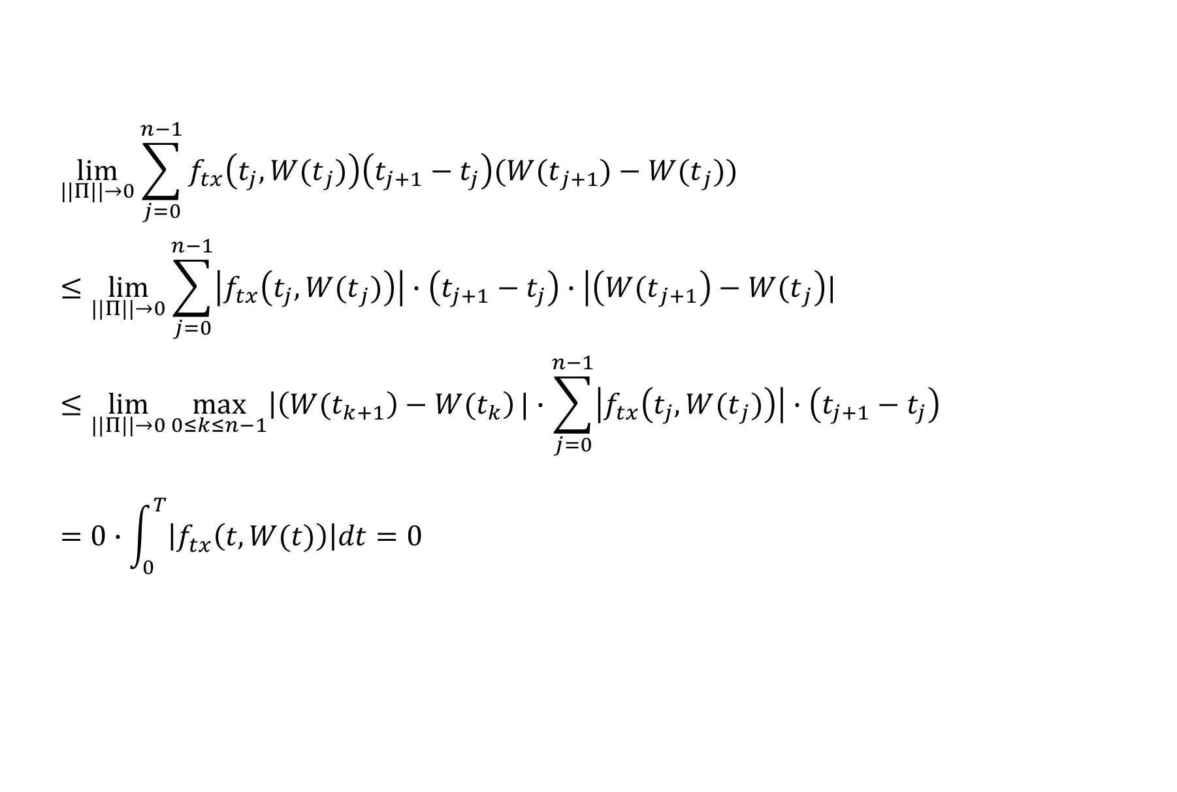
Proof: Theorem 4.4.1 Itô-Doeblin formula for Brownian motion(9)
$$\lim_{||Π||→0}{\sum_{j=0}^{n−1}{f_{tx}\left(t_{j},{W(t}_{j})\right)\left(t_{j+1}−t_{j}\right)({W(t}_{j+1})−{W(t}_{j}))}}$$
$$≤\lim_{||Π||→0}{\sum_{j=0}^{n−1}{\left|f_{tx}\left(t_{j},{W(t}_{j})\right)\right|∙\left(t_{j+1}−t_{j}\right)∙\left|\left({W(t}_{j+1}\right)−{W(t}_{j}\right)|}}$$
$$≤\lim_{||Π||→0}{\max_{0≤k≤n−1}\left|\left({W(t}_{k+1}\right)−{W(t}_{k}\right)|∙\sum_{j=0}^{n−1}{\left|f_{tx}\left(t_{j},{W(t}_{j})\right)\right|∙\left(t_{j+1}−t_{j}\right)}}$$
$$=0∙\int_{0}^{T}{\left|f_{tx}\left(t,W(t)\right)\right|dt=0}$$
(4.4.10)
Lebesgue Integral

Slide 22
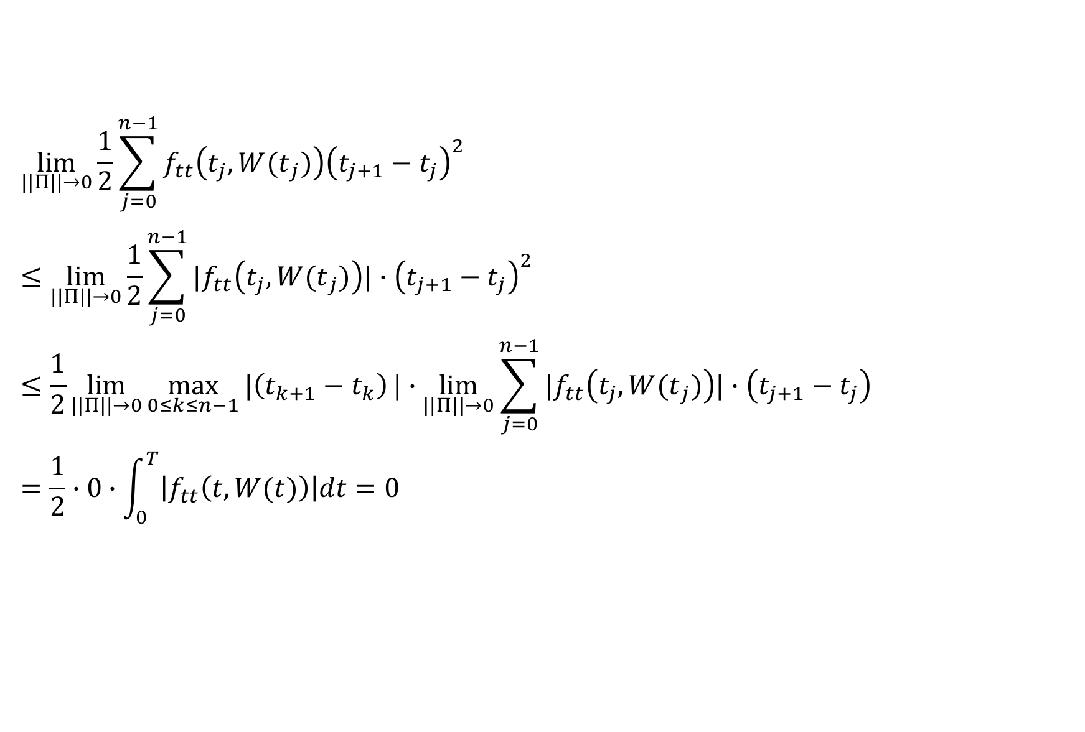
Proof: Theorem 4.4.1 Itô-Doeblin formula for Brownian motion(10)
$$\lim_{||Π||→0}{\frac{1}{2}\sum_{j=0}^{n−1}{f_{tt}\left(t_{j},{W(t}_{j})\right){\left(t_{j+1}−t_{j}\right)}^{2}}}$$
$$≤\lim_{||Π||→0}{\frac{1}{2}\sum_{j=0}^{n−1}{{|f}_{tt}\left(t_{j},{W(t}_{j})\right)|∙{\left(t_{j+1}−t_{j}\right)}^{2}}}$$
$$≤\frac{1}{2}\lim_{||Π||→0}{\max_{0≤k≤n−1}{|\left(t_{k+1}−t_{k}\right)}|∙\lim_{||Π||→0}\sum_{j=0}^{n−1}{|f_{tt}\left(t_{j},{W(t}_{j})\right)|∙\left(t_{j+1}−t_{j}\right)}}$$
$$=\frac{1}{2}∙0∙\int_{0}^{T}{\left|f_{tt}\left(t,W(t)\right)\right|dt=0}$$
(4.4.11)
Lebesgue Integral

Slide 23

Remark 4.4.2
From (4.4.10) , $(t_{j+1}−t_{j})(W(t_{j+1})−W(t_{j}))$has limit zero
$$dtdW\left(t\right)=0$$
Similarly, (4.4.11) ,${(t_{j+1}−t_{j})}^{2}$ also has limit zero
$$dtdt=0$$

Slide 24
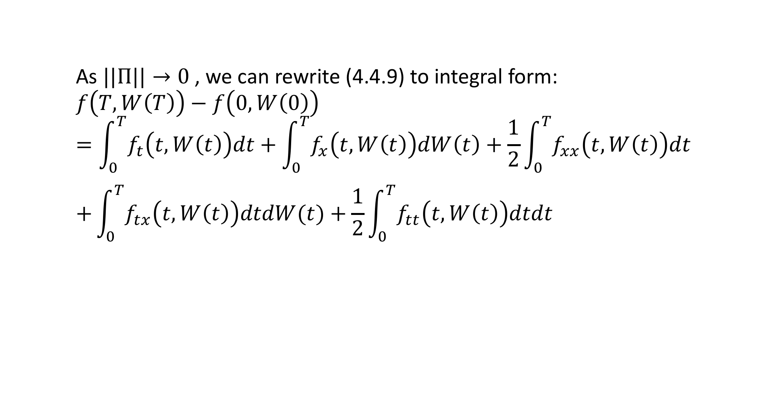
Remark 4.4.2
As $||Π||→0$, we can rewrite (4.4.9) to integral form:
$$f\left(T,W\left(T\right)\right)−f\left(0,W\left(0\right)\right)=\int_{0}^{T}{f_{t}\left(t,W\left(t\right)\right)dt}+\int_{0}^{T}{f_{x}\left(t,W\left(t\right)\right)dW\left(t\right)}+\frac{1}{2}\int_{0}^{T}{f_{xx}\left(t,W\left(t\right)\right)dt}$$
$$+\int_{0}^{T}{f_{tx}\left(t,W\left(t\right)\right)dtdW(t)}+\frac{1}{2}\int_{0}^{T}{f_{tt}\left(t,W\left(t\right)\right)dtdt}$$

Slide 25
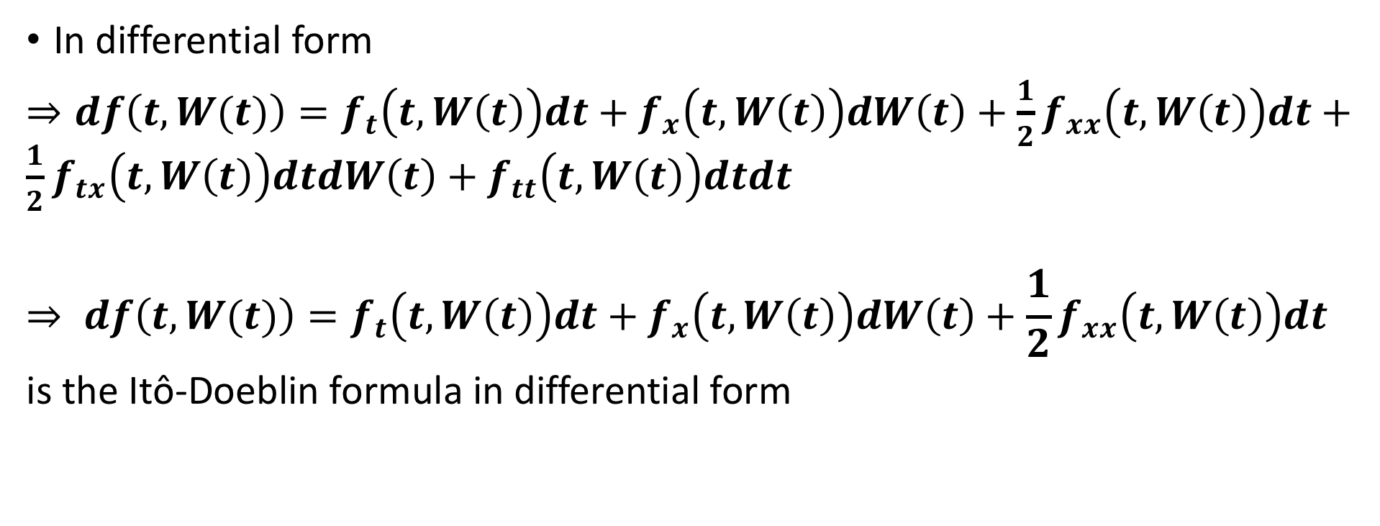
Remark 4.4.2
In differential form
$⇒df\left(t,W(t)\right)=f_{t}\left(t,W\left(t\right)\right)dt+f_{x}\left(t,W\left(t\right)\right)dW\left(t\right)+{\frac{1}{2}f}_{xx}\left(t,W\left(t\right)\right)dt+{\frac{1}{2}f}_{tx}\left(t,W\left(t\right)\right)dtdW\left(t\right)+f_{tt}\left(t,W\left(t\right)\right)dtdt$
$$⇒ df\left(t,W(t)\right)=f_{t}\left(t,W\left(t\right)\right)dt+f_{x}\left(t,W\left(t\right)\right)dW\left(t\right)+{\frac{1}{2}f}_{xx}\left(t,W\left(t\right)\right)dt$$
is the Itô-Doeblin formula in differential form

Slide 26
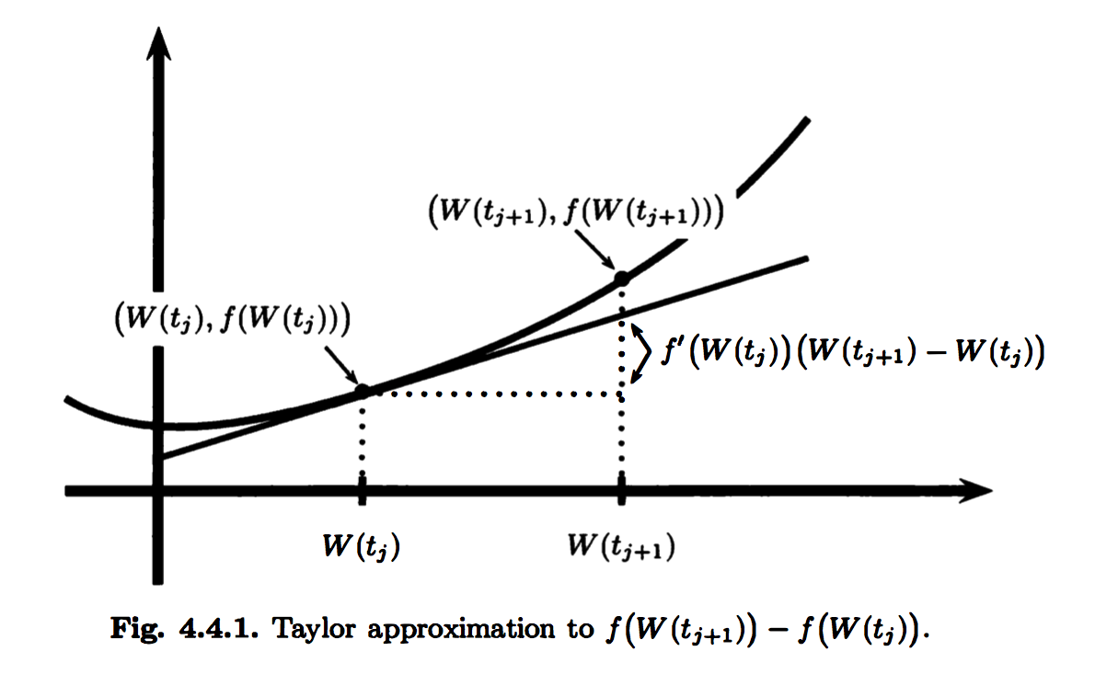
Remark 4.4.2

Slide 27

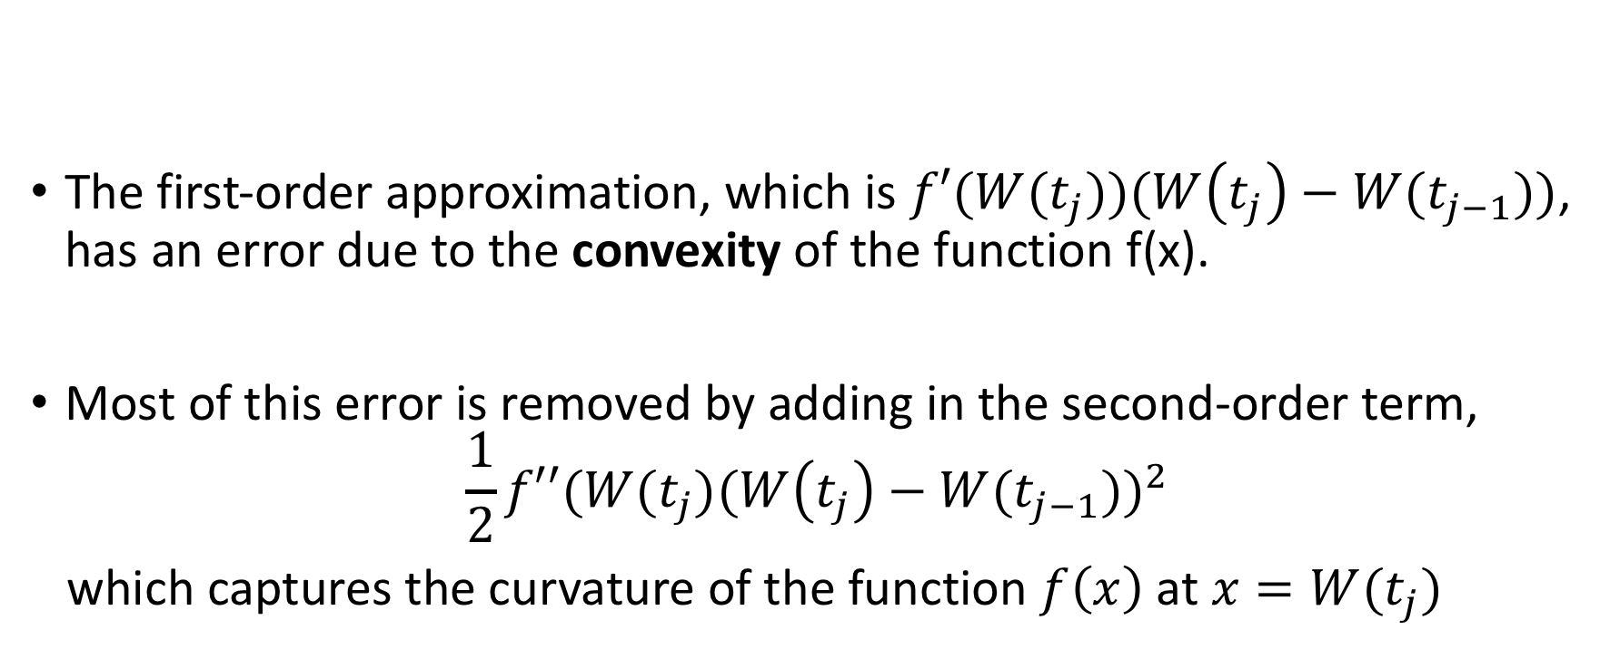
Remark 4.4.2
$$f\left(W(t_{j+1}) )−f(W(t_{j}) \right)=f^{′}\left(W(t_{j}) \right)\left(W(t_{j+1}) −W(t_{j}) \right)+\frac{1}{2}{f′′\left(W(t_{j}) \right)(W(t_{j+1}) −W(t_{j}) )}^{2}$$
The first-order approximation, which is $f′(W(t_{j}))(W\left(t_{j}\right)−W(t_{j−1}))$, has an error due to the convexity of the function f(x).
Most of this error is removed by adding in the second-order term,
$$\frac{1}{2}f′′(W(t_{j}){(W\left(t_{j}\right)−W(t_{j−1}))}^{2}$$
which captures the curvature of the function $f\left(x\right)$ at $x=W(t_{j})$

Slide 28
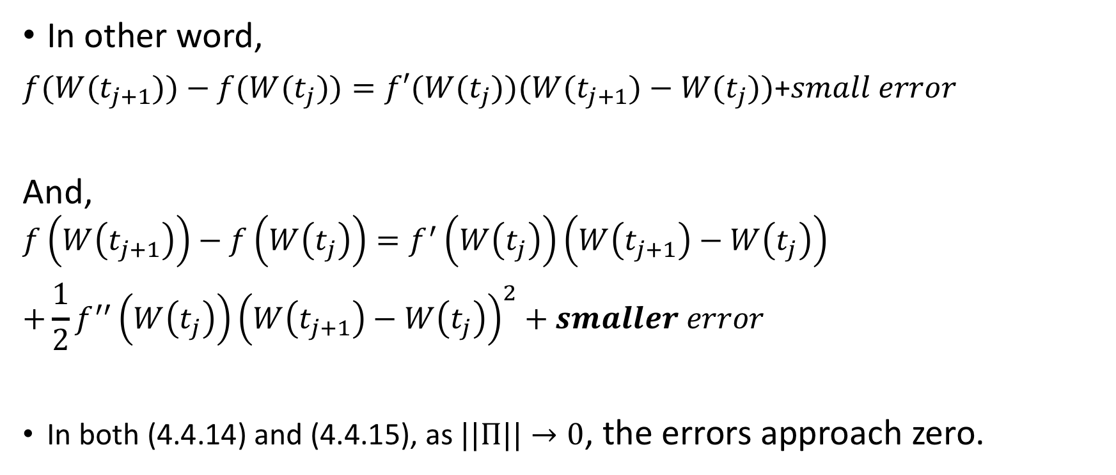
Remark 4.4.2
In other word,
$f(W(t_{j+1}))−f(W(t_{j}))=f′(W(t_{j}))(W(t_{j+1})−W(t_{j}))$+$small error$
And,
$$f\left(W\left(t_{j+1}\right)\right)−f\left(W\left(t_{j}\right)\right)=f^{′}\left(W\left(t_{j}\right)\right)\left(W\left(t_{j+1}\right)−W\left(t_{j}\right)\right)$$
$$+\frac{1}{2}f^{′′}\left(W\left(t_{j}\right)\right){\left(W\left(t_{j+1}\right)−W\left(t_{j}\right)\right)}^{2}+smaller error$$
In both (4.4.14) and (4.4.15), as $||Π||→0$, the errors approach zero.
(4.4.14)
(4.4.15)

Slide 29
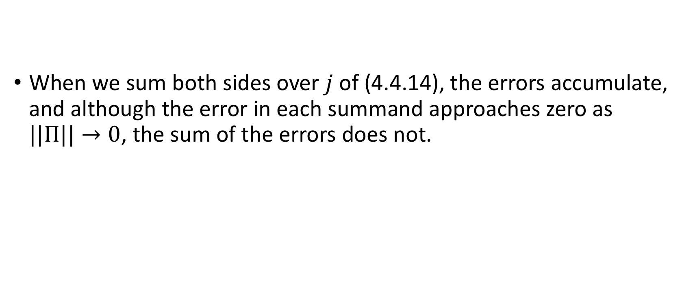
Remark 4.4.2
When we sum both sides over $j$ of (4.4.14), the errors accumulate, and although the error in each summand approaches zero as $||Π||→0$, the sum of the errors does not.
$f(W(t_{j+1}))−f(W(t_{j}))=f′(W(t_{j}))(W(t_{j+1})−W(t_{j}))$+$small error$
(4.4.14)

Slide 30
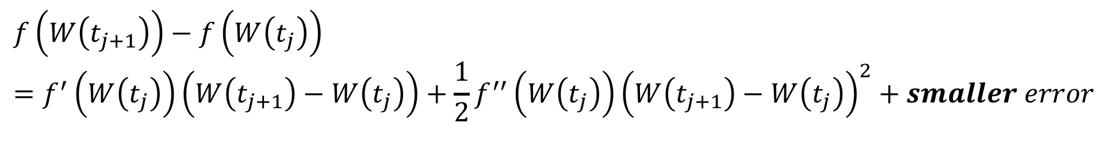
Remark 4.4.2
$$f\left(W\left(t_{j+1}\right)\right)−f\left(W\left(t_{j}\right)\right)=f^{′}\left(W\left(t_{j}\right)\right)\left(W\left(t_{j+1}\right)−W\left(t_{j}\right)\right)+\frac{1}{2}f^{′′}\left(W\left(t_{j}\right)\right){\left(W\left(t_{j+1}\right)−W\left(t_{j}\right)\right)}^{2}+smaller error$$
(4.4.15)
When we use the more accurate approximation (4.4.15), this does not happen; the limit of the sum of the smaller errors is zero.
We need the extra accuracy of (4.4.15) because the paths of Brownian motion are so volatile (i.e., they have nonzero quadratic variation).
This extra term makes stochastic calculus different from ordinary calculus.

Slide 31

Remark 4.4.2
The Itô-Doeblin formula often simplifies the computation of Itô Integrals. For example, with $f\left(x\right)=\frac{1}{2}x^{2}$ ,this formula says that

Slide 32
Rearranging terms, we have formula
and have obtained it without going through the approximation of the integrand by simple processes as we did in Example 4.3.2.
(4.3.6)

