Slide 1
Employee stock option
Update
學生：陳俊愷
指導老師：戴天時教授

Slide 2
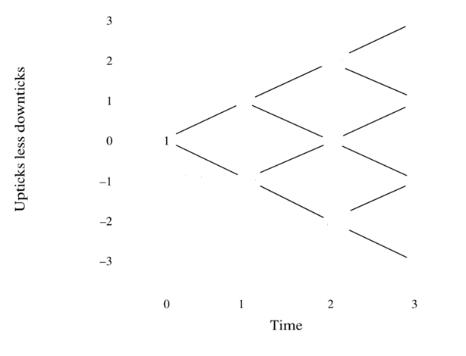
Q:為何公司不依員工的風險程度，將員工執行履約後的收益折現，在期初發放等值的獎金替代發放員工選擇權?或是公司依照員工會履約的最大效用折現回期初，反推等價獎金發放。
Problem1:折現(How)?
Problem2:針對超過一張員工選擇權，一次履約或是部分履約?(履約的最適比例)
8
4
2/3
2
2
1
1/3
1/2
1/2
1/4
1/8

Slide 3












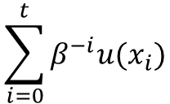













Discounted utility
在經濟學，對於未來 t 時間事件(例如:消費者購買商品、員工履約選擇權後的收益)的效用，依折現因子β，將該時間點的效用折現至時間點0。
離散時間
$β^{−t}u(x_{t})$ $, 0<β<1$
$$0$$
$$1$$
$$2$$
$$⋯⋯⋯⋯⋯$$
$$t$$
事件$x_{t}$
$$\text{帶入效用函數}u$$
$$u(x_{t})$$
$$β^{−t}$$
$β^{−t}u(x_{t})$
$$0$$
$$1$$
$$2$$
$$⋯⋯⋯⋯⋯$$
$$t$$
$$β^{−t}$$
u$(x_{t})$
$$β^{−(t−1)}$$
u$(x_{t−1})$
$$β^{−(t−2)}$$
u$(x_{t−2})$
$$\sum_{i=0}^{t}{β^{−i}u(x_{i})}$$
$$⋮ \\ ⋮$$
$$β^{−2}$$
u$(x_{2})$
$$β^{−1}$$
u$(x_{1})$

Slide 4


















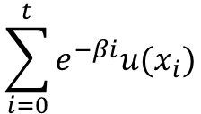





連續時間
$$0$$
$$1$$
$$2$$
$$⋯⋯⋯⋯⋯$$
$$t$$
事件$x_{t}$
$$\text{帶入效用函數}u$$
$$u(x_{t})$$
$e^{−βt}u(x_{t})$
$$0$$
$$1$$
$$2$$
$$⋯⋯⋯⋯⋯$$
$$t$$
$$e^{−βt}$$
u$(x_{t})$
$$e^{−β(t−1)}$$
u$(x_{t−1})$
$$\sum_{i=0}^{t}{e^{−βi}u(x_{i})}$$
$$e^{−β(t−2)}$$
u$(x_{t−2})$
$$e^{−2β}$$
$$⋮ \\ ⋮$$
u$(x_{2})$
$$e^{−β}$$
u$(x_{1})$

Slide 5
Utility-based valuation method
N employee stock options
Exercise price: K
Maturity date: T
M期
Assume No dividends No vesting period After exercising, sell the stocks directly Do not consider the diluted of stock price

Slide 6


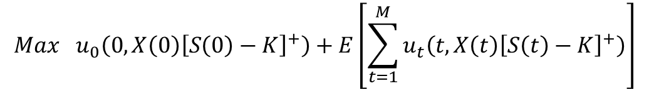


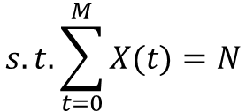

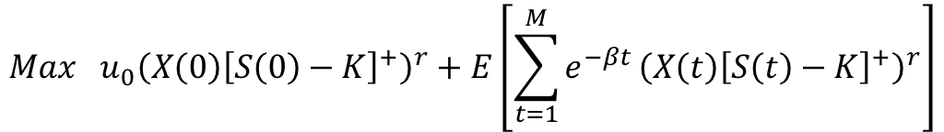

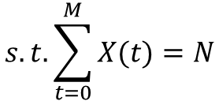

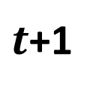
Assume the utility function u$\left(t,w\right)=e^{−βt}w^{r} ,0<r≤1$
$$0$$
$$1$$
$$2$$
$$⋯⋯⋯⋯⋯$$
$$t$$
$t$+1
$$⋯⋯⋯⋯$$
$$t_{M}=T$$
$$U_{0}=u_{0}+{E[u}_{1}]+⋯⋯+E[u_{M}]$$
$$Max u_{0}\left(0,X\left(0\right){\left[S\left(0\right)−K\right]}^{+}\right)+E\left[\sum_{t=1}^{M}{u_{t}\left(t,X\left(t\right){\left[S\left(t\right)−K\right]}^{+}\right)}\right]$$
$$s.t. \sum_{t=0}^{M}{X(t)}=N$$
$$Max u_{0}{\left(X\left(0\right){\left[S\left(0\right)−K\right]}^{+}\right)}^{r}+E\left[\sum_{t=1}^{M}{e^{−βt}}{\left(X\left(t\right){\left[S\left(t\right)−K\right]}^{+}\right)}^{r}\right]$$
$$s.t. \sum_{t=0}^{M}{X(t)}=N$$
X(t): t 時間點執行選擇權張數

Slide 7
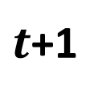



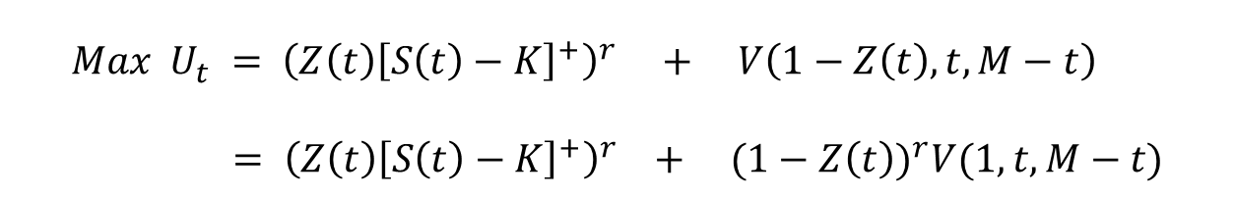



more simple
assume the employee has the stock option at anytime t < T
M-t
0
1
2
$$⋯⋯⋯⋯⋯$$
$$t$$
$t$+1
$$⋯⋯⋯⋯$$
$$t_{M}=T$$
And his utility at time t is :
t時間點執行選擇權的效用
t時間點後執行選擇權的預期折現效用
$$Max{ U}_{t} = {\left(Z\left(t\right){\left[S\left(t\right)−K\right]}^{+}\right)}^{r} + V\left(1−Z\left(t\right),t,M−t\right) \\ = {\left(Z\left(t\right){\left[S\left(t\right)−K\right]}^{+}\right)}^{r} + (1−Z{\left(t\right))}^{r}V(1,t,M−t)$$
$Z\left(t\right)=\frac{X\left(t\right)}{N}$，t 時間點執行選擇權的比例
$$V(x, t, M−t)=$$
從 t 點到期末還握有 x 張選擇權，還剩 M-t 期，在這段期間執行選擇權所產生的效用折現到 t 點的效用總合

Slide 8
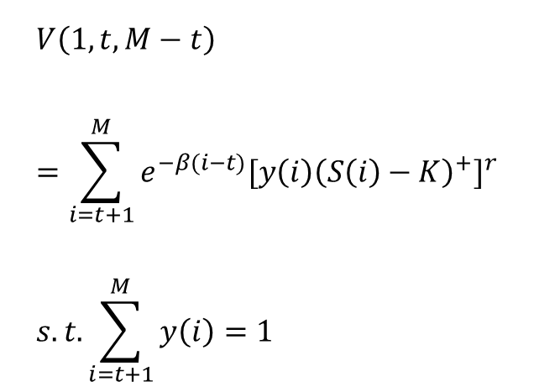
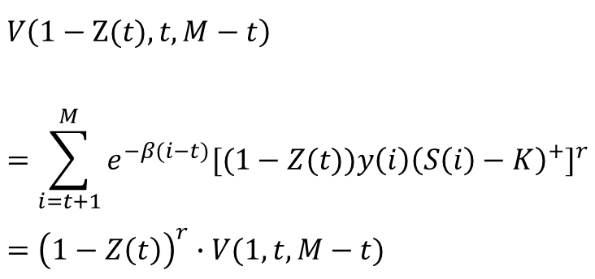
state： $V\left(1−Z\left(t\right),t,M−t\right)=(1−Z{\left(t\right))}^{r}V(1,t,M−t)$
$$V\left(1,t,M−t\right) \\ =\sum_{i=t+1}^{M}{e^{−β(i−t)}{[y\left(i\right){\left(S\left(i\right)−K\right)}^{+}]}^{r}} \\ s.t.\sum_{i=t+1}^{M}{y\left(i\right)=1}$$
$$V\left(1−Z(t),t,M−t\right) \\ =\sum_{i=t+1}^{M}{e^{−β(i−t)}{[(1−Z(t))y\left(i\right){\left(S\left(i\right)−K\right)}^{+}]}^{r}} \\ ={\left(1−Z\left(t\right)\right)}^{r}∙V(1,t,M−t)$$

Slide 9
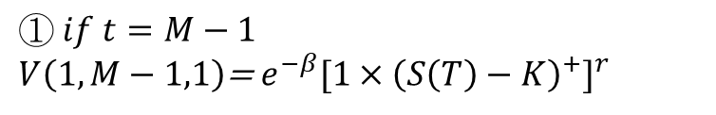



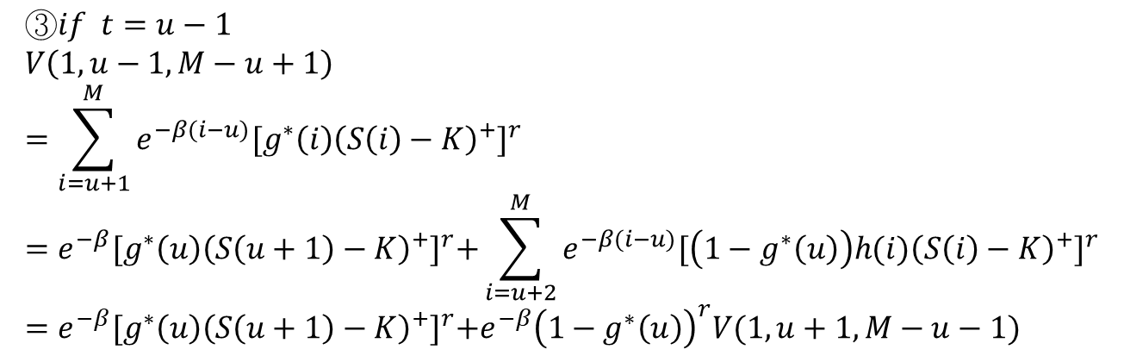
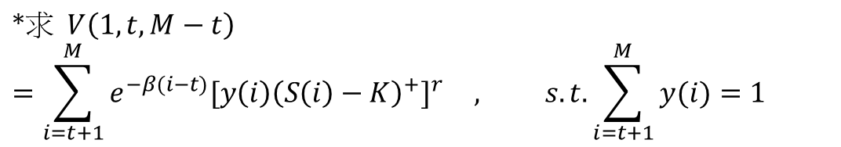







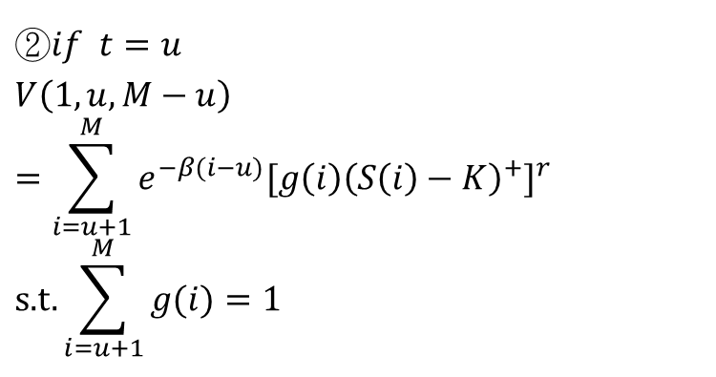


$$∗求 V\left(1,t,M−t\right) \\ =\sum_{i=t+1}^{M}{e^{−β(i−t)}{[y\left(i\right){\left(S\left(i\right)−K\right)}^{+}]}^{r}} , s.t.\sum_{i=t+1}^{M}{y(i)}=1$$
$$① if t=M−1$$
$V\left(1,M−1,1\right)$= $e^{−β}{[1×{\left(S\left(T\right)−K\right)}^{+}]}^{r}$
$$0$$
$$1$$
$$⋯⋯⋯$$
$M$-1
$$M$$
$$②if t=u$$
$$V\left(1,u,M−u\right) \\ =\sum_{i=u+1}^{M}{e^{−β(i−u)}{[g\left(i\right){\left(S\left(i\right)−K\right)}^{+}]}^{r}}$$
$$\text{s}\text{.}\text{t}\text{.}\sum_{i=u+1}^{M}{g(i)}=1$$
$$0$$
$$1$$
$$⋯$$
$$u−1$$
$$u$$
$$⋯⋯$$
$$M$$
$$③if t=u−1 \\ V\left(1,u−1,M−u+1\right) \\ =\sum_{i=u+1}^{M}{e^{−β(i−u)}{[g^{∗}\left(i\right){\left(S\left(i\right)−K\right)}^{+}]}^{r}} \\ =e^{−β}{[g^{∗}\left(u\right){\left(S\left(u+1\right)−K\right)}^{+}]}^{r}+\sum_{i=u+2}^{M}{e^{−β(i−u)}{[\left(1−g^{∗}\left(u\right)\right)h(i){\left(S\left(i\right)−K\right)}^{+}]}^{r}} \\ =e^{−β}{[g^{∗}\left(u\right){\left(S\left(u+1\right)−K\right)}^{+}]}^{r}+e^{−β}{\left(1−g^{∗}\left(u\right)\right)}^{r}V(1,u+1,M−u−1)$$

Slide 10
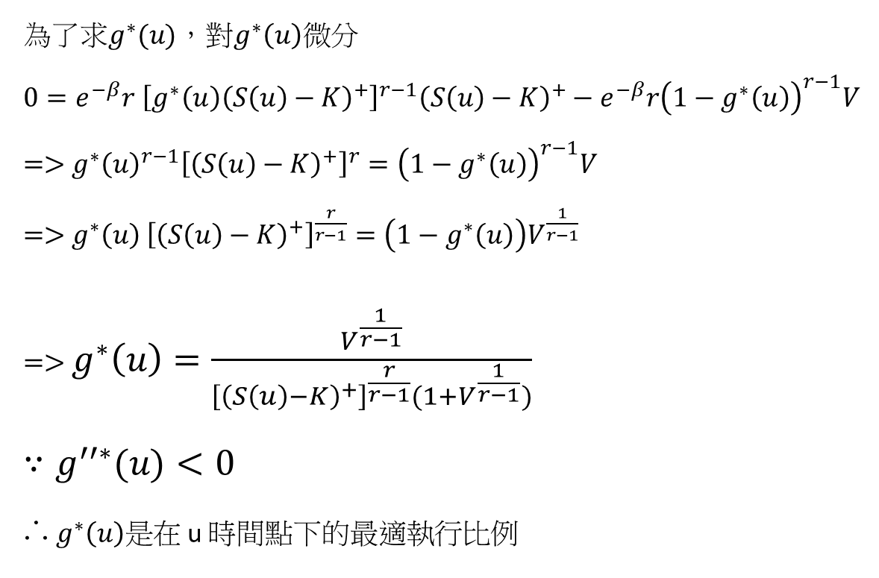
$$=>V\left(1,u−1,M−u+1\right)$$ $=$ $e^{−β}{[g^{∗}\left(u\right){\left(S\left(u\right)−K\right)}^{+}]}^{r}+e^{−β}{\left(1−g^{∗}\left(u\right)\right)}^{r}V(1,u,M−u)$
為了求$g^{∗}(u)$，對$g^{∗}\left(u\right)微分$
$0=e^{−β}r$ ${\left[g^{∗}\left(u\right){\left(S\left(u\right)−K\right)}^{+}\right]}^{r−1}{\left(S\left(u\right)−K\right)}^{+}−e^{−β}r{\left(1−g^{∗}\left(u\right)\right)}^{r−1}V$ $=>$ $g^{∗}{\left(u\right)}^{r−1}{\left[{\left(S\left(u\right)−K\right)}^{+}\right]}^{r}={\left(1−g^{∗}\left(u\right)\right)}^{r−1}V$ $=>$ $g^{∗}\left(u\right)$ ${\left[{\left(S\left(u\right)−K\right)}^{+}\right]}^{\frac{r}{r−1}}=\left(1−g^{∗}\left(u\right)\right)V^{\frac{1}{r−1}}$ $=>$ $g^{∗}\left(u\right)=\frac{V^{\frac{1}{r−1}}}{{\left[{\left(S\left(u\right)−K\right)}^{+}\right]}^{\frac{r}{r−1}}(1+V^{\frac{1}{r−1}})}$
$$∵g^{′′∗}(u)<0$$
∴ $g^{∗}\left(u\right)是$在 u 時間點下的最適執行比例

Slide 11
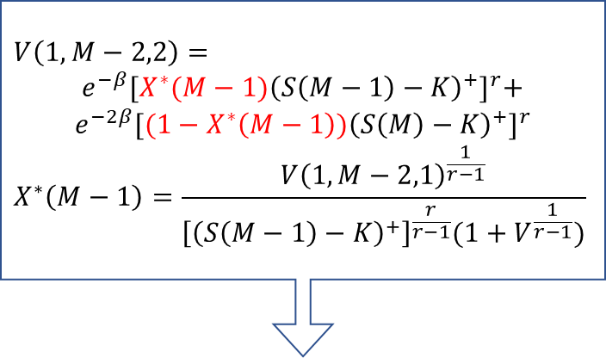
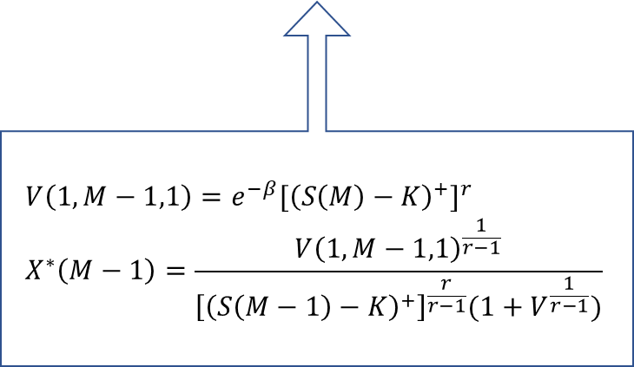
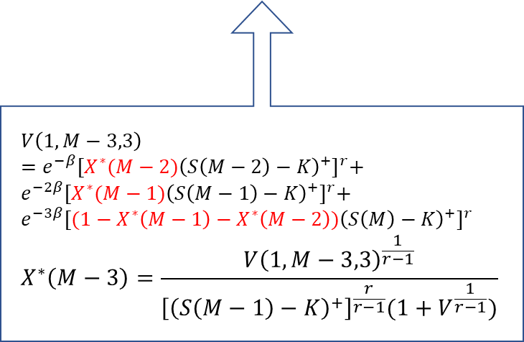
$$V\left(1,M−2,2\right)=$$ $e^{−β}{[X^{∗}(M−1){\left(S\left(M−1\right)−K\right)}^{+}]}^{r}+$ $e^{−2β}{[(1−X^{∗}\left(M−1\right)){\left(S\left(M\right)−K\right)}^{+}]}^{r}$ $$X^{∗}\left(M−1\right)=\frac{{V\left(1,M−2,1\right)}^{\frac{1}{r−1}}}{{\left[{\left(S\left(M−1\right)−K\right)}^{+}\right]}^{\frac{r}{r−1}}(1+V^{\frac{1}{r−1}})}$$
0
M-3
M-2
M-1
M
$$V\left(1,M−3,3\right)=e^{−β}{[X^{∗}(M−2){\left(S\left(M−2\right)−K\right)}^{+}]}^{r}+ e^{−2β}{[X^{∗}(M−1){\left(S\left(M−1\right)−K\right)}^{+}]}^{r}+ \\ e^{−3β}{[(1−X^{∗}\left(M−1\right)−X^{∗}\left(M−2\right)){\left(S\left(M\right)−K\right)}^{+}]}^{r} \\ X^{∗}\left(M−3\right)=\frac{{V\left(1,M−3,3\right)}^{\frac{1}{r−1}}}{{\left[{\left(S\left(M−1\right)−K\right)}^{+}\right]}^{\frac{r}{r−1}}(1+V^{\frac{1}{r−1}})}$$
$$V\left(1,M−1,1\right)=e^{−β}{[{\left(S\left(M\right)−K\right)}^{+}]}^{r} \\ X^{∗}\left(M−1\right)=\frac{{V\left(1,M−1,1\right)}^{\frac{1}{r−1}}}{{\left[{\left(S\left(M−1\right)−K\right)}^{+}\right]}^{\frac{r}{r−1}}(1+V^{\frac{1}{r−1}})}$$

Slide 12
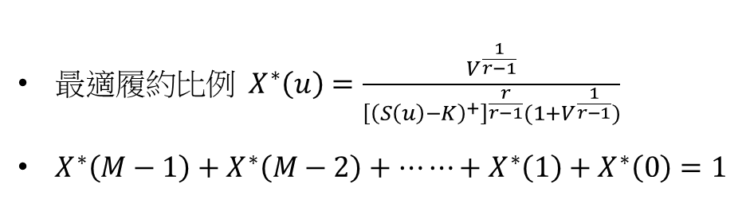
最$適履約比例 X^{∗}\left(u\right)=\frac{V^{\frac{1}{r−1}}}{{\left[{\left(S\left(u\right)−K\right)}^{+}\right]}^{\frac{r}{r−1}}(1+V^{\frac{1}{r−1}})}$
$X^{∗}\left(M−1\right)+X^{∗}\left(M−2\right)+⋯⋯+X^{∗}\left(1\right)+X^{∗}\left(0\right)=1$

