Slide 1
Bellman Equation
傅鈺婷、陳柏壬
指導教授：戴天時 教授

Slide 2












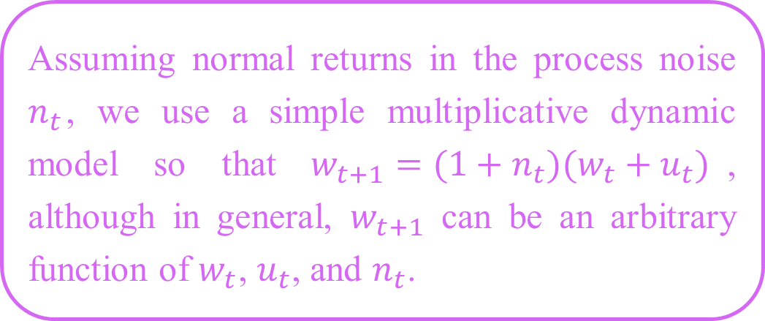













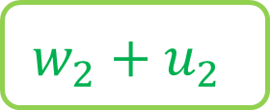
回顧MIT
Assuming normal returns in the process noise $n_{t}$, we use a simple multiplicative dynamic model so that $w_{t+1}=(1+n_{t})(w_{t}+u_{t})$, although in general, $w_{t+1}$ can be an arbitrary function of $w_{t}$, $u_{t}$, and $n_{t}$.
……
$$time=0$$
$$1$$
$$2$$
$$3$$
$$4$$
$$t−1$$
$$t$$
$$w_{0}$$
$$w_{1}$$
$$w_{2}$$
$$w_{3}$$
$$w_{4}$$
……
$$w_{t−1}$$
$$w_{t}$$
$$u_{0}$$
$$u_{1}$$
$$u_{2}$$
$$u_{3}$$
$$u_{4}$$
……
$$u_{t−1}$$
$$u_{t}$$
$$w_{2}^{′}$$
$$w_{3}^{′}$$
$$w^{∗}$$
$$w_{1}+u_{1}$$
不用調整
$$w_{2}+u_{2}$$
需要調整
不需要調整

Slide 3
Bellman Equation貝爾曼方程
也被稱作「動態規劃方程（Dynamic Programming Equation）」
貝爾曼方程是動態規劃（Dynamic Programming）這種數學最佳化方法能夠達到最佳化的必要條件。
通常指離散時間（discrete-time）最佳化問題的動態規劃方程。
處理連續時間（continuous-time）最佳化問題上，也有類似的偏微分方程，稱作漢彌爾頓-雅各比-貝爾曼方程（Hamilton–Jacobi–Bellman Equation, HJB Equation）。

Slide 4
Bellman Equation貝爾曼方程
在無限時間期下，可以使用以下方式解決：
猜測法 (Guessing)
Guess on a value function and make sure it satisfies the Bellman equation.
迭代法 (Iteration)
Iterate on the Bellman equation until it converges.

Slide 5
猜測法 (Guessing)
Guessing is often feasible when the problem is autonomous (stationary).
針對時間定態的要求：
time is infinite
the law of motion for the state is independent of time
per-period return function is the same over time
any restriction on the control variable is the same over time

Slide 6
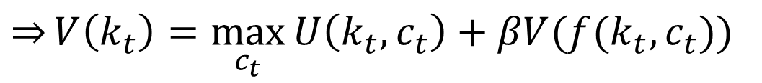
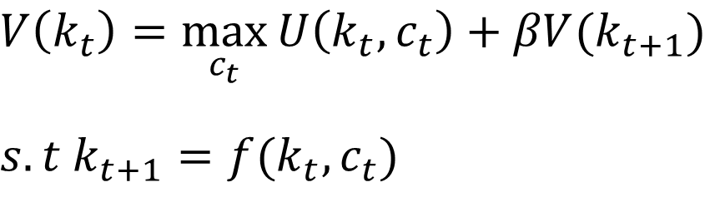

猜測法 (Guessing)
$$V\left(k_{t}\right)=\max_{c_{t}}{U\left(k_{t},c_{t}\right)+βV(k_{t+1})}$$
$$s.t k_{t+1}=f(k_{t},c_{t})$$
$$\overset{⇒}{}V\left(k_{t}\right)=\max_{c_{t}}{U\left(k_{t},c_{t}\right)+βV(f(k_{t},c_{t}))}$$
一階條件
$$U_{c}\left(k_{t},c_{t}\right)+βV^{′}\left(f\left(k_{t},c_{t}\right)\right)f_{c}\left(k_{t},c_{t}\right)=0$$
$$\overset{⇒}{}c(k_{t})$$
$$V\left(k_{t}\right)=U\left(k_{t},c(k_{t})\right)+βV(f(k_{t},c(k_{t})))$$

Slide 7
猜測法 (Guessing)
We can define this functional as T(V).
The Bellman equation then defines a fixed point for T in the space of functions V.
The Bellman equation can thus be written
$$V\left(k\right)=T(V\left(k\right))≡\max_{c}{U\left(k,c\right)+βV(f\left(k,c\right))}$$

Slide 8



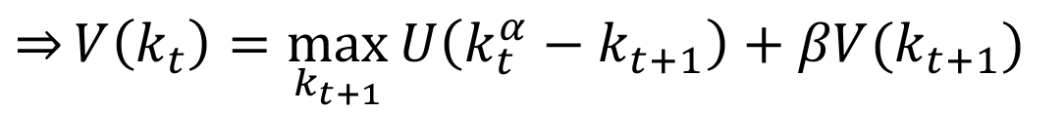
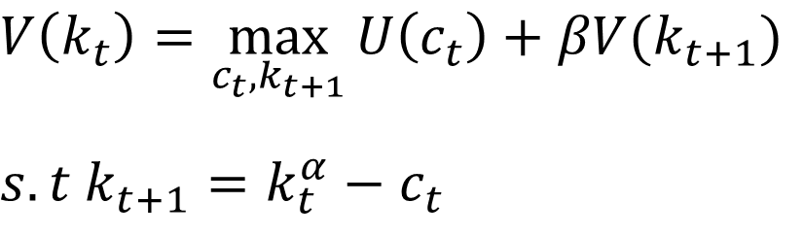
猜測法 (Guessing) - Example
$$U\left(k,c,t\right)=ln⁡(c)$$
$f\left(k,c,t\right)=k^{α}−c$ ,$0<α<1$
$$V\left(k_{t}\right)=\max_{c_{t},k_{t+1}}{U\left(c_{t}\right)+βV(k_{t+1})}$$
$$s.t k_{t+1}=k_{t}^{α}−c_{t}$$
$$c_{t}=k_{t}^{α}−k_{t+1}$$
$$\overset{⇒}{}V\left(k_{t}\right)=\max_{k_{t+1}}{U\left(k_{t}^{α}−k_{t+1}\right)+βV(k_{t+1})}$$

Slide 9
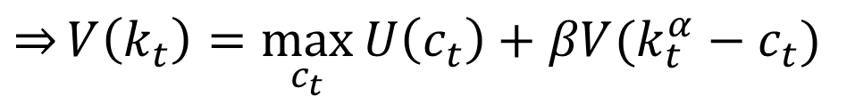
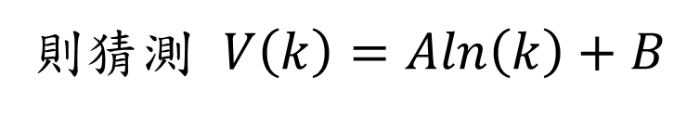
猜測法 (Guessing) - Example
For example if the utility function is logarithmic
則猜測 $V\left(k\right)=\operatorname{Aln}\left(k\right)+B$
$$V\left(k_{t}\right)=\max_{c_{t},k_{t+1}}{U\left(c_{t}\right)+βV(k_{t+1})}$$
$$s.t k_{t+1}=k_{t}^{α}−c_{t}$$
$$\overset{⇒}{}V\left(k_{t}\right)=\max_{c_{t}}{U\left(c_{t}\right)+βV(k_{t}^{α}−c_{t})}$$

Slide 10

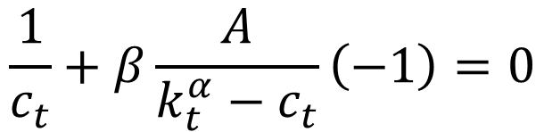

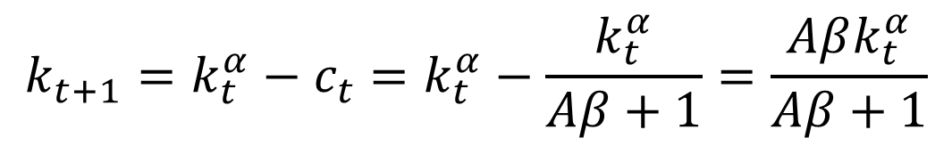
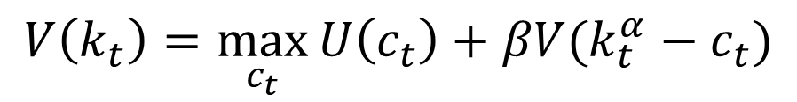
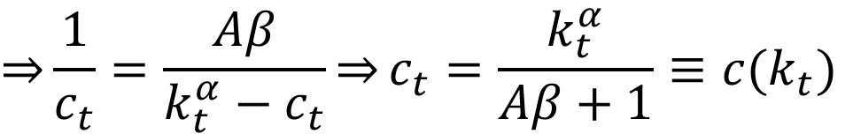
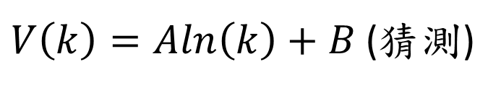
猜測法 (Guessing) - Example
$$U\left(k,c,t\right)=ln⁡(c)$$
$$V\left(k_{t}\right)=\max_{c_{t}}{U\left(c_{t}\right)+βV(k_{t}^{α}−c_{t})}$$
$f\left(k,c,t\right)=k^{α}−c$ ,$0<α<1$
一階條件
$V\left(k\right)=\operatorname{Aln}\left(k\right)+B$ (猜測)
$$U_{c}\left(k_{t},c_{t}\right)+βV^{′}\left(f\left(k_{t},c_{t}\right)\right)f_{c}\left(k_{t},c_{t}\right)=0$$
$$\frac{1}{c_{t}}+β\frac{A}{k_{t}^{α}−c_{t}}\left(−1\right)=0$$
$$\overset{⇒}{}\frac{1}{c_{t}}=\frac{Aβ}{k_{t}^{α}−c_{t}}\overset{⇒}{}c_{t}=\frac{k_{t}^{α}}{Aβ+1}≡c(k_{t})$$
$$k_{t+1}=k_{t}^{α}−c_{t}=k_{t}^{α}−\frac{k_{t}^{α}}{Aβ+1}=\frac{Aβk_{t}^{α}}{Aβ+1}$$

Slide 11
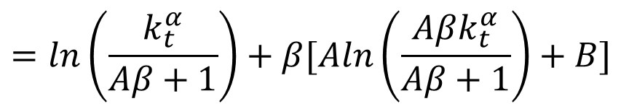

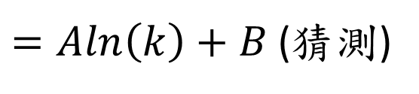

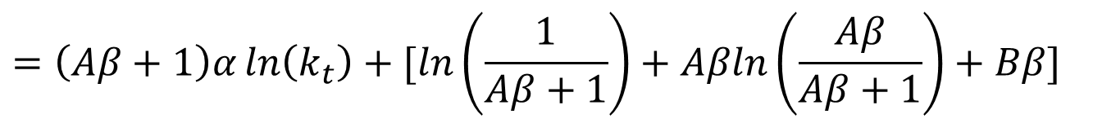
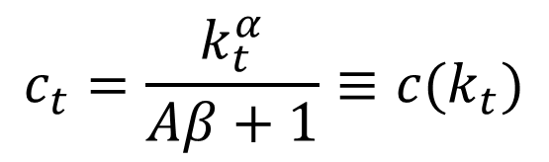
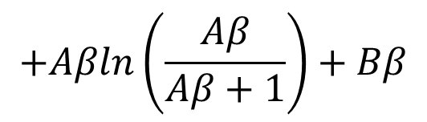
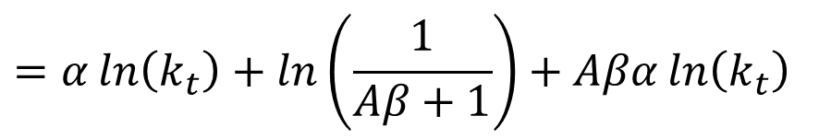
猜測法 (Guessing) - Example
$$U\left(k,c,t\right)=ln⁡(c)$$
代回Bellman equation
$f\left(k,c,t\right)=k^{α}−c$ ,$0<α<1$
$$V\left(k_{t}\right)=U\left(c_{t}\right)+βV(k_{t+1})$$
$V\left(k\right)=\operatorname{Aln}\left(k\right)+B$ (猜測)
$$=ln\left(\frac{k_{t}^{α}}{Aβ+1}\right)+β[Aln\left(\frac{Aβk_{t}^{α}}{Aβ+1}\right)+B]$$
$$c_{t}=\frac{k_{t}^{α}}{Aβ+1}≡c(k_{t})$$
$$=α\ln\left(k_{t}\right)+ln\left(\frac{1}{Aβ+1}\right)+Aβα\ln\left(k_{t}\right)$$
$$k_{t+1}=\frac{Aβk_{t}^{α}}{Aβ+1}$$
$$+Aβln\left(\frac{Aβ}{Aβ+1}\right)+Bβ$$
$$=\left(Aβ+1\right)α\ln\left(k_{t}\right)+[ln\left(\frac{1}{Aβ+1}\right)+Aβln\left(\frac{Aβ}{Aβ+1}\right)+Bβ]$$
$=\operatorname{Aln}\left(k\right)+B$ (猜測)

Slide 12
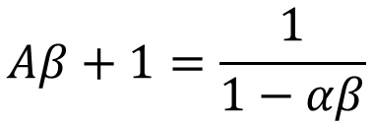
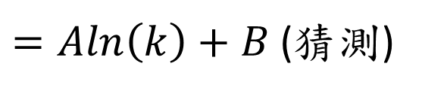

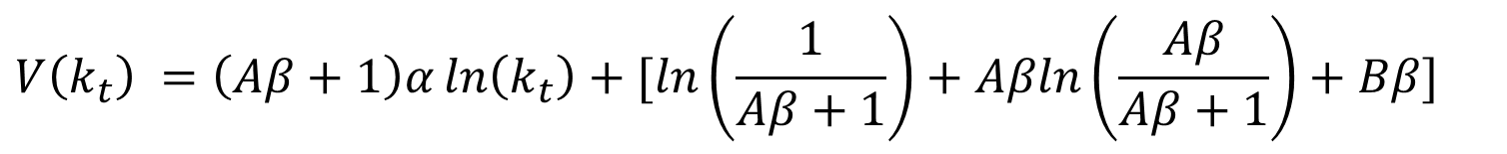
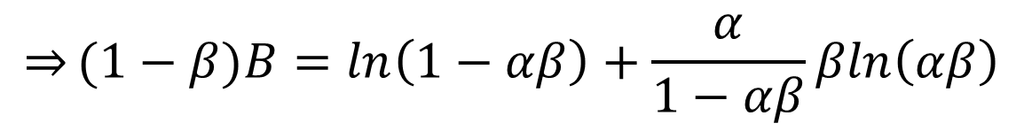
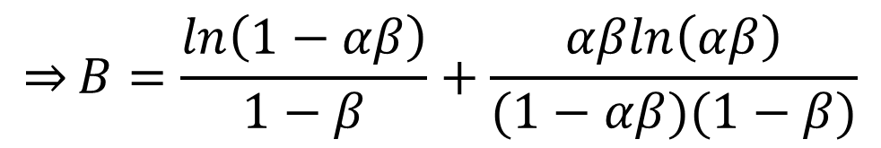
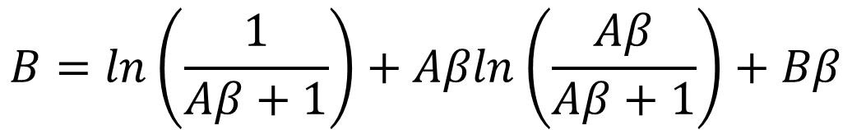

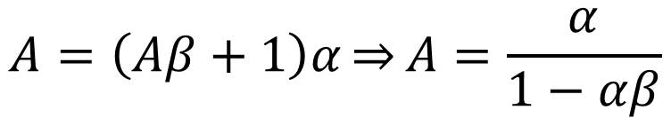
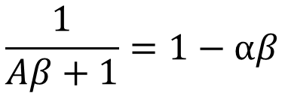
猜測法 (Guessing) - Example
$$V\left(k_{t}\right) =\left(Aβ+1\right)α\ln\left(k_{t}\right)+[ln\left(\frac{1}{Aβ+1}\right)+Aβln\left(\frac{Aβ}{Aβ+1}\right)+Bβ]$$
$=\operatorname{Aln}\left(k\right)+B$ (猜測)
$$Aβ=\frac{αβ}{1−αβ}$$
$$A=\left(Aβ+1\right)α\overset{⇒}{}A=\frac{α}{1−αβ}$$
$$Aβ+1=\frac{1}{1−αβ}$$
$$B=ln\left(\frac{1}{Aβ+1}\right)+Aβln\left(\frac{Aβ}{Aβ+1}\right)+Bβ$$
$$\frac{1}{Aβ+1}=1−αβ$$
$$\overset{⇒}{}(1−β)B=ln\left(1−αβ\right)+\frac{α}{1−αβ}βln\left(αβ\right)$$
$$\frac{Aβ}{Aβ+1}=αβ$$
$$\overset{⇒}{}B=\frac{ln\left(1−αβ\right)}{1−β}+\frac{αβln\left(αβ\right)}{(1−αβ)(1−β)}$$

Slide 13
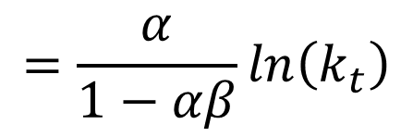

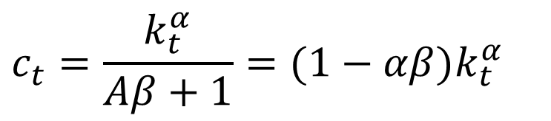
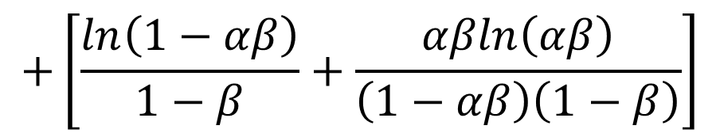
猜測法 (Guessing) - Example
$$U\left(k,c,t\right)=ln⁡(c)$$
$V\left(k_{t}\right)=\operatorname{Aln}\left(k_{t}\right)+B$
$f\left(k,c,t\right)=k^{α}−c$ ,$0<α<1$
$$=\frac{α}{1−αβ}\ln\left(k_{t}\right)$$
$V\left(k\right)=\operatorname{Aln}\left(k\right)+B$ (猜測)
$$c_{t}=\frac{k_{t}^{α}}{Aβ+1}≡c(k_{t})$$
$$+\left[\frac{ln\left(1−αβ\right)}{1−β}+\frac{αβln\left(αβ\right)}{\left(1−αβ\right)\left(1−β\right)}\right]$$
$$k_{t+1}=\frac{Aβk_{t}^{α}}{Aβ+1}$$
$$c_{t}=\frac{k_{t}^{α}}{Aβ+1}=(1−αβ)k_{t}^{α}$$

Slide 14
猜測法 (Guessing)
在後面有介紹與MIT更接近的 Bellman equation 形式
Stochastic Dynamic Programming
As long as the recursive structure of the problem is intact adding a stochastic element to the transition equation does not change the Bellman equation.

Slide 15
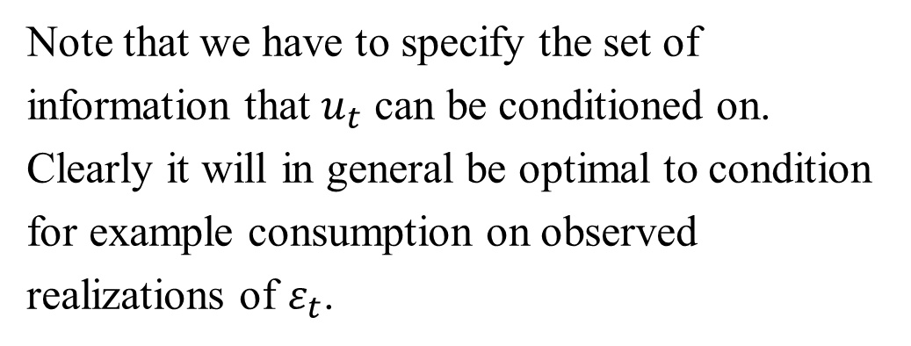


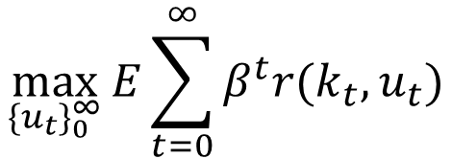

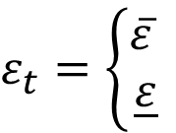
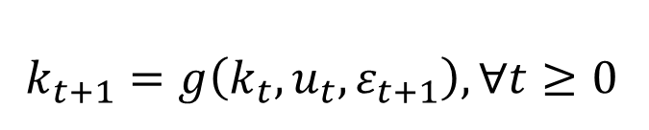
猜測法 (Guessing)-Stochastic Dynamic Programming
$$\max_{{\{u_{t}\}}_{0}^{∞}}{E\sum_{t=0}^{∞}{β^{t}r(k_{t},u_{t})}}$$
E is the expectations operator
Note that we have to specify the set of information that $u_{t}$ can be conditioned on.
Clearly it will in general be optimal to condition for example consumption on observed realizations of $ε_{t}$.
$$s.t k_{0}=\overline{k_{0}}$$
$$k_{t+1}=g\left(k_{t},u_{t},ε_{t+1}\right), ∀t≥0$$
$$ε_{t}=\left\{\begin{aligned}\overline{ε} \\ \underline{ε}\end{aligned}\right.$$
$$,with probability p$$
$$,with probability(1−p)$$

Slide 16
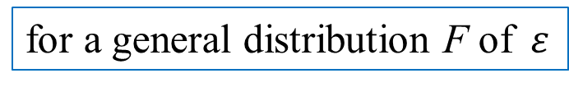

猜測法 (Guessing)-Stochastic Dynamic Programming
If the agent may condition on information available at t we get the Bellman equation with first order conditions
current value function
$$V\left(k_{t}\right)≡\max_{u_{t}}\left\{r\left(k_{t},u_{t}\right)+β\left[pV\left(g\left(k_{t},u_{t},\overline{ε}\right)\right)+\left(1−p\right)V\left(g\left(k_{t},u_{t},\underline{ε} \right)\right)\right]\right\}$$
$$FOC. r_{u}\left(k_{t},u_{t}\right)+β\left[pV^{′}\left(g\left(k_{t},u_{t},\overline{ε}\right)\right)g_{u}\left(k_{t},u_{t},\overline{ε}\right)+\left(1−p\right)V′\left(g\left(k_{t},u_{t},\underline{ε} \right)\right)g_{u}\left(k_{t},u_{t},\underline{ε} \right)\right]$$
$$=0$$
for a general distribution F of $ε$
$$V\left(k_{t}\right)≡\max_{u_{t}}\left\{r\left(k_{t},u_{t}\right)+βEV\left(g\left(k_{t},u_{t},\overline{ε}\right)\right)\right\}$$
$$FOC. r_{u}\left(k_{t},u_{t}\right)+βE\left(V^{′}\left(g\left(k_{t},u_{t},\overline{ε}\right)\right)g_{u}\left(k_{t},u_{t},\overline{ε}\right)\right)=0$$

Slide 17
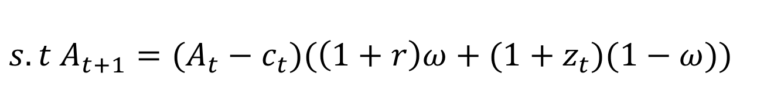
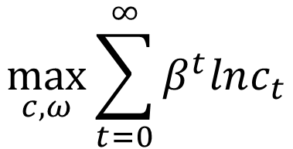
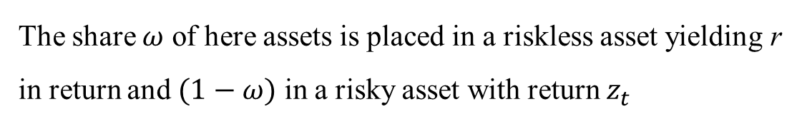
猜測法 (Guessing)-Stochastic Dynamic Programming
Example
The share $ω$ of here assets is placed in a riskless asset yielding r in return and $(1−ω)$ in a risky asset with return $z_{t}$
$$\max_{c,ω}{\sum_{t=0}^{∞}{β^{t}lnc_{t}}}$$
$$s.t A_{t+1}=(A_{t}−c_{t})(\left(1+r\right)ω+(1+z_{t})(1−ω))$$
current value function
$$V\left(A_{t}\right)≡\max_{c_{t},ω}\left\{ln\left(c_{t}\right)+βE_{t}V\left((A_{t}−c_{t})(\left(1+r\right)ω+(1+z_{t})(1−ω))\right)\right\}$$

Slide 18
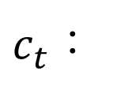


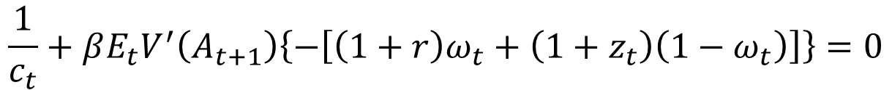


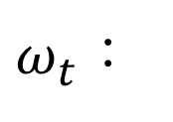
猜測法 (Guessing)-Stochastic Dynamic Programming
current value function
$$A_{t+1}$$
$$V\left(A_{t}\right)≡\max_{c_{t},ω}\left\{ln\left(c_{t}\right)+βE_{t}V\left((A_{t}−c_{t})(\left(1+r\right)ω+(1+z_{t})(1−ω))\right)\right\}$$
$$FOC.$$
$$\frac{1}{c_{t}}+βE_{t}V^{′}\left(A_{t+1}\right)\left\{−\left[\left(1+r\right)ω_{t}+\left(1+z_{t}\right)\left(1−ω_{t}\right)\right]\right\}=0$$
$c_{t}$：
$ω_{t}$：
$$βE_{t}V^{′}\left(A_{t+1}\right)\left[\left(A_{t}−c_{t}\right)\left(1+r\right)−(A_{t}−c_{t})\left(1+z_{t}\right)\right]$$
$$=βE_{t}V^{′}\left(A_{t+1}\right)(A_{t}−c_{t})\left(r−z_{t}\right)=0$$
猜測
$$V\left(A_{t}\right)=\operatorname{aln}\left(A_{t}\right)+B$$

Slide 19
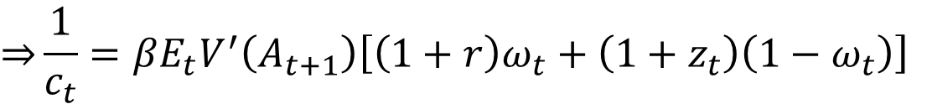
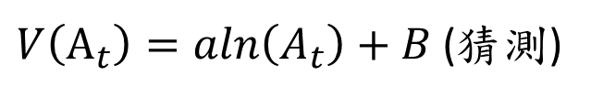

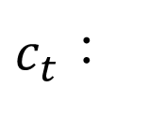
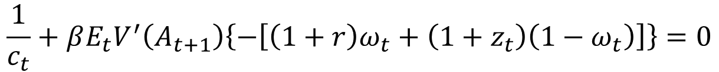
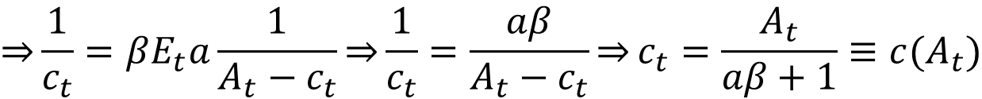


猜測法 (Guessing)-Stochastic Dynamic Programming
$$V\left(A_{t}\right)≡\max_{c_{t},ω}\left\{ln\left(c_{t}\right)+βE_{t}V\left(A_{t+1}\right)\right\}$$
$$A_{t+1}=(A_{t}−c_{t})(\left(1+r\right)ω+(1+z_{t})(1−ω))$$
解針對$c_{t}$的一階條件
$V\left(A_{t}\right)=\operatorname{aln}\left(A_{t}\right)+B$ (猜測)
$$\frac{1}{c_{t}}+βE_{t}V^{′}\left(A_{t+1}\right)\left\{−\left[\left(1+r\right)ω_{t}+\left(1+z_{t}\right)\left(1−ω_{t}\right)\right]\right\}=0$$
$c_{t}$：
$$\overset{⇒}{}\frac{1}{c_{t}}=βE_{t}V^{′}\left(A_{t+1}\right)\left[\left(1+r\right)ω_{t}+\left(1+z_{t}\right)\left(1−ω_{t}\right)\right]$$
$$\overset{⇒}{}\frac{1}{c_{t}}=βE_{t}\frac{a}{A_{t+1}}\left[\left(1+r\right)ω_{t}+\left(1+z_{t}\right)\left(1−ω_{t}\right)\right]$$
$$\overset{⇒}{}\frac{1}{c_{t}}=βE_{t}a\frac{1}{A_{t}−c_{t}}\overset{⇒}{}\frac{1}{c_{t}}=\frac{aβ}{A_{t}−c_{t}}\overset{⇒}{}c_{t}=\frac{A_{t}}{aβ+1}≡c(A_{t})$$

Slide 20









猜測法 (Guessing)-Stochastic Dynamic Programming
$$V\left(A_{t}\right)≡\max_{c_{t},ω}\left\{ln\left(c_{t}\right)+βE_{t}V\left(A_{t+1}\right)\right\}$$
$$A_{t+1}=(A_{t}−c_{t})(\left(1+r\right)ω+(1+z_{t})(1−ω))$$
解針對$ω_{t}$的一階條件
$V\left(A_{t}\right)=\operatorname{aln}\left(A_{t}\right)+B$ (猜測)
$ω_{t}$：
$$βE_{t}V^{′}\left(A_{t+1}\right)(A_{t}−c_{t})\left(r−z_{t}\right)=0$$
$$\overset{⇒}{}E_{t}V^{′}\left(A_{t+1}\right)(A_{t}−c_{t})\left(r−z_{t}\right)=0$$
$$\overset{⇒}{}E_{t}\frac{a}{A_{t+1}}(A_{t}−c_{t})\left(r−z_{t}\right)=0$$
$$\overset{⇒}{}E_{t}\frac{a\left(r−z_{t}\right)}{\left(1+r\right)ω+(1+z_{t})(1−ω)} =0$$
$$\overset{⇒}{}E_{t}\frac{\left(r−z_{t}\right)}{\left(1+r\right)ω+(1+z_{t})(1−ω)} =0$$
$$∵z_{t} i.i.d$$
$∴ω$ is constant

Slide 21










猜測法 (Guessing)-Stochastic Dynamic Programming
$$c_{t}=\frac{A_{t}}{aβ+1}$$
$$V\left(A_{t}\right)≡\max_{c_{t},ω}\left\{ln\left(c_{t}\right)+βE_{t}V\left(A_{t+1}\right)\right\}$$
解$a$
$$A_{t+1}=(A_{t}−c_{t})(\left(1+r\right)ω+(1+z_{t})(1−ω))$$
$$V\left(A_{t}\right)=ln\left(c_{t}\right)+βE_{t}V\left(A_{t+1}\right)$$
$V\left(A_{t}\right)=\operatorname{aln}\left(A_{t}\right)+B$ (猜測)
$$=ln\left(\frac{A_{t}}{aβ+1}\right)+βE_{t}[\operatorname{aln}\left(A_{t+1}\right)+B]$$
$$lnA_{t+1}=ln\left(A_{t}−c_{t}\right)$$
$$=lnA_{t}+ln\left(\frac{1}{aβ+1}\right)+βE_{t}[\operatorname{aln}\left(A_{t+1}\right)+B]$$
$$+ln(\left(1+r\right)ω+(1+z_{t})(1−ω))$$
$$A_{t}−c_{t}=\frac{aβA_{t}}{aβ+1}$$
$$=lnA_{t}+ln\left(\frac{1}{aβ+1}\right)+aβlnA_{t}+ln\left(\frac{aβ}{aβ+1}\right)+Bβ$$
$$+aβE_{t}[\ln\left(\left(1+r\right)ω+(1+z_{t})(1−ω)\right)]$$
$$=(1+aβ)lnA_{t}+k$$

Slide 22




猜測法 (Guessing)-Stochastic Dynamic Programming
$$c_{t}=\frac{A_{t}}{aβ+1}$$
$$V\left(A_{t}\right)≡\max_{c_{t},ω}\left\{ln\left(c_{t}\right)+βE_{t}V\left(A_{t+1}\right)\right\}$$
$$A_{t+1}=(A_{t}−c_{t})(\left(1+r\right)ω+(1+z_{t})(1−ω))$$
$$V\left(A_{t}\right)=(1+aβ)lnA_{t}+k$$
$V\left(A_{t}\right)=\operatorname{aln}\left(A_{t}\right)+B$ (猜測)
$$=alnA_{t}+B$$
$$\overset{⇒}{}a=\frac{1}{1−β}$$
$$c_{t}=\frac{A_{t}}{aβ+1}=(1−β)A_{t}$$

Slide 23
猜測法 (Guessing)
我們認為此方法在應用上的困難點：
評定 “Bellman equation 時間定態”
the law of motion for the state is independent of time
per-period return function is the same over time
any restriction on the control variable is the same over time
如何準確猜測對的value function

Slide 24

Bellman Equation貝爾曼方程
在無限時間期下，可以使用以下方式解決：
猜測法 (Guessing)
Guess on a value function and make sure it satisfies the Bellman equation.
迭代法 (Iteration)
Iterate on the Bellman equation until it converges.
過於複雜
作者使用

