Slide 1
Optimal Rebalancing for Institutional Portfolios
傅鈺婷
指導教授：戴天時 教授
論文作者：Walter Sun, Ayres Fan, Li-Wei Chen, Tom Schouwenaars, Marius A. Albota

Slide 2
Rebalancing Strategies
Applying the concept of certainty-equivalents to create risk-adjusted returns that allow us to convert tracking error into a dollar-denominated cost.
Optimal policy trades only when the expected cost of trading is less than the expected cost of doing nothing, evaluating costs over the next period and all future periods.

Slide 3


Dynamic Model – Bellman Equation
The state transition is defined by an arbitrary function h：
$w_{t}$ is our state
$u_{t}$ is our policy
$n_{t}$ is the state uncertainty.

Slide 4









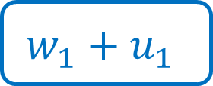


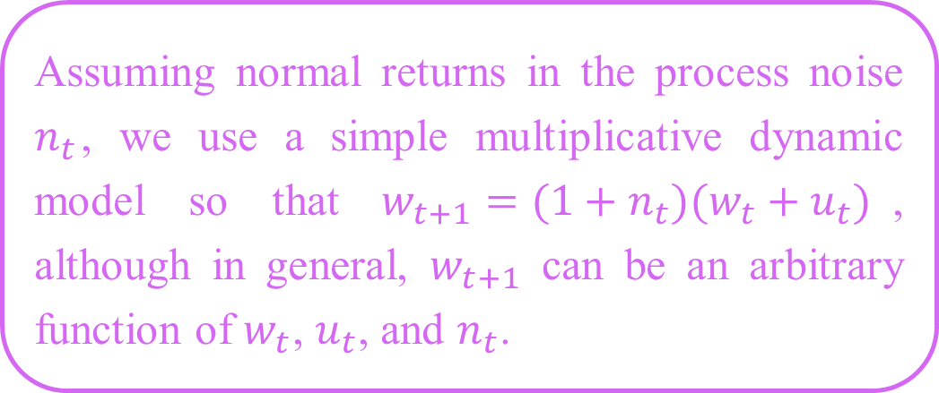













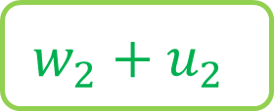
Dynamic Model – Bellman Equation
Assuming normal returns in the process noise $n_{t}$, we use a simple multiplicative dynamic model so that $w_{t+1}=(1+n_{t})(w_{t}+u_{t})$, although in general, $w_{t+1}$ can be an arbitrary function of $w_{t}$, $u_{t}$, and $n_{t}$.
……
$$time=0$$
$$1$$
$$2$$
$$3$$
$$4$$
$$t−1$$
$$t$$
$$w_{0}$$
$$w_{1}$$
$$w_{2}$$
$$w_{3}$$
$$w_{4}$$
……
$$w_{t−1}$$
$$w_{t}$$
$$u_{0}$$
$$u_{1}$$
$$u_{2}$$
$$u_{3}$$
$$u_{4}$$
……
$$u_{t−1}$$
$$u_{t}$$
$$w_{2}^{′}$$
$$w_{3}^{′}$$
$$w^{∗}$$
$$w_{1}+u_{1}$$
不用調整
$$w_{2}+u_{2}$$
需要調整
不需要調整

Slide 5

Dynamic Model – Bellman Equation
Cost-to-go function：
G function is the cost for the current period
$J_{t}$ is the so-called cost-to-go function ; the expected future cost from t onwards given all future decisions
Notes:
So, the cost at any given period is the expected cost from t to t + 1 along with the expected cost from t + 1 onwards.

Slide 6

Dynamic Model – Bellman Equation
At each time t, the optimal strategy is to choose $u_{t}$ such that the cost is minimized：
$J_{t}^{∗}$ is the discrete-time Bellman Equation

Slide 7

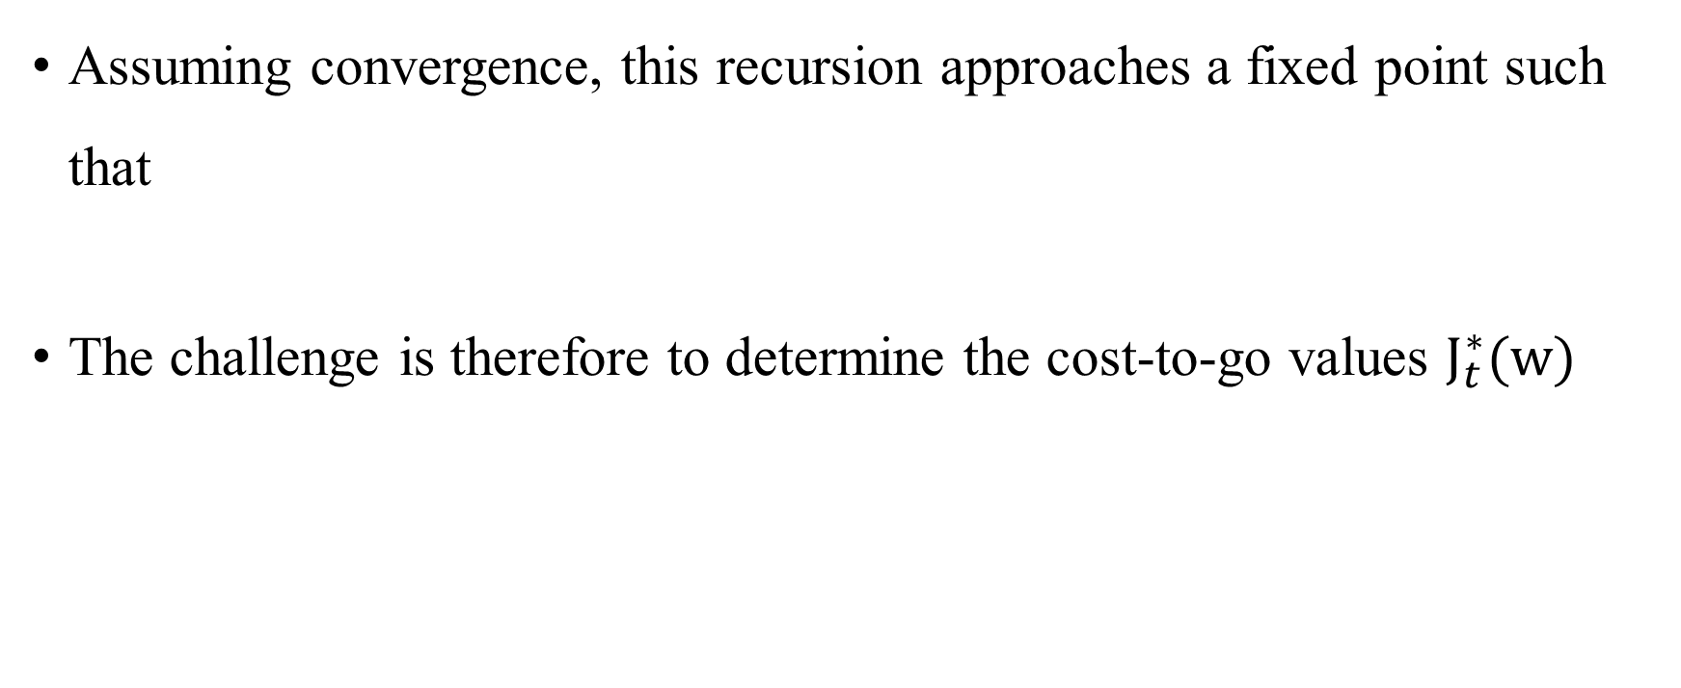
Dynamic Model – Bellman Equation
Assuming convergence, this recursion approaches a fixed point such that
The challenge is therefore to determine the cost-to-go values $J_{t}^{∗}(w)$

Slide 8
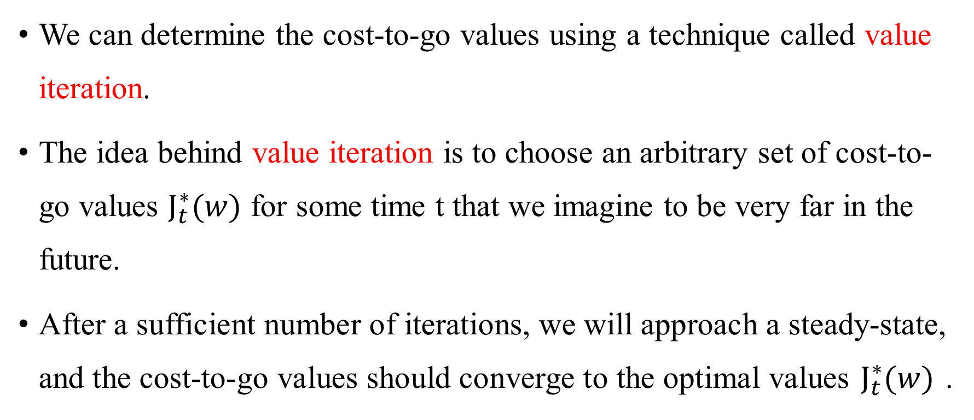
Dynamic Model – Bellman Equation
We can determine the cost-to-go values using a technique called value iteration.
The idea behind value iteration is to choose an arbitrary set of cost-to-go values $J_{t}^{∗}(w)$ for some time t that we imagine to be very far in the future.
After a sufficient number of iterations, we will approach a steady-state, and the cost-to-go values should converge to the optimal values $J_{t}^{∗}(w)$ .
Notes:
We then repeatedly apply (3) to obtain cost-to-go values successively closer to the present.

Slide 9
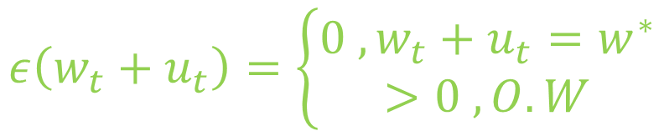
Dynamic Model – Bellman Equation
To apply dynamic programming, we must specify the cost function in the Bellman Equation.
In our case, we write:
Sub-optimality Costs
$$ε\left(w_{t}+u_{t}\right)=\left\{\begin{aligned}0 ,w_{t}+u_{t}=w^{∗} \\ >0 , O.W\end{aligned}\right.$$
Transaction Costs

Slide 10
Sub-optimality Costs
Furthermore, not rebalancing leads to the portfolio deviating from the optimal portfolio, resulting in a lower utility for the investor.
This leads to an increase in sub-optimality costs.
The utility shortfall in comparison to having a perfectly balanced optimal portfolio – measured in bps.

Slide 11
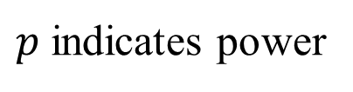

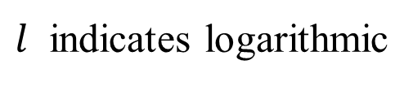
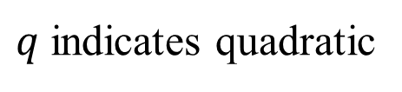

Sub-optimality Costs
These are modeled using Certainty Equivalent Costs：
$r_{CE}\left(w\right)=\exp\left[U_{l}\left(μ^{T}w , w^{T}Λw\right)\right]−1$
set of target portfolio weights $w^{∗}=\{w_{1}^{∗},…,w_{N}^{∗}\}$
$$U_{i}\left(μ,σ^{2}\right) ,i=\{q,l,p\}$$
$q$ indicates quadratic
$l$ indicates logarithmic
$p$ indicates power

Slide 12

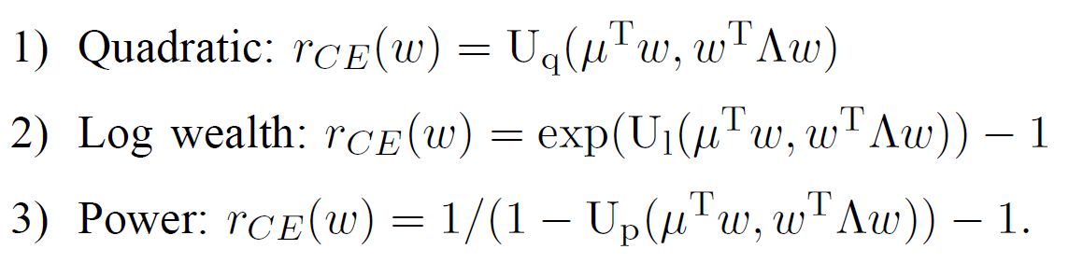
Certainty Equivalent Cost

Slide 13
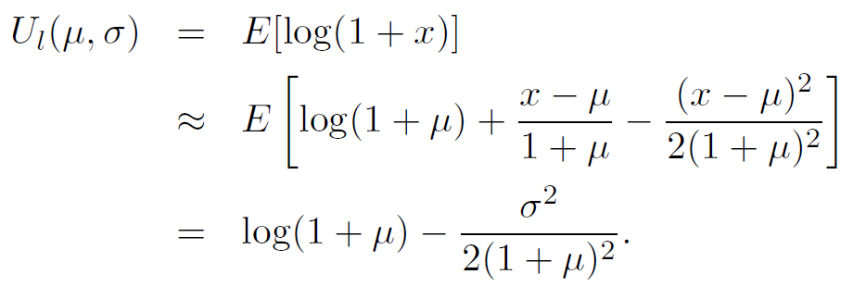
Certainty Equivalent Cost

Slide 14

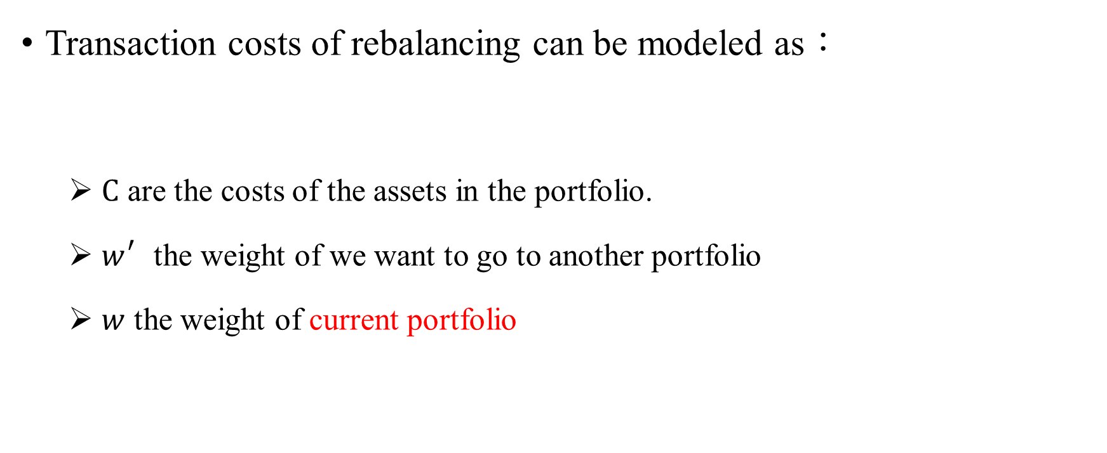
Transaction Costs
Transaction costs of rebalancing can be modeled as：
$C$ are the costs of the assets in the portfolio.
$w_{}^{′}$the weight of we want to go to another portfolio
$w$ the weight of current portfolio

Slide 15
使用動態方程
Leland
Sun
連續時間（continuous-time）的最佳化問題
漢彌爾頓-雅各比-貝爾曼方程（Hamilton–Jacobi–Bellman Equation, HJB Equation）。
離散時間（discrete-time）的最佳化問題
貝爾曼方程(Bellman Equation)

Slide 16
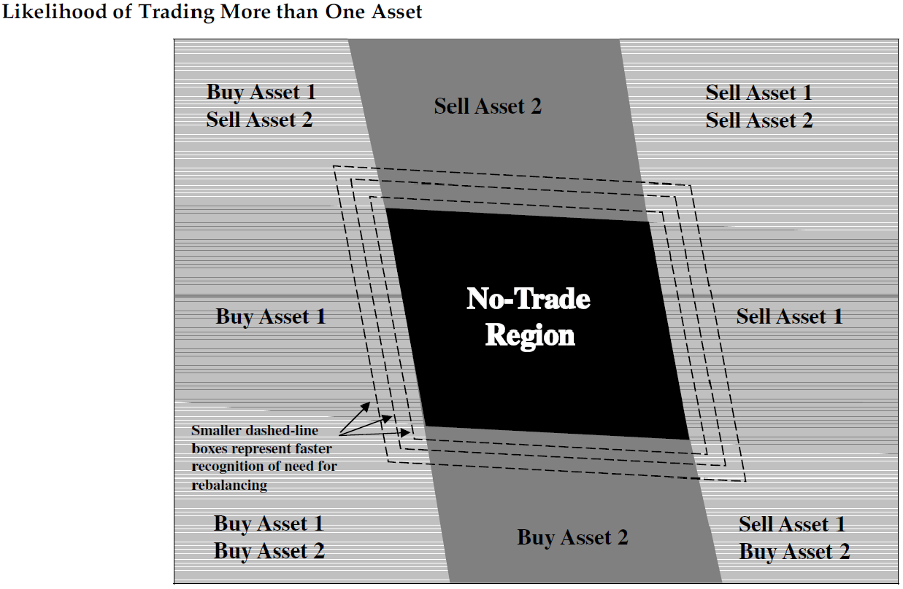
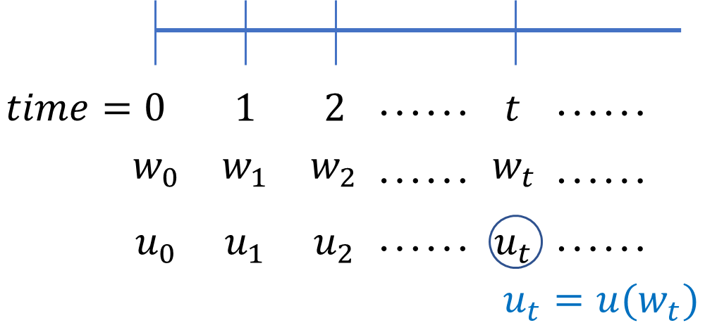
使用動態方程
Leland
求解邊界
Sun
求解調整量

