Slide 1
3.3 Brownian Motion

Slide 2
3.3.1 Definition of Brownian Motion
Definition 3.3.1
Let be a probability space.
For each , suppose there is a continuous function of that satisfies and that depends on (可視為路徑).
Then , is a Brownian motion if for all
Increments
are independent and each of these increments is normally distributed with
…

Slide 3
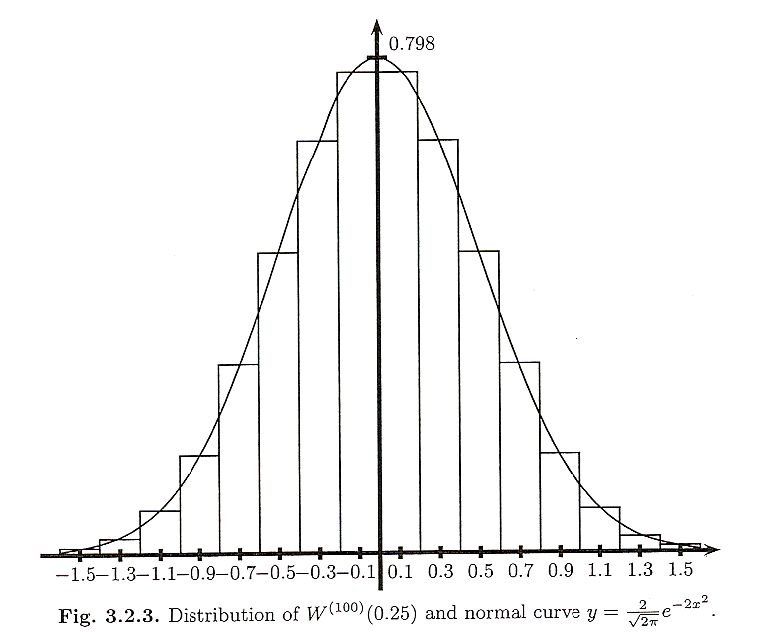

The difference between Scaled Random Walk and Brownian Motion
Scaled Random Walk
only approximated normal
for each t
Brownian Motion
exactly normal ( N(0, t) )

Slide 4
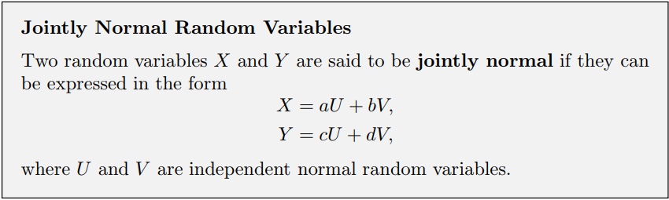
Jointly normal Random Variables
試著從Brownian motion生成Jointly normal Random Variables
目的:產生第一個等價性質

Slide 5
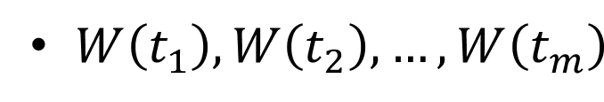
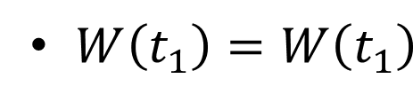
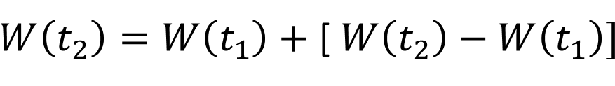
Increments (Definition 3.3.1)
are independent and each of these increments is normally distributed with
are jointly normal random variables.
Proof: (只用到獨立和normal，沒用到mean和variance)
….

Slide 6
3.3.2 Distribution of Brownian Motion
The random variables are jointly normally distributed.
Distribution is determined by their means and covariances.
1. has zero mean.
2. the covariance of and : (Let t > s)
不同時間點間的covariance=時間點較前的variance !!!
…

Slide 7
The covariance matrix for Brownian motion
( i.e., for the m-dimensional random vector ) is
…
…
…
…
…
…
…

Slide 8
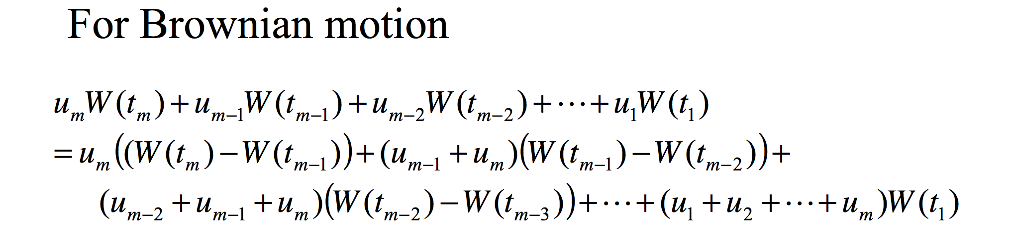
第二個等價性質
The MGF of this random vector can be computed using the MGF for a zero-mean normal random variable with variance t and the independence of the increments.
PS. the MGF of 1-dim normal r.v ~ N(0,t)

Slide 9
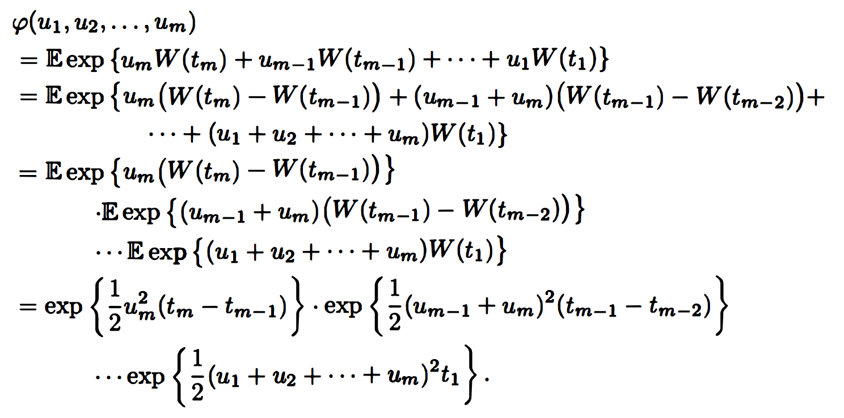
MGF of random vector
1.Increments間獨立
2.Increments是
Zero-mean和variance為t的normal

Slide 10
Thm3.3.2 Alternative characterizations of Brownian motion
Let be a probability space.
For each , suppose there is a continuous function , that satisfies and that depends on .
For all , The following three properties are equivalent.
1. The increments
are independent and each of these increments is normally distributed with
mean and variance given by and

Slide 11
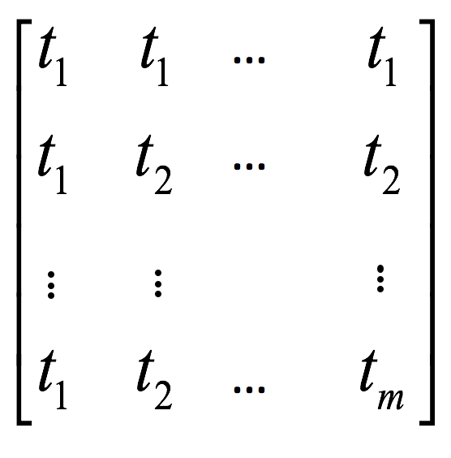
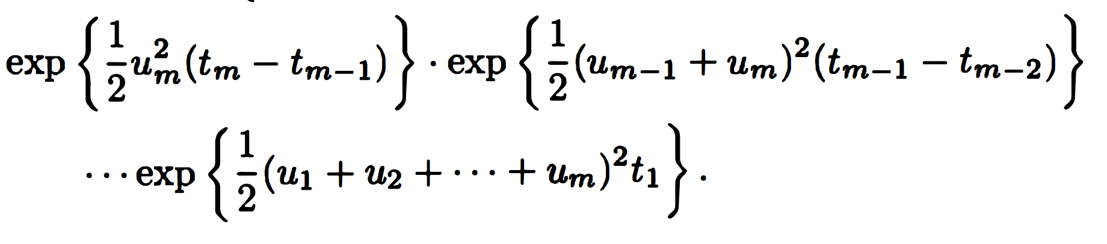
The random variables are jointly normally distributed
with means equal to zero and covariance matrix
3. The random variables have the joint MGF.
…
…
If any of 1, 2, or 3 holds (and hence they all hold), then , is a Brownian motion.

Slide 12
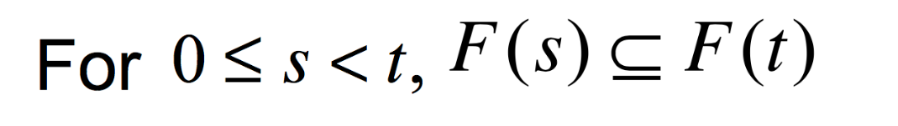
3.3.3 Filtration for Brownian Motion
Definition 3.3.3
Let be a probability space on which is defined a Brownian motion
A filtration for the Brownian motion is a collection of -algebra
, satisfying：
( Information accumulates )
(Adaptivity) W(t) is F(t) msb.
(Independence of future increments)
For the increment W(u)-W(t) is indep. of F(t).

Slide 13
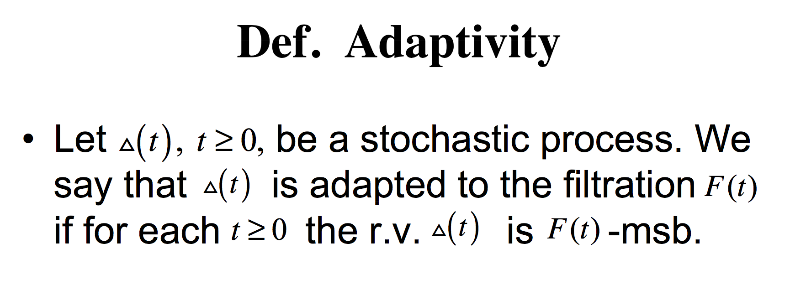

Slide 14
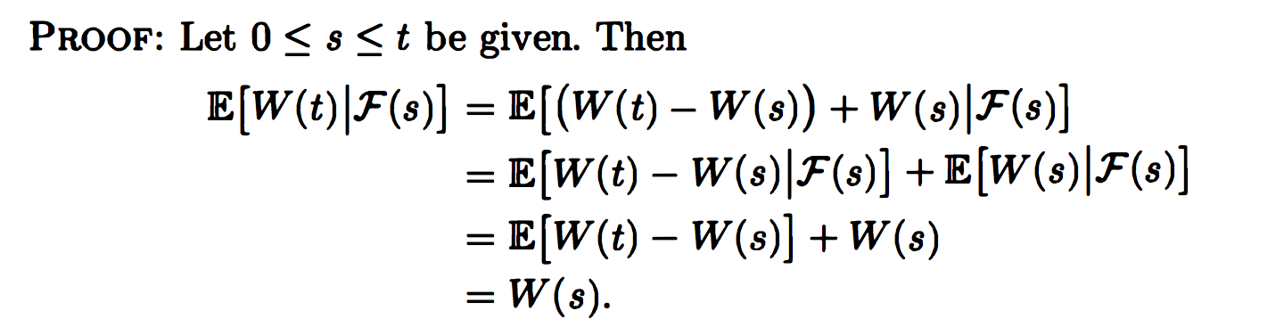
3.3.4 Martingale Property for Brownian Motion
Theorem 3.3.4 Brownian motion is a martingale

Slide 15
3.4 Quadratic Variation

Slide 16
3.4.1 First-Order Variation
3.4.2 Quadratic Variation
3.4.3 Volatility of Geometric Brownian Motion

Slide 17
3.4.1 First-Order Variation
• Compute the amount of up and down oscillation(震盪)
– the down moves adding to rather than subtracting
from the up moves.
– 計算移動距離,而非位移
– Use FVT(f) to denotes the First-order Variation
of function f to time T

Slide 18
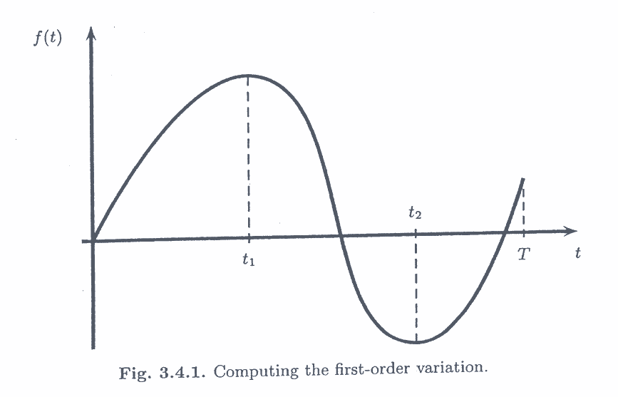

Slide 19
One example

Slide 20
total.

Slide 23
Our first task is to verify that the definition (3.4.3) is consistent with the formula (3.4.2) for the function shown in Figure 3.4.1.
To do this, we use the Mean value Theorem, which applies to any function whose derivative is defined everywhere.

Slide 24
