Slide 1
4.6 Multivariable Stochastic Calculus

Slide 2
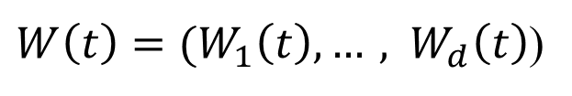
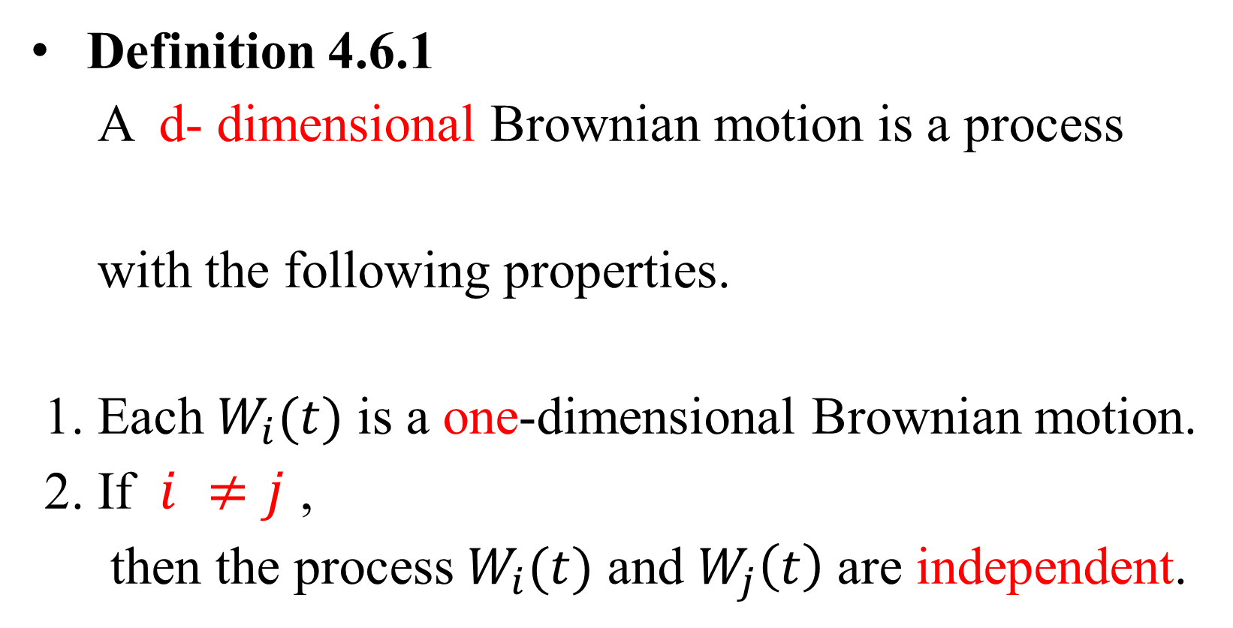
4.6.1 Multiple Brownian Motions
Definition 4.6.1
A d- dimensional Brownian motion is a process
with the following properties.
1. Each $W_{i}(t)$ is a one-dimensional Brownian motion.
2. If $i ≠j$ ,
then the process $W_{i}(t)$ and $W_{j}\left(t\right)$ are independent.

Slide 3
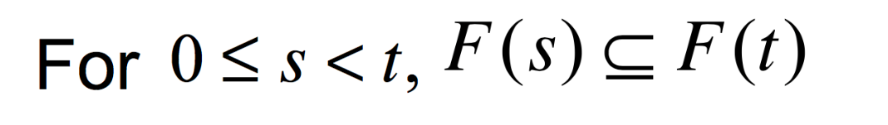
3.3.3 Filtration for d-dimensional Brownian Motion
We have a filtration ,such that the following holds.
( Information accumulates )
(Adaptivity) the random vector W(t) is F(t) msb.
(Independence of future increments)
For the vector of increment W(u)-W(t) is indep. of F(t).

Slide 4

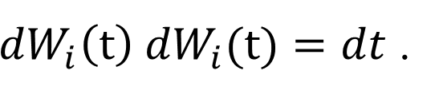
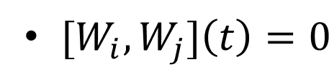
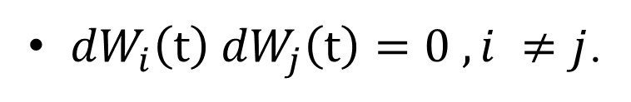
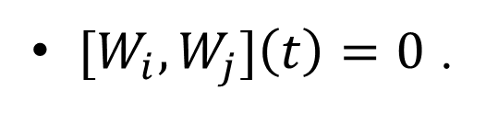
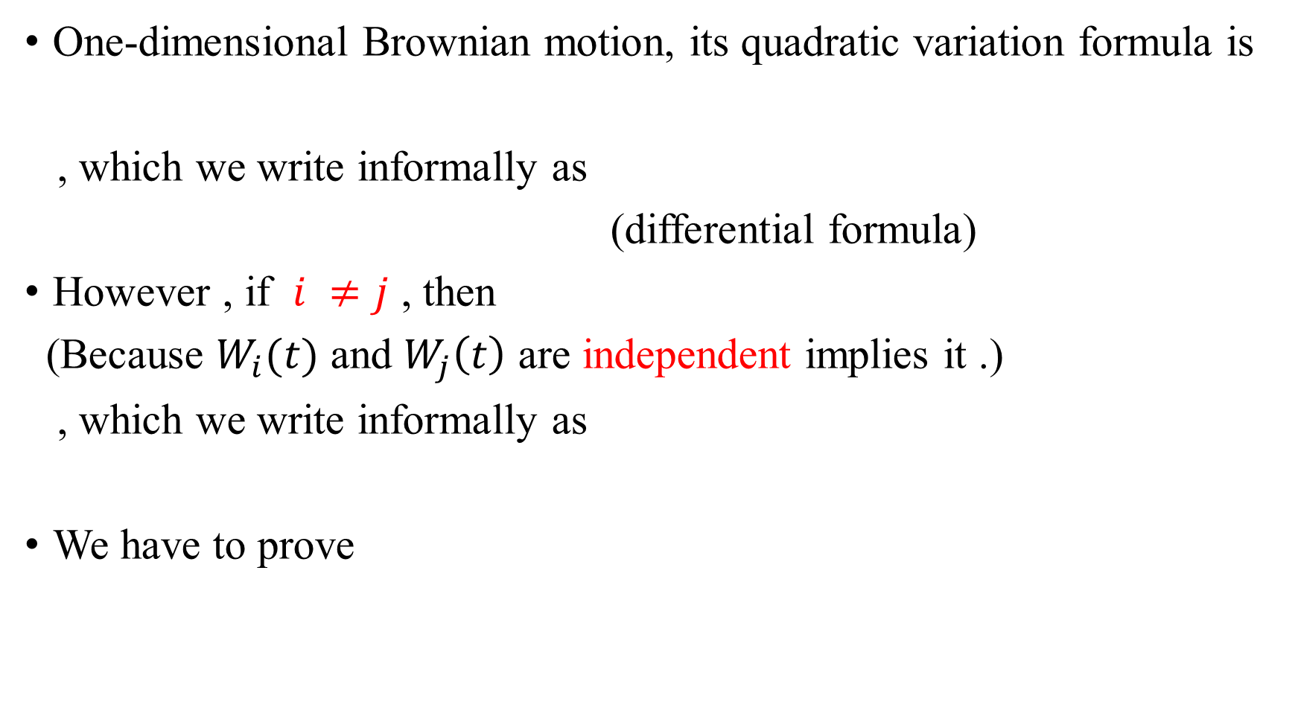
One-dimensional Brownian motion, its quadratic variation formula is
, which we write informally as
(differential formula)
However , if $i ≠j$ , then
(Because $W_{i}(t)$ and $W_{j}\left(t\right)$ are independent implies it .)
, which we write informally as
We have to prove

Slide 5
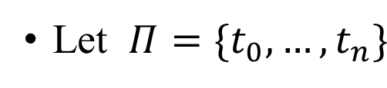
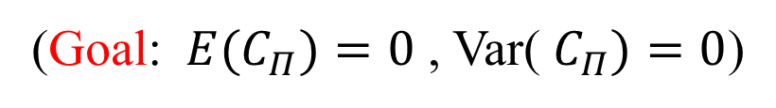
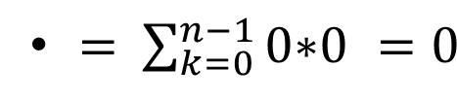



be the partition of [0,T].
For $i ≠j$ , define the sampled cross variation of $W_{i}$ and $W_{j}$ on [0,T]
to be
($W_{i}$ and $W_{j}$ are independent.)
Compute Var($C_{Π}$) , We first compute ${C_{Π}}^{2}$
( 此交乘項期望值為0，因為各項間獨立，且各項期望值為0 )

Slide 6
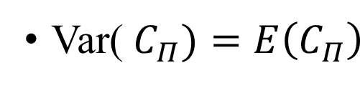
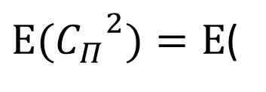

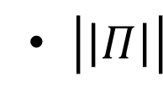

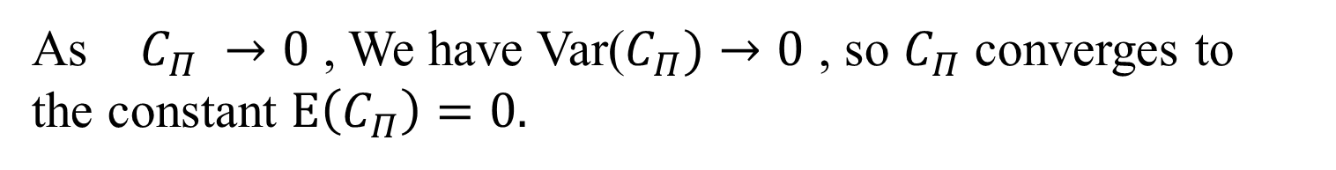
(兩平方項獨立，且期望值皆為$t_{k+1}−t_{k}$)
As $C_{Π}$ $→0$ , We have Var($C_{Π})→0$ , so $C_{Π}$ converges to
the constant $E\left(C_{Π}\right)=0.$
Thus , we prove that

Slide 7

4.6.2 Two-dimensional It$\hat{\text{o}}$-Doeblin Formula

Slide 8
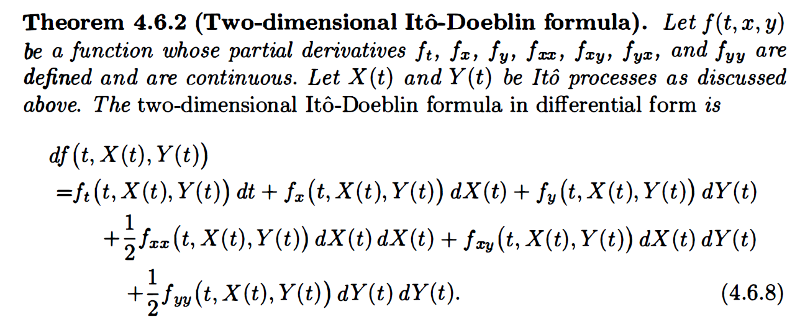

Slide 9

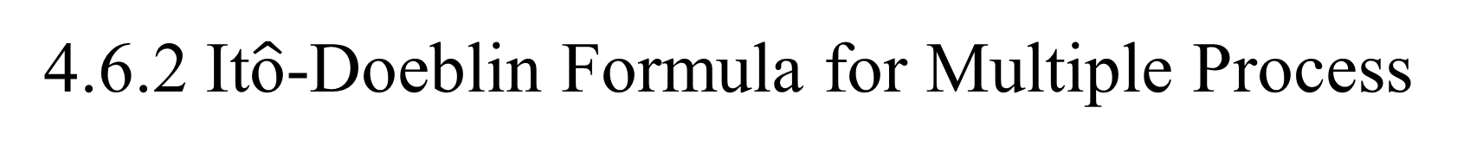
4.6.2 It$\hat{\text{o}}$-Doeblin Formula for Multiple Process
Let X(t) and Y(t) be Ito process , and $θ_{i}(t)$ and $σ_{ij}\left(t\right)$ are adapted
process , then (2-dimensional Brownian Motion)
In differential form , then
(4.6.1)
(4.6.2)

Slide 10
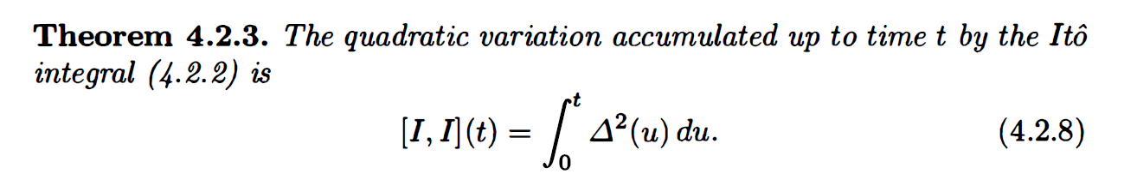





$$∆_{1}$$
$$∆_{2}$$
(4.6.1)
$${∆_{1}}^{2}$$
$${∆_{2}}^{2}$$
(4.6.3)
也可用
從 (4.6.1) 推導 (4.6.3)

Slide 11

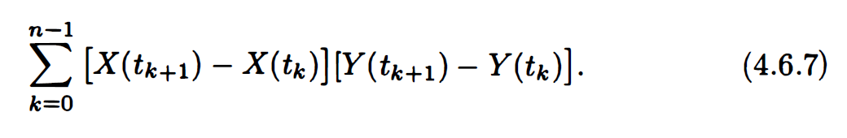

(4.6.4)
(4.6.5)
將 (4.6.5) 換句話說，for every T $≥0$ ,
4.6.6 等式的左邊可以寫成4.6.7 經過計算後和等式右邊相等
有了4.6.1~5 就可以得出 It$\hat{\text{o}}$-Doeblin Formula
(4.6.6)

Slide 12

Let ${\text{I}}_{ij}\left(t\right)=\int_{0}^{t}{σ_{ij}\left(u\right)dW_{j}(u)}$ , $R_{i}\left(t\right)=\int_{0}^{t}{θ_{i}\left(u\right)du}$
$${ R}_{1}\left(t_{k+1}\right)−R_{1}\left(t_{k}\right) R_{2}\left(t_{k+1}\right)−R_{2}\left(t_{k}\right)$$
$=\sum_{k=0}^{n−1}{ +{ I}_{11}\left(t_{k+1}\right)−I_{11}\left(t_{k}\right) {+I}_{21}\left(t_{k+1}\right)−I_{21}\left(t_{k}\right)}$
$+{ I}_{12}\left(t_{k+1}\right)−I_{12}\left(t_{k}\right)$ $+I_{22}\left(t_{k+1}\right)−I_{22}\left(t_{k}\right)$
已知
所以只有 第二項相乘 和第三項相乘 有值
其他皆為0
(4.6.6)

Slide 13

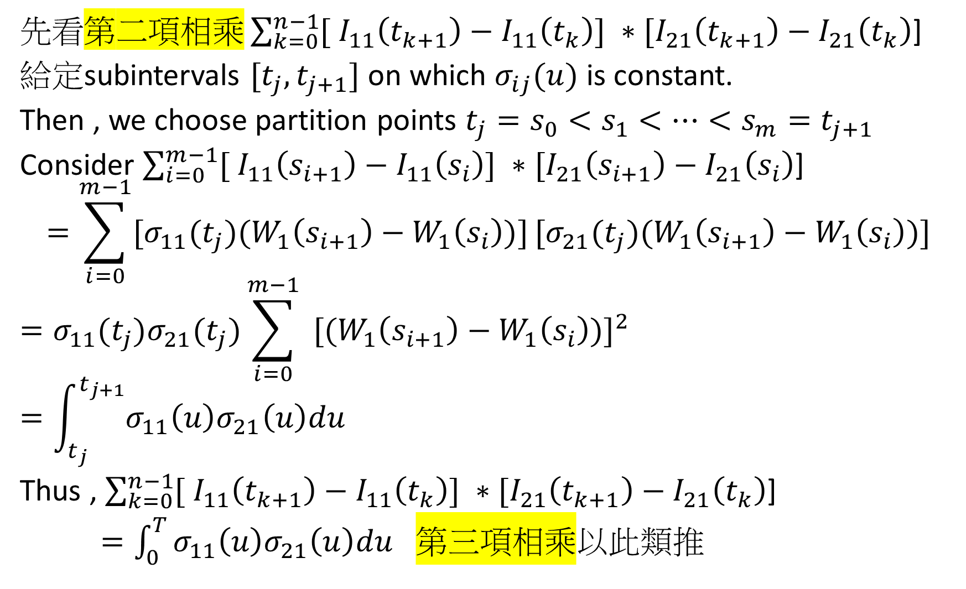
先看第$二項相乘\sum_{k=0}^{n−1}{[{ I}_{11}\left(t_{k+1}\right)−I_{11}\left(t_{k}\right)]\text{ ∗ }[I_{21}\left(t_{k+1}\right)−I_{21}\left(t_{k}\right)\text{]}}$
給定subintervals $[t_{j},t_{j+1}]$ on which $σ_{ij}(u)$ is constant.
Then , we choose partition points $t_{j}=s_{0}<s_{1}<…<s_{m}=t_{j+1}$
Consider $\sum_{i=0}^{m−1}{[{ I}_{11}\left(s_{i+1}\right)−I_{11}\left(s_{i}\right)]\text{ ∗ }[I_{21}\left(s_{i+1}\right)−I_{21}\left(s_{i}\right)\text{]}}$
$$=\sum_{i=0}^{m−1}{[{σ_{11}(t_{j})(W}_{1}\left(s_{i+1}\right)−W_{1}\left(s_{i}\right))]}[{σ_{21}(t_{j})(W}_{1}\left(s_{i+1}\right)−W_{1}\left(s_{i}\right))]$$
$$=σ_{11}(t_{j})σ_{21}(t_{j})\sum_{i=0}^{m−1}{{{ [(W}_{1}\left(s_{i+1}\right)−W_{1}\left(s_{i}\right))]}^{2}}$$
$$=\int_{t_{j}}^{t_{j+1}}{σ_{11}\left(u\right)σ_{21}\left(u\right)du}$$
Thus , $\sum_{k=0}^{n−1}{[{ I}_{11}\left(t_{k+1}\right)−I_{11}\left(t_{k}\right)]\text{ ∗ }[I_{21}\left(t_{k+1}\right)−I_{21}\left(t_{k}\right)\text{]}}$
$=\int_{0}^{T}{σ_{11}\left(u\right)σ_{21}\left(u\right)du}$ 第三項相乘以此類推
對$所有區間的總積分就是$
$$\int_{0}^{T}{σ_{11}\left(u\right)σ_{21}\left(u\right)du}$$

Slide 14
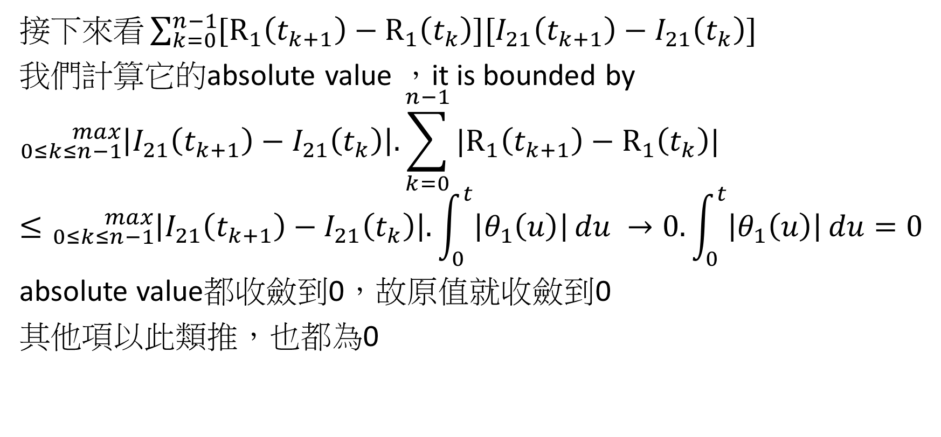
接$下來看\sum_{k=0}^{n−1}{[R_{1}\left(t_{k+1}\right)−R_{1}\left(t_{k}\right)][I_{21}\left(t_{k+1}\right)−I_{21}\left(t_{k}\right)]}$
我們計算它的absolute value ，it is bounded by
$${}_{0≤k≤n−1}^{max}{\left|I_{21}\left(t_{k+1}\right)−I_{21}\left(t_{k}\right)\right|.}\sum_{k=0}^{n−1}{|R_{1}\left(t_{k+1}\right)−R_{1}\left(t_{k}\right)|}$$
$$≤{}_{0≤k≤n−1}^{max}{\left|I_{21}\left(t_{k+1}\right)−I_{21}\left(t_{k}\right)\right|.}\int_{0}^{t}{\left|θ_{1}\left(u\right)\right|}du →0.\int_{0}^{t}{\left|θ_{1}\left(u\right)\right|}du=0$$
absolute value都收斂到0，故原值就收斂到0
其他項以此類推，也都為0
(4.6.6)

Slide 16
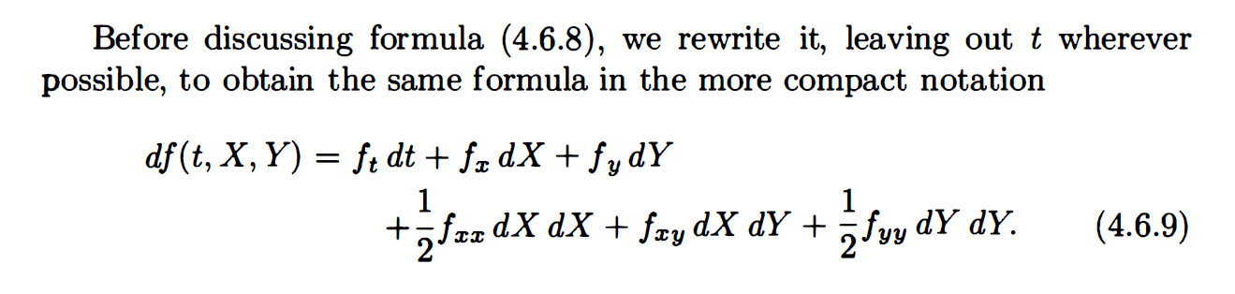


$$\frac{1}{2}f_{xy}dXdY$$
$$\frac{1}{2}f_{yx}dYdX$$
(4.6.1)
(4.6.2)
(4.6.3)
(4.6.4)
(4.6.5)

Slide 17
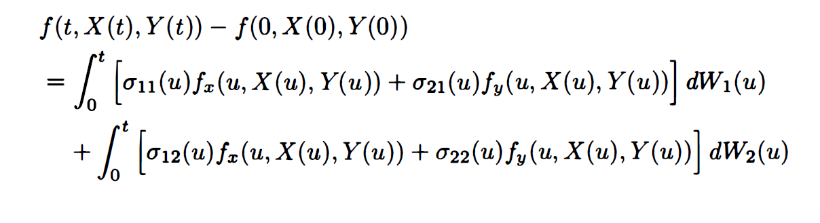
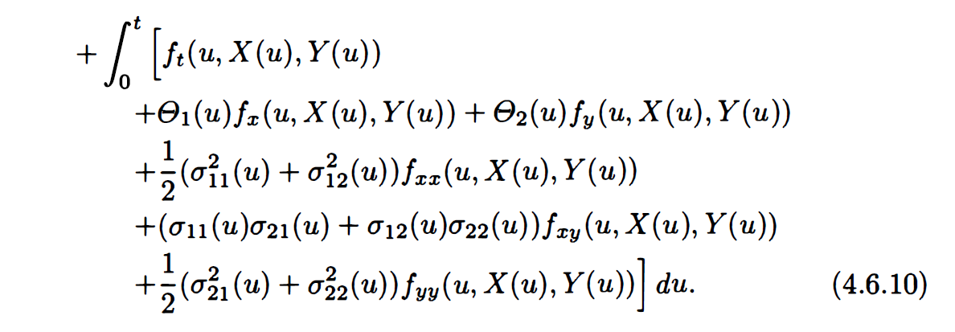

Slide 18
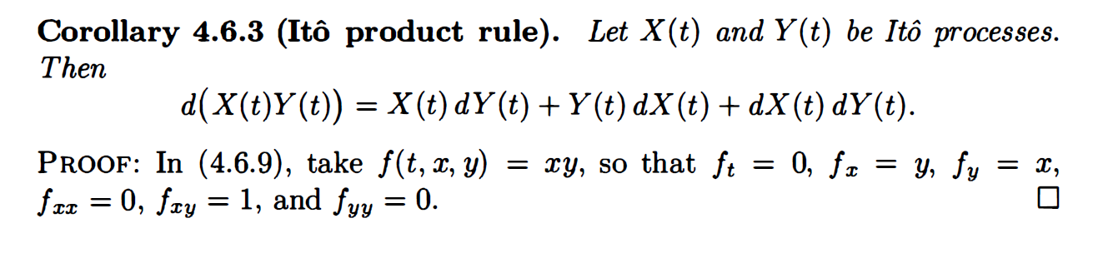
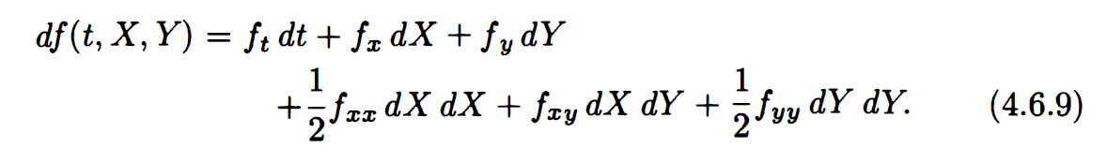
xy
0
y
x
0
1
0

Slide 19
4.6.3 Recognizing Brownian Motion

Slide 20
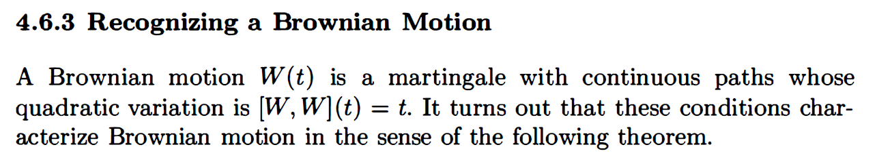
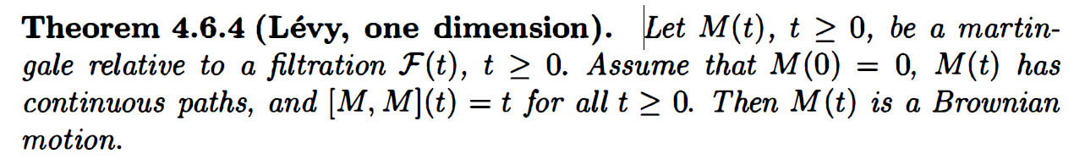
one-dimensional Brownian motion
(1)
(2)
(3)

Slide 21
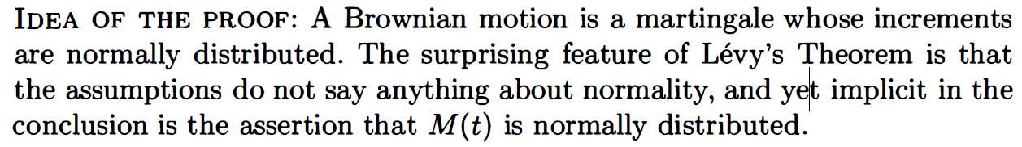
此段證明有趣的點為，Brownian motion 的增量為常態分配，
而我們只需要靠原來的3個假設，即可推出常態的結果，
不需加入額外常態假設!!

Slide 22
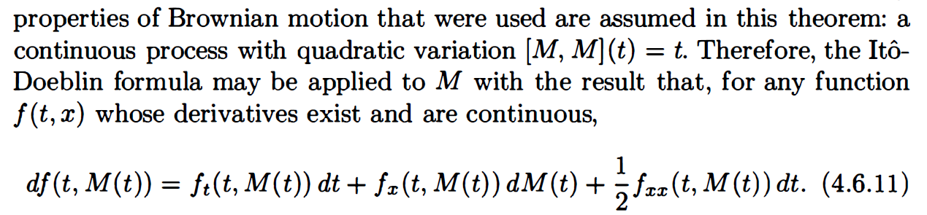
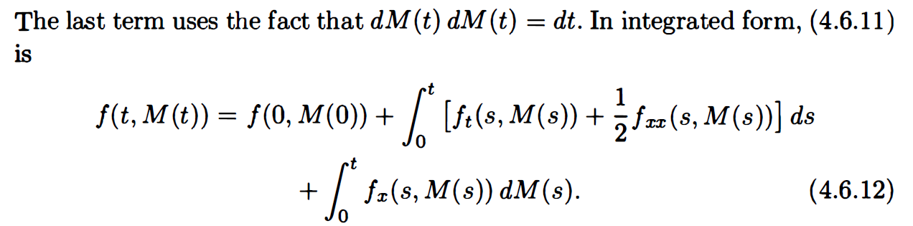
(2)
(3)
(3)

Slide 23
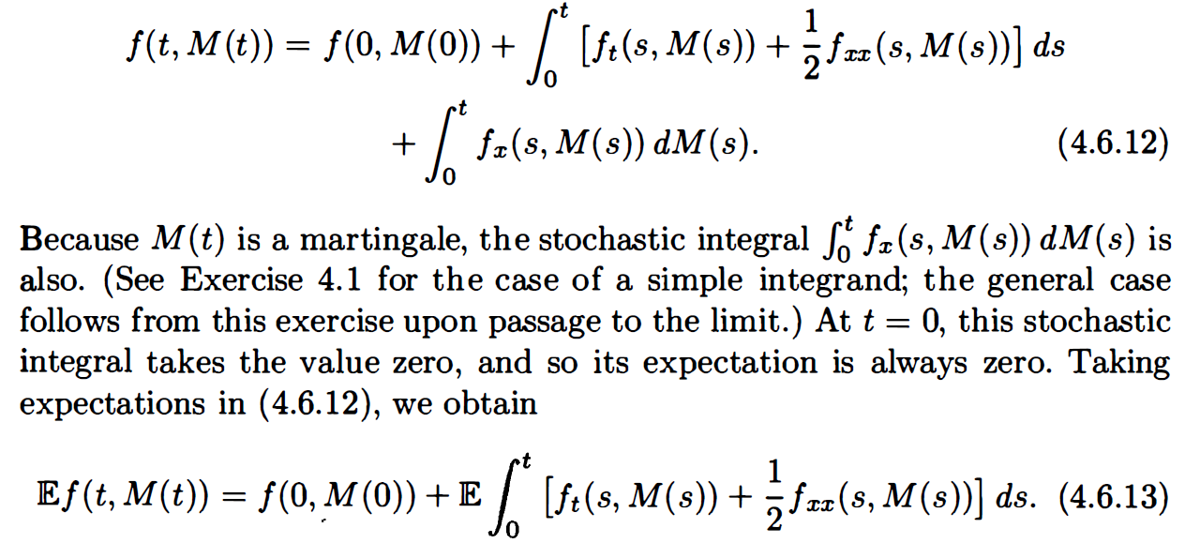
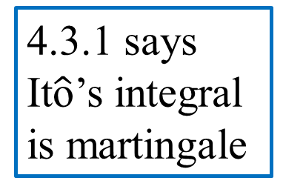
4.3.1 says It$\hat{\text{o}}$’s integral is martingale
(1)

Slide 24
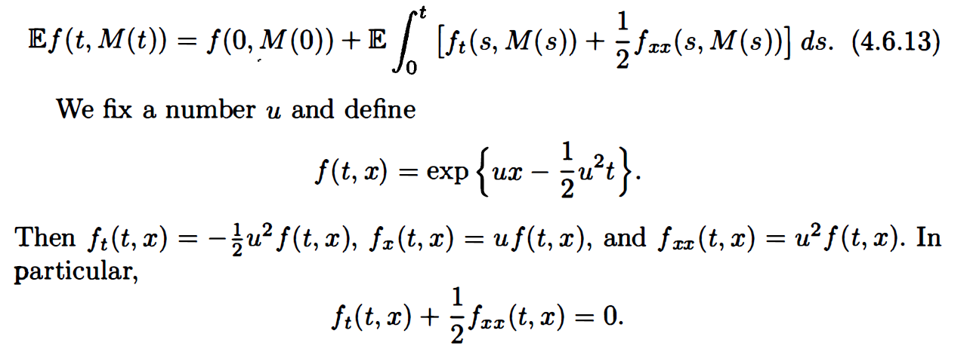
1
0

Slide 25
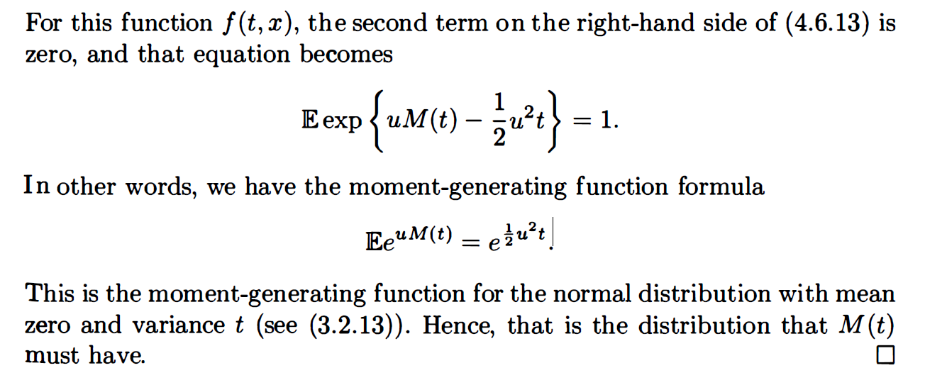

Slide 26
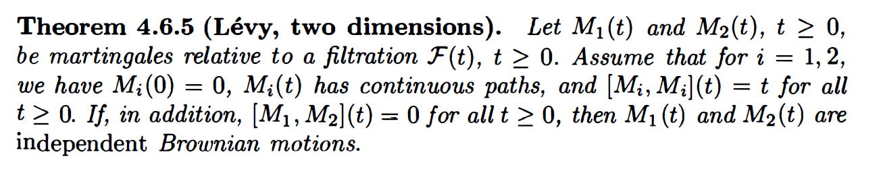
2-dimensional Brownian motion
(4)
和one-dimensional 比起來，多了一個cross variation為0的假設!

Slide 27
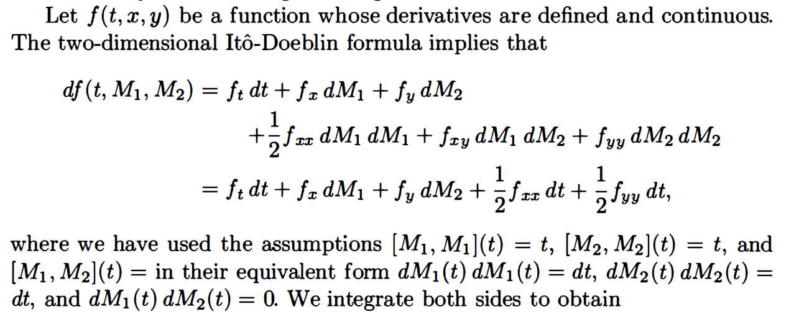

(2)
+$\frac{1}{2}$
(3)
(4)

Slide 28
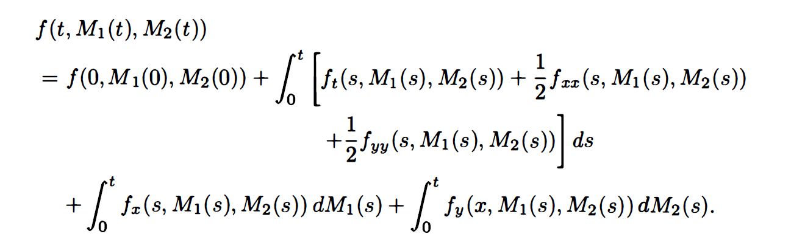
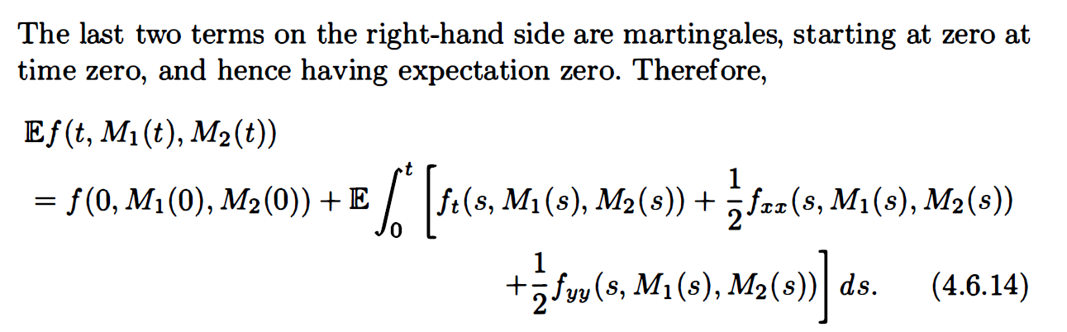
martingale

Slide 29
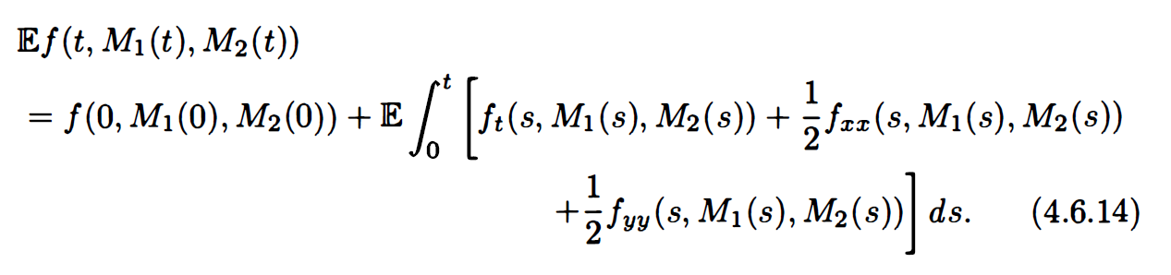
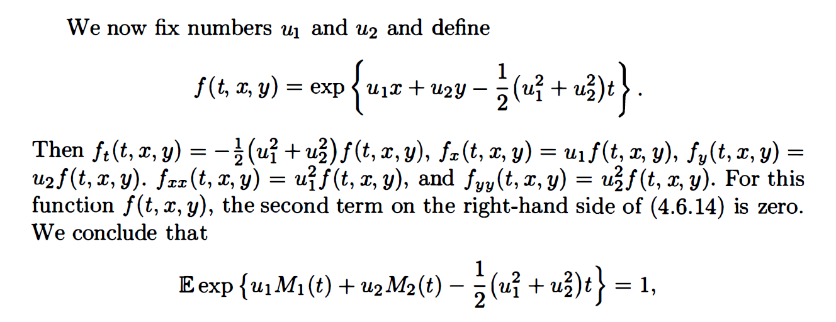

Slide 30
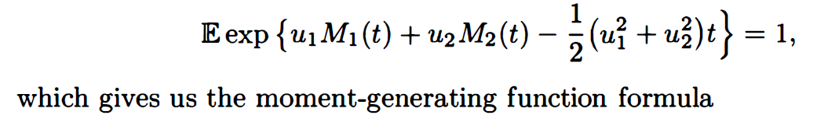
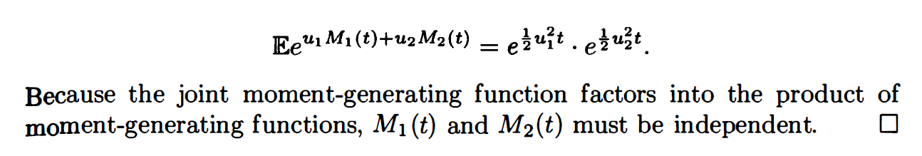
可拆開相乘表獨立
且皆為mean=0 variance=t 的normal

Slide 31
Example 4.6.6

Slide 32


Slide 33

(2)
(1)
(3)

Slide 34


Slide 35



martingale
$$Cov\left(X,Y\right)=E\left[XY\right]−E\left[X\right]E[Y]$$
我們用2獨立Brownian motions建出相關係數為$ρ$的Brownian motions!
也藉此產生相關係數為$ρ$的兩資產!

