Slide 1
4.Stochastic Calculus

Slide 2
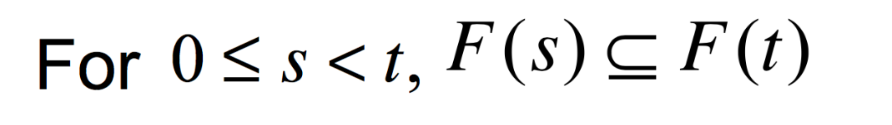
3.3.3 Filtration for Brownian Motion
Definition 3.3.3
Let be a probability space on which is defined a Brownian motion
A filtration for the Brownian motion is a collection of -algebra
, satisfying：
( Information accumulates )
(Adaptivity) W(t) is F(t) msb.
(Independence of future increments)
For the increment W(u)-W(t) is indep. of F(t).

Slide 3
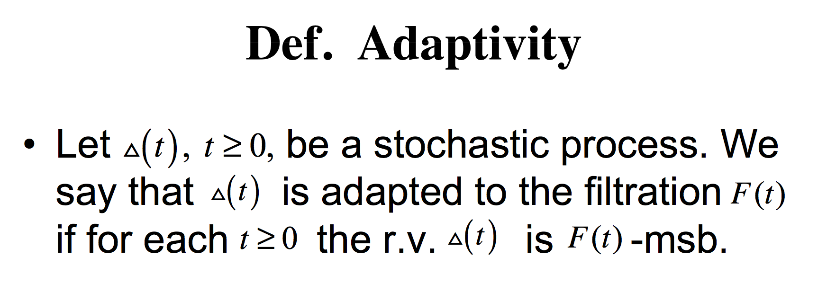

Slide 4
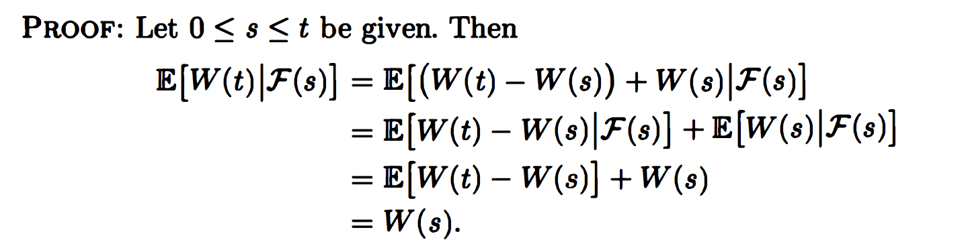
3.3.4 Martingale Property for Brownian Motion
Theorem 3.3.4 Brownian motion is a martingale

Slide 5

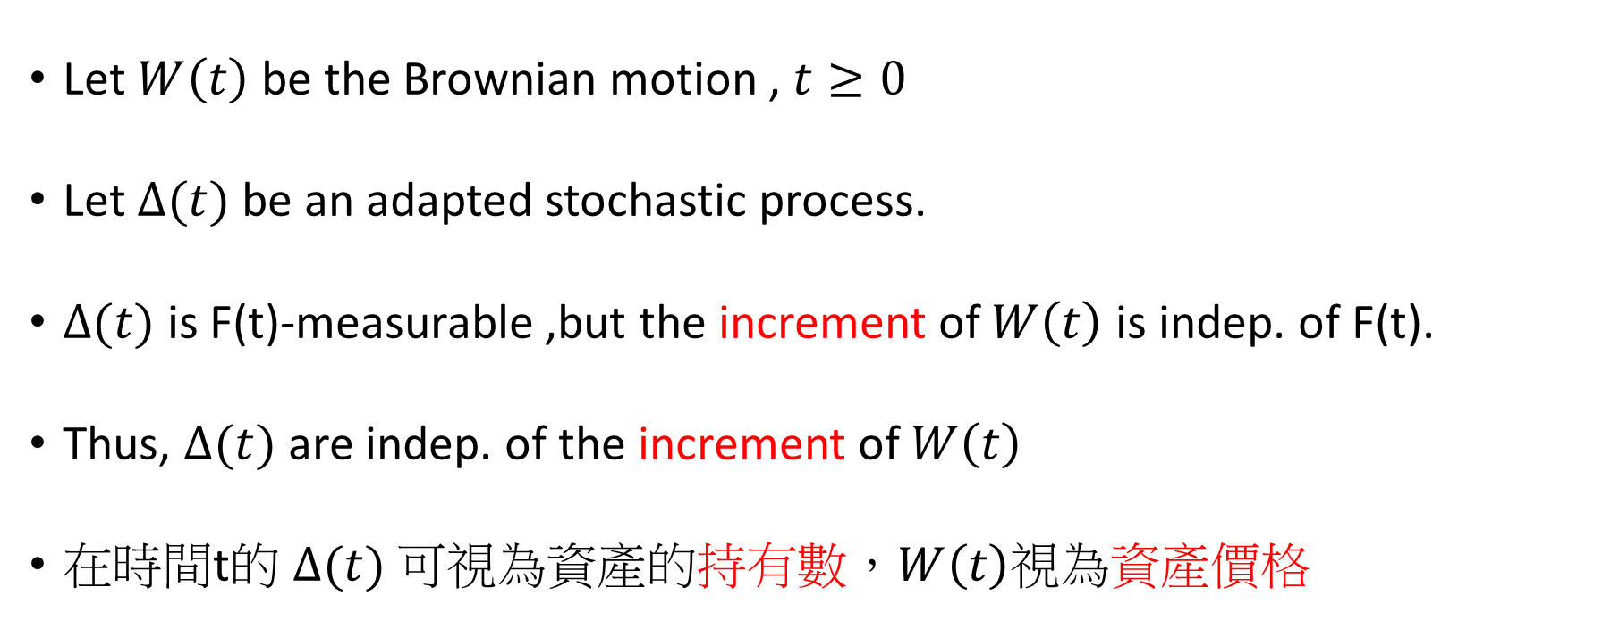
4.2 Ito’s Integral for Simple Integrands
Let $W\left(t\right)$ be the Brownian motion ,$t≥0$
Let $∆(t)$ be an adapted stochastic process.
$∆(t)$ is F(t)-measurable ,but the increment of $W\left(t\right)$ is indep. of F(t).
Thus, $∆(t)$ are indep. of the increment of $W\left(t\right)$
在時間t的 $∆(t)$ 可視為資產的持有數，$W\left(t\right)$視為資產價格

Slide 6
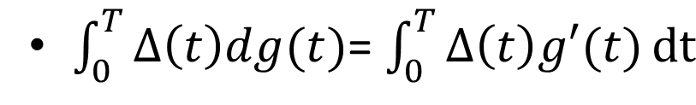

(Continue)
If g can be differentiated, then the equation holds.
Unfortunately, $W\left(t\right)$can’t be differentiated. (因為路徑中有很多尖點)
Thus, we can only use the original integral.

Slide 7
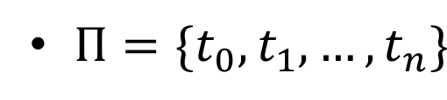
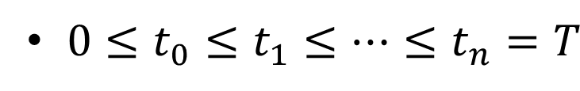


4.2.1 Construction of the integral
Let be the partition of [ 0 , T ] , i.e.,
Suppose that $∆(t)$ is constant in t on each subinterval [$t_{j}$, $t_{j+1}$] .
Such a process $∆(t)$ is a simple process.
$$=$$

Slide 8
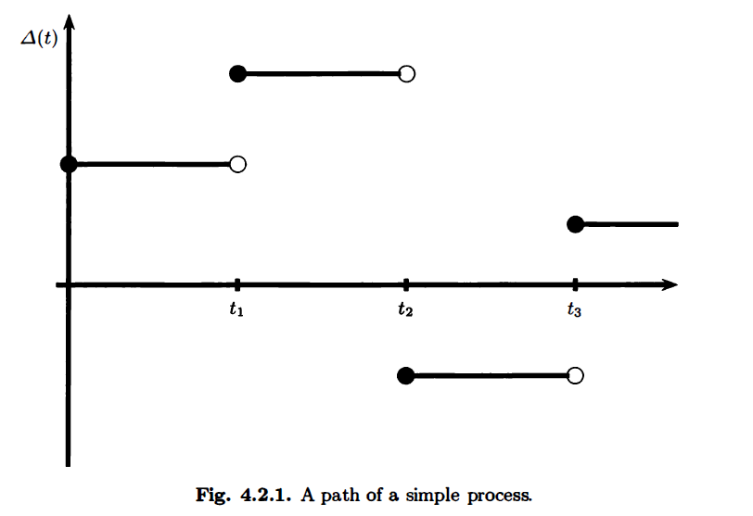

Slide 9
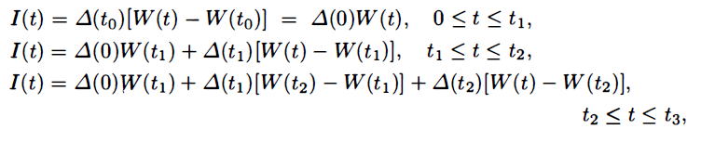
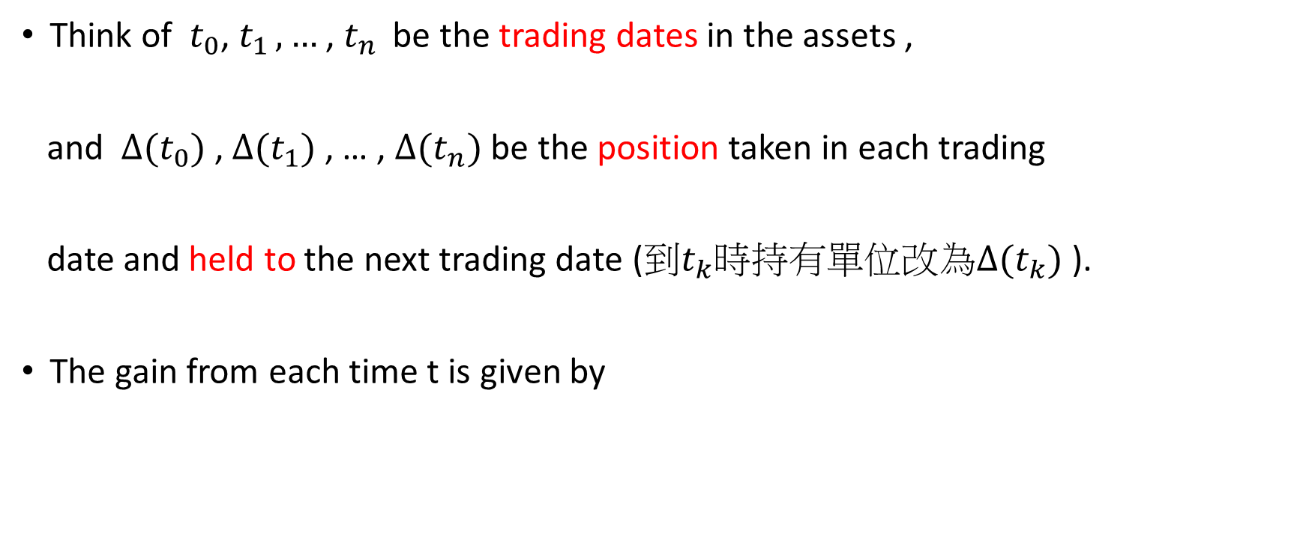
Think of $t_{0}$, $t_{1 },…$ , $t_{n }$ be the trading dates in the assets ,
and $∆(t_{0})$ , $∆(t_{1})$ , … , $∆(t_{n})$ be the position taken in each trading
date and held to the next trading date (到$t_{k}$時持有單位改為$∆(t_{k})$ ).
The gain from each time t is given by

Slide 10
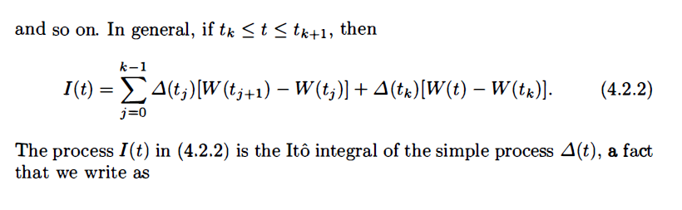
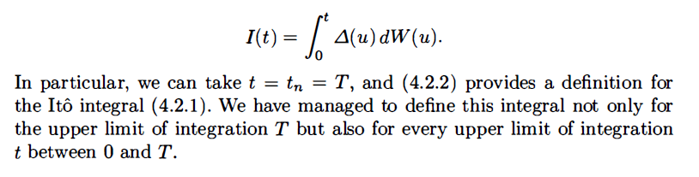

Slide 11
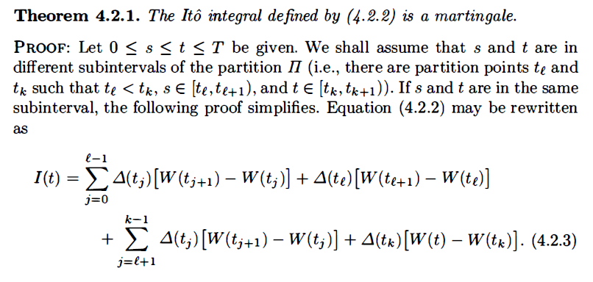

4.2.2 Properties of integral
因為股價為$W\left(t\right)$，而martingale的$W\left(t\right)會產生$我們的gain，
所以我們可以合理推測 gain $I\left(t\right)$ 也為martingale
Subinterval:[0,tl+1]
Subinterval:[tl+1,t]

Slide 12
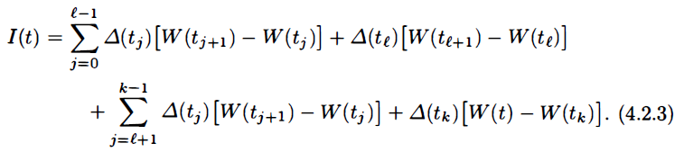
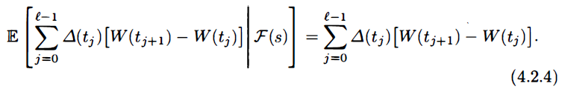



Martingale Show $E\left(I\left(t\right) | F\left(s\right)\right)=I(s)$
(1)
F(s)-measurable
(2)
(3)
(4)
(1)
的條件期望值=
(2)
的條件期望值=
(1)+(2)
的條件期望值=
l-1
(s)
(s)
所以只要得出(3)和(4)的條件期望值皆=0即得證

Slide 13
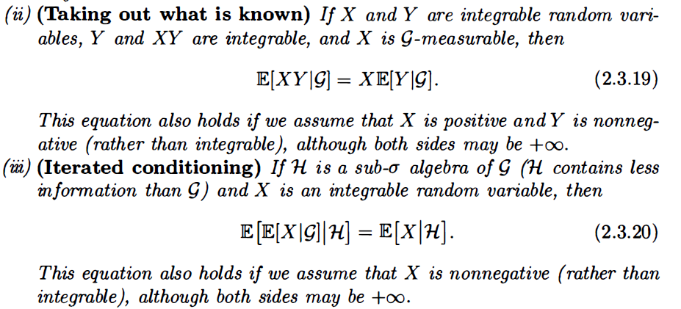
(3)和(4)會用到的工具

Slide 14
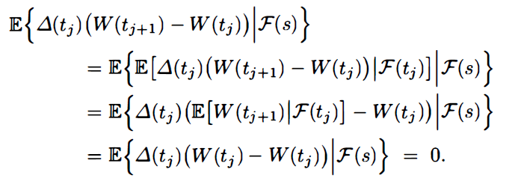
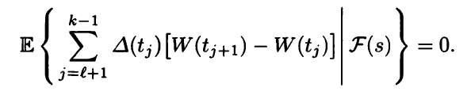
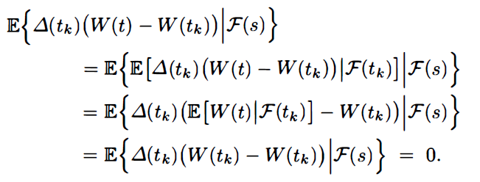

得出(3)和(4)的條件期望值皆=0
(3)的任一項 =
的條件期望值
G
H
(3)
的條件期望值=
(4)
的條件期望值=
$得I\left(t\right)$ 也為martingale

Slide 15
4.2.2 Ito’s isoemtry

Slide 16
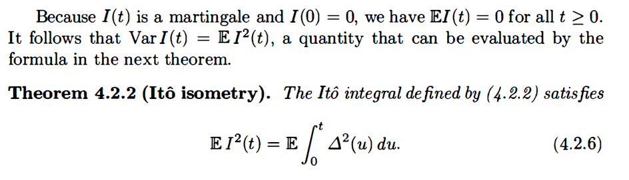

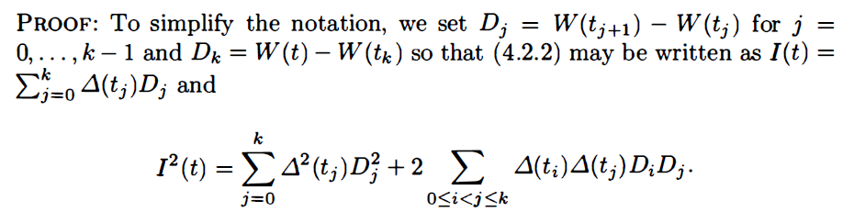
平方項
交乘項

Slide 17
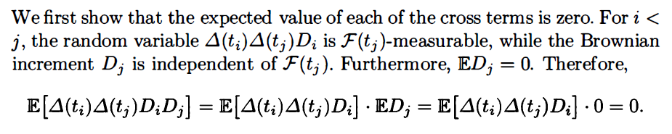
Recall the property of Brownian Motion
For $0≤t≤u$ the increment W(u)-W(t) is indep. of F(t).
Result : 交乘項=0

Slide 18
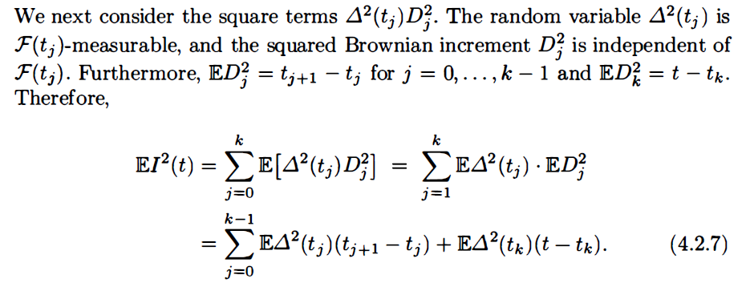
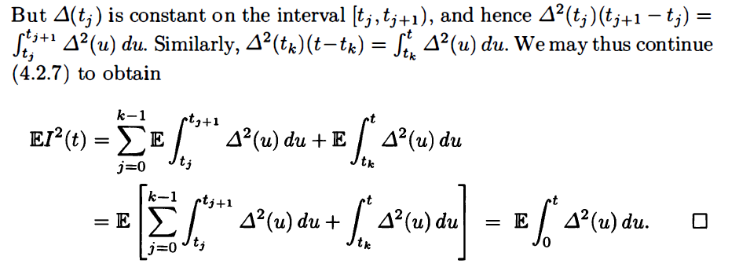

Slide 19
4.2.3 The Quadratic variation of Ito integral

Slide 20
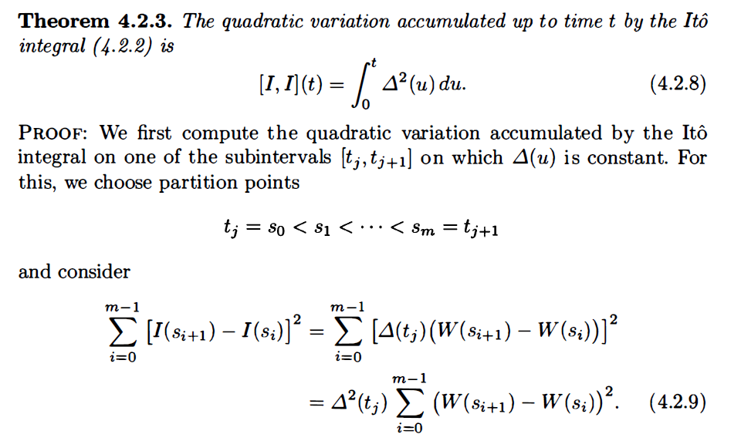

Slide 21
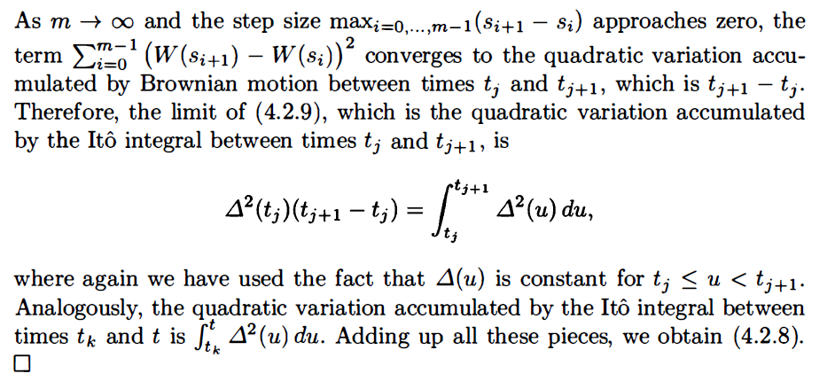
和Variance不同的地方在於 Variance是全部路徑的平均 Quadratic variation 的值
只由一條路徑產生

Slide 22
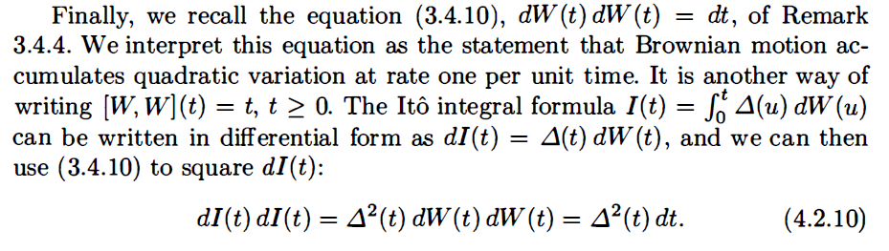
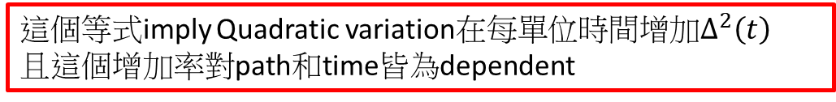
Quadratic variation
這個等式imply Quadratic variation在每單位時間增加$∆^{2}\left(t\right)$
且這個增加率對path和time皆為dependent

Slide 23
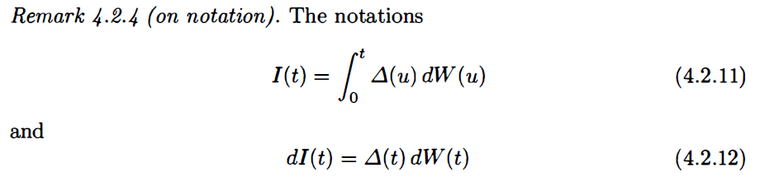



在$I$(0)=0的條件下
Asset 的Value
波動
股票持有數
股價波動
沒$有I$(0)=0的條件

Slide 24
4.3 Ito’s Integral
for General Integrands

Slide 25
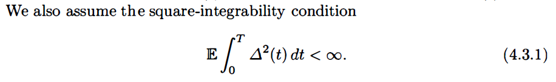
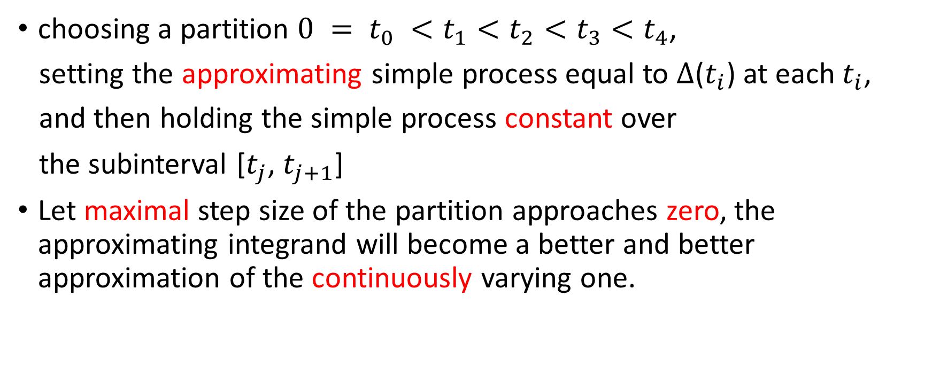
choosing a partition $0 = t_{0} <t_{1}<t_{2}<t_{3}<t_{4}$,
setting the approximating simple process equal to $∆$($t_{i}$) at each $t_{i}$,
and then holding the simple process constant over
the subinterval [$t_{j}$, $t_{j+1}$]
Let maximal step size of the partition approaches zero, the approximating integrand will become a better and better approximation of the continuously varying one.

Slide 26
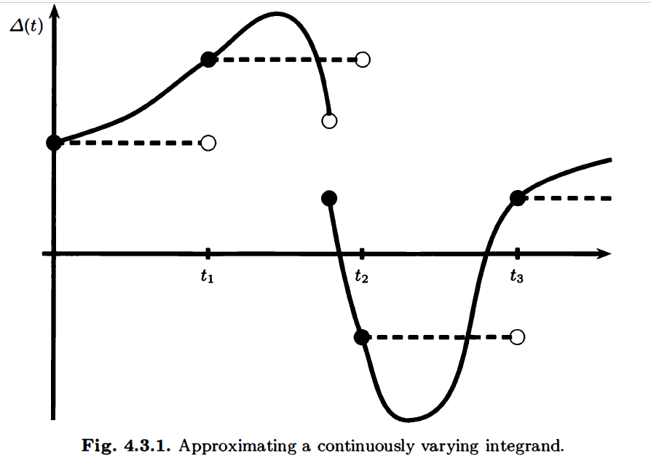

Slide 27
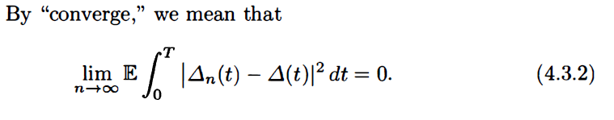
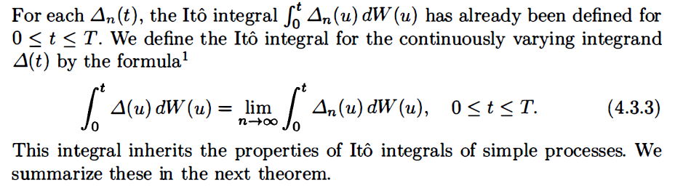

As $n→∞ ,∆_{n}(t)$ $→ ∆(t)$ ($∆_{n}(t)$ converges to $∆(t)$)

Slide 28
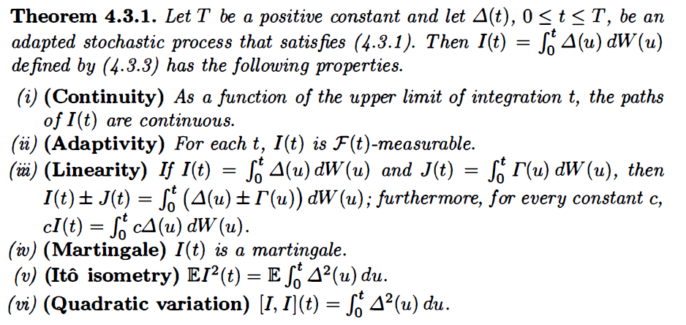

Slide 30
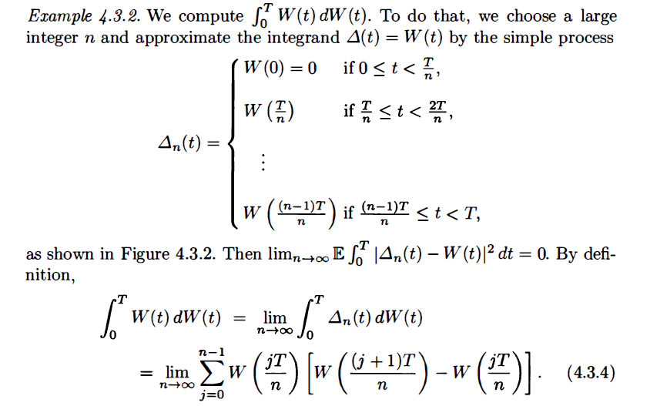

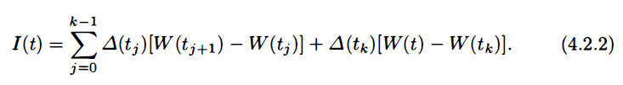

Slide 31
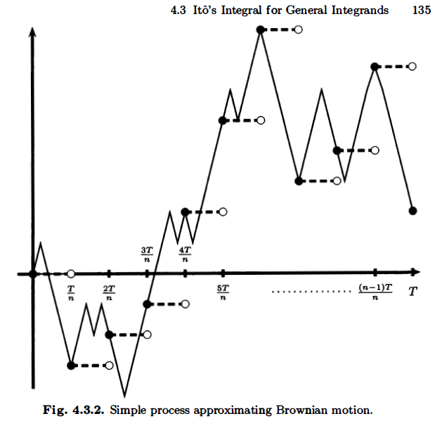

Slide 32
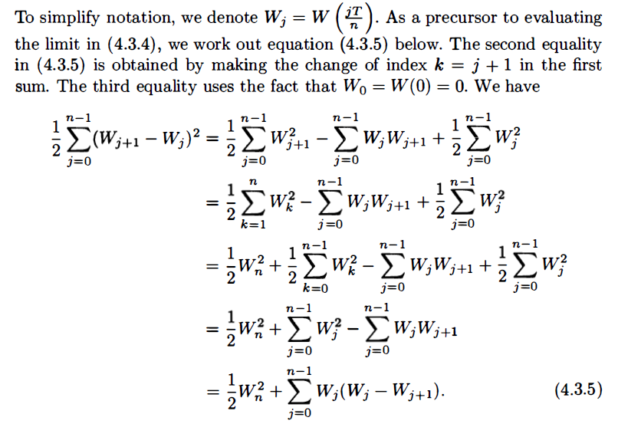
利用W(0)=0

Slide 33
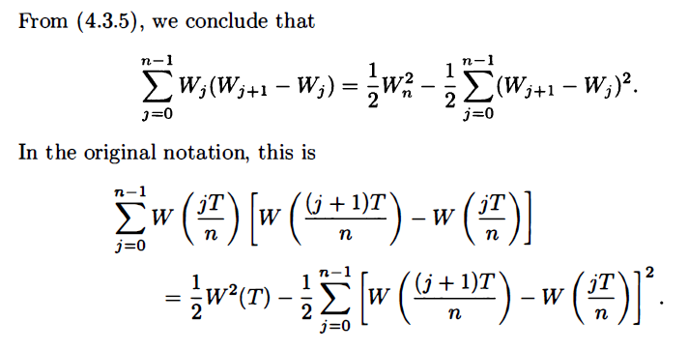
Quadratic Variation

Slide 34
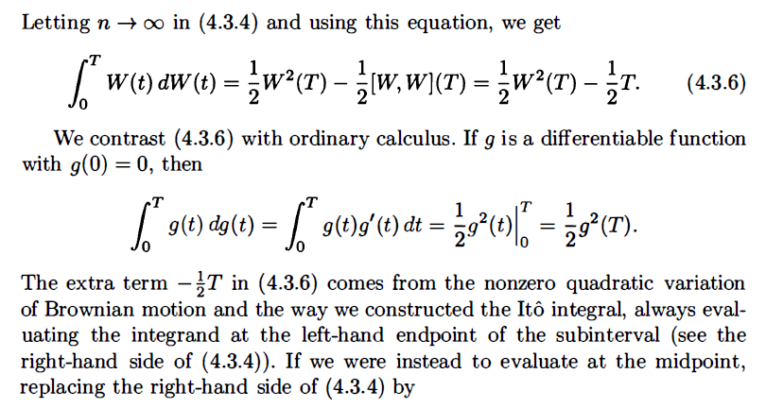
不可微的會多出
Quadratic Variation 的減項

Slide 35
