Slide 1
6. Connections with Partial Differential Equations

Slide 2
Introduction
衍生性商品有兩種定價方式
(1) Monte Carlo 法
(2) 以數學方法解 partial differential equation
本章採用第二種方法，並搭配Markov property …等理論，
可以用來模擬利率模型，進而可以計算出債券或其
衍生性商品的價格。

Slide 3
6.2 Stochastic Differential Equations

Slide 4

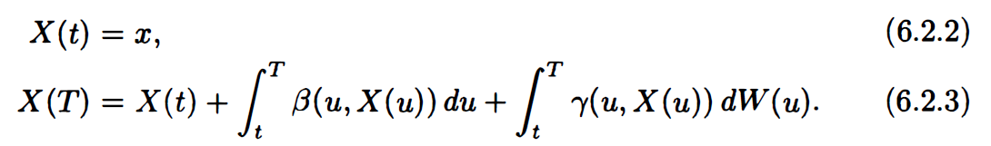

A stochastic differential equation is an equation of the form
$β and γ$ are given functions.
Adding initial condition: $X\left(t\right)=x , ∀t≥0 and x∈ℝ$
We can rewrite 6.2.1
drift
diffusion

Slide 5
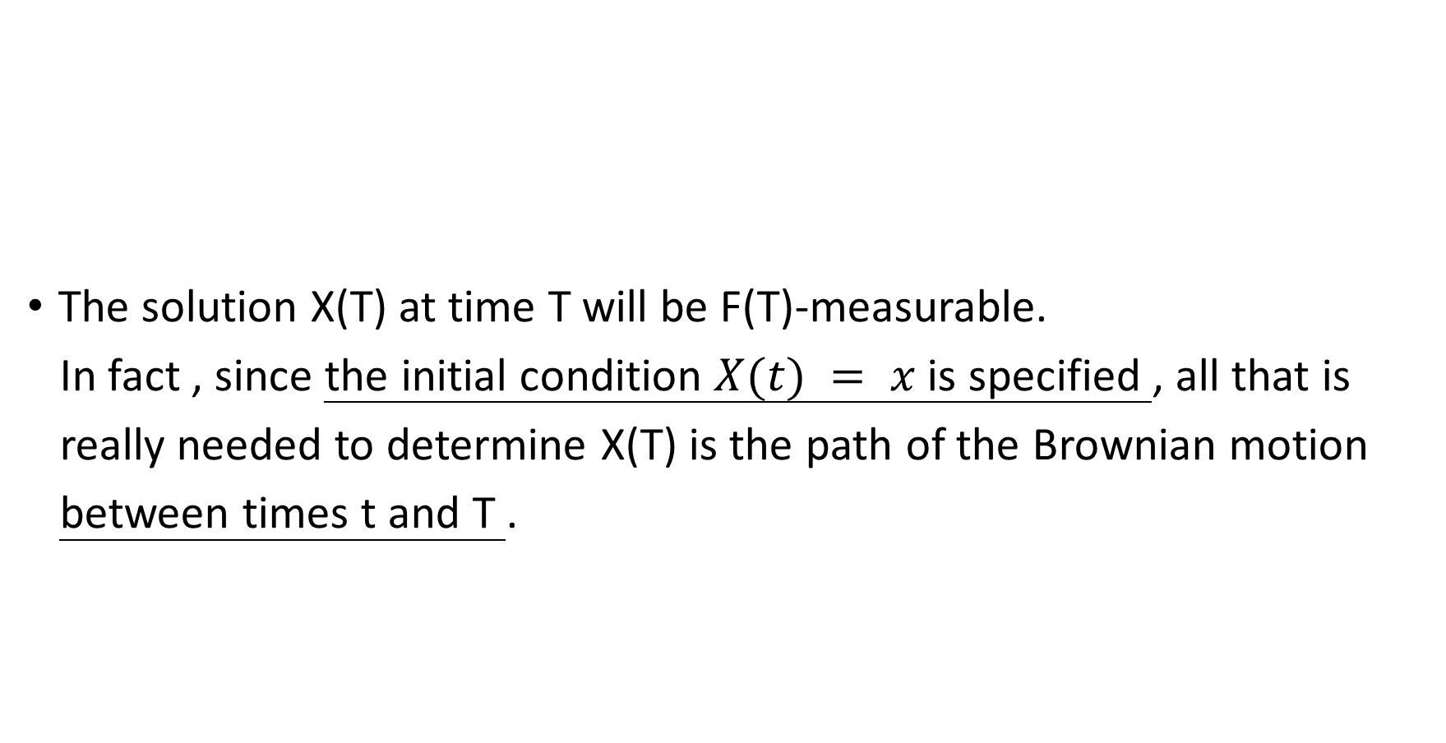
The solution X(T) at time T will be F(T)-measurable.
In fact , since the initial condition $X(t) = x$is specified , all that is
really needed to determine X(T) is the path of the Brownian motion
between times t and T .

Slide 6
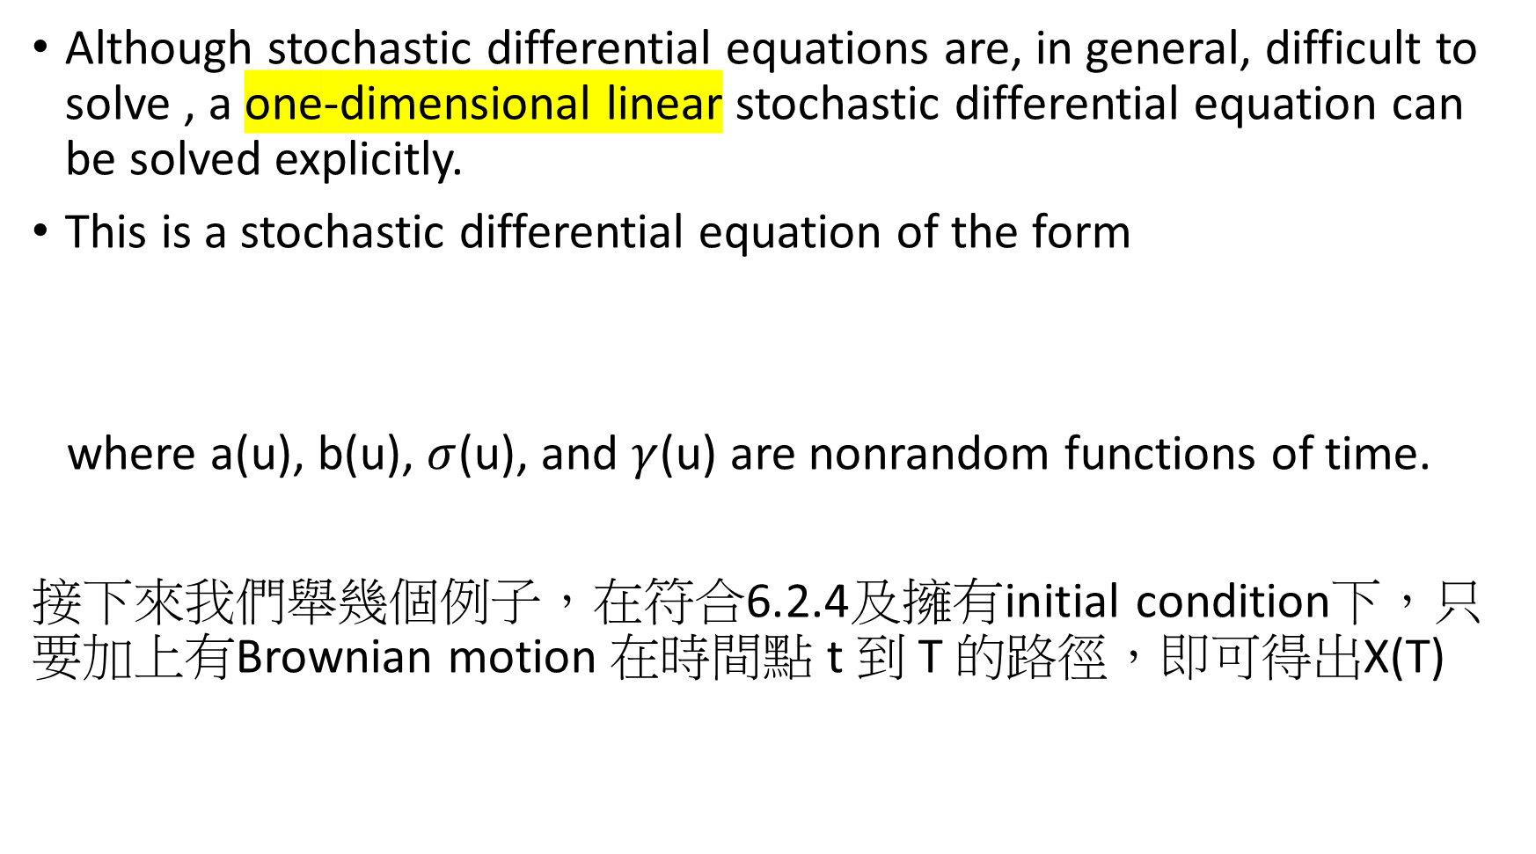
Although stochastic differential equations are, in general, difficult to solve , a one-dimensional linear stochastic differential equation can be solved explicitly.
This is a stochastic differential equation of the form
where a(u), b(u), $σ$(u), and $γ$(u) are nonrandom functions of time.
接下來我們舉幾個例子，在符合6.2.4及擁有initial condition下，只要加上有Brownian motion 在時間點 t 到 T 的路徑，即可得出X(T)

Slide 7
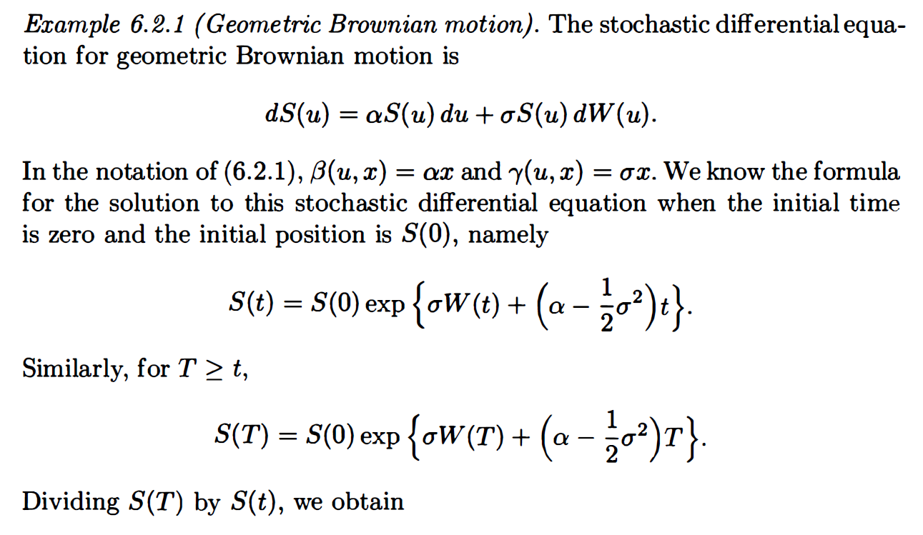






Example 1
$$αx$$
$$σx$$
$$0$$
$$αx$$
$$0$$
$$σx$$

Slide 8
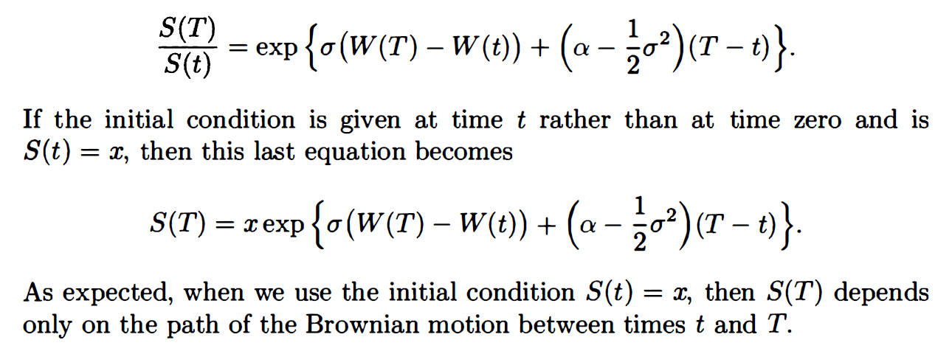

Slide 9
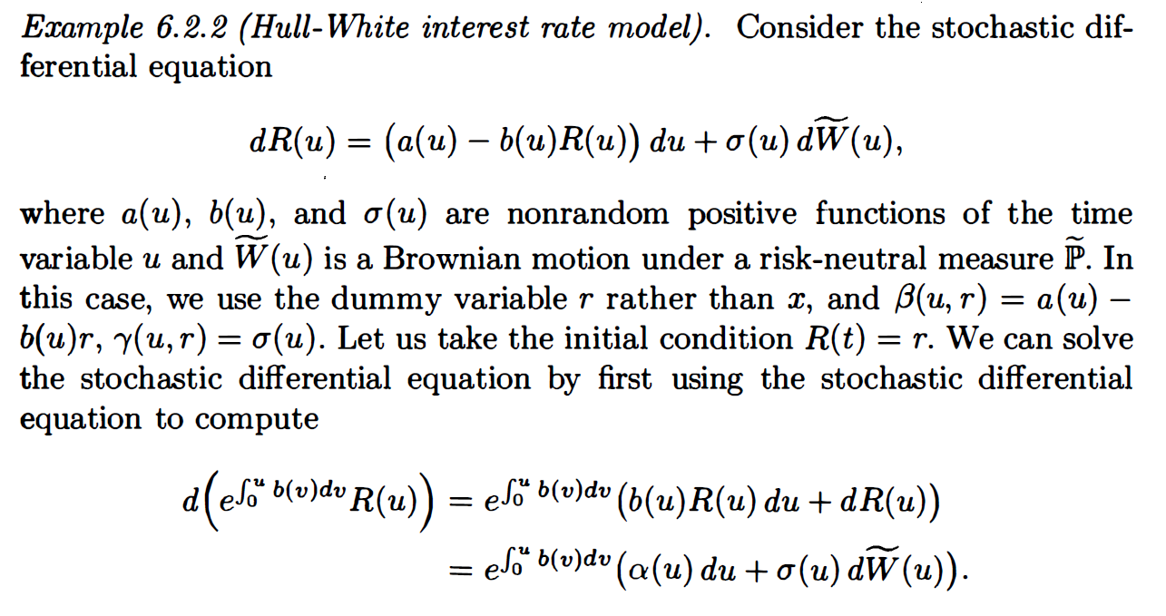

Example 2

Slide 10
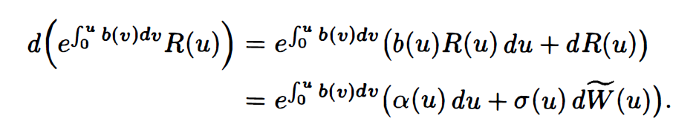
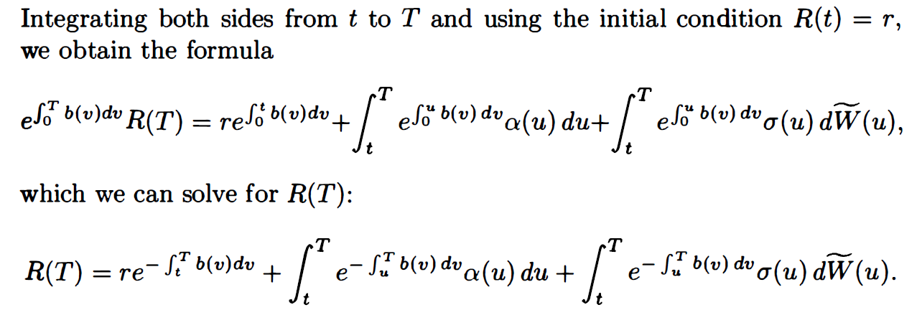

Slide 11
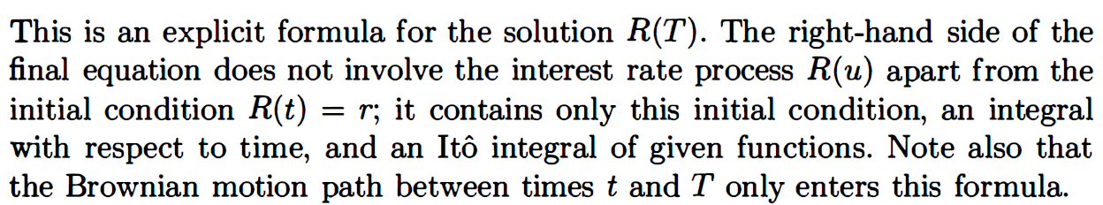

Slide 12
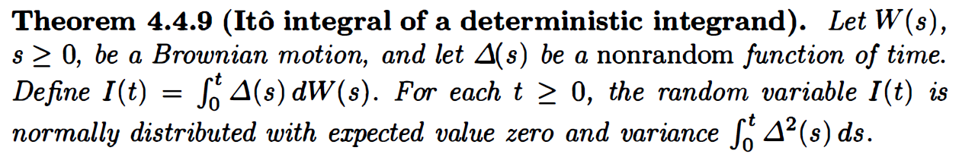
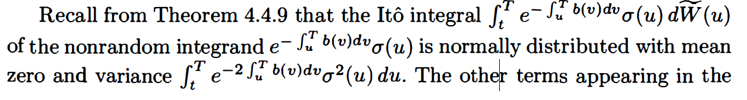

Slide 13
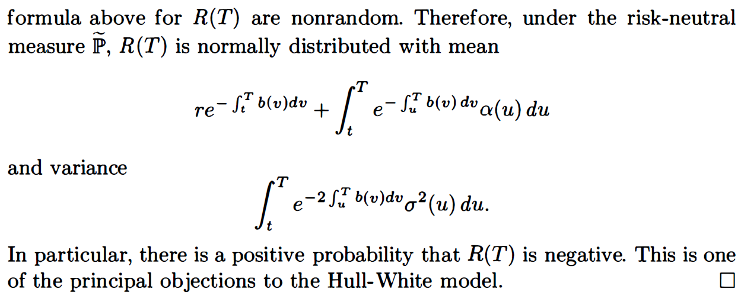

Slide 19
