Slide 1
Callable Bond
學生:游雅萱

Slide 2

模型假設
假設沒有舉債的公司資產服從隨機過程
$\frac{dV_{t}^{U}}{V_{t}^{U}}=\left(r−q\right)dt+σd$z
公司的payout
$$δ_{t}=V_{t}^{U}e^{q∆t}−V_{t}^{U}$$
公司破產
在股東價值第一次為零時破產
當破產時立即清算，並扣除破產成本
Notes:
假定沒有舉債的公司資產價值服從隨機過程(unleveraged firm asset value)
是以沒有舉債的公司資產價值為標的物的或有選擇權
R 無風險利率
Q 每一期公司會固定支付公司資產價值的某個比率
Sigma 資產的波動度
dz 標準布朗運動
每一期都會從公司的資產價值扣除某個比例優先用於支付債息，其餘當作股利發給股東
反之，不足以支付債息，公司將用發行新股的方式來償還債息
在股東價值第一次為零時破產
當破產時立即清算，並扣除破產成本後給債權人

Slide 3
模型設定
公司發行一張可贖回債券能夠不斷地贖回再舉或到期再舉
以時間長度為一張T年期債券的兩倍做舉例
允許債券在$\frac{T}{2}$時能提前贖回
每一張債券都有一個提前贖回的時間點
在最後一個贖回點($\frac{3T}{2}$)到期或贖回
發行一張$\frac{T}{2}$年期的不可贖回債券
Notes:
假定沒有舉債的公司資產價值服從隨機過程(unleveraged firm asset value)
是以沒有舉債的公司資產價值為標的物的或有選擇權
R 無風險利率
Q 每一期公司會固定支付公司資產價值的某個比率
Sigma 資產的波動度
dz 標準布朗運動
每一期都會從公司的資產價值扣除某個比例優先用於支付債息，其餘當作股利發給股東
反之，不足以支付債息，公司將用發行新股的方式來償還債息
在股東價值第一次為零時破產
當破產時立即清算，並扣除破產成本後給債權人

Slide 4
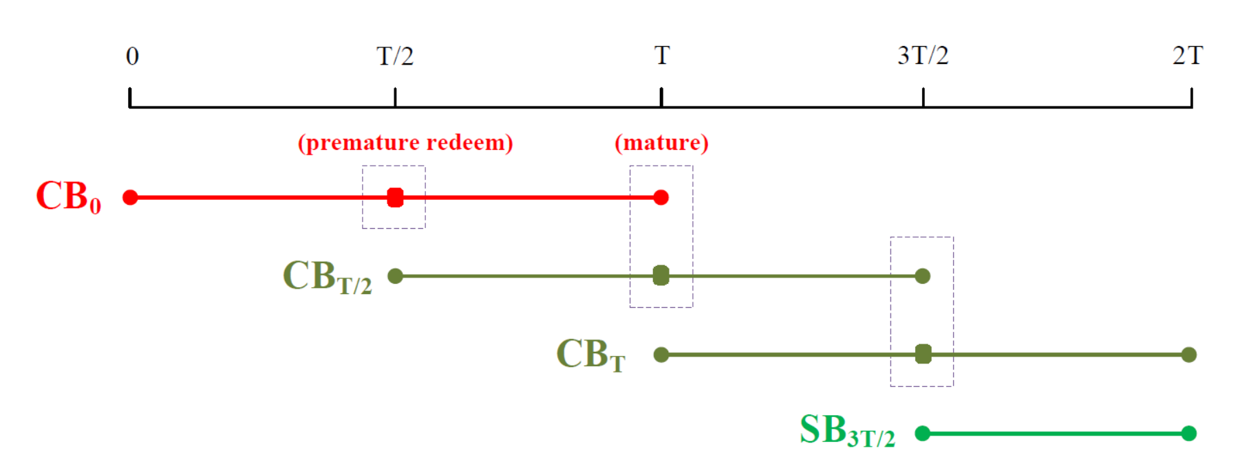

Slide 5
0
$$T$$
$$2T$$
提$前贖回$
$$到期贖回$$
Notes:
此模型是公司發行的債券有可贖回條款，允許債券可以提前贖回，
最上層的樹是公司在時間點0發行的債券
加上紅色節點的圖

Slide 6

部分贖回
模型設定
公司發行一張可贖回債券能夠不斷地贖回再舉或到期再舉
以時間長度為一張T年期債券的兩倍做舉例
允許債券在$\frac{T}{2}$時能部份提前贖回
每一張債券都有一個提前贖回的時間點，可提前贖回50%,100%
在最後一個贖回點($\frac{3T}{2}$)到期或贖回
發行一張$\frac{T}{2}$年期的不可贖回債券
Notes:
假定沒有舉債的公司資產價值服從隨機過程(unleveraged firm asset value)
是以沒有舉債的公司資產價值為標的物的或有選擇權
R 無風險利率
Q 每一期公司會固定支付公司資產價值的某個比率
Sigma 資產的波動度
dz 標準布朗運動
每一期都會從公司的資產價值扣除某個比例優先用於支付債息，其餘當作股利發給股東
反之，不足以支付債息，公司將用發行新股的方式來償還債息
在股東價值第一次為零時破產
當破產時立即清算，並扣除破產成本後給債權人

Slide 7
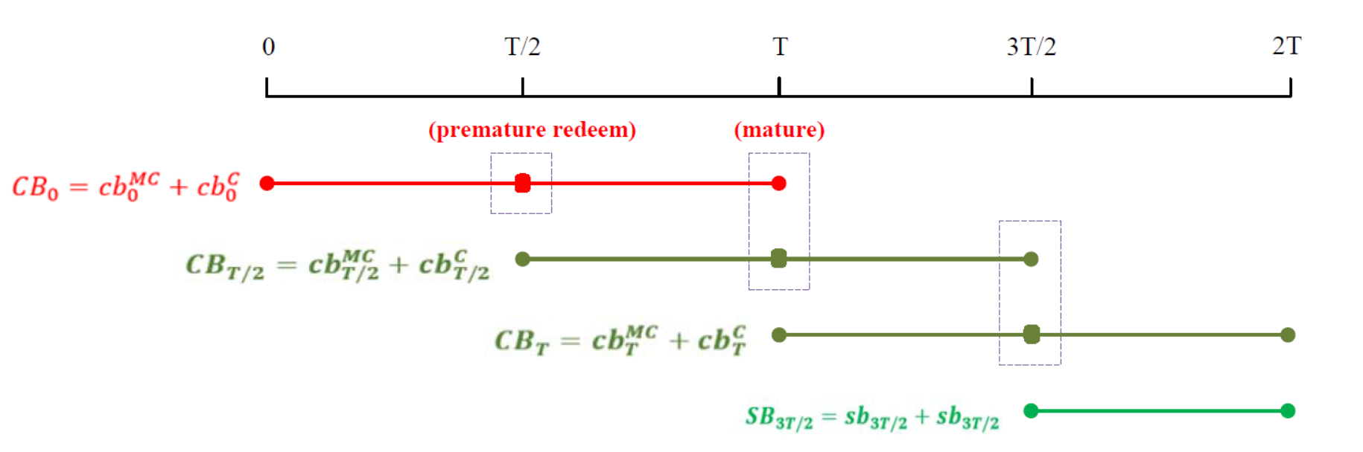

Slide 8
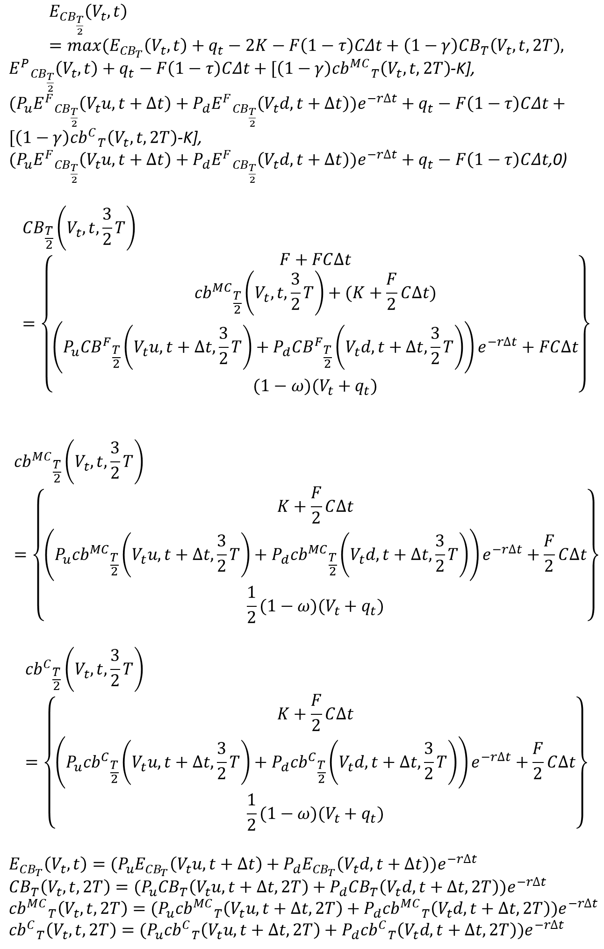
$$E_{{CB}_{\frac{T}{2}}}\left(V_{t},t\right)=max⁡(E_{{CB}_{T}}\left(V_{t},t\right)+q_{t}−2K−F\left(1−τ\right)CΔt+\left(1−γ\right){CB}_{T}\left(V_{t},t,2T\right),$$
${E^{P}}_{{CB}_{\frac{T}{2}}}\left(V_{t},t\right)+q_{t}−F\left(1−τ\right)CΔt+[\left(1−γ\right){{cb}^{MC}}_{T}\left(V_{t},t,2T\right)$-K],
$(P_{u}{E^{F}}_{{CB}_{\frac{T}{2}}}\left(V_{t}u,t+∆t\right)+P_{d}{E^{F}}_{{CB}_{\frac{T}{2}}}\left(V_{t}d,t+∆t\right))e^{−r∆t}+q_{t}−F\left(1−τ\right)CΔt+[\left(1−γ\right){{cb}^{C}}_{T}\left(V_{t},t,2T\right)$-K],
$(P_{u}{E^{F}}_{{CB}_{\frac{T}{2}}}\left(V_{t}u,t+∆t\right)+P_{d}{E^{F}}_{{CB}_{\frac{T}{2}}}\left(V_{t}d,t+∆t\right))e^{−r∆t}+q_{t}−F\left(1−τ\right)CΔt$,0)
$${CB}_{\frac{T}{2}}\left(V_{t},t,\frac{3}{2}T\right)=\left\{\begin{aligned}F+FC∆t \\ {{cb}^{MC}}_{\frac{T}{2}}\left(V_{t},t,\frac{3}{2}T\right)+(K+\frac{F}{2}C∆t) \\ \left(P_{u}{{CB}^{F}}_{\frac{T}{2}}\left(V_{t}u,t+∆t,\frac{3}{2}T\right)+P_{d}{{CB}^{F}}_{\frac{T}{2}}\left(V_{t}d,t+∆t,\frac{3}{2}T\right)\right)e^{−r∆t}+FC∆t \\ (1−ω)(V_{t}+q_{t})\end{aligned}\right\}$$
$${{cb}^{MC}}_{\frac{T}{2}}\left(V_{t},t,\frac{3}{2}T\right)=\left\{\begin{aligned}K+\frac{F}{2}C∆t \\ \left(P_{u}{{cb}^{MC}}_{\frac{T}{2}}\left(V_{t}u,t+∆t,\frac{3}{2}T\right)+P_{d}{{cb}^{MC}}_{\frac{T}{2}}\left(V_{t}d,t+∆t,\frac{3}{2}T\right)\right)e^{−r∆t}+\frac{F}{2}C∆t \\ \frac{1}{2}(1−ω)(V_{t}+q_{t})\end{aligned}\right\}$$
$${{cb}^{C}}_{\frac{T}{2}}\left(V_{t},t,\frac{3}{2}T\right)=\left\{\begin{aligned}K+\frac{F}{2}C∆t \\ \left(P_{u}{{cb}^{C}}_{\frac{T}{2}}\left(V_{t}u,t+∆t,\frac{3}{2}T\right)+P_{d}{{cb}^{C}}_{\frac{T}{2}}\left(V_{t}d,t+∆t,\frac{3}{2}T\right)\right)e^{−r∆t}+\frac{F}{2}C∆t \\ \frac{1}{2}(1−ω)(V_{t}+q_{t})\end{aligned}\right\}$$
$$E_{{CB}_{T}}\left(V_{t},t\right)=(P_{u}E_{{CB}_{T}}\left(V_{t}u,t+∆t\right)+P_{d}E_{{CB}_{T}}\left(V_{t}d,t+∆t\right))e^{−r∆t}$$
$${CB}_{T}\left(V_{t},t,2T\right)=(P_{u}{CB}_{T}\left(V_{t}u,t+∆t,2T\right)+{P_{d}CB}_{T}\left(V_{t}d,t+∆t,2T\right))e^{−r∆t}$$
$${{cb}^{MC}}_{T}\left(V_{t},t,2T\right)=(P_{u}{{cb}^{MC}}_{T}\left(V_{t}u,t+∆t,2T\right)+P_{d}{{cb}^{MC}}_{T}\left(V_{t}d,t+∆t,2T\right))e^{−r∆t}$$
$${{cb}^{C}}_{T}\left(V_{t},t,2T\right)=(P_{u}{{cb}^{C}}_{T}\left(V_{t}u,t+∆t,2T\right)+P_{d}{{cb}^{C}}_{T}\left(V_{t}d,t+∆t,2T\right))e^{−r∆t}$$

Slide 9
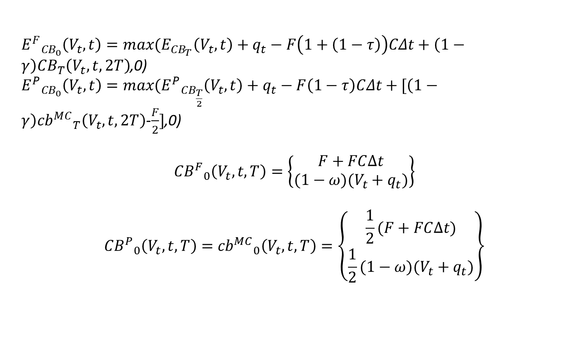
${E^{F}}_{{CB}_{0}}\left(V_{t},t\right)=max⁡(E_{{CB}_{T}}\left(V_{t},t\right)+q_{t}−F\left(1+\left(1−τ\right)\right)CΔt+\left(1−γ\right){CB}_{T}\left(V_{t},t,2T\right)$,0)
${E^{P}}_{{CB}_{0}}\left(V_{t},t\right)=max⁡({E^{P}}_{{CB}_{\frac{T}{2}}}\left(V_{t},t\right)+q_{t}−F\left(1−τ\right)CΔt+[\left(1−γ\right){{cb}^{MC}}_{T}\left(V_{t},t,2T\right)$-$\frac{F}{2}]$,0)
$${{CB}^{F}}_{0}\left(V_{t},t, T\right)=\left\{\begin{aligned}F+FC∆t \\ (1−ω)(V_{t}+q_{t})\end{aligned}\right\}$$
$${{CB}^{P}}_{0}\left(V_{t},t, T\right)={{cb}^{MC}}_{0}\left(V_{t},t, T\right)=\left\{\begin{aligned}\frac{1}{2}(F+FC∆t) \\ \frac{1}{2}(1−ω)(V_{t}+q_{t})\end{aligned}\right\}$$

Slide 10
$$E_{{CB}_{\frac{T}{2}}}\left(V_{t},t\right)=max⁡(E_{{CB}_{T}}\left(V_{t},t\right)+q_{t}−2K−F\left(1−τ\right)CΔt+\left(1−γ\right){CB}_{T}\left(V_{t},t,2T\right),$$
${E^{P}}_{{CB}_{\frac{T}{2}}}\left(V_{t},t\right)+q_{t}−F\left(1−τ\right)CΔt+[\left(1−γ\right){{cb}^{MC}}_{T}\left(V_{t},t,2T\right)$-K],
$(P_{u}{E^{F}}_{{CB}_{\frac{T}{2}}}\left(V_{t}u,t+∆t\right)+P_{d}{E^{F}}_{{CB}_{\frac{T}{2}}}\left(V_{t}d,t+∆t\right))e^{−r∆t}+q_{t}−F\left(1−τ\right)CΔt+[\left(1−γ\right){{cb}^{C}}_{T}\left(V_{t},t,2T\right)$-K],
$(P_{u}{E^{F}}_{{CB}_{\frac{T}{2}}}\left(V_{t}u,t+∆t\right)+P_{d}{E^{F}}_{{CB}_{\frac{T}{2}}}\left(V_{t}d,t+∆t\right))e^{−r∆t}+q_{t}−F\left(1−τ\right)CΔt$,0)
$${CB}_{\frac{T}{2}}\left(V_{t},t,\frac{3}{2}T\right)=\left\{\begin{aligned}F+FC∆t \\ {{cb}^{MC}}_{\frac{T}{2}}\left(V_{t},t,\frac{3}{2}T\right)+(K+\frac{F}{2}C∆t) \\ \left(P_{u}{{CB}^{F}}_{\frac{T}{2}}\left(V_{t}u,t+∆t,\frac{3}{2}T\right)+P_{d}{{CB}^{F}}_{\frac{T}{2}}\left(V_{t}d,t+∆t,\frac{3}{2}T\right)\right)e^{−r∆t}+FC∆t \\ (1−ω)(V_{t}+q_{t})\end{aligned}\right\}$$
$${{cb}^{MC}}_{\frac{T}{2}}\left(V_{t},t,\frac{3}{2}T\right)=\left\{\begin{aligned}K+\frac{F}{2}C∆t \\ \left(P_{u}{{cb}^{MC}}_{\frac{T}{2}}\left(V_{t}u,t+∆t,\frac{3}{2}T\right)+P_{d}{{cb}^{MC}}_{\frac{T}{2}}\left(V_{t}d,t+∆t,\frac{3}{2}T\right)\right)e^{−r∆t}+\frac{F}{2}C∆t \\ \frac{1}{2}(1−ω)(V_{t}+q_{t})\end{aligned}\right\}$$
$${{cb}^{C}}_{\frac{T}{2}}\left(V_{t},t,\frac{3}{2}T\right)=\left\{\begin{aligned}K+\frac{F}{2}C∆t \\ \left(P_{u}{{cb}^{C}}_{\frac{T}{2}}\left(V_{t}u,t+∆t,\frac{3}{2}T\right)+P_{d}{{cb}^{C}}_{\frac{T}{2}}\left(V_{t}d,t+∆t,\frac{3}{2}T\right)\right)e^{−r∆t}+\frac{F}{2}C∆t \\ \frac{1}{2}(1−ω)(V_{t}+q_{t})\end{aligned}\right\}$$
$$E_{{CB}_{T}}\left(V_{t},t\right)=(P_{u}E_{{CB}_{T}}\left(V_{t}u,t+∆t\right)+P_{d}E_{{CB}_{T}}\left(V_{t}d,t+∆t\right))e^{−r∆t}$$
$${CB}_{T}\left(V_{t},t,2T\right)=(P_{u}{CB}_{T}\left(V_{t}u,t+∆t,2T\right)+{P_{d}CB}_{T}\left(V_{t}d,t+∆t,2T\right))e^{−r∆t}$$
$${{cb}^{MC}}_{T}\left(V_{t},t,2T\right)=(P_{u}{{cb}^{MC}}_{T}\left(V_{t}u,t+∆t,2T\right)+P_{d}{{cb}^{MC}}_{T}\left(V_{t}d,t+∆t,2T\right))e^{−r∆t}$$
$${{cb}^{C}}_{T}\left(V_{t},t,2T\right)=(P_{u}{{cb}^{C}}_{T}\left(V_{t}u,t+∆t,2T\right)+P_{d}{{cb}^{C}}_{T}\left(V_{t}d,t+∆t,2T\right))e^{−r∆t}$$

Slide 11
${E^{F}}_{{CB}_{0}}\left(V_{t},t\right)=max⁡(E_{{CB}_{T}}\left(V_{t},t\right)+q_{t}−F\left(1+\left(1−τ\right)\right)CΔt+\left(1−γ\right){CB}_{T}\left(V_{t},t,2T\right)$,0)
${E^{P}}_{{CB}_{0}}\left(V_{t},t\right)=max⁡({E^{P}}_{{CB}_{\frac{T}{2}}}\left(V_{t},t\right)+q_{t}−F\left(1−τ\right)CΔt+[\left(1−γ\right){{cb}^{MC}}_{T}\left(V_{t},t,2T\right)$-$\frac{F}{2}]$,0)
$${{CB}^{F}}_{0}\left(V_{t},t, T\right)=\left\{\begin{aligned}F+FC∆t \\ (1−ω)(V_{t}+q_{t})\end{aligned}\right\}$$
$${{CB}^{P}}_{0}\left(V_{t},t, T\right)={{cb}^{MC}}_{0}\left(V_{t},t, T\right)=\left\{\begin{aligned}\frac{1}{2}(F+FC∆t) \\ \frac{1}{2}(1−ω)(V_{t}+q_{t})\end{aligned}\right\}$$

Slide 12
在債券發行時間點的評價
在債券可提前贖回時間點的評價
在債券到期時間點的評價

Slide 13
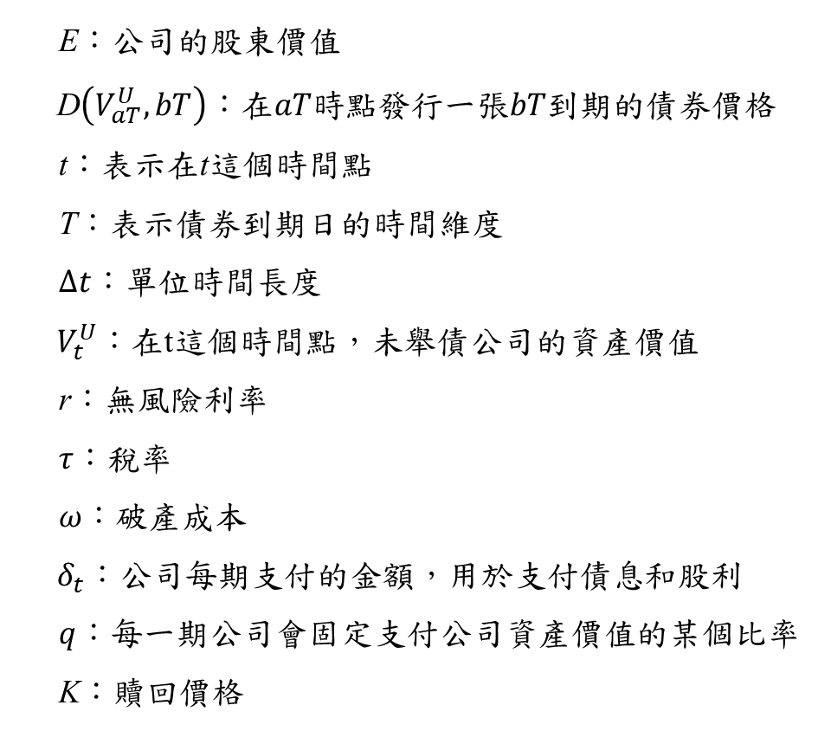
參數 介紹
E：公司的股東價值
D$\left(V_{aT}^{U},bT\right)$ ：$在aT時點發行一張bT到期的債券價格$
t：表示在t這個時間點
T：表示債券到期日的時間維度
$∆t$：單位時間長度
$V_{t}^{U}$：在t這個時間點，未舉債公司的資產價值
r：無風險利率
$τ$：稅率
$ω$：破產成本
$δ_{t}$：公司每期支付的金額，用於支付債息和股利
$q$：每一期公司會固定支付公司資產價值的某個比率
K：贖回價格

Slide 14
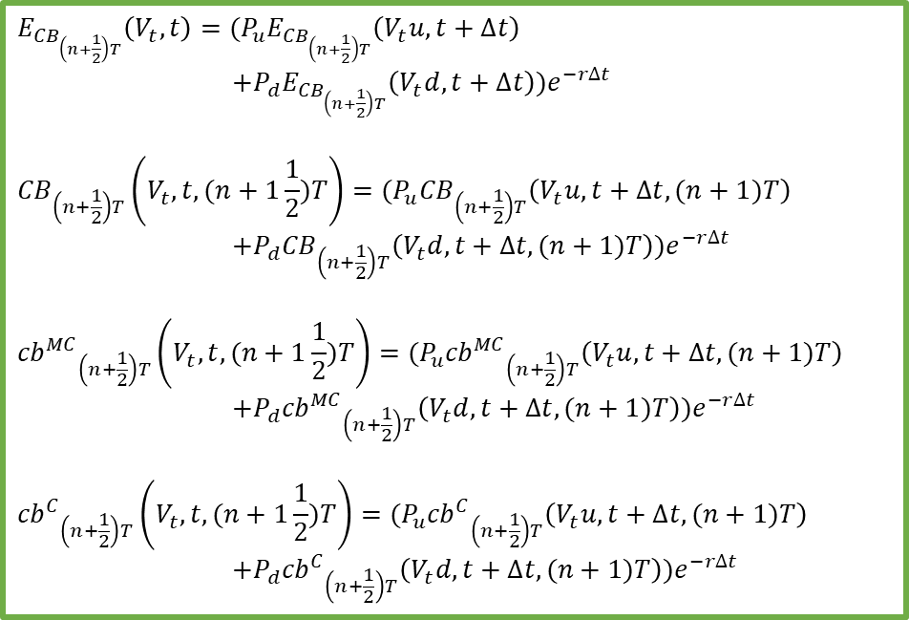

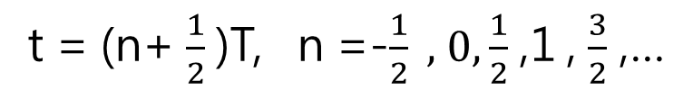
t = (n+ $\frac{1}{2}$)T, n =-$\frac{1}{2} ,$ $0,\frac{1}{2}$ ,1 , $\frac{3}{2}$ ,…
在債券發行時間點的評價
$$(n+1)T$$
(n+2)T
$$E_{{CB}_{\left(n+\frac{1}{2}\right)T}}\left(V_{t},t\right)=(P_{u}E_{{CB}_{\left(n+\frac{1}{2}\right)T}}\left(V_{t}u,t+∆t\right)$$
$$+P_{d}E_{{CB}_{\left(n+\frac{1}{2}\right)T}}\left(V_{t}d,t+∆t\right))e^{−r∆t}$$
$${CB}_{\left(n+\frac{1}{2}\right)T}\left(V_{t},t,(n+1\frac{1}{2})T\right)=(P_{u}{CB}_{\left(n+\frac{1}{2}\right)T}\left(V_{t}u,t+∆t,(n+1)T\right)$$
$$+{P_{d}CB}_{\left(n+\frac{1}{2}\right)T}\left(V_{t}d,t+∆t,(n+1)T\right))e^{−r∆t}$$
$${{cb}^{MC}}_{\left(n+\frac{1}{2}\right)T}\left(V_{t},t,(n+1\frac{1}{2})T\right)=(P_{u}{{cb}^{MC}}_{\left(n+\frac{1}{2}\right)T}\left(V_{t}u,t+∆t,(n+1)T\right)$$
$$+P_{d}{{cb}^{MC}}_{\left(n+\frac{1}{2}\right)T}\left(V_{t}d,t+∆t,(n+1)T\right))e^{−r∆t}$$
$${{cb}^{C}}_{\left(n+\frac{1}{2}\right)T}\left(V_{t},t,(n+1\frac{1}{2})T\right)=(P_{u}{{cb}^{C}}_{\left(n+\frac{1}{2}\right)T}\left(V_{t}u,t+∆t,(n+1)T\right)$$
$$+P_{d}{{cb}^{C}}_{\left(n+\frac{1}{2}\right)T}\left(V_{t}d,t+∆t,(n+1)T\right))e^{−r∆t}$$

Slide 15
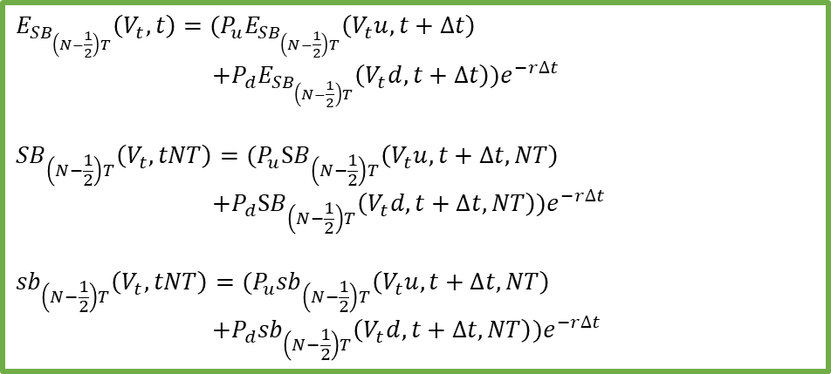

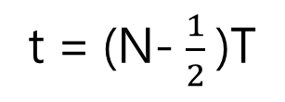
t = (N- $\frac{1}{2}$)T
在債券發行時間點的評價
$$(N−1)T$$
NT
$$E_{{SB}_{\left(N−\frac{1}{2}\right)T}}\left(V_{t},t\right)=(P_{u}E_{{SB}_{\left(N−\frac{1}{2}\right)T}}\left(V_{t}u,t+∆t\right)$$
$$+P_{d}E_{{SB}_{\left(N−\frac{1}{2}\right)T}}\left(V_{t}d,t+∆t\right))e^{−r∆t}$$
$${SB}_{\left(N−\frac{1}{2}\right)T}\left(V_{t},tNT\right)=(P_{u}{SB}_{\left(N−\frac{1}{2}\right)T}\left(V_{t}u,t+∆t,NT\right)$$
$$+{P_{d}SB}_{\left(N−\frac{1}{2}\right)T}\left(V_{t}d,t+∆t,NT\right))e^{−r∆t}$$
$${sb}_{\left(N−\frac{1}{2}\right)T}\left(V_{t},tNT\right)=(P_{u}{sb}_{\left(N−\frac{1}{2}\right)T}\left(V_{t}u,t+∆t,NT\right)$$
$$+P_{d}{sb}_{\left(N−\frac{1}{2}\right)T}\left(V_{t}d,t+∆t,NT\right))e^{−r∆t}$$

Slide 16


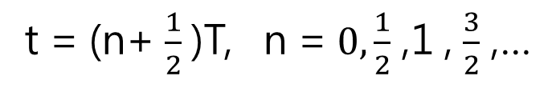
t = (n+ $\frac{1}{2}$)T, n = $0,\frac{1}{2}$ ,1 , $\frac{3}{2}$ ,…
在債券可提前贖回時間點的評價
nT
$$(n+1)T$$
(n+2)T
$$E_{{CB}_{nT}}\left(V_{t},t\right)=max⁡[$$
$$E_{{CB}_{\left(n+\frac{1}{2}\right)T}}\left(V_{t},t\right)+q_{t}−F\left(1−τ\right)CΔt$$
$$+\left(1−γ\right){CB}_{\left(n+\frac{1}{2}\right)T}\left(V_{t},t,(n+1)T\right)−2K,$$
$${E^{P}}_{{CB}_{nT}}\left(V_{t},t\right)+q_{t}−F\left(1−τ\right)CΔt$$
$+[\left(1−γ\right){{cb}^{MC}}_{\left(n+\frac{1}{2}\right)T}\left(V_{t},t,(n+1)T\right)$-K],
$$\left(P_{u}{E^{F}}_{{CB}_{nT}}\left(V_{t}u,t+∆t\right)+P_{d}{E^{F}}_{{CB}_{nT}}\left(V_{t}d,t+∆t\right)\right)e^{−r∆t}$$
$+q_{t}−F\left(1−τ\right)CΔt+[\left(1−γ\right){{cb}^{C}}_{\left(n+\frac{1}{2}\right)T}\left(V_{t},t,2T\right)$-K],
$$\left(P_{u}{E^{F}}_{{CB}_{nT}}\left(V_{t}u,t+∆t\right)+P_{d}{E^{F}}_{{CB}_{nT}}\left(V_{t}d,t+∆t\right)\right)e^{−r∆t}$$
$+q_{t}−F\left(1−τ\right)CΔt$,
0]
A
B
C
D
E

Slide 17
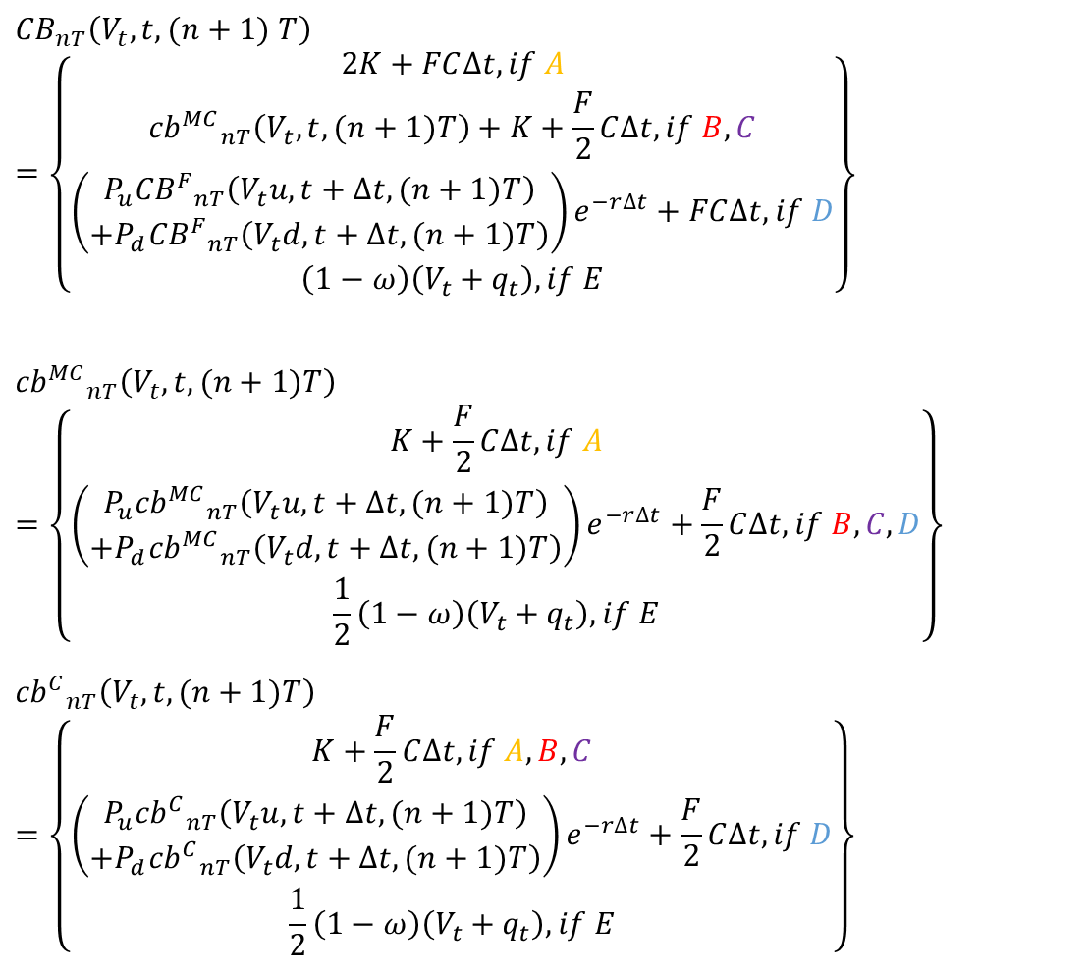
t = (n+ $\frac{1}{2}$)T, n = $0,\frac{1}{2}$ ,1 , $\frac{3}{2}$ ,…
$${CB}_{nT}\left(V_{t},t,(n+1) T\right)=\left\{\begin{aligned}2K+FC∆t,if A \\ {{cb}^{MC}}_{nT}\left(V_{t},t, (n+1)T\right)+K+\frac{F}{2}C∆t, if B,C \\ \left(\begin{aligned}P_{u}{{CB}^{F}}_{nT}\left(V_{t}u,t+∆t, (n+1)T\right) \\ +P_{d}{{CB}^{F}}_{nT}\left(V_{t}d,t+∆t, (n+1)T\right)\end{aligned}\right)e^{−r∆t}+FC∆t, if D \\ \left(1−ω\right)\left(V_{t}+q_{t}\right), if E\end{aligned}\right\}$$
$${{cb}^{MC}}_{nT}\left(V_{t},t, (n+1)T\right)=\left\{\begin{aligned}K+\frac{F}{2}C∆t, if A \\ \left(\begin{aligned}P_{u}{{cb}^{MC}}_{nT}\left(V_{t}u,t+∆t, (n+1)T\right) \\ +P_{d}{{cb}^{MC}}_{nT}\left(V_{t}d,t+∆t, (n+1)T\right)\end{aligned}\right)e^{−r∆t}+\frac{F}{2}C∆t, if B,C,D \\ \frac{1}{2}\left(1−ω\right)\left(V_{t}+q_{t}\right), if E\end{aligned}\right\}$$
$${{cb}^{C}}_{nT}\left(V_{t},t, (n+1)T\right)=\left\{\begin{aligned}K+\frac{F}{2}C∆t, if A,B,C \\ \left(\begin{aligned}P_{u}{{cb}^{C}}_{nT}\left(V_{t}u,t+∆t, (n+1)T\right) \\ +P_{d}{{cb}^{C}}_{nT}\left(V_{t}d,t+∆t, (n+1)T\right)\end{aligned}\right)e^{−r∆t}+\frac{F}{2}C∆t, if D \\ \frac{1}{2}\left(1−ω\right)\left(V_{t}+q_{t}\right), if E\end{aligned}\right\}$$
nT
$$(n+1)T$$
(n+2)T

Slide 18


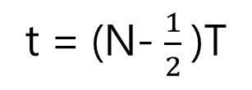
t = (N- $\frac{1}{2}$)T
在債券可提前贖回時間點的評價
(N-1)T
$$NT$$
$$E_{{CB}_{(N−1)T}}\left(V_{t},t\right)=max⁡[$$
$$E_{{SB}_{\left(N−\frac{1}{2}\right)T}}\left(V_{t},t\right)+q_{t}−F\left(1−τ\right)CΔt$$
$$+\left(1−γ\right){SB}_{\left(N−\frac{1}{2}\right)T}\left(V_{t},t,NT\right)−2K,$$
$$E_{{SB}_{\left(N−\frac{1}{2}\right)T}}\left(V_{t},t\right)+q_{t}−F\left(1−τ\right)CΔt$$
$+[\left(1−γ\right){sb}_{\left(N−\frac{1}{2}\right)T}\left(V_{t},t,NT\right)$-K],
$$\left(P_{u}E_{{CB}_{(N−1)T}}\left(V_{t}u,t+∆t\right)+P_{d}E_{{CB}_{(N−1)T}}\left(V_{t}d,t+∆t\right)\right)e^{−r∆t}$$
$+q_{t}−F\left(1−τ\right)CΔt$,
0]
F
G
H
I

Slide 19
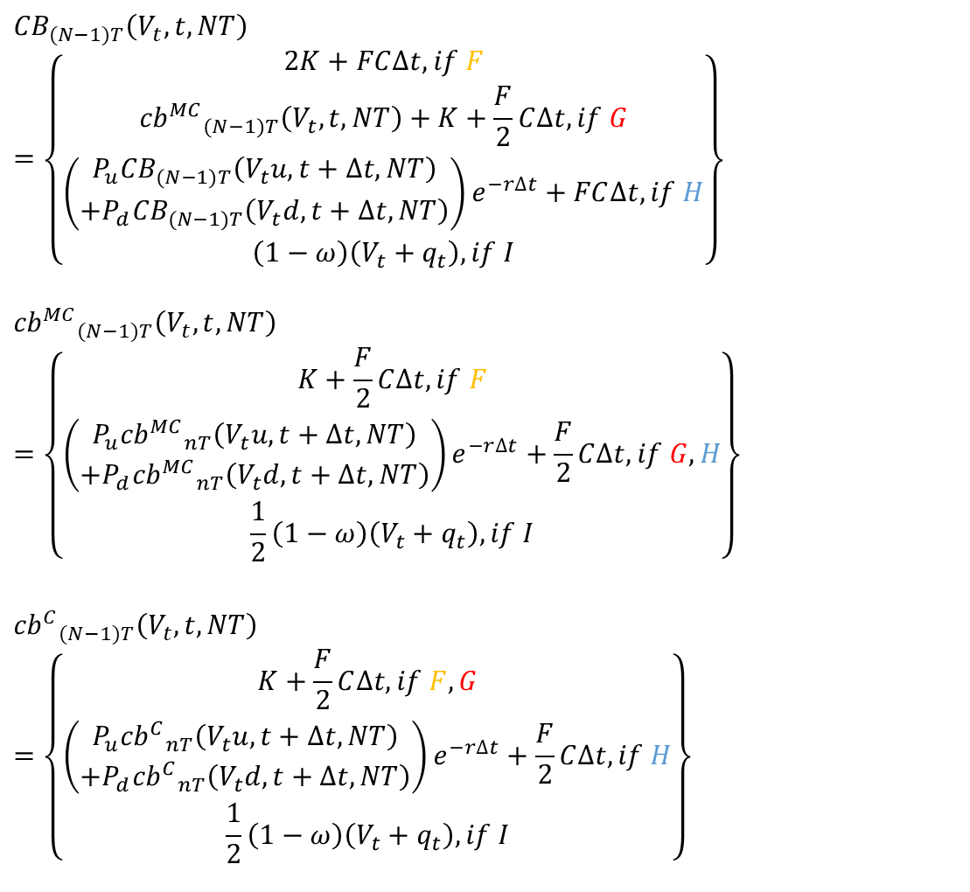
t = (N- $\frac{1}{2}$)T
$${CB}_{(N−1)T}\left(V_{t},t, NT\right)=\left\{\begin{aligned}2K+FC∆t,if F \\ {{cb}^{MC}}_{(N−1)T}\left(V_{t},t, NT\right)+K+\frac{F}{2}C∆t, if G \\ \left(\begin{aligned}P_{u}{CB}_{(N−1)T}\left(V_{t}u,t+∆t, NT\right) \\ +P_{d}{CB}_{(N−1)T}\left(V_{t}d,t+∆t, NT\right)\end{aligned}\right)e^{−r∆t}+FC∆t, if H \\ \left(1−ω\right)\left(V_{t}+q_{t}\right), if I\end{aligned}\right\}$$
$${{cb}^{MC}}_{(N−1)T}\left(V_{t},t, NT\right)=\left\{\begin{aligned}K+\frac{F}{2}C∆t, if F \\ \left(\begin{aligned}P_{u}{{cb}^{MC}}_{nT}\left(V_{t}u,t+∆t, NT\right) \\ +P_{d}{{cb}^{MC}}_{nT}\left(V_{t}d,t+∆t, NT\right)\end{aligned}\right)e^{−r∆t}+\frac{F}{2}C∆t, if G,H \\ \frac{1}{2}\left(1−ω\right)\left(V_{t}+q_{t}\right), if I\end{aligned}\right\}$$
$${{cb}^{C}}_{(N−1)T}\left(V_{t},t, NT\right)$$
$$=\left\{\begin{aligned}K+\frac{F}{2}C∆t, if F,G \\ \left(\begin{aligned}P_{u}{{cb}^{C}}_{nT}\left(V_{t}u,t+∆t, NT\right) \\ +P_{d}{{cb}^{C}}_{nT}\left(V_{t}d,t+∆t, NT\right)\end{aligned}\right)e^{−r∆t}+\frac{F}{2}C∆t, if H \\ \frac{1}{2}\left(1−ω\right)\left(V_{t}+q_{t}\right), if I\end{aligned}\right\}$$
(N-1)T
$$NT$$

Slide 20
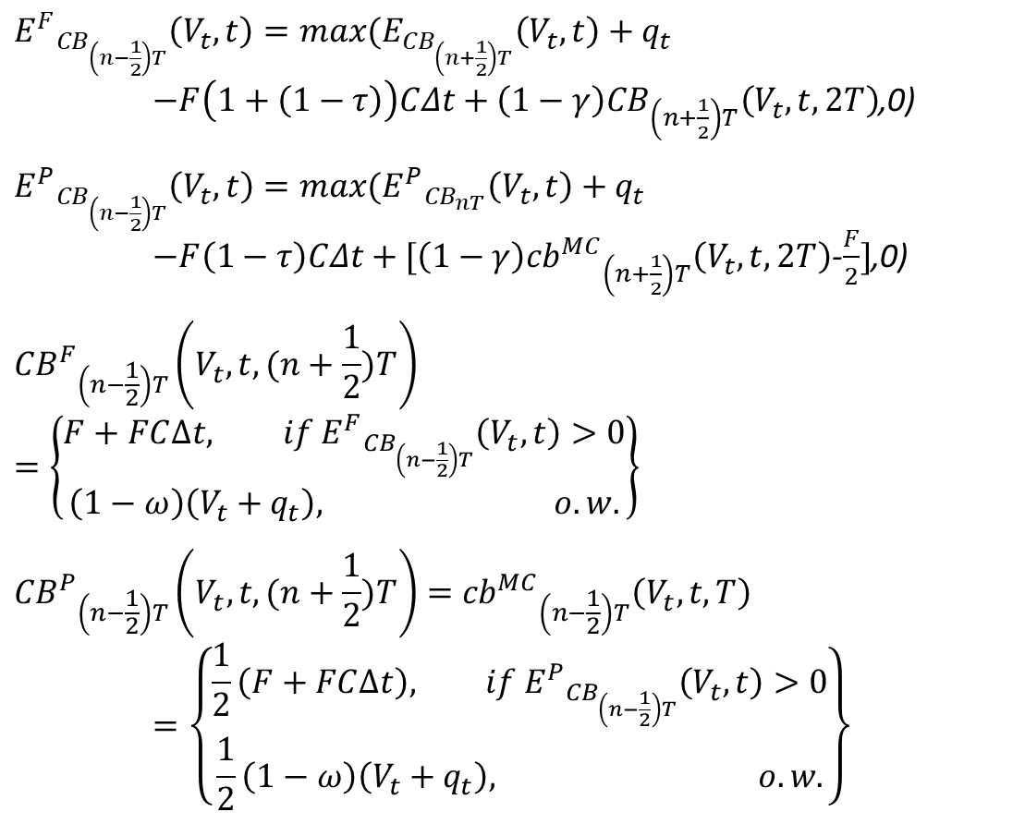

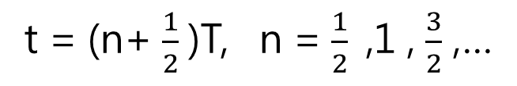
t = (n+ $\frac{1}{2}$)T, n = $\frac{1}{2}\text{ ,}$1 , $\frac{3}{2}$ ,…
在債券到期時間點的評價
$${E^{F}}_{{CB}_{\left(n−\frac{1}{2}\right)T}}\left(V_{t},t\right)=max⁡(E_{{CB}_{\left(n+\frac{1}{2}\right)T}}\left(V_{t},t\right)+q_{t}$$
$−F\left(1+\left(1−τ\right)\right)CΔt+\left(1−γ\right){CB}_{\left(n+\frac{1}{2}\right)T}\left(V_{t},t,2T\right)$,0)
$${E^{P}}_{{CB}_{\left(n−\frac{1}{2}\right)T}}\left(V_{t},t\right)=max⁡({E^{P}}_{{CB}_{nT}}\left(V_{t},t\right)+q_{t}$$
$−F\left(1−τ\right)CΔt+[\left(1−γ\right){{cb}^{MC}}_{\left(n+\frac{1}{2}\right)T}\left(V_{t},t,2T\right)$-$\frac{F}{2}]$,0)
$${{CB}^{F}}_{\left(n−\frac{1}{2}\right)T}\left(V_{t},t, (n+\frac{1}{2})T\right)=\left\{\begin{aligned}F+FC∆t, if {E^{F}}_{{CB}_{\left(n−\frac{1}{2}\right)T}}\left(V_{t},t\right)>0 \\ \left(1−ω\right)\left(V_{t}+q_{t}\right), o.w.\end{aligned}\right\}$$
$${{CB}^{P}}_{\left(n−\frac{1}{2}\right)T}\left(V_{t},t,(n+\frac{1}{2})T\right)={{cb}^{MC}}_{\left(n−\frac{1}{2}\right)T}\left(V_{t},t, T\right)$$
$$=\left\{\begin{aligned}\frac{1}{2}\left(F+FC∆t\right), if{ E^{P}}_{{CB}_{\left(n−\frac{1}{2}\right)T}}\left(V_{t},t\right)>0 \\ \frac{1}{2}\left(1−ω\right)\left(V_{t}+q_{t}\right), o.w.\end{aligned}\right\}$$
$$nT$$
(n+1)T

Slide 21
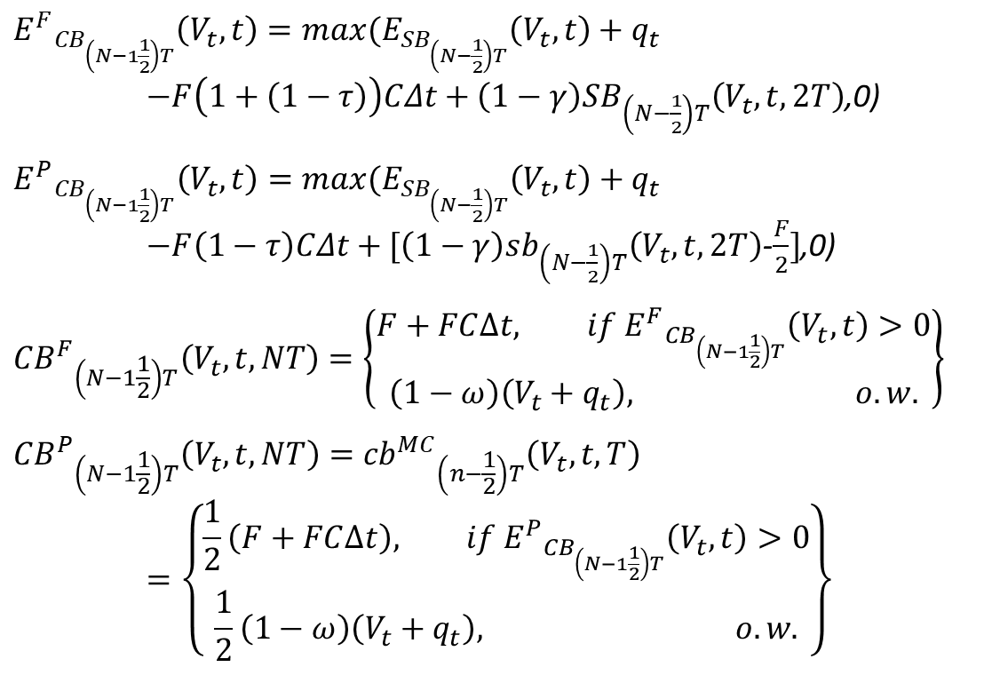

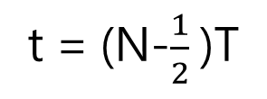
t = (N-$\frac{1}{2}$)T
在債券到期時間點的評價
$$(N−1)T$$
NT
$${E^{F}}_{{CB}_{\left(N−1\frac{1}{2}\right)T}}\left(V_{t},t\right)=max⁡(E_{{SB}_{\left(N−\frac{1}{2}\right)T}}\left(V_{t},t\right)+q_{t}$$
$−F\left(1+\left(1−τ\right)\right)CΔt+\left(1−γ\right){SB}_{\left(N−\frac{1}{2}\right)T}\left(V_{t},t,2T\right)$,0)
$${E^{P}}_{{CB}_{\left(N−1\frac{1}{2}\right)T}}\left(V_{t},t\right)=max⁡(E_{{SB}_{\left(N−\frac{1}{2}\right)T}}\left(V_{t},t\right)+q_{t}$$
$−F\left(1−τ\right)CΔt+[\left(1−γ\right){sb}_{\left(N−\frac{1}{2}\right)T}\left(V_{t},t,2T\right)$-$\frac{F}{2}]$,0)
$${{CB}^{F}}_{\left(N−1\frac{1}{2}\right)T}\left(V_{t},t, NT\right)=\left\{\begin{aligned}F+FC∆t, if {E^{F}}_{{CB}_{\left(N−1\frac{1}{2}\right)T}}\left(V_{t},t\right)>0 \\ \left(1−ω\right)\left(V_{t}+q_{t}\right), o.w.\end{aligned}\right\}$$
$${{CB}^{P}}_{\left(N−1\frac{1}{2}\right)T}\left(V_{t},t, NT\right)={{cb}^{MC}}_{\left(n−\frac{1}{2}\right)T}\left(V_{t},t, T\right)$$
$$=\left\{\begin{aligned}\frac{1}{2}\left(F+FC∆t\right), if{ E^{P}}_{{CB}_{\left(N−1\frac{1}{2}\right)T}}\left(V_{t},t\right)>0 \\ \frac{1}{2}\left(1−ω\right)\left(V_{t}+q_{t}\right), o.w.\end{aligned}\right\}$$

Slide 22
0
$$T$$
$$2T$$
Notes:
此模型是公司發行的債券有可贖回條款，允許債券可以提前贖回，
最上層的樹是公司在時間點0發行的債券
加上紅色節點的圖

Slide 23
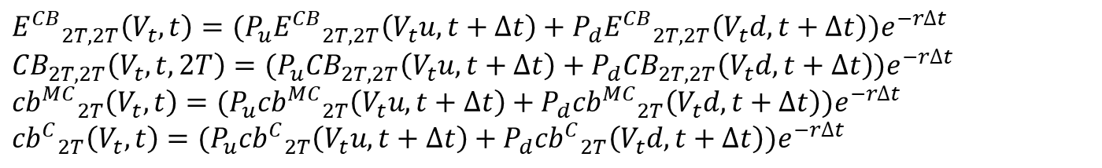
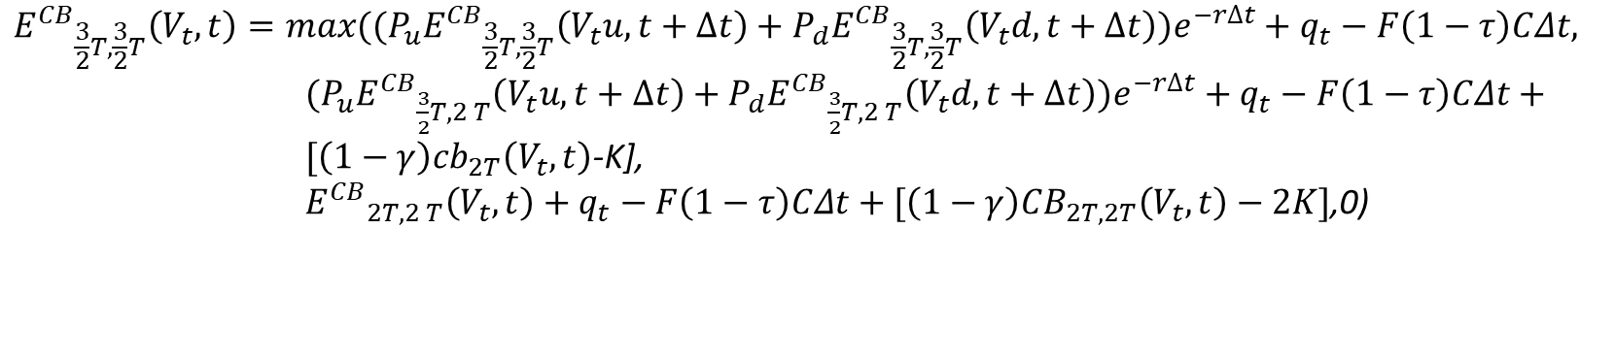
$${E^{CB}}_{2T,2T}\left(V_{t},t\right)=(P_{u}{E^{CB}}_{2T,2T}\left(V_{t}u,t+∆t\right)+P_{d}{E^{CB}}_{2T,2T}\left(V_{t}d,t+∆t\right))e^{−r∆t}$$
$${CB}_{2T,2T}\left(V_{t},t,2T\right)=(P_{u}{CB}_{2T,2T}\left(V_{t}u,t+∆t\right)+{P_{d}CB}_{2T,2T}\left(V_{t}d,t+∆t\right))e^{−r∆t}$$
$${{cb}^{MC}}_{2T}\left(V_{t},t\right)=(P_{u}{{cb}^{MC}}_{2T}\left(V_{t}u,t+∆t\right)+P_{d}{{cb}^{MC}}_{2T}\left(V_{t}d,t+∆t\right))e^{−r∆t}$$
$${{cb}^{C}}_{2T}\left(V_{t},t\right)=(P_{u}{{cb}^{C}}_{2T}\left(V_{t}u,t+∆t\right)+P_{d}{{cb}^{C}}_{2T}\left(V_{t}d,t+∆t\right))e^{−r∆t}$$
$${E^{CB}}_{\frac{3}{2}T,\frac{3}{2}T}\left(V_{t},t\right)=max⁡((P_{u}{E^{CB}}_{\frac{3}{2}T,\frac{3}{2}T}\left(V_{t}u,t+∆t\right)+P_{d}{E^{CB}}_{\frac{3}{2}T,\frac{3}{2}T}\left(V_{t}d,t+∆t\right))e^{−r∆t}+q_{t}−F\left(1−τ\right)CΔt,$$
$(P_{u}{E^{CB}}_{\frac{3}{2}T,2 T}\left(V_{t}u,t+∆t\right)+P_{d}{E^{CB}}_{\frac{3}{2}T,2 T}\left(V_{t}d,t+∆t\right))e^{−r∆t}+q_{t}−F\left(1−τ\right)CΔt+[\left(1−γ\right){cb}_{2T}\left(V_{t},t\right)$-K],
${E^{CB}}_{2T,2 T}\left(V_{t},t\right)+q_{t}−F\left(1−τ\right)CΔt+[\left(1−γ\right){CB}_{2T,2T}\left(V_{t},t\right)−2K]$,0)

Slide 24
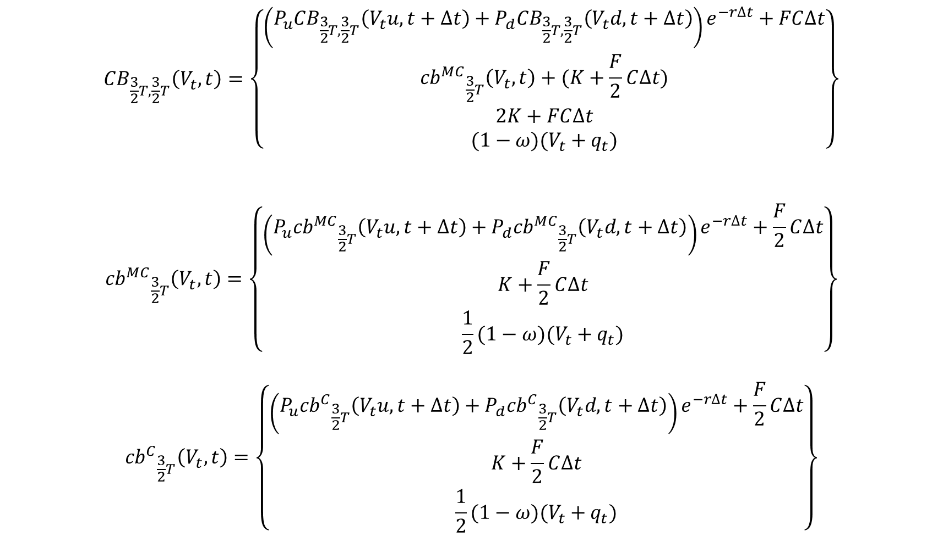
$${CB}_{\frac{3}{2}T,\frac{3}{2}T}\left(V_{t},t\right)=\left\{\begin{aligned}\left(P_{u}{CB}_{\frac{3}{2}T,\frac{3}{2}T}\left(V_{t}u,t+∆t\right)+P_{d}{CB}_{\frac{3}{2}T,\frac{3}{2}T}\left(V_{t}d,t+∆t\right)\right)e^{−r∆t}+FC∆t \\ {{cb}^{MC}}_{\frac{3}{2}T}\left(V_{t},t\right)+(K+\frac{F}{2}C∆t) \\ 2K+FC∆t \\ (1−ω)(V_{t}+q_{t})\end{aligned}\right\}$$
$${{cb}^{MC}}_{\frac{3}{2}T}\left(V_{t},t\right)=\left\{\begin{aligned}\left(P_{u}{{cb}^{MC}}_{\frac{3}{2}T}\left(V_{t}u,t+∆t\right)+P_{d}{{cb}^{MC}}_{\frac{3}{2}T}\left(V_{t}d,t+∆t\right)\right)e^{−r∆t}+\frac{F}{2}C∆t \\ K+\frac{F}{2}C∆t \\ \frac{1}{2}(1−ω)(V_{t}+q_{t})\end{aligned}\right\}$$
$${{cb}^{C}}_{\frac{3}{2}T}\left(V_{t},t\right)=\left\{\begin{aligned}\left(P_{u}{{cb}^{C}}_{\frac{3}{2}T}\left(V_{t}u,t+∆t\right)+P_{d}{{cb}^{C}}_{\frac{3}{2}T}\left(V_{t}d,t+∆t\right)\right)e^{−r∆t}+\frac{F}{2}C∆t \\ K+\frac{F}{2}C∆t \\ \frac{1}{2}(1−ω)(V_{t}+q_{t})\end{aligned}\right\}$$

Slide 25
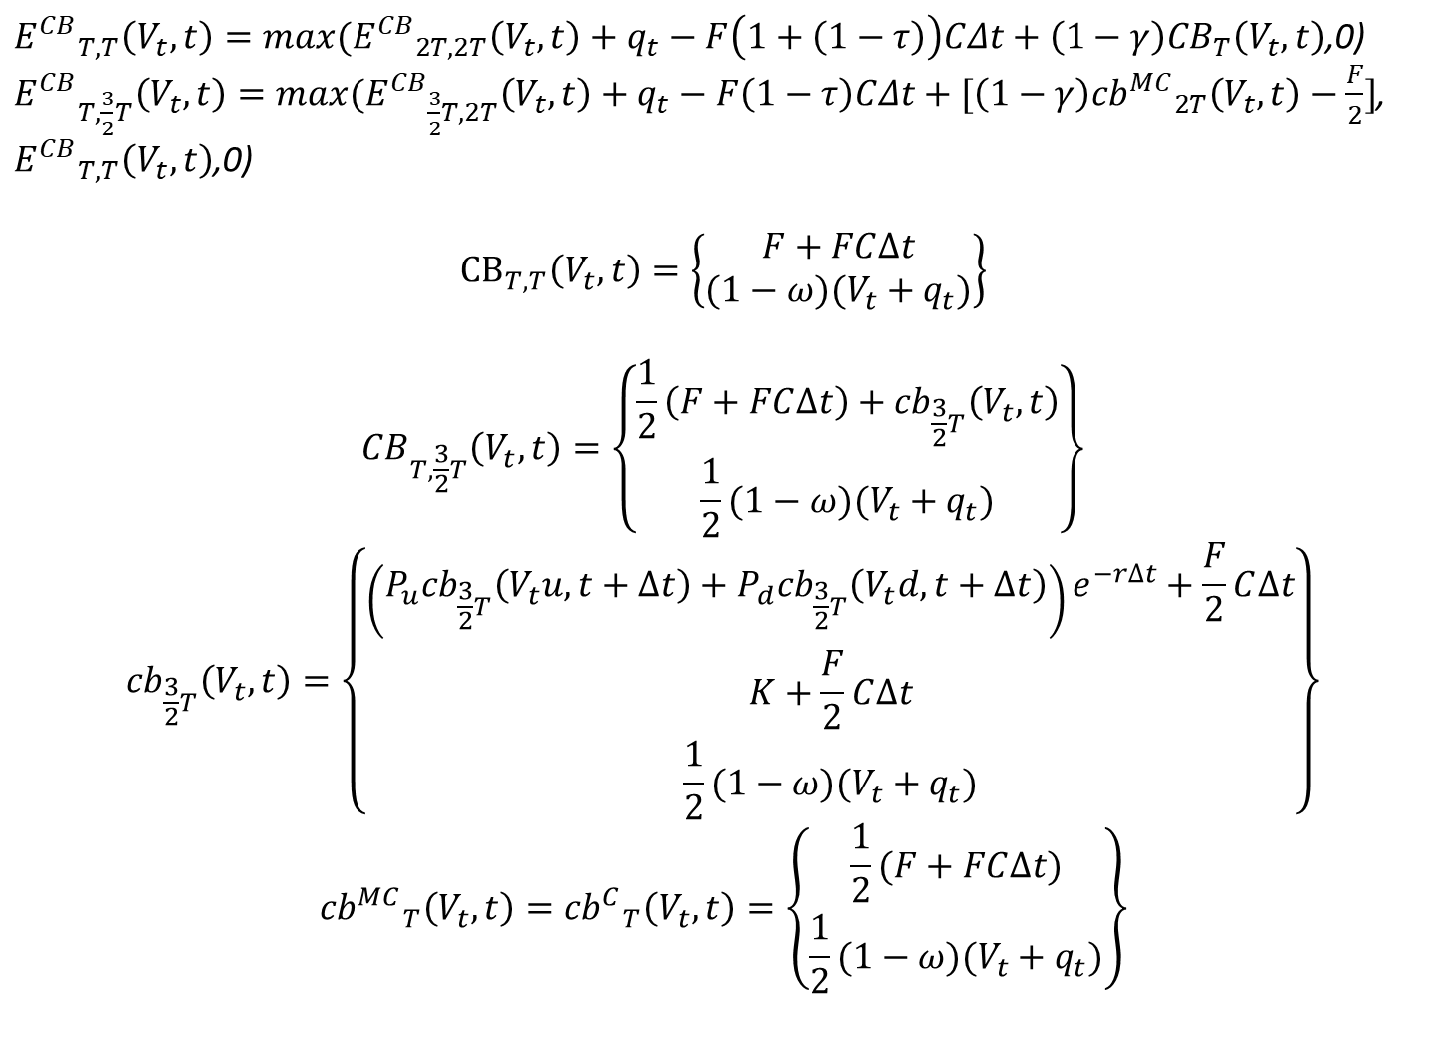
${E^{CB}}_{T,T}\left(V_{t},t\right)=max⁡({E^{CB}}_{2T,2T}\left(V_{t},t\right)+q_{t}−F\left(1+\left(1−τ\right)\right)CΔt+\left(1−γ\right){CB}_{T}\left(V_{t},t\right)$,0)
${E^{CB}}_{T,\frac{3}{2}T}\left(V_{t},t\right)=max⁡({E^{CB}}_{\frac{3}{2}T, 2T}\left(V_{t},t\right)+q_{t}−F\left(1−τ\right)CΔt+[\left(1−γ\right){{cb}^{MC}}_{2T}\left(V_{t},t\right)−\frac{F}{2}]$, ${E^{CB}}_{T,T}\left(V_{t},t\right)$,0)
$${CB}_{T,T}\left(V_{t},t\right)=\left\{\begin{aligned}F+FC∆t \\ (1−ω)(V_{t}+q_{t})\end{aligned}\right\}$$
$${CB}_{T,\frac{3}{2}T}\left(V_{t},t\right)=\left\{\begin{aligned}\frac{1}{2}\left(F+FC∆t\right)+{cb}_{\frac{3}{2}T}\left(V_{t},t\right) \\ \frac{1}{2}(1−ω)(V_{t}+q_{t})\end{aligned}\right\}$$
$${cb}_{\frac{3}{2}T}\left(V_{t},t\right)=\left\{\begin{aligned}\left(P_{u}{cb}_{\frac{3}{2}T}\left(V_{t}u,t+∆t\right)+P_{d}{cb}_{\frac{3}{2}T}\left(V_{t}d,t+∆t\right)\right)e^{−r∆t}+\frac{F}{2}C∆t \\ K+\frac{F}{2}C∆t \\ \frac{1}{2}(1−ω)(V_{t}+q_{t})\end{aligned}\right\}$$
$${{cb}^{MC}}_{T}\left(V_{t},t\right)={{cb}^{C}}_{T}\left(V_{t},t\right)=\left\{\begin{aligned}\frac{1}{2}(F+FC∆t) \\ \frac{1}{2}(1−ω)(V_{t}+q_{t})\end{aligned}\right\}$$

Slide 26

$${E^{SB}}_{2T,2T}\left(V_{t},t\right)$$

Slide 27
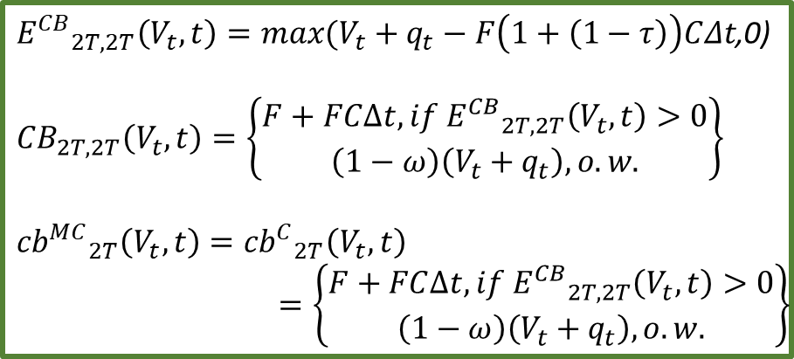
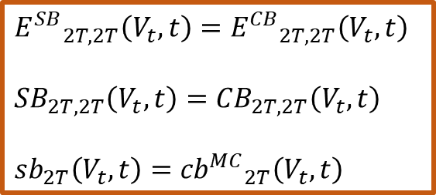
t = 2T 債券到期時
0
$$T$$
$$2T$$
${E^{CB}}_{2T,2T}\left(V_{t},t\right)=max⁡(V_{t}+q_{t}−F\left(1+\left(1−τ\right)\right)CΔt$,0)
$${CB}_{2T,2T}\left(V_{t},t\right)=\left\{\begin{aligned}F+FC∆t, if {E^{CB}}_{2T,2T}\left(V_{t},t\right)>0 \\ \left(1−ω\right)\left(V_{t}+q_{t}\right), o.w.\end{aligned}\right\}$$
$${{cb}^{MC}}_{2T}\left(V_{t},t\right)={{cb}^{C}}_{2T}\left(V_{t},t\right)$$
$$=\left\{\begin{aligned}F+FC∆t, if {E^{CB}}_{2T,2T}\left(V_{t},t\right)>0 \\ \left(1−ω\right)\left(V_{t}+q_{t}\right), o.w.\end{aligned}\right\}$$
$${E^{SB}}_{2T,2T}\left(V_{t},t\right)={E^{CB}}_{2T,2T}\left(V_{t},t\right)$$
$${SB}_{2T,2T}\left(V_{t},t\right)={CB}_{2T,2T}\left(V_{t},t\right)$$
$${sb}_{2T}\left(V_{t},t\right)={{cb}^{MC}}_{2T}\left(V_{t},t\right)$$

Slide 29

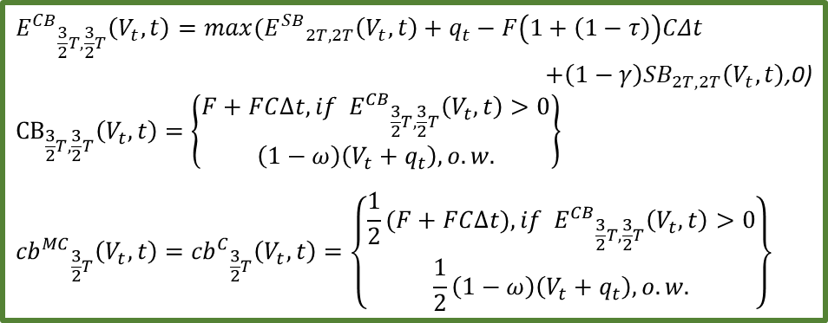
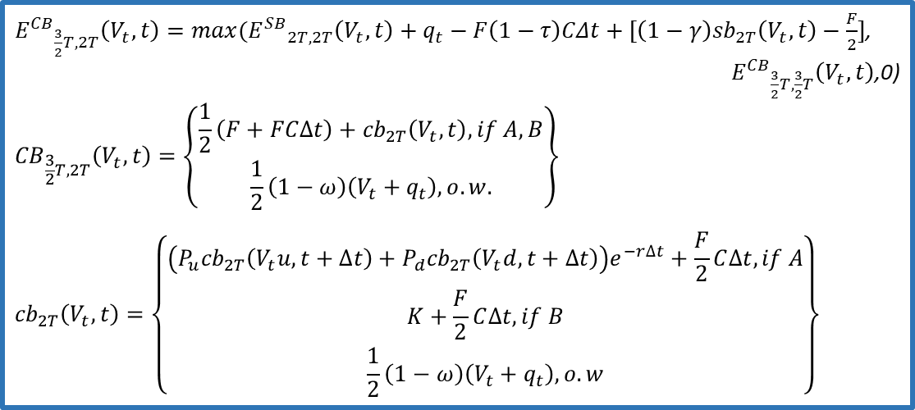
t = $\frac{3}{2}T$ 債券到期時
0
$$T$$
$$2T$$
$${E^{CB}}_{\frac{3}{2}T,\frac{3}{2}T}\left(V_{t},t\right)=max⁡({E^{SB}}_{2T,2T}\left(V_{t},t\right)+q_{t}−F\left(1+\left(1−τ\right)\right)CΔt$$
$+\left(1−γ\right){SB}_{2T,2T}\left(V_{t},t\right)$,0)
$${CB}_{\frac{3}{2}T,\frac{3}{2}T}\left(V_{t},t\right)=\left\{\begin{aligned}F+FC∆t, if {E^{CB}}_{\frac{3}{2}T,\frac{3}{2}T}\left(V_{t},t\right)>0 \\ \left(1−ω\right)\left(V_{t}+q_{t}\right), o.w.\end{aligned}\right\}$$
$${{cb}^{MC}}_{\frac{3}{2}T}\left(V_{t},t\right)={{cb}^{C}}_{\frac{3}{2}T}\left(V_{t},t\right)=\left\{\begin{aligned}\frac{1}{2}(F+FC∆t), if {E^{CB}}_{\frac{3}{2}T,\frac{3}{2}T}\left(V_{t},t\right)>0 \\ \frac{1}{2}\left(1−ω\right)\left(V_{t}+q_{t}\right), o.w.\end{aligned}\right\}$$
${E^{CB}}_{\frac{3}{2}T, 2T}\left(V_{t},t\right)=max⁡({E^{SB}}_{2T, 2T}\left(V_{t},t\right)+q_{t}−F\left(1−τ\right)CΔt+[\left(1−γ\right){sb}_{2T}\left(V_{t},t\right)−\frac{F}{2}]$,
${E^{CB}}_{\frac{3}{2}T,\frac{3}{2}T}\left(V_{t},t\right)$,0)
$${CB}_{\frac{3}{2}T, 2T}\left(V_{t},t\right)=\left\{\begin{aligned}\frac{1}{2}\left(F+FC∆t\right)+{cb}_{2T}\left(V_{t},t\right), if A, B \\ \frac{1}{2}\left(1−ω\right)\left(V_{t}+q_{t}\right), o.w.\end{aligned}\right\}$$
$${cb}_{2T}\left(V_{t},t\right)=\left\{\begin{aligned}\left(P_{u}{cb}_{2T}\left(V_{t}u,t+∆t\right)+P_{d}{cb}_{2T}\left(V_{t}d,t+∆t\right)\right)e^{−r∆t}+\frac{F}{2}C∆t, if A \\ K+\frac{F}{2}C∆t, if B \\ \frac{1}{2}\left(1−ω\right)\left(V_{t}+q_{t}\right), o.w\end{aligned}\right\}$$
A
B

Slide 30
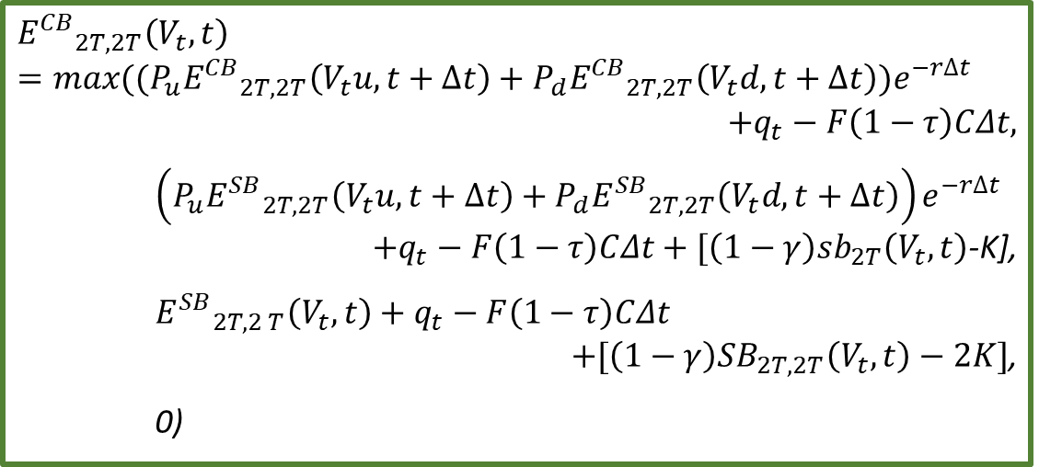

t = $\frac{3}{2}T$ 債券可提前贖回時
0
$$T$$
$$2T$$
$${E^{CB}}_{2T,2T}\left(V_{t},t\right)=max⁡((P_{u}{E^{CB}}_{2T, 2T}\left(V_{t}u,t+∆t\right)+P_{d}{E^{CB}}_{2T, 2T}\left(V_{t}d,t+∆t\right))e^{−r∆t}$$
$$+q_{t}−F\left(1−τ\right)CΔt,$$
$$\left(P_{u}{E^{SB}}_{2T,2T}\left(V_{t}u,t+∆t\right)+P_{d}{E^{SB}}_{2T,2T}\left(V_{t}d,t+∆t\right)\right)e^{−r∆t}$$
$+q_{t}−F\left(1−τ\right)CΔt+[\left(1−γ\right){sb}_{2T}\left(V_{t},t\right)$-K],
$${E^{SB}}_{2T,2 T}\left(V_{t},t\right)+q_{t}−F\left(1−τ\right)CΔt$$
$+[\left(1−γ\right){SB}_{2T,2T}\left(V_{t},t\right)−2K]$,
0)
C
D
E

Slide 31

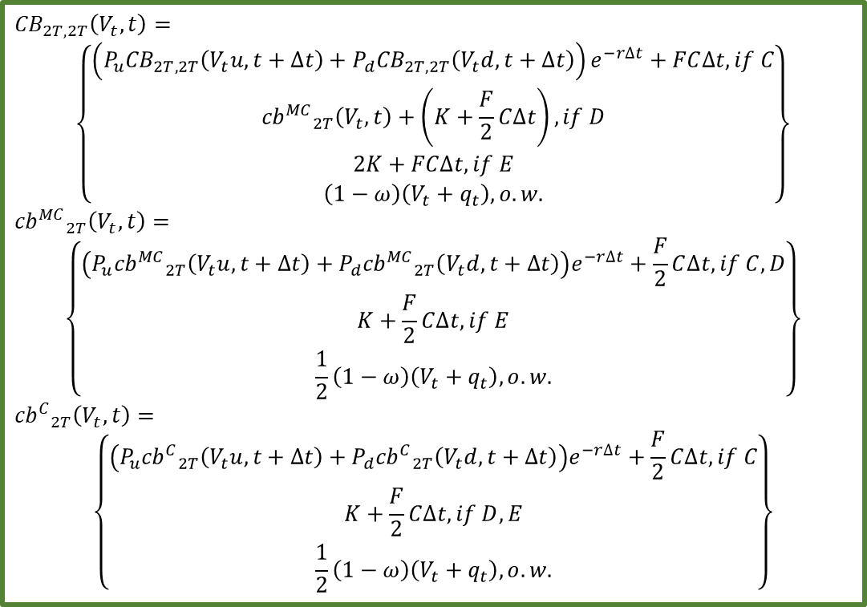
t = $\frac{3}{2}T$ 債券可提前贖回時
0
$$T$$
$$2T$$
$${CB}_{2T, 2T}\left(V_{t},t\right)=$$
$$\left\{\begin{aligned}\left(P_{u}{CB}_{2T, 2T}\left(V_{t}u,t+∆t\right)+P_{d}{CB}_{2T, 2T}\left(V_{t}d,t+∆t\right)\right)e^{−r∆t}+FC∆t, if C \\ {{cb}^{MC}}_{2T}\left(V_{t},t\right)+\left(K+\frac{F}{2}C∆t\right), if D \\ 2K+FC∆t, if E \\ \left(1−ω\right)\left(V_{t}+q_{t}\right), o.w.\end{aligned}\right\}$$
$${{cb}^{MC}}_{2T}\left(V_{t},t\right)=$$
$$\left\{\begin{aligned}\left(P_{u}{{cb}^{MC}}_{2T}\left(V_{t}u,t+∆t\right)+P_{d}{{cb}^{MC}}_{2T}\left(V_{t}d,t+∆t\right)\right)e^{−r∆t}+\frac{F}{2}C∆t,if C,D \\ K+\frac{F}{2}C∆t, if E \\ \frac{1}{2}\left(1−ω\right)\left(V_{t}+q_{t}\right), o.w.\end{aligned}\right\}$$
$${{cb}^{C}}_{2T}\left(V_{t},t\right)=$$
$$\left\{\begin{aligned}\left(P_{u}{{cb}^{C}}_{2T}\left(V_{t}u,t+∆t\right)+P_{d}{{cb}^{C}}_{2T}\left(V_{t}d,t+∆t\right)\right)e^{−r∆t}+\frac{F}{2}C∆t, if C \\ K+\frac{F}{2}C∆t, if D,E \\ \frac{1}{2}\left(1−ω\right)\left(V_{t}+q_{t}\right), o.w.\end{aligned}\right\}$$

Slide 32

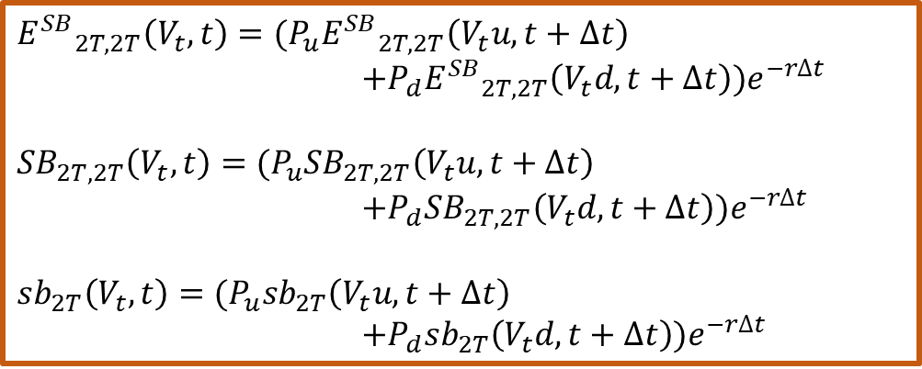
t = $\frac{3}{2}T$ 債券發行時
0
$$T$$
$$2T$$
$${E^{SB}}_{2T,2T}\left(V_{t},t\right)=(P_{u}{E^{SB}}_{2T,2T}\left(V_{t}u,t+∆t\right)$$
$$+P_{d}{E^{SB}}_{2T,2T}\left(V_{t}d,t+∆t\right))e^{−r∆t}$$
$${SB}_{2T,2T}\left(V_{t},t\right)=(P_{u}{SB}_{2T,2T}\left(V_{t}u,t+∆t\right)$$
$$+{P_{d}SB}_{2T,2T}\left(V_{t}d,t+∆t\right))e^{−r∆t}$$
$${sb}_{2T}\left(V_{t},t\right)=(P_{u}{sb}_{2T}\left(V_{t}u,t+∆t\right)$$
$$+P_{d}{sb}_{2T}\left(V_{t}d,t+∆t\right))e^{−r∆t}$$

Slide 34

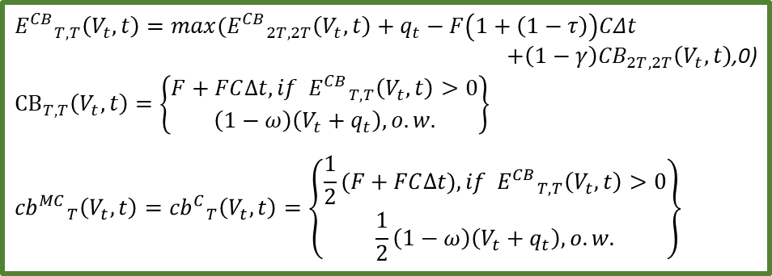
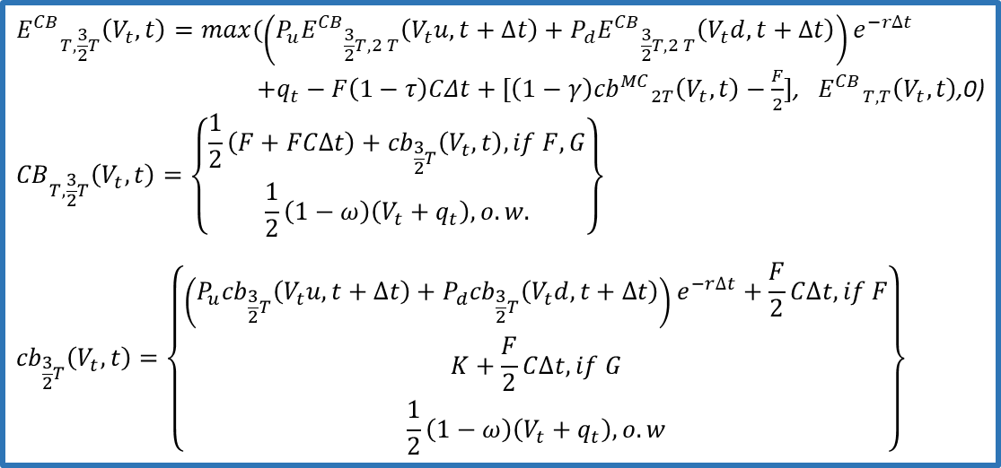
t = $T$ 債券到期時
0
$$T$$
$$2T$$
$${E^{CB}}_{T, T}\left(V_{t},t\right)=max⁡({E^{CB}}_{2T,2T}\left(V_{t},t\right)+q_{t}−F\left(1+\left(1−τ\right)\right)CΔt$$
$+\left(1−γ\right){CB}_{2T,2T}\left(V_{t},t\right)$,0)
$${CB}_{T, T}\left(V_{t},t\right)=\left\{\begin{aligned}F+FC∆t, if {E^{CB}}_{T, T}\left(V_{t},t\right)>0 \\ \left(1−ω\right)\left(V_{t}+q_{t}\right), o.w.\end{aligned}\right\}$$
$${{cb}^{MC}}_{T}\left(V_{t},t\right)={{cb}^{C}}_{T}\left(V_{t},t\right)=\left\{\begin{aligned}\frac{1}{2}(F+FC∆t), if {E^{CB}}_{T, T}\left(V_{t},t\right)>0 \\ \frac{1}{2}\left(1−ω\right)\left(V_{t}+q_{t}\right), o.w.\end{aligned}\right\}$$
$${E^{CB}}_{T,\frac{3}{2}T}\left(V_{t},t\right)=max⁡(\left(P_{u}{E^{CB}}_{\frac{3}{2}T,2 T}\left(V_{t}u,t+∆t\right)+P_{d}{E^{CB}}_{\frac{3}{2}T,2 T}\left(V_{t}d,t+∆t\right)\right)e^{−r∆t}$$
$+q_{t}−F\left(1−τ\right)CΔt+[\left(1−γ\right){{cb}^{MC}}_{2T}\left(V_{t},t\right)−\frac{F}{2}]$, ${E^{CB}}_{T,T}\left(V_{t},t\right)$,0)
$${CB}_{T,\frac{3}{2}T}\left(V_{t},t\right)=\left\{\begin{aligned}\frac{1}{2}\left(F+FC∆t\right)+{cb}_{\frac{3}{2}T}\left(V_{t},t\right), if F,G \\ \frac{1}{2}\left(1−ω\right)\left(V_{t}+q_{t}\right), o.w.\end{aligned}\right\}$$
$${cb}_{\frac{3}{2}T}\left(V_{t},t\right)=\left\{\begin{aligned}\left(P_{u}{cb}_{\frac{3}{2}T}\left(V_{t}u,t+∆t\right)+P_{d}{cb}_{\frac{3}{2}T}\left(V_{t}d,t+∆t\right)\right)e^{−r∆t}+\frac{F}{2}C∆t, if F \\ K+\frac{F}{2}C∆t, if G \\ \frac{1}{2}\left(1−ω\right)\left(V_{t}+q_{t}\right), o.w\end{aligned}\right\}$$
F
G

Slide 35
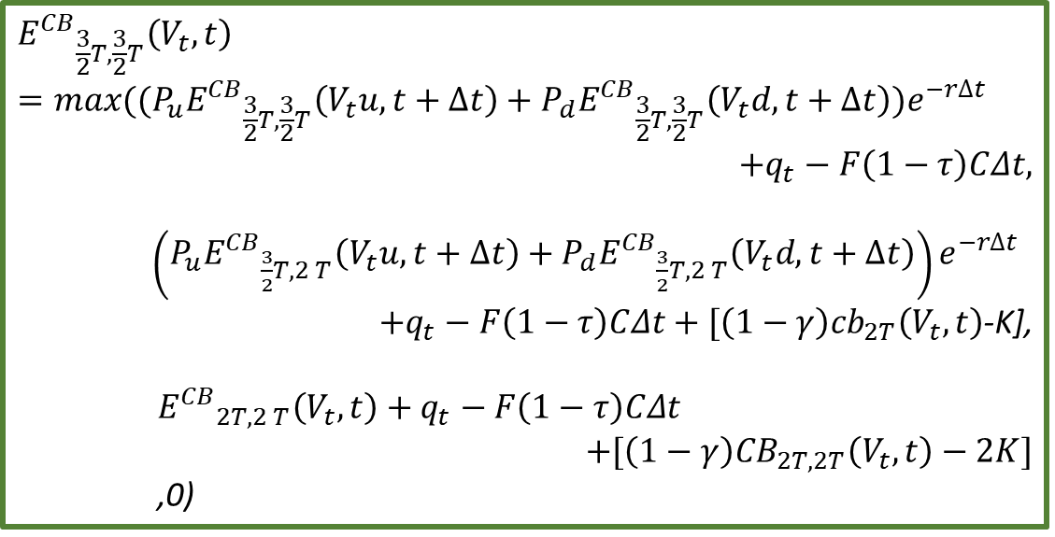

t = $T$ 債券可提前贖回時
0
$$T$$
$$2T$$
$${E^{CB}}_{\frac{3}{2}T,\frac{3}{2}T}\left(V_{t},t\right)$$
$$=max⁡((P_{u}{E^{CB}}_{\frac{3}{2}T,\frac{3}{2}T}\left(V_{t}u,t+∆t\right)+P_{d}{E^{CB}}_{\frac{3}{2}T,\frac{3}{2}T}\left(V_{t}d,t+∆t\right))e^{−r∆t}$$
$$+q_{t}−F\left(1−τ\right)CΔt,$$
$\left(P_{u}{E^{CB}}_{\frac{3}{2}T,2 T}\left(V_{t}u,t+∆t\right)+P_{d}{E^{CB}}_{\frac{3}{2}T,2 T}\left(V_{t}d,t+∆t\right)\right)e^{−r∆t}$
$+q_{t}−F\left(1−τ\right)CΔt+[\left(1−γ\right){cb}_{2T}\left(V_{t},t\right)$-K],
$${E^{CB}}_{2T,2 T}\left(V_{t},t\right)+q_{t}−F\left(1−τ\right)CΔt$$
$$+[\left(1−γ\right){CB}_{2T,2T}\left(V_{t},t\right)−2K]$$
,0)
H
I
J

Slide 36

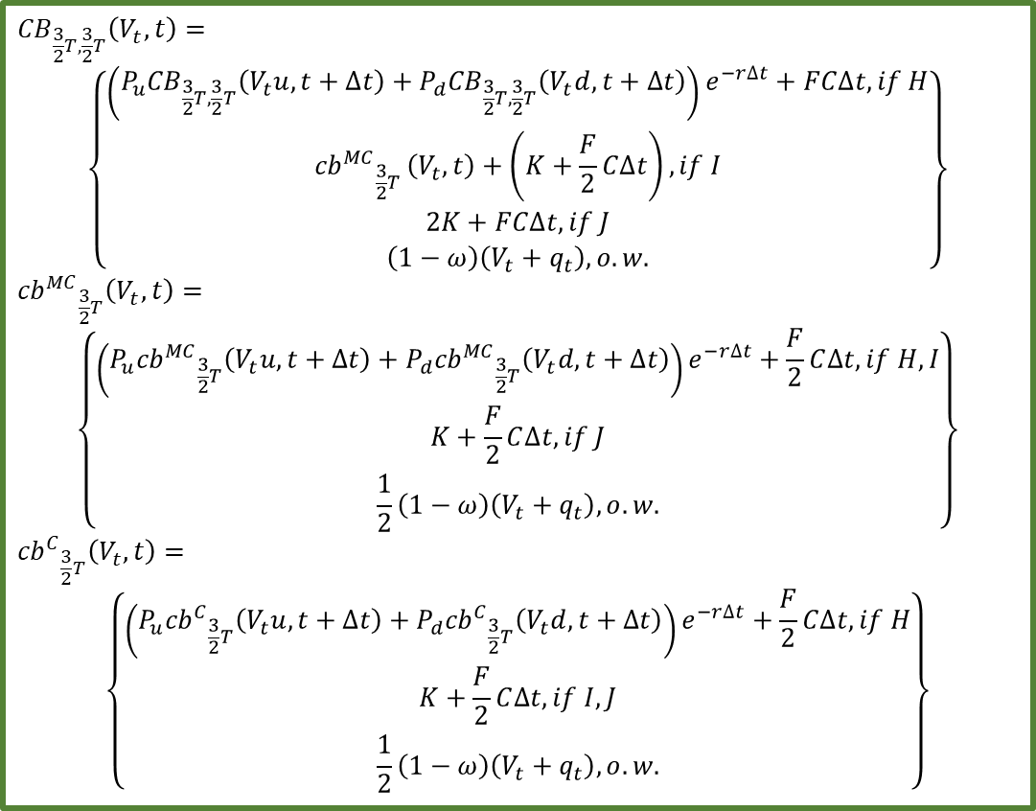
t = $T$ 債券可提前贖回時
0
$$T$$
$$2T$$
$${CB}_{\frac{3}{2}T,\frac{3}{2}T}\left(V_{t},t\right)=$$
$$\left\{\begin{aligned}\left(P_{u}{CB}_{\frac{3}{2}T,\frac{3}{2}T}\left(V_{t}u,t+∆t\right)+P_{d}{CB}_{\frac{3}{2}T,\frac{3}{2}T}\left(V_{t}d,t+∆t\right)\right)e^{−r∆t}+FC∆t, if H \\ {{cb}^{MC}}_{\frac{3}{2}T }\left(V_{t},t\right)+\left(K+\frac{F}{2}C∆t\right), if I \\ 2K+FC∆t, if J \\ \left(1−ω\right)\left(V_{t}+q_{t}\right), o.w.\end{aligned}\right\}$$
$${{cb}^{MC}}_{\frac{3}{2}T}\left(V_{t},t\right)=$$
$$\left\{\begin{aligned}\left(P_{u}{{cb}^{MC}}_{\frac{3}{2}T}\left(V_{t}u,t+∆t\right)+P_{d}{{cb}^{MC}}_{\frac{3}{2}T}\left(V_{t}d,t+∆t\right)\right)e^{−r∆t}+\frac{F}{2}C∆t,if H,I \\ K+\frac{F}{2}C∆t, if J \\ \frac{1}{2}\left(1−ω\right)\left(V_{t}+q_{t}\right), o.w.\end{aligned}\right\}$$
$${{cb}^{C}}_{\frac{3}{2}T}\left(V_{t},t\right)=$$
$$\left\{\begin{aligned}\left(P_{u}{{cb}^{C}}_{\frac{3}{2}T}\left(V_{t}u,t+∆t\right)+P_{d}{{cb}^{C}}_{\frac{3}{2}T}\left(V_{t}d,t+∆t\right)\right)e^{−r∆t}+\frac{F}{2}C∆t, if H \\ K+\frac{F}{2}C∆t, if I,J \\ \frac{1}{2}\left(1−ω\right)\left(V_{t}+q_{t}\right), o.w.\end{aligned}\right\}$$

Slide 37


t = $T$ 債券發行時
0
$$T$$
$$2T$$
$${E^{CB}}_{2T,2T}\left(V_{t},t\right)=(P_{u}{E^{CB}}_{2T,2T}\left(V_{t}u,t+∆t\right)$$
$$+P_{d}{E^{CB}}_{2T,2T}\left(V_{t}d,t+∆t\right))e^{−r∆t}$$
$${CB}_{2T,2T}\left(V_{t},t\right)=(P_{u}{CB}_{2T,2T}\left(V_{t}u,t+∆t\right)$$
$$+{P_{d}CB}_{2T,2T}\left(V_{t}d,t+∆t\right))e^{−r∆t}$$
$${{cb}^{MC}}_{2T}\left(V_{t},t\right)=(P_{u}{{cb}^{MC}}_{2T}\left(V_{t}u,t+∆t\right)$$
$$+P_{d}{{cb}^{MC}}_{2T}\left(V_{t}d,t+∆t\right))e^{−r∆t}$$
$${{cb}^{C}}_{2T}\left(V_{t},t\right)=(P_{u}{{cb}^{C}}_{2T}\left(V_{t}u,t+∆t\right)$$
$$+P_{d}{{cb}^{C}}_{2T}\left(V_{t}d,t+∆t\right))e^{−r∆t}$$

Slide 39
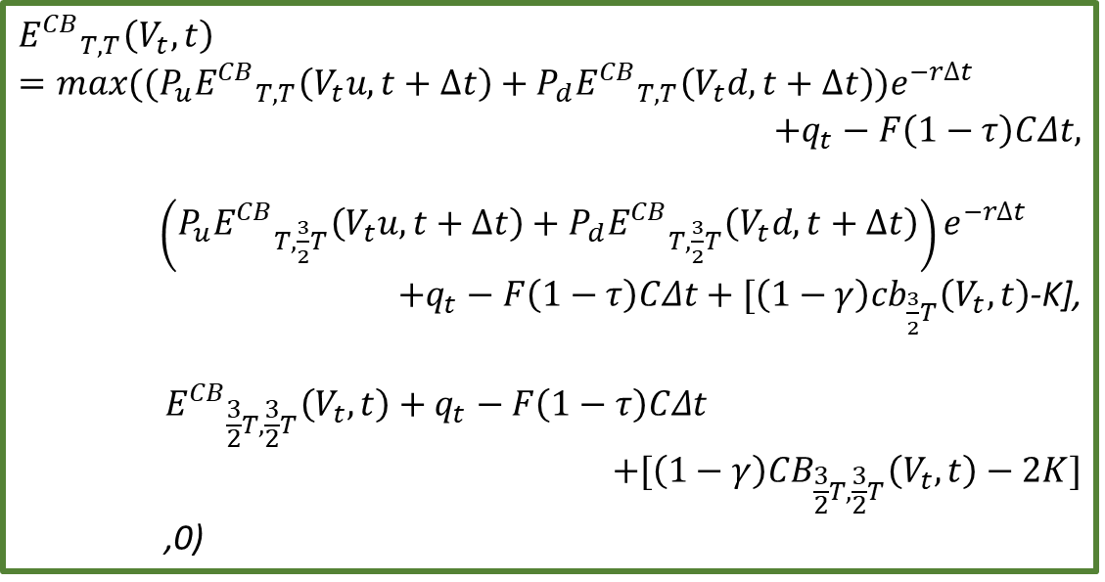

t = $\frac{1}{2}T$ 債券可提前贖回時
0
$$T$$
$$2T$$
$${E^{CB}}_{T, T}\left(V_{t},t\right)$$
$$=max⁡((P_{u}{E^{CB}}_{T, T}\left(V_{t}u,t+∆t\right)+P_{d}{E^{CB}}_{T, T}\left(V_{t}d,t+∆t\right))e^{−r∆t}$$
$$+q_{t}−F\left(1−τ\right)CΔt,$$
$\left(P_{u}{E^{CB}}_{T,\frac{3}{2}T}\left(V_{t}u,t+∆t\right)+P_{d}{E^{CB}}_{T,\frac{3}{2}T}\left(V_{t}d,t+∆t\right)\right)e^{−r∆t}$
$+q_{t}−F\left(1−τ\right)CΔt+[\left(1−γ\right){cb}_{\frac{3}{2}T}\left(V_{t},t\right)$-K],
$${E^{CB}}_{\frac{3}{2}T,\frac{3}{2}T}\left(V_{t},t\right)+q_{t}−F\left(1−τ\right)CΔt$$
$$+[\left(1−γ\right){CB}_{\frac{3}{2}T,\frac{3}{2}T}\left(V_{t},t\right)−2K]$$
,0)
H
I
J

Slide 40

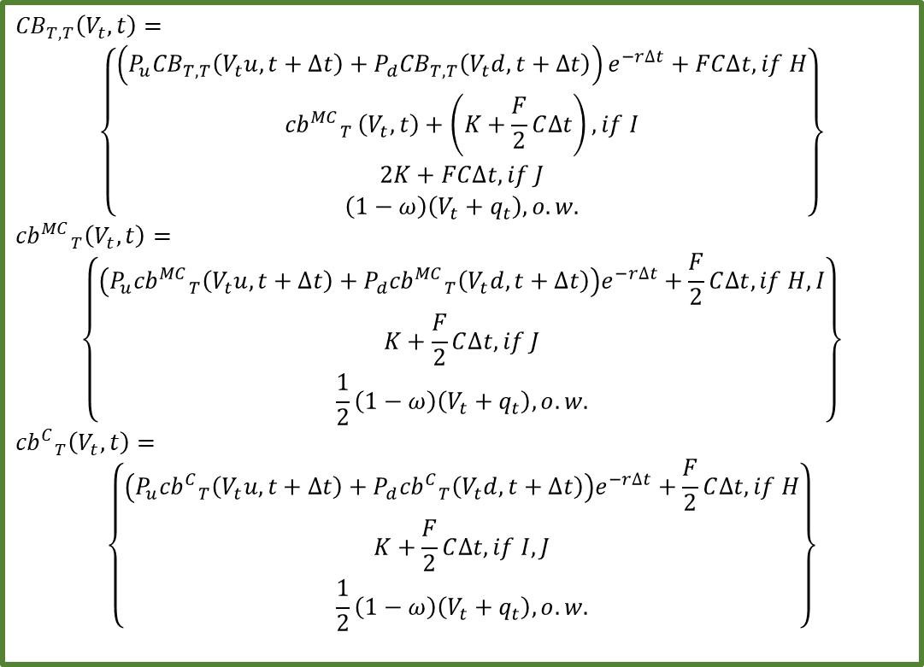
t = $\frac{1}{2}T$ 債券可提前贖回時
0
$$T$$
$$2T$$
$${CB}_{T, T}\left(V_{t},t\right)=$$
$$\left\{\begin{aligned}\left(P_{u}{CB}_{T, T}\left(V_{t}u,t+∆t\right)+P_{d}{CB}_{T, T}\left(V_{t}d,t+∆t\right)\right)e^{−r∆t}+FC∆t, if H \\ {{cb}^{MC}}_{T }\left(V_{t},t\right)+\left(K+\frac{F}{2}C∆t\right), if I \\ 2K+FC∆t, if J \\ \left(1−ω\right)\left(V_{t}+q_{t}\right), o.w.\end{aligned}\right\}$$
$${{cb}^{MC}}_{T}\left(V_{t},t\right)=$$
$$\left\{\begin{aligned}\left(P_{u}{{cb}^{MC}}_{T}\left(V_{t}u,t+∆t\right)+P_{d}{{cb}^{MC}}_{T}\left(V_{t}d,t+∆t\right)\right)e^{−r∆t}+\frac{F}{2}C∆t,if H,I \\ K+\frac{F}{2}C∆t, if J \\ \frac{1}{2}\left(1−ω\right)\left(V_{t}+q_{t}\right), o.w.\end{aligned}\right\}$$
$${{cb}^{C}}_{T}\left(V_{t},t\right)=$$
$$\left\{\begin{aligned}\left(P_{u}{{cb}^{C}}_{T}\left(V_{t}u,t+∆t\right)+P_{d}{{cb}^{C}}_{T}\left(V_{t}d,t+∆t\right)\right)e^{−r∆t}+\frac{F}{2}C∆t, if H \\ K+\frac{F}{2}C∆t, if I,J \\ \frac{1}{2}\left(1−ω\right)\left(V_{t}+q_{t}\right), o.w.\end{aligned}\right\}$$

Slide 42
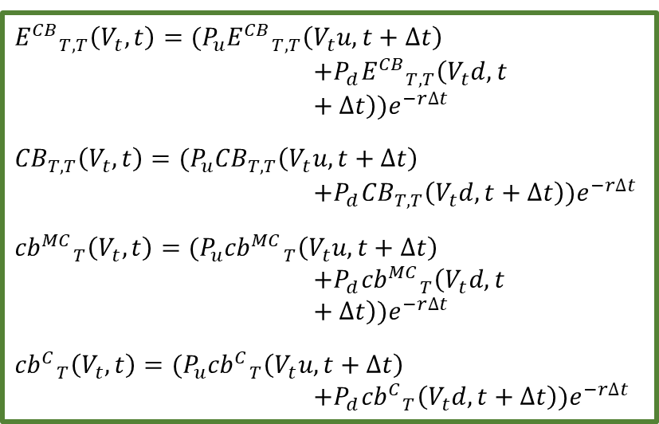
t = $T$ 債券發行時
0
$$T$$
$$2T$$
$${E^{CB}}_{T,T}\left(V_{t},t\right)=(P_{u}{E^{CB}}_{T,T}\left(V_{t}u,t+∆t\right)$$
$$+P_{d}{E^{CB}}_{T,T}\left(V_{t}d,t+∆t\right))e^{−r∆t}$$
$${CB}_{T,T}\left(V_{t},t\right)=(P_{u}{CB}_{T,T}\left(V_{t}u,t+∆t\right)$$
$$+{P_{d}CB}_{T,T}\left(V_{t}d,t+∆t\right))e^{−r∆t}$$
$${{cb}^{MC}}_{T}\left(V_{t},t\right)=(P_{u}{{cb}^{MC}}_{T}\left(V_{t}u,t+∆t\right)$$
$$+P_{d}{{cb}^{MC}}_{T}\left(V_{t}d,t+∆t\right))e^{−r∆t}$$
$${{cb}^{C}}_{T}\left(V_{t},t\right)=(P_{u}{{cb}^{C}}_{T}\left(V_{t}u,t+∆t\right)$$
$$+P_{d}{{cb}^{C}}_{T}\left(V_{t}d,t+∆t\right))e^{−r∆t}$$

