Slide 1
Black-Litterman Model
學生 : 陳柏壬
指導教授 : 戴天時

Slide 2
Model | Thinking | Parameters | Pros | Cons | Applicable timing
Markowitz mean-variance portfolio | Given expected returns, then minimizes the expected risk, vice versa. | Expected returns Variance Covariance | Easy Maximize the returns after the adjustment based on the risk. | The parameters are sensitive so that the output is unstable. It makes the portfolio easily concentrates on the certain assets. | Confident on the expected returns of the assets.
Black-Litterman | Given expected returns, then minimizes the expected risk by considering the point of views. | Variance Covariance Risk aversion coefficient Weight from the market portfolio Point of the views | Compared to mean-variance method, the output is stable. Allows for the investor’s views. | The weight of the market portfolio is not easy to be confirmed. Views are not easy to be confirmed. There are too many inputs. | The proportion of each asset’s market values are easy to obtained. Investor’s views are clear and specified.

Slide 3
Idea of B-L model
Market equilibrium returns
Set of investor views
Expected returns

Slide 4
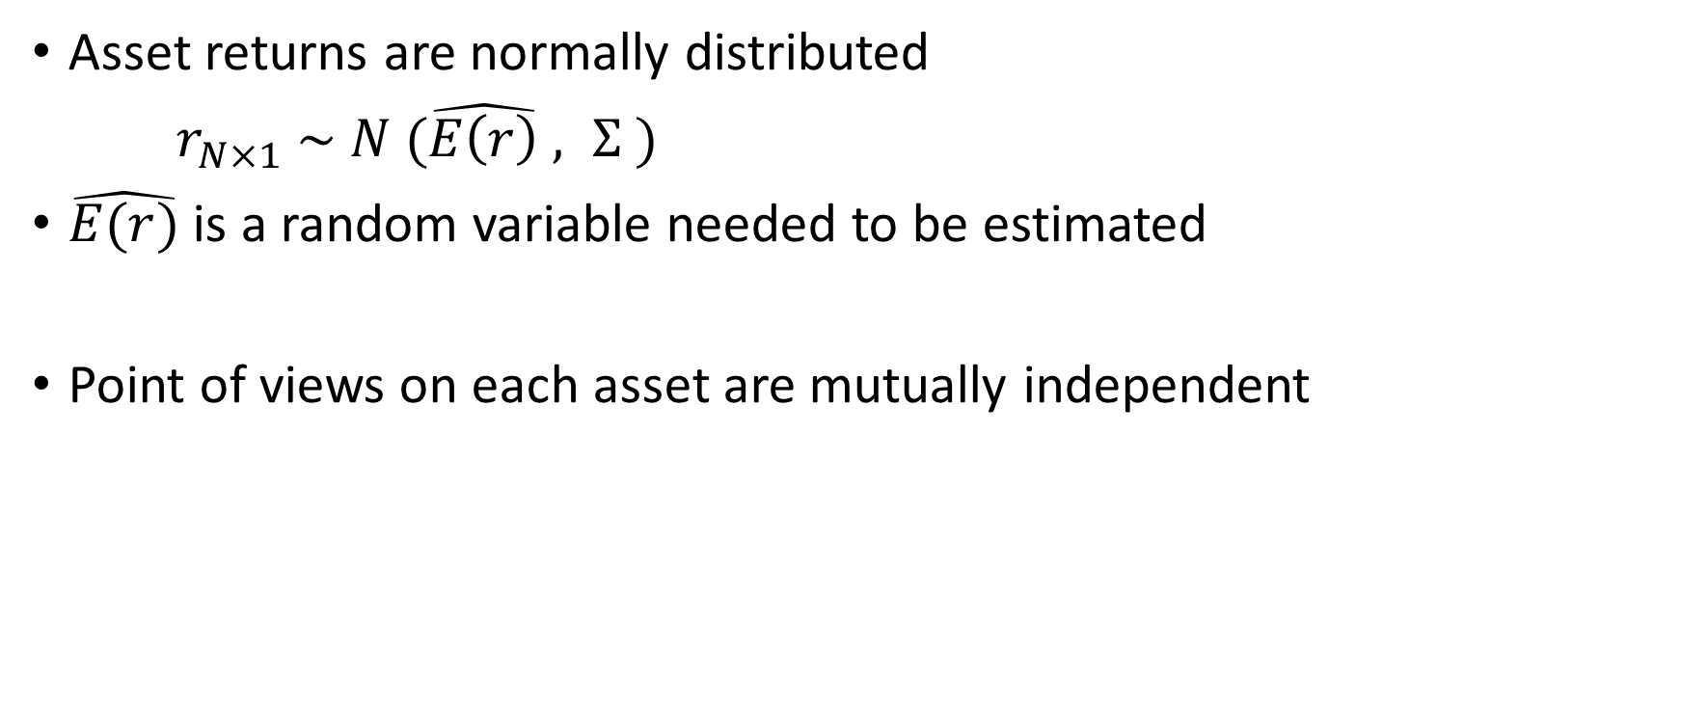
Key Assumption
Asset returns are normally distributed
$r_{N×1} \sim N (\hat{E\left(r\right)} , Σ )$
$\hat{E(r)}$ is a random variable needed to be estimated
Point of views on each asset are mutually independent

Slide 5
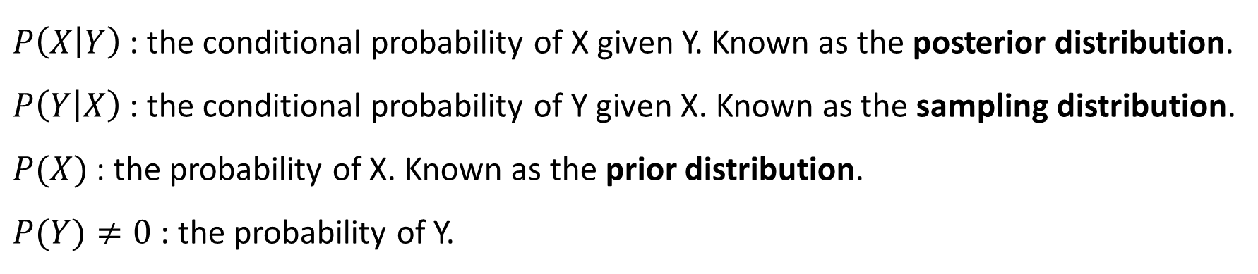

Bayes Theorem
$$P\left(X | Y\right)=\frac{P\left(Y | X\right)P(X)}{P(Y)}$$
$P\left(X | Y\right)$ : the conditional probability of X given Y. Known as the posterior distribution.
$P\left(Y | X\right)$ : the conditional probability of Y given X. Known as the sampling distribution.
$P(X)$ : the probability of X. Known as the prior distribution.
$P(Y)≠0$ : the probability of Y.

Slide 6
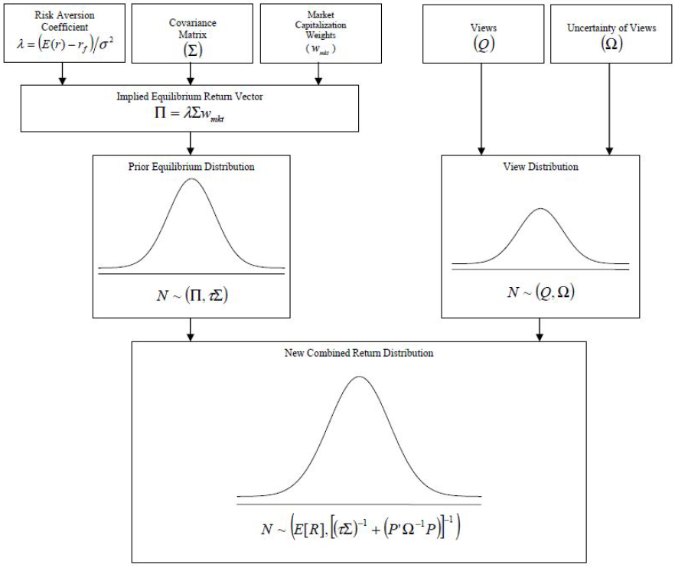









Returns for views
Uncertainty of views
$$δ$$
Market implied
Equilibrium excess returns
Set of investor’s views
$$δ$$
$$\hat{E(r)}$$
$$\hat{PE(r)}|\hat{E(r)}$$
Prior distribution
Sampling distribution
$$N(Π,τΣ)$$
$$N(Q,Ω)$$
What we are going to derive.
$$E\left(r\right) |\hat{ PE(r)}$$
$$N(μ^{∗},Σ^{∗})$$
$$μ^{∗}$$

Slide 7
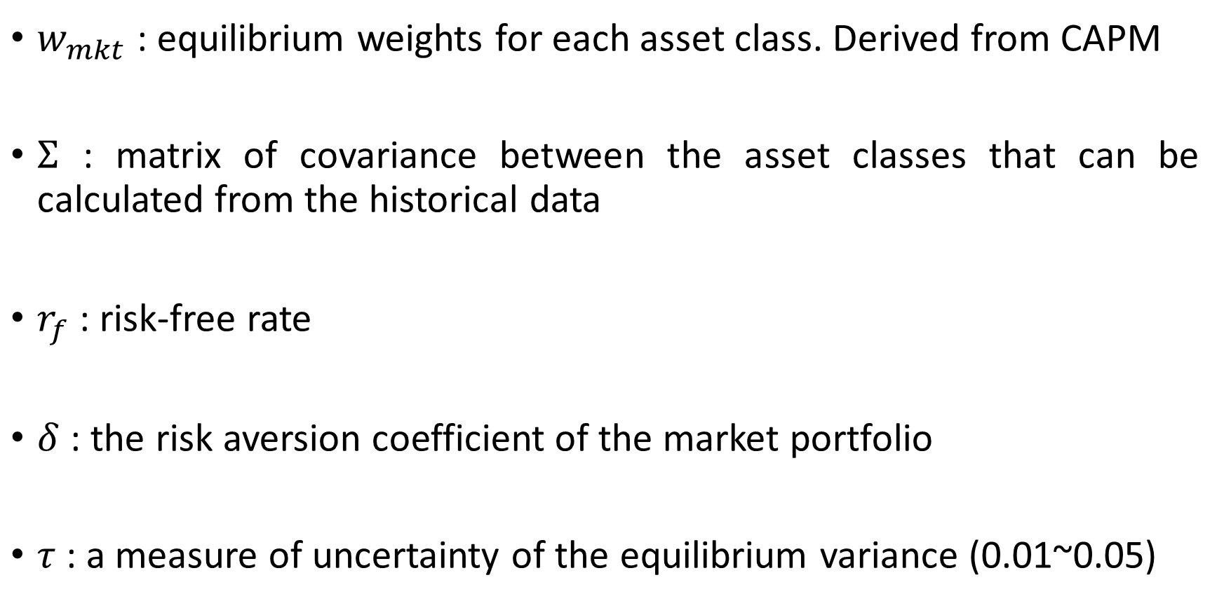
Step 1 : Inputs
$w_{mkt}$ : equilibrium weights for each asset class. Derived from CAPM
$Σ$ : matrix of covariance between the asset classes that can be calculated from the historical data
$r_{f}$ : risk-free rate
$δ$ : the risk aversion coefficient of the market portfolio
$τ$ : a measure of uncertainty of the equilibrium variance (0.01~0.05)

Slide 8
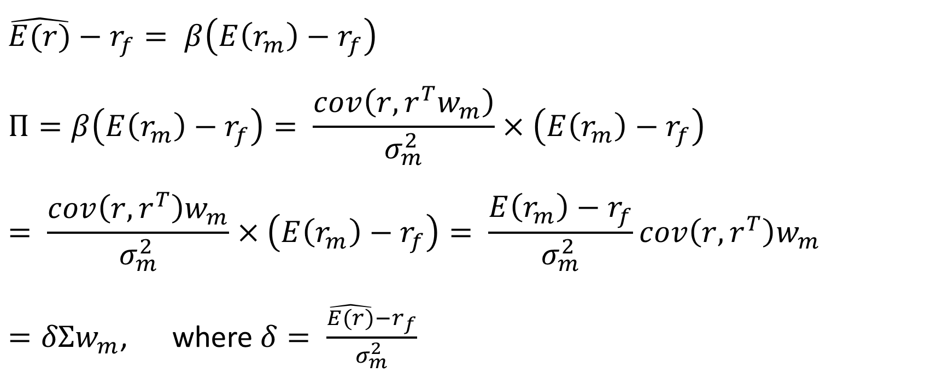

Derivation of$δ$
$$\hat{E(r)}−r_{f}= β\left(E\left(r_{m}\right)−r_{f}\right)$$
$$Π=β\left(E\left(r_{m}\right)−r_{f}\right)= \frac{cov\left(r,r^{T}w_{m}\right)}{σ_{m}^{2}}×\left(E\left(r_{m}\right)−r_{f}\right)$$
$$= \frac{cov\left(r,r^{T}\right)w_{m}}{σ_{m}^{2}}×\left(E\left(r_{m}\right)−r_{f}\right)= \frac{E\left(r_{m}\right)−r_{f}}{σ_{m}^{2}}cov\left(r,r^{T}\right)w_{m}$$
$=δΣw_{m}$, where$δ= \frac{\hat{E(r)}−r_{f}}{σ_{m}^{2}}$

Slide 9
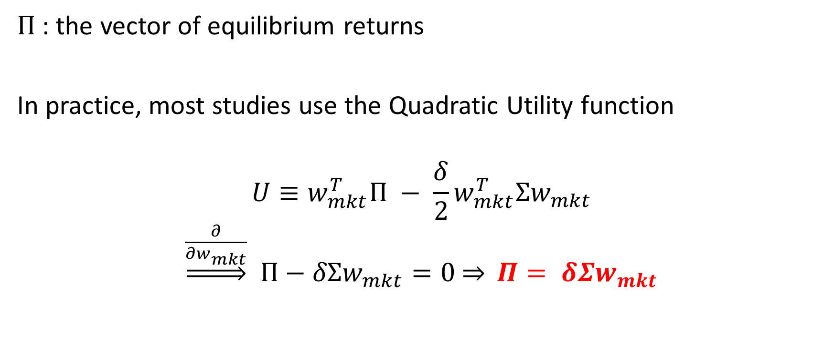
Step 2 : Compute equilibrium returns
$Π$ : the vector of equilibrium returns
In practice, most studies use the Quadratic Utility function
$$U≡w_{mkt}^{T}Π − \frac{δ}{2}w_{mkt}^{T}Σw_{mkt}$$
$\underset{⇒}{\frac{∂}{∂w_{mkt}}}$ $Π−δΣw_{mkt}=0$ $\underset{⇒}{} Π= δΣw_{mkt}$

Slide 10
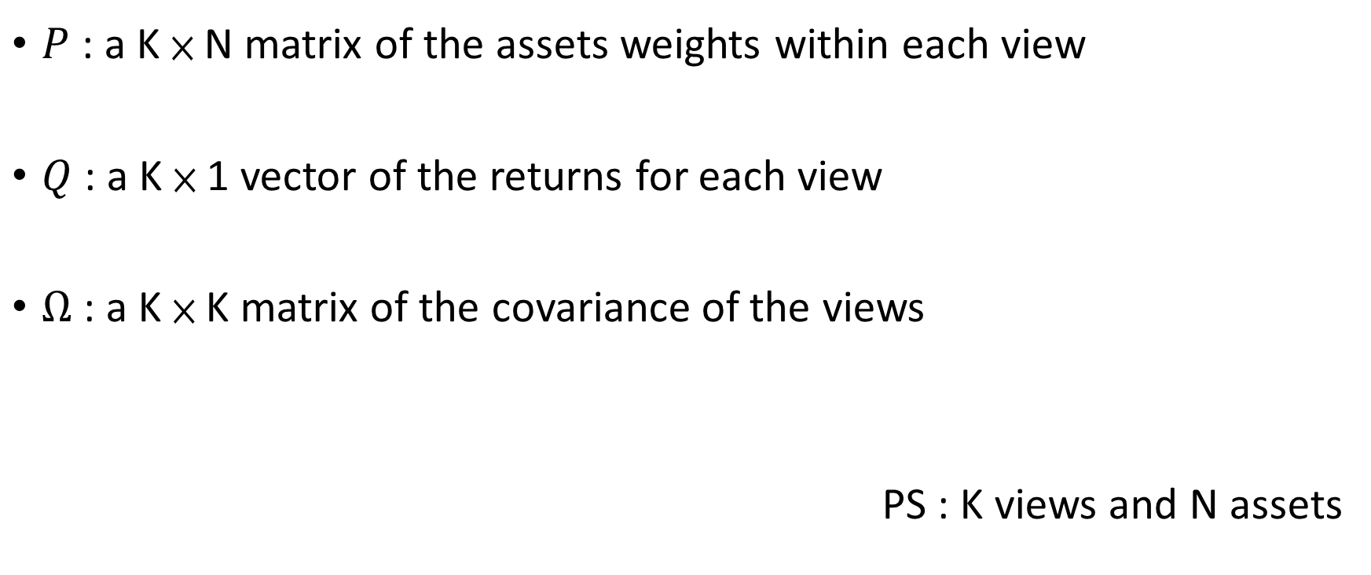

Step 3 : Formulate $P, Q, Ω$
$P$ : a K × N matrix of the assets weights within each view
$Q$ : a K × 1 vector of the returns for each view
$Ω$ : a K × K matrix of the covariance of the views
PS : K views and N assets

Slide 11
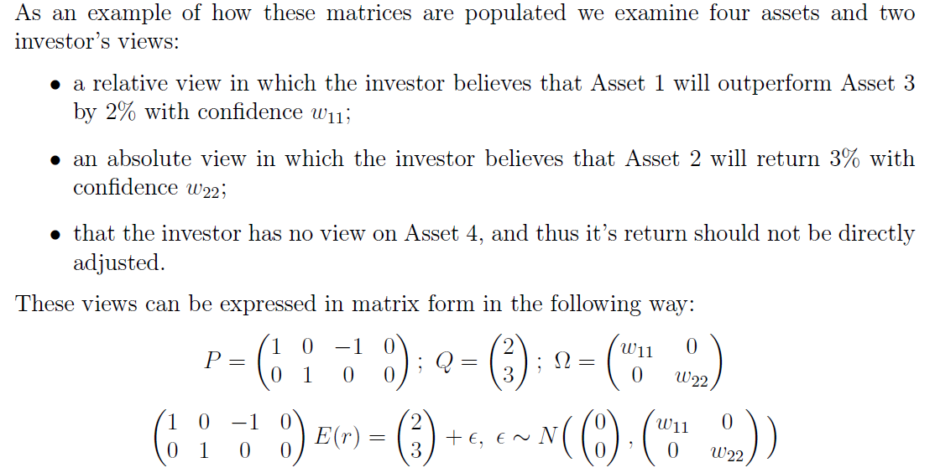
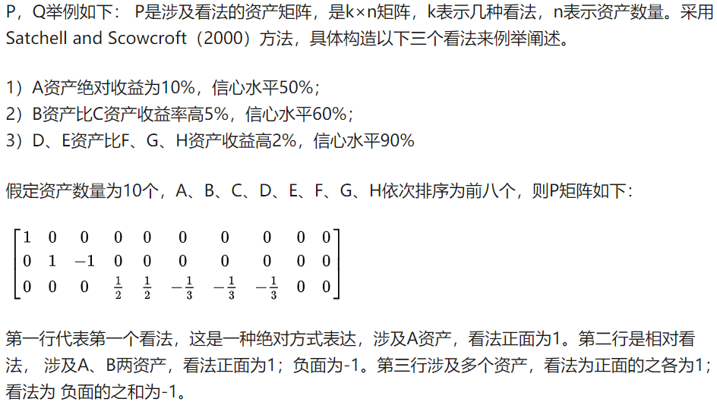
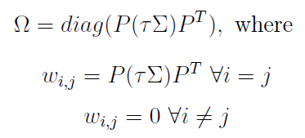


Example, $P$ and $Q$
$$\hat{E(r)}$$

Slide 12
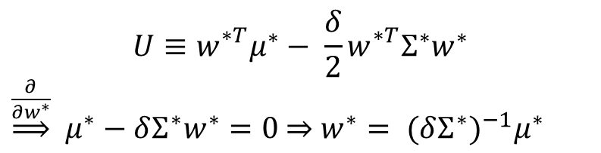

Step4 : compute the expected returns
$r \sim N ( μ^{∗} , Σ^{∗})$
$μ^{∗}= {[{\left(τΣ\right)}^{−1}+P^{T}Ω^{−1}P]}^{−1}[{\left(τΣ\right)}^{−1}Π+ P^{T}Ω^{−1}Q]$
$Σ^{∗}={ Σ+\left(τΣ\right)}^{−1}+P^{T}Ω^{−1}P$
$w^{∗}= {(δΣ^{∗})}^{−1}μ^{∗}$
$$U≡w_{}^{∗T}μ^{∗}− \frac{δ}{2}w_{}^{∗T}Σ^{∗}w^{∗}$$
$\underset{⇒}{\frac{∂}{∂w^{∗}}}$ $μ^{∗}−δΣ^{∗}w^{∗}=0$ $w^{∗}= {(δΣ^{∗})}^{−1}μ^{∗}$

Slide 13
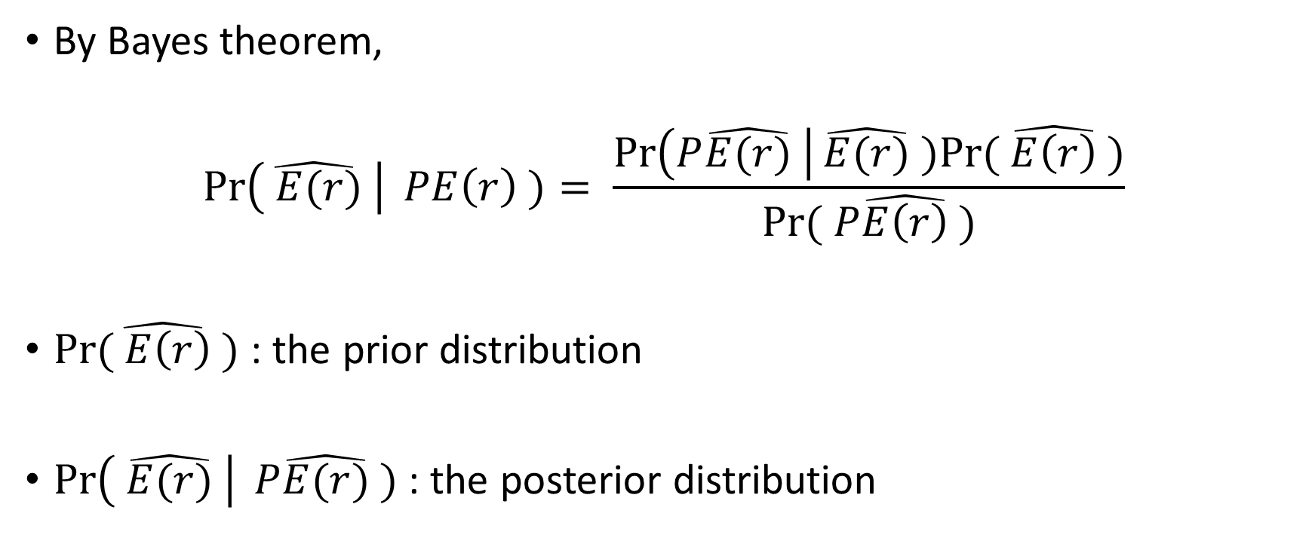

Derivation of $μ^{∗}$ and $Σ^{∗}$
By Bayes theorem,
$$\operatorname{Pr}\left(\hat{ E(r)} \right| PE\left(r\right) )= \frac{\operatorname{Pr}\left(P\hat{E(r)} \right|\hat{E(r)} )Pr⁡(\hat{ E\left(r\right) })}{Pr⁡( P\hat{E\left(r\right)} )}$$
$Pr⁡(\hat{ E\left(r\right)} )$ : the prior distribution
$\operatorname{Pr}\left( \hat{E(r)} \right| P\hat{E(r)} )$ : the posterior distribution

Slide 14
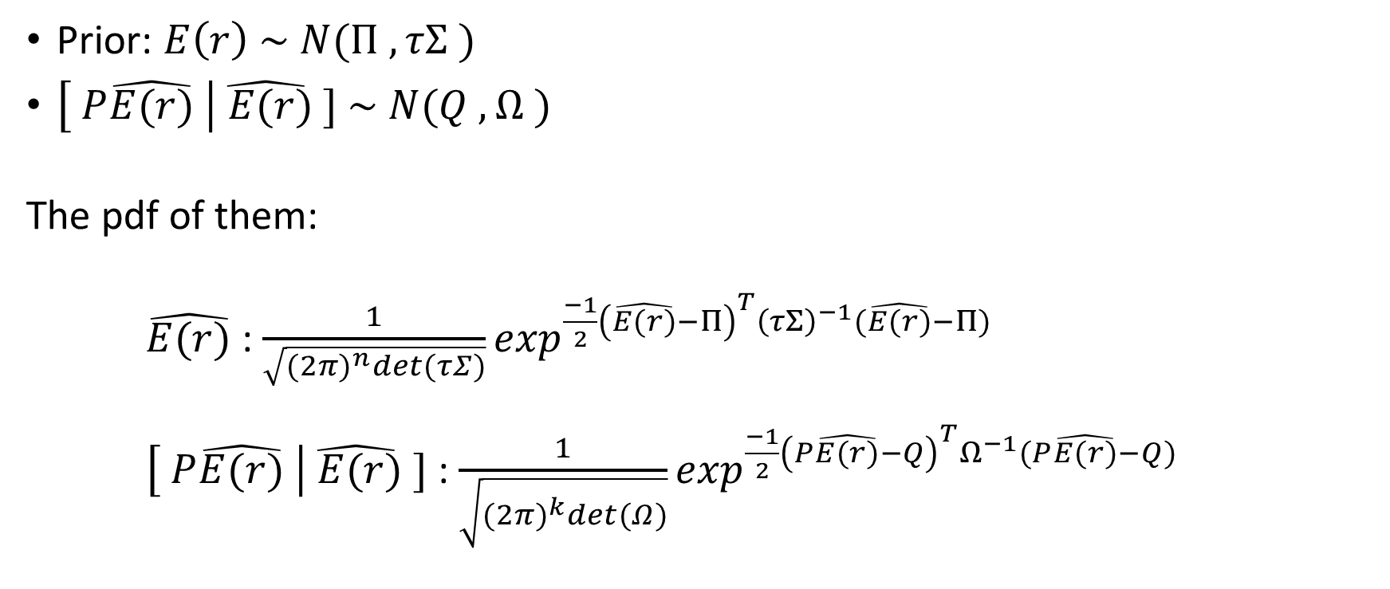

Derivation of $μ^{∗}$ and $Σ^{∗}$ (conti.)
Prior: $E\left(r\right) \sim N(Π ,τΣ )$
$\left[ P\hat{E(r)} \right|\hat{ E(r)} ] \sim N(Q ,Ω )$
The pdf of them:
$\hat{E(r)}$ : $\frac{1}{\sqrt{{(2π)}^{n}det⁡(τΣ)}}\exp^{\frac{−1}{2}{\left(\hat{E(r)}−Π\right)}^{T}{\left(τΣ\right)}^{−1}(\hat{E(r)}−Π)}$
$\left[ P\hat{E(r)} \right|\hat{ E(r)} ]$ : $\frac{1}{\sqrt{{(2π)}^{k}det⁡(Ω)}}\exp^{\frac{−1}{2}{\left(P\hat{E(r)}−Q\right)}^{T}Ω^{−1}(P\hat{E(r)}−Q)}$

Slide 15
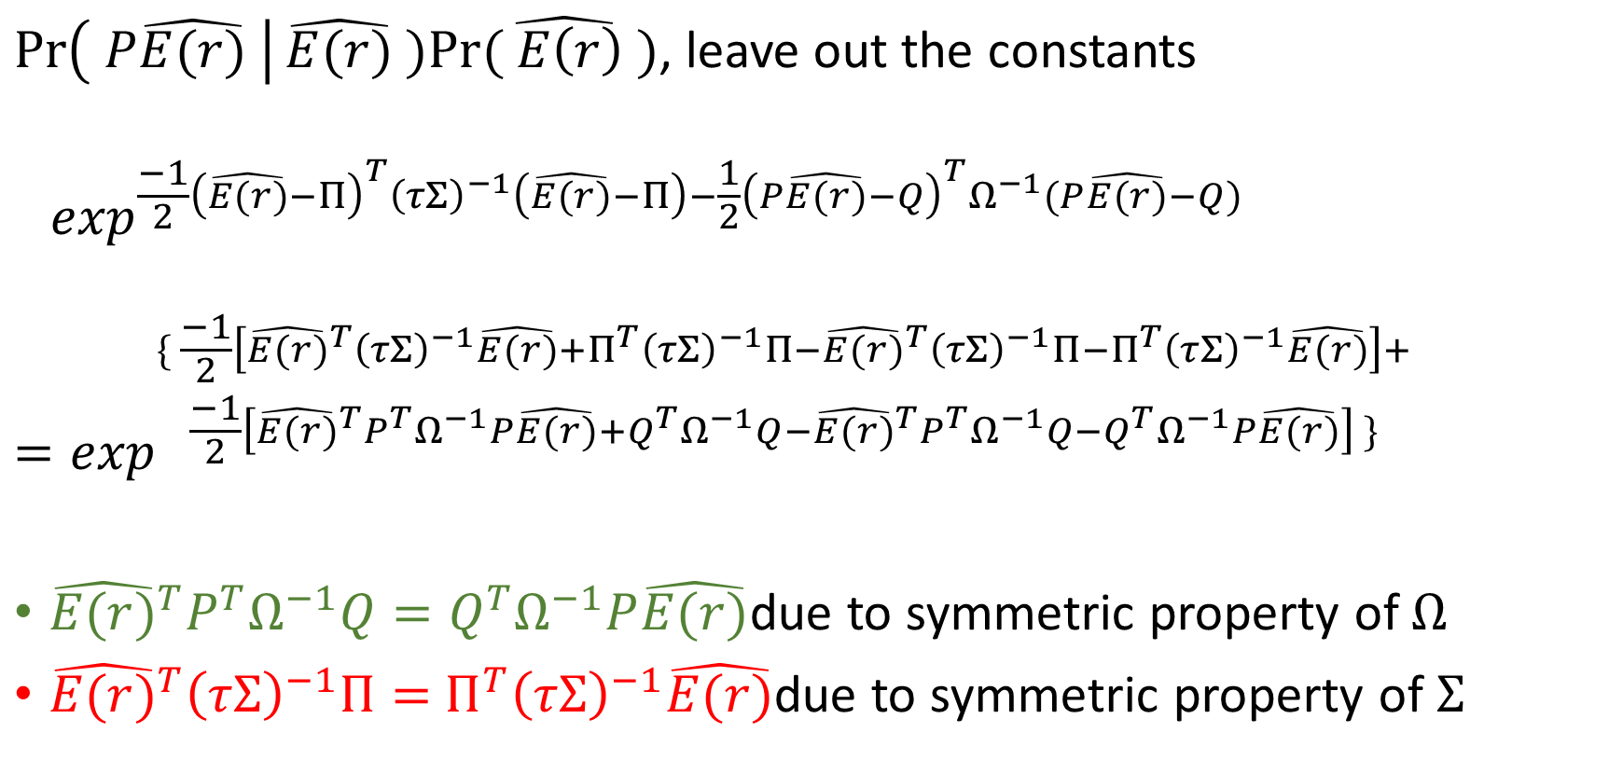
Derivation of $μ^{∗}$ and $Σ^{∗}$ (conti.)
$\operatorname{Pr}\left( P\hat{E(r)} \right|\hat{E(r)} )Pr⁡(\hat{ E\left(r\right)} )$, leave out the constants
$$⁡\exp^{\frac{−1}{2}{\left(\hat{E(r)}−Π\right)}^{T}{\left(τΣ\right)}^{−1}\left(\hat{E(r)}−Π\right)−\frac{1}{2}{\left(P\hat{E(r)}−Q\right)}^{T}Ω^{−1}(P\hat{E(r)}−Q)}$$
$$=\exp^{\begin{aligned}\{ \frac{−1}{2}\left[{\hat{E(r)}}^{T}{\left(τΣ\right)}^{−1}\hat{E(r)}+Π^{T}{\left(τΣ\right)}^{−1}Π−{\hat{E(r)}}^{T}{\left(τΣ\right)}^{−1}Π−Π^{T}{\left(τΣ\right)}^{−1}\hat{E(r)}\right]+ \\ \frac{−1}{2}\left[{\hat{E(r)}}^{T}P^{T}Ω^{−1}P\hat{E(r)}+Q^{T}Ω^{−1}Q−{\hat{E(r)}}^{T}P^{T}Ω^{−1}Q−Q^{T}Ω^{−1}P\hat{E(r)}\right] \}\end{aligned}}$$
${\hat{E(r)}}^{T}P^{T}Ω^{−1}Q=Q^{T}Ω^{−1}P\hat{E(r)}$due to symmetric property of $Ω$
${\hat{E(r)}}^{T}{\left(τΣ\right)}^{−1}Π=$ $Π^{T}{\left(τΣ\right)}^{−1}\hat{E(r)}$due to symmetric property of $Σ$

Slide 16
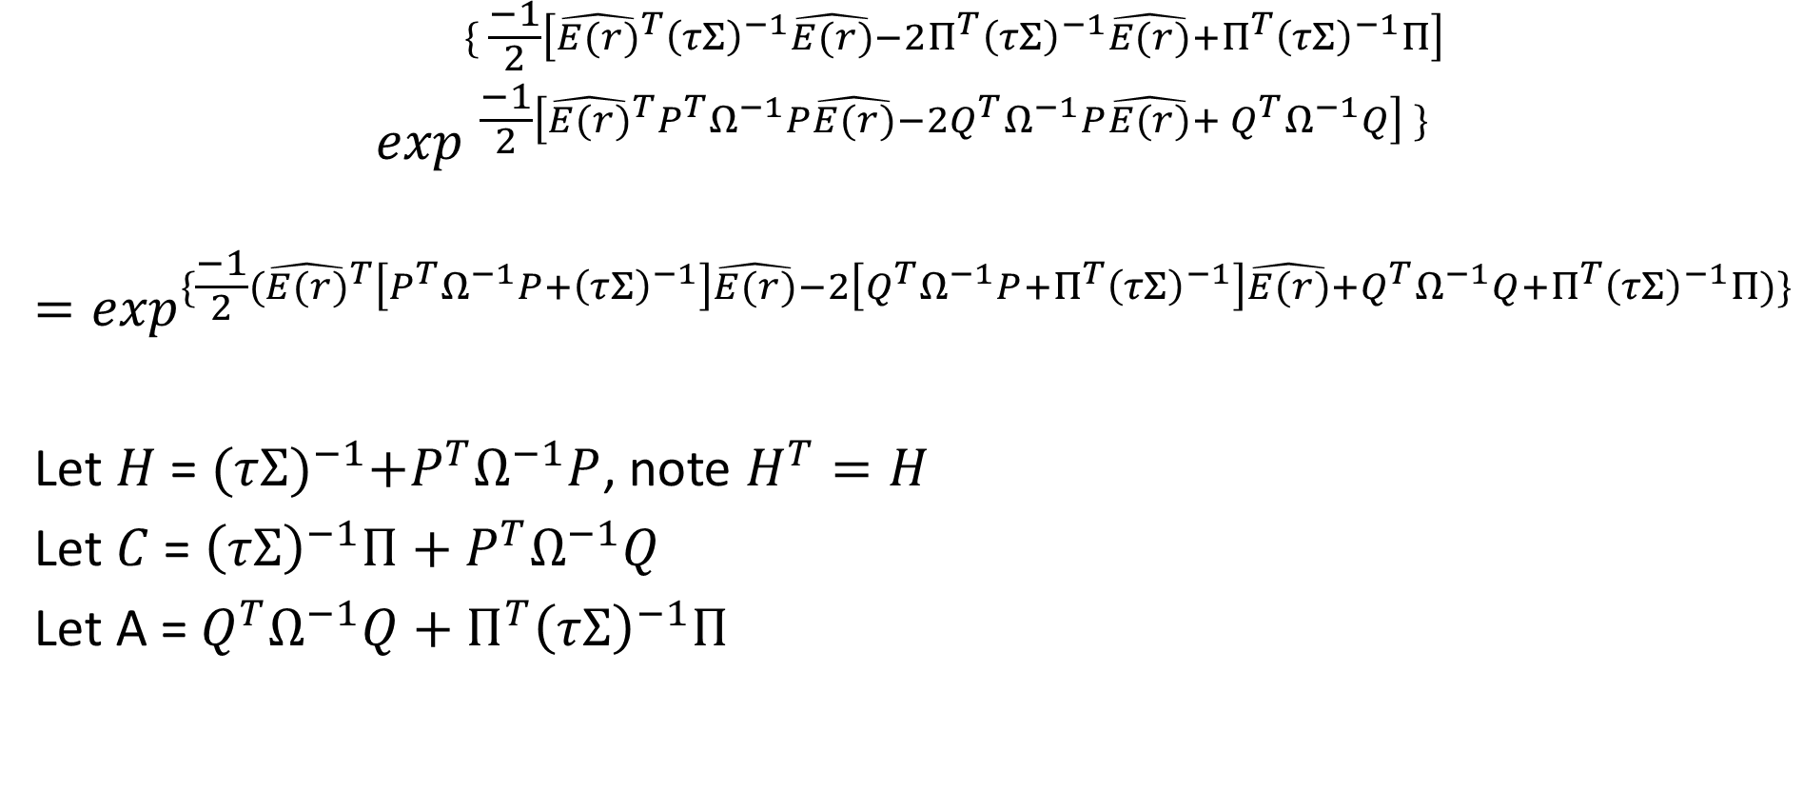

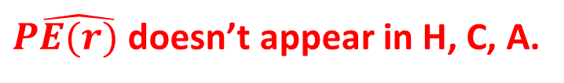
Derivation of $μ^{∗}$ and $Σ^{∗}$ (conti.)
$$\exp^{\begin{aligned}\{ \frac{−1}{2}\left[{\hat{E(r)}}^{T}{\left(τΣ\right)}^{−1}\hat{E(r)}−2Π^{T}{\left(τΣ\right)}^{−1}\hat{E(r)}+Π^{T}{\left(τΣ\right)}^{−1}Π\right] \\ \frac{−1}{2}\left[{\hat{E(r)}}^{T}P^{T}Ω^{−1}P\hat{E(r)}−{2Q}^{T}Ω^{−1}P\hat{E(r)}+{ Q}^{T}Ω^{−1}Q\right] \}\end{aligned}}$$
$$=\exp^{\{\frac{−1}{2}({\hat{E(r)}}^{T}\left[P^{T}Ω^{−1}P+{\left(τΣ\right)}^{−1}\right]\hat{E(r)}−2\left[Q^{T}Ω^{−1}P+Π^{T}{\left(τΣ\right)}^{−1}\right]\hat{E(r)}+Q^{T}Ω^{−1}Q+Π^{T}{\left(τΣ\right)}^{−1}Π)\}}$$
Let $H$ = ${(τΣ)}^{−1}+P^{T}Ω^{−1}P$, note $H^{T}=H$
Let $C$ = ${\left(τΣ\right)}^{−1}Π+P^{T}Ω^{−1}Q$
Let A = $Q^{T}Ω^{−1}Q+Π^{T}{\left(τΣ\right)}^{−1}Π$
$P\hat{E(r)}$ doesn’t appear in H, C, A.

Slide 17
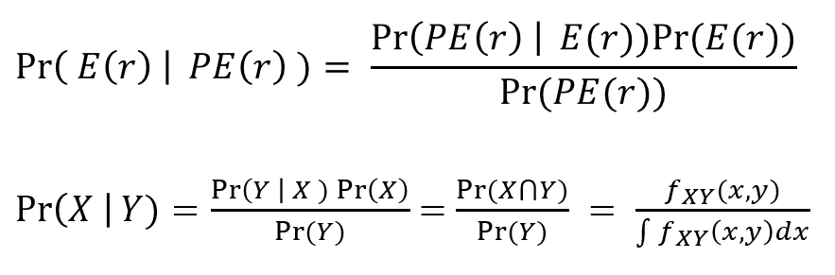







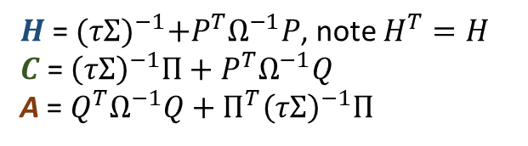

Derivation of $μ^{∗}$ and $Σ^{∗}$ (conti.)
$$H$$
$$\hat{E(r)}$$
$$C^{T}$$
A
$$\hat{E(r)}$$
$$\hat{E(r)}$$
$$\exp^{\{\frac{−1}{2}({\hat{E(r)}}^{T}\left[P^{T}Ω^{−1}P+{\left(τΣ\right)}^{−1}\right]\hat{E(r)}−2\left[Q^{T}Ω^{−1}P+Π^{T}{\left(τΣ\right)}^{−1}\right]\hat{E(r)}+Q^{T}Ω^{−1}Q+Π^{T}{\left(τΣ\right)}^{−1}Π)\}}$$
$${=exp}^{\{\frac{−1}{2}({\hat{E(r)}}^{T}H\hat{E(r)}−2C^{T}\hat{E(r)}+A)\}}$$
$$=\exp^{\{\frac{−1}{2}[{\left(H\hat{E(r)}\right)}^{T}H^{−1}H\hat{E(r)}−2C^{T}H^{−1}H\hat{E(r)}+A]\}}$$
$$= \exp^{\{\frac{−1}{2}[{\left(H\hat{E(r)}−C\right)}^{T}H^{−1}\left(H\hat{E(r)}−C\right)+A−C^{T}H^{−1}C]\}}$$
$$= \exp^{\{\frac{−1}{2}[{\left(\hat{E(r)}−H^{−1}C\right)}^{T}H\left(\hat{E(r)}−H^{−1}C\right)+A−C^{T}H^{−1}C]\}}$$
Since $A−C^{T}H^{−1}C$ doesn’t depend on $P\hat{E(r)}$,
It disappears into the constant of integration
$$\hat{E(r)}$$
$$\hat{E(r)}$$
$H$ = ${(τΣ)}^{−1}+P^{T}Ω^{−1}P$, note $H^{T}=H$
$C$ = ${\left(τΣ\right)}^{−1}Π+P^{T}Ω^{−1}Q$
A = $Q^{T}Ω^{−1}Q+Π^{T}{\left(τΣ\right)}^{−1}Π$

Slide 18
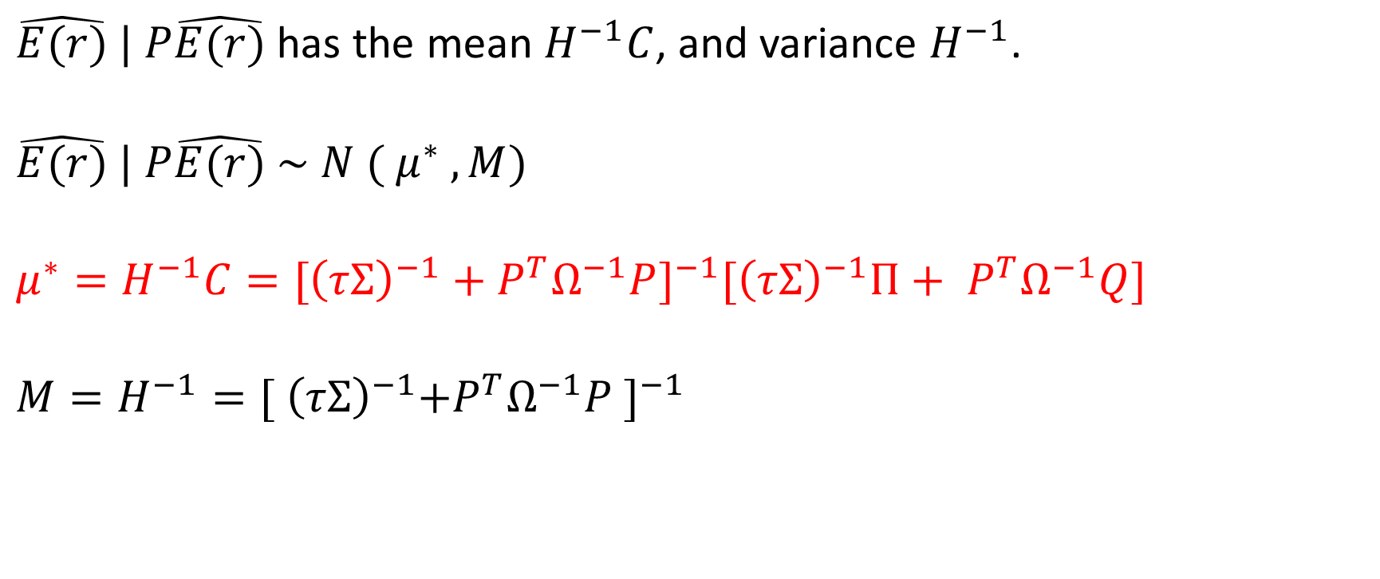
Derivation of $μ^{∗}$ and $Σ^{∗}$ (conti.)
$\hat{E(r)} | P\hat{E(r)}$ has the mean $H^{−1}C$, and variance $H^{−1}$.
$$\hat{E(r)} | P\hat{E(r)} \sim N ( μ^{∗} ,M)$$
$$μ^{∗}=H^{−1}C={[{\left(τΣ\right)}^{−1}+P^{T}Ω^{−1}P]}^{−1}[{\left(τΣ\right)}^{−1}Π+ P^{T}Ω^{−1}Q]$$
$$M=H^{−1}={[{ \left(τΣ\right)}^{−1}+P^{T}Ω^{−1}P ]}^{−1}$$

Slide 19
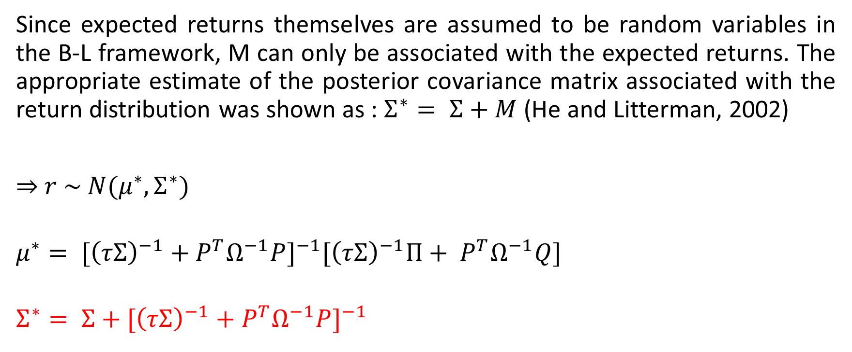
Derivation of $μ^{∗}$ and $Σ^{∗}$ (conti.)
Since expected returns themselves are assumed to be random variables in the B-L framework, M can only be associated with the expected returns. The appropriate estimate of the posterior covariance matrix associated with the return distribution was shown as : $Σ^{∗}= Σ+M$ (He and Litterman, 2002)
⇒ $r \sim N(μ^{∗},Σ^{∗})$
$$μ^{∗}= {[{\left(τΣ\right)}^{−1}+P^{T}Ω^{−1}P]}^{−1}[{\left(τΣ\right)}^{−1}Π+ P^{T}Ω^{−1}Q]$$
$$Σ^{∗}= Σ+{[{\left(τΣ\right)}^{−1}+P^{T}Ω^{−1}P]}^{−1}$$

Slide 20

Conclusion
$r \sim N ( μ^{∗} , Σ^{∗})$
$μ^{∗}= {[{\left(τΣ\right)}^{−1}+P^{T}Ω^{−1}P]}^{−1}[{\left(τΣ\right)}^{−1}Π+ P^{T}Ω^{−1}Q]$
$Σ^{∗}={ Σ+\left(τΣ\right)}^{−1}+P^{T}Ω^{−1}P$
$w^{∗}= {(δΣ^{∗})}^{−1}μ^{∗}$

