Slide 1
No Trade Region Implementation ( N=1 )
指導教授 : 戴天時
學生 : 陳柏壬

Slide 2
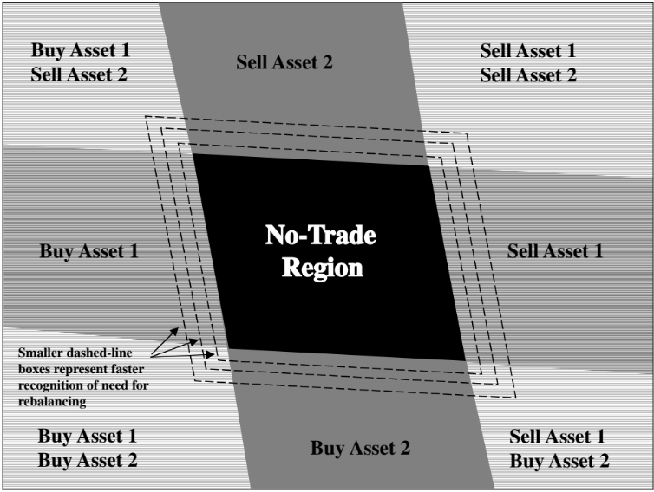
Major assumptions
The target strategy is to maintain (exogenously determined) constant asset proportions.
Transactions costs are proportional to the dollar amount of stock purchased and/or sold.
Instantaneous asset returns follow a joint diffusion process with constant means, volatilities, and correlations .

Slide 3

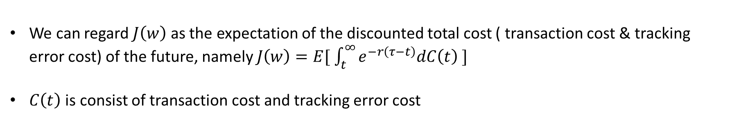
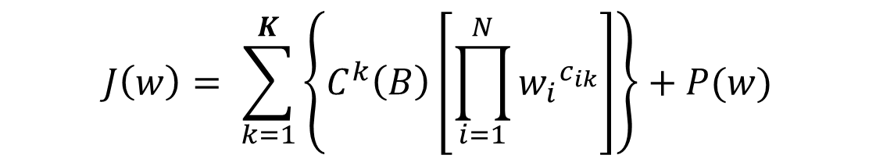
Cost function
$$J\left(w\right)= \sum_{k=1}^{K}{\left\{C^{k}\left(B\right)\left[\prod_{i=1}^{N}{{w_{i}}^{c_{ik}}}\right]\right\}+P(w)}$$
We can regard $J\left(w\right)$ as the expectation of the discounted total cost ( transaction cost & tracking error cost) of the future, namely $J\left(w\right)=E[ \int_{t}^{∞}{e^{−r\left(τ−t\right)}dC\left(t\right) }]$
$C\left(t\right)$ is consist of transaction cost and tracking error cost
To find out $C^{k}\left(B\right)$ and the optimal $w_{max}$ and $w_{min}$ for each asset, $J\left(w\right)$ must satisfy the following conditions

Slide 4
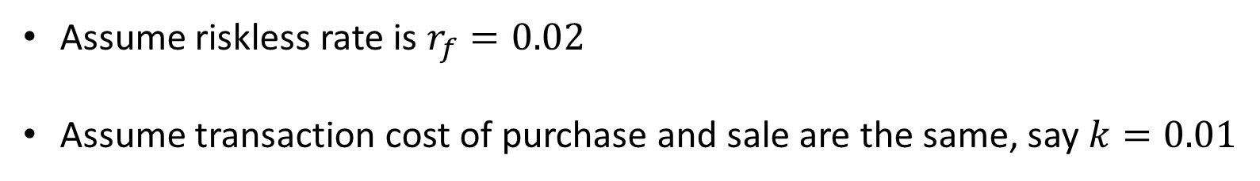
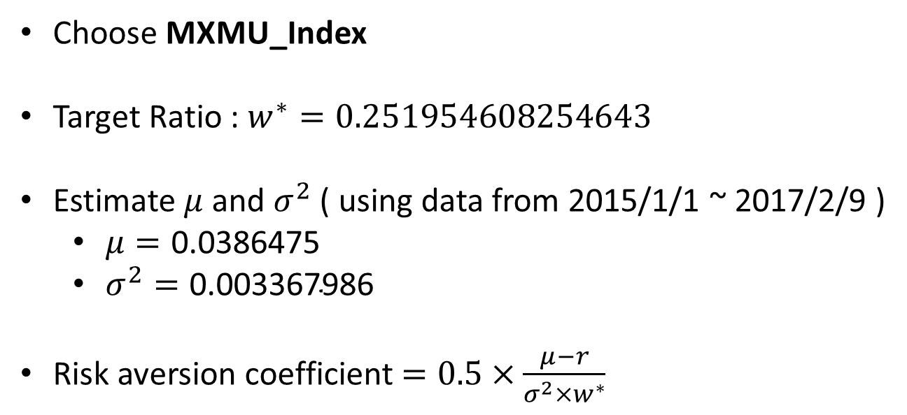
Parameter Input
Assume riskless rate is $r_{f}=0.02$
Assume transaction cost of purchase and sale are the same, say $k=0.01$
Choose MXMU_Index
Target Ratio : $w^{∗}=0.251954608254643$
Estimate $μ$ and $σ^{2}$ ( using data from 2015/1/1 ~ 2017/2/9 )
$μ=\text{0.0386475}$
$σ^{2}=\text{0.003367986}$
Risk aversion coefficient $=0.5×\frac{μ−r}{σ^{2}×w^{∗}}$
Data from the file : (SAA)Growth_BT
Target ratio of 2017/2/10

Slide 5
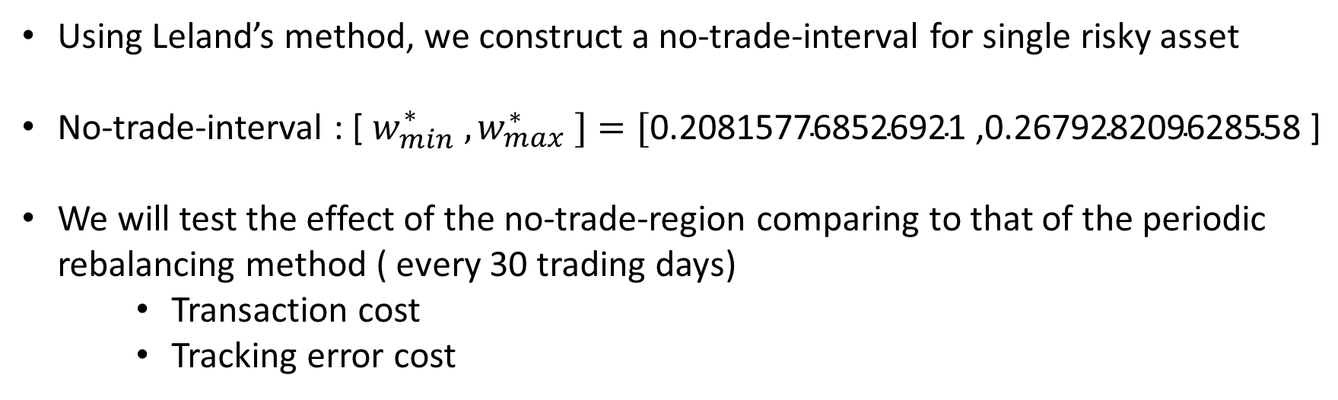
No-Trade-Region
Using Leland’s method, we construct a no-trade-interval for single risky asset
No-trade-interval : [ $w_{min}^{∗} , w_{max}^{∗} ]=[\text{0.208157768526921}\text{ ,}\text{0.267928209628558}\text{ ]}$
We will test the effect of the no-trade-region comparing to that of the periodic rebalancing method ( every 30 trading days)
Transaction cost
Tracking error cost

Slide 6
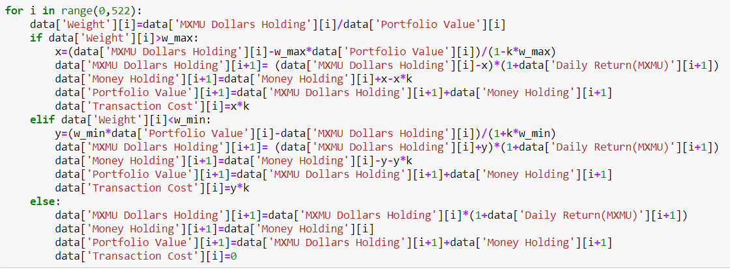
Thinking of the Program
No-trade-region method

Slide 7
Date | MXMU_Index | Daily Return | MXMU Dollars Holding | Money Holding | Portfolio Value | Weight
2017-2-10 | 305.87 | NaN | 305.87 | 908.118512 | 1213.988512 | 0.251955
2017-2-13 | 307.13 | 0.004119 | 307.13 | 908.118512 | 1215.248512 | 0.252730
2017-2-14 | 306.69 | -0.001433 | 306.69 | 908.118512 | 1214.808512 | 0.252460
乘上 (1+0.004119)
Inside the NTR, no need to trade.

Slide 8
Date | MXMU_Index | Daily Return | MXMU Dollars Holding | Money Holding | Portfolio Value | Weight
2017-2-10 | 305.87 | NaN | 305.87 | 908.118512 | 1213.988512 | 0.251955
2017-2-13 | 307.13 | 0.004119 | 307.13 | 908.118512 | 1215.248512 | 0.252730
2017-2-14 | 306.69 | -0.001433 | 306.69 | 908.118512 | 1214.808512 | 0.252460
times (1-0.001433)
Inside the NTR, no need to trade.

Slide 9
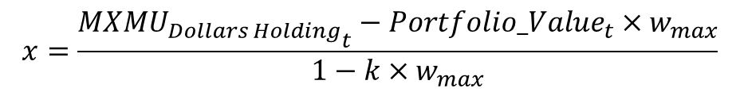
Date | MXMU_Index | Daily Return | MXMU Dollars Holding | Money Holding | Portfolio Value | Weight
2017-8-28 | 333.68 | 0.012655155 | 333.68 | 908.1185121 | 1241.798512 | 0.268707038
2017-8-29 | 332.08 | -0.004795013 | 331.1149038 | 909.0785608 | 1240.193465 | 0.266986493
2017-8-30 | 334.36 | 0.006865815 | 333.3882776 | 909.0785608 | 1242.466838 | 0.268327707
**
**
** : ${MXMU_{Dollars Holding}}_{t+1}=$[${MXMU_{Dollars Holding}}_{t}−x$]$×$ ( 1 – 0.004795013)
$$x=\frac{{MXMU_{Dollars Holding}}_{t}−{Portfolio_Value}_{t}×w_{max}}{1−k×w_{max}}$$
** : ${Money_Holding}_{t+1}={Money_Holding}_{t}+x−k∗x$
NTR : [ $w_{min}^{∗} , w_{max}^{∗} ]=[\text{0.208157768526921 ,0.267928209628558 ]}$

Slide 10
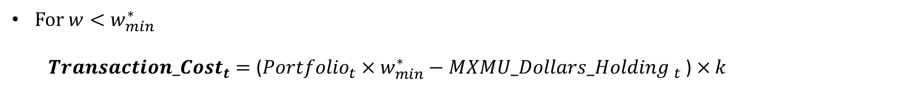
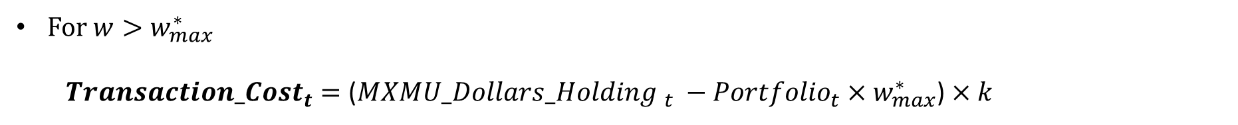
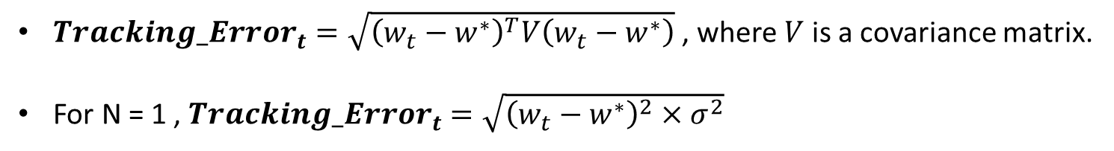
Calculating the Transaction Cost & Tracking Error
For $w>w_{max}^{∗}$
${Transaction_Cost}_{t}=\text{(}{MXMU_Dollars_Holding }_{t} −{Portfolio}_{t}×w_{max}^{∗}$) $×k$
For $w<w_{min}^{∗}$
${Transaction_Cost}_{t}=\text{(}{Portfolio}_{t}×w_{min}^{∗}−{MXMU_Dollars_Holding }_{t}$) $×k$
${Tracking_Error}_{t}=\sqrt{{\left(w_{t}−w^{∗}\right)}^{T}V\left(w_{t}−w^{∗}\right)}$ , where $V$ is a covariance matrix.
For N = 1 , ${Tracking_Error}_{t}$ $=\sqrt{{\left(w_{t}−w^{∗}\right)}^{2}×σ^{2}}$

Slide 11

 | Transaction Cost | Tracking Error | Total Cost
NTR method | 0.370679169 | 0.465194414 | 0.835873583
Periodic Rebalancing (every 30 trading days) | 1.486328485 | 0.155483175 | 1.64181166
$$×2$$
The total cost of the NTR method is almost half of that of periodic rebalancing
The result satisfies the statement of the paper.

Slide 12
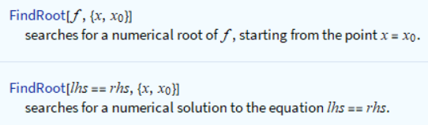
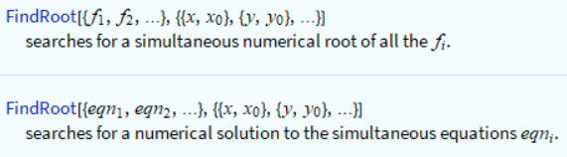
Difficulties of the Method
In the program, we use a function called FindRoot to solve the root of the function.
To use the function, we need to import the initial value(s) so that the function can find the nearest root from the initial value.
Different initial values input, different outcomes may be generated.

Slide 13
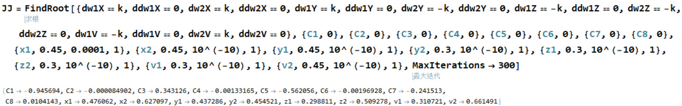
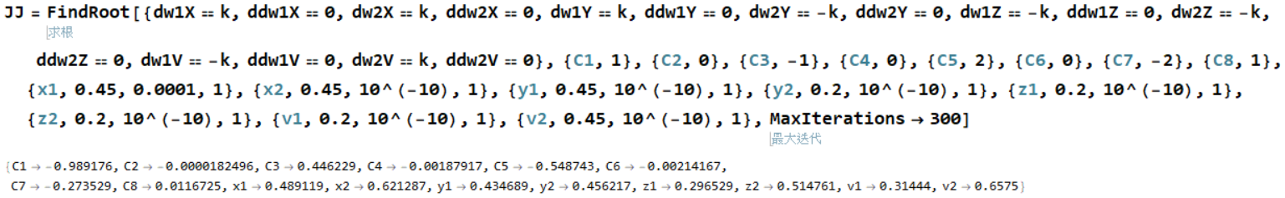
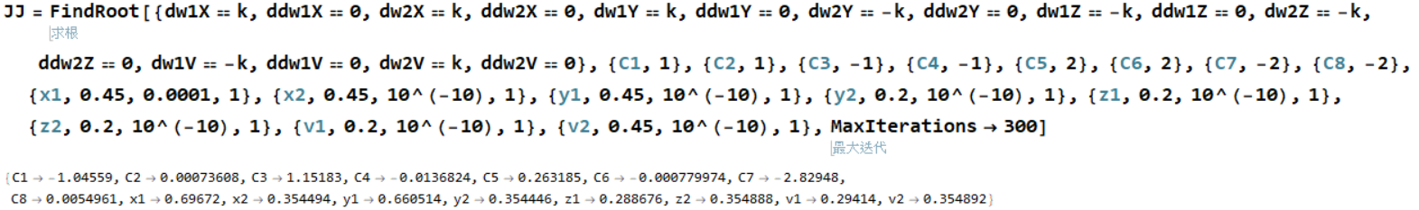

Slide 14
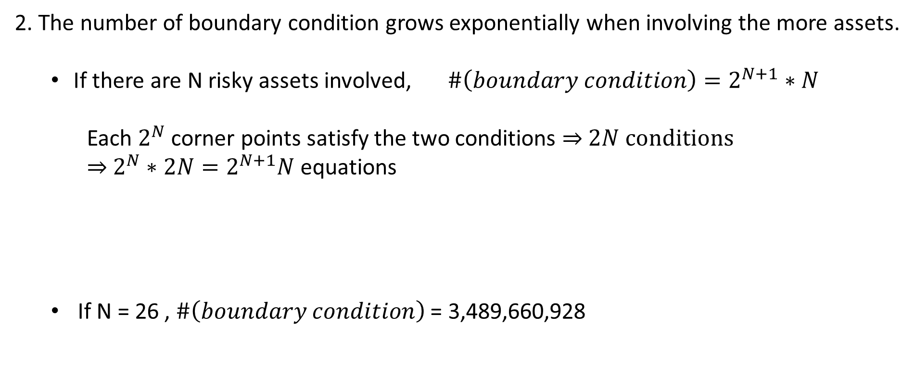
2. The number of boundary condition grows exponentially when involving the more assets.
If there are N risky assets involved, $\#\left(boundary condition\right)=2^{N+1}∗N$
Each $2^{N}$ corner points satisfy the two conditions ⇒ $2N$ conditions
⇒ $2^{N}∗2N=2^{N+1}N$ equations
If N = 26 , $\#\left(boundary condition\right)$ = 3,489,660,928

