Slide 1
OPTIMAL PORTFOLIO IMPLEMENTATION: ASSET MANAGEMENT WITH TRANSACTIONS COSTS AND CAPITAL GAINS TAXES Author : Leland
學生 : 陳柏壬
指導教授 : 戴天時

Slide 2
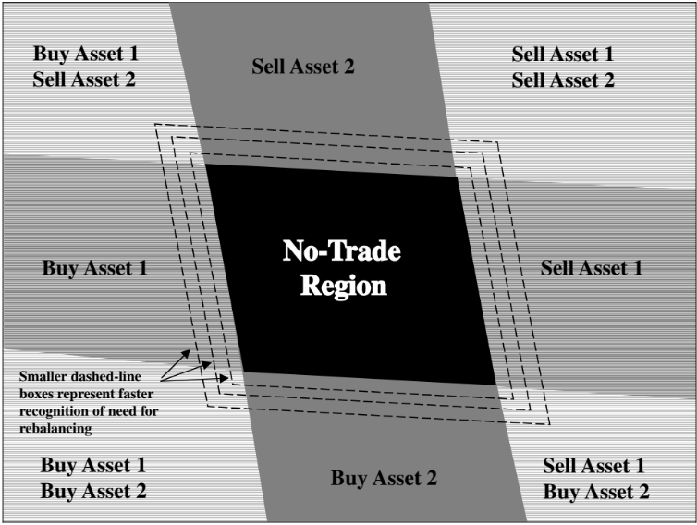
Work of the paper
Focusing on implementation explicitly
Loss function = Trading cost + Cost associated with tracking error
Determining optimal implementation strategies for the multi-asset case
Developing a technique for determining E[turnover] and E[tracking error]

Slide 3
Work of the paper
Considering the effects of capital gains taxes on optimal trading strategies.
Addressing tax and regulatory policy questions.
transactions tax
capital gains tax cut

Slide 4
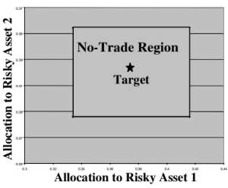
Major assumptions
The target strategy is to maintain (exogenously determined) constant asset proportions.
Transactions costs are proportional to the dollar amount of stock purchased and/or sold.
Instantaneous asset returns follow a joint diffusion process with constant means, volatilities, and correlations .

Slide 5
Asset price and proportion dynamics

Slide 6
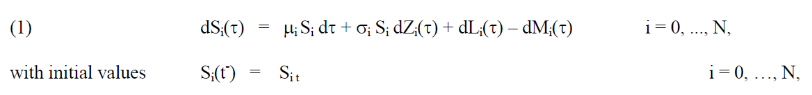
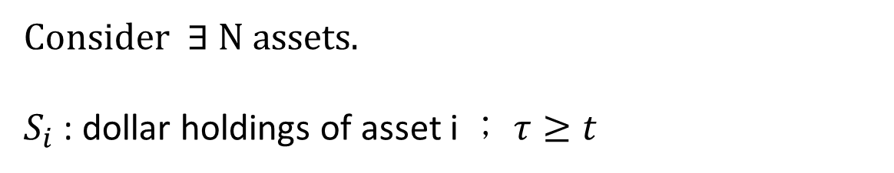
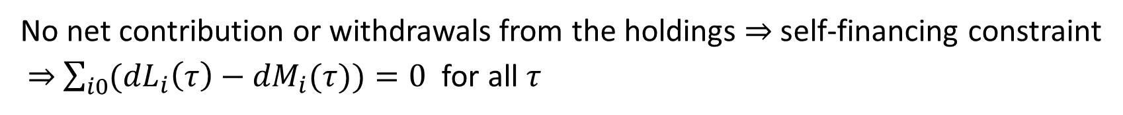
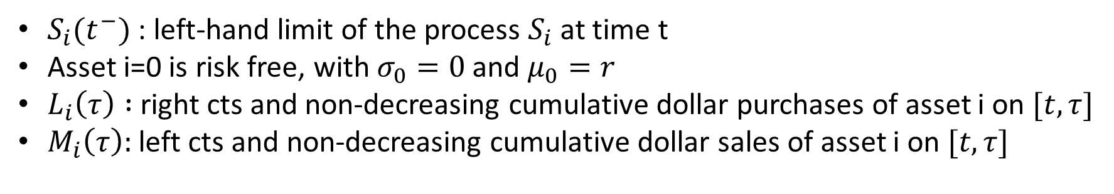
Consider $∃$ N assets.
$S_{i}$ : dollar holdings of asset i ； $τ≥t$
$S_{i}(t^{−})$ : left-hand limit of the process $S_{i}$ at time t
Asset i=0 is risk free, with $σ_{0}=0$and $μ_{0}=r$
$L_{i}\left(τ\right) :$ right cts and non-decreasing cumulative dollar purchases of asset i on $[t,τ]$
$M_{i}\left(τ\right):$ left cts and non-decreasing cumulative dollar sales of asset i on $[t,τ]$
No net contribution or withdrawals from the holdings $⇒$ self-financing constraint
$⇒$ $\sum_{i0}{({dL}_{i}\left(τ\right)−{dM}_{i}(τ))}=0$for all $τ$

Slide 7
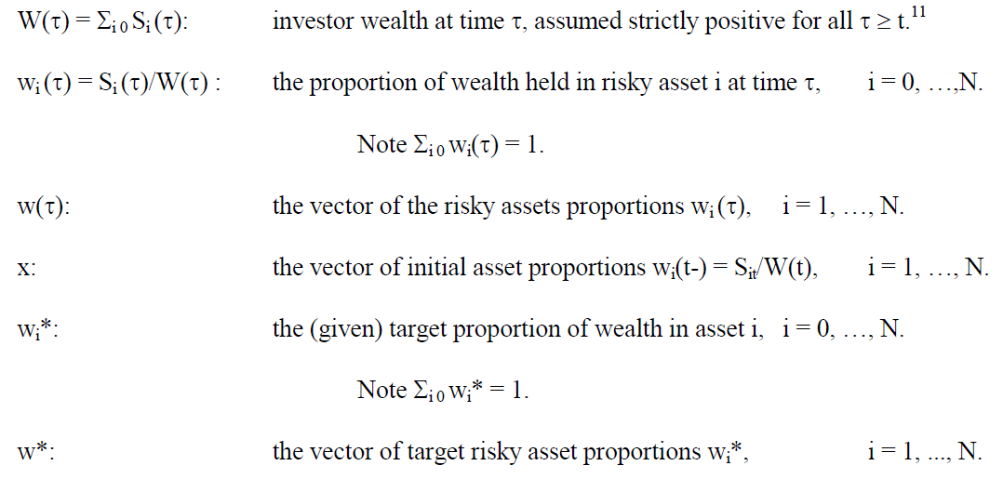
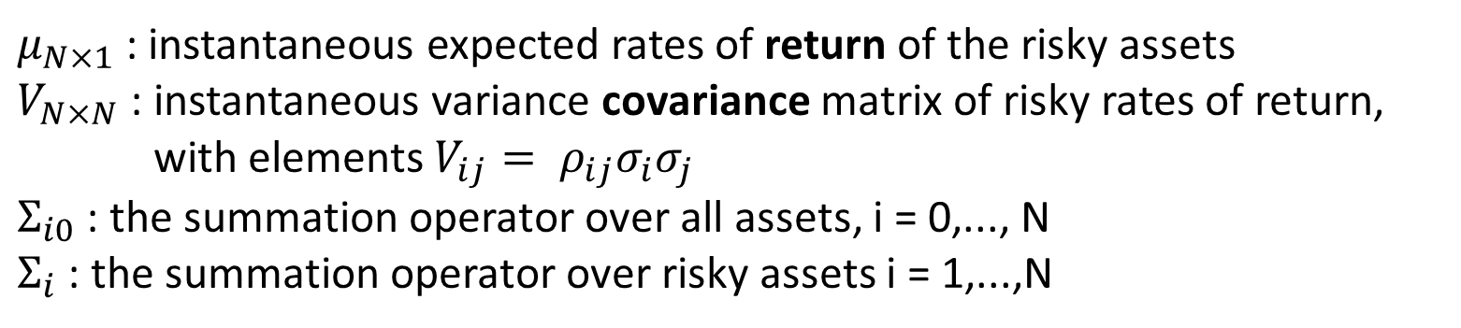
$μ_{N×1}$: instantaneous expected rates of return of the risky assets
$V_{N×N}$ : instantaneous variance covariance matrix of risky rates of return,
with elements $V_{ij}= ρ_{ij}σ_{i}σ_{j}$
$Σ_{i0}$ : the summation operator over all assets, i = 0,..., N
$Σ_{i}$ : the summation operator over risky assets i = 1,...,N

Slide 8

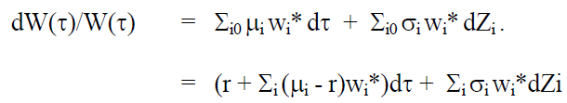
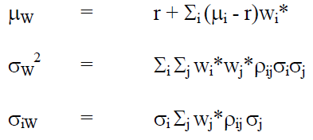
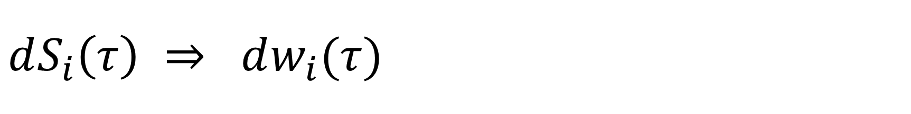

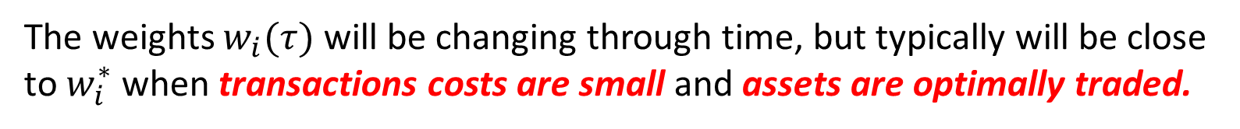
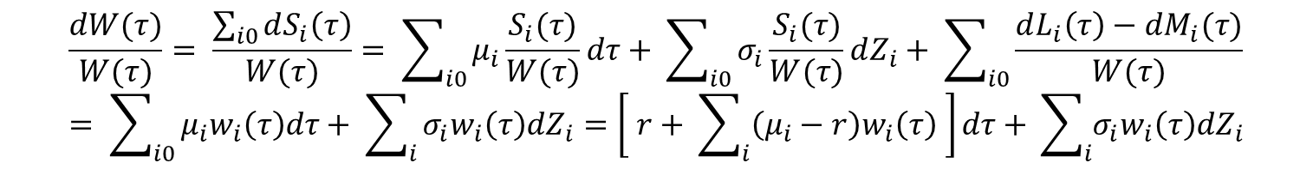
$$dS_{i}\left(τ\right) ⇒ dw_{i}(τ)$$
$$\frac{dW(τ)}{W(τ)}= \frac{\sum_{i0}{dS_{i}\left(τ\right)}}{W(τ)}= \sum_{i0}{μ_{i}\frac{S_{i}(τ)}{W(τ)}dτ}+ \sum_{i0}{σ_{i}\frac{S_{i}(τ)}{W(τ)}dZ_{i}+ \sum_{i0}{\frac{dL_{i}\left(τ\right)−dM_{i}(τ)}{W(τ)}}}= \sum_{i0}{μ_{i}w_{i}\left(τ\right)dτ+ \sum_{i}{σ_{i}w_{i}\left(τ\right)dZ_{i}=\left[ r+ \sum_{i}{\left(μ_{i}−r\right)w_{i}\left(τ\right)} \right]dτ+ }}\sum_{i}{σ_{i}w_{i}\left(τ\right)dZ_{i}}$$
The weights $w_{i}(τ)$ will be changing through time, but typically will be close to $w_{i}^{∗}$ when transactions costs are small and assets are optimally traded.
Thus to a close order of approximation,
$$μ_{w}$$

Slide 9
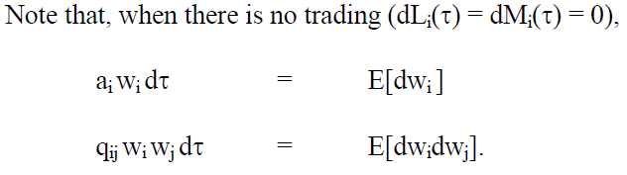
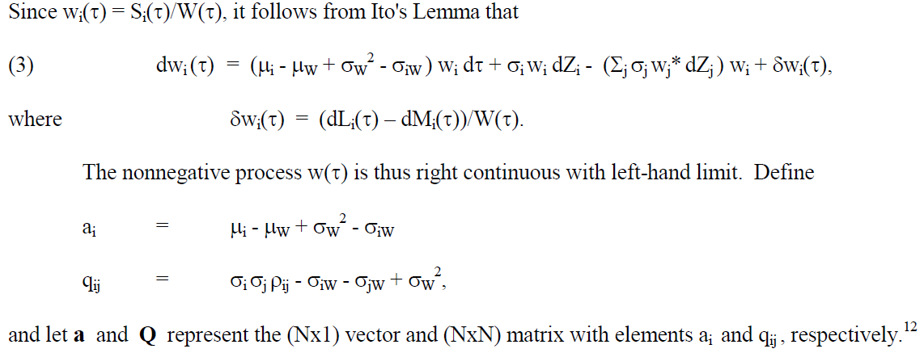

Slide 10
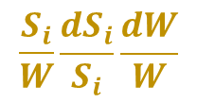


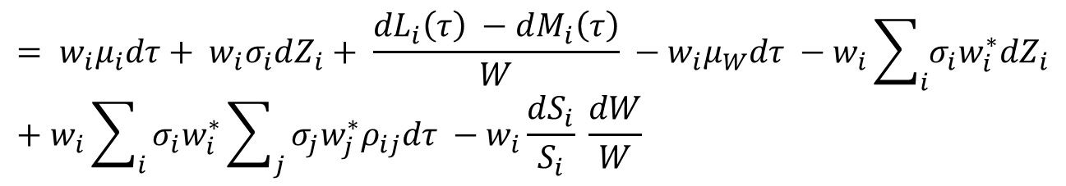
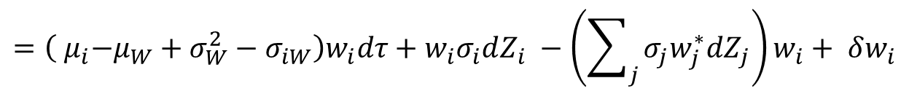
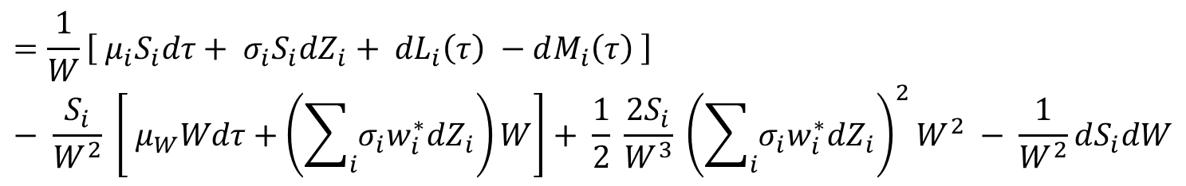
Derivation of ${dw}_{i}$
0
$$= \frac{∂w_{i}}{∂S_{i}} dS_{i}+ \frac{1}{2} \frac{∂^{2}w_{i}}{∂S_{i}^{2}} {(dS_{i}^{})}^{2}+ \frac{∂w_{i}}{∂W} \left(dW\right)+ \frac{1}{2} \frac{∂^{2}w_{i}}{{∂W}^{2}} {(dW)}^{2}+ \frac{∂^{2}w_{i}}{∂S_{i}∂W} dS_{i}dW$$
$$=\frac{1}{W}\left[{ μ}_{i}S_{i}dτ+ σ_{i}S_{i}dZ_{i}+ {dL}_{i}\left(τ\right) −dM_{i}\left(τ\right) \right] − \frac{S_{i}}{W^{2}} \left[ μ_{W}Wdτ+\left(\sum_{i}{σ_{i}w_{i}^{∗}dZ_{i}}\right)W\right]+ \frac{1}{2} \frac{2S_{i}}{W^{3}} {\left(\sum_{i}{σ_{i}w_{i}^{∗}dZ_{i}}\right)}^{2}W^{2} − \frac{1}{W^{2}}dS_{i}dW$$
$$= w_{i}μ_{i}dτ+ w_{i}σ_{i}dZ_{i}+ \frac{{dL}_{i}\left(τ\right) −dM_{i}\left(τ\right)}{W} −w_{i}μ_{W}dτ −w_{i}\sum_{i}{σ_{i}w_{i}^{∗}dZ_{i}}+w_{i}\sum_{i}{σ_{i}w_{i}^{∗}\sum_{j}{σ_{j}w_{j}^{∗}ρ_{ij}dτ −w_{i}\frac{dS_{i}}{S_{i}} \frac{dW}{W}}}$$
$E[ \frac{dS_{i}}{S_{i}} \frac{dW}{W} ] =$ $σ_{iW}dτ$
$$\frac{S_{i}}{W}\frac{dS_{i}}{S_{i}}\frac{dW}{W}$$
$$=\left({ μ}_{i}−μ_{W}+σ_{W}^{2}−σ_{iW}\right)w_{i}dτ+w_{i}σ_{i}dZ_{i} −\left(\sum_{j}{σ_{j}w_{j}^{∗}dZ_{j}}\right)w_{i}+ δw_{i}$$

Slide 11
The investor’s objective
Trade off between transaction costs and tracking error costs

Slide 12
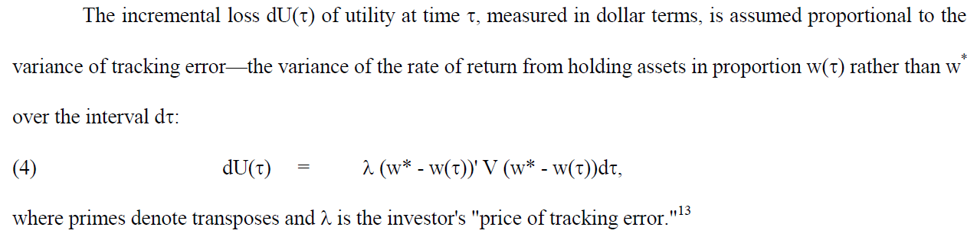
Tracking error cost
Notes:
where  is the price of portfolio risk (variance), and the second equality follows from the mean-variance optimal portfolio condition

Slide 13
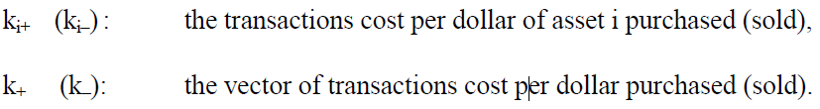
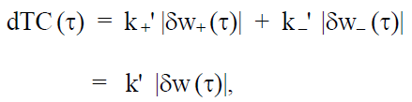

Transaction cost
Trading costs are assumed to be proportional to the dollar amount of trades.
Assume the riskless asset (i = 0) is costless to trade.
$$\sum_{i}{k_{i^{+}} ∗ dL_{i} + \sum_{i}{k_{i^{−}} ∗ dM_{i} }}$$
The incremental total trading costs $dTC(τ)$ per unit wealth at time $τ$ will be
Notes:
Since the loss (4) is expressed in terms of the tracking error on portfolio rates of return (i.e. dollar return divided by wealth), we also normalize dollar transactions cost by wealth W().

Slide 14
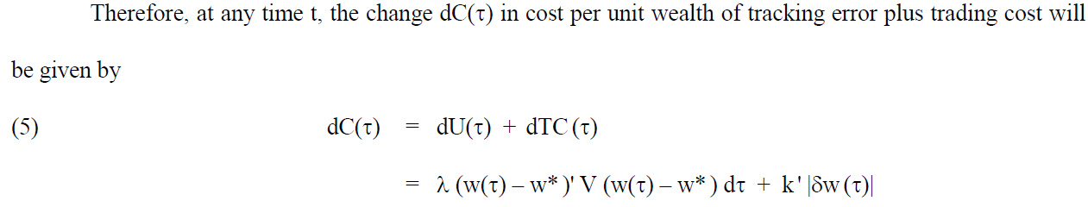

Slide 15
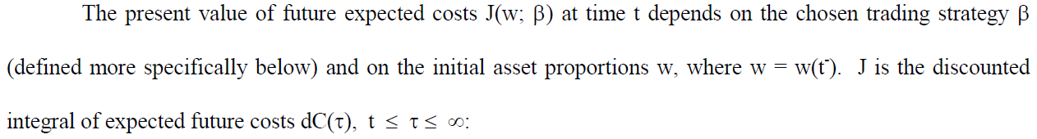
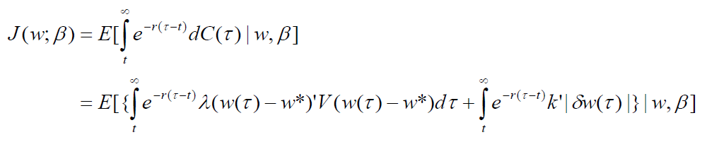
Total discounted costs

Slide 16
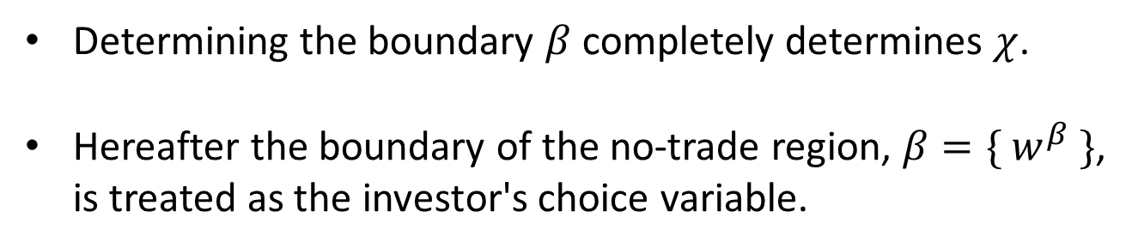
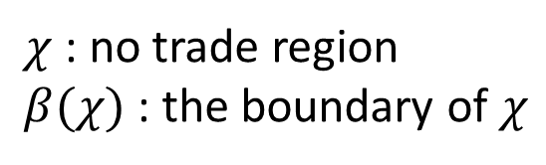
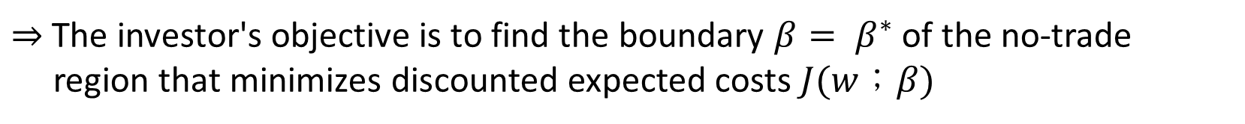
$χ$ : no trade region
$β(χ)$ : the boundary of $χ$
Determining the boundary $β$ completely determines $χ$.
Hereafter the boundary of the no-trade region, $β=\{ w^{β} \}$,
is treated as the investor's choice variable.
$⇒$ The investor's objective is to find the boundary $β= β^{∗}$ of the no-trade
region that minimizes discounted expected costs $J(w；β)$

Slide 17
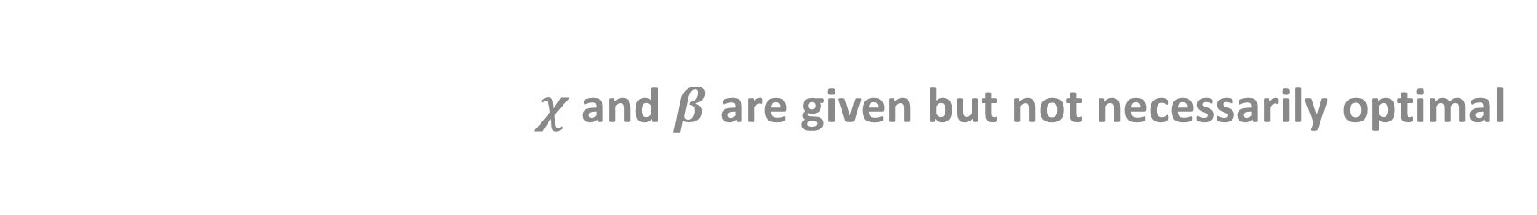

Determining $J(w；β)$ for a given boundary $β$
$χ$ and $β$ are given but not necessarily optimal

Slide 18
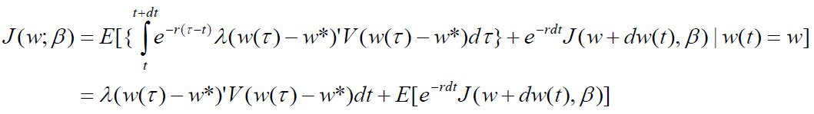
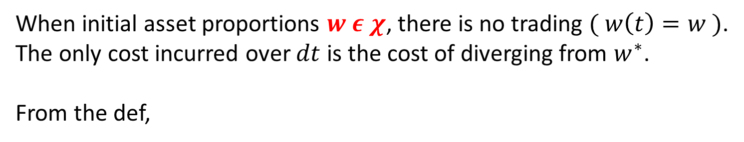
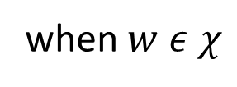
When initial asset proportions $w ε χ$, there is no trading $( w\left(t\right)=w )$.
The only cost incurred over $dt$ is the cost of diverging from $w^{∗}$.
From the def,
and recall that
when $w ε χ$

Slide 19

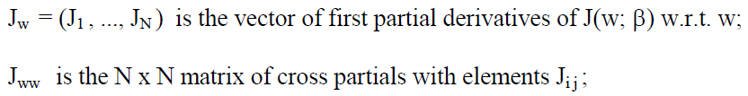
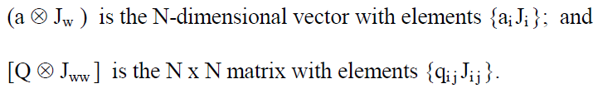
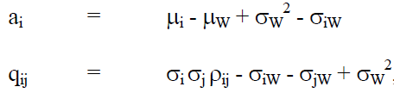
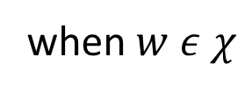
when $w ε χ$
Expanding the expectation term, and simplifying gives the PDE,

Slide 20
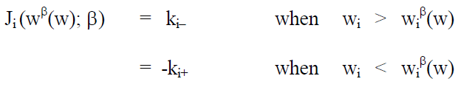
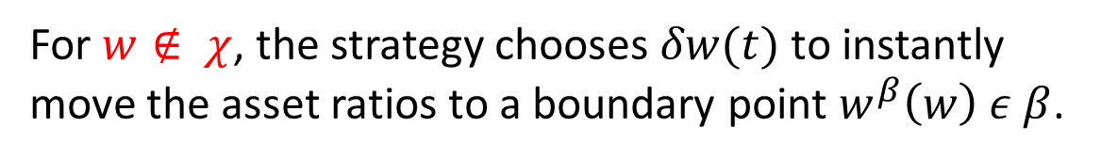
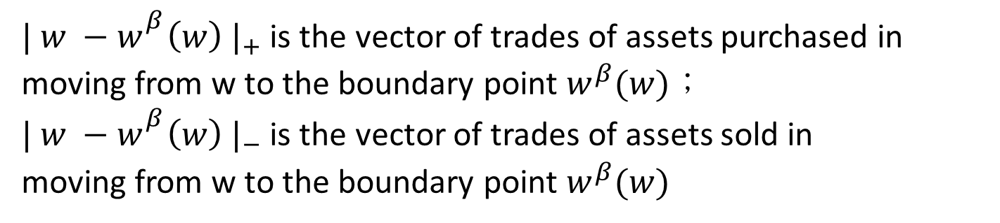
For $w∉ χ$, the strategy chooses $δw(t)$ to instantly move the asset ratios to a boundary point $w^{β}\left(w\right) ε β$.
${| w −w_{}^{β}\left(w\right) |}_{+}$ is the vector of trades of assets purchased in moving from w to the boundary point $w^{β}(w)$；
${| w −w_{}^{β}\left(w\right) |}_{−}$ is the vector of trades of assets sold in
moving from w to the boundary point $w^{β}(w)$
${−k}_{i^{+}} ≤ J_{i}\left(w^{β}\left(w\right)；β\right)≤k_{i^{−}}$ only if $w_{i}=w^{β}\left(w\right)$
Notes:
As J_ww(w^B, B) is positive (semi-) definite, it follows directly that the optimal w^B will satisfy the Kuhn-Tucker conditions.卡羅需－庫恩－塔克條件
在數學中，卡羅需-庫恩-塔克條件（英文原名：Karush-Kuhn-Tucker Conditions常見別名：Kuhn-Tucker，KKT條件，Karush-Kuhn-Tucker最優化條件，Karush-Kuhn-Tucker條件，Kuhn-Tucker最優化條件，Kuhn-Tucker條件）是在滿足一些有規則的條件下，一個非線性規劃（Nonlinear Programming）問題能有最優化解法的一個必要和充分條件。這是一個廣義化拉格朗日乘數的成果。

Slide 21
Determining the optimal no-trade region in the single risky asset case (N = 1)

Slide 22
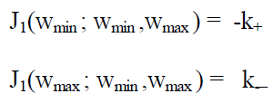
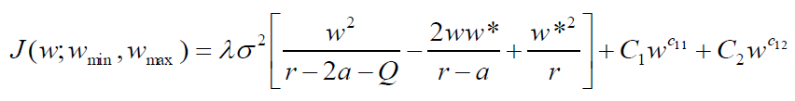
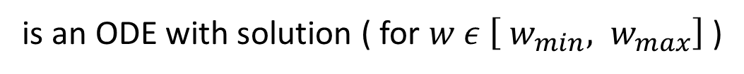
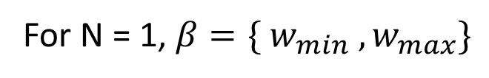
For N = 1, $β=\{ w_{min} , w_{max}\}$
${−k}_{i^{+}} ≤ J_{i}\left(w^{β}\left(w\right)；β\right)≤k_{i^{−}}$ only if $w_{i}=w^{β}\left(w\right)$
In the single risky asset case, the equation
is an ODE with solution ( for $w ε \left[ w_{min}, w_{max}\right]$)

Slide 23
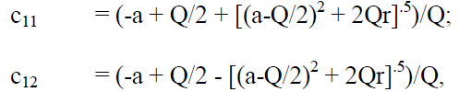
For a given $β=\{ w_{min} , w_{max} \}$ , $C_{1}$ and $C_{2}$ are determined by

Slide 24
Solution to PDE (N=1)
Homogeneous part

Slide 25
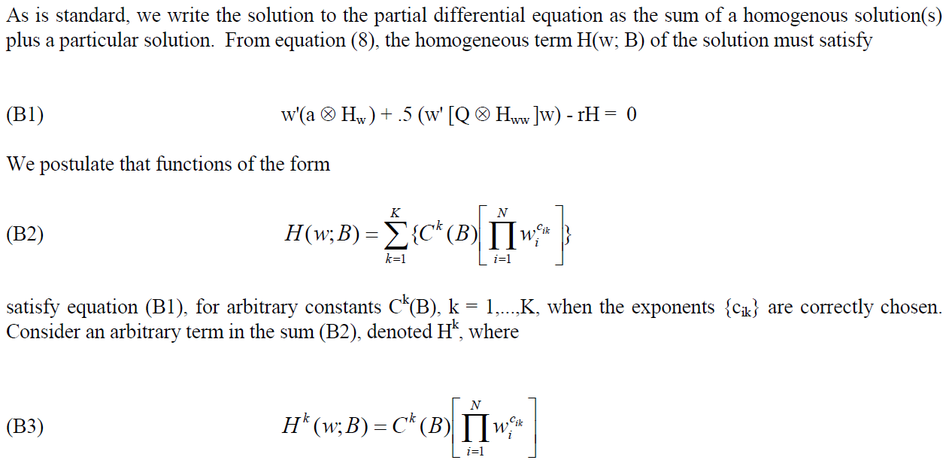

$K = 2^{N}∗N$, introduce later

Slide 26
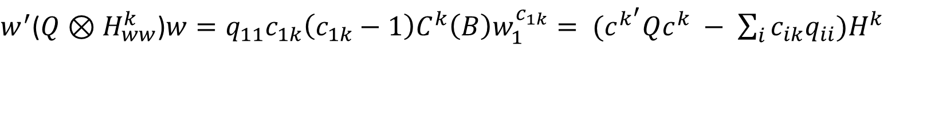

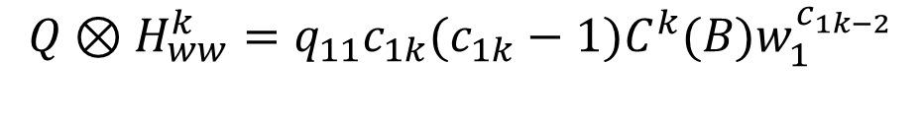

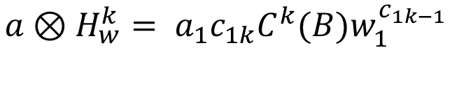
$$H^{k}= C^{k}(B)w_{1}^{c_{1k}}$$
$$H_{w}^{k}= {c_{1k}C}^{k}(B)w_{1}^{c_{1k−1}}$$
$$a⊗H_{w}^{k}= a_{1}{c_{1k}C}^{k}(B)w_{1}^{c_{1k−1}}$$
$$w^{′}\left(a⊗H_{w}^{k}\right)=a_{1}{c_{1k}C}^{k}\left(B\right)w_{1}^{c_{1k}}= {(a}^{′}c^{k})H^{k}$$
$$H_{ww}^{k}={c_{1k}(c_{1k}−1)C}^{k}(B)w_{1}^{c_{1k−2}}$$
$${Q⊗H}_{ww}^{k}={q_{11}c_{1k}(c_{1k}−1)C}^{k}(B)w_{1}^{c_{1k−2}}$$
$w^{′}$(${Q⊗H}_{ww}^{k}$)$w={q_{11}c_{1k}\left(c_{1k}−1\right)C}^{k}\left(B\right)w_{1}^{c_{1k}}= {(c}^{k^{′}}Qc^{k} − \sum_{i}{c_{ik}q_{ii})H^{k}}$

Slide 27
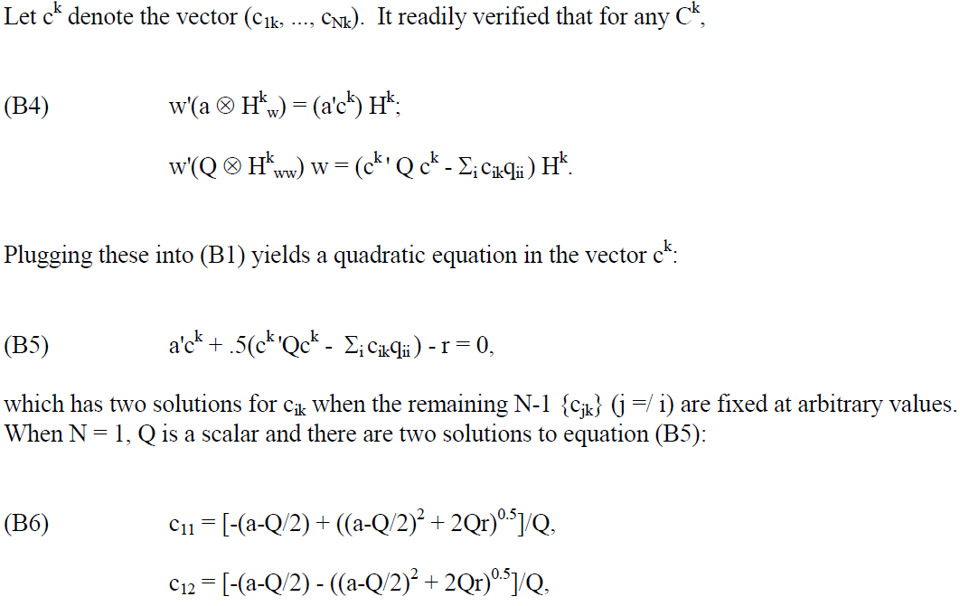

Slide 28
Solution to PDE (N=1)
Particular part

Slide 29
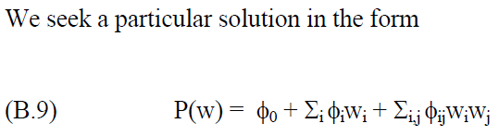





$$P\left(w\right)= φ_{0}+ φ_{1}w_{1}+ φ_{11}w_{1}^{2}$$
$$P_{w}=φ_{1}+2φ_{11w_{1}}$$
$$P_{ww}=2φ_{11}$$
$$w^{′}\left(a⊗P_{w}\right)+ \frac{1}{2}\left(w^{′}\left[Q⊗P_{ww}\right]w\right) −rP=−λ{(w−w^{∗})}^{2}V(w−w^{∗})$$
$$w_{1}\left(a_{1}φ_{1}+2a_{1}φ_{11}w_{1}\right)+ q_{11}φ_{11}w_{1}^{2} −rφ_{0} −rφ_{1}w_{1} −rφ_{11}w_{1}^{2}=−λσ^{2}(w_{1}^{2}−2w_{1}w^{∗}+w^{∗^{2}})$$
$$\left( 2a_{1}φ_{11}+q_{11}φ_{11} −rφ_{11}+ λσ^{2} \right)w_{1}^{2}+\left(a_{1}φ_{1} −rφ_{1} −rλσ^{2}w^{∗}\right)w_{1}+\left( −rφ_{0}+ λσ^{2}w^{∗^{2}} \right)=0$$
$φ_{11}\left( 2a_{1}+q_{11}−r \right)=−λσ^{2}$ ⇒ $φ_{11}= \frac{−λσ^{2}}{2a_{1}+q_{11}−r}$
${φ_{1}(a}_{1} −r)=rλσ^{2}w^{∗}$ ⇒ $φ_{1}= \frac{rλσ^{2}w^{∗}}{a_{1}−r}$
$rφ_{0}= λσ^{2}w^{∗^{2}}$ ⇒ $φ_{0}= \frac{λσ^{2}w^{∗^{2}}}{r}$

Slide 30



The optimal boundary $β^{∗}=\{ w_{min}^{∗} , w_{max}^{∗} \}$ is determined by the “super contact” conditions, which require that $J\left(w；w_{min} , w_{max}\right)$ is minimized w.r.t $w_{min}$ and $w_{max}$
This provides the two final conditions needed for optimization, that at the optimal $w_{min}$ and $w_{max}$
Following Dumas [1991], it can in turn be shown that these conditions imply

Slide 31



For short, what we are doing is to solve
subject to
such that generate solutions for the optimal strategy parameters $w_{min}^{∗}$ and $w_{max}^{∗}$, and for the constants $C_{1}$ and $C_{2}$
Thereby uniquely determining $J(w；β^{∗})$

Slide 32

Determining the Optimal No-Trade Region with Multiple Risky Assets (N $≥$ 2)
Thinking of the strategy

Slide 33



Recall that at every boundary point $w^{β}$,
In addition,
Implies that
The conditions we are going to utilize.

Slide 34
When $N≥2 ,$ we are unware of closed form solutions to the PDE
that satisfy
at all points of the boundary $β=\{ w^{β}(w) \}$ of the no-trade region $χ$
$⇒$ We turn to finding an approximation of the optimal strategy, quasi-optimal strategy.

Slide 35

The strategy is to find a quasi-optimal solution $JA(w；B)$ satisfying the PDE
and the boundary conditions
at a finite set ( but potentially arbitrarily large )of boundary points B.
Given $JA$, we can then construct the remaining boundary points $β$ between these points B ( by an algorithm described later).
In general, these in-between boundary points will be constructed to satisfy either one of the two conditions, unlike a fully-optimal solution, won’t satisfy both everywhere.

Slide 36

Determining the Optimal No-Trade Region with Multiple Risky Assets (N $≥$ 2)
Solution to the PDE

Slide 37




A solution to
is composed of homogeneous part $H(w；B)$ and particular part $P(w；B)$.
$$H\left(w；B\right)= \sum_{k=1}^{K}{\{C^{k}(B)[\prod_{i=1}^{N}{{w_{i}}^{c_{ik}}}]\}}$$
where the coefficients $\{ c_{ik} \}$ satisfy
where
$C^{k}(B)$ depends on the boundary conditions at points B.

Slide 38





The actual number of K needed depends on the number of boundary points B.
N assets ⇒ $2^{N}$ corner points ( each point is of N-dim )
⇒ there exist $2^{N}∗N$ variables characterizing the points $w^{β} ε B$ to be determined.
Additionally, we must determine K constants ${\{ C}^{k}\left(B\right) \}$
$$2^{N}∗N+K$$
Each $2^{N}$ corner points satisfy the two conditions ⇒ $2N$ conditions
⇒ $2^{N}∗2N=2^{N+1}N$ equations
$$2^{N+1}∗N$$
⇒ $K= 2^{N}∗N$

Slide 39

When N = 2, there are an infinite number of solutions. We may set $c_{2k}$ at any value, and solve (B5) for two possible values for $c_{1k}$:
$$c_{1k}= \frac{1}{q_{11}} [ −\left(a_{1}+q_{12}c_{2k}−\frac{1}{2}q_{11} \right) ± \sqrt{{({ a}_{1}+q_{12}c_{2k}−\frac{1}{2}q_{11} )}^{2} − 2q_{11}(a_{2}c_{2k}+ \frac{1}{2}\left(q_{22}c_{2k}^{2}−q_{22}c_{2k}\right)−r )} ]$$
Conversely, we could set $c_{1k}$ at any value, and derive two possible values for $c_{2k}$. We may set $c_{21}$ = $c_{22}$ = 0, and $c_{23}$ = $c_{24}$ = 1 for k = 1, 2, 3, and 4, respectively. We can then use the formula to derive $c_{11}$, …, $c_{14}$

Slide 40




Finally, we set $c_{15}$ = $c_{16}$ = 0, $c_{17}$ = $c_{18}$ = 1, and derive $c_{25}$, ..., $c_{28}$ in a similar manner.
$$c_{2k}= \frac{1}{q_{22}} [ −\left( a_{2}+q_{12}c_{1k}−\frac{1}{2}q_{22} \right) ± \sqrt{{(a_{2}+q_{21}c_{1k}− \frac{1}{2}q_{22})}^{2} − 2q_{22}(a_{1}c_{1k}+ \frac{1}{2}\left(q_{11}c_{1k}^{2}−q_{11}c_{k}\right)−r )} ]$$
$$c_{1k} ⟺ c_{2k} k=1 \sim 8$$
For N = 3, we may set $c_{ik}$ as following :
$$c_{1k} ⟺ c_{2k} ,c_{3k} k=1 \sim 8$$
$$c_{2k} ⟺ c_{1k} ,c_{3k} k=8 \sim 16$$
$$c_{3k} ⟺ c_{1k} ,c_{2k} k=16 \sim 24$$

Slide 41
Cost, turnover and tracking error of optimal strategy

Slide 42

$T\left(w；β\right) ≡J\left(w；β \right| λ=0)$ measures the expected PV of trading cost.
$TA(w；B)$ :
Approximate cost function, given the boundary set B determined by $J(w；B)$.
 | Formula
Annualized expected trading cost | $$ATC=r∗TA(w；B)$$
Annualized expected (1-way) turnover | $$Turnover= \frac{ATC}{k}$$
Expected discounted tracking error cost | $$TE\left(w；B\right)=JA\left(w；B\right)−TA(w；B)$$
Annual variance of tracking error | $$AV= \frac{r∗TE}{λ}$$
Notes:
When ki varies across assets, it is still possible to estimate turnover associated with the quasi-optimal strategy JA(x; B). We construct a function TA*(x; B) as above, but which satisfies the value-matching conditions |TAi*(x; B)| = k for all i, where is k is an arbitrary constant across all assets i. The solution is the expected discounted transactions costs associated with B, when k is the (common) cost of trading each asset. Annualized turnover is given by rTA*/k.

Slide 43
Example ( single risky asset )

Slide 44



Consider the following base parameters for asset returns:
Risky asset : $μ=0.125$ ； $σ^{2}=0.04$
Riskless interest rate : $r=0.075$
Target proportion of risky asset : $w^{∗}=0.6$
 | 0.001 | 0.05 | 0.01 | 0.05 | 0.1
$$λ=1$$ | [56.2%,63.3%] | [53.3%,65.5%] | [51.3%,69.9%] | [43.6%,72.5%] | [38.1%,77.5%]
 | (3.24/0.41) | (1.85/0.7) | (1.44/0.88) | (0.8/1.52) | (0.6/1.92)
$$λ=10$$ | [58.3%,61.6%] | [57.1%,62.7%] | [56.2%,63.3%] | [53.3%,65.5%] | [51.3%,66.9%]
 | (7.05/0.19) | (4.1/0.32) | (3.24/0.41) | (1.85/0.7) | (1.44/0.88)

Slide 45
Example ( single risky asset )
Turnover of the optimal strategy vs. periodic rebalancing

Slide 46


Consider now rebalancing periodically at a time interval $δt$.
At the end of each rebalancing period, the random asset proportions $w(t+δt)$are adjusted back to the desired proportions w*.
Set $δt$ = 0.357 ( rebalancing approximately three times per year )
 | Optimal Strategy | Periodical Rebalancing
Annual tracking error ($σ$) | 0.41% | 0.41%
Expected annual turnover | 3.24% | 6.36%

