Slide 1
3.2 Scaled Random Walks
黃于珊

Slide 2
3.2 Scaled Random Walks
Properties of symmetric random walk
Increments
Martingale
Quadratic Variation

Slide 3
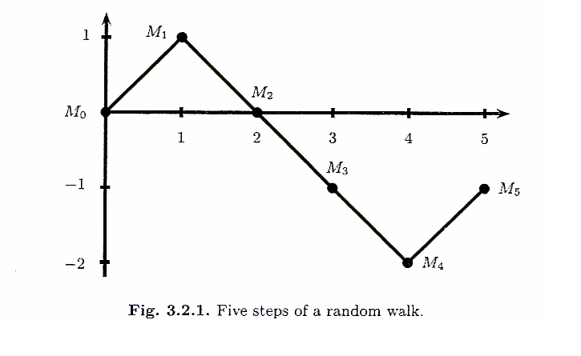
3.2.1 Symmetric Random Walk
Toss a fair coin repeatedly
With each toss, it either steps up one unit or down one unit, and each of the two probabilities is equally likely
Define = 0 ,
is a symmetric random walk
Notes:
Fair: p and q (1-p) are equal 0.5

Slide 4

3.2.2 Increments of the Symmetric Random Walk
A random walk has independent increments
If we choose nonnegative integers
0= ,
are independent

Slide 5

3.2.2 Increments of the Symmetric Random Walk
is called an increment of the random walk
E( )=0
Var( )=
ki+1
=4
M₅-M₃=X₄+X₅
k1
k2
ki
ki+1
=5
3=
Increments over nonoverlapping time intervals are indep. because they depend on different coin tosses

Slide 6

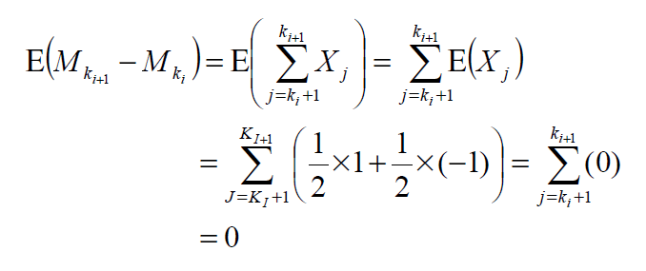

Proof of

Slide 7

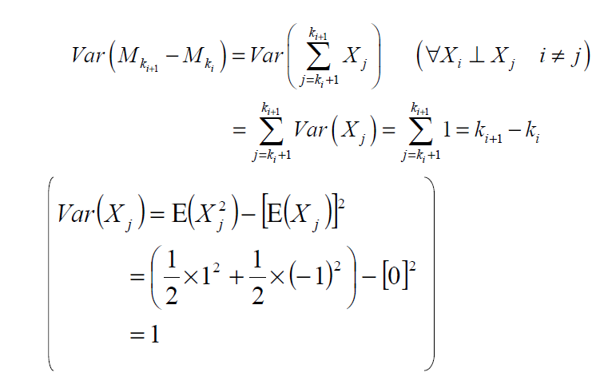

Proof of
=k_{i+1}-(k_{i}+1)+1

Slide 8
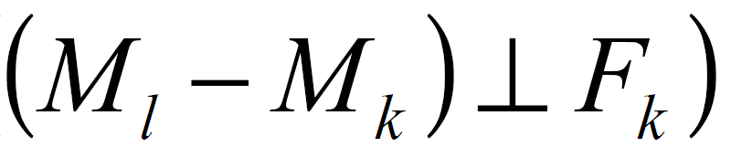
3.2.3 Martingale Property for the Symmetric Random Walk
Choose nonnegative integers k < l , then,
在F_{k}資訊集合的情況下M_{l}的期望值為M_{k}
Linearity of conditional expectations
M_{k}為F_{k}可測

Slide 9
3.2.4 Quadratic Variation of the Symmetric Random Walk
The quadratic variation up to time k is defined to be
Note :
．This is computed path-by-path
．by taking all the one-step increments along that path, squaring
these increments, and then summing them
(3.2.6)
One-step increments M_{j}-M_{j-1}=X_{j}, X_{j}²=1

Slide 10
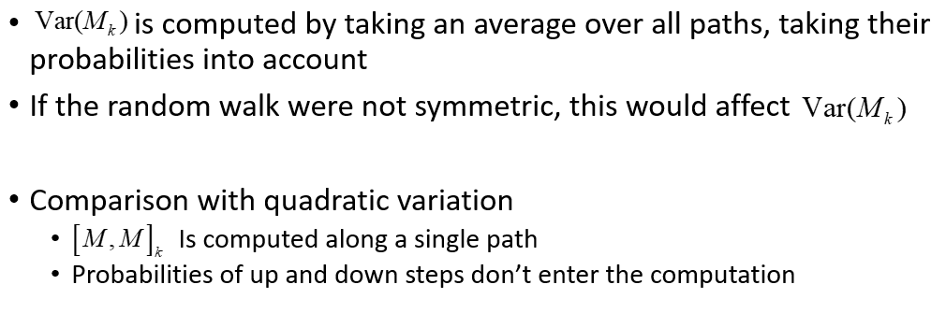
How to compute the
Notes:
Var(M_{k})=E(M_{k}²) –[E(M_{k})]²
E(M_{k})=E($\sum_{j=1}^{k}{Xj}$)$=\sum_{j=1}^{k}{E(Xj})=\sum_{j=1}^{k}{(}\frac{1}{2}$*1+ $\frac{1}{2}\text{∗}$(-1))=0 (p=q=$\frac{1}{2}$)
Var(M_{k})=E(M_{k}²)

Slide 11
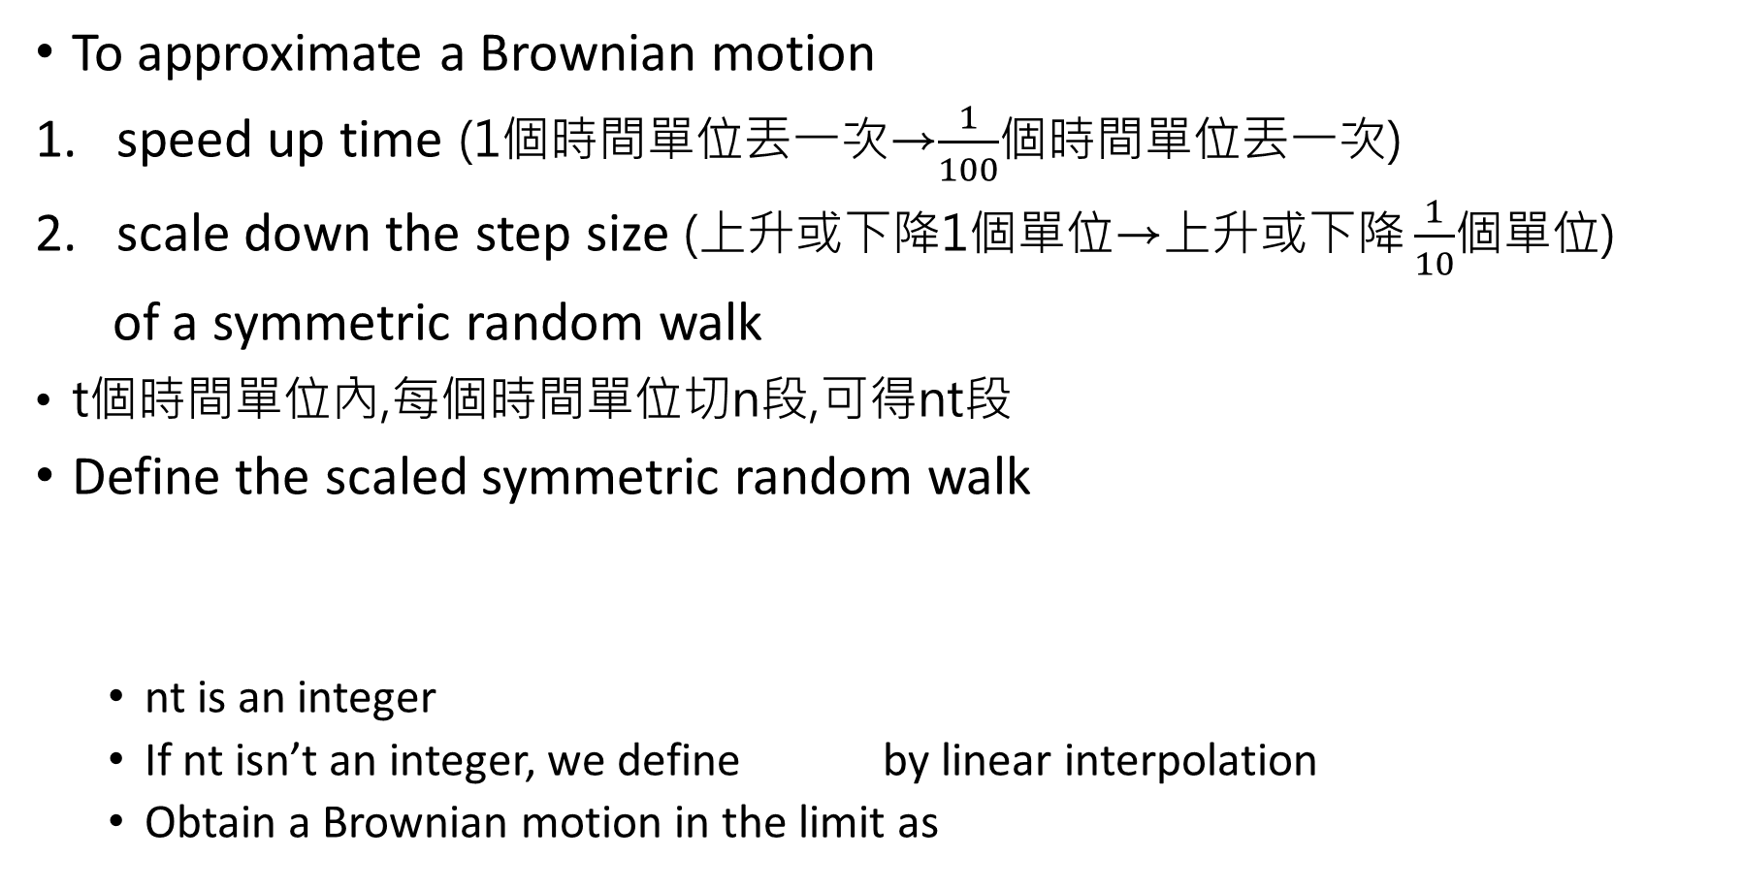
3.2.5 Scaled Symmetric Random Walk
To approximate a Brownian motion
speed up time (1個時間單位丟一次→$\frac{1}{100}$個時間單位丟一次)
scale down the step size (上升或下降1個單位→$\text{上升或下降}\frac{1}{10}$個單位)
of a symmetric random walk
t個時間單位內,每個時間單位切n段,可得nt段
Define the scaled symmetric random walk
nt is an integer
If nt isn’t an integer, we define by linear interpolation
Obtain a Brownian motion in the limit as
(3.2.7)
integer
integer
s
t
u
Notes:
ns nu integers

Slide 12
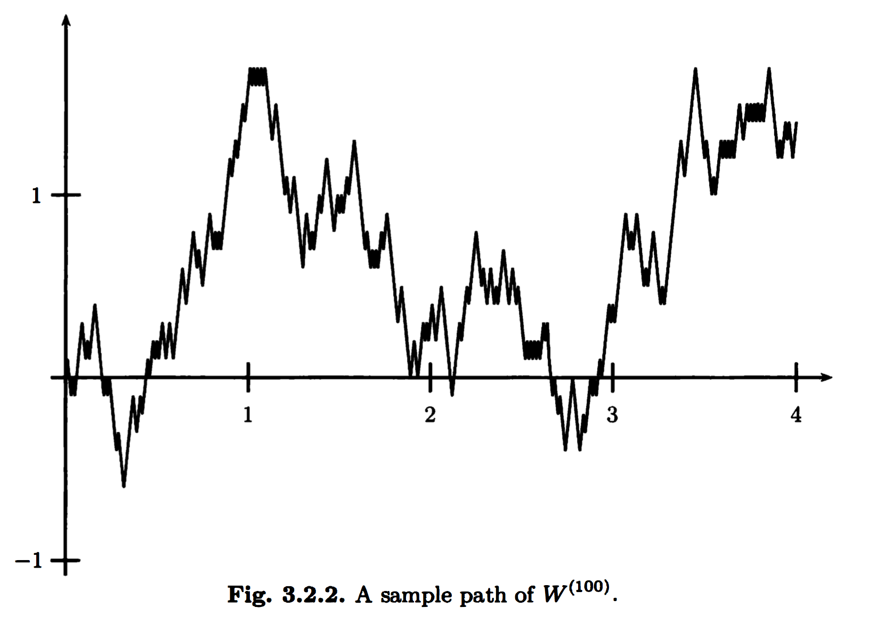
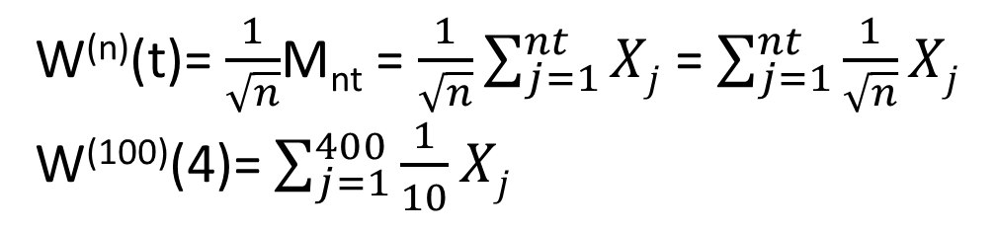
W^{(n)}(t)= $\frac{1}{\sqrt{n}}$M_{nt} = $\frac{1}{\sqrt{n}}\sum_{j=1}^{nt}{Xj}$ = $\sum_{j=1}^{nt}{\frac{1}{\sqrt{n}}Xj}$
W⁽¹⁰⁰⁾(4)= $\sum_{j=1}^{400}{\frac{1}{10}Xj}$
(1個時間單位丟100次，共丟400次，每次上升或下降$\frac{1}{10}$個單位)

Slide 13
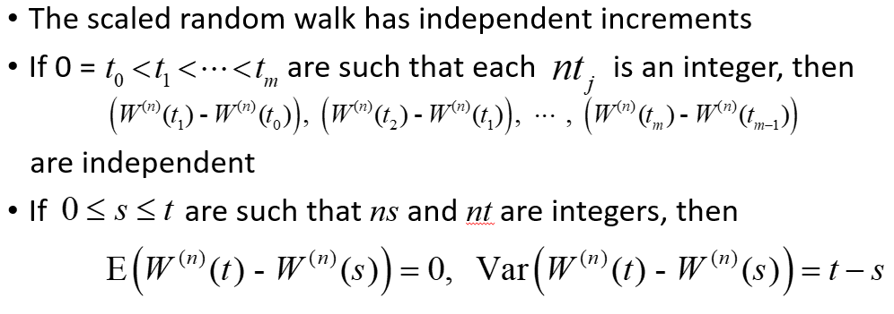
Property of Scaled Random Walk
because they depend on different coin tosses

Slide 14
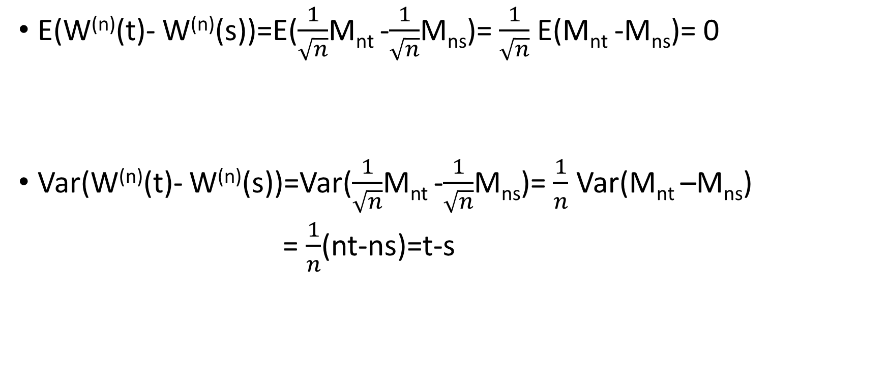
E(W^{(n)}(t)- W^{(n)}(s))=E($\frac{1}{\sqrt{n}}$M_{nt} -$\frac{1}{\sqrt{n}}$M_{ns})= $\frac{1}{\sqrt{n}}$ E(M_{nt} -M_{ns})= 0
Var(W^{(n)}(t)- W^{(n)}(s))=Var($\frac{1}{\sqrt{n}}$M_{nt} -$\frac{1}{\sqrt{n}}$M_{ns})= $\frac{1}{n}$ Var(M_{nt} –M_{ns})
= $\frac{1}{n}$(nt-ns)=t-s

Slide 15
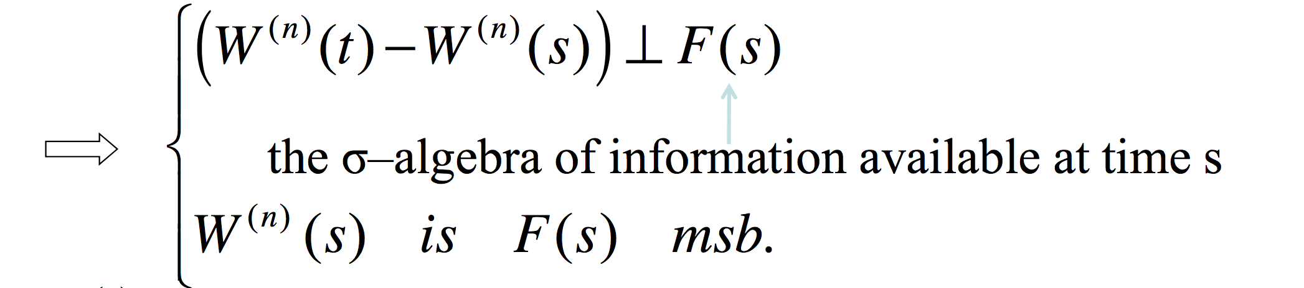
The martingale property for scaled random walk
Let be given, and decompose as
If s and t are chosen so that ns and nt are integers

Slide 16



Prove
W^{(n)} (t) is mtgle.
Linearity of conditional expectations

Slide 17
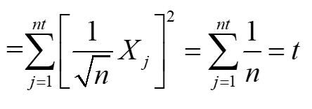
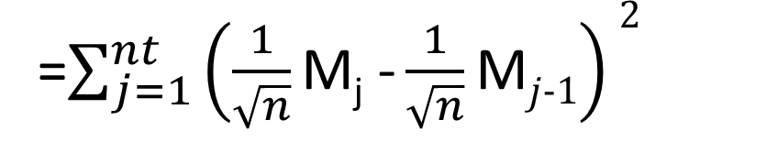
Quadratic variation of the scaled random walk
每段時間的增量平方後加總
=$\sum_{j=1}^{nt}{\left(\frac{1}{\sqrt{n}}\text{M}\text{j}\text{ −}\frac{1}{\sqrt{n}}\text{M}j−1\right)2}$
M_{j}-M_{j-1}=X_{j} , X_{j}²=1
進行計算的時間長度

Slide 18

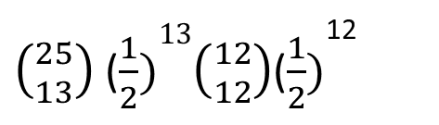
3.2.6 Limiting Distribution of the Scaled Random Walk
fixed a sequence of coin tosses and drawn the path of the resulting process as time t varies
Fix t and consider the set of all possible paths evaluated at that time t
Set t = 0.25 and consider the set of possible values of
M₂₅ can take any odd integer (丟奇數次 ) between -25 and 25
W⁽¹⁰⁰⁾(0.25) can take any of the values -2.5,-2.3,…,-0.3,-0.1,0.1,0.3,…2.3,2.5
In order for to take value 0.1, we must get 13H and 12T in the 25 coin tosses.
The probability of this is
Figure 3.2.2
奇H,偶T
偶H,奇T
$\left({25 \atop 13}\right)$ ($\frac{1}{2})13\left({12 \atop 12}\right)$($\frac{1}{2})$¹²

Slide 19
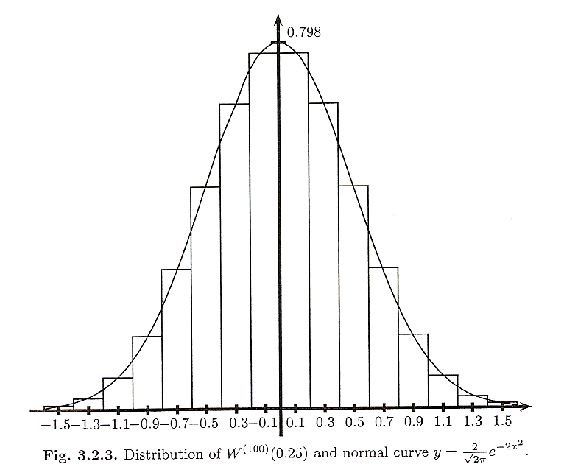


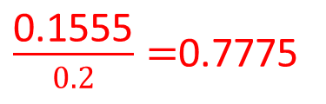
E(W^{(n)}(t)- W^{(n)}(s))=0
Var(W^{(n)}(t)- W^{(n)}(s))=t-s
S=0
E(W^{(n)}(t))=0
Var(W^{(n)}(t))=t
the distribution of
is nearly normal
N(0,0.25)
$\frac{\text{0.1555}}{0.2}=$0.7775
0.2
The bar has width 0.2, its height must be 0.1555 / 0.2 = 0.7775

Slide 20
Approximate the integral
Given a continuous bounded function g(x)
Asked to compute
We can obtain a good approximation by multiplying g(x) by the normal density and integrating
The Central Limit Theorem asserts that the approximation in (3.2.12) is valid
(3.2.12)

Slide 21


Theorem 3.2.1 (Central Limit Theorem)
Outline of proof:
藉由動差生成函數(MGF)的唯一性來判斷r.v.屬於何種分配
as
as

Slide 22
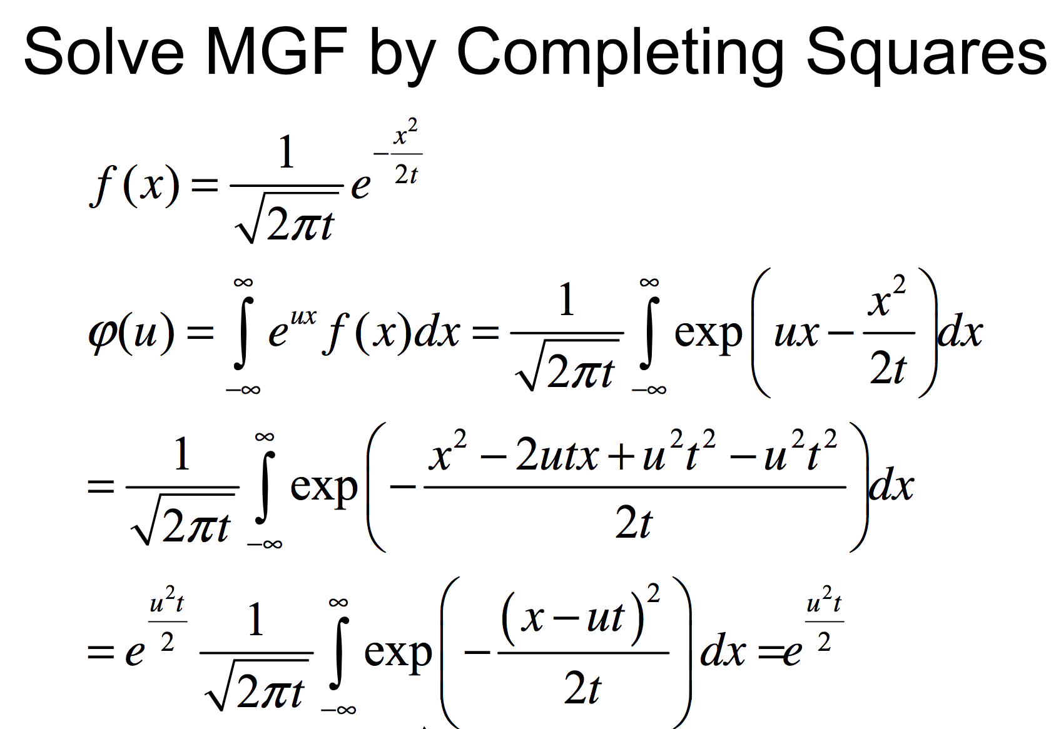
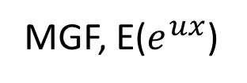
X~N(0,t)
Normal density
MGF, E($e^{ux}$)
N(ut,t)
=1

Slide 23
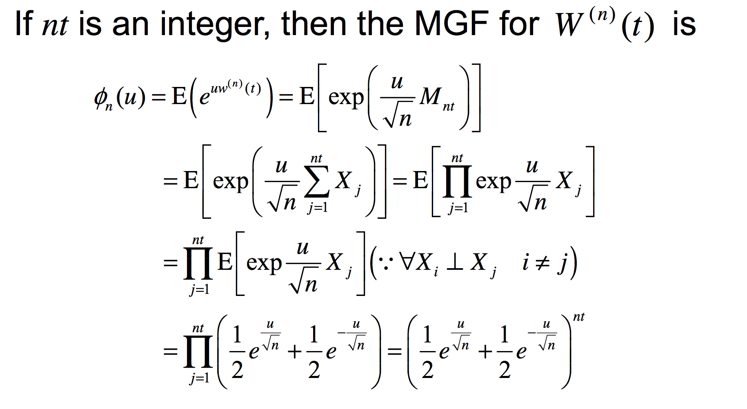

$$\text{M}\text{nt}\text{ =}\sum_{j=1}^{nt}{Xj}$$

Slide 24

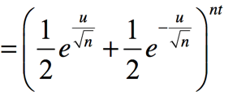


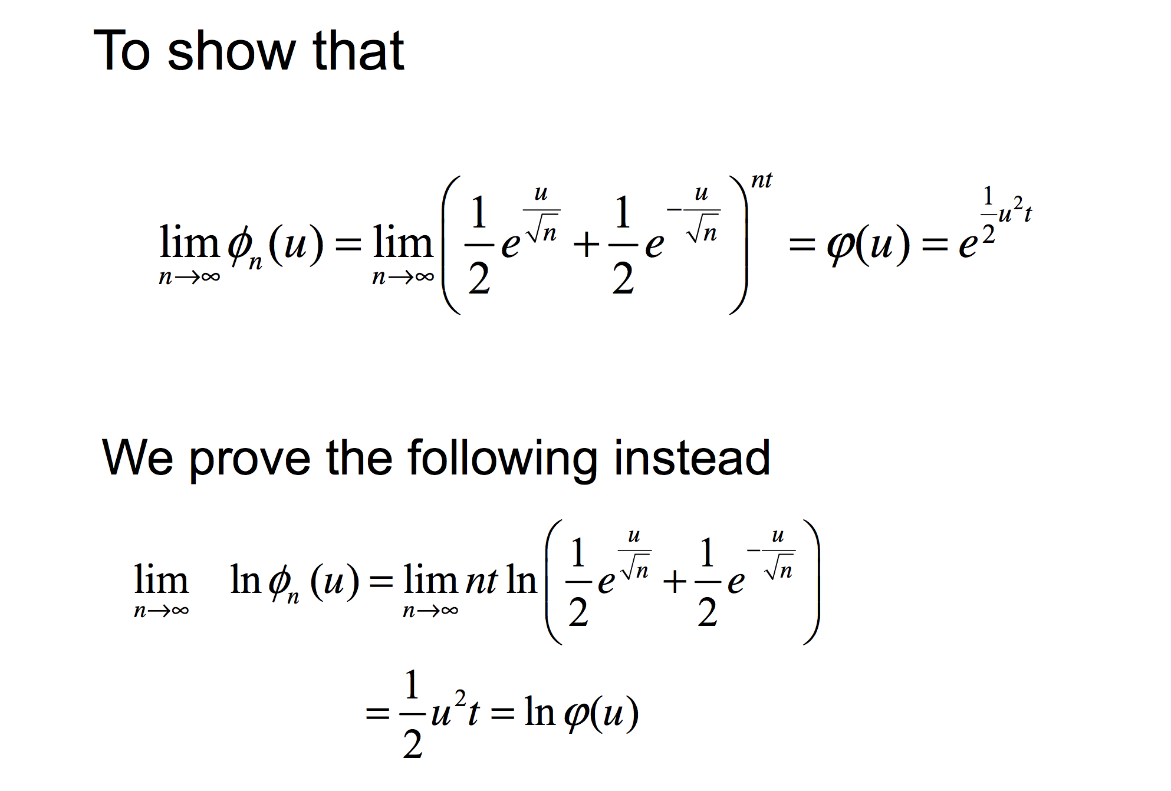

Slide 25
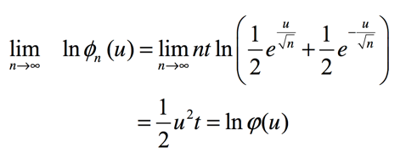
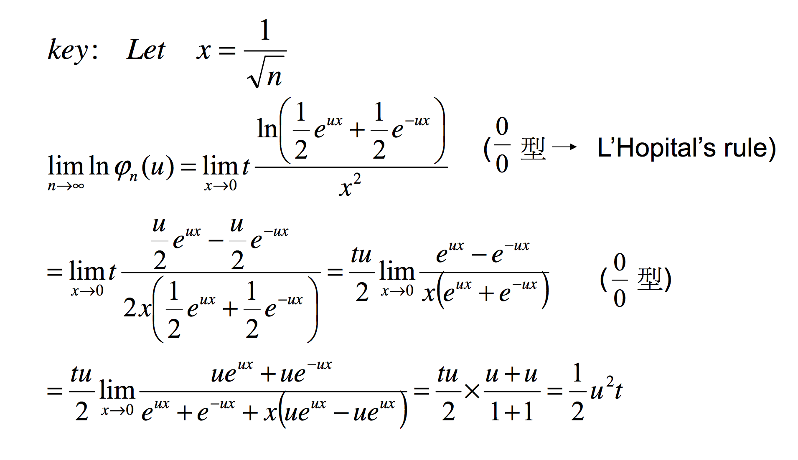

-ux

Slide 26
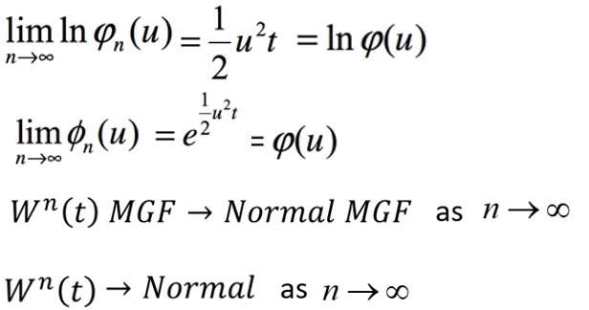
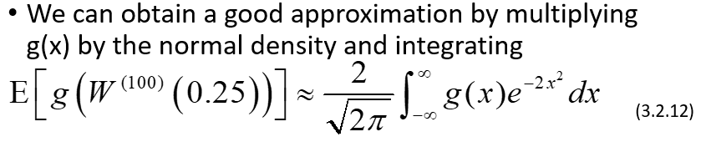
W⁽¹⁰⁰⁾(0.25)~N(0,0.25)

