Slide 1
3.6 First Passage Time Distribution
黃于珊

Slide 2
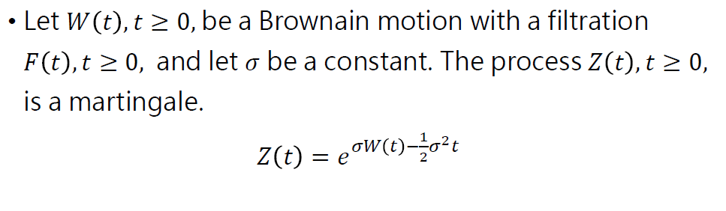
Exponential martingale
A martingale containing Brownian motion in the exponential function

Slide 3
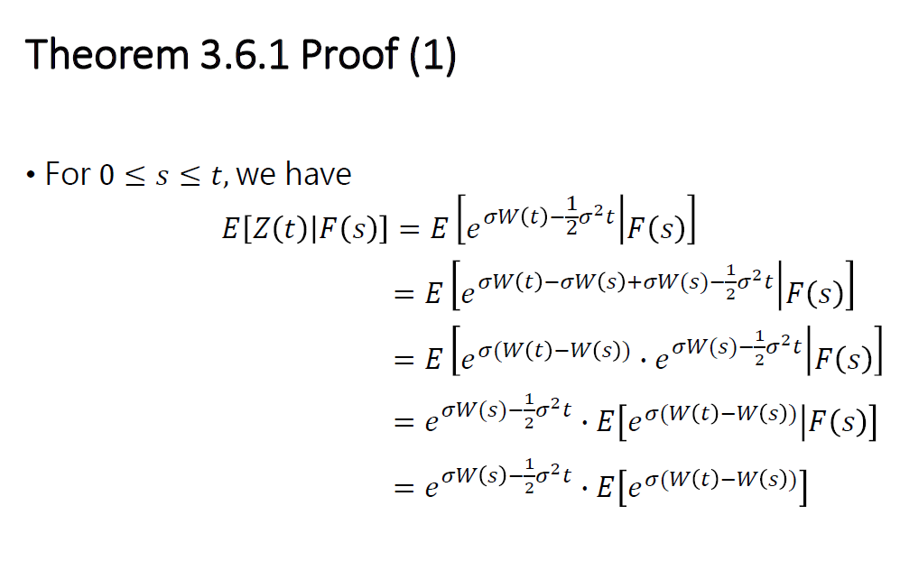
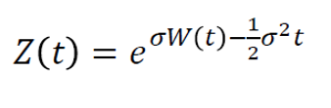
W(s) is F(s)-measurable
(W(t)-W(s))⊥F(s)

Slide 4
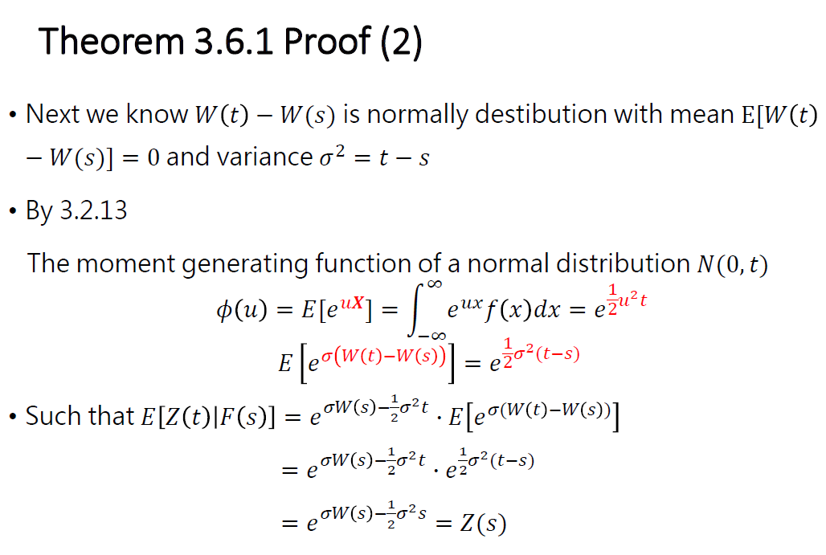

distributed

Slide 5
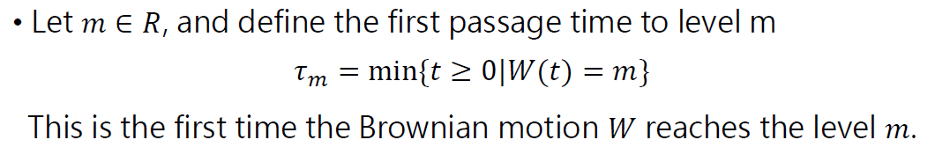
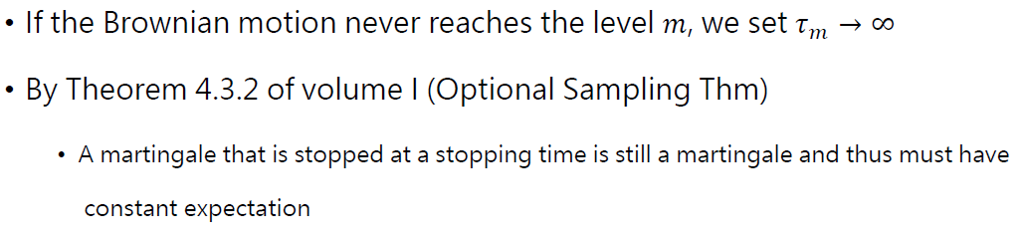
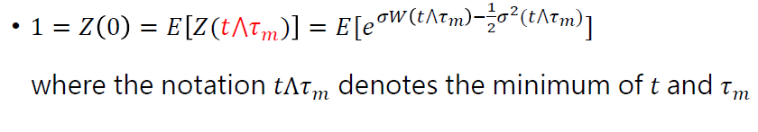

Definition of First Passage Time

Slide 6


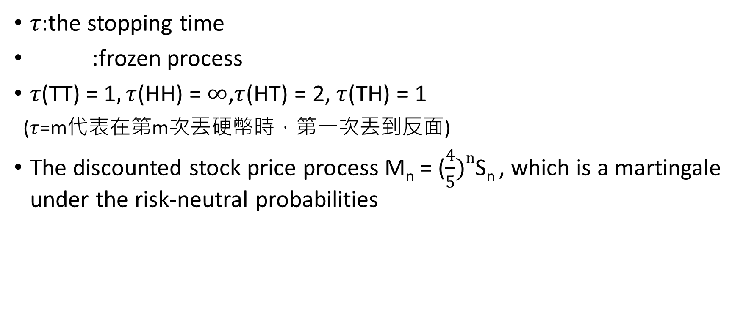
$τ:$the stopping time
:frozen process
$τ\text{(}\text{TT}\text{) = 1}, τ$(HH) = $∞$,$τ$(HT) = 2,$τ$(TH) = 1
($τ$=m代表在第m次丟硬幣時，第一次丟到反面)
The discounted stock price process M_{n} = ($\frac{4}{5})n$S_{n} , which is a martingale under the risk-neutral probabilities
M

Slide 7
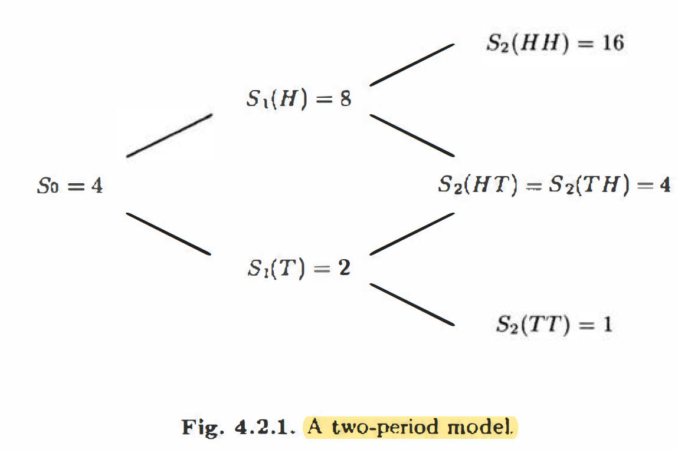

Slide 8
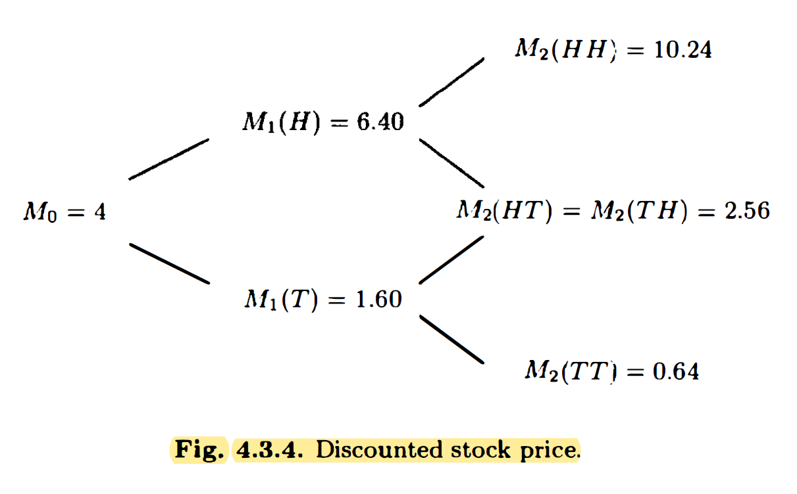



At every node, the value is the average of the values at the two subsequent nodes.
16$×\left(\frac{4}{5}\right)2=10.24$

Slide 9
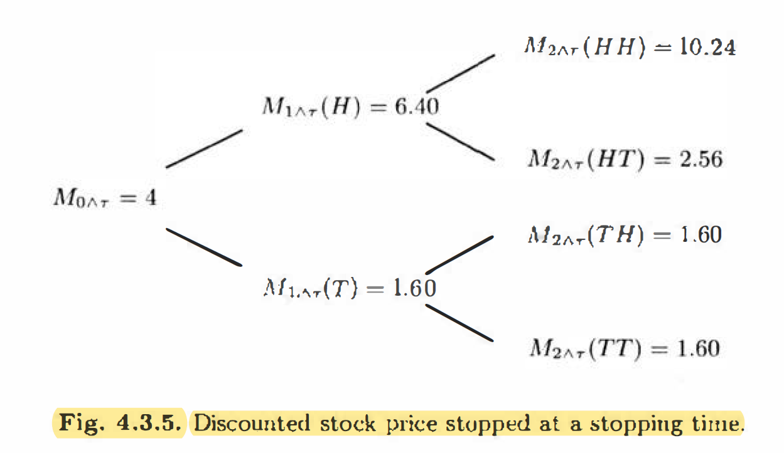



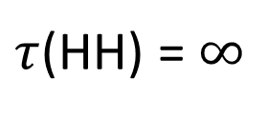
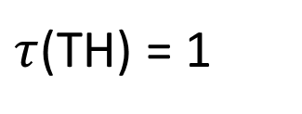
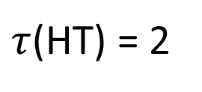


At every node, the value is the average of the values at the two subsequent nodes.
$τ$(HH) = $∞$
$τ$(HT) = 2
$τ$(TH) = 1
M
A martingale stopped at a stopping time is a martingale.
Time is not stopped. However. the value of the process is frozen at time $τ$
$$τ\text{(}\text{TT}\text{) = 1}$$

Slide 10
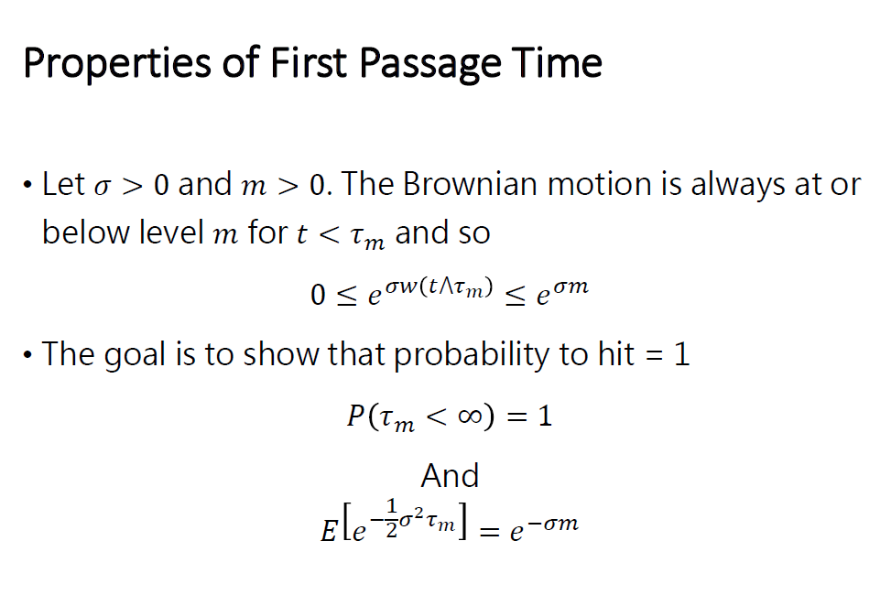

m

Slide 11
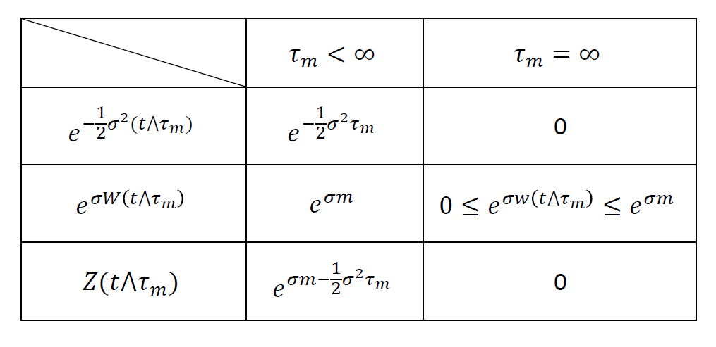

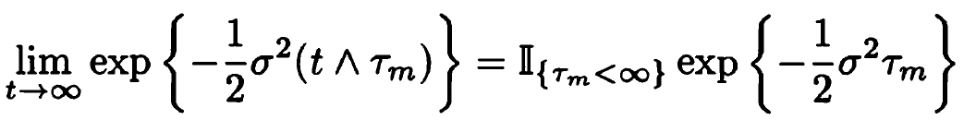

W($τ$_{m})=m

Slide 12
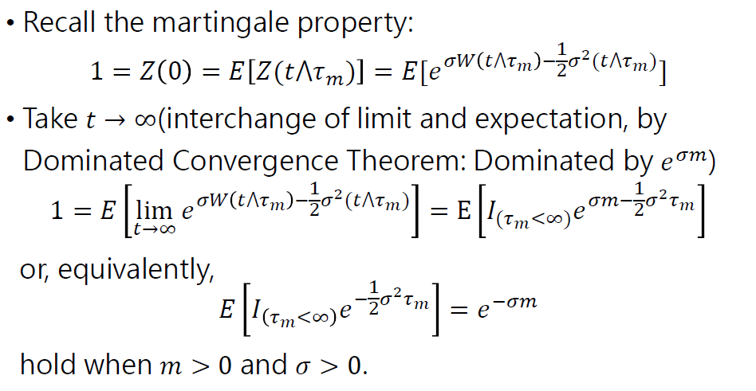




Slide 13
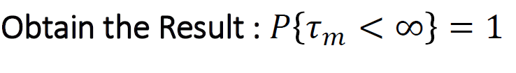







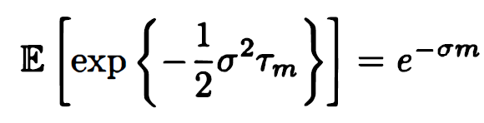

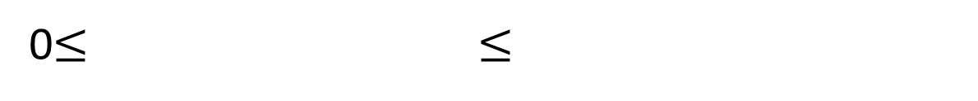
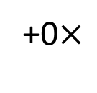

$$×$$
+0$×$
0$≤ ≤$
1
2

Slide 14
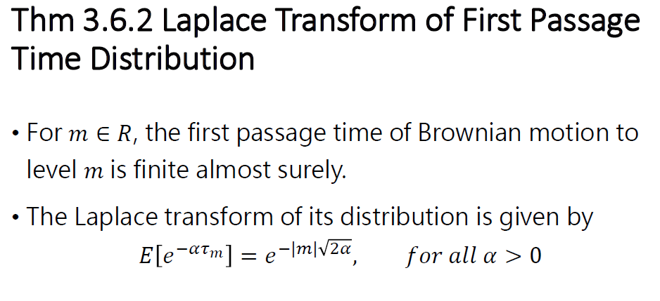


Slide 15
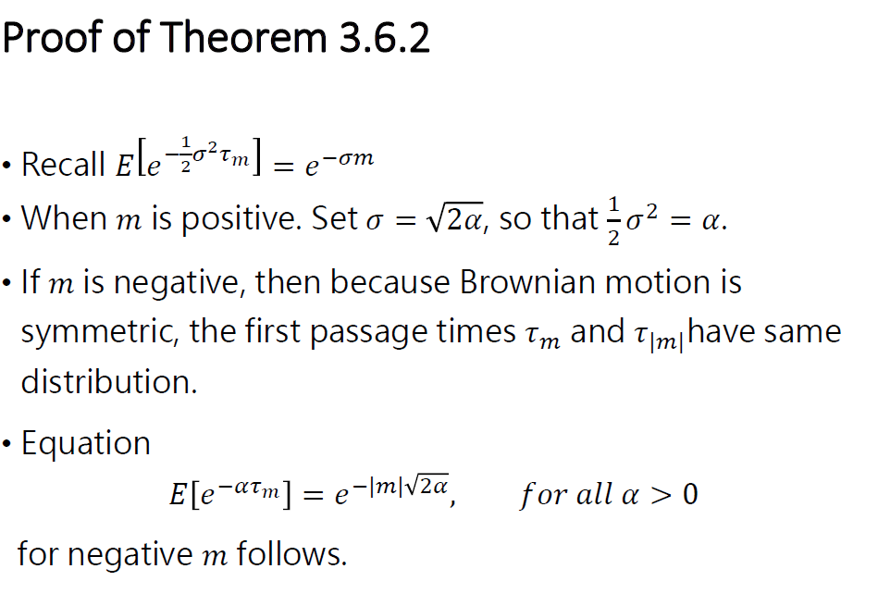
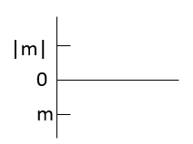


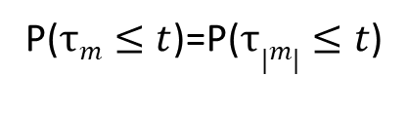
P($τm≤t$)=P($τ|m|≤t$)

Slide 16
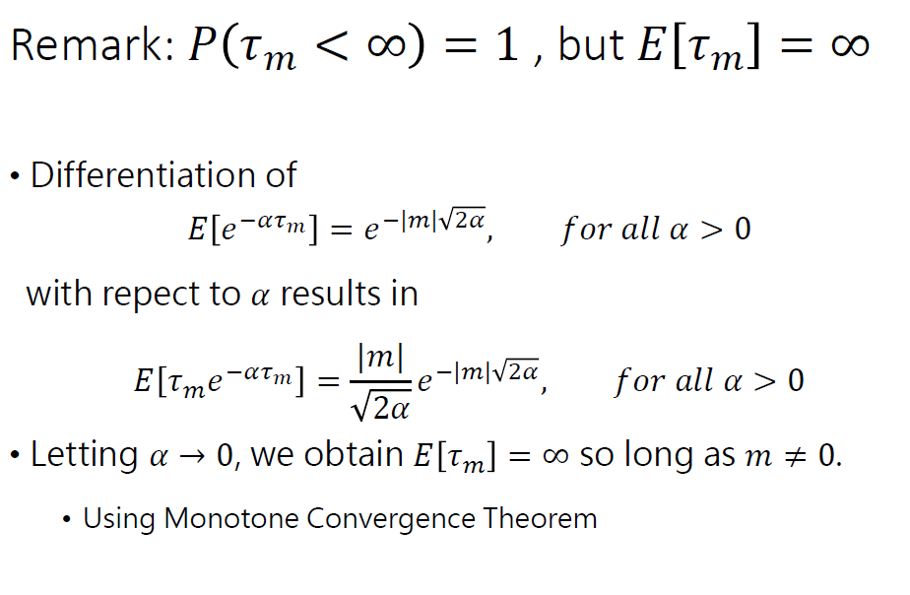





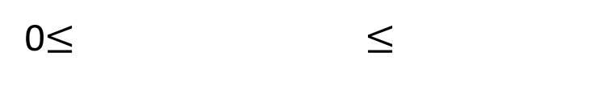

$$\frac{−|m|\sqrt{2}}{2\sqrt{α}}$$
-
1
2
0$≤$ $≤$

