Slide 1
3.7 Reflection Principle
黃于珊

Slide 2
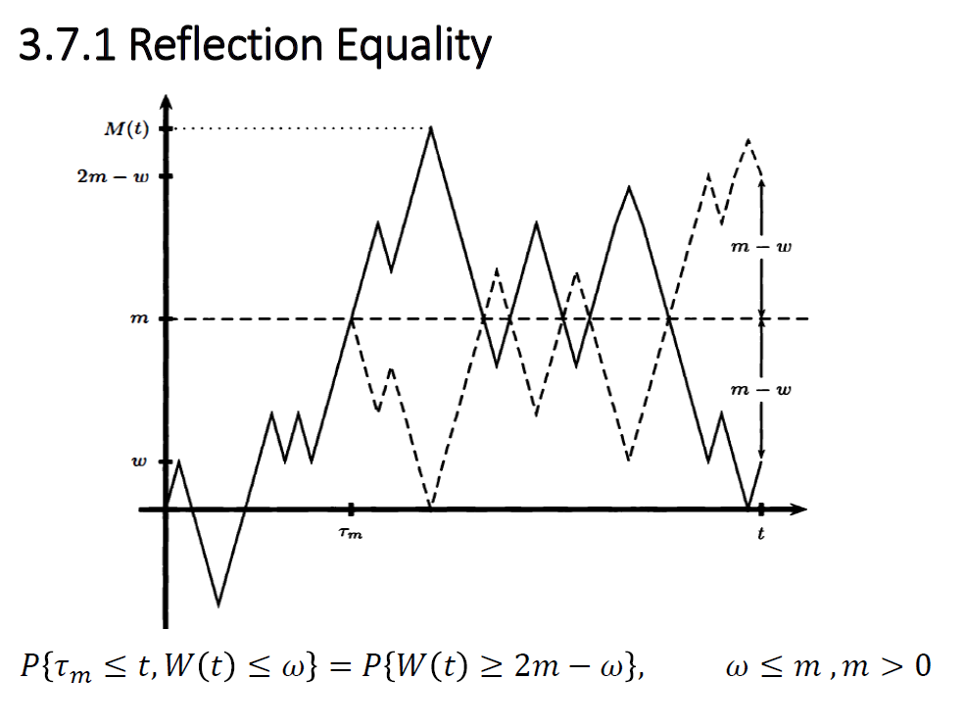
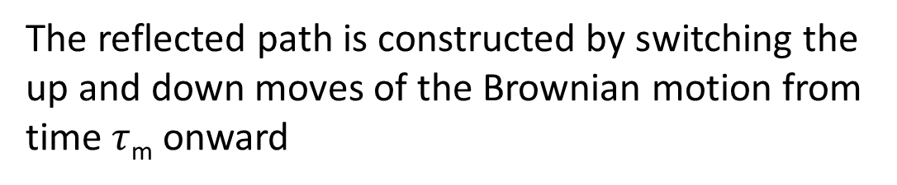


The reflected path is constructed by switching the up and down moves of the Brownian motion from time$τ$_{m} onward
at or above 2m -$ω$ at time t
reach level m prior to time t
at or below level $ω$ at time t

Slide 3
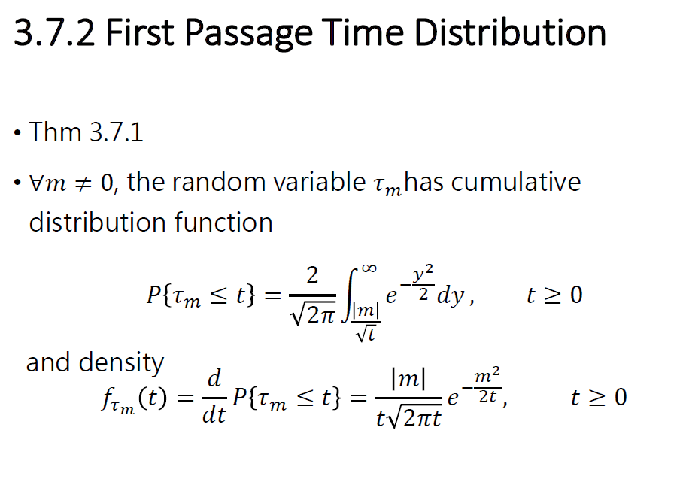

Slide 4
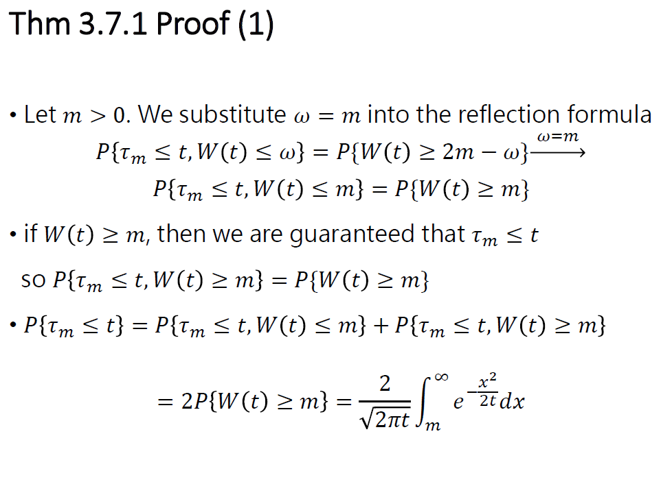



If
m
$$τm$$
t
W(t)~N(0,t)

Slide 5
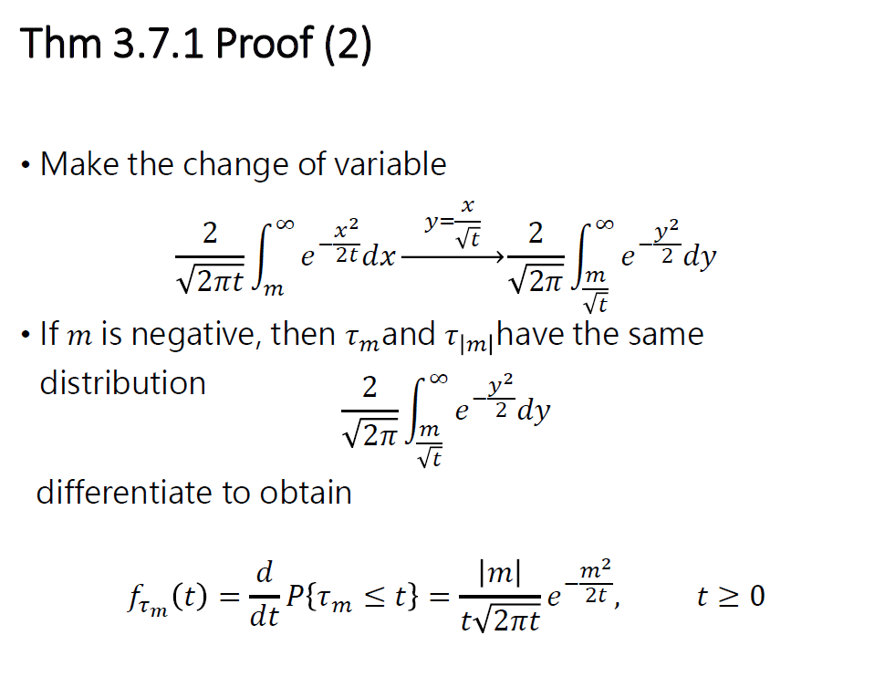
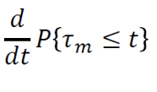

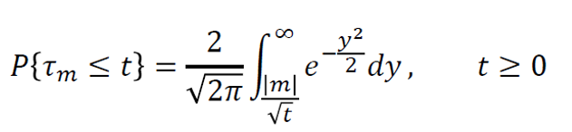


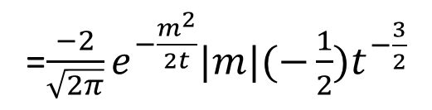


$$\frac{\text{d}\text{(}\frac{|m|}{\sqrt{t}}\text{)} }{dt}$$
d($\frac{|m|}{\sqrt{t}}$)
dy=$\frac{1}{\sqrt{t}}$dx
=$\frac{−2}{\sqrt{2π}}e^{−\frac{m^{2}}{2t}}|m|(−\frac{1}{2})t^{−\frac{3}{2}}$

Slide 6
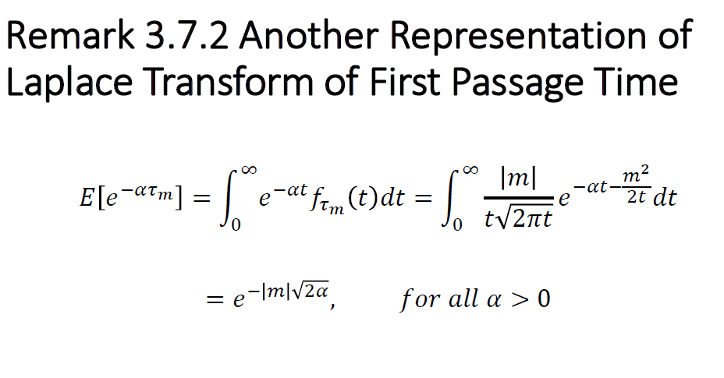
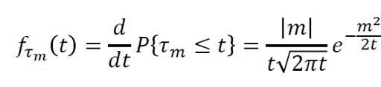

Slide 7
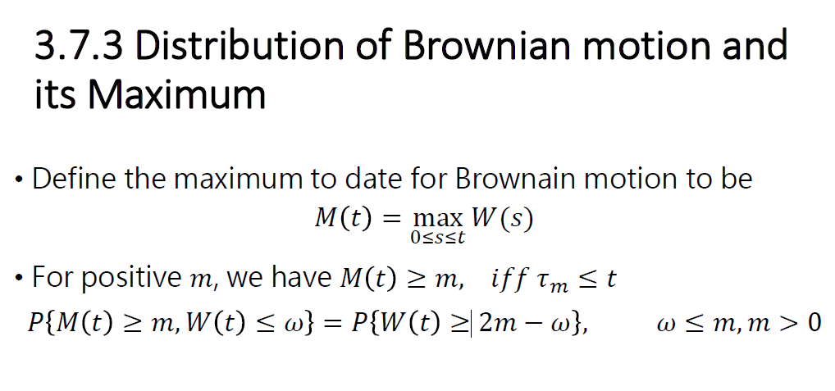


m
$$τm$$
t

Slide 8
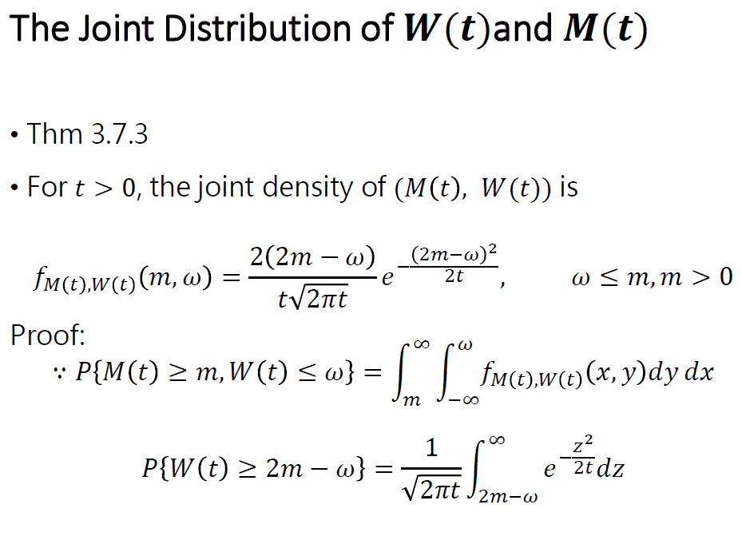

Slide 9
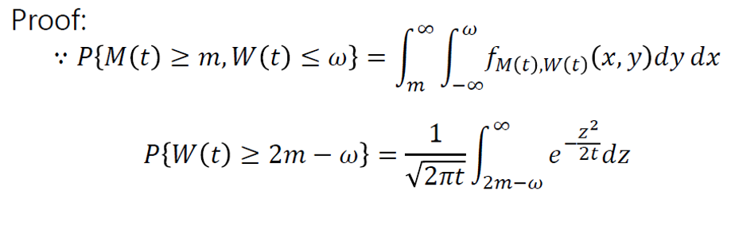
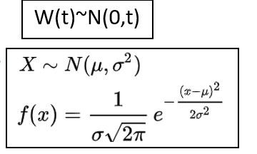
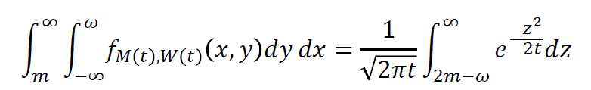

Slide 10
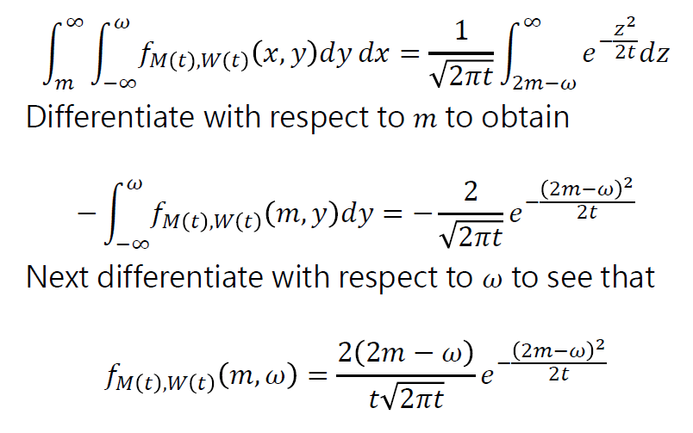



Slide 11
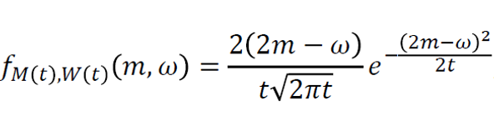
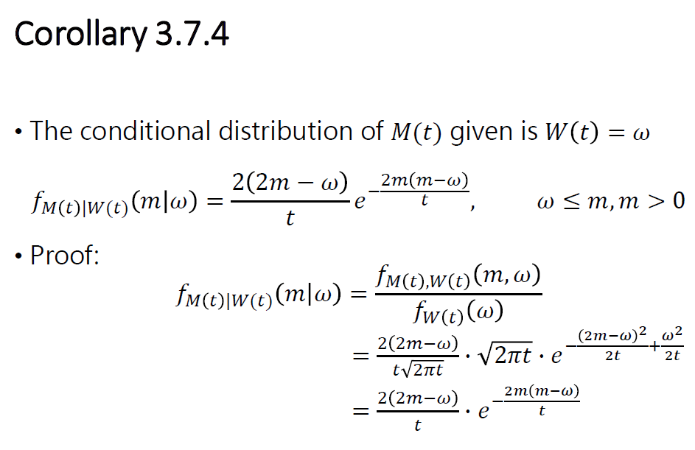





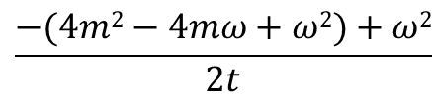

$$\frac{−(4m2−4mω+ω2)+ω2}{2t}$$
$$ω^{2}$$
t
$$\sqrt{2πt}$$

