Slide 1
Ito-Doeblin Formula

Slide 2
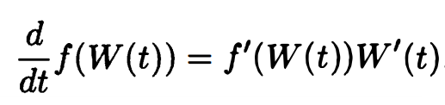
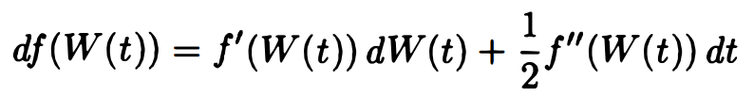
Formula for Brownian Motion
We want a rule to "differentiate" expressions of the form f(W(t)), where f(x) is a differentiable function and W(t) is a Brownian motion.
Chain Rule from ordinary calculus tell us
Because W has nonzero quadratic variation, the correct formula has an extra term, namely,

Slide 3
This is the lto-Doeblin formula in differential form.
Integrating this, we obtain the lto-Doeblin formula in integral form:
The mathematically meaningful form of the lto--Doeblin formula is the integral form (4.4.2) .
The first integral is an Ito integral.
The second integral is an ordinary (Lebesgue) integral with respect to the time variable.

Slide 4
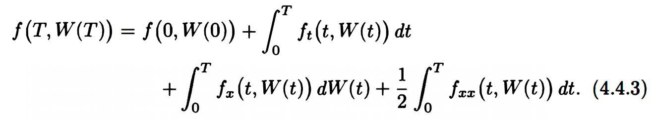
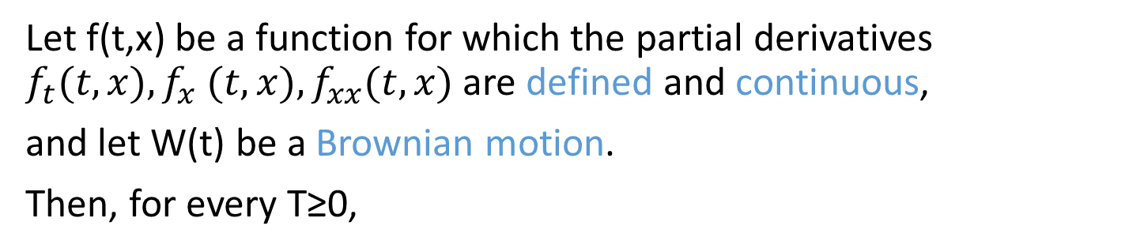
Theorem 4.4.1
Let f(t,x) be a function for which the partial derivatives $f_{t}(t,x), f_{x} (t,x), f_{xx}(t, x)$are defined and continuous,
and let W(t) be a Brownian motion.
Then, for every T≥0,

Slide 5
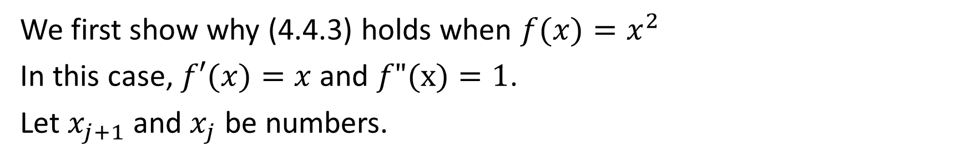

Simple Case for Thm 4.4.1
We first show why (4.4.3) holds when $f(x)=x^{2}$
In this case, $f′(x)=x$and $f"(x)=1$.
Let $x_{j+1}$and $x_{j}$ be numbers.
By Taylor Series:
$$f\left(x\right)=f\left(a\right)+f^{′}\left(a\right)\left(x−a\right)+\frac{f′′(a)}{2!}{(x−a)}^{2}+…+\frac{f^{\left(k\right)}\left(a\right)}{k!}{\left(x−a\right)}^{k}+…$$
Then we have
$f′′′$ and higher are zeros

Slide 6
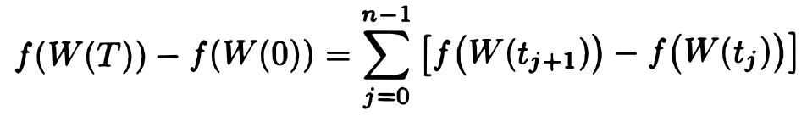

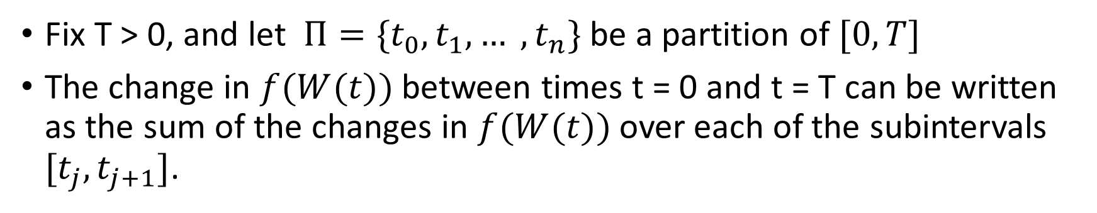

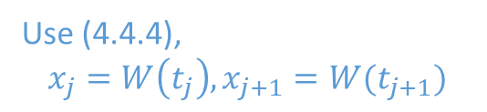
Fix T > 0, and let $Π=\{t_{0}, t_{1}, … , t_{n}\}$ be a partition of $[0, T]$
The change in $f(W(t))$between times t = 0 and t = T can be written as the sum of the changes in $f(W(t))$over each of the subintervals $[t_{j}, t_{j+1}]$.
Use (4.4.4),
$$x_{j}=W\left(t_{j}\right),x_{j+1}=W(t_{j+1})$$
$$f′(x)=x \text{,} f"(x)=1$$

Slide 7
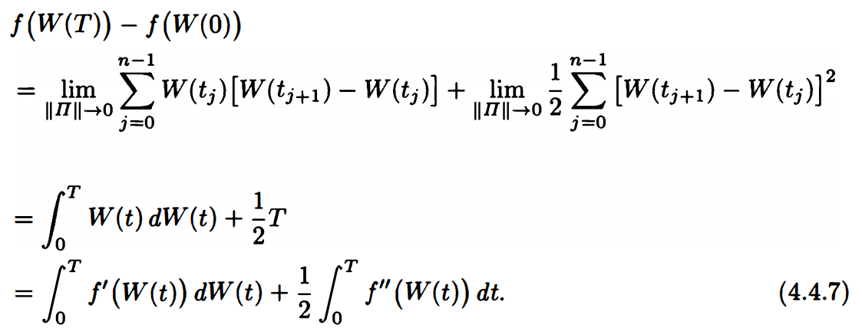
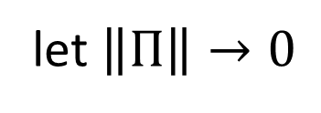


let $\left\|Π\right\|→0$
Quadratic variation
Ito integral
$$∵f′(x)=x$$
$$f"(x)=1$$

Slide 8
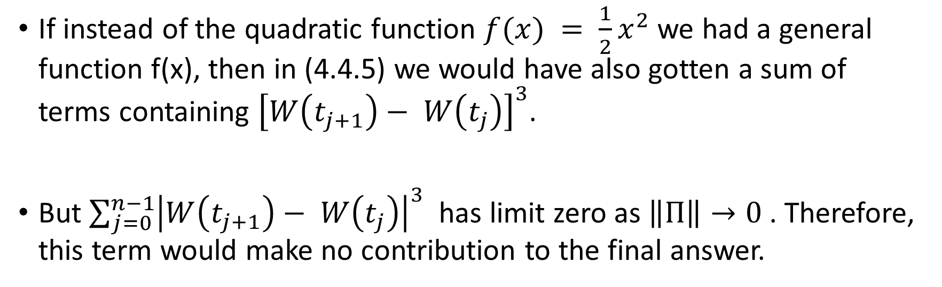
If instead of the quadratic function $f(x) = \frac{1}{2}x^{2}$we had a general function f(x), then in (4.4.5) we would have also gotten a sum of terms containing ${\left[W\left(t_{j+1}\right)− W\left(t_{j}\right)\right]}^{3}$.
But $\sum_{j=0}^{n−1}{{\left|W\left(t_{j+1}\right)− W\left(t_{j}\right)\right|}^{3}}$has limit zero as $\left\|Π\right\|→0$. Therefore, this term would make no contribution to the final answer.

Slide 9
Theorem 4.4.1
Let f(t,x) be a function for which the partial derivatives $f_{t}(t,x), f_{x} (t,x), f_{xx}(t, x)$are defined and continuous,
and let W(t) be a Brownian motion.
Then, for every T≥0,
a
b
c

Slide 10
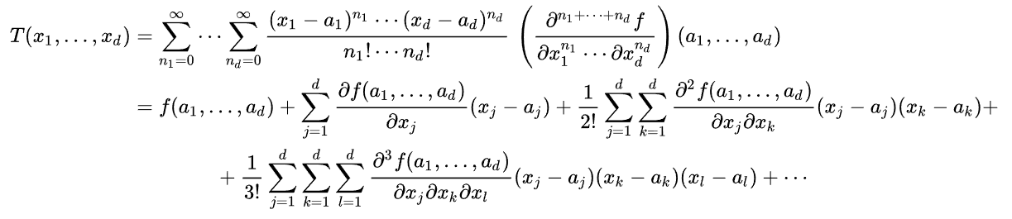
Taylor series in several variables

Slide 11
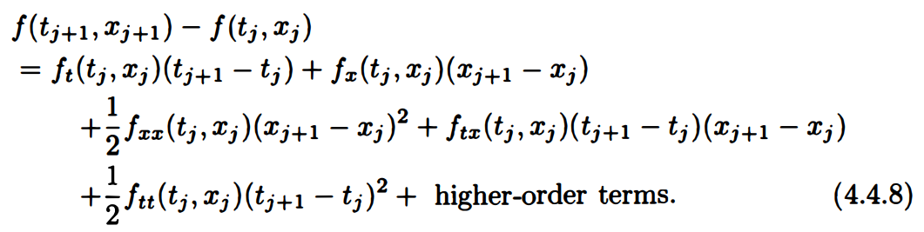
Proof of thm 4.4.1
First, apply Taylor expansion

Slide 12
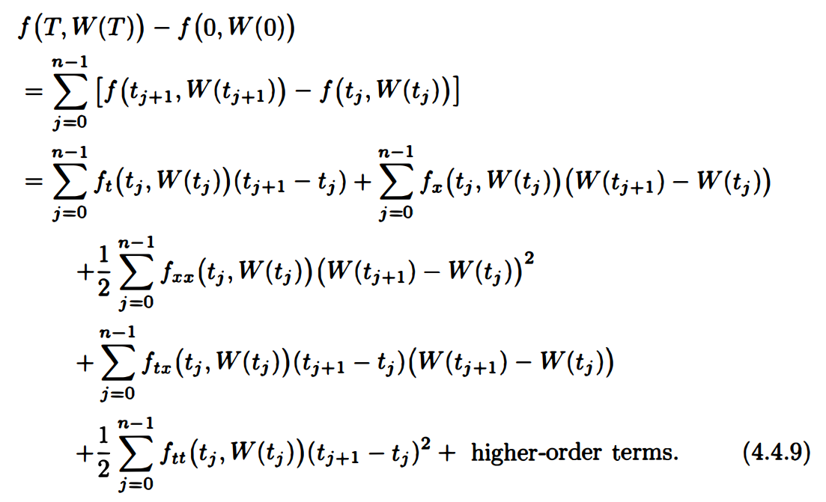
We replace $x_{j}$ by $W(t_{j})$, replace $x_{j+1}$by $W(t_{j+1})$, and sum:
1
2
3
4
5
0
we take the limit as $\left\|Π\right\|→0$ on both side

Slide 13
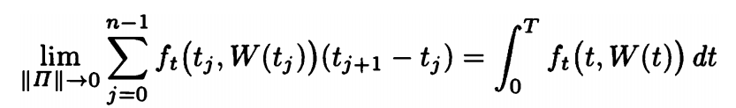
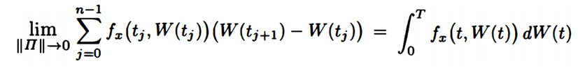
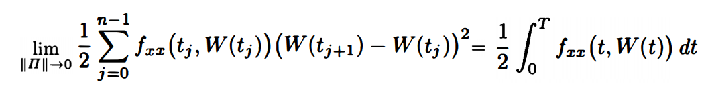
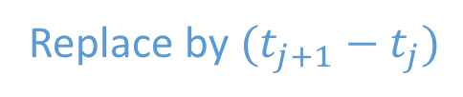
1
a
2
b
3
c
Replace by $(t_{j+1}−t_{j})$

Slide 14
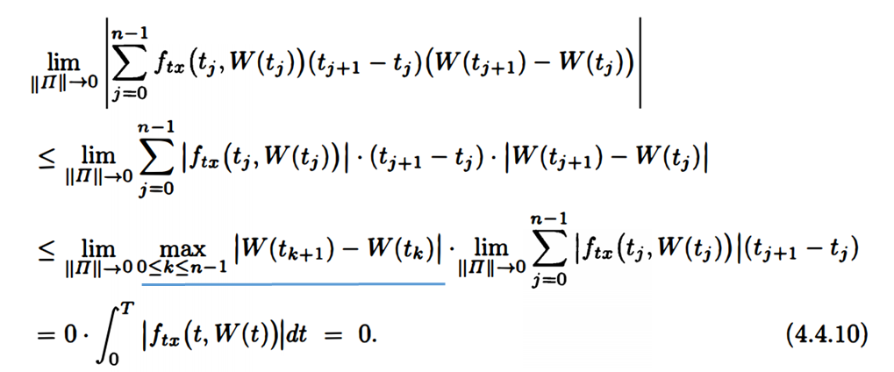
4

Slide 15
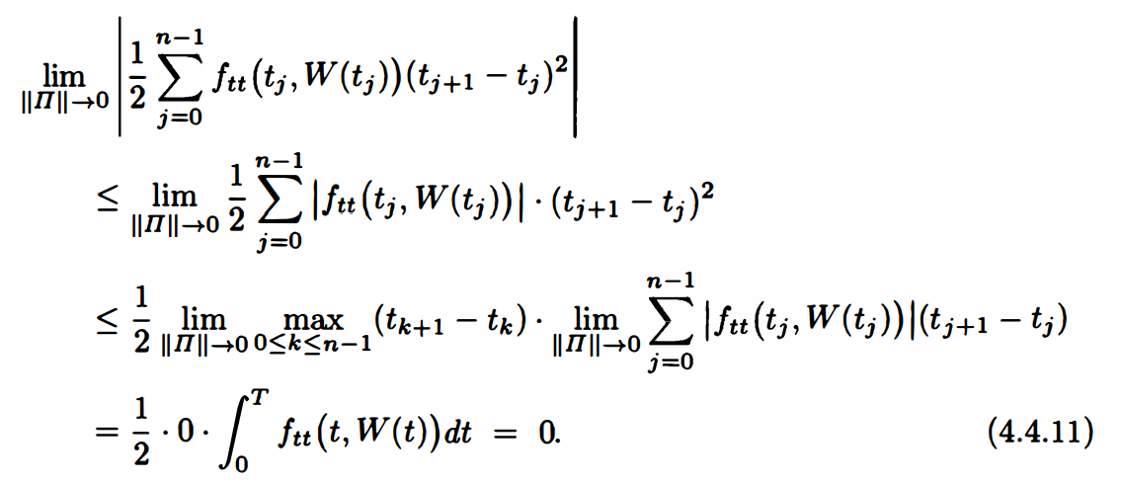
5

Slide 16
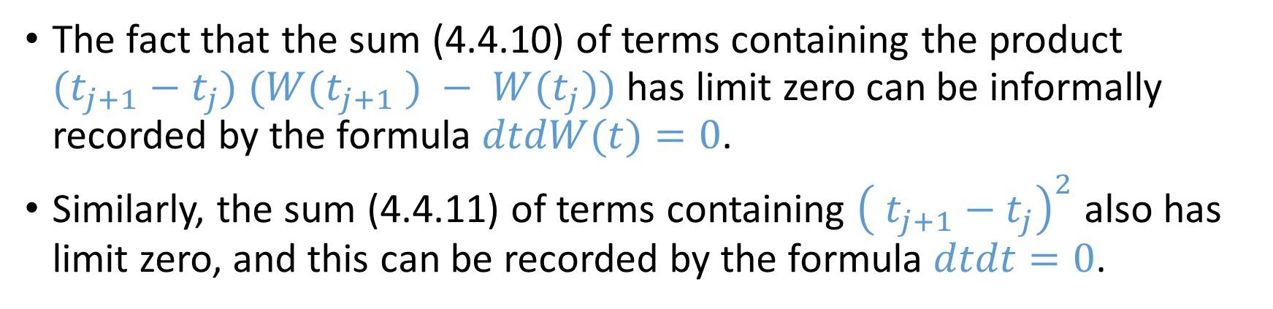
Remark 4.4.2
The fact that the sum (4.4.10) of terms containing the product $(t_{j+1}−t_{j}) (W(t_{j+1} ) − W(t_{j}))$has limit zero can be informally recorded by the formula $dtdW(t)=0$.
Similarly, the sum (4.4.11) of terms containing ${\left( t_{j+1}−t_{j}\right)}^{2}$also has limit zero, and this can be recorded by the formula $dtdt=0$.

Slide 17
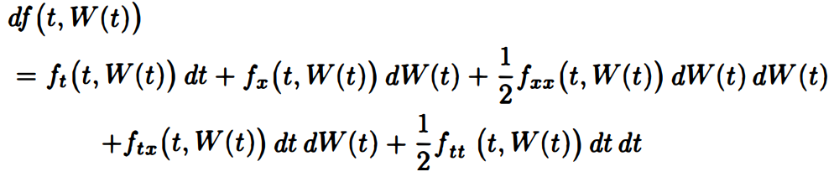
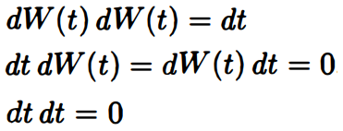

Slide 18
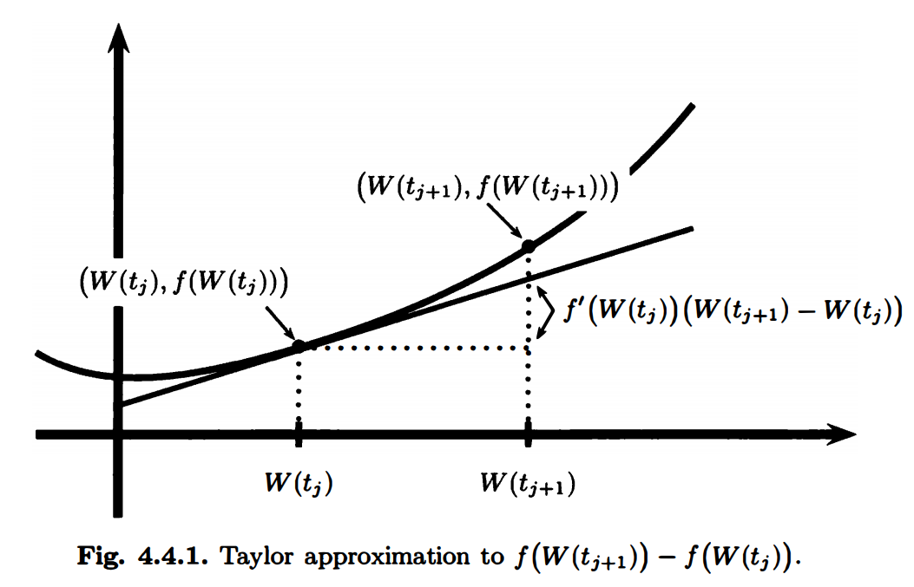
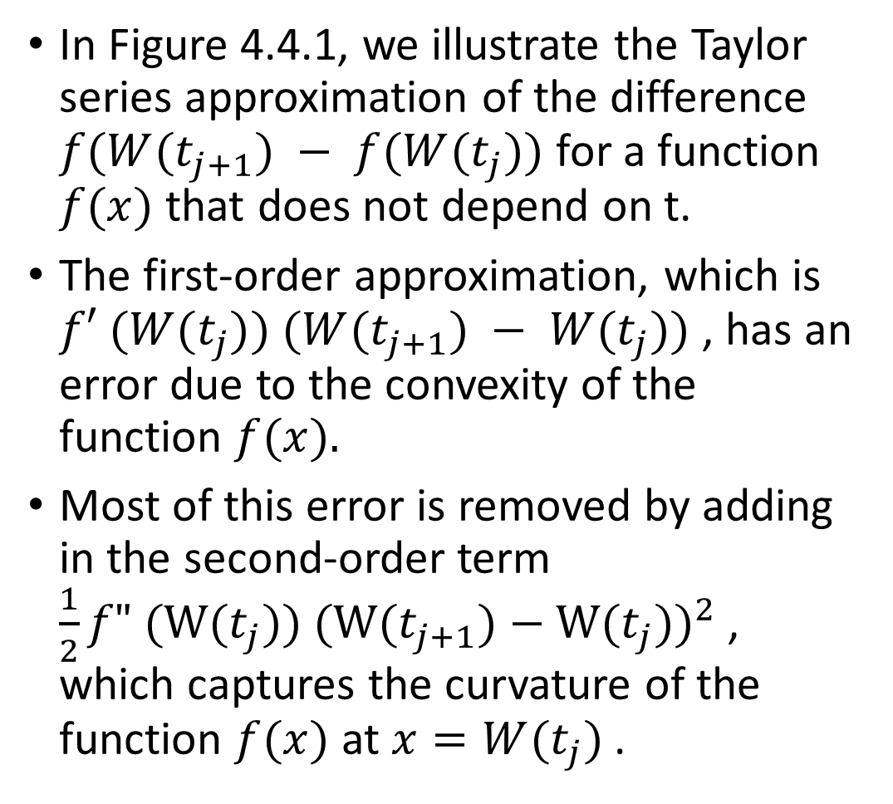
In Figure 4.4.1, we illustrate the Taylor series approximation of the difference $f(W(t_{j+1}) − f(W(t_{j}))$for a function $f(x)$ that does not depend on t.
The first-order approximation, which is $f′ (W(t_{j})) (W(t_{j+1}) − W(t_{j}))$ , has an error due to the convexity of the function $f(x).$
Most of this error is removed by adding in the second-order term ${\frac{1}{2}f" (W(t_{j})) (W(t_{j+1})−W(t_{j}))}^{2}$, which captures the curvature of the function $f(x)$ at $x=W(t_{j})$.

Slide 19
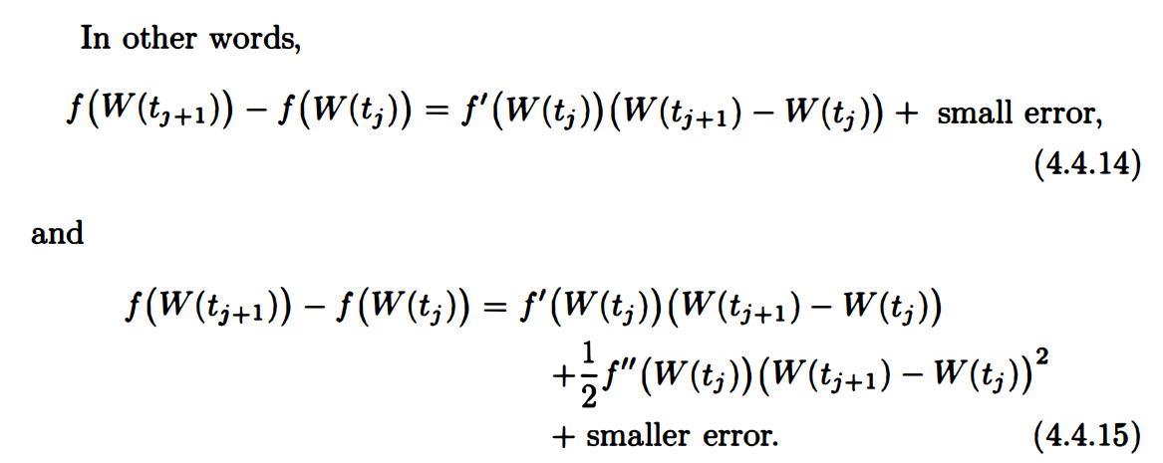
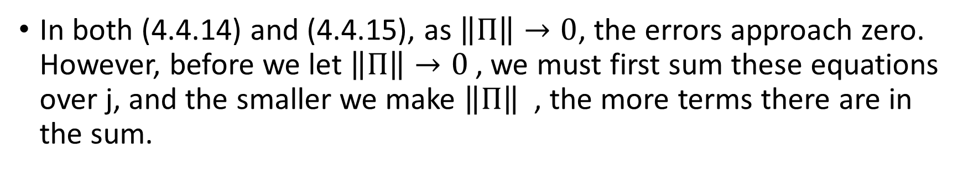
In both (4.4.14) and (4.4.15), as $\left\|Π\right\|→0$, the errors approach zero. However, before we let $\left\|Π\right\|→0$, we must first sum these equations over j, and the smaller we make $\left\|Π\right\|$ , the more terms there are in the sum.

Slide 20
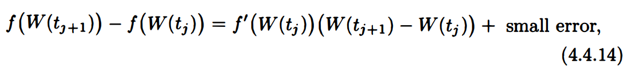
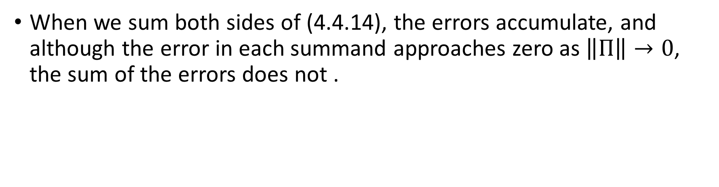
When we sum both sides of (4.4.14), the errors accumulate, and although the error in each summand approaches zero as $\left\|Π\right\|→0$, the sum of the errors does not .

Slide 21
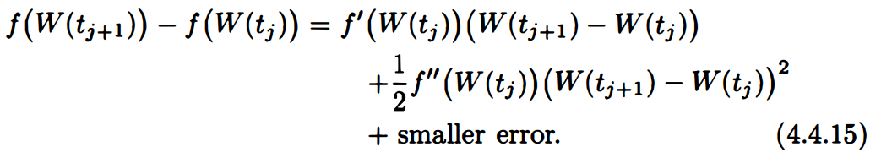
When we use the more accurate approximation (4.4.15), this does not happen; the limit of the sum of the smaller errors is zero.
We need the extra accuracy of (4.4.15) because the paths of Brownian motion are so volatile (i.e. , they have nonzero quadratic variation).
This extra term makes stochastic calculus different from ordinary calculus.

Slide 22
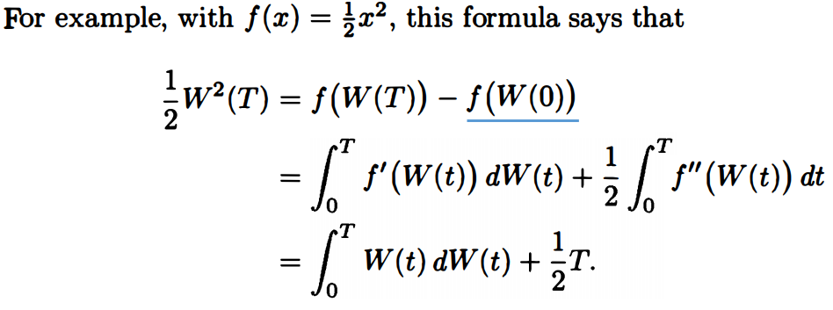
The Ito-Doeblin formula often simplifies the computation of Ito integrals.
=0
(Example 4.3.2)

Slide 23
Formula for Ito Processes
We extend the Ito-Doeblin formula to stochastic processes more general than Brownian motion.
The processes for which we develop stochastic calculus are the Ito processes.
Almost all stochastic processes, except those that have jumps, are Ito processes.

Slide 24

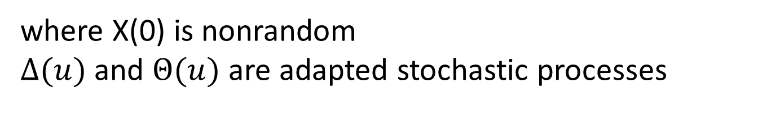
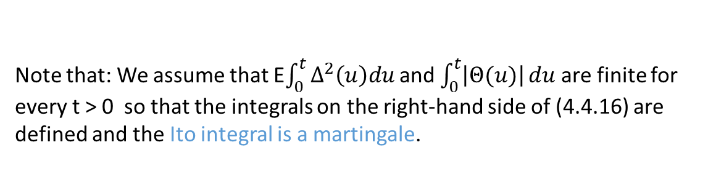
Definition 4.4.3
Let W(t), t≥0, be a Brownian motion
Let F(t), t≥0, be an associated filtration
An Ito process is a stochastic process of the form
where X(0) is nonrandom
$Δ(u)$ and $Θ(u)$ are adapted stochastic processes
Note that: We assume that E$\int_{0}^{t}{Δ^{2}\left(u\right)du}$ and $\int_{0}^{t}{\left|Θ(u)\right|}du$ are finite for every t > 0 so that the integrals on the right-hand side of (4.4.16) are defined and the Ito integral is a martingale.

Slide 25

Lemma 4.4.4
The quadratic variation of the Ito process (4.4.16) is

Slide 26
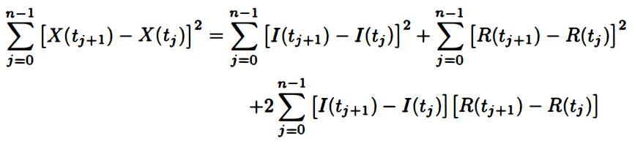

Proof of Lemma
We introduce the notation
choose a partition $Π=\{t_{0}, t_{1}, . . . , t_{n}\}$of $\left[0,t\right]$(i.e. , $0 =t_{0}<t_{1} < ··· <t_{n} = t$)
1
2
3

Slide 27
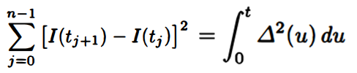
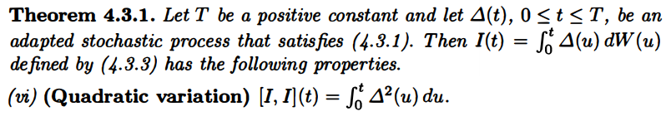
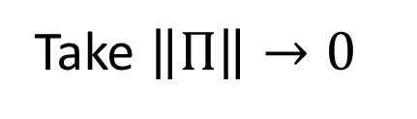
Take $\left\|Π\right\|→0$
1

Slide 28

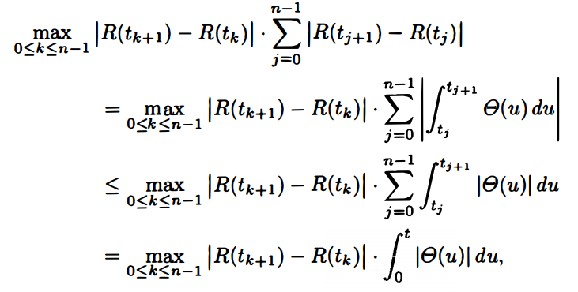
2
0

Slide 29
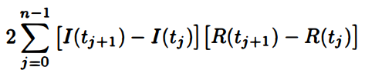
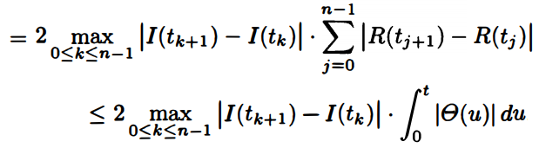
3
0

Slide 30


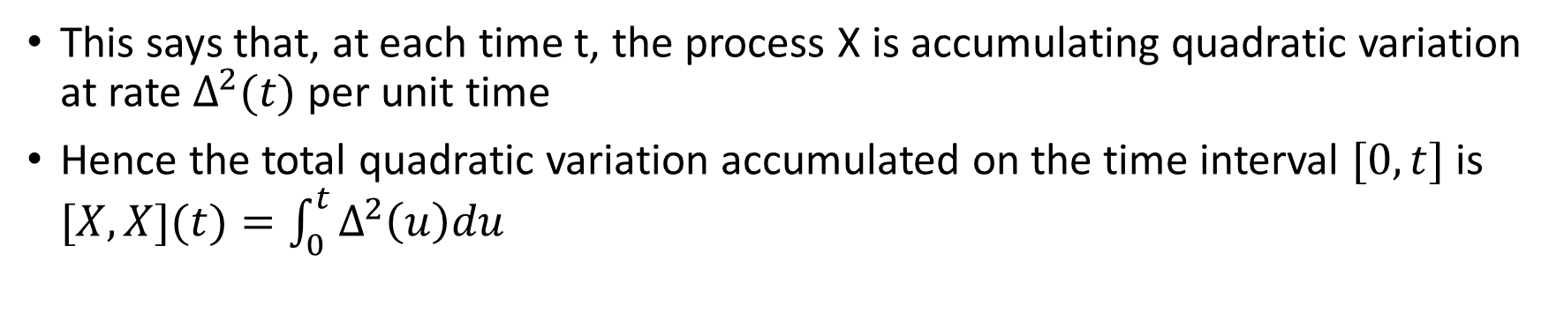
Conclusion of lemma
This says that, at each time t, the process X is accumulating quadratic variation at rate $Δ^{2}(t)$ per unit time
Hence the total quadratic variation accumulated on the time interval $[0, t]$is $[X, X](t)=\int_{0}^{t}{Δ^{2}\left(u\right)du}$

Slide 31

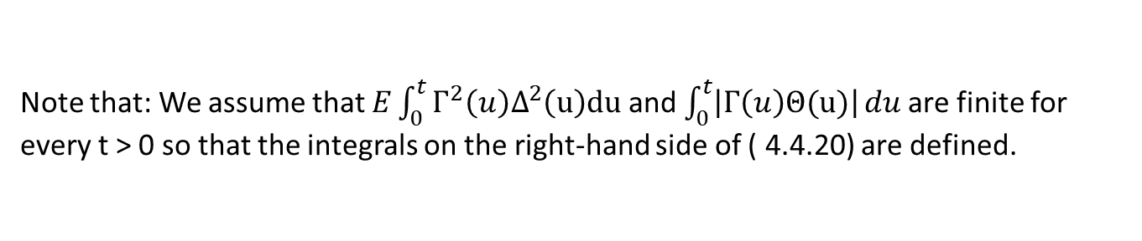
Definition 4.4.5
let X(t), t≥0 , be an Ito process as described in Definition 4.4.3,
let $Γ$(t), t≥0 , be an adapted process.
We define the integral with respect to an Ito process
Note that: We assume that $E\int_{0}^{t}{Γ^{2}\left(u\right)Δ^{2}\left(u\right)du}$ and $\int_{0}^{t}{\left|Γ\left(u\right)Θ(u)\right|}du$are finite for every t > 0 so that the integrals on the right-hand side of ( 4.4.20) are defined.

Slide 32
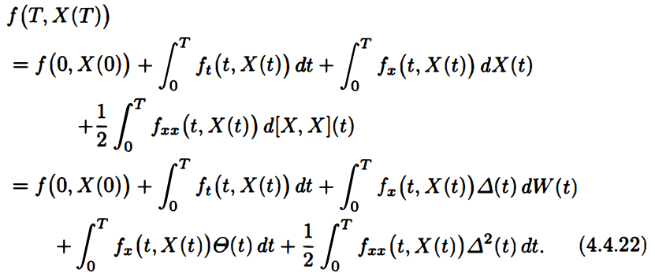

Theorem 4.4.6 (Ito-Doeblin formula for an Ito process)
let X(t) , t≥0, be an Ito process as described in Definition 4.4.3
let $f(t,x)$ be a function for which the partial derivatives $f_{t}(t,x)$, $f_{x}(t,x)$, and $f_{xx}(t,x)$ are defined and continuous
Then, for every T≥0,

Slide 33
Proof of thm 4.4.6
Recall: proof of thm 4.4.1

Slide 34
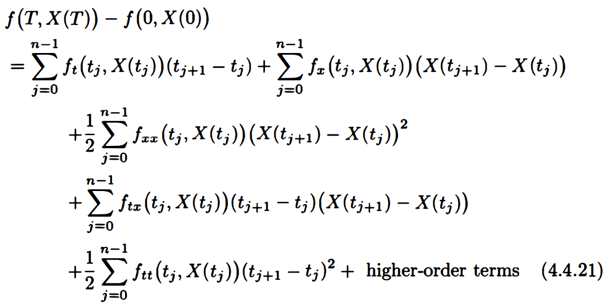
Change W(t) by X(t)
1
2
3
4
5
we take the limit as $\left\|Π\right\|→0$ on both side

Slide 35
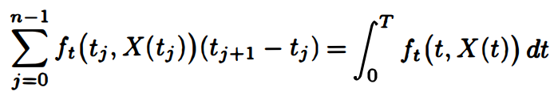
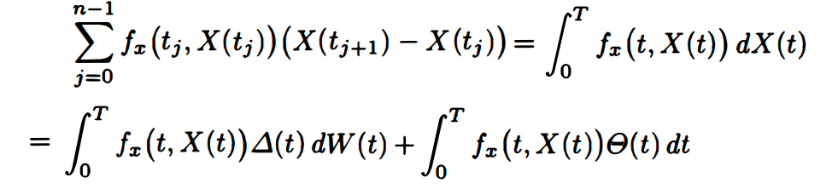
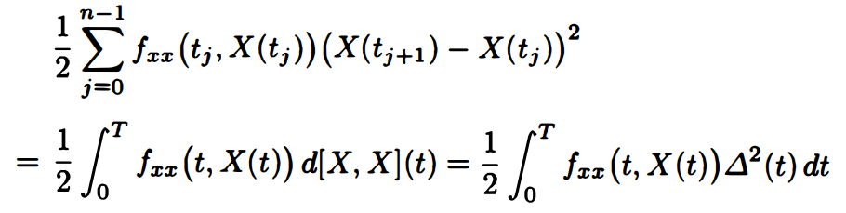
1
2
3

Slide 36



4
5
Have zero limits as $\left\|Π\right\|→ 0$for the same reasons the analogous terms have zero limits in the sketch of the proof of Theorem 4.4.1 (see (4.4.10) and (4.4.11))

Slide 37


Remark 4.4.7 (Summary of stochastic calculus)
Every term on the right-hand side has a solid definition, and in the end the right-hand side reduces to a sum of a nonrandom quantity $f(0, X(0))$, three ordinary (Lebesgue) integrals with respect to time, and an Ito integral.

Slide 38


It is easier to remember and use the result of this theorem if we recast it in differential notation. We may rewrite (4.4.22) as
plug in

Slide 39


Example 4.4.8 (Generalized geometric Brownian motion)
Let $W(t)$, t ≥ 0, be a Brownian motion
Let $F(t)$ , t ≥ 0, be an associated filtration
Let $α(t)$and $σ(t)$ be adapted processes
Define the Ito process
Then

Slide 40


Consider an asset price process given by
where S(0) is nonrandom and positive.
Compare with Section 3.4.3

Slide 41


We may write $S(t)=f(X(t))$,
where $f\left(x\right)=S\left(0\right)e^{x}$ , $f′ (x)=S\left(0\right)e^{x}$ , $f" (x)=S(0)e^{x}$
According to the Ito-Doeblin formula

Slide 42

The asset price S(t) has instantaneous mean rate of return $α(t)$ and volatility $σ(t)$
Both the instantaneous mean rate of return and the volatility are allowed to be time-varying and random.
This example includes all possible models of an asset price process that is always positive, has no jumps, and is driven by a single Brownian motion.
Although the model is driven by a Brownian motion, the distribution of S(t) does not need to be log-normal because $α(t)$ and $σ(t)$ are allowed to be timevarying and random.

Slide 43




If $α$ and $σ$ are constant, we have the usual geometric Brownian motion model, and the distribution of S(t) is log-normal.
In the case of constant $α$ and $σ$, (4.4.26) becomes
Note that: the mean rate of return for S(t) is not $α−\frac{1}{2}σ^{2}$
Although $W(t)$ is a martingale, $S\left(0\right)e^{σW\left(t\right)}$ is not.
Recall: Theorem 3.6.1 (Exponential Martingale)

Slide 44



The lto-Doeblin formula automatically keeps track of these effects, even when a and a are time-varying and random.
If $α$ = 0, then (4.4.27) yields
In other words, the term $σ\left(t\right)S(t)dW(t)$on the right-hand side of (4.4.27) contributes no drift, just pure volatility, to the asset price.
When $α(t)$ is a nonzero random process, (4.4.27) shows that it plays the role of the mean rate of return.
In the case of time-varying and random $α(t)$ , we will call this the instantaneous mean rate of return since it depends on the time (and the sample path) where it is evaluated.

Slide 45



Integration of both sides yields
The right-hand side is the nonrandom constant $S(0)$ plus an Ito integral, which is a martingale,
and hence , in the case $α$=0, (4.4.29) is a martingale.

Slide 46

Theorem 4.4.9 (Ito integral of a deterministic integrand)
Let $W(s)$, s ≥ 0, be a Brownian motion
Let $Δ(s)$be a nonrandom function of time
Define $I(t) = \int_{0}^{t}{Δ\left(s\right)dW(s)}$
For each t ≥ 0,
the random variable $I(t)$ is normally distributed with expected value zero and variance $\int_{0}^{t}{Δ^{2}\left(s\right)ds}$.

Slide 47



Proof of thm 4.4.9
The mean and variance of $I(t)$ are easy to determine.
Recall: Thm 4.3.1
Since $I(t)$ is a martingale and $I(0)=0$, we must have $EI(t)=I(0)=0$.
Ito isometry implies that

Slide 48





The challenge is to show that $I(t)$ is normally distributed.
We shall do this by establishing that $I(t)$ has the moment-generating function of a normal random variable with mean zero and variance$\int_{0}^{t}{Δ^{2}\left(s\right)ds}$
$Ee^{tX}=exp⁡(μt+σ^{2}t^{2}/2)$
$$X\sim N(μ,σ^{2})$$
Because $Δ(s)$is not random, (4.4.30) is equivalent to
Rmk: Need to proof

Slide 49

Now we need to proof
Recall: (4.4.29) is a martingale
Plug in $σ\left(s\right)=uΔ\left(s\right)$, then we have done.
Note that (4.4.31) always holds, regardless of whether $Δ(s)$ is random.
However, we need to assume that $Δ(s)$ is nonrandom in order to obtain the moment-generating function formula (4.4.30) from (4.4.31).
When $Δ(s)$ is random, there is no reason that the distribution of $\int_{0}^{t}{Δ\left(s\right)dW(s)}$should be normal.

Slide 50

Example 4.4.10 (Vasicek interest rate model)
Let W(t), t ≥ 0, be a Brownian motion.
The Vasicek model for the interest rate process R(t) is
where $α$, $β$, and $σ$ are positive constants.
Equation (4.4.32) is an example of a stochastic differential equation.
It defines a random process, R(t) in this case, by giving a formula for its differential, and the formula involves the random process itself and the differential of a Brownian motion.

Slide 51


The solution to the stochastic differential equation (4.4.32) can be determined in closed form and is
a claim that we now verify.
To do this, we use the Ito-Doeblin formula with
and

Slide 52



For the Ito-Doeblin formula, we shall need the following partial derivatives of $f(t,x)$ :
We shall also need the differential of $X(t)$ , which is
The Ito-Doeblin formula states that

Slide 53

This shows that $f(t, X(t))$satisfies the stochastic differential equation (4.4.32) that defines $R(t)$.
Moreover, $f(0, X(0))=R(0)$.
Because f(t, X(t)) satisfies the equation defining $R(t)$ and has the same initial condition as R(t), it must be the case that $f(t, X(t)) = R(t)$for all t≥0.

Slide 54



Theorem 4.4.9 implies that the random variable $\int_{0}^{t}{e^{βs}dW(s)}$appearing on the right-hand side of (4.4.33) is normally distributed with mean zero and variance
Therefore, $R(t)$ is normally distributed with mean $e^{−βt}R\left(0\right)+\frac{α}{β}(1−e^{−βt})$and variance $\frac{σ^{2}}{2β}(1−e^{−2βt})$.
In particular, no matter how the parameters $α$ > 0, $β$ > 0, and $σ$ > 0 are chosen, there is positive probability that R(t) is negative, an undesirable property for an interest rate model.

Slide 55

The Vasicek model has the desirable property that the interest rate is mean-reverting.
When $R(t)=\frac{α}{β}$ , the drift term (the dt term) in (4.4.32) is zero.
When $R(t)>\frac{α}{β}$ , this term is negative, which pushes $R(t)$ back toward $\frac{α}{β}$ .
When $R(t)<\frac{α}{β}$ , this term is positive, which again pushes $R(t)$ back toward $\frac{α}{β}$ .
If $R(0)=\frac{α}{β}$ , then $ER\left(t\right)=\frac{α}{β}$ ,for all t≥0 .
If $R\left(0\right)≠\frac{α}{β}$ , then $\lim_{t→∞}{ER(t)}=\frac{α}{β}$ .

Slide 56
Example 4.4.11 (Cox-Ingersoll-Ross (CIR) interest rate model)
Let W(t) , t ≥0, be a Brownian motion.
The Cox-Ingersoll-Ross model for the interest rate process R(t) is
where $α$, $β$, $σ$ are positive constants.

Slide 57

Unlike the Vasicek equation (4.4.32), the CIR equation (4.4.34) does not have a closed-form solution.
The advantage of (4.4.34) over the Vasicek model is that the interest rate in the CIR model does not become negative.
If R(t) reaches zero, the term multiplying $dW(t)$ vanishes and the positive drift term $αdt$in equation (4.4.34) drives the interest rate back into positive territory.
Like the Vasicek model, the CIR model is mean-reverting.

Slide 58






Although one cannot derive a closed-form solution for (4.4.34), the distribution of R(t) for each positive t can be determined.
That computation would take us too far afield. We instead content ourselves with the derivation of the expected value and variance of R(t).
To do this, we use the function $f(t,x)=e^{βt}x$and the Ito-Doeblin formula to compute
$$f_{t}\left(t,x\right)=βe^{βt}x$$
$$f_{x}\left(t,x\right)=e^{βt}$$
$$f_{xx}\left(t,x\right)=0$$
$$dR\left(t\right)=\left(α−βR\left(t\right)\right)dt+σ\sqrt{R\left(t\right)}dW(t)$$

Slide 59



Integration of both sides of (4.4.35) yields
Recalling that the expectation of an Ito integral is zero, we obtain
This is the same expectation as in the Vasicek model.

Slide 60






To compute the variance of R(t), we set
use
According to the lto-Doeblin formula
$$f\left(x\right)=x^{2}$$
$$df\left(x\right)=f^{′}\left(x\right)dx+\frac{1}{2}f^{′′}\left(x\right)dxdx$$
$$f^{′}\left(x\right)=2x$$
$$f^{′}′\left(x\right)=2$$

Slide 61
Integration of (4.4.37) yields

Slide 62


Taking expectations, using the fact that the expectation of an Ito integral is zero and the formula already derived for $EX(t)$ , we obtain

Slide 63


Now, we have
Therefore,

Slide 64

Finally,

Slide 65

In particular,

