Slide 1
3.4 Quadratic variation
學生:黃品翰
指導老師:戴天時

Slide 2
First-order variation
Quadratic variation
Quadratic Variation for Brownian Motion
Volatility of Geometric Brownian Motion

Slide 3
First-order variation

Slide 4
但這邊需要用到 f’可積

Slide 5
General Case

Slide 6
Note: $‖Π‖→0$ 的強度比 $n→∞$還強

Slide 7
Quadratic Variation

Slide 8
f’ conti. s.t.這裡有值

Slide 9
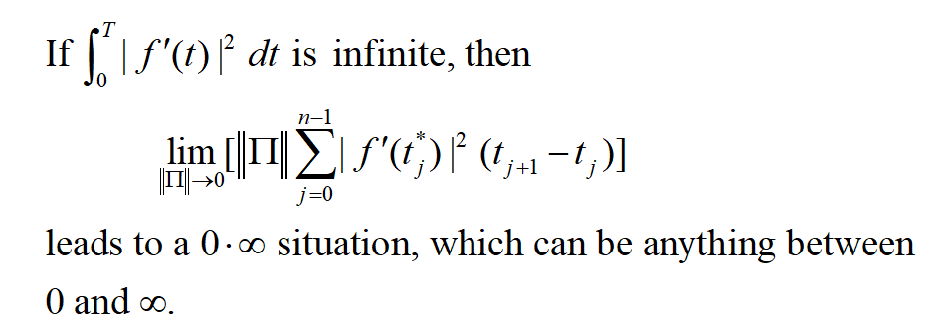

Slide 10
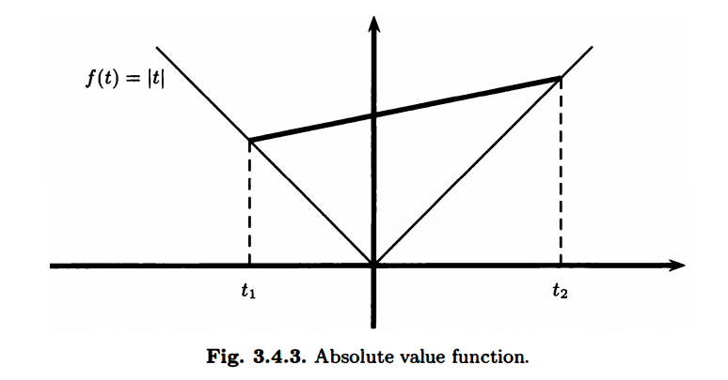
Case for f’ not conti.

Slide 11
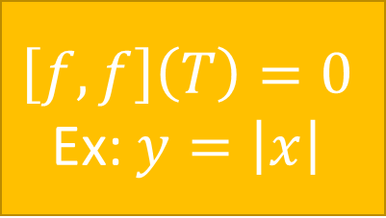
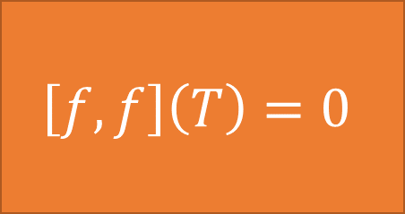
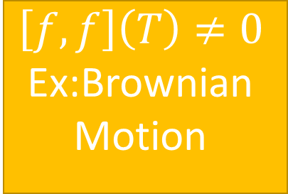
$$\left[f,f\right]\left(T\right)=0$$
Yes
f’ conti.
$$\left[f,f\right]\left(T\right)=0$$
Ex: $y=\left|x\right|$
No
Yes
f’ 可積
No
$$\left[f,f\right]\left(T\right)≠0$$
Ex:Brownian Motion

Slide 12
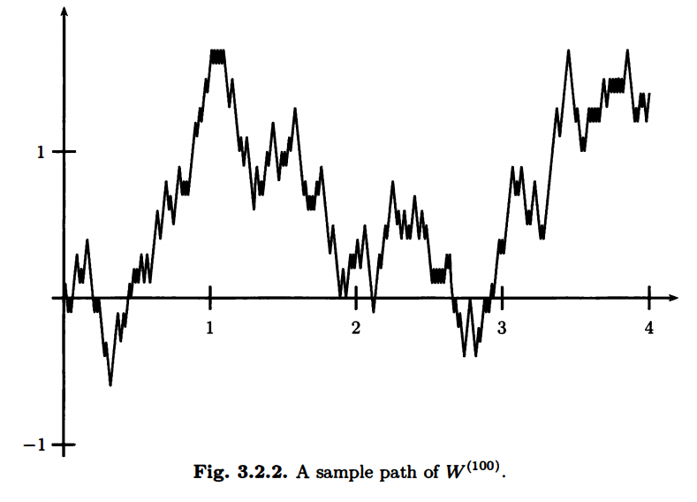
Quadratic Variation for Brownian Motion
The paths of Brownian motion, on the other hand, cannot be differentiated with respect to the time variable.

Slide 14
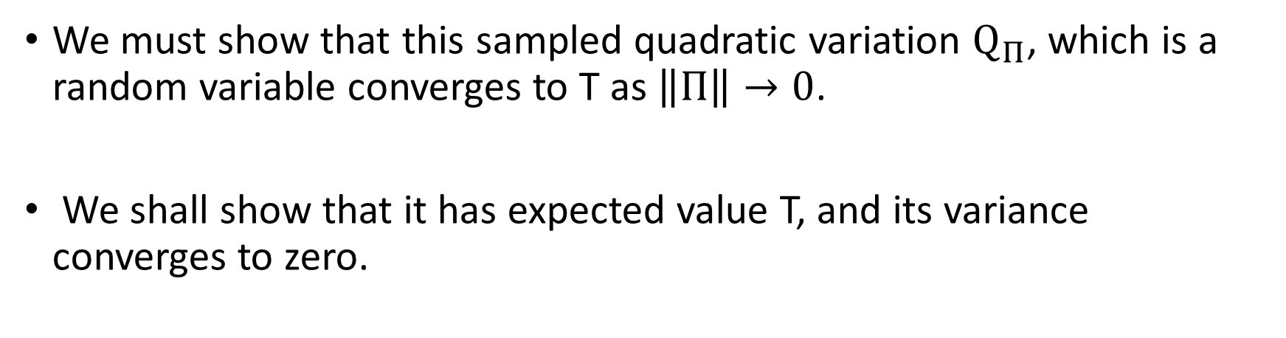
Proof of Thm 3.4.3
We must show that this sampled quadratic variation $Q_{Π}$, which is a random variable converges to T as $\left\|Π\right\|→0$.
We shall show that it has expected value T, and its variance converges to zero.

Slide 15
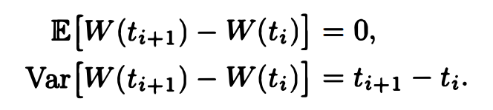
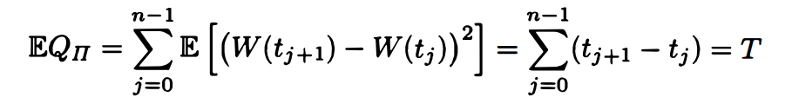
Proof of Thm 3.4.3
Recall: Brownian Motion
Then we have
This implies

Slide 16

Proof of Thm 3.4.3
$$Var\left(X\right)=E\left[{\left(X−μ\right)}^{2}\right], μ=E[X]$$
$$E\left[X^{4}\right]=3σ^{2}, where X\sim N\left(0,σ^{2}\right)$$

Slide 17
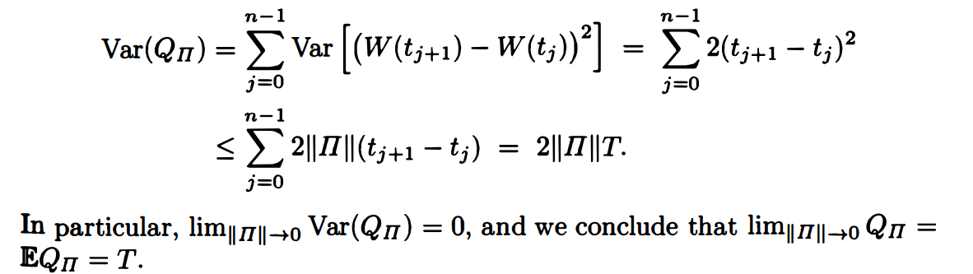
Proof of Thm 3.4.3

Slide 18
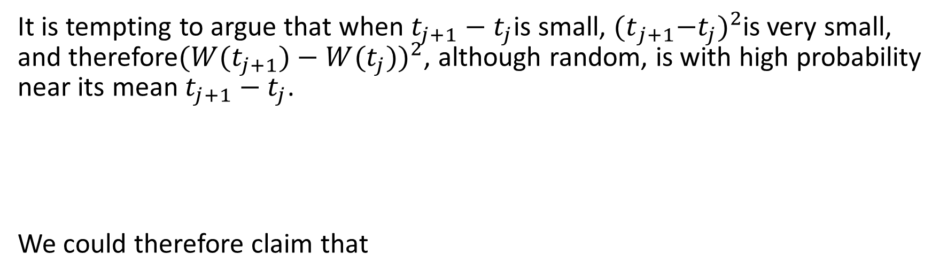
It is tempting to argue that when $t_{j+1}−t_{j}$is small, ${{(t}_{j+1}−t_{j})}^{2}$is very small, and therefore${(W(t_{j+1})−W(t_{j}))}^{2}$, although random, is with high probability near its mean $t_{j+1}−t_{j}$.
We could therefore claim that

Slide 19
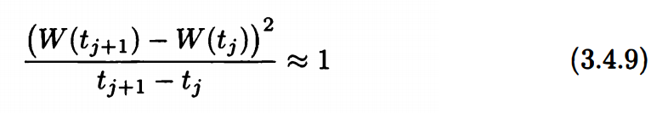
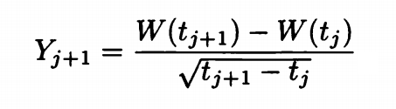
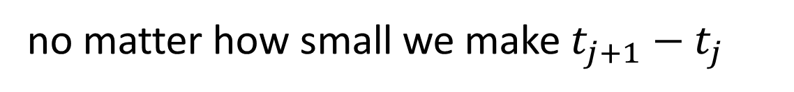

A better way to try to capture what we think is going on is to write
However, (3.4.9) is in fact not near 1
$$\sim N\left(0,1\right)$$
no matter how small we make $t_{j+1}−t_{j}$

Slide 20

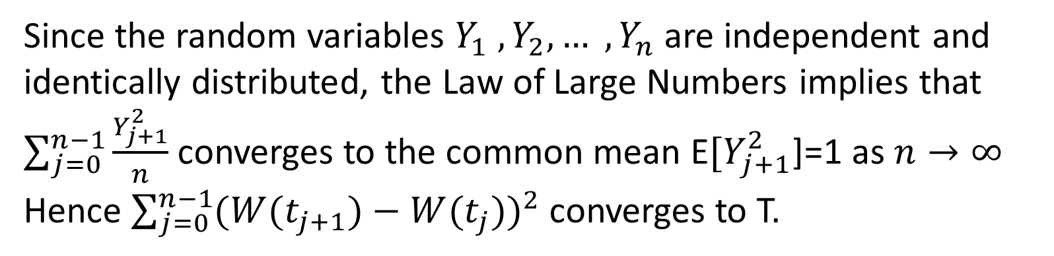
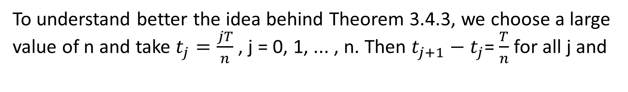
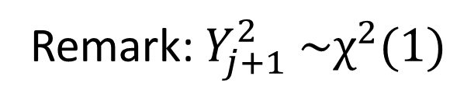

To understand better the idea behind Theorem 3.4.3, we choose a large value of n and take $t_{j}=\frac{jT}{n}$, j = 0, 1, ... , n. Then $t_{j+1}−t_{j}$= $\frac{T}{n}$ for all j and
$$\sim N\left(0,1\right)$$
Remark: $Y_{j+1}^{2} \sim χ^{2}(1)$
Since the random variables $Y_{1} , Y_{2}, … , Y_{n}$are independent and identically distributed, the Law of Large Numbers implies that $\sum_{j=0}^{n−1}{\frac{Y_{j+1}^{2}}{n}}$converges to the common mean E${[Y}_{j+1}^{2}$]=1 as $n→∞$
Hence $\sum_{j=0}^{n−1}{{(W(t_{j+1})−W(t_{j}))}^{2}}$ converges to T.

Slide 21

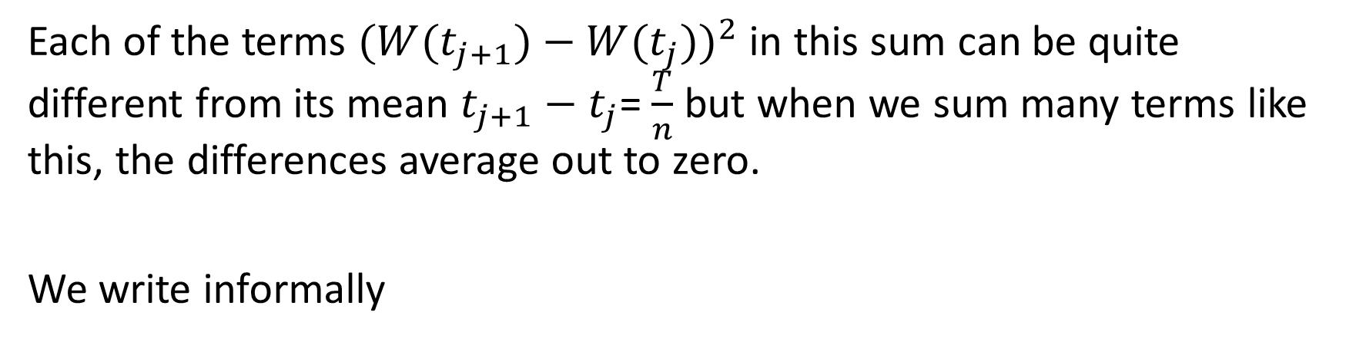
Each of the terms ${(W(t_{j+1})−W(t_{j}))}^{2}$ in this sum can be quite different from its mean $t_{j+1}−t_{j}$= $\frac{T}{n}$ but when we sum many terms like this, the differences average out to zero.
We write informally

Slide 24
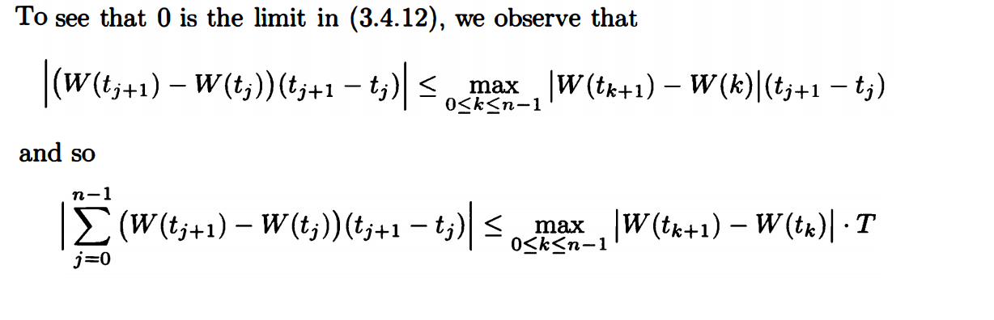
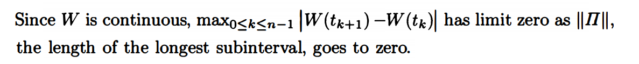

Slide 25
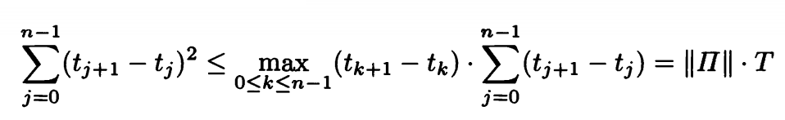

Slide 26
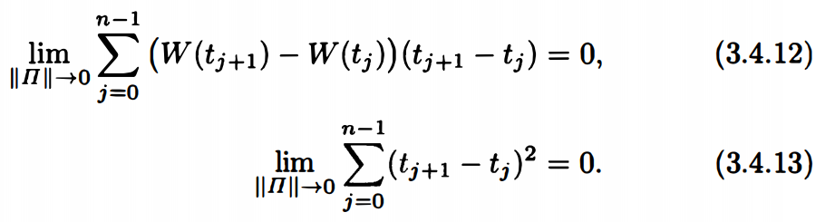


Slide 27
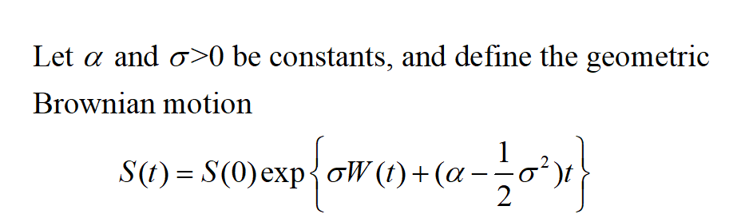
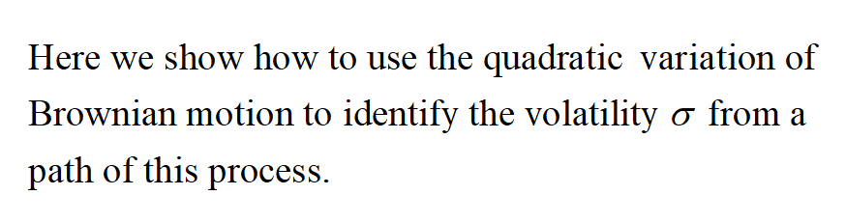
3.4.3 Volatility of Geometric Brownian Motion

Slide 28
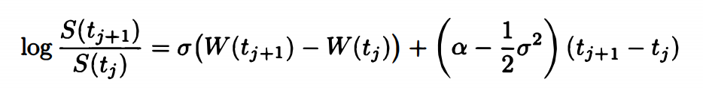
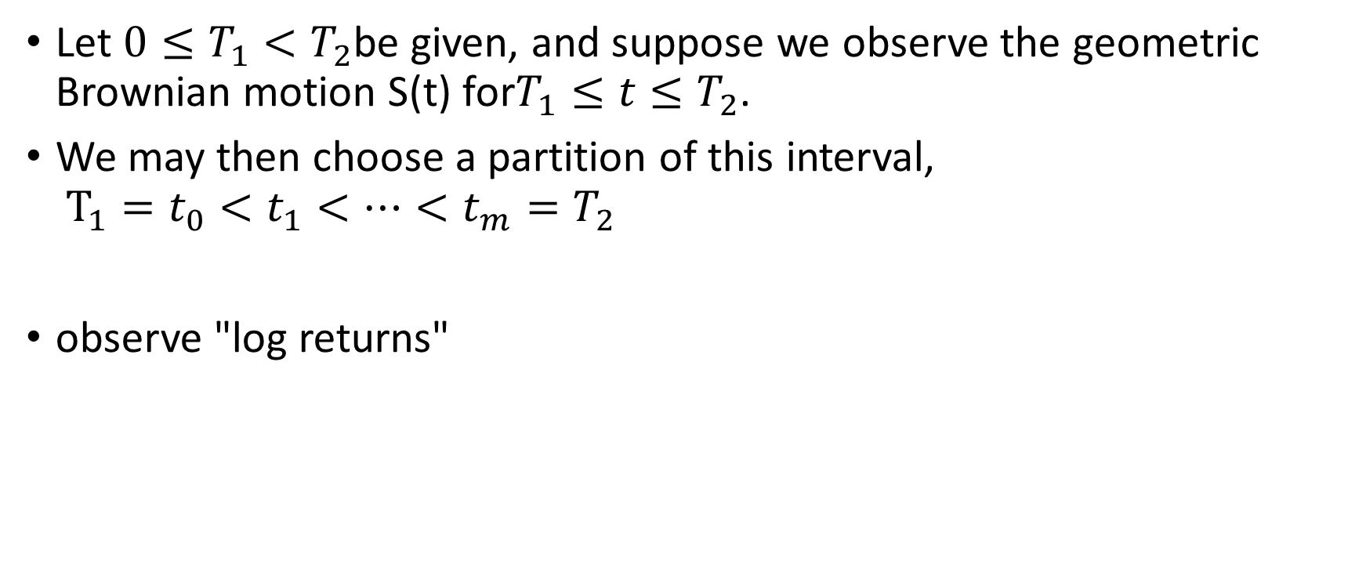
Let $0≤T_{1}<T_{2}$be given, and suppose we observe the geometric Brownian motion S(t) for$T_{1}≤t≤T_{2}$.
We may then choose a partition of this interval, $T_{1}=t_{0}<t_{1}<…<t_{m}=T_{2}$
observe "log returns"

Slide 29
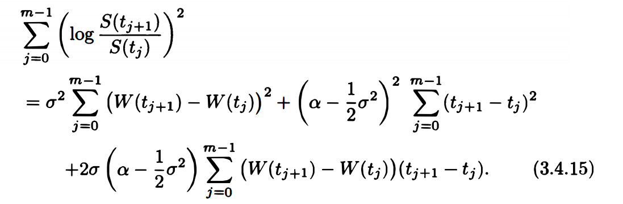
The sum of the squares of the log returns, sometimes called the realized volatility, is

Slide 30
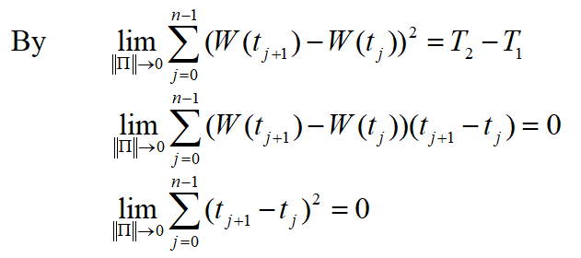
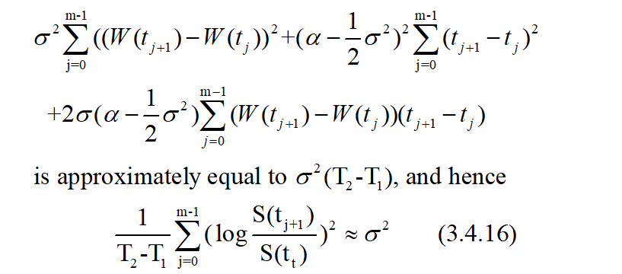

Slide 31
3.5 Markov Property
Notes:
In this section, we show that Brownian motion is a Markov process and discuss its transition density.

Slide 32
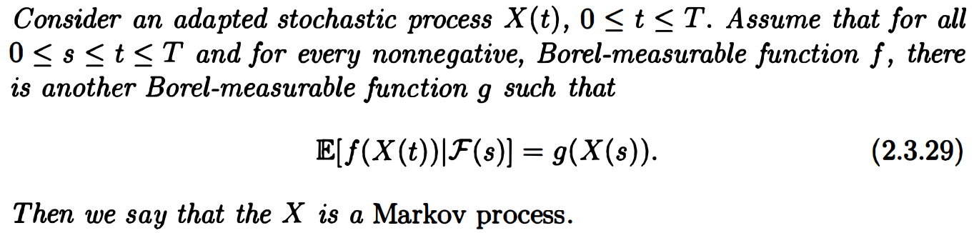
Definition 2.3.6 : Markov process

Slide 33
Theorem 3.5.1.
Let W(t), t≥0, be a Brownian motion and
let F(t), t ≥0, be a filtration for this Brownian motion.
Then W(t), t≥0, is a Markov process.

Slide 34
Proof of Thm 3.5.1
According to Definition 2.3.6, we must show that whenever 0≦s≦ t and f is a Borel-measurable function, there is another Borel-measurable function g such that

Slide 35


Proof of Thm 3.5.1
The random variable W(t) - W(s) is independent of F(s) ,
and the random variable W(s) is F(s)-measurable.
This permits us to apply the Independence Lemma.

Slide 36

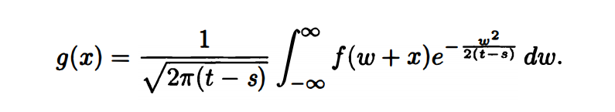
Proof of Thm 3.5.1

Slide 37




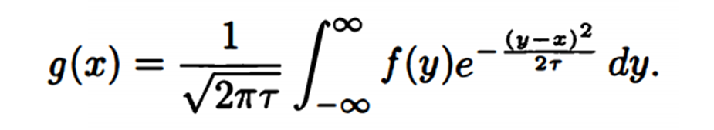
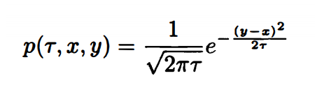
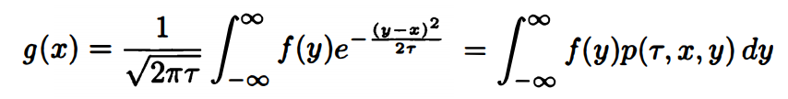
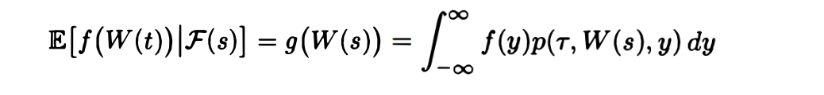

Slide 38
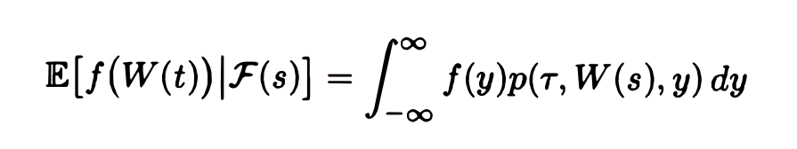
where
Conditioned on the information in F(s)
The conditional density of W(t) is p(r, W(s), y). This is a density in the variable y. This density is normal with mean W(s) and variance T = t - s.
In particular, the only information from F(s) that is relevant is the value of W(s).
The fact that only W(s) is relevant is the essence of the Markov property.

