Slide 1
Copula

Slide 2
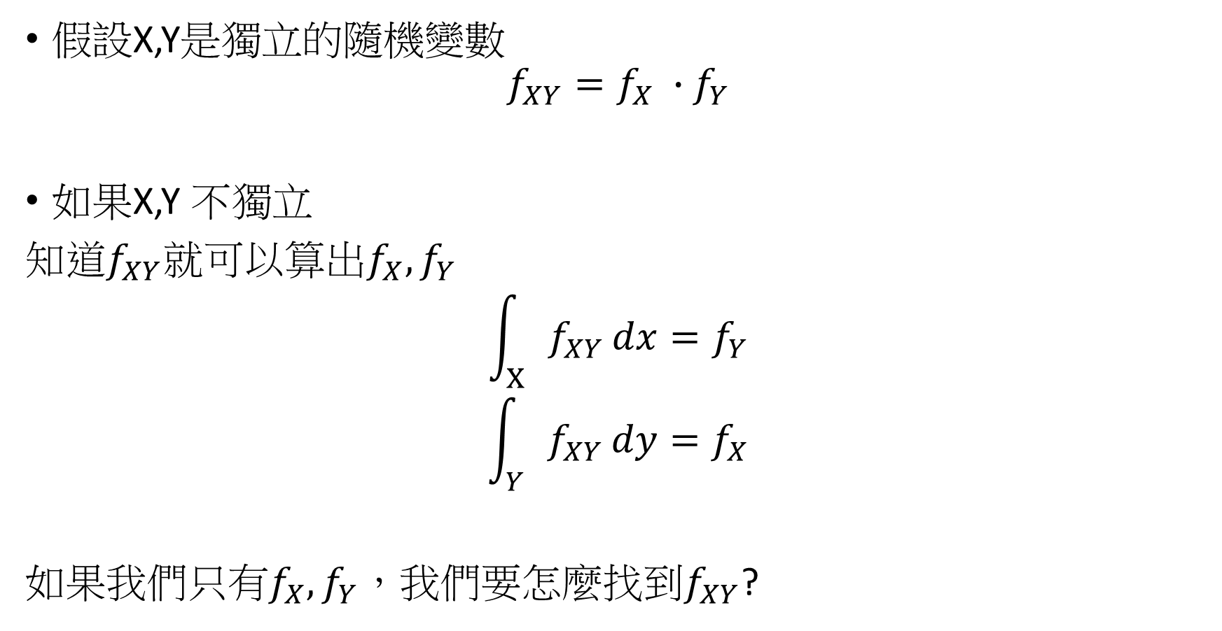
假設X,Y是獨立的隨機變數
$$f_{XY}=f_{X} ∙f_{Y}$$
如果X,Y 不獨立
知道$f_{XY}就可以算出f_{X},f_{Y}$
$$\int_{X}{f_{XY}}dx=f_{Y}$$
$$\int_{Y}{f_{XY}}dy=f_{X}$$
如果我們只有$f_{X},f_{Y}$，我們要怎麼找到$f_{XY}$?

Slide 3

假設$X,Y\sim N(0,1)$
$$f_{X}=\frac{1}{\sqrt{2π}}exp⁡(−\frac{x^{2}}{2})$$
$$f_{Y}=\frac{1}{\sqrt{2π}}exp⁡(−\frac{y^{2}}{2})$$
如果X,Y獨立
$$f_{XY}=\frac{1}{2π}exp⁡[−\frac{x^{2}}{2}−\frac{y^{2}}{2}]$$
如果X,Y不獨立，相關係數$ρ≠0$
$$f_{XY}=\frac{1}{2π\sqrt{1−ρ^{2}}}\exp\left[−\frac{1}{2\left(1−ρ^{2}\right)}\left(x^{2}−2ρxy+y^{2}\right)\right]$$

Slide 4
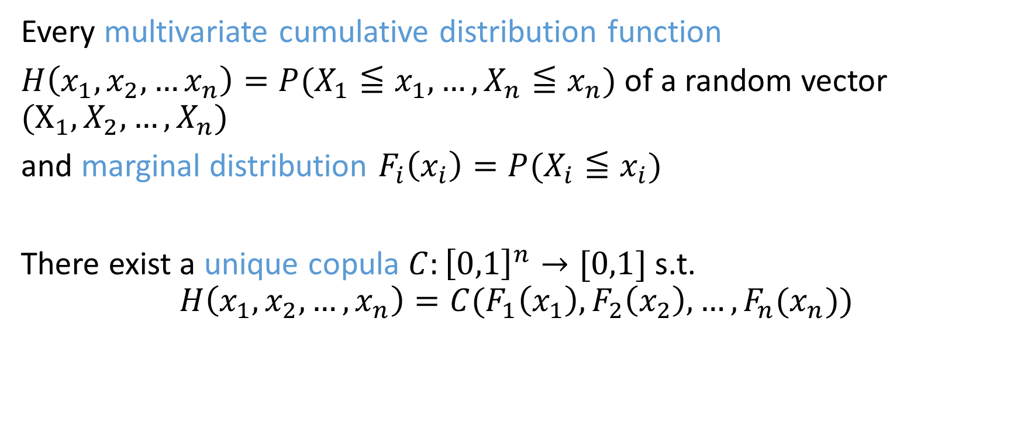
Sklar’s Theorem
Every multivariate cumulative distribution function
$H\left(x_{1},x_{2},…x_{n}\right)=P(X_{1}≦x_{1},…,X_{n}≦x_{n})$of a random vector $(X_{1},X_{2},…,X_{n})$
and marginal distribution $F_{i}\left(x_{i}\right)=P(X_{i}≦x_{i})$
There exist a unique copula $C:{\left[0,1\right]}^{n}→[0,1]$ s.t.
$$H\left(x_{1},x_{2},…,x_{n}\right)=C(F_{1}\left(x_{1}\right),F_{2}\left(x_{2}\right),…,F_{n}(x_{n}))$$

Slide 5
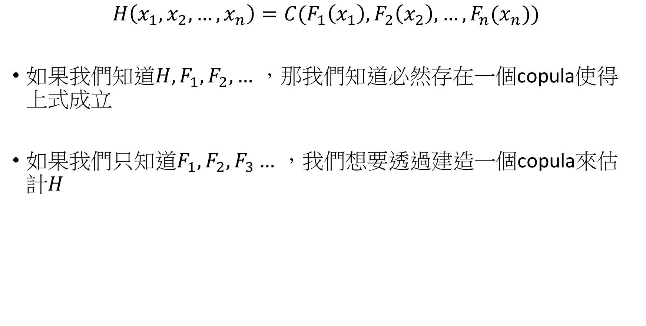
$$H\left(x_{1},x_{2},…,x_{n}\right)=C(F_{1}\left(x_{1}\right),F_{2}\left(x_{2}\right),…,F_{n}(x_{n}))$$
如果我們知道$H,F_{1},F_{2},…$ ，那我們知道必然存在一個copula使得上式成立
如果我們只知道$F_{1},F_{2},F_{3}…$ ，我們想要透過建造一個copula來估計$H$

Slide 6
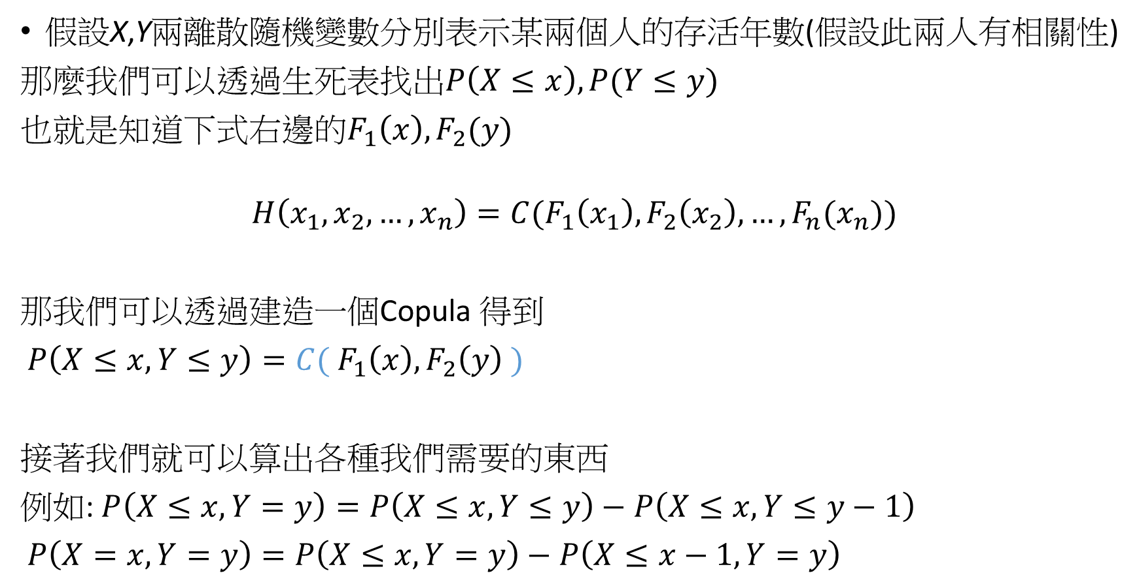
假設X,Y兩離散隨機變數分別表示某兩個人的存活年數(假設此兩人有相關性)
那麼我們可以透過生死表找出$P\left(X≤x\right),P(Y≤y)$
也就是知道下式右邊的$F_{1}\left(x\right),F_{2}(y)$
$$H\left(x_{1},x_{2},…,x_{n}\right)=C(F_{1}\left(x_{1}\right),F_{2}\left(x_{2}\right),…,F_{n}(x_{n}))$$
那我們可以透過建造一個Copula 得到
$P\left(X≤x,Y≤y\right)=C( F_{1}\left(x\right),F_{2}\left(y\right) )$
接著我們就可以算出各種我們需要的東西
例如: $P\left(X≤x,Y=y\right)=P\left(X≤x,Y≤y\right)−P\left(X≤x,Y≤y−1\right)$
$P\left(X=x,Y=y\right)=P\left(X≤x,Y=y\right)−P\left(X≤x−1,Y=y\right)$

Slide 7

Gaussian Copula
$C_{R}^{Gauss}\left(u\right)=Φ_{R}\left(Φ^{−1}(u_{1}\right),…, Φ^{−1}\left(u_{n}\right) )$

Slide 8

Student-t Copula
$C\left(u_{1},u_{2};ρ,ν\right)=t_{ρ,ν}(t_{ρ}^{−1}\left(u_{1}\right) , t_{ρ}^{−1}(u_{2}) )$

Slide 9

Clayton Copula
$C\left(u_{1},u_{2};α\right)={\left(u_{1}^{−α}+u_{2}^{−α}−1\right)}^{−\frac{1}{α}}$

